Slide 1

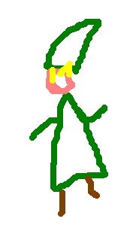

Adult link
Units: oot units
30-40
20-30
60
35
PLAYER_BODYPART_TORSO
75% of image width

