Slide 1
Automated System for Social Monitoring
Berciu Liviu
Cotrau Andreea
Tamas Florin
Ungur Maria

Slide 2
Agenda
Introduction
Motivation and Utility
Solution
Other approaches
Results
Demo
SWOT analysis
Conclusion

Slide 3
Introduction
Covid19 pandemic took by surprise the entire world. Social distancing became a standard and a thing that had to be considered in our day to day life.
Companies across the globe are continuously working to deliver solutions regarding this problem.

Slide 4
Motivation
Our main purpose is helping people enforce social distancing.
Safety is our number #1 concern.
We create a solid, robust camera system that can be used in a multitude of domains, slowly bringing things back to normal.

Slide 5
Utility and Social Impact
Overcrowding can be avoided
The density of people can be monitored the whole time
Various statistics on the number of people in a certain room/area
Lower chances of getting infected
Safer environment & safer people

Slide 6
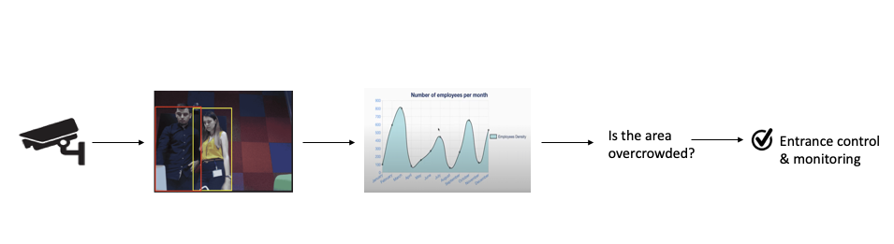
Our Approach
Our approach follows the following main steps:
capture the image from a room/area
persons detection
critical density analysis & statistics

Slide 7
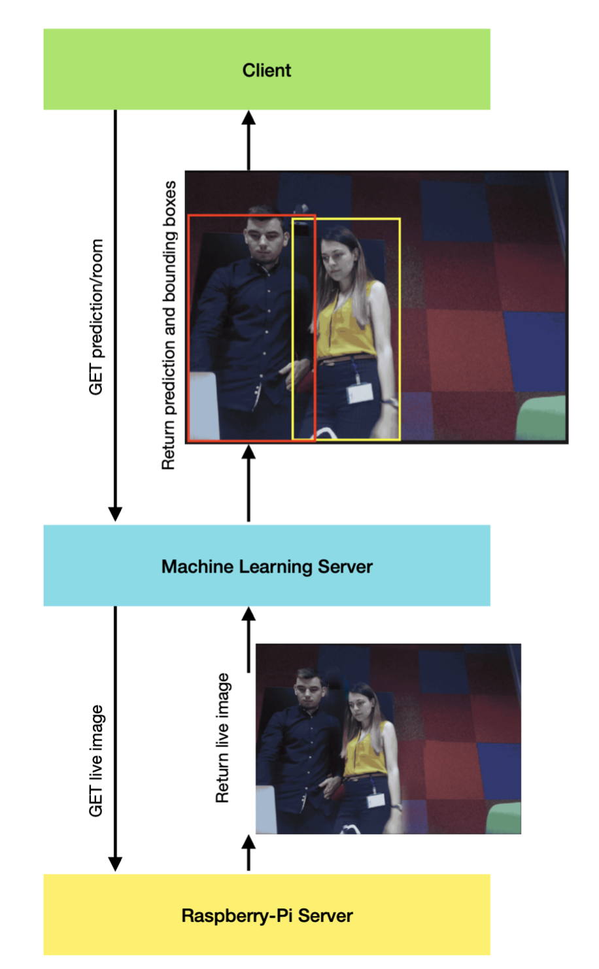
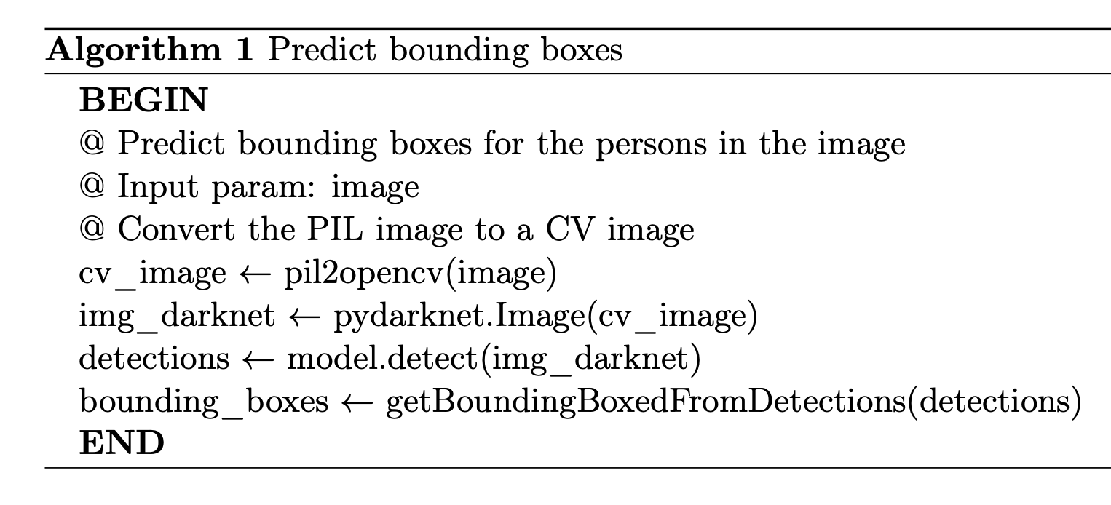
How it works

Slide 8
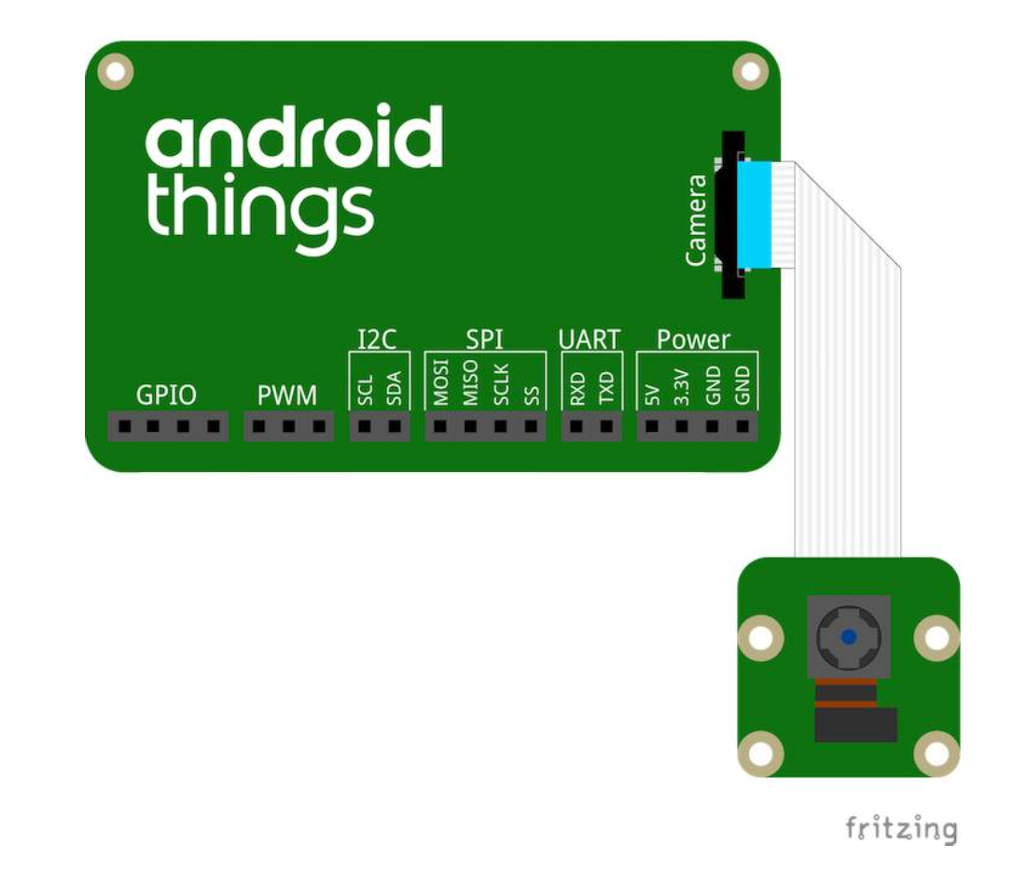







Tools and Technologies

Slide 9
Other existing approaches
In our research we came across other approaches:
Open-CV + Computer vision + Deep learning → Too complex to implement for resource limited systems
Deep learning + cached images → Not real time surveillance
We targeted a more simpler solution for real time data!
🔀

Slide 10
Results - ML component
We tested with:
different network weights
different sizes for the input image (320x320, 416x416 and 608x608)
different datasets: COCO and INRIA
The main aim was to find the best algorithm in terms of response time and accuracy. Some compromises had to be made.

Slide 11
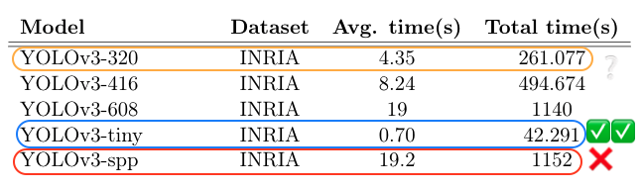
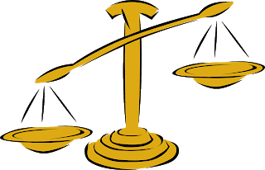
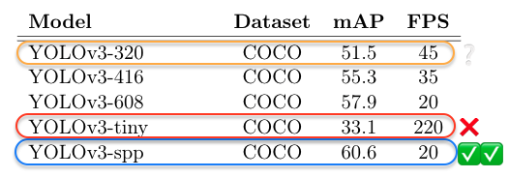
Results - ML component
Response time
Accuracy
Response time
Accuracy
Winner: YOLOv3-320

Slide 12
Demo
Video goes here...

Slide 13
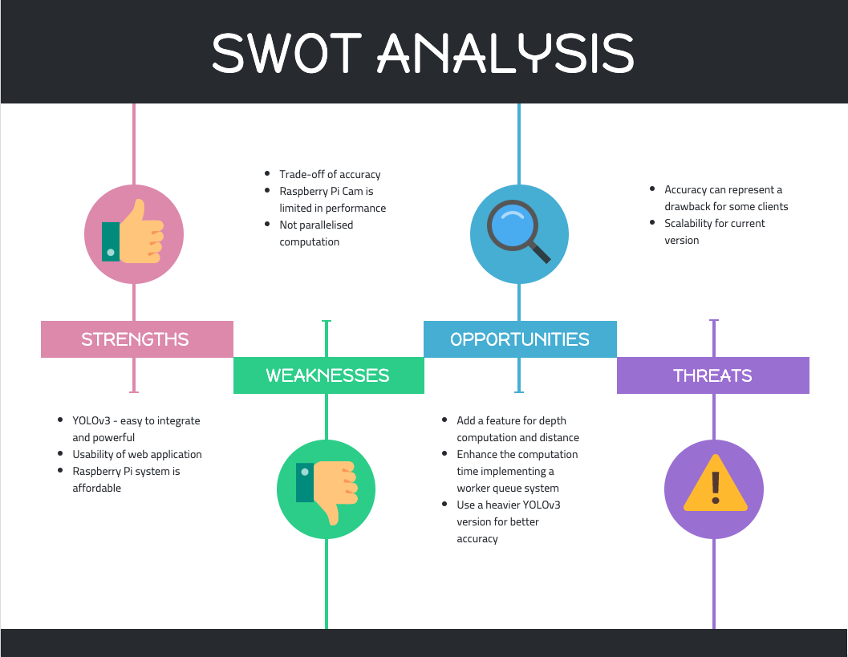

Slide 14
Concluding words
The use of YOLOv3 can be seen as a strength, being easy to integrate and maintain in a system like this, whilst performing good the given task.
We considered the trade-off between accuracy and response time which is an important aspect for real-time computer vision tasks.
We believe that this paper would offer support and encouragement for future endeavours in the social distancing monitoring.

