Slide 1
Automated System for Social MONITORING
Berciu Liviu
Cotrau Andreea
Tamas Florin
Ungur Maria

Slide 2
INTRODUCTION HOW COVID CHANGED THE WORLD
The year 2020 has proven to be different from many points of view, the main reason being the Covid19 pandemic that took by surprise the entire globe. People had to adapt to this peculiar virus and adopted a set of rules to fight the "invisible enemy". Among those, we find the so-called social distancing which basically can be translated as a safe distance maintained between two persons. This rule was supported by the World Health Organization so it quickly gained popularity among the countries. It became a standard and a thing that had to be considered in our day to day life.

Slide 3
OUR VISION
Our mission is clear: provide a tool that allows people to maintain social distancing.
How are we doing it? By creating a system of image recognition, more specifically, person recognition from images taken from web cameras or surveillance cameras.
Our approach uses YoloV3 for the real-time human recognition algorithm, all connected with a web-page that allows the user to interact with the system

Slide 4
SOCIAL IMPACT
Overcrowding can be avoided
The density of people can be monitored the whole time
Various statistics on the number of people in a room
Happier people!

Slide 5
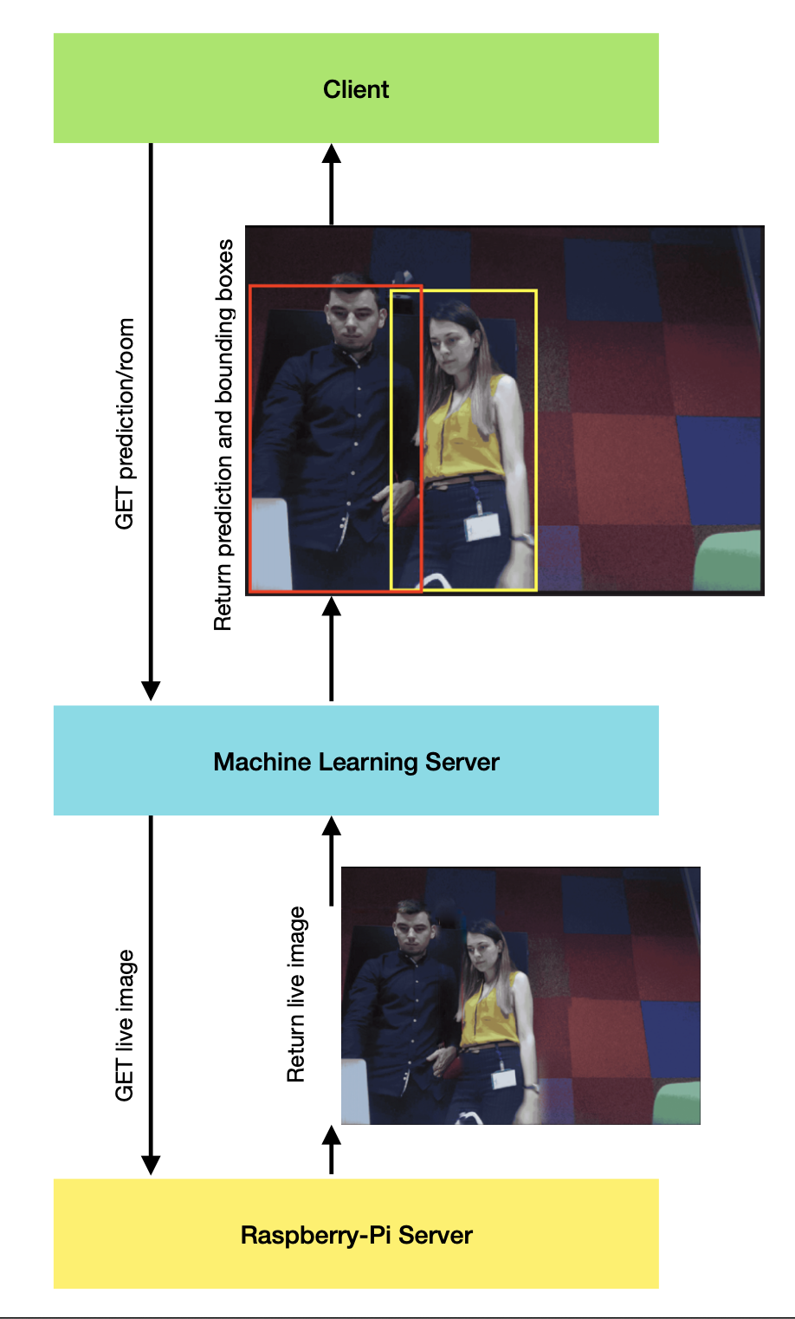
How our system works

Slide 6
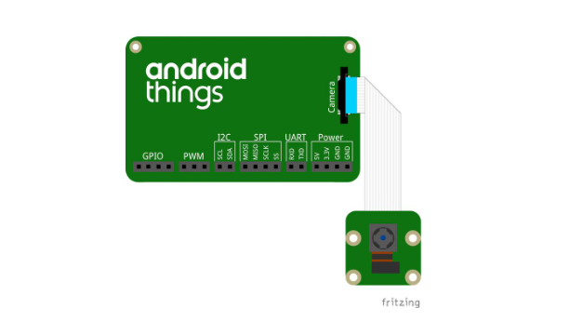
Hardware system

Slide 7
METHODOLOGIES
One of the methodologies was the usage of different network weights: the weights for the full model and the wights for the minified model(which contains a lower number of convolutional layers – known as YOLOv3-tiny).
Another methodology was the usage of different sizes for the input image: 320x320, 416x416 and 608x608. We wanted to measure the link between the image size and the precision of the network.

Slide 8
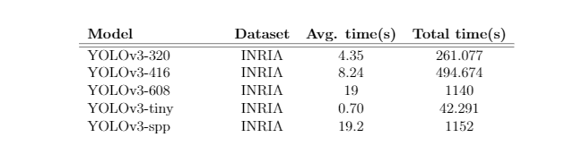
RESULTS AFTER TESTING THE MODEL

Slide 9
CONCLUSION
The use of YOLOv3 can be seen as a strength, being easy to integrate and maintain in a system like this, whilst performing good the given task.
We considered the trade-off between accuracy and performance which is an important aspect for real-time computer vision tasks.
Another benefit of our system is providing a dashboard web application, offering the user another view of more spaces/rooms. The statistics panel also provides a better understanding of the density evolution.
We believe that this paper would offer support and encouragement for future endeavours in the social distancing monitoring.

Slide 10
APP DEMO

Slide 11
Q&A

Slide 12
Thank you!

