Slide 1
Submarin Drive Assistant
Lung Andreea, Katona Ildiko-Noemi, Nagy Barnabás, Popa Cătălin
Group 258/2

Slide 2
Summary
Problem statement
Challenges
Our approach
Results
Optimizations
Demo
Conclusions and future work

Slide 3
Problem statement

Slide 4
The problem statement
Help the driver to make critical decisions in traffic and avoid accidents, collisions
tracking surrounding vehicles and participants to the traffic
303936Parola0
detecting pedestrians and road signs

Slide 5
Challenges

Slide 6
Difficulties / Challenges
working with pre-trained models
models are pretty large and take up a great deal of resources to run
we have little control over the time it takes the algorithm to do a detection
difficult to deploy our app in the cloud due to lack of free options for dedicated GPU servers

Slide 7
Our approach

Slide 8
Solution
proposal
a user friendly mobile app that offers in-app information about the current speed, weather conditions and enables the user to detect other participants to the traffic from their own phone camera or gallery.

Slide 9
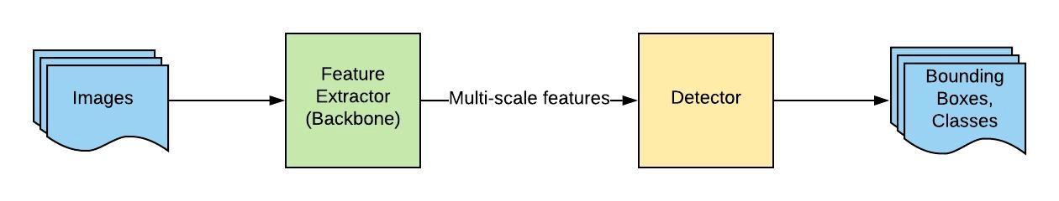
Flow diagram

Slide 10
The algorithm
pre-trained model: TinyYoloV3
tested on datasets
INRIA (288 images)
Caltech (10,800 images)

Slide 11
Results

Slide 12
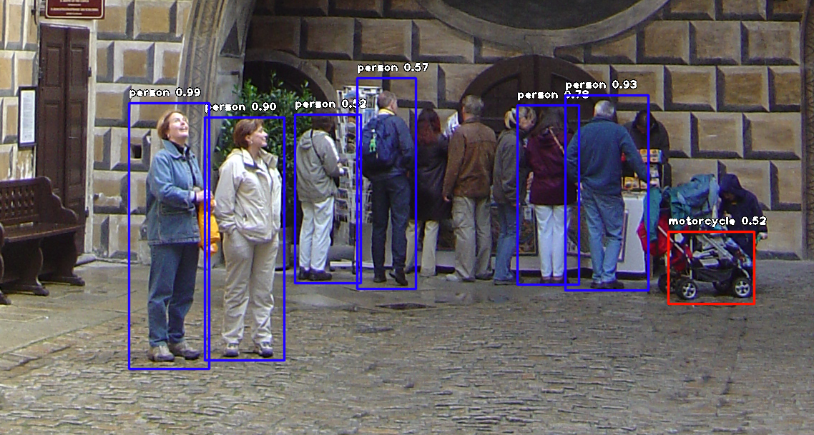
Results
Sample output:
On INRIA:
accuracy:
63.33% (383/589 detections per pedestrians)

Slide 13
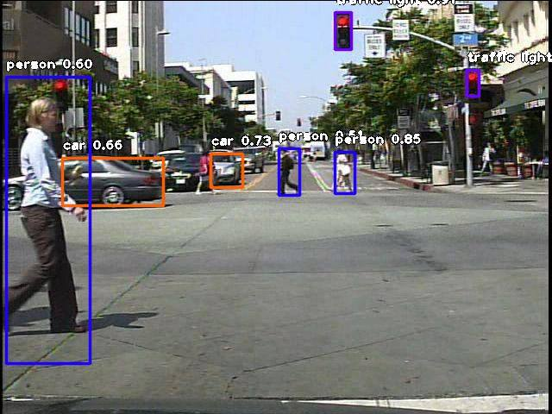
Results
Sample output:
On Caltech:
accuracy:
28.71% (10,499/36,569 pedestrians detected)

Slide 14
Runtime comparison
INRIA (288 images)
Caltech (1800 images)
115.08 seconds
150.00 seconds
Notes:
The reason for the small difference in processing time between the two, despite the large difference in the number of images is that the bigger the picture is, the more time it will take for the algorithm to process it. Caltech offers standard resolution images (under 100kB), whilst INRIA has different dimension pictures (between 0,5 MB and a bit under 2,0 MB), hence it explains the processing times.

Slide 15
Optimizations
resizing the images if they are too large – 480 pixels height → an visibly increased speed performance
store the received images on the server for further use – lay the ground for different statistics, studies of accuracy etc.
Use the extended YOLOv3 algorithm instead of the tiny version → accuracy jumped up to a 63.01%

Slide 16
Demo
Notes:
We will now present a demo including our application’s functionalities and present how it works.

Slide 17
Conclusions
YoloV3 produces better accuracy than TinyYoloV3
TinyYoloV3 is faster than YoloV3 -> great for delivering real time results
poorer results on darker images
hard to tell apart individual persons in a large group of people

Slide 18
Future work
Move the processing of the image and the detection part on the client in order to decrease the overall processing time and deliver faster results, which could further bring us closer to a real-time experience
Further study about the inclusion of different races and ethnicities

