Slide 1
Signals and systems

Slide 2
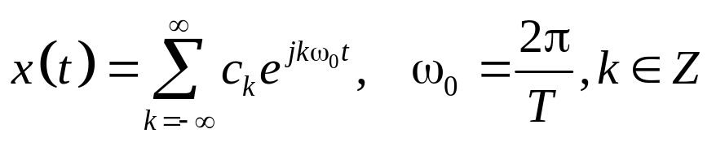
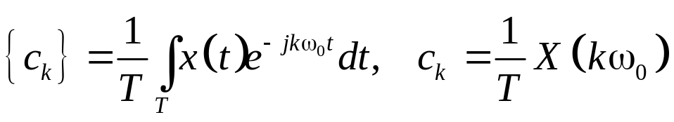
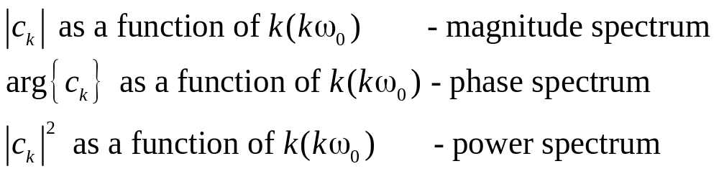
Seminar 3. Continuous and Discrete time Fourier series: CTFS and DTFS
Quick overview/CTFS
The periodic signal x(t) can be decomposed into a Fourier series. Exponential Fourier series
The coefficients of the exponential Fourier series are:

Slide 3
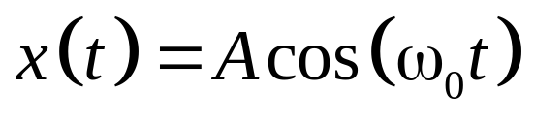
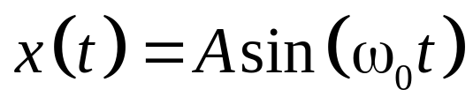
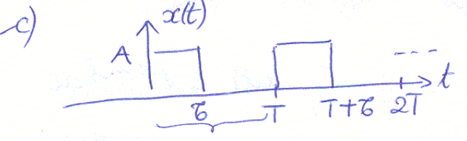

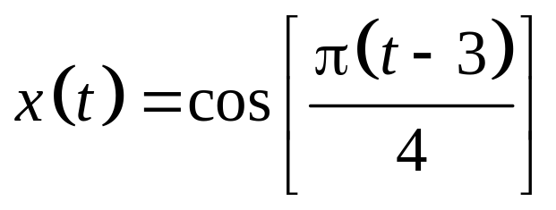
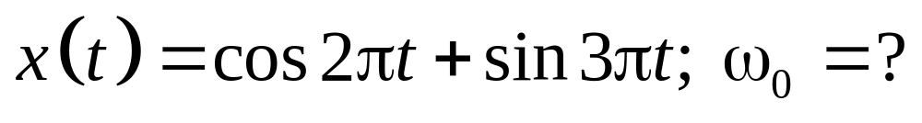
Continuous-time Fourier series. Problems.
Problem 1) Determine and sketch the magnitude and phase spectra of the following periodic signals
a)
b)
c)
d)
e)

Slide 4
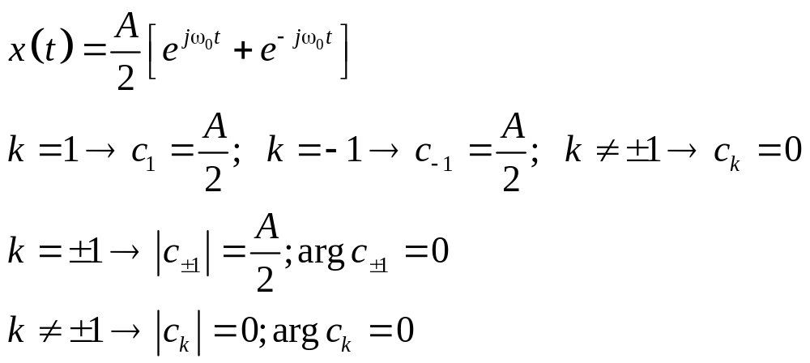
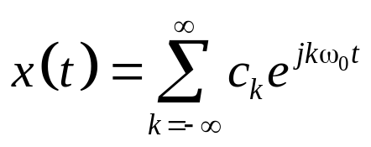
a)
Coefficient identification
|c_{k}|
A/2
k
…. -2 -1 0 1 2 …..
Arg{c_{k}}
k
…. -2 -1 0 1 2 …..

Slide 5
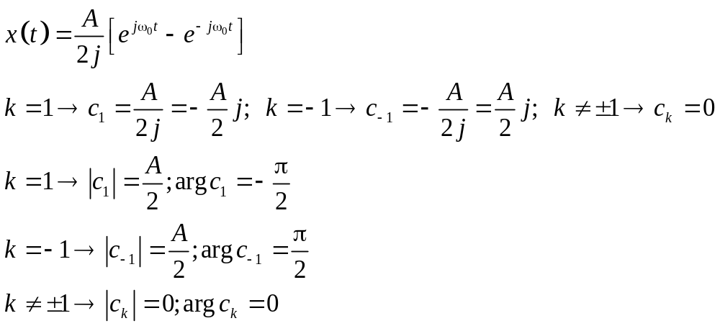
b)
Coefficient identification
Im
c₋₁
π/2
Re
|c_{k}|
A/2
c₁
-π/2
k
…. -2 -1 0 1 2 …..
Arg{c_{k}}
π/2
k
…. -2 -1 0 1 2 …..
-π/2

Slide 6
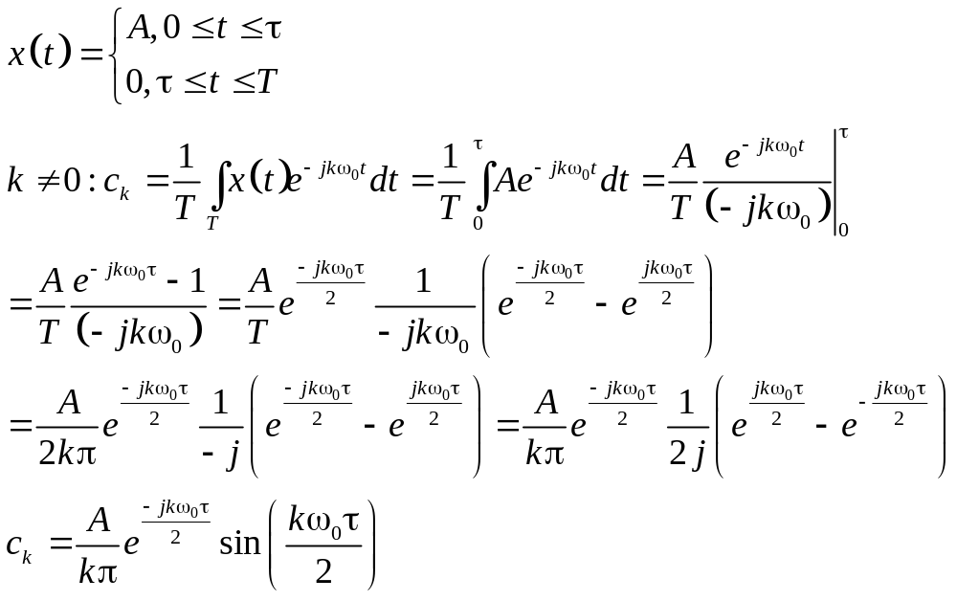
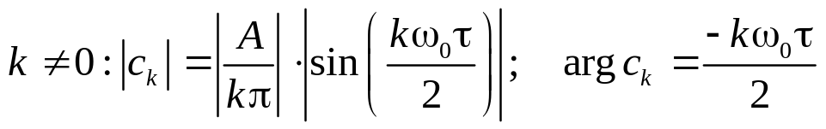
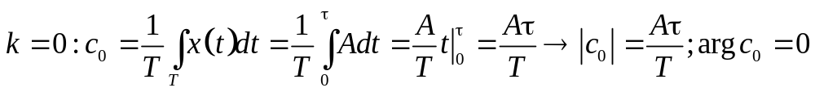
c)direct computation
x(t) is a square wave, of period T, duty cycle τ/T
The DC component:

Slide 7
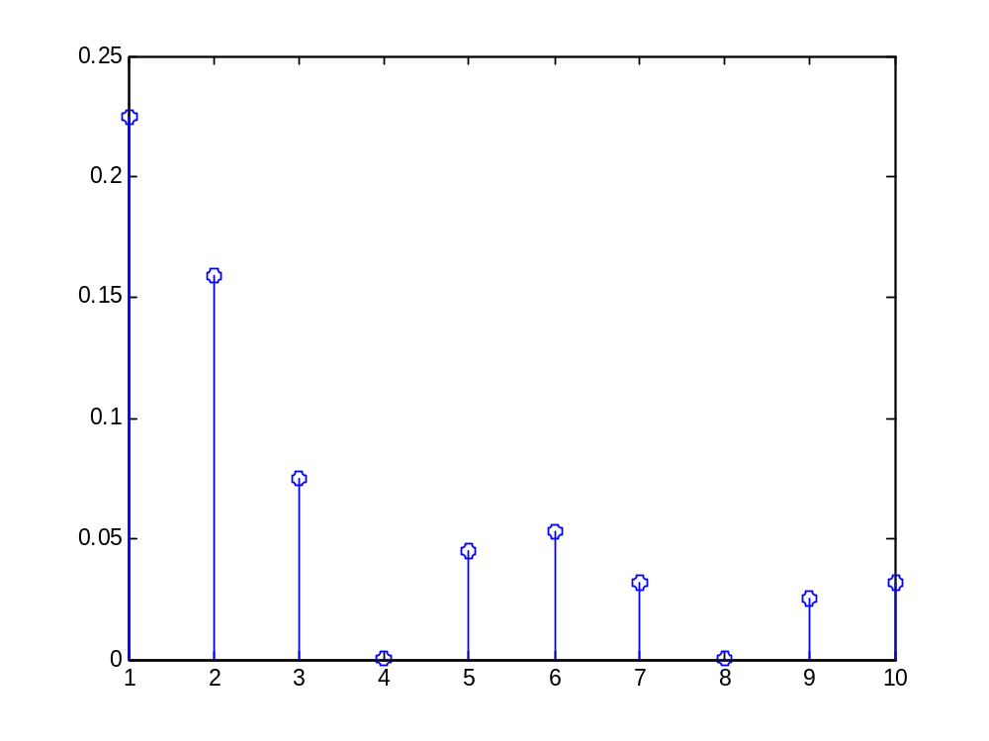
τ/T=3/4

Slide 8
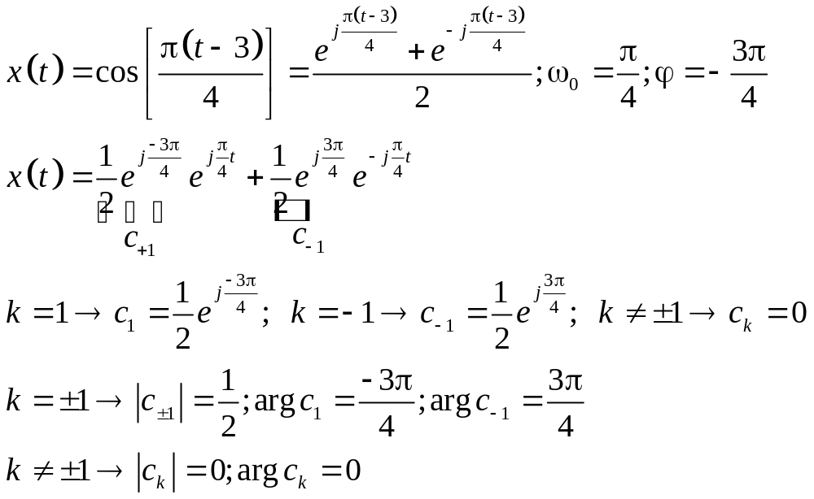
d)Coefficient identification
|c_{k}|
1/2
k
…. -2 -1 0 1 2 …..
Arg{c_{k}}
3π/4
k
…. -2 -1 0 1 2 …..
-3π/4

Slide 9
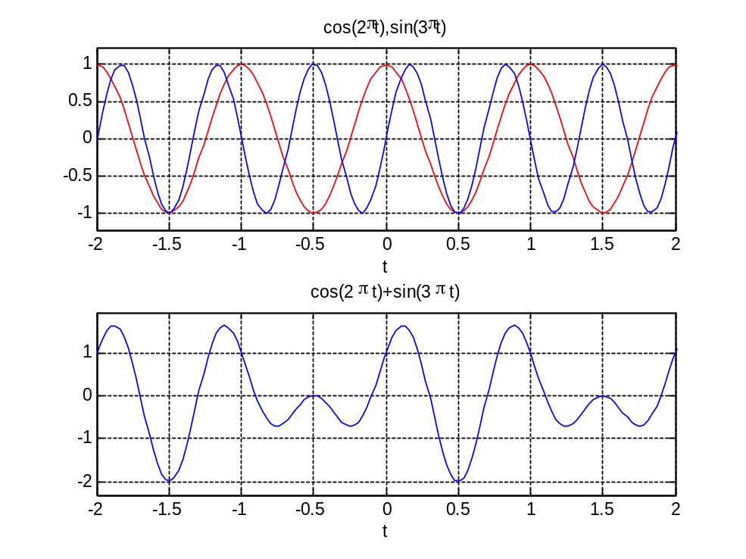
e)coeff.identification
2T₁=T₀
3T₂ = T₀
We need to establish the frequency of the signal. For that we compute first the period of each component:
ω₁=2π =>T₁=2π/ω₁= 1
ω₂=3π =>T₂=2π/ω₂= 2/3
After this step we determine the period of the signal x(t), by finding the period T₀ as the “least multiple common” of T₁ and T₂:
T₀ = lmc(T₁,T₂)=2
Thus its frequency is
ω₀=2π/T₀= 2π/ 2= π
T₀

Slide 10
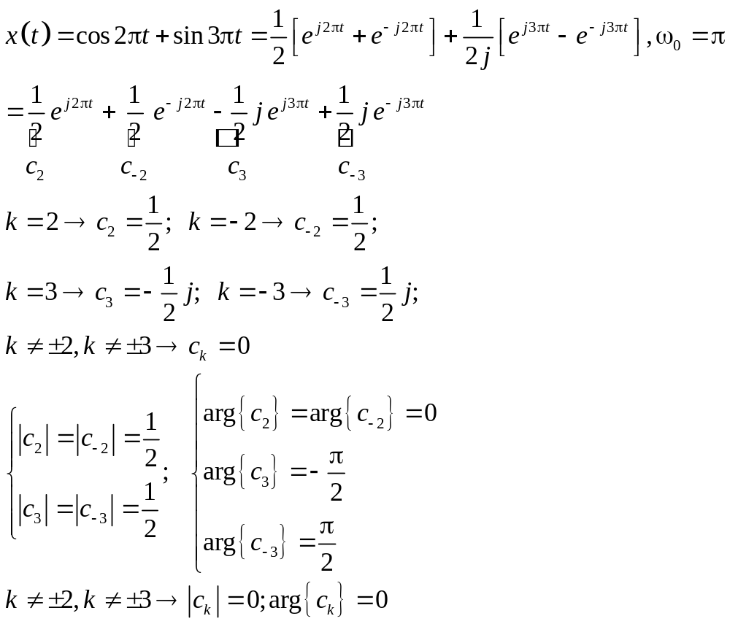
|c_{k}|
1/2
k
... -4 -3 -2 -1 0 1 2 3 4 …
Arg{c_{k}}
π/2
k
... -4 -3 -2 -1 0 1 2 3 4 …
-π/2

Slide 11
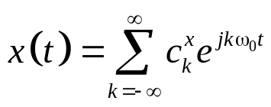
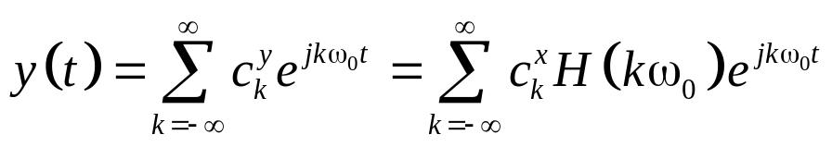
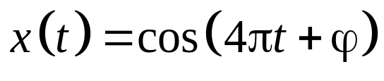
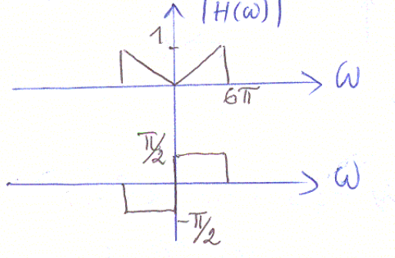
Problem 3) a) Show that the following connection between the Fourier coefficients of the input periodic signal, and the output periodic signal, is true, for a linear time-invariant system LTI, knowing the frequency response of the system H(ω)
b) Determine the response of the filter (magnitude and phase spectra below) to the input signal:
LTI system
h(t), H(ω)

Slide 12
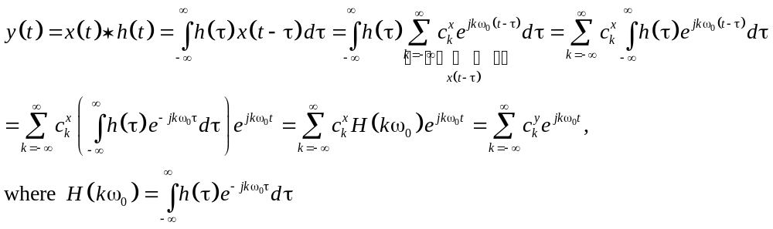
P3a) Show that the following connection between the Fourier coefficients of the input periodic signal, and the output periodic signal, is true, for a linear time-invariant system LTI, knowing the frequency response of the system H(ω)
LTI system
h(t), H(ω)
The relation is shown using the definition of the convolution, the Fourier series and the notation of H(ω)

Slide 13
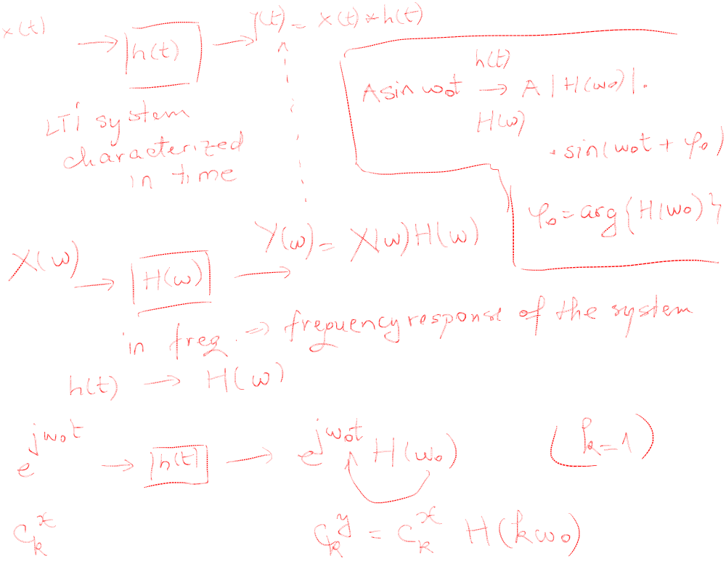

Slide 14
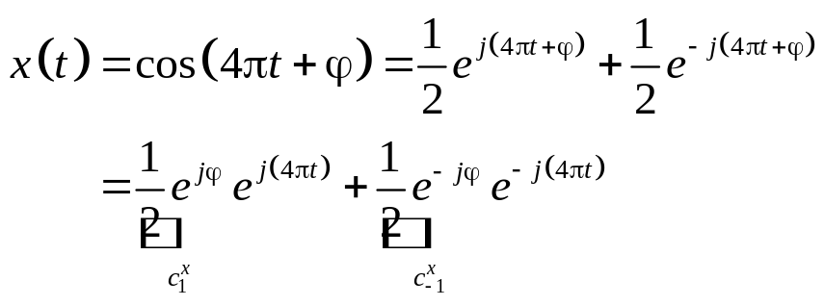
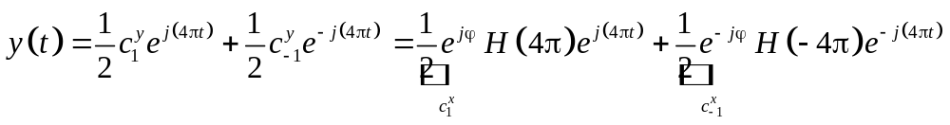
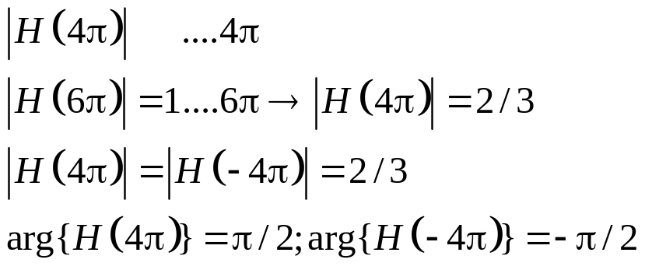
Problem 3)
b) Determine the response of the filter (magnitude and phase spectra below) to the input signal:
the frequency of the input signal is ω₀=4π
=> the period is T=2π/ω₀= 1/2

Slide 15
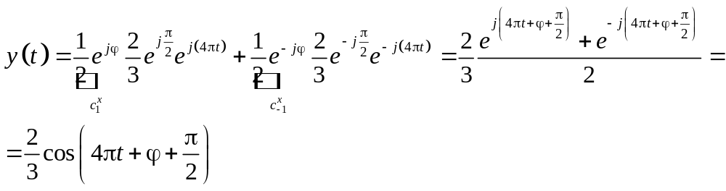
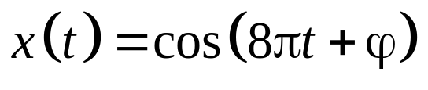
Homework:

Slide 16
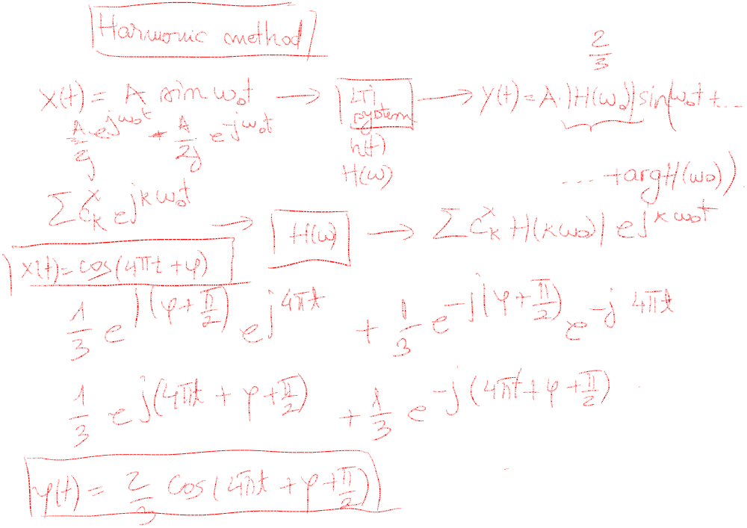

Slide 17
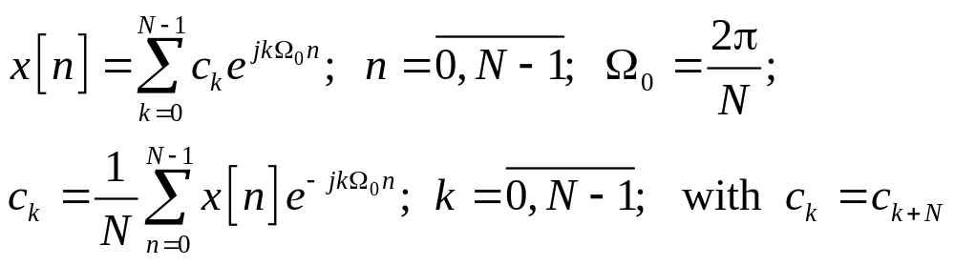
Discrete-time Fourier series/DTFS. Problems
The Fourier Series decomposition is given below, where N is the period of the signal. The spectrum is periodic of period N: c_{k}=c_{k+N} (as opposed to analog case)

Slide 18
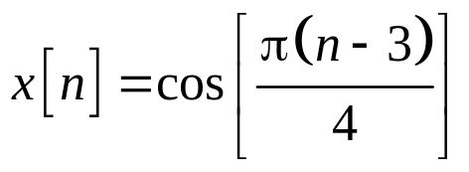
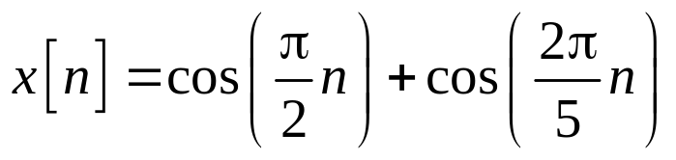

Problem 1) Determine and sketch the magnitude, phase and power spectra for the following:
a)
b)
c)

Slide 19
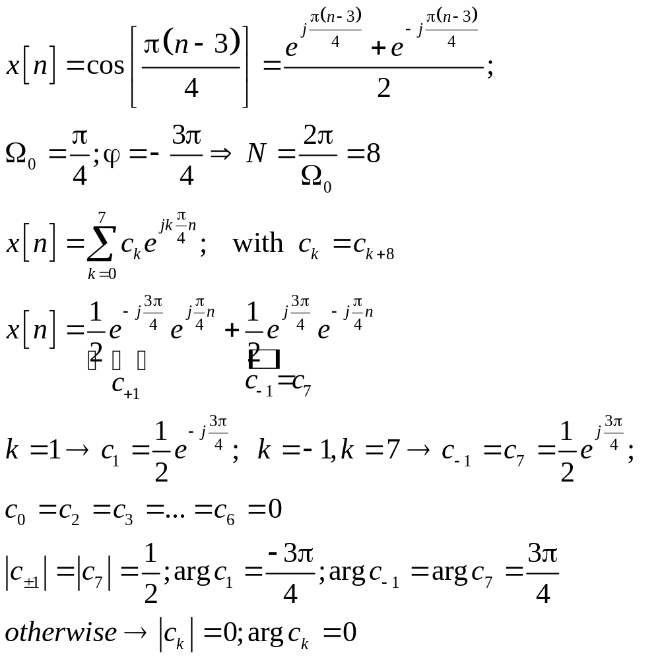
P1a)

Slide 20
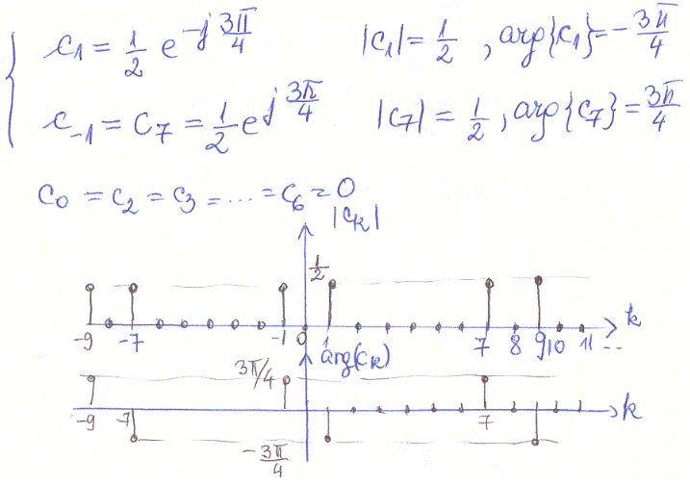
0
N-1

Slide 21
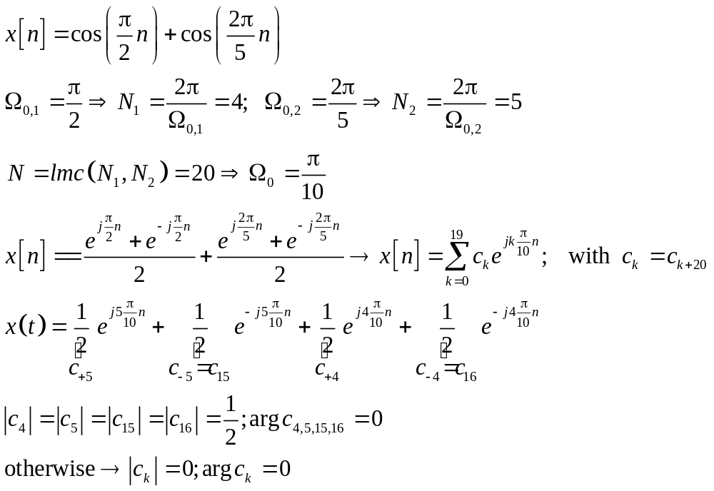
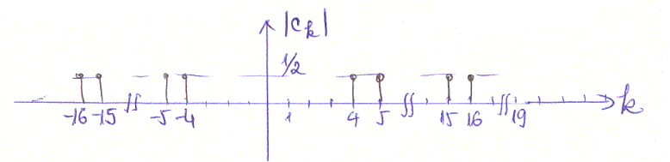
P1b)
Only magnitude spectrum is represented, since the phase is zero for all values of k

Slide 22
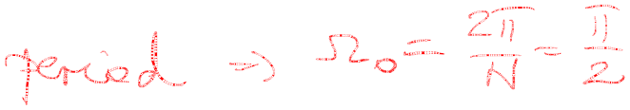
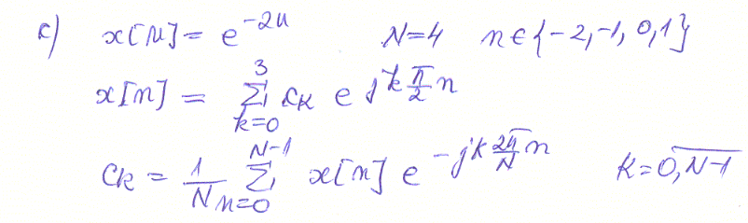
P1c)
homework

