Slide 1
Signals and systems

Slide 2
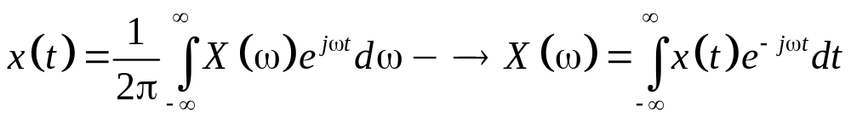
Seminar 4 The Fourier transform: CTFT and DTFT
Continuous-time Fourier transform (CTFT)
aperiodic continuous-time signals
Spectrum is continuous

Slide 3
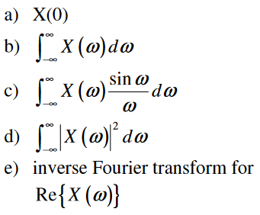
Problem 1. Denote X(ω) – the Fourier transform of the signal x(t). Determine the following values, without computing X(ω).
x(t)
3
2
t
-1
0
1
2
3

Slide 4
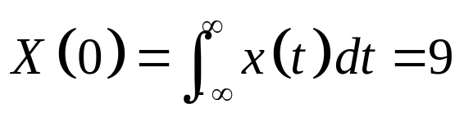
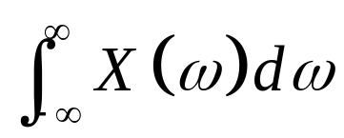
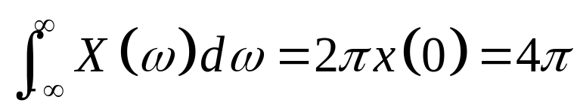
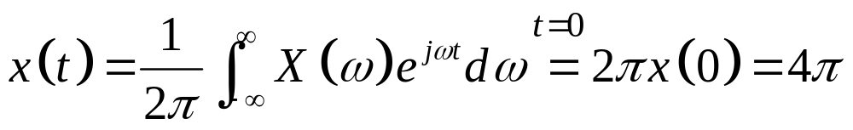
x(t)
3
2
a) X(0)
From the definition
b)
t
-1
0
1
2
3

Slide 5
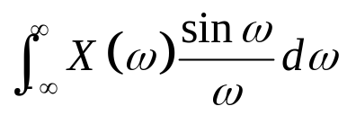
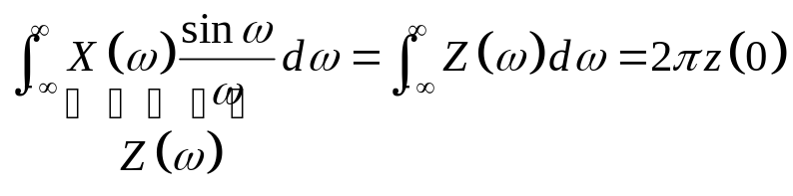
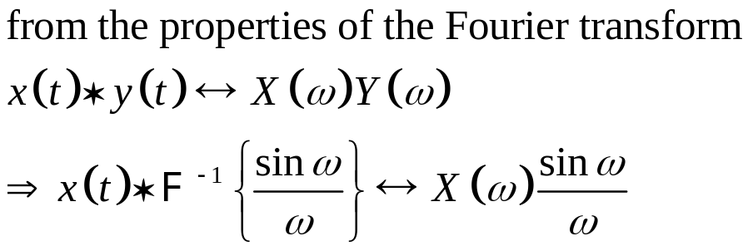
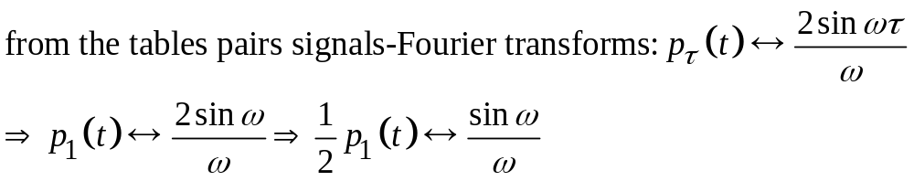
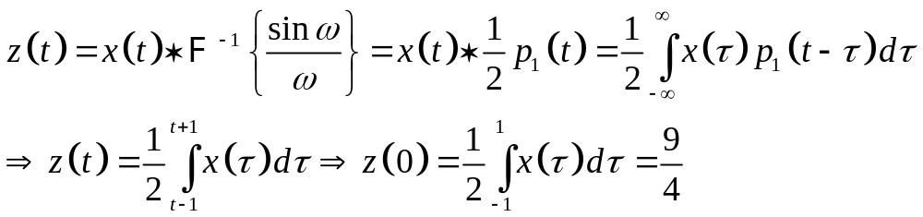
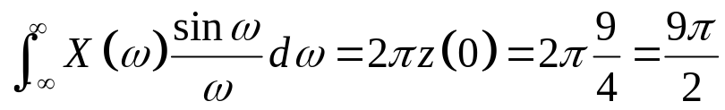
c)
p_{τ}(t)
1
t
-τ
τ
Here, τ=1
The result is

Slide 6
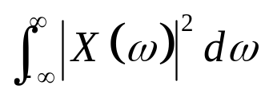
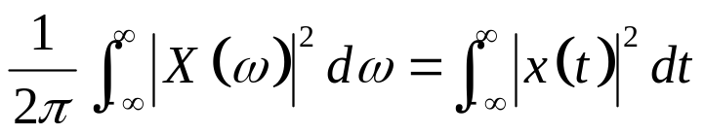
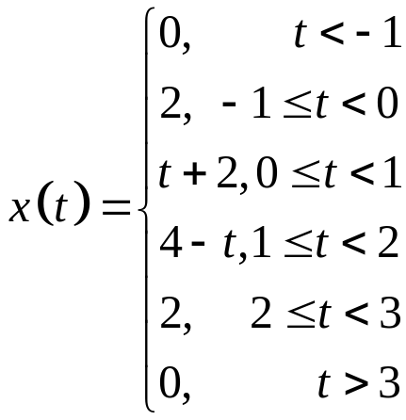
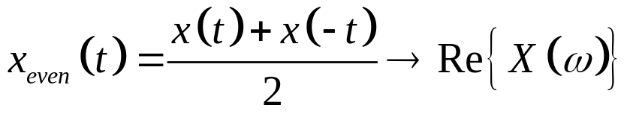
d)
x(t)
3
2
t
-1
0
1
2
3
homework
e) The inverse transform of Re{X(ω)}
homework

Slide 7
P2. For a linear invariant time (LTI) system S with input signal x(t) and output signal y(t)
a) determine the frequency response of the system
b) determine the impulse response of the system
c) determine the differential equation ; implement the system using integrators, adders and multipliers

Slide 8

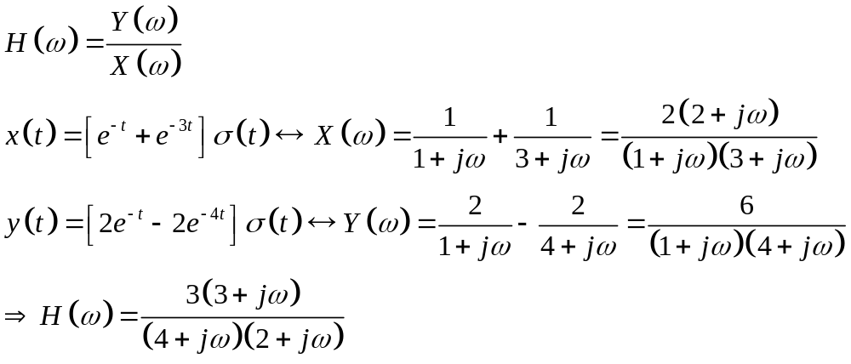
From the tables pairs signals-Fourier transform we have:
a)

Slide 9
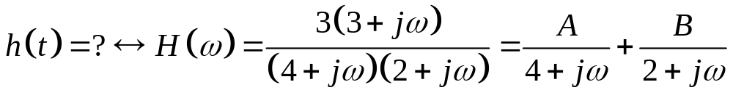
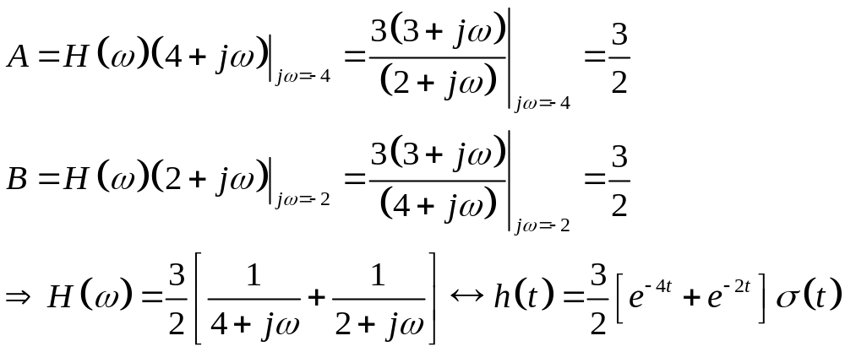
b) h(t)=?
Partial fraction expansion

Slide 10
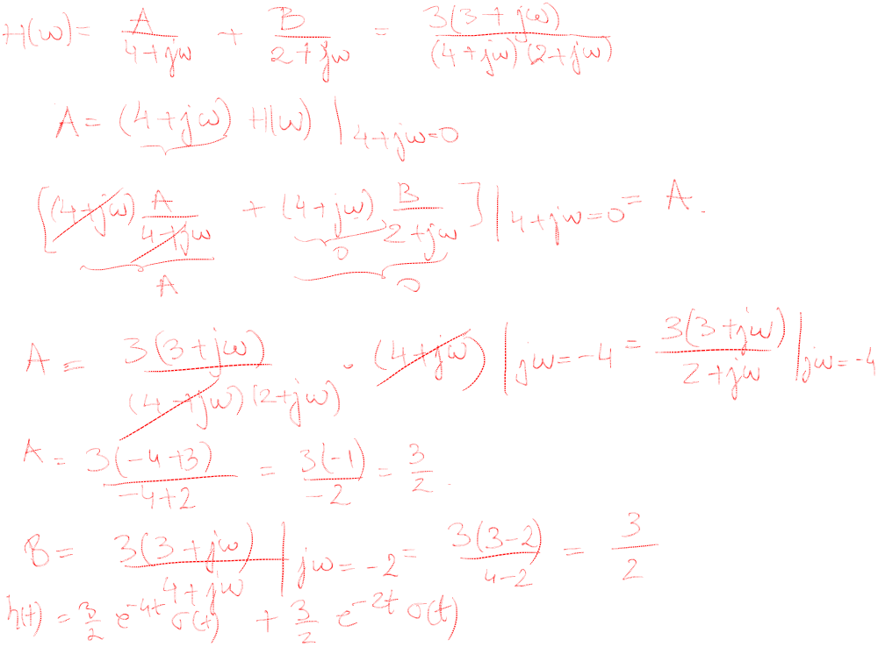

Slide 11
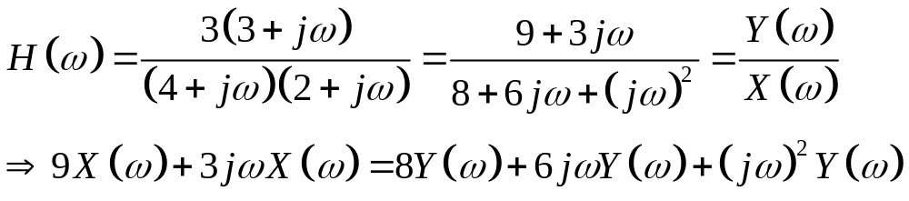
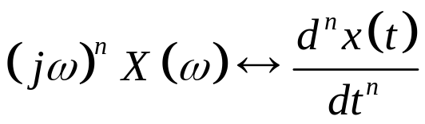
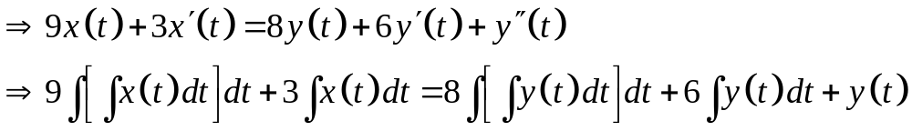
c) Differential eq + implementation with integrators

Slide 12
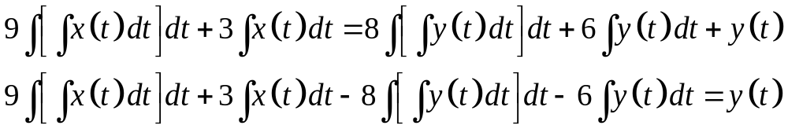
x(t)
y(t)
∫
∫
3
-6
Direct form I
∫
∫
9
-8
x(t)
y(t)
∫
Direct form II
-6
3
∫
-8
9

Slide 13

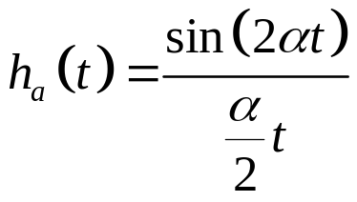
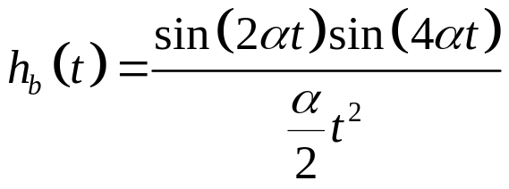

P3. The signal
is connected to the input of the system with the following impulse response (three cases):
a) Determine the frequency response of the system in the three cases H(ω). Sketch the corresponding magnitude spectra |H(ω)|.
b) Determine the response of the three systems to x(t)
If x(t) would has a useful component and a noisy component, which of the three systems would you pick, assuming the disturbance is cos(αt) ?
What if it’s cos(3αt)?

Slide 14
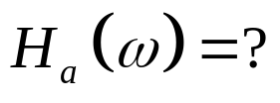
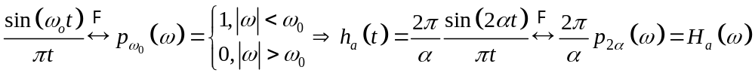
Solution
a)
For ha(t) from the table pairs signals-Fourier transform we have
Low-pass filter
|H_{a}(ω)|
2π/α
ω
-2α
2α

Slide 15
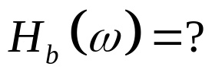
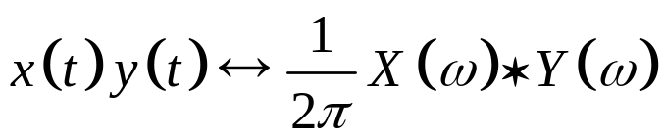
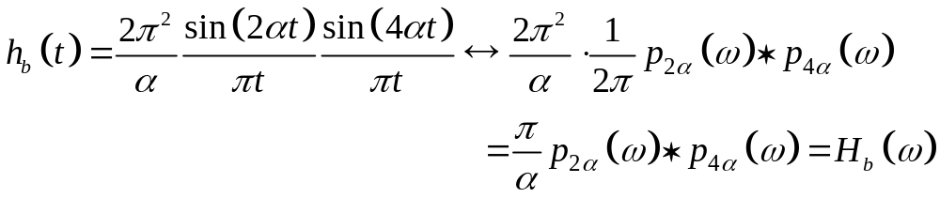
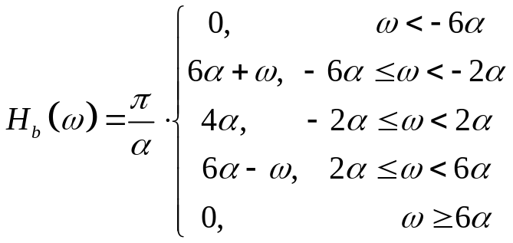
From the properties of the Fourier transform, we have the product theorem
(π/α)4α=4π max amplitude of the spectrum
|H_{b}(ω)|
Trapezoidal spectrum, 4α max amplitude
4π
ω
-6α
-2α
2α
6α

Slide 16
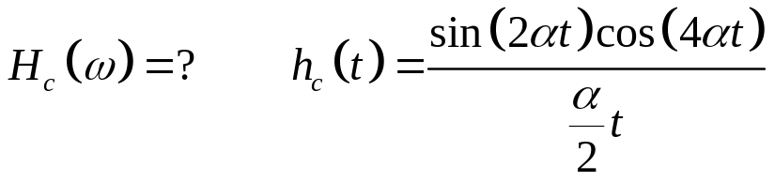
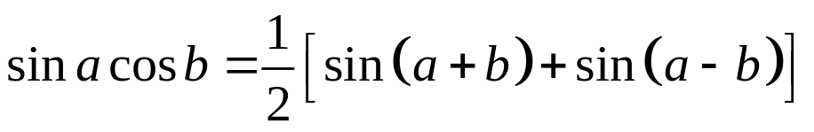
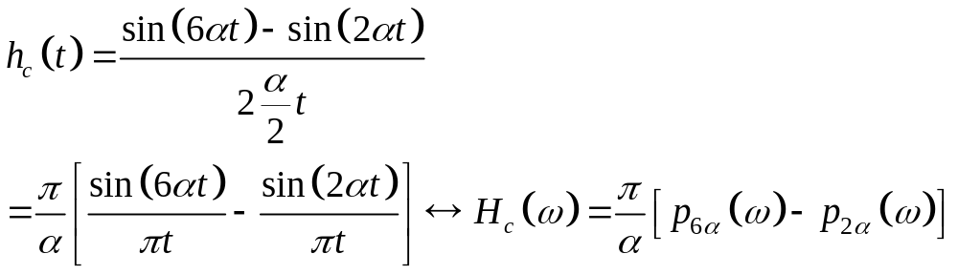
Trigonometric identity
Band-pass filter
|H_{c}(ω)|
π/α
ω
-6α
-2α
2α
6α

Slide 17
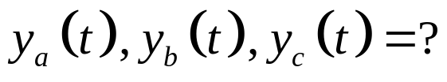
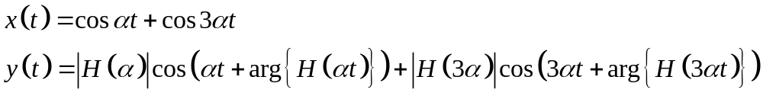
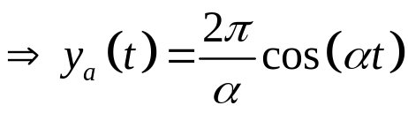

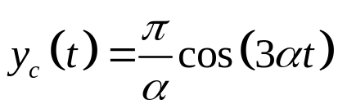
b)
c) ?

Slide 18
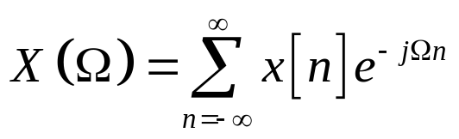
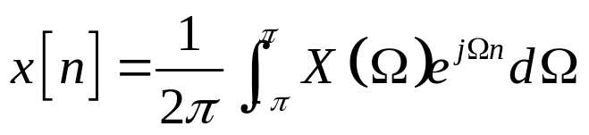
Discrete-time Fourier transform (DTFT)
The spectrum of an aperiodic discrete-time signal x[n] is
The inverse Fourier transform is
Remarks.
  X(Ω) is a continuous spectrum.
  X(Ω) is periodic by 2π: X(Ω)= X(Ω+ 2π)

Slide 19
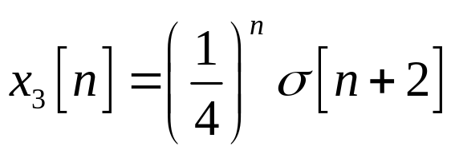
P1 Determine the Fourier transform for the following discrete-time signals
x₁[n]
1
n
0 1 2 3
x₂[n]
2
3/2
1
1/2
n
-3 -2 -1 0 1 2 3

Slide 20
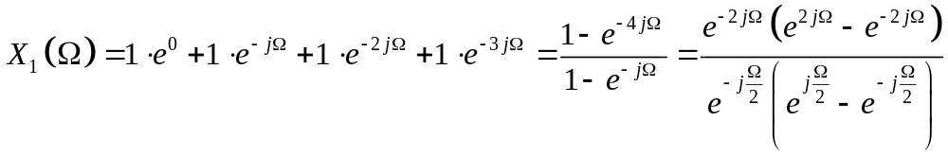
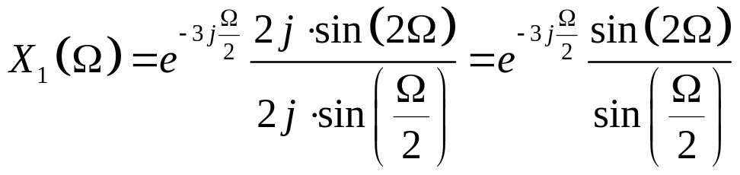
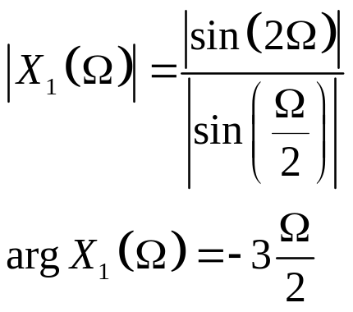
x₁[n]
a.
1
n
0 1 2 3
By definition, the DTFT is

Slide 21
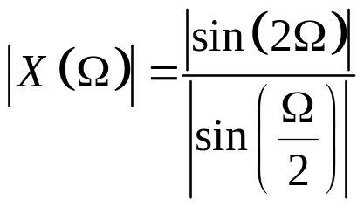
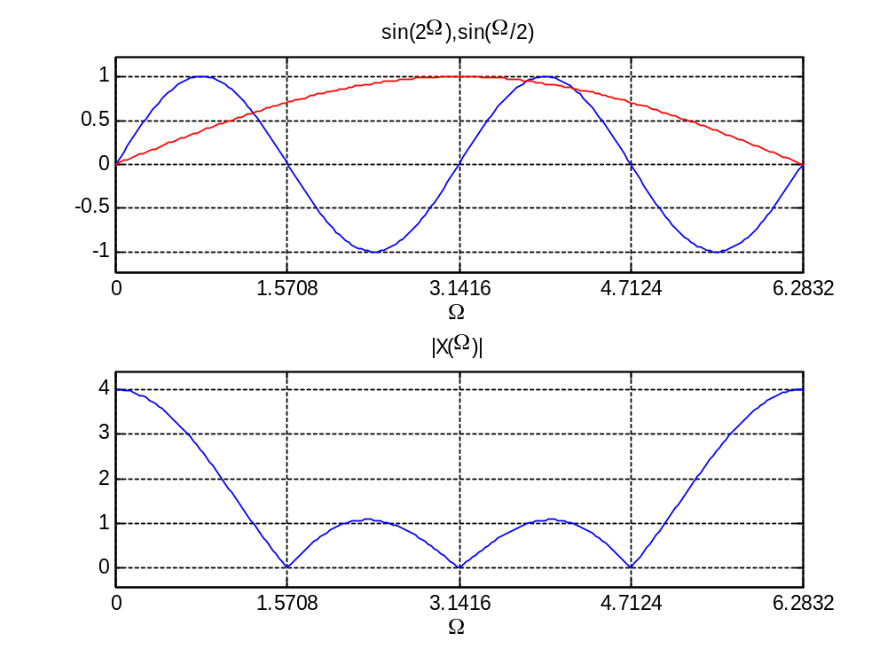
2Ω=2π -> Ω₁= π
Ω/2=2π -> Ω₂= 4π

Slide 22
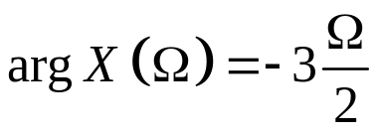
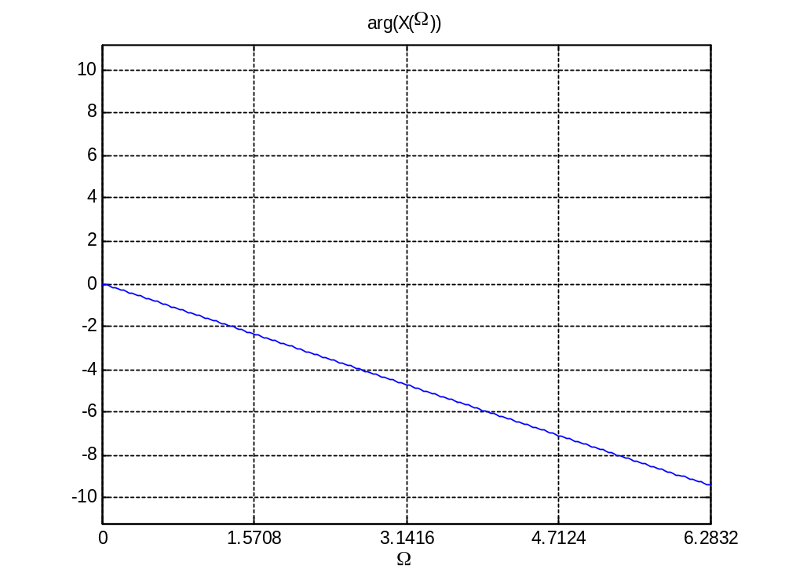

Slide 23
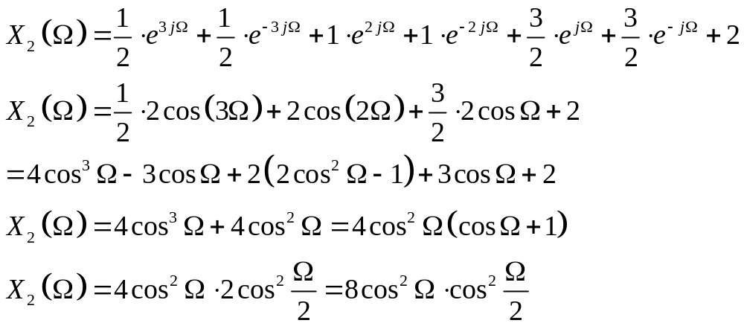
b.
x₂[n]
2
3/2
1
1/2
n
-3 -2 -1 0 1 2 3
n=-3
n=3
Method 1: applying the definition like the previous case

Slide 24



Method 2
x₁[k]
1
k
0 1 2 3
x₁[n-k]
Convolution x₁[n]*x₁[n]
1
k
n-3 n-2 n-1 n
y[n]=x₁[n]*x₁[n]
4
3
2
1
n
0 1 2 3 4 5 6
Time shift and attenuation
x₂[n]
2
3/2
1
1/2
n
-3 -2 -1 0 1 2 3

Slide 25


n₀=-3
Result is the same by both methods:

Slide 26

c.
1-Direct computation

Slide 27



c.
2-Using tables+properties
From the table Pairs signals- Fourier transform

Slide 28






P2. We have the signal x[n]
a) X(0)
b)
c)
d)
e)
f)
g)
X(π)
inverse Fourier transform for

Slide 29



a.
b.
By shifting x[n] to the left by 2, we obtain an even signal y[n] -> its spectrum Y(Ω) is real

Slide 30





c.
d
e
because

Slide 31


f
From the properties, we have
g
The inverse Fourier transform of

Slide 32
P3. We have the LTI system described by the difference equation
a)Find the frequency response of the system
b)Find the impulse response of the system
c)Give a form of implementation using adders, proportional systems and delay cells

Slide 33



a)Find the frequency response of the system. We apply the Fourier transform both sides:
b)Find the impulse response of the system.
Partial fraction expansion, with variable e^{-jΩ}

Slide 34




From the tables we have the pair
c) Give a form of implementation using adders, proportional systems and delay cells

