Slide 1

Image processing
2D convolution with CUDA and OpenMP
Dragos Tanasa
Firenze, 07/09/2023

Slide 2

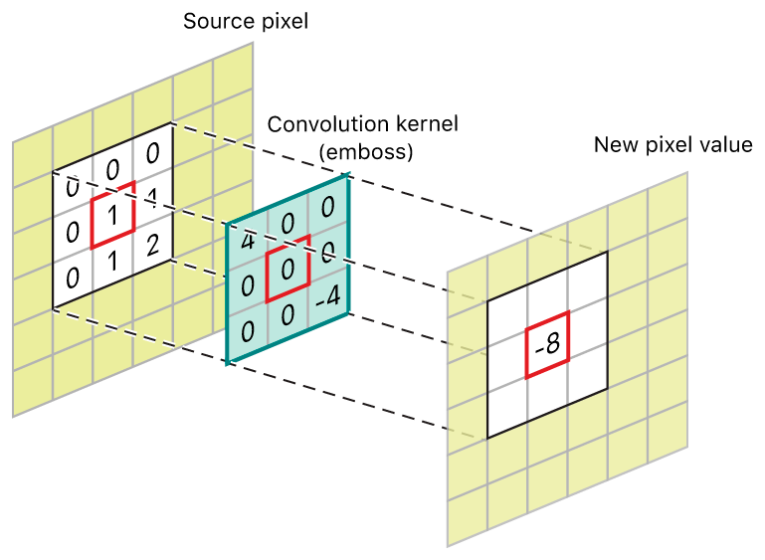
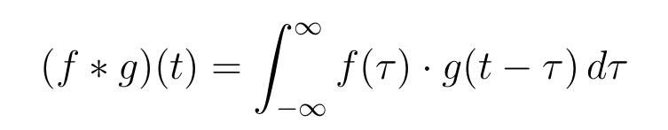
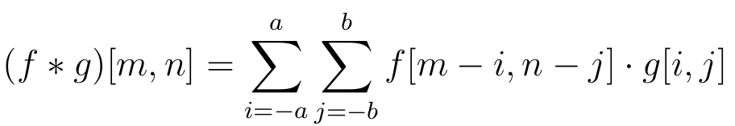
Image processing
Firenze, 07/09/2023
Convolution
Matematical background
Given two functions f and g their convolution is defined as:
We are however focusing on 2-dimensional discrete convolution operation in which both function has finite support, in this case the convolution has the following form
2

Slide 3
Image processing
Firenze, 07/09/2023
Image Processing
Convolution application
The effect of the convolution on the input image depend on the kernel used.
It can be used both as preprocessing tool or a image manipulation tool.
3

Slide 4
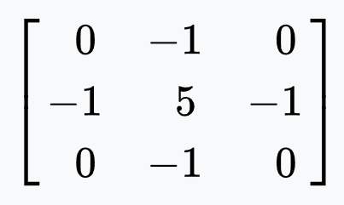
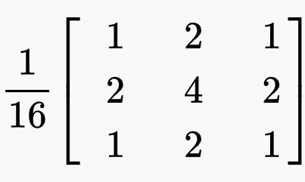
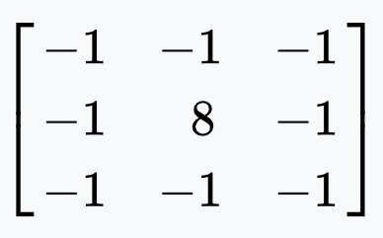
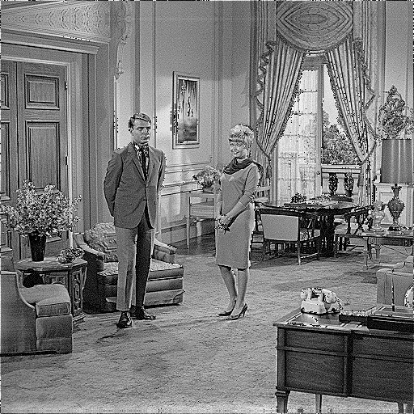
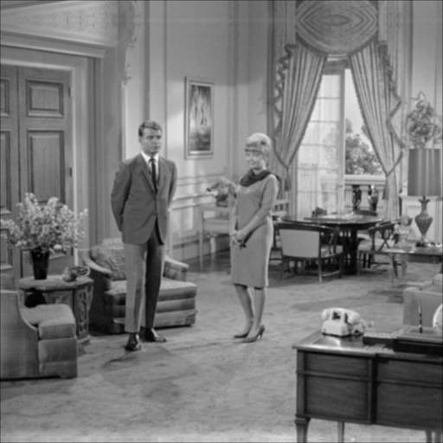
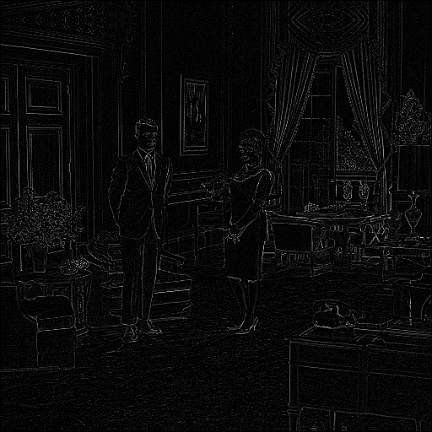
Image processing
Firenze, 07/09/2023
Image Processing
Convolution application
Sharpen
Gaussian blur
Edge detection
4

Slide 5
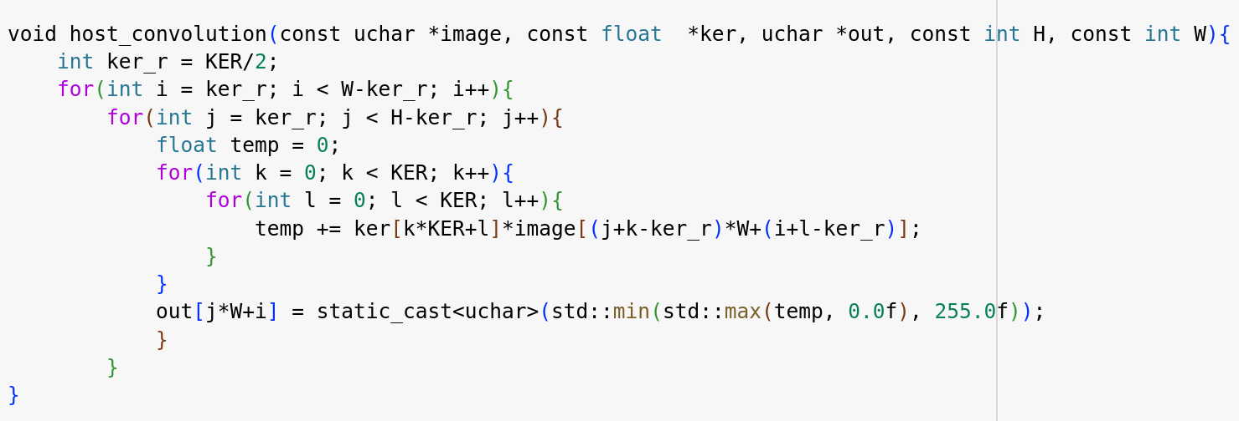
Image processing
Firenze, 07/09/2023
Sequential Implementation
No passing was add to deal with the edge problem. Outher loops was simply started from the kernel’s radius (ker_r)
Necessary becuase of how the cast to uchar works in C++
5

Slide 6
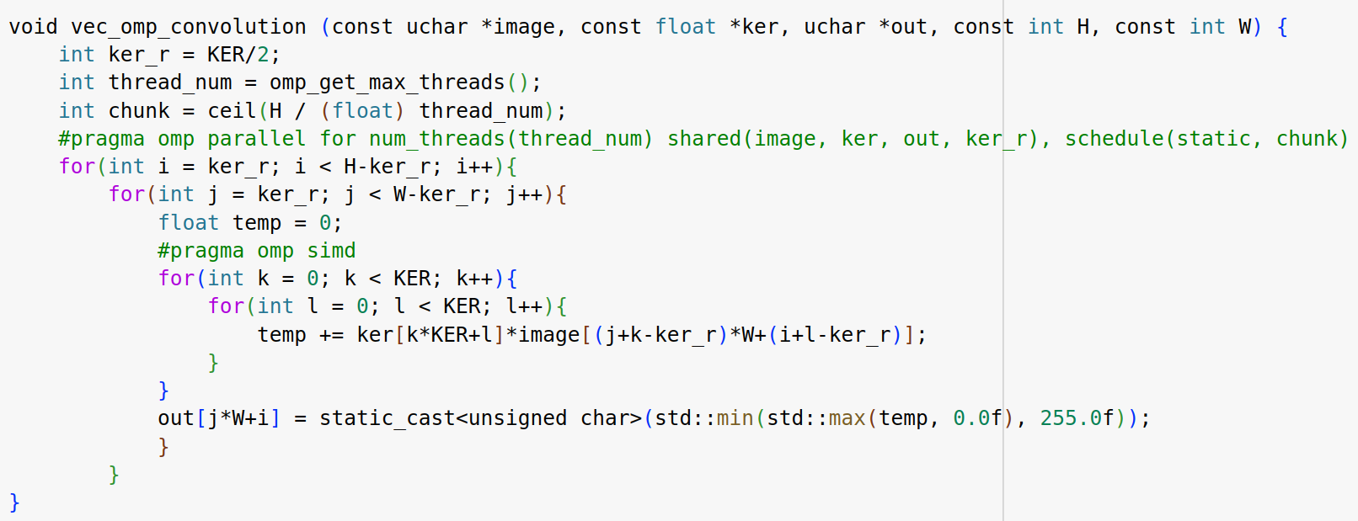
Image processing
Firenze, 07/09/2023
OpenMP implementation
Overview
Simple #pragma omp parallel for used to schedule threads to a chunk of image
Foundamental role of temp variable: reduces the access to shared out image by KER^2
#pragma omp simd instruction to speed up the single convolution operation
6

Slide 7
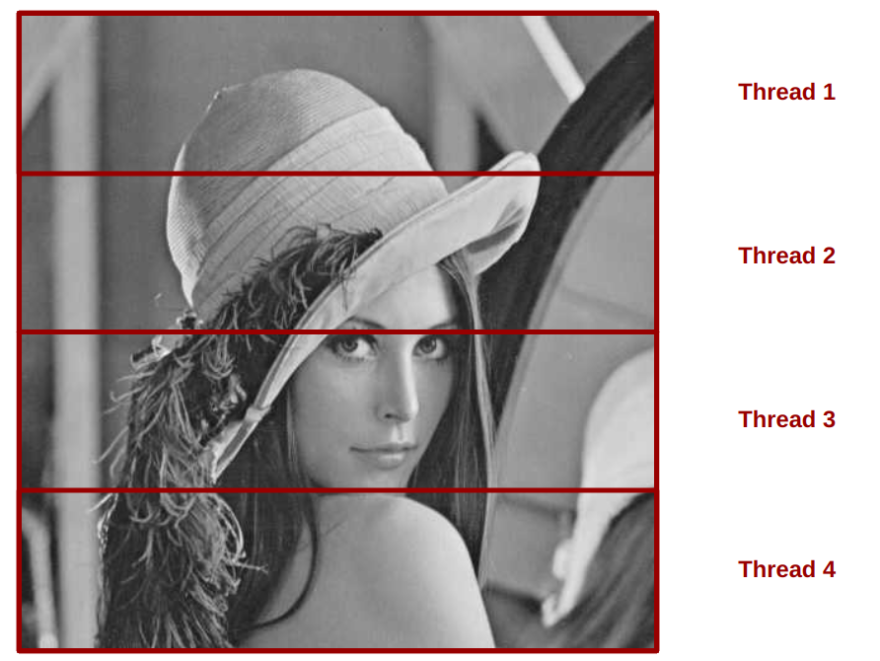
Image processing
Firenze, 07/09/2023
Visualization of OpenMP implementation
Each thread gets assigned a horizontal portion of image
2

Slide 8
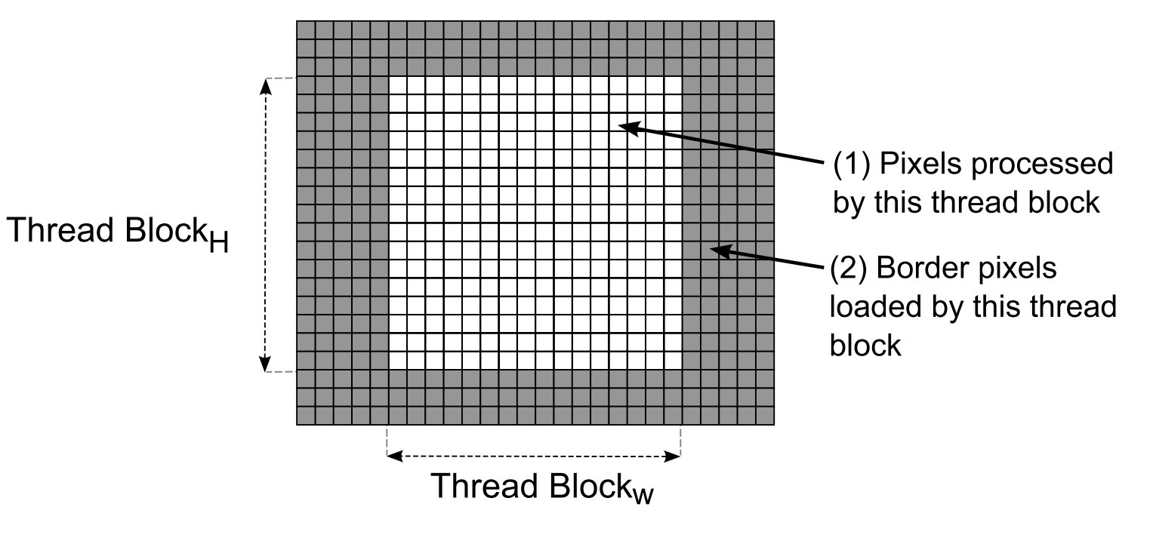
Image processing
Firenze, 07/09/2023
CUDA implementation
Strategy used
CUDA implementation takes advantage of both Constant Memory and Shared Memory
The strategy used to exploit the shared memory implies that threads load more than a pixel from Global Memory but are all involved in the computation task.
2

Slide 9
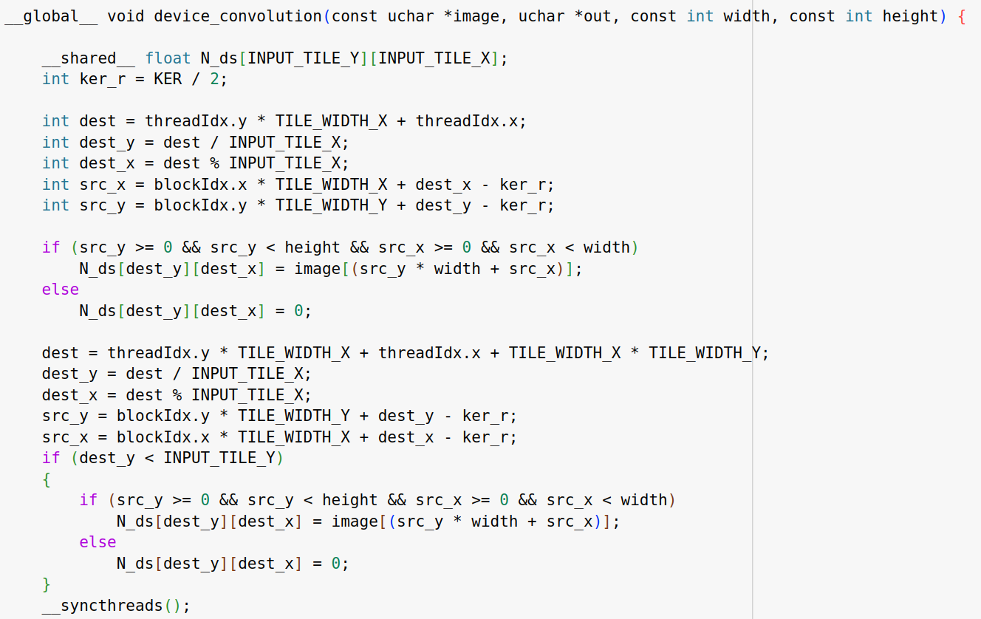
Image processing
Firenze, 07/09/2023
CUDA implementation
Loading phase
The loading phase is carried out in two phases:
In the first phase all threads of the block are involved in copying data from global to shared memory filling the first part of the N_ds matrix.
In the second phase a portion of threads are responsible for filling the remaining part of the shared memory.
Given the fact that our tile tends to be larger than the kernel used each thread load at most 2 pixel values.
9

Slide 10
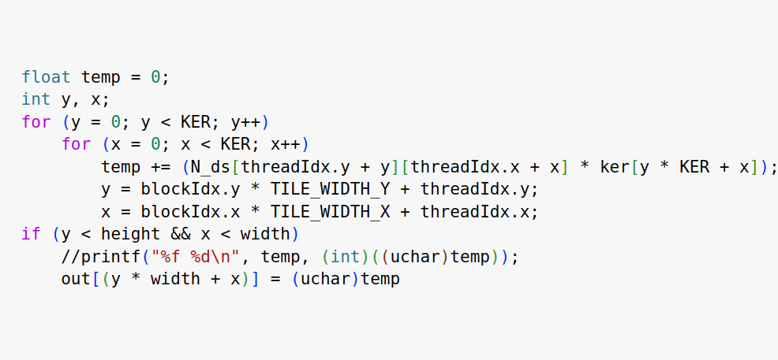
Image processing
Firenze, 07/09/2023
CUDA implementation
Compuation phase
Computation phase is straighforward and resembles the serial implementation.
Simple casting to uchar would suffice for the CUDA kernel. Apparently casting to uchar is implemented differently in the CUDA compiler than in g++.
10

Slide 11
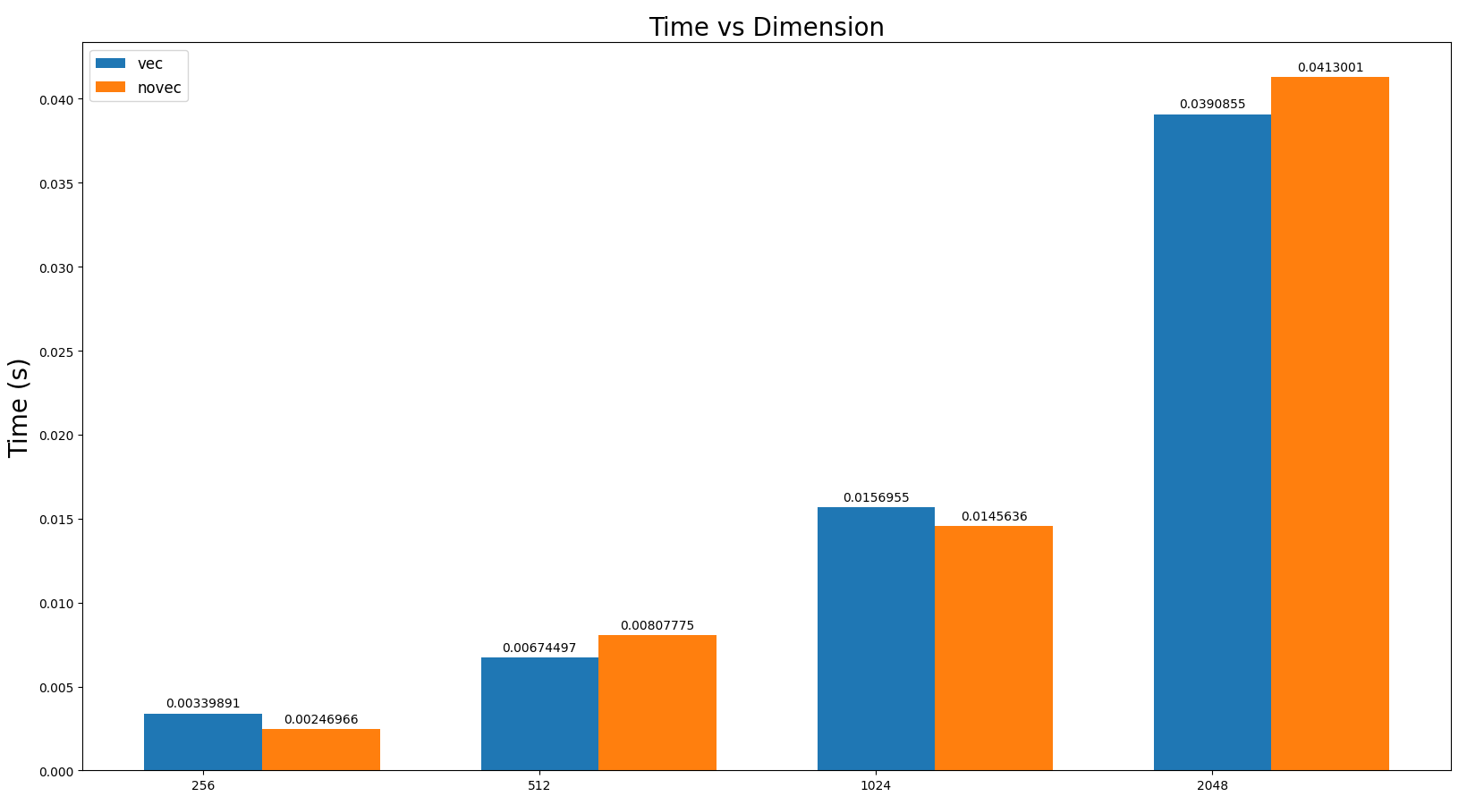
Image processing
Firenze, 07/09/2023
OpenMP Performances
Vectorization
Vectorization doesn’t seem to improve the execution time of the OpenMP implementation.
The reason my be related to the “complex” memory access patter of the image pixel and to the fact that kernels tend to have odd number of elements making it hard to take advantage of AVX2 registers that can store 256 bit.
12

Slide 12
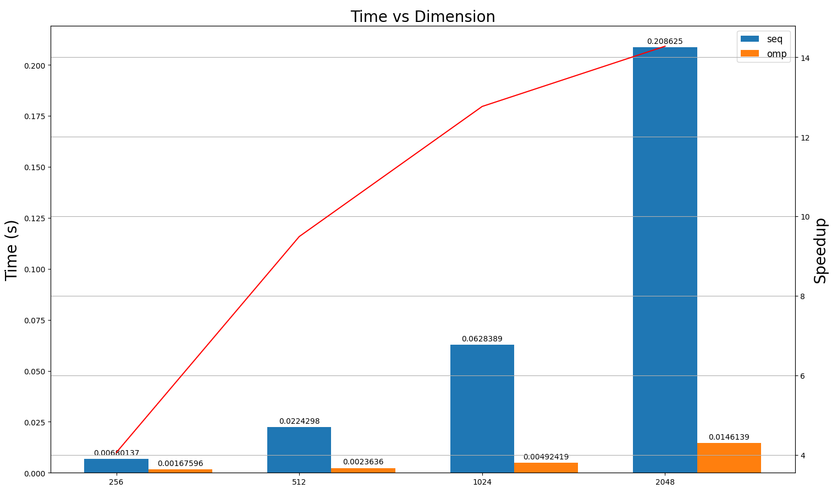
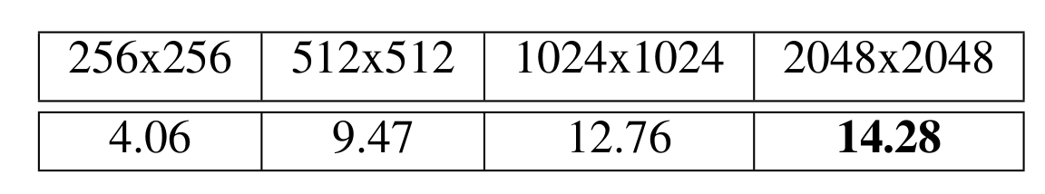
Image processing
Firenze, 07/09/2023
OpenMP Performances
Speedup
As expected the speedup tends to increase with the dimension of the input image being constant the overhead of spawning and managing the same number of threads (16 in this case).
13

Slide 13
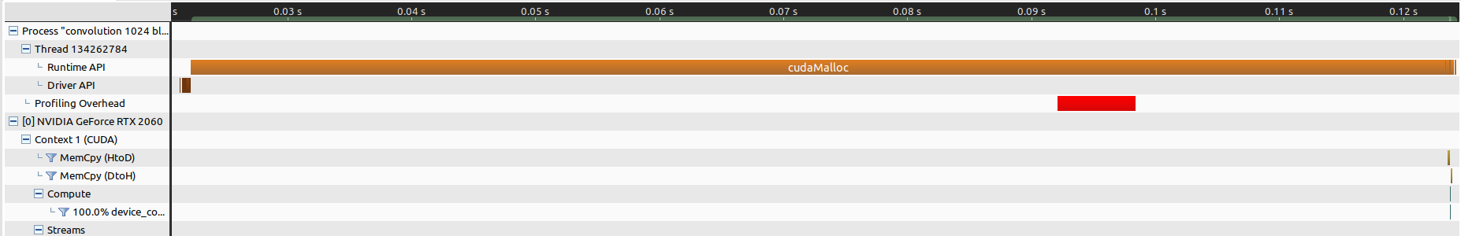
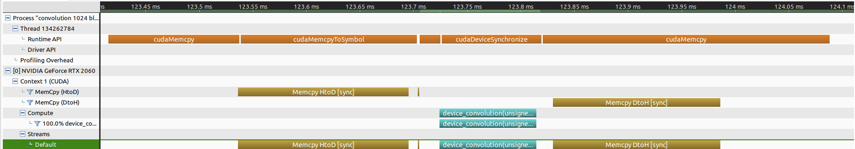
Image processing
Firenze, 07/09/2023
CUDA Performances
cudaMalloc()
The memory allocation task was the slowest one as suggested by the Nvidia Visual Profiler. The cudaMemcpy and the kernel execution are comparable.
14

Slide 14
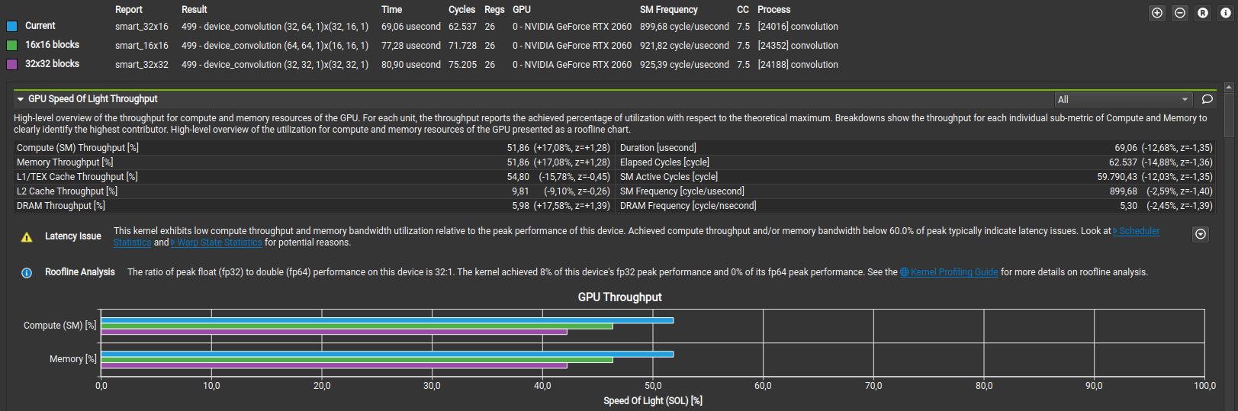
Image processing
Firenze, 07/09/2023
CUDA Performances
Optimizing the TILE dimensions
For the optimal TILE dimensions the Nsight compute tool was used
The results show that the optimal tile dimension for the given hardware is 32x16 pixel
15

Slide 15
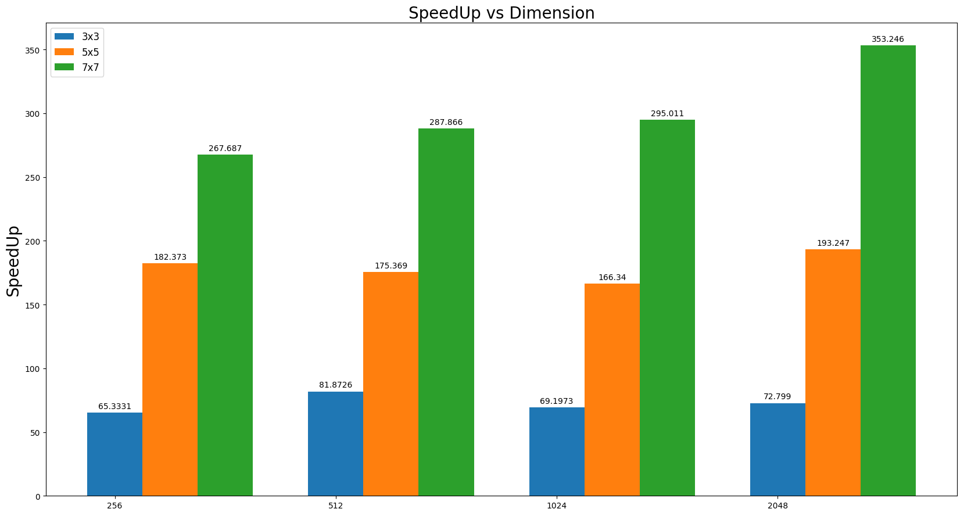
Image processing
Firenze, 07/09/2023
CUDA Performances
Speedup
Speedup increase drasticlly with the kernel dimension at the same image dimensions.
We touch a speed up of 353 in the most extreme case.
16

Slide 16
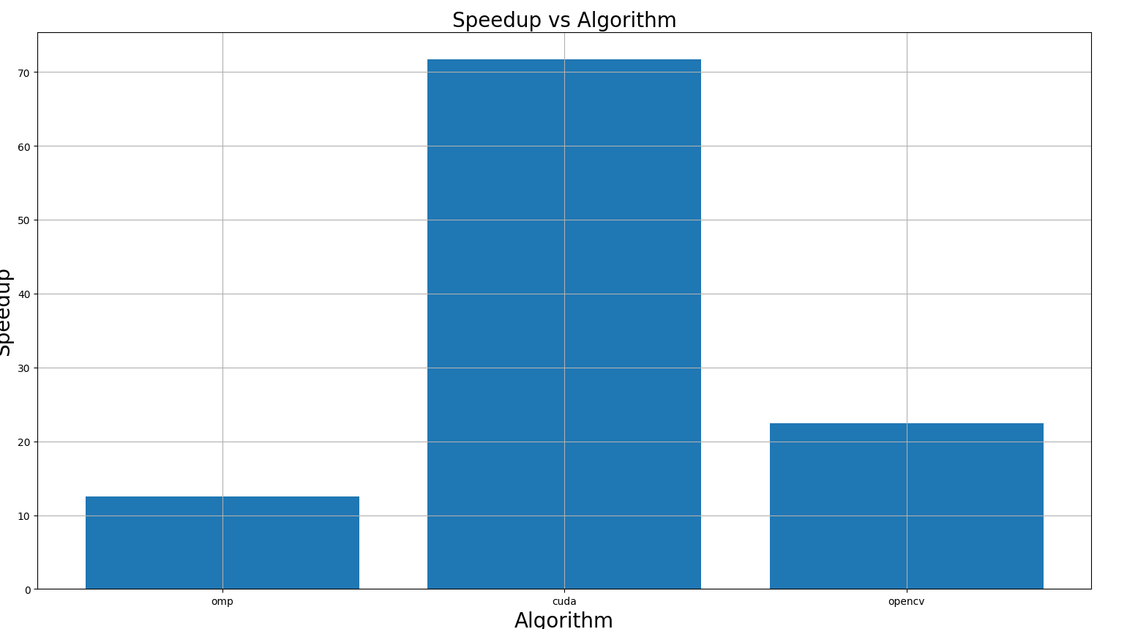
Image processing
Firenze, 07/09/2023
Overall performances
Test done using a 1024x1024 image size to compare the CUDA and OpenMP implementation with respect to the OpenCV one.
Must be noticed that the OpenCV library was compiled using -O3 optimization.
17

