Slide 1

K-means
OpenMP paralleization
Dragos Tanasa
Firenze, 07/09/2023

Slide 2

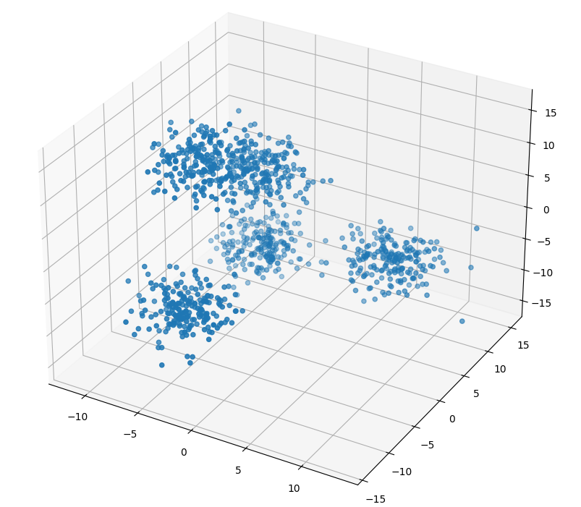
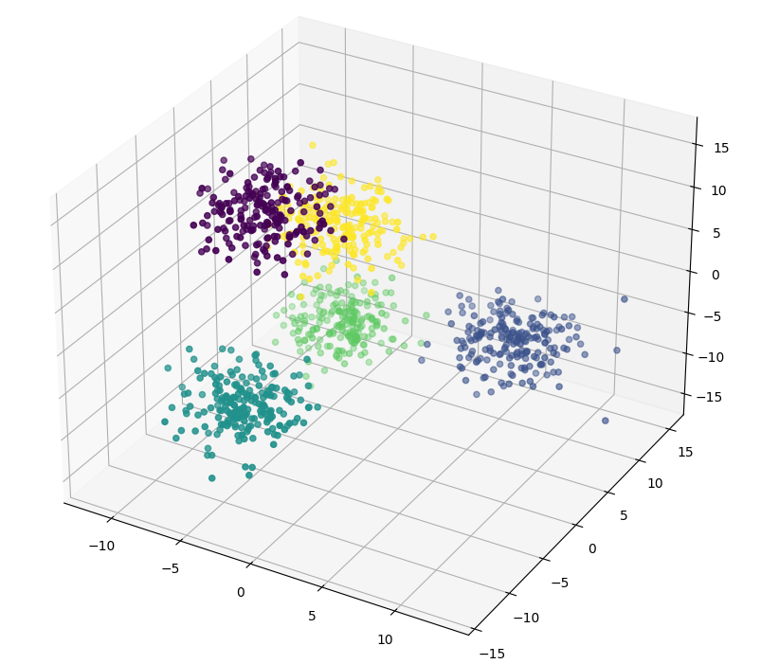
K-means algorithm
Overview
Unsupervised learning algorithm that aims to partition n observations into k clusters in which each observation belongs to the cluster with the nearest mean (cluster centers or cluster centroid), serving as a prototype of the cluster.
1. Initialization: Choose K initial cluster cen-
ters from the dataset.
2. Assignment: Assign each data point to the
nearest cluster center based on a distance
Metric
3. Update: Calculate the new cluster centers
(centroids) by computing the mean of all data
points assigned to each cluster.
4. Repeat: Iterate steps 2 and 3 until conver-
gence.
2

Slide 3
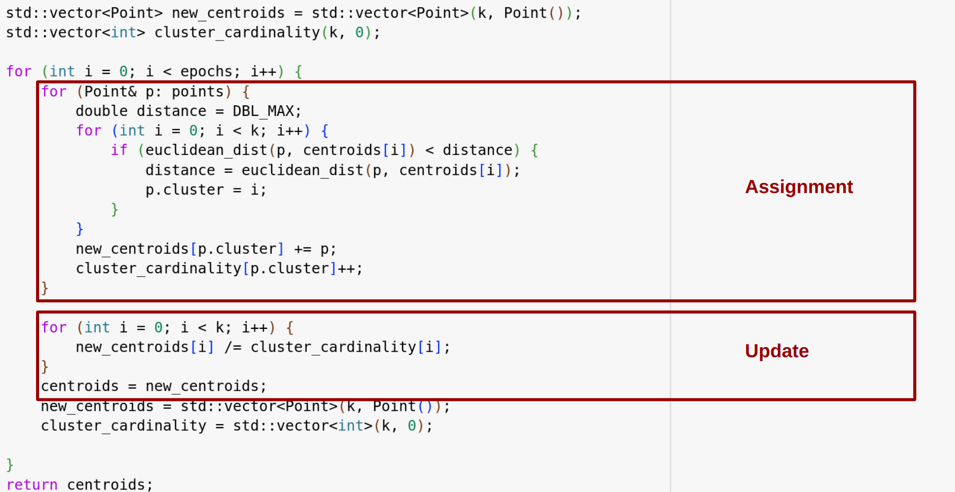
K-means algorithm
Serial implementation
In each epoch the assignment task is performed alongside the update of the new_centroids and cluster_cardinality vectors, these are both used in the update phase.
The assignment itself has a cost of O(n*k*d) with n being the number of points, k the number of clusters and d the dimensionality of the dataset. The update phase has a cost of O(k).
3

Slide 4
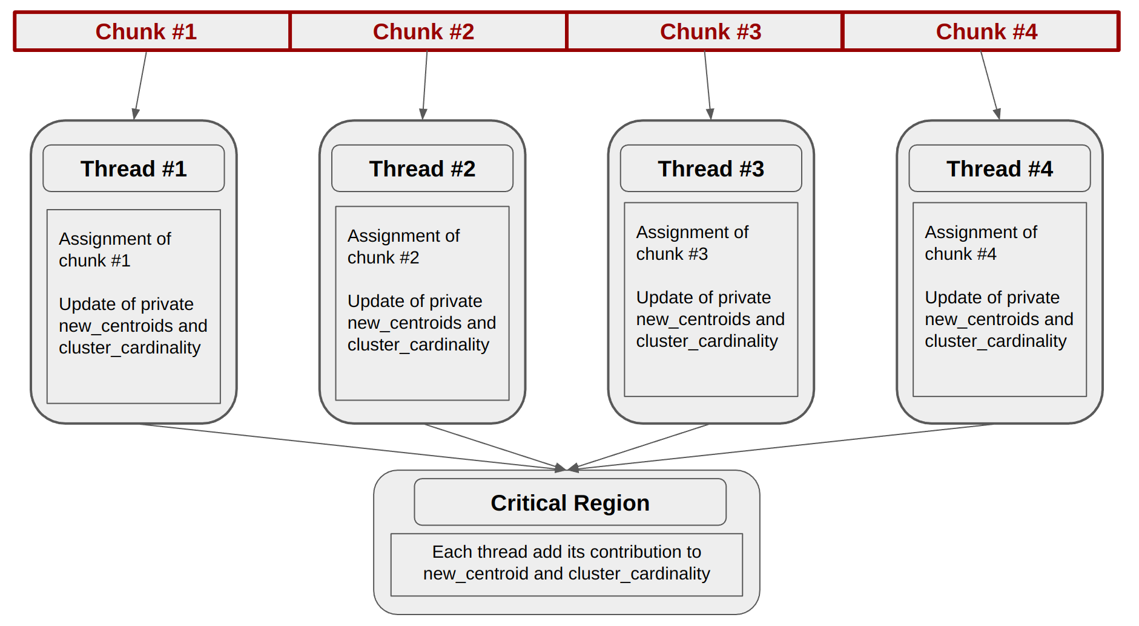
K-means algorithm
Parallelization strategy
4

Slide 5
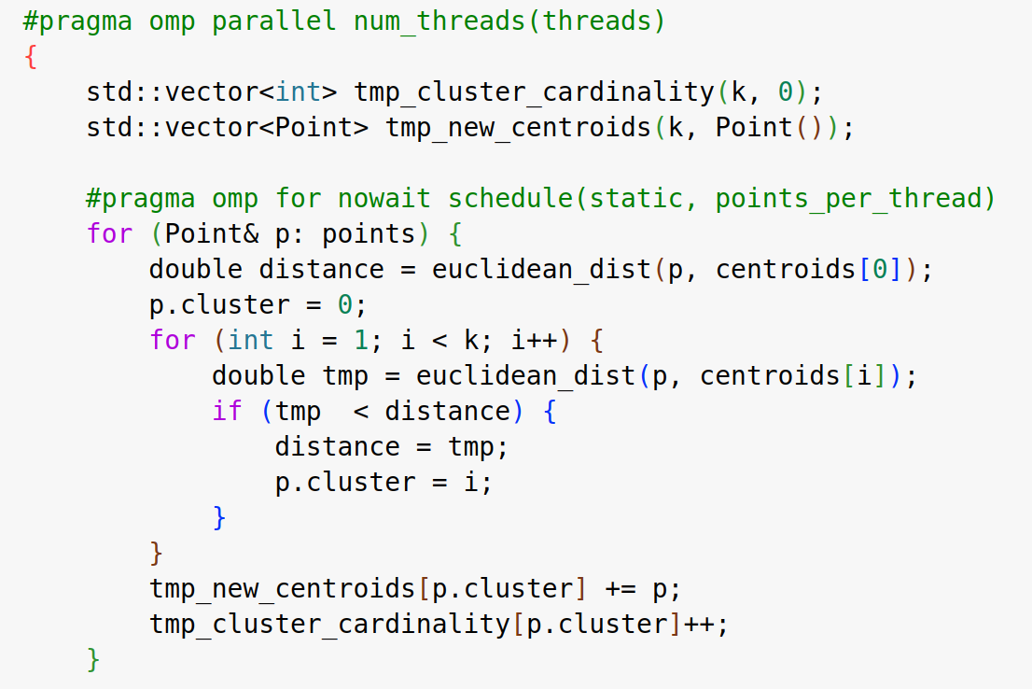
K-means algorithm
Assignment in the parallel implementation
Computational complexity has been reduced to a teoretical O((n/N)*k*d) with N being the number of threads.
5

Slide 6
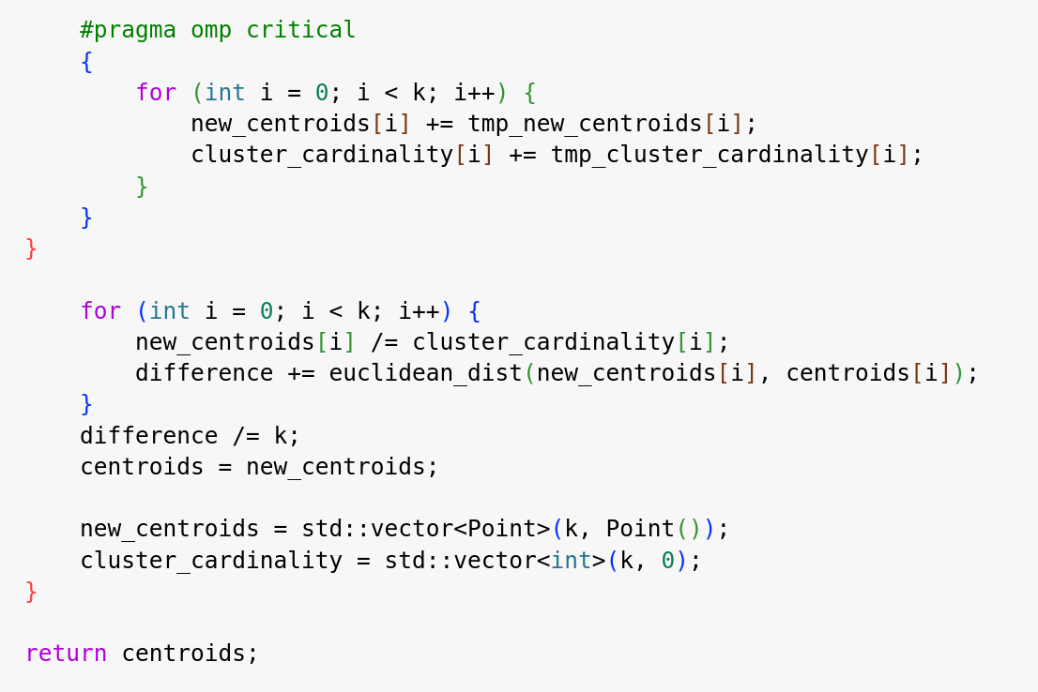
K-means algorithm
Update in parallel implementation
Each thread adds its contribution to new_centroids and custer_cardinality
6

Slide 7
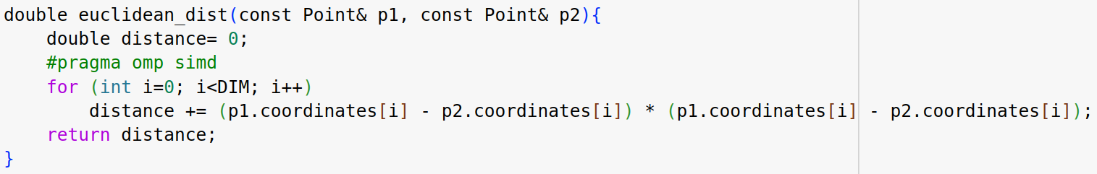
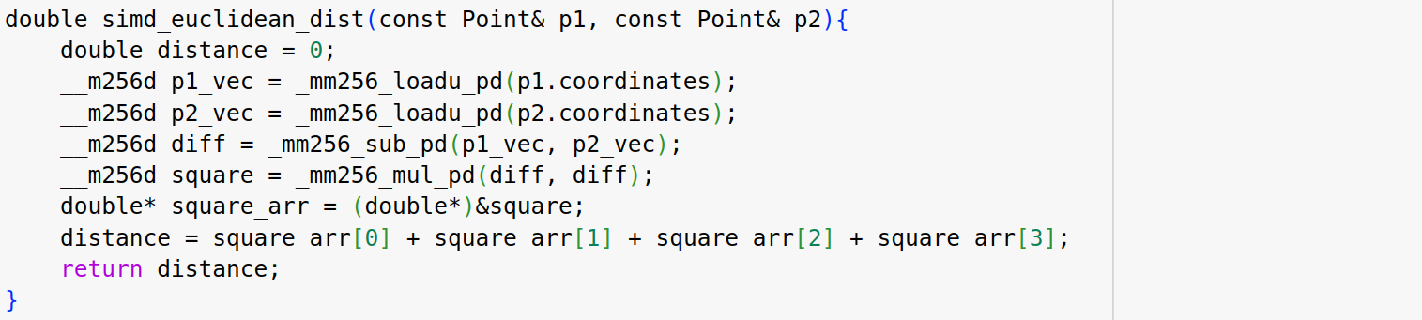
Perfomance results
Vectorization implementation
Two strategies were tested to check if vectorization could improve the execution time of the implementation.
The first one, more general that uses the #pragma omp simd instruction
The second one uses AVX2 instructions and works only for DIM = 4
7

Slide 8
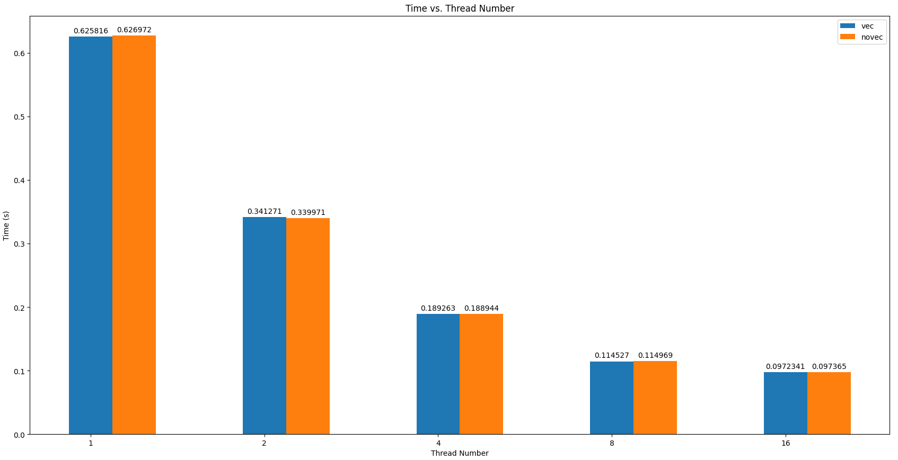
Performance results
Vectorization
Here are reported the results relative to the #pragma omp simd implementation only but the one that uses AVX2 instruction are comparable.
As we can see vectorizing the distance calculation does not improve execution time.
8

Slide 9
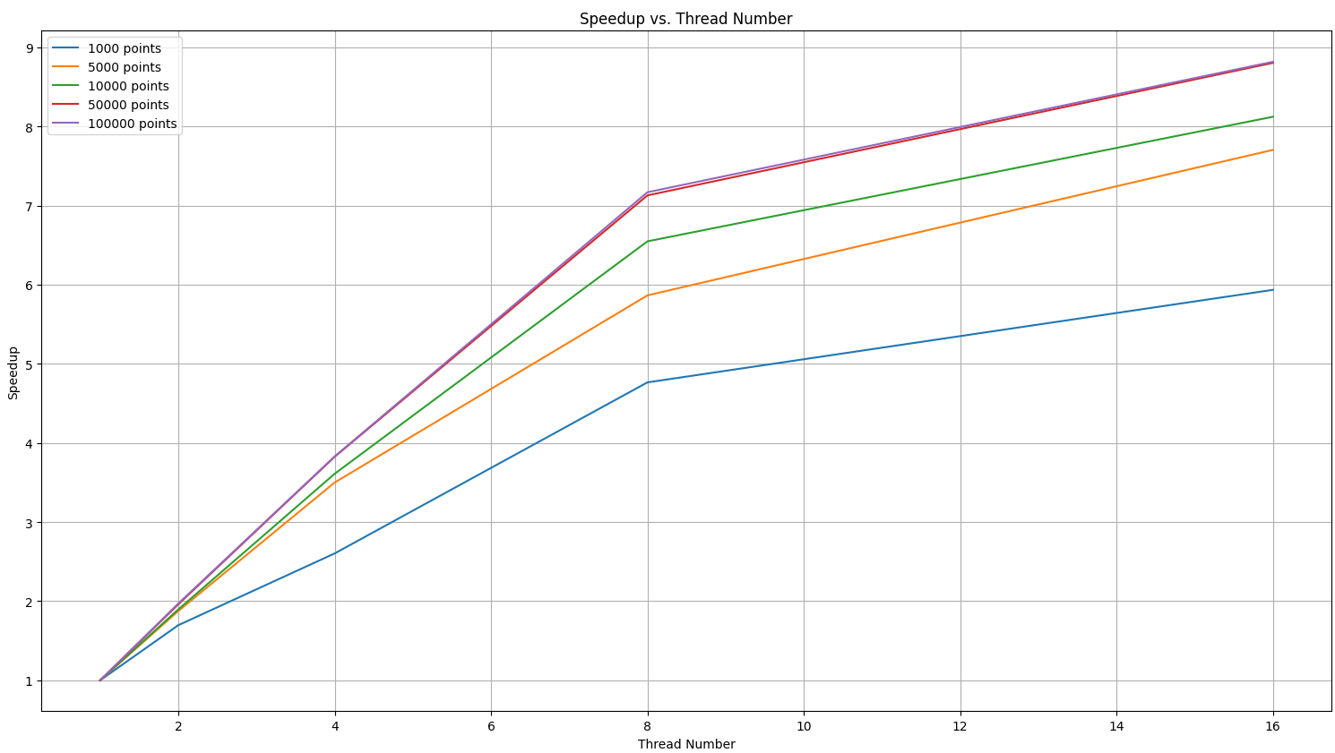
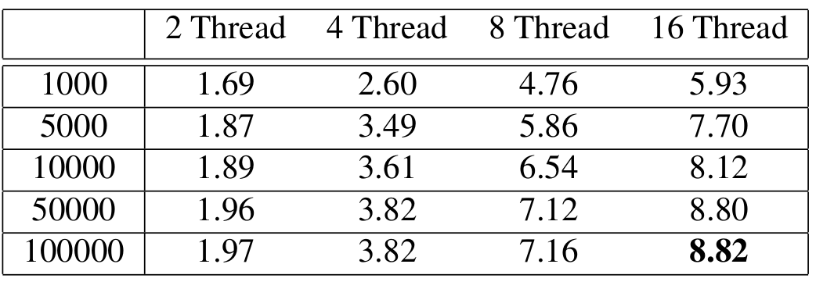
Performance results
Speedup: number of points
Results are in line with what we expected. Speedup tends to grow with respect to threads with the being bigger for dataset with higher cardinality al thing beeing equal. That’s becuase the cost in terms of time of spawning and managing threads is the same.
9

Slide 10
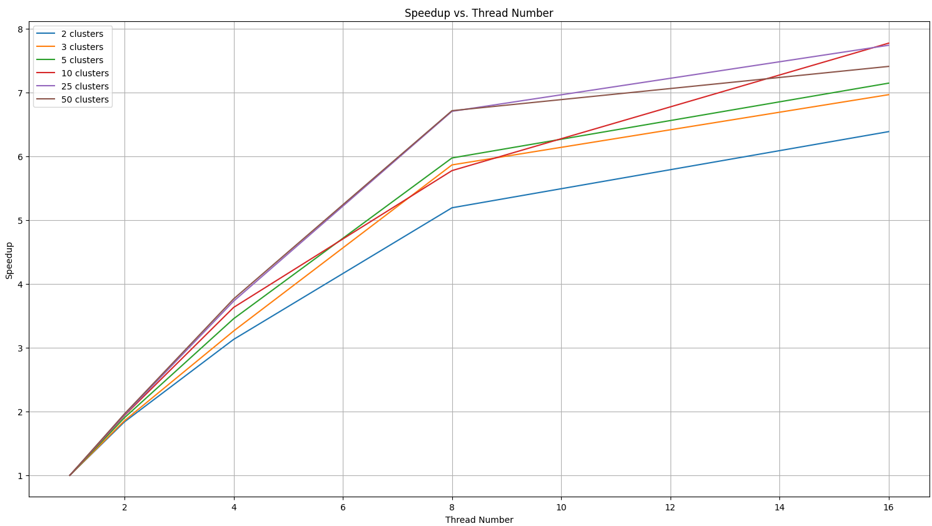
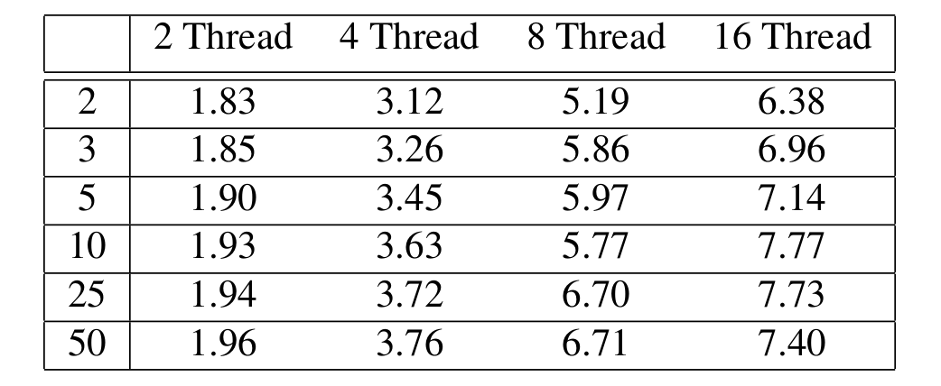
Performance results
Speedup: number of clusters
Results are comparable with the previous ones
10

Slide 11
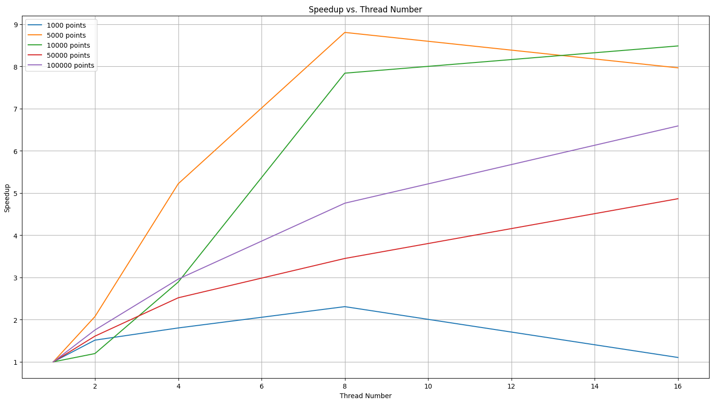
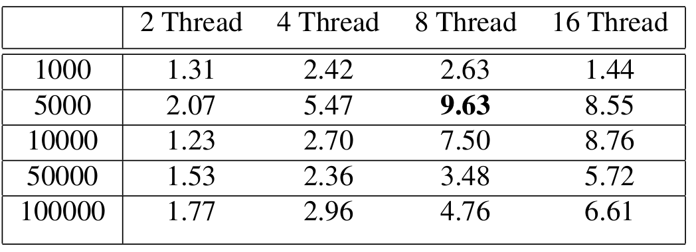
Performance results
Speedup with -O3 optimization
Results are in line with what we expected. Speedup tends to grow with respect to threads with the exception of those case where the execution time of the single iteration becomes comparable with the cost of spawning and managing threads.
Speedup seems to be superlinear but probably is just the g++ compiler that manages to exploit vectorization.
11

