Slide 1
PERFORMANCE ANALYSIS
Burrows-Wheeler’s algorithm + Run-Length Encoding
Unguru Dragos-Gabriel, 343C1

Slide 2
01
TABLE OF CONTENTS
02
03
04
What does the algorithm do?
What’s the purpose?
How does it behave on various inputs?
Show me some execution times!
What do these times mean?
Does the data tell us something?
Conclusions?
Have we obtained the expected results?

Slide 3
“Redesigning your application to run multithreaded on a multicore machine is a little like learning to swim by jumping into the deep end.”
—Herb Sutter, chair of the ISO C++ standards comittee

Slide 4
01
What does the algorithm do?

Slide 5
Burrows-Wheeler algorithm
The Burrows-Wheeler transform rearranges a string (in a lossless way) to a form where the repeating characters are near
one another.
This makes the Run Length Encoding much more efficient (and worthy).

Slide 6
Run-Length Encoding
Basically, counts the occurrences of repeating characters.
Turns BANNANA ADDICT to 1B1A2N1A1N2A2D1I1C1T

Slide 7
The use of these two transforms together is fairly common as the BW Transform facilitates a good way to increase the number of repeating characters in the RLE phase.
Burrows-Wheeler
(in three easy steps)
Run-Length
(in two easy steps)
Generate all rotations of the word and store them in a table
Sort these lines/rotations in lexical order
The result is the word consisting of the last column of the sorted table
Replace the repeating character with the character itself and the number of linked occurrences
???

Slide 8
02
How does it behave on various inputs?

Slide 9
The implementation encodes each line individually. As discussed earlier, the BW Transform has a sorting phase. For this, I’ve gone with a Quicksort approach.
Many short lines
This impacts the multithreaded sorting phase, as there aren’t many rotations to sort.
Less but huge lines
Every thread has much work to do. Should scale better!

Slide 10
APPROACHES TAKEN
PTHREADS
Offers the highest level of code-control, every thread works on their allocated chunk.
OPENMP
Parallelizes the most operations, including the quicksort algorithm by spawning a tree of threads recursively that sorts each block. Also thoroughly benchmarked to use the best combination of scheduling.
MPI
Makes use of the Boss-Worker model, splits work to procs.
SEQUENTIAL
Sets the stakes for any other implementation.
HYBRID
MPI Boss-Worker model meets OpenMP task parallelization.

Slide 11
Very Long Lines: 93 lines to encode 18,500 average bytes/line Many Lines: 999,600 lines to encode 44 average bytes/line The presented times are measured using the bash’s time tool and interpreting the ‘real’ value given
 | SEQUENTIAL |  | PTHREADS |  | OPENMP |  | MPI |  | HYBRID (MPI + OPENMP)
 | Very Long Lines | Many Lines | Very Long Lines | Many Lines | Very Long Lines | Many Lines | Very Long Lines | Many Lines
1 thread | 158.748s | 33.722s | 159.375s | 31.232s | 160.993s | 177.465s | - | - | -
2 threads | - | - | 88.977s | 20.796s | 82.255s | 77.586s | 180.397s | 64.586s | 170.802s
4 threads | - | - | 54.084s | 21.744s | 49.732s | 42.080s | 70.754s | 42.080s | 67.043s
8 threads | - | - | 45.570s | 26.789s | 34.342s | 41.596s | 40.335s | 41.596s | 41.645s
Note: The MPI approach isn’t designed to run on one processor as it implements the Boss-Worker model

Slide 12
What can we learn from the execution times?
Many Lines
Very Long Lines
We’ve discovered an edge case where parallelizing the program won’t come with any benefits.
The OpenMP approach takes a hit. This is because it spawns threads recursively in the sorting phase which comes with a heavy unnecessary cost when there aren’t many rotations to sort.
In this case, the program also starts to behave worse from an increased number of threads from a point on, not only limited to the OpenMP implementation.
The algorithm scales and behaves just as expected. Pthreads and OpenMP take a slight lead against the MPI which suffers from the message passing overhead when running on a lesser number of execution units.

Slide 13
03
What do these times mean?
03
Diving into data

Slide 14
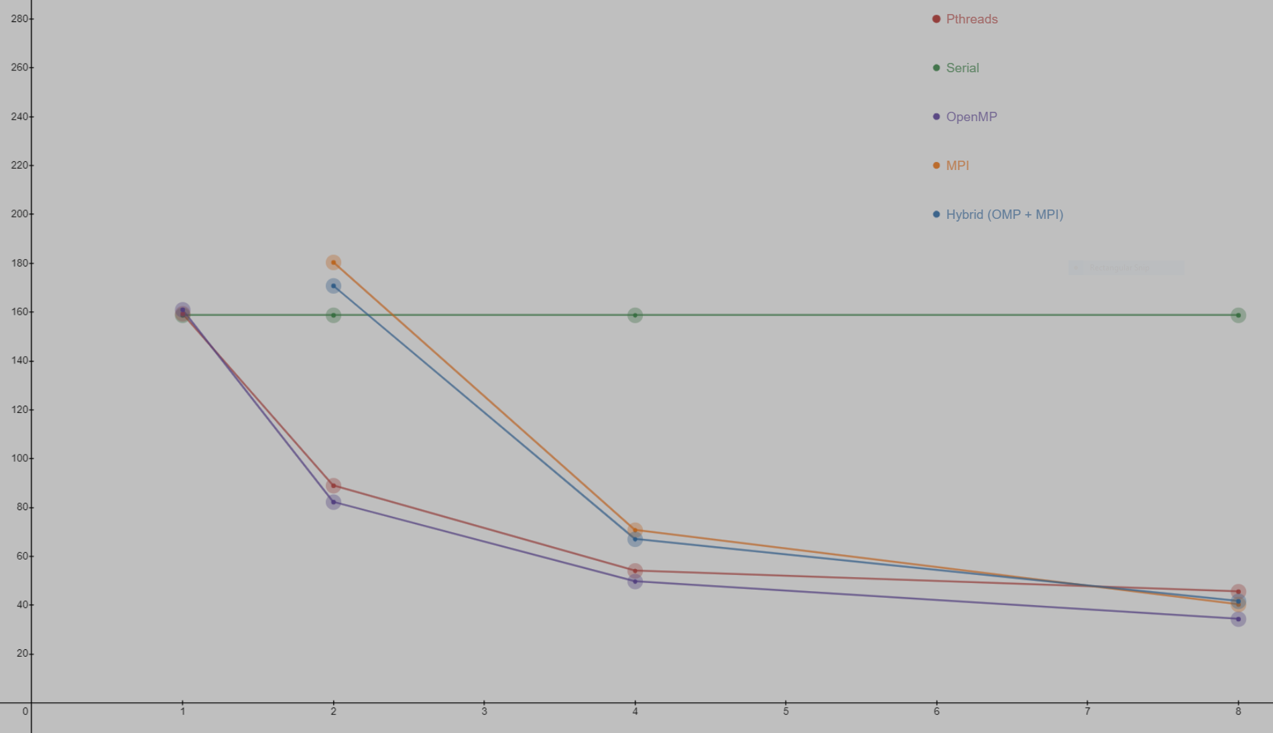
We’ve debunked the problem with the Many Lines scenario, therefore we’ll continue with the Very Long Lines story. Plotting the execution times doesn’t show us more than we already know: OpenMP & PThreads take the lead against the message passing approach, at least for the lesser number of threads.

Slide 15
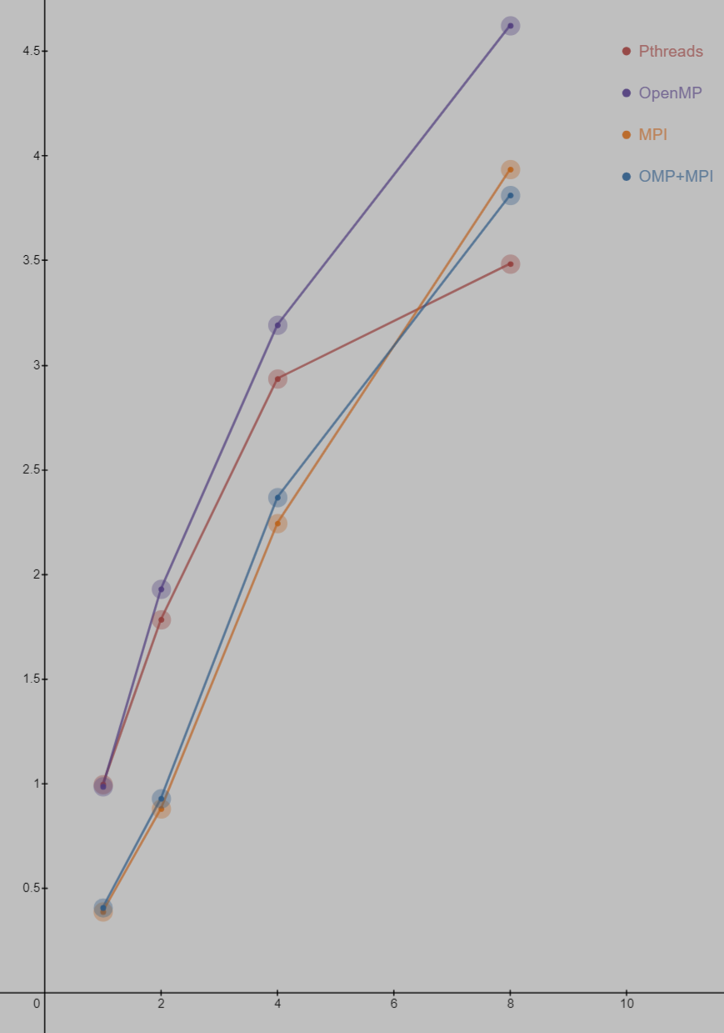
Presented is the SPEEDUP and we can observe that as we increase the number of threads, the MPI based implementations tend to take the lead. We have an almost perfect speedup for two threads but it rapidly starts to deteriorate as we increase the number of threads. This is an expected behavior, increasing the number of threads will soon become an overkill for the application. Even tough the MPI seems to gain some ground in the many-core race, all implementations tend to flatline at some point.

Slide 16
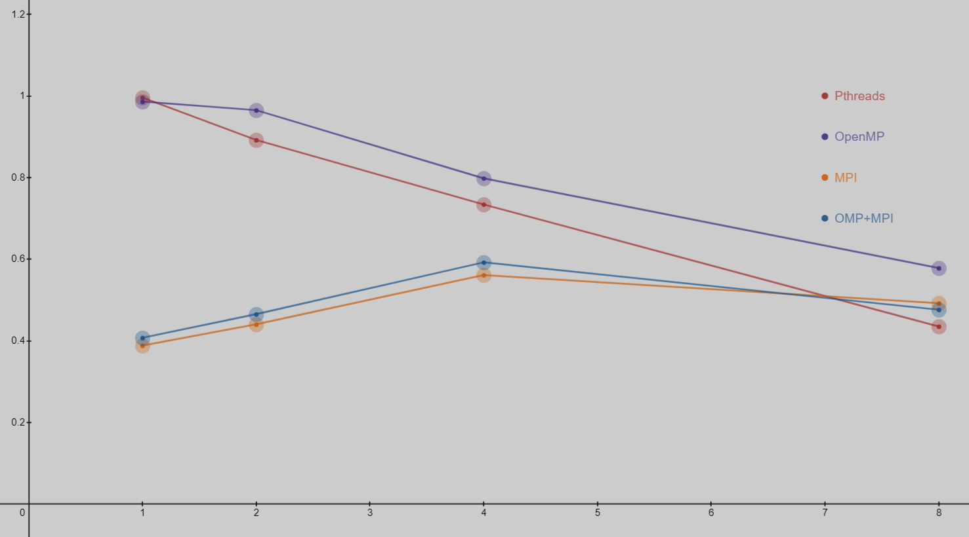
Having computed the speedup, now we can visualize the EFFICIENCY. The conclusions taken at the speedup graph are still visible here. For a lower number of threads, the thread-level parallelization of the algorithm is superior; the message-passing approach tends to do better with a higher number of cores (Boss-Worker model may influence this outcome), but at the end, all implementations tend to degrade in speedup, therefore in efficiency too.

Slide 17
8
INPUT AND DIFFERENT USE CASES
SPEEDUP & EFFICIENCY
threads are more than enough
make a huge impact on how the program scales and behaves
prove exactly that; moreover, the unparallelizable part becomes more noticeable as efficiency and speedup begin to stall regardless of the number of threads

Slide 18
04
Conclusions

Slide 19
WIND-UP
All the graphs that we’ve recently seen comply with our expectations, therefore, to summarize,
Amdhal’s Law is still relevant
A larger number of threads won’t do it
The unparallelizable part is highly important
Everything turned out as expected, besides…
... the fact that the input matters and may greatly influence the behavior of the program

Slide 20
THANKS!
Unguru Dragos-Gabriel, 343C1
@
dragos.unguru@stud.acs.upb.ro

