Slide 1
Presentation name from python

Slide 2
Content
Content from python
Table from python
Plot from python

Slide 3
Python Programming Language
Python is the most popular programming language in the world

Slide 4
Our company bitcoin profit
Quarter | Price expected | Price actual | Profit
Q1 2025 | $0.1M | $0.07M | $-0.03M
Q2 2025 | $0.2M | $0.07M | $-1.03M
Q3 2025 | $0.3M | $1.0M | $0.7M
Q4 2025 | $0.4M | $2.0M | $1.6M

Slide 5
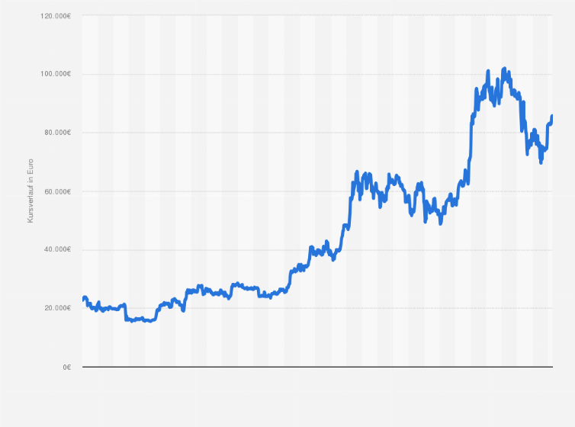
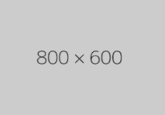
Bitcoin price 2025

Slide 6
Thank you
Dragos Josan
01773241760
dragosjosan@gmail.com

