Slide 1
Web functionalities testing.
Mersul trenurilor / cfr calatori

Slide 2
Website(s) description
Mersul trenurilor / CFR calatori.
Web application.
Online store for train tickets.
Online page for information. (about train routes/ tickets/related things)
National transit and more.

Slide 3
Testing Approach.
UI testing to ensure that there are no visual bugs.
Exploratory testing for the search engine.
Exploratory testing until I found a bug, taking time on that specific area to see if it is worth testing it any further.
Compatibility testing.
Usability testing
A bit of mobile testing in the case of searching for train stations by map.

Slide 4
Tools used.
TestLink – Test case management
Mantis Bug Tracker – Bug reporting
Snipping Tool – Screenshots
Xmind – Mapping

Slide 5
Testing types.
Functional Testing
Exploratory Testing
Smoke testing
Compatibility testing
Usability testing
Integration testing (for the search engine)

Slide 6
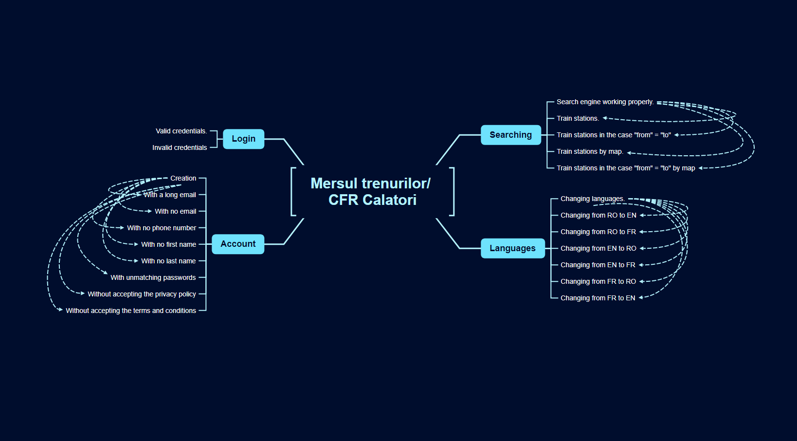
Test cases overview.

Slide 7
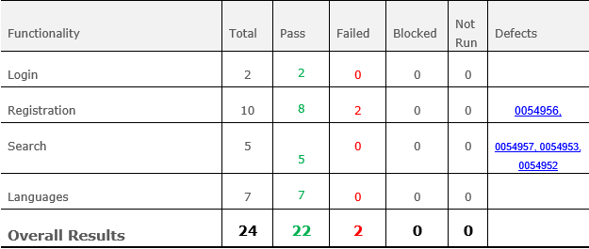
Test cases results.

Slide 8
Conclusions.
24 Test Cases were executed to test Mersul Trenurilor / CFR Calatori, 22 test cases passed and only 2 failed.
6 bugs were identified: 2 major, 3 normal, and one minor.
The bugs that were identified were found by using Exploratory Testing methods.
Data type used during testing: Valid, Invalid, Blank, and Big Data.
Fixing the major severity bugs is recommended.

Slide 9
Lessons learned.
Exploratory testing merges very well with usability testing, compatibility testing, and Ad Hoc testing and saves time.
Rewriting the same stems to recreate a bug can be extremely tiring and boring.
Its better to start the work early.

Slide 10
THANK YOU

