Slide 1
The Early Years of AI
Development of Artificial Intelligence: 1950 - 1960
Team: Vision Quest
Members: ADRYANNA Garcia, Elizabeth Carrillo, Michael Lai, Richard Evans, Stanley Huynh

Slide 2
This workshop, organized by John McCarthy, brought together multiple brilliant scientists and mathematicians to discuss and receive funding for his newly coined "artificial intelligence" theorem.
Samuel designed a machine learning technique that he called "rote learning", in which the program would essentially memorize actions and record positive and negative outcomes to those actions respectively.
The paper proposed a test of machine intelligence called the "Imitation Game" and would eventually be known as the "Turing Test".
1950
Arthur Samuel developed a program to play checkers, which is the first to ever learn the game independently.
1956
The Dartmouth Summer Research Project on Artificial Intelligence (DSRPAI) is held at Dartmouth College.
Alan Turing publishes the seminal paper “Computer Machinery and Intelligence”.
1952
John McCarthy creates the first programming language for AI research, LISP.
1958
When giving a speech about teaching machines to play chess better than humans, Arthur Samuel creates the term “machine learning”.
1959
Samuel's checkers program would pave the way for future game-playing algorithms. Most notably IBM's Watson computer and its victory in a game of Jeopardy! against two of the show's best players.
The Lisp programming language continues to be used and modified by programmers to this day. It has many different varying offshoots known as dialects. Some dialects include Common Lisp, Scheme, and Clojure.

Slide 3
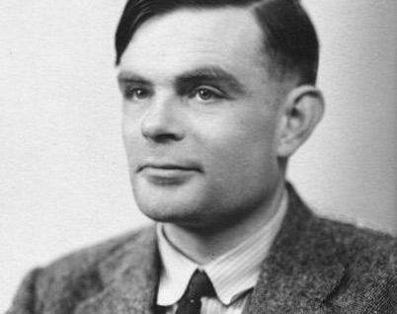
Alan Turing
June 23, 1912 – Born in Maida Vale, London, England.
1934 – Graduated from King's College in Cambridge, England in 1934.
1936 – Invented the Turing machine, a hypothetical machine designed to compute real numbers. Turing machines can be considered as the basis and foundation of computers.
1950 – Published "Computing Machinery and Intelligence", addressing the issues of artificial intelligence and proposing the "Turing Test", a test to determine whether or not a machine could be intelligent.
June 8, 1954 – Died of suspected suicide via cyanide poisoning.

Slide 4
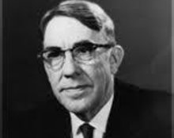
Arthur Samuel
December 5, 1901 – Born in Emporia, Kansas.
1923 – Graduated from College of Emporia in Kansas.
1949 – Began working at IBM, where he would go on to create the first computer program that could play a game of checkers. This program would be the conceptual foundation that gives way to more advanced game-playing algorithms. His research and development into teaching computers how to play games is also the basis of machine learning as we know it.
July 29, 1990 – Died of complications from Parkinson's disease.

Slide 5
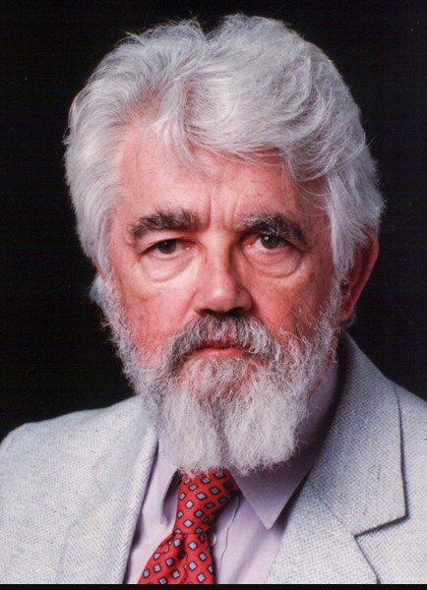
John McCarthy
September 4, 1927 – Born in Boston, Massachusetts.
1951 – Graduated from Princeton University in New Jersey.
1956 – Organized and held the Dartmouth conference, bringing together up to eleven participants that would kickstart the field of artificial intelligence research.
1958 – Produced the list processing (LISP) programming language, which was designed to compute mathematical equations. Lisp is still used to this day.
October 24, 2011 – Died at his home in Stanford.

Slide 6
References
https://sitn.hms.harvard.edu/flash/2017/history-artificial-intelligence/
Nilsson, N., The Quest for Artificial Intelligence, Cambridge University Press, 2010
https://www.tableau.com/data-insights/ai/history
https://www.biography.com/scientists/alan-turing
https://plato.stanford.edu/entries/turing-machine/#:~:text=Turing%20machines%2C%20first%20described%20by,the%20computing%20of%20real%20numbers
https://www.biography.com/scientists/alan-turing
https://forum.stanford.edu/people/arthur-samuel
https://news.stanford.edu/2011/10/25/stanfords-john-mccarthy-seminal-figure-artificial-intelligence-dies-84/

