Slide 1
CLOUD ENGINEERING · PROJECT 1
3-Tier Cloud Architecture on AWS
Designed, built, secured, tested, and cost-analyzed — presented through the live AWS console.
Dennis · us-east-1 · 2026-07

Slide 2
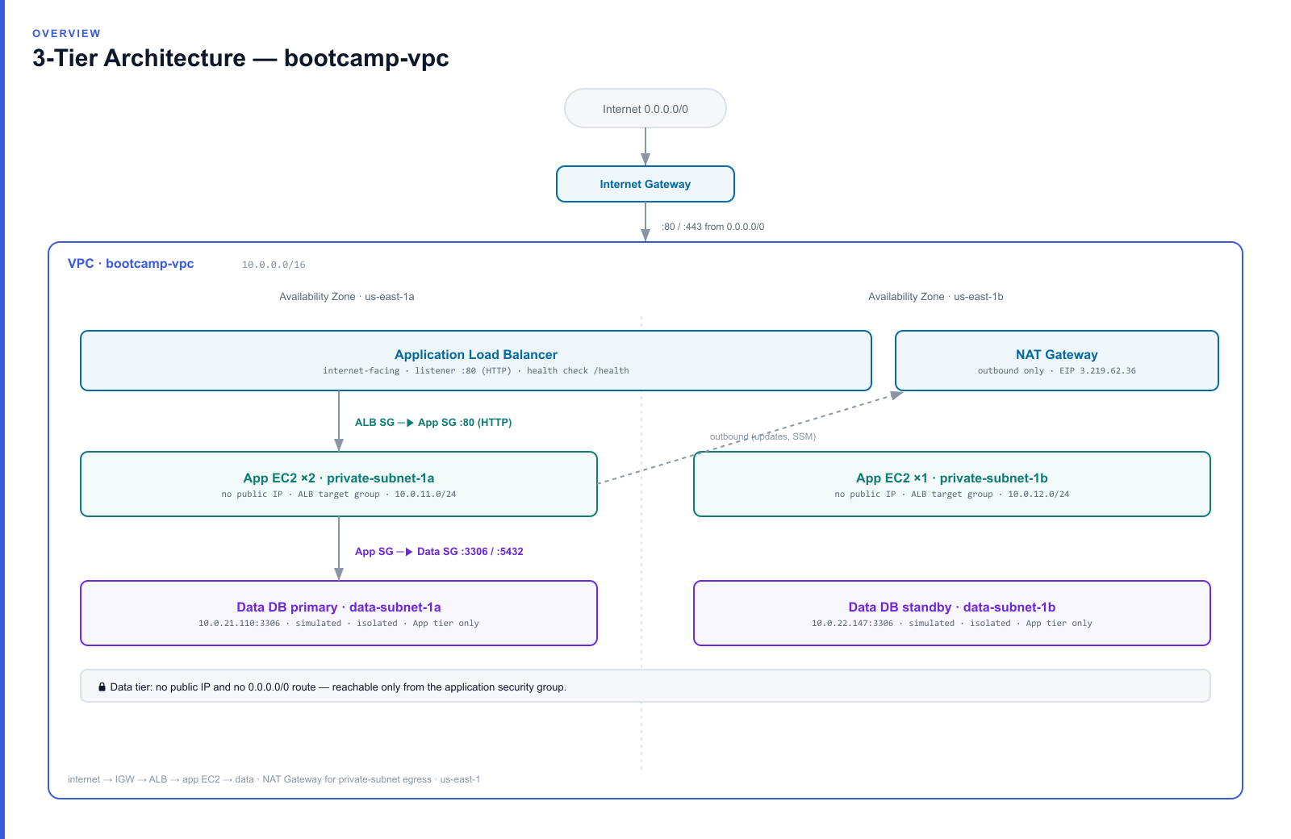
OVERVIEW
Architecture at a glance

Slide 3
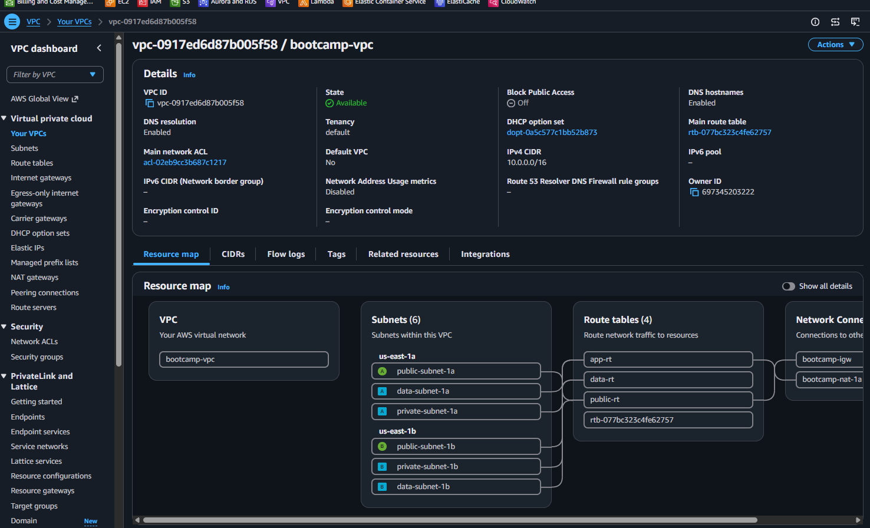
NETWORK FOUNDATION
VPC & subnets — 6 subnets across 2 AZs
One VPC, 10.0.0.0/16
2 public + 2 app + 2 data subnets
Spread across us-east-1a and 1b
/24 each — room to grow
01-vpc-subnets.png

Slide 4
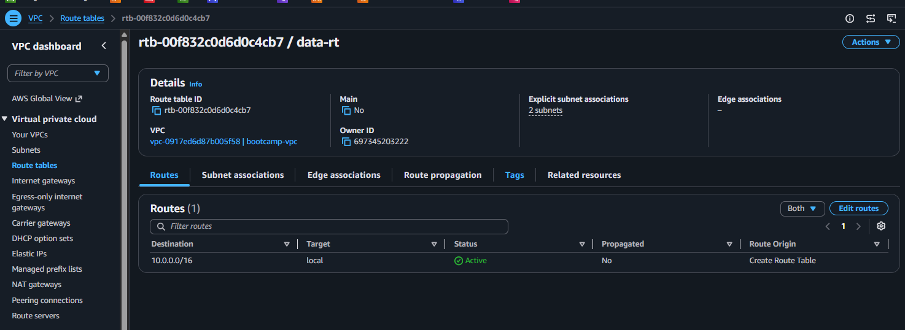
NETWORK FOUNDATION
Data-tier isolation — route table
data-rt has only the local route
No 0.0.0.0/0 → no path to the internet
Isolated by routing, not just firewall
02-route-tables-only-local.png

Slide 5
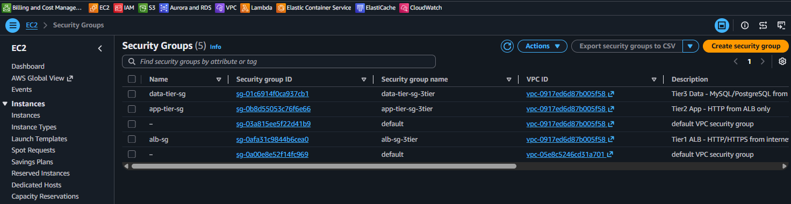
SECURITY
The three tier security groups
ALB → App → Data chain
One SG per tier
Each trusts only the tier in front
03-security-groups.png

Slide 6
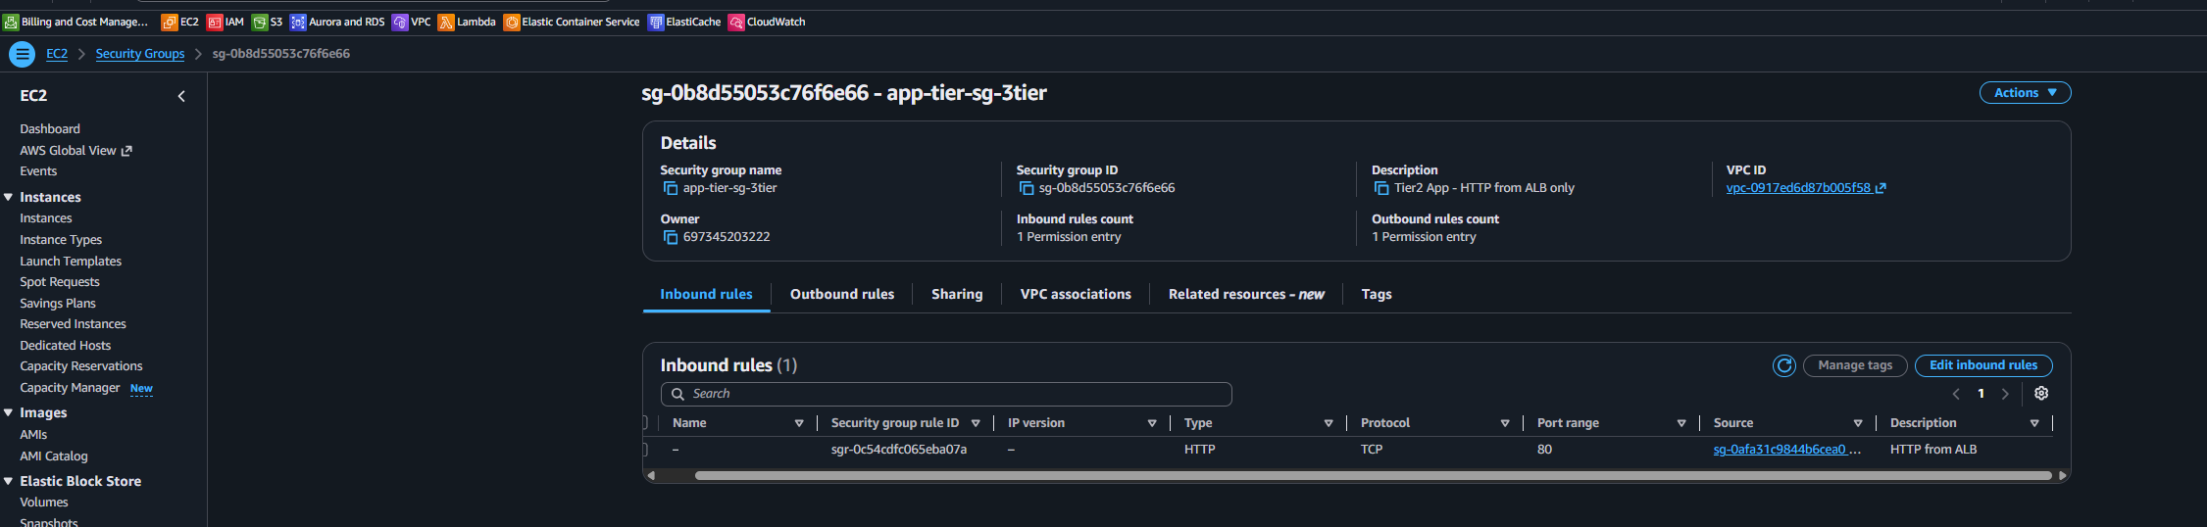
SECURITY
Least privilege — App SG inbound
App SG: :80 from ALB SG only
SG-to-SG reference, not IP ranges
Direct hits to instances are dropped
04-app-sg-rules.png

Slide 7
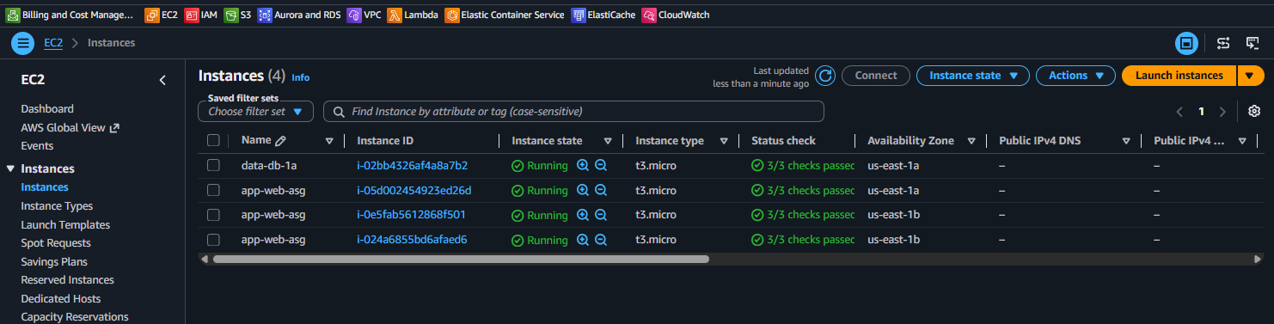
COMPUTE
EC2 instances across both AZs
App instances + data nodes running
Private subnets, no public IP
Spread over us-east-1a / 1b
05-instances.png

Slide 8
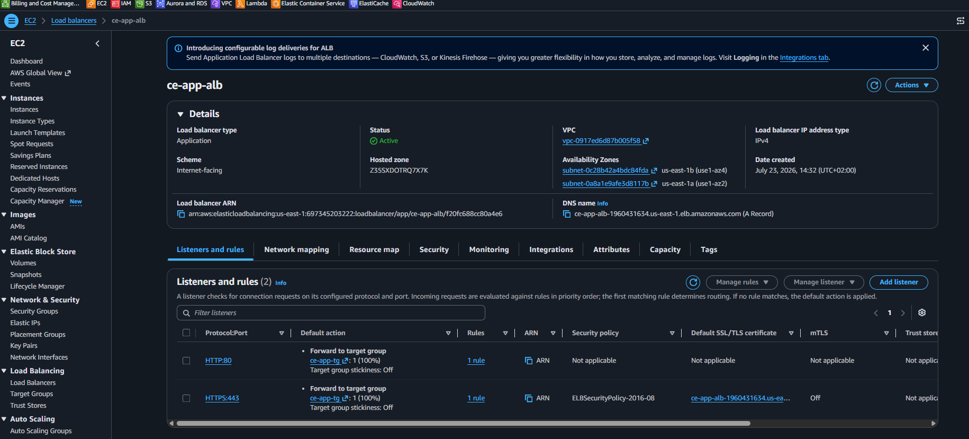
LOAD BALANCING
Application Load Balancer
Internet-facing
Listeners :80 (HTTP) and :443 (HTTPS)
Spans both Availability Zones
06-load-balancer.png

Slide 9
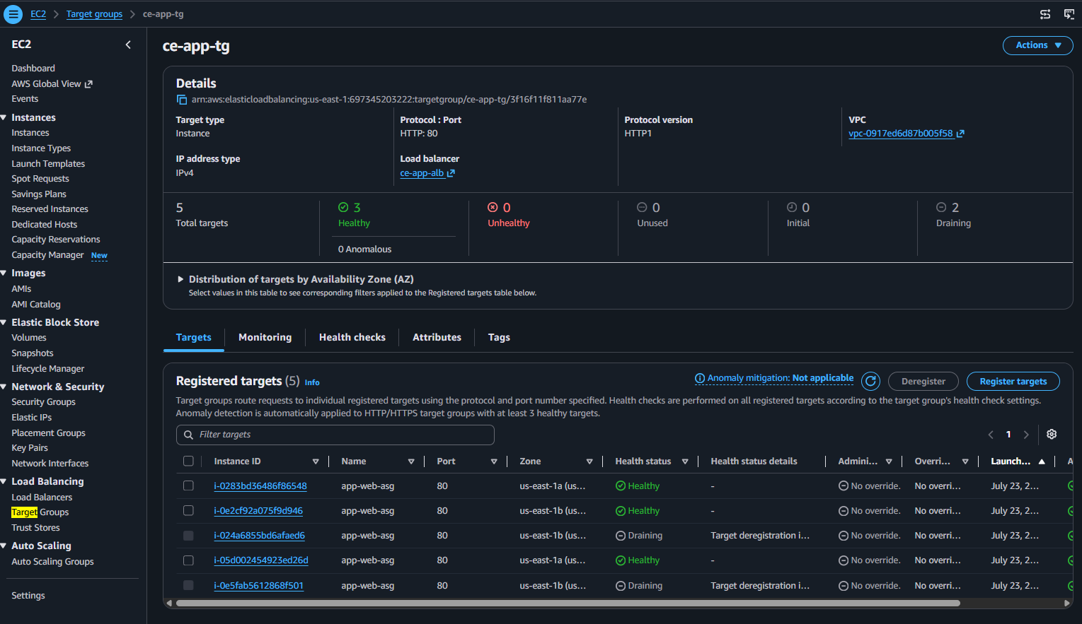
LOAD BALANCING
Target group — 3/3 healthy
All targets healthy
Health check: GET /health
Live load-balancing: app-load-balancing.gif (repo)
07-target-group.png

Slide 10
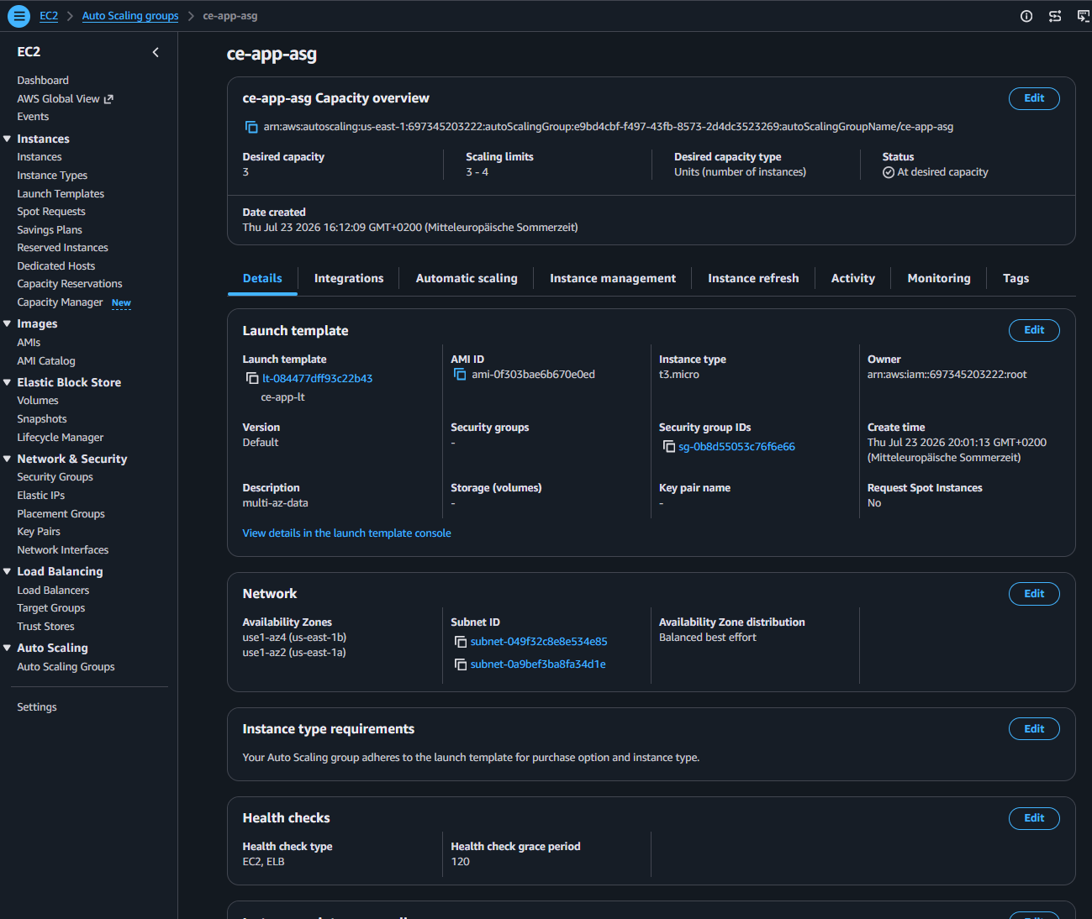
HIGH AVAILABILITY
Auto Scaling Group
min 3 / desired 3 / max 4
Replaces failed instances automatically
Instances across 2 AZs
08-asg.png

Slide 11
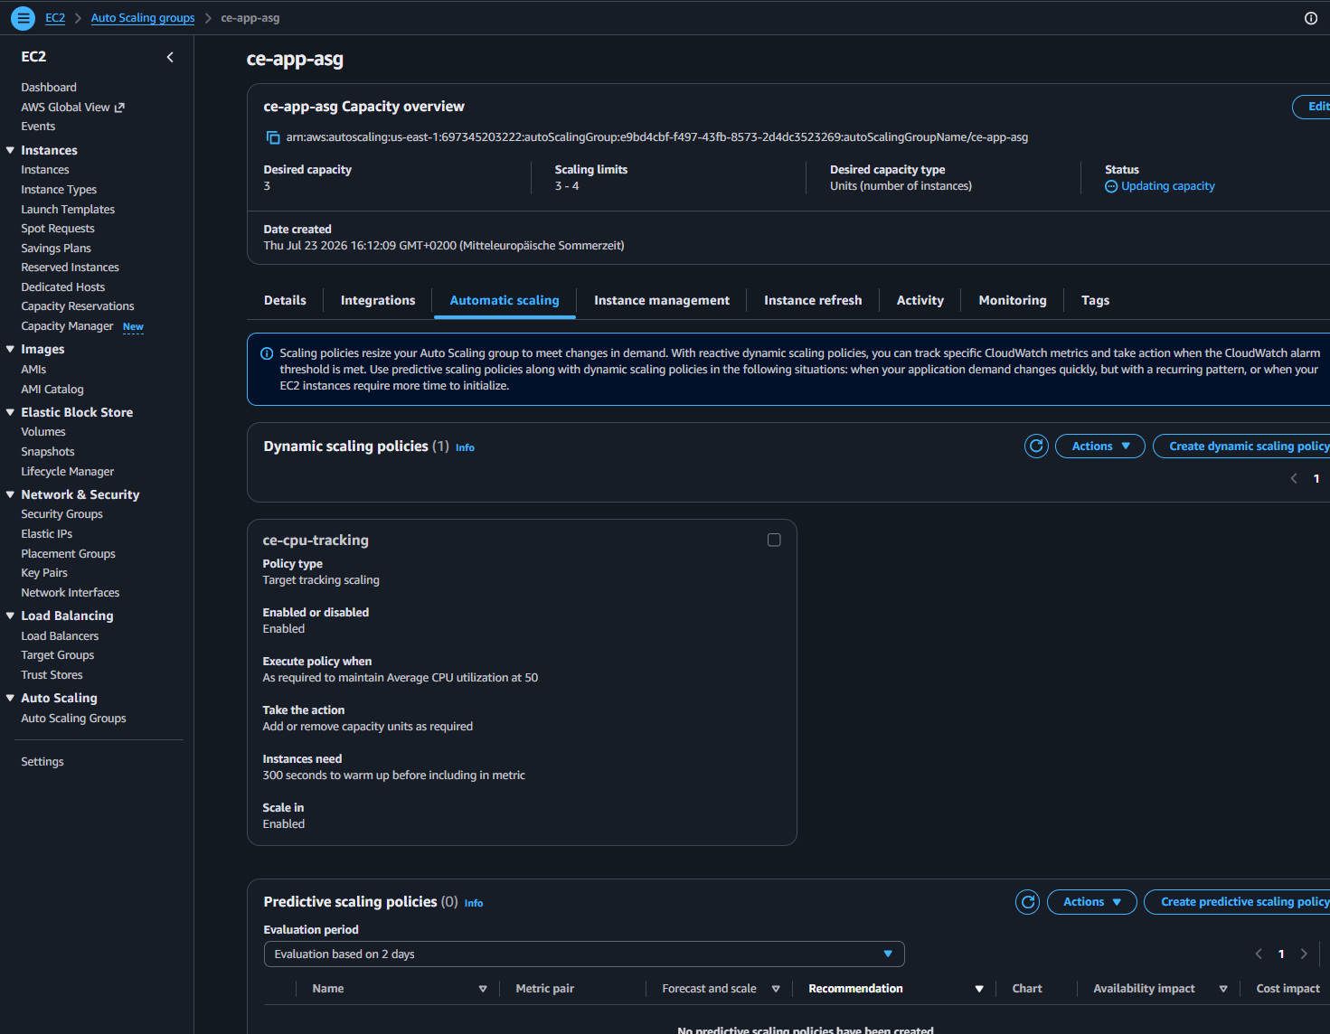
HIGH AVAILABILITY
CPU target-tracking policy
Scales on average CPU = 50%
Scales out to 4 under load
Floor of 3 guarantees the HA baseline
09-asg-scaling-policy.png

Slide 12
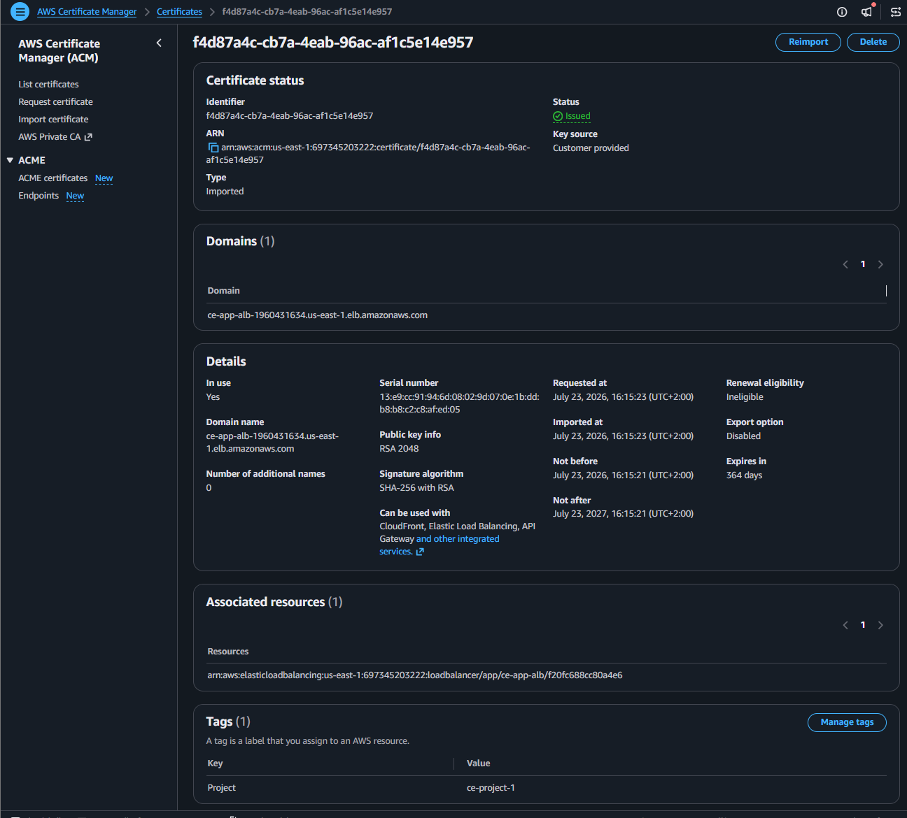
SECURITY ADD-ON
HTTPS — ACM certificate
TLS on the ALB (:443)
ACM-managed certificate
Self-signed for the demo
10-acm-https-cert.png

Slide 13
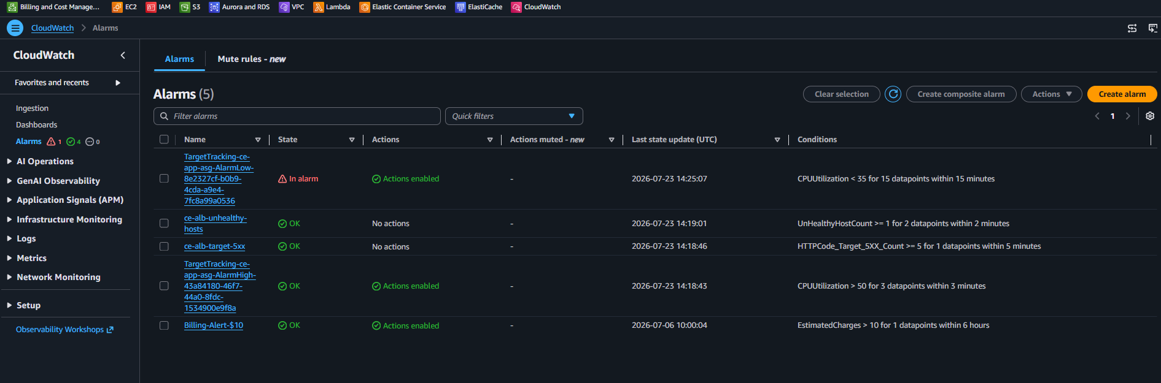
MONITORING
CloudWatch alarms
Unhealthy hosts + target 5XX
Alerting on the ALB health
Plus billing guardrail
11-cloudwatch-alarms.png

Slide 14
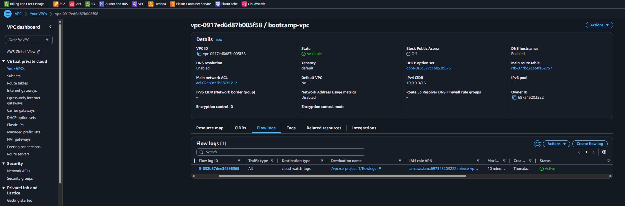
MONITORING
VPC Flow Logs
All VPC traffic → CloudWatch
Network forensics & troubleshooting
Enabled at the VPC level
12-flow-logs.png

Slide 15
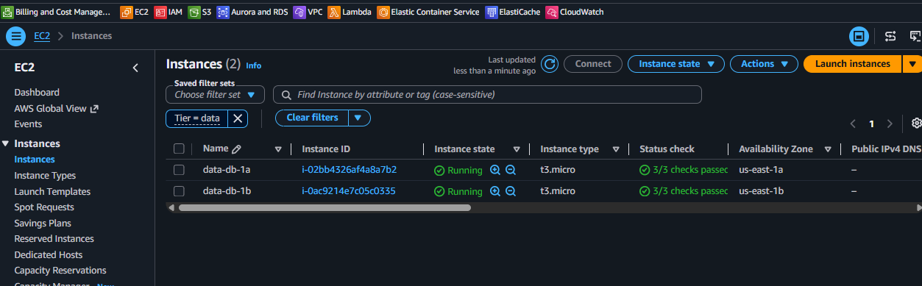
DATA TIER
Multi-AZ data — primary + standby
primary in 1a, standby in 1b
App fails over primary → standby
Isolated subnets, app-tier access only
15-data-instances.png

Slide 16
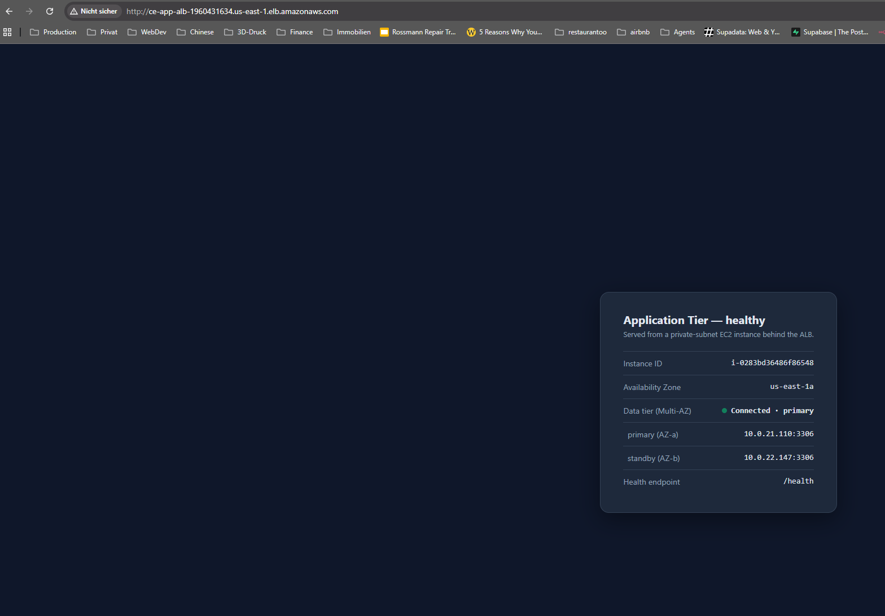
THE APP
Running app over HTTP
Instance-id + AZ shown
Data tier: Connected (Multi-AZ)
Refresh = different instance (balanced)
12-app-http.png

Slide 17
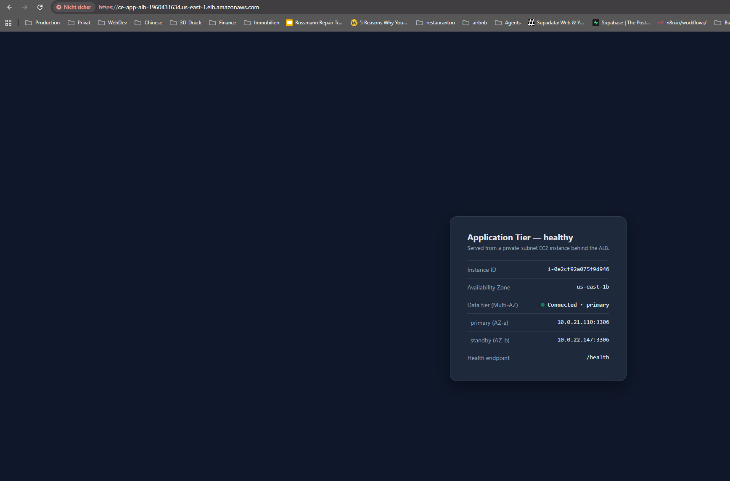
THE APP
Running app over HTTPS
Same app over TLS :443
Cert warning expected (self-signed)
14-app-https.png

Slide 18
TEST RESULTS
Verified: balanced, self-healing, Multi-AZ
3/3
6/6/6
~30s
failover
targets healthy
even load spread
auto-recovery
primary→standby
Load: 18 requests spread evenly across all 3 instances and both AZs
App-tier failover: stop an instance → ALB routes around it, ASG relaunches it
Data-tier failover: stop the primary → app flips to the standby, stays up
Full output in tests/
test-results.md · failover-test.md

Slide 19
COST ANALYSIS
~$101/month running — $0 when torn down
~$35
~$22
~$30
$0
NAT Gateway
Load Balancer
EC2 (ASG+data)
after teardown
NAT + ALB are ~57% of the bill and run regardless of traffic
Biggest lever = don't leave it running idle (stop/start script, or full teardown)
Torn down after capturing evidence — presenting from screenshots, $0 ongoing
on-demand, us-east-1
COSTS.md

Slide 20
CHALLENGES & SOLUTIONS
What broke, and how I fixed it
Blackholed NAT route — reused VPC pointed at a deleted NAT → new NAT + EIP, repaired route
Data-tier isolation — split the data subnets onto their own route table, no internet route
Idle scale-in dropped below 3 — raised the ASG floor to min 3 to hold the HA baseline
Testing private hosts — used SSM (no SSH, no bastion); Git Bash path gotcha → MSYS_NO_PATHCONV

Slide 21
IMPROVEMENTS & NEXT STEPS
Path to production
Done as bonus
Auto Scaling Group + CPU scaling
HTTPS / ACM
VPC Flow Logs + alarms
Multi-AZ data tier
Next
Real RDS Multi-AZ (managed)
Per-AZ NAT · ACM public cert
Infrastructure as Code (Terraform)
CI/CD · WAF · multi-region DR
IMPROVEMENTS.md

Slide 22
THANK YOU
Questions?
A production-shaped 3-tier architecture: multi-AZ HA, least-privilege security, auto-scaling, HTTPS, monitoring, and a Multi-AZ data tier — all evidenced in the AWS console.
Dennis · CE Project 1 · github.com/Draian123/ce-project-1-three-tier-architecture

