Slide 1

The Ghost of Jeremy Bentham
By Chris Obasi, Nithin Anand and Konrad Niedzielski

Slide 2
Background
Limited programming experience; Python the only common language.
Wanted to use the data from the Bookings section of the API.
Messing around with a Twitter bot seemed like a fun idea.

Slide 3
The Backstory
Jeremy Bentham’s mummified head has been moved out of solitude and is being prepared for public display.
Experiencing the glorious world of 2017 has convinced Jeremy that he wants to be part of modern life.
Therefore, he has decided to haunt a random society each day.
He notifies the public of his location for that day.

Slide 4
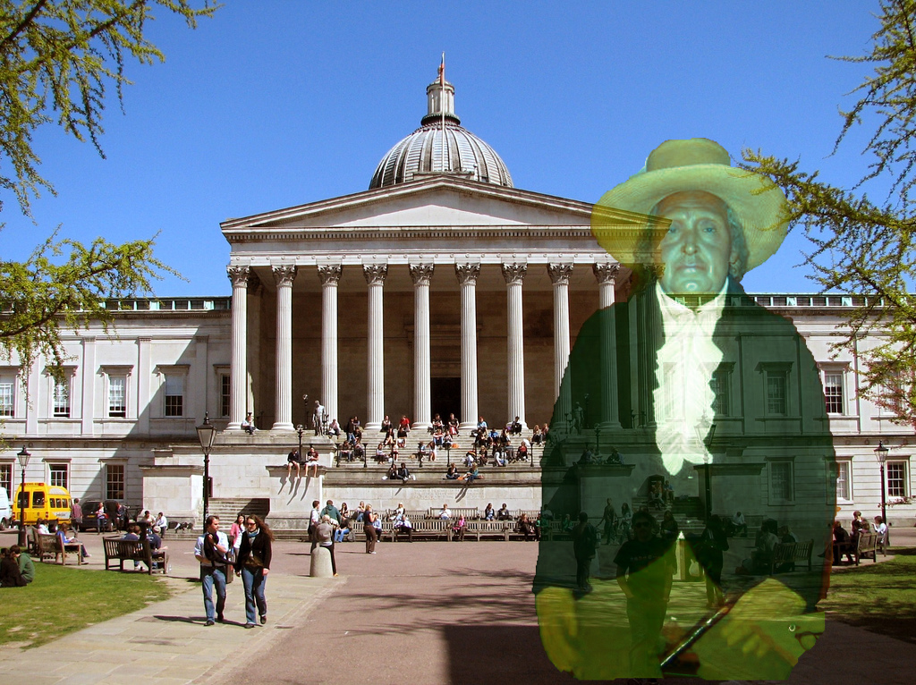

Slide 5
How it Works
Using the ‘Get Bookings’ feature of UCL API and ‘datetime’ function of Python, the program requests all the Society events occurring in the coming 24 hours.
The program then selects a random valid event, cuts the relevant text from the requested data and then constructs a message using a random opening and ending.
The formatted message is then published as a tweet

Slide 6
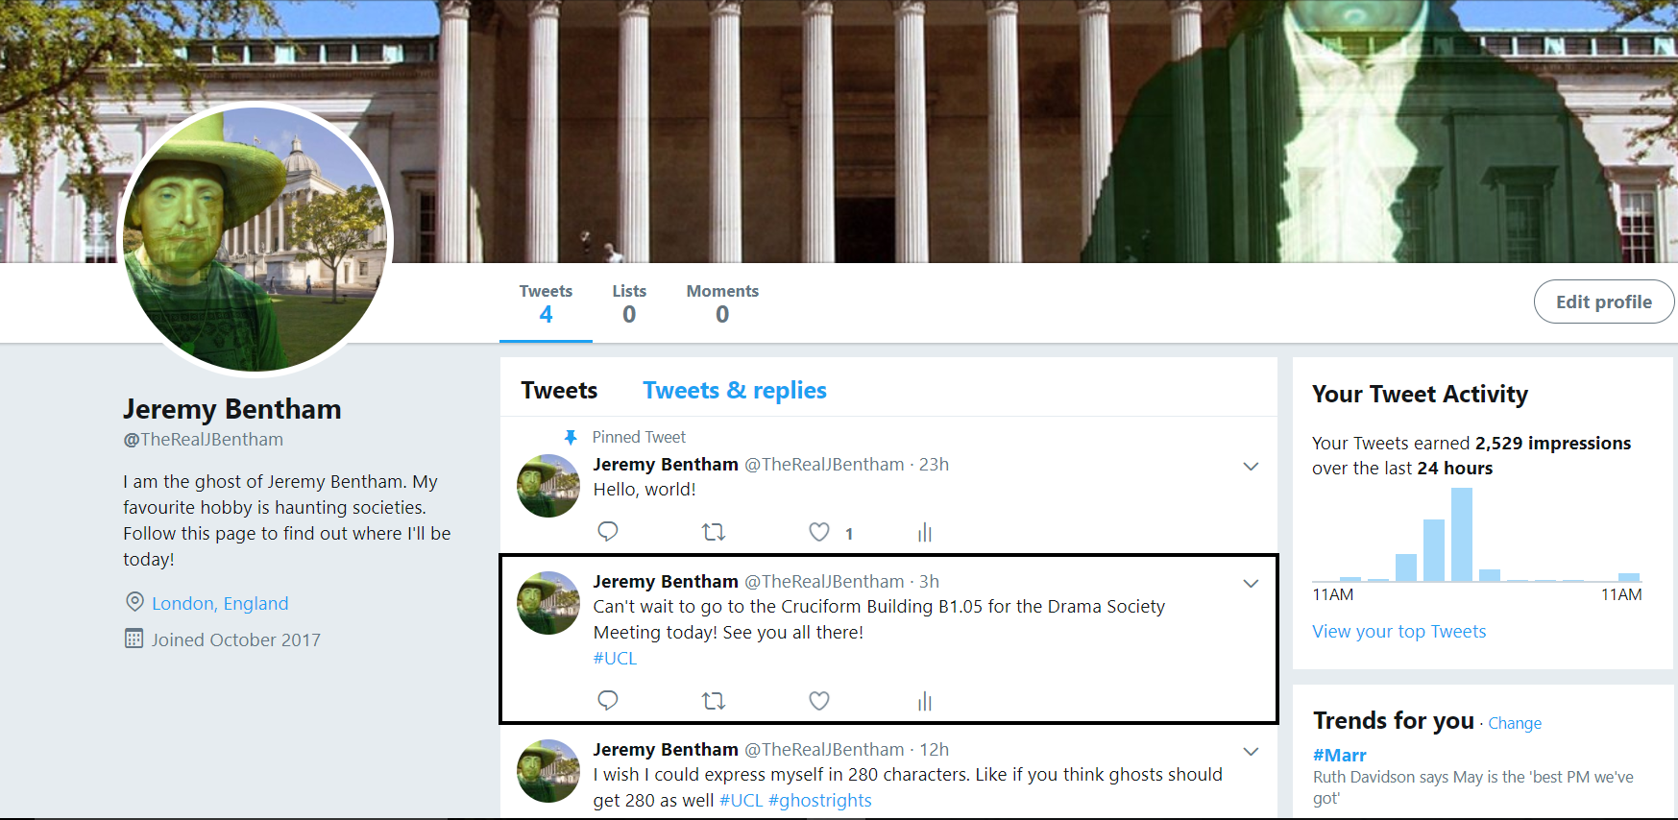

Slide 7
Software Used
Written in Python 3
The ‘Get Bookings’ feature of the UCL API
The Twitter API and tweepy in order to tweet the formatted message

Slide 8
Planned Improvements
Jeremy would like to eventually announce the time of the event that he is attending.
Adding more endings and openings, including more society-specific phrases.
Want to take advantage of the upcoming 280 character limit for tweets by adding more hashtags and longer phrases.

Slide 9
Link

