Slide 1

Ansys Automation
Michael Quach
DiTTA - ARO
October 13th, 2023

Slide 2

Introduction
Programming Essentials
Ansys Design Modeler API
Ansys Mechanical API
References
Courtesy:
Ansys

Slide 3
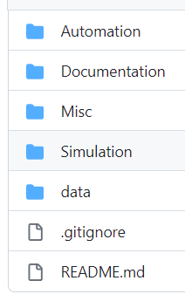
Programming Essentials
GitHub
GitHub is a data repository and management tool for software development
Folders are categorized for their specific purpose
JavaScript
Ansys Design Modeler uses JavaScript to automatically populate the workspace with a previous constructed model
Allows the user the ability to save their sketches as a Javas Script
Python
Ansys Mechanical uses Python to automate the simulation and exporting the results

Slide 4
For Demonstration Purposes Only
Ansys DesignModeler
(JavaScript)
Utilize the project files in “Simulation” Folder as a starter

Slide 5
Ansys DesignModeler Essentials
Key Objects
agb: Points to the batch interface
p: Plane sketches object for whole model
Key Functions
HorizontalDim and VerticalDim
HoriztonalCon, VerticalCon, CoincidentCon
Key Properties and Methods
p.Sk: Specific sketch of the model
p.Ln(): Dimensions of the model
agb.regen(): Regenerates the workspace
agb.Extrude(): Extrudes a specific sketch based on given parameters

Slide 6
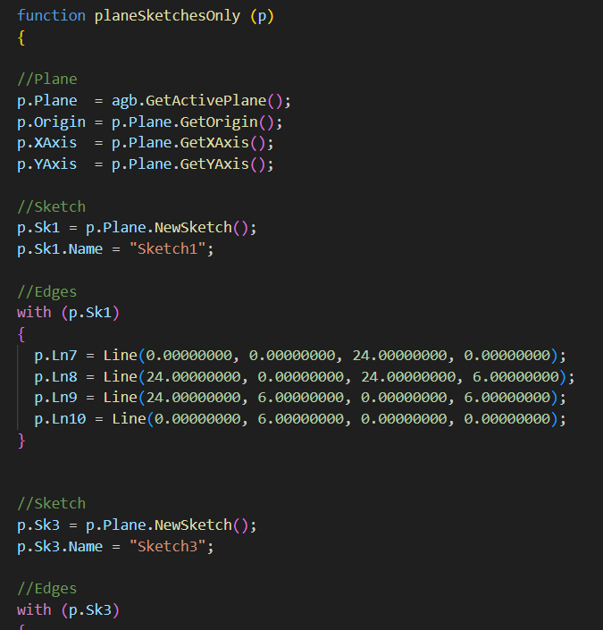
Top Portion of Script
beamModel_Inches.js

Slide 7
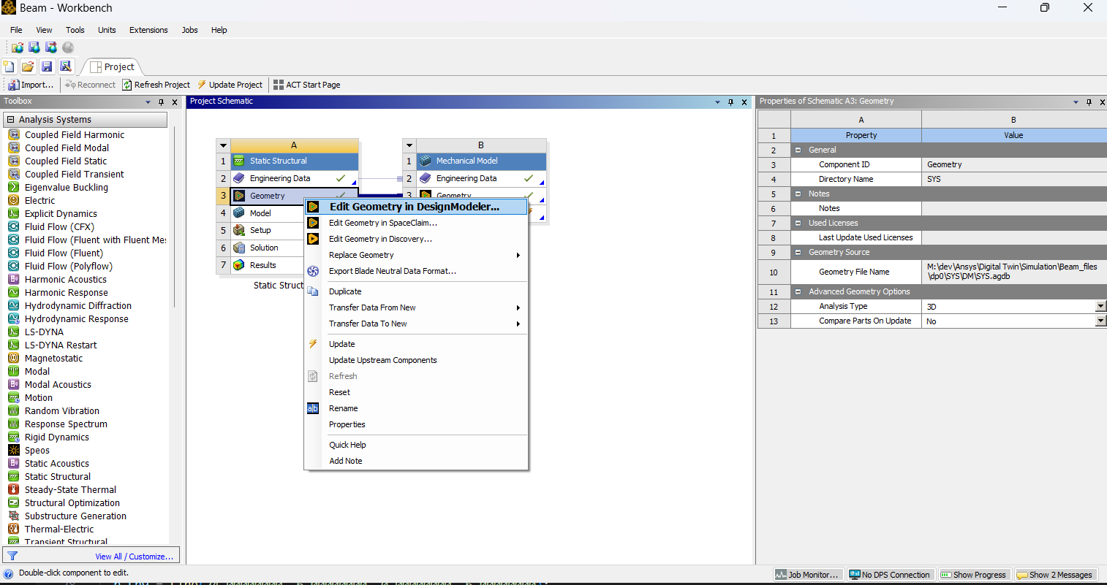
Ansys Design Modeler
Right-click on
“Geometry”
Right-click on
“Edit Geometry in DesignModeler”

Slide 8
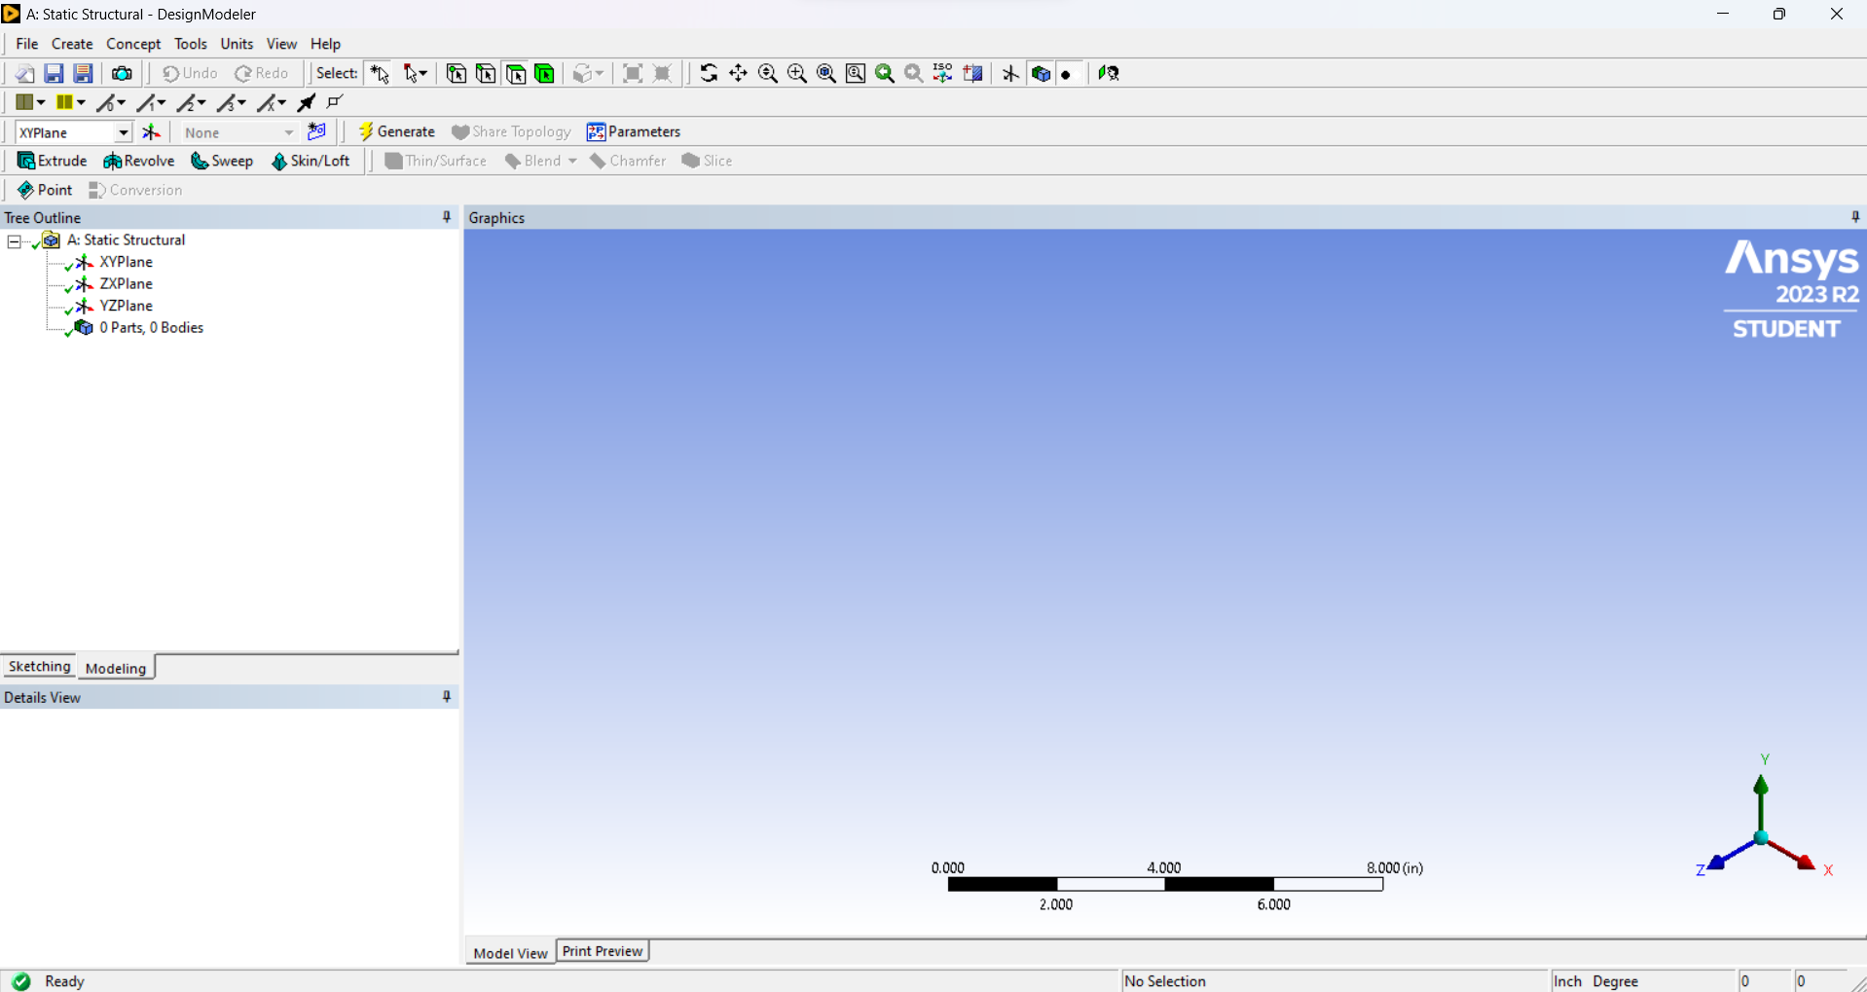
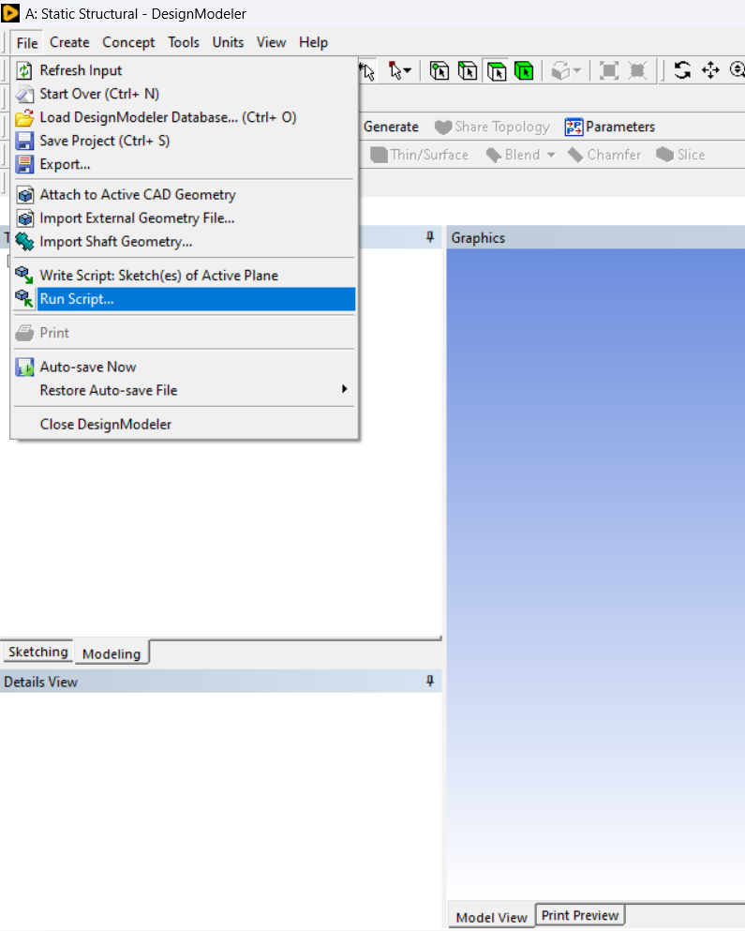
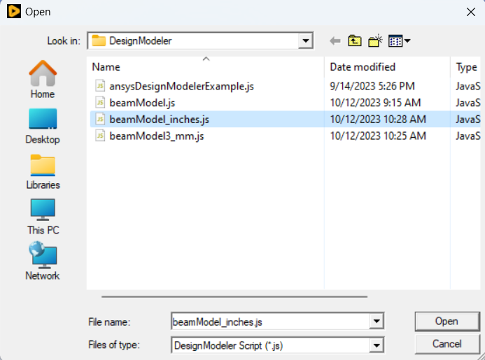
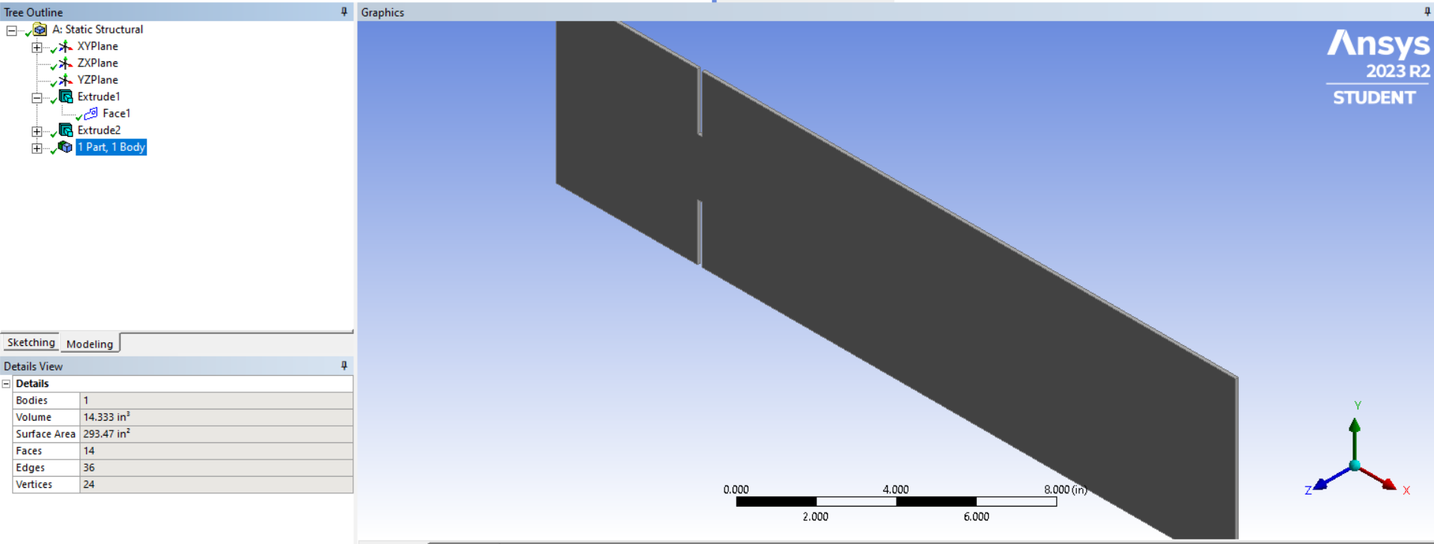
Setting-up the Model (DesignModeler)
Click on
“File -> Run Script”
Select JavaScript file based on desired units
Automatically produces beam with damaged cuts

Slide 9
Ansys Mechanical
(Python)

Slide 10
Key Methods and Properties
Key Objects
DataModel: Main object that houses all the sub-objects, methods, and properties
Key Properties and Methods
.Solution: Sets up the solution
.Activate(): Activates the solution object within the workspace
.AddTotalDeformation(): One of the various methods provided to add a desired result/analysis
.Solve(True): Solves for all the desired results
.ExportToTextFile(filePath): Exports all the results for the nodes to individual text files

Slide 11
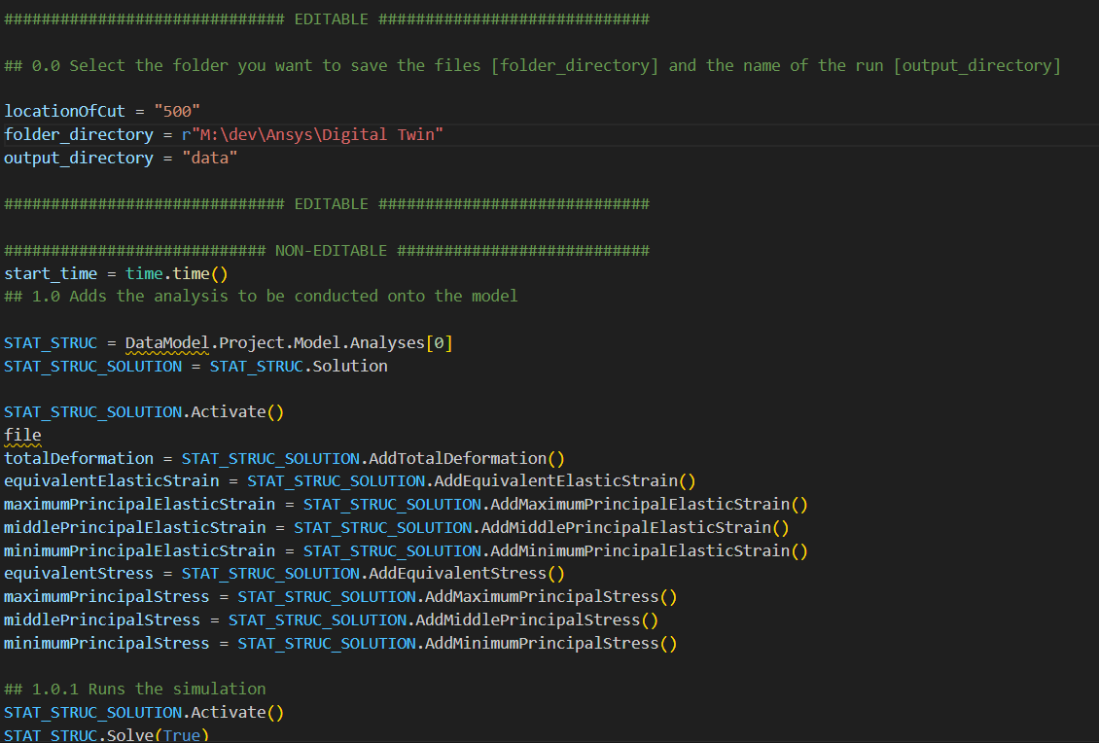
Top Portion of Script
solutionsAndExport.py

Slide 12
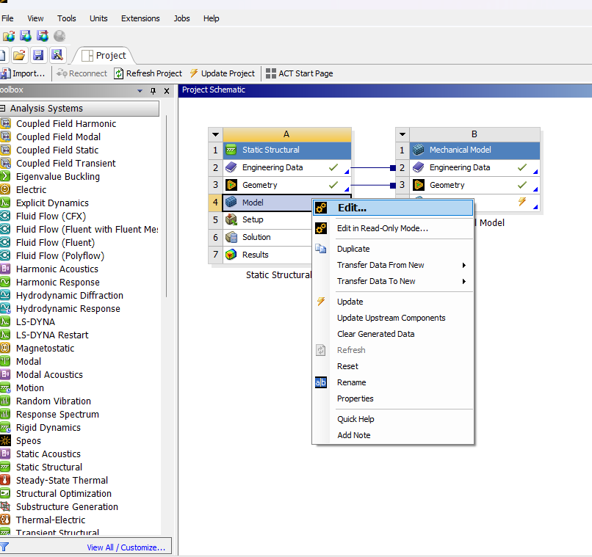
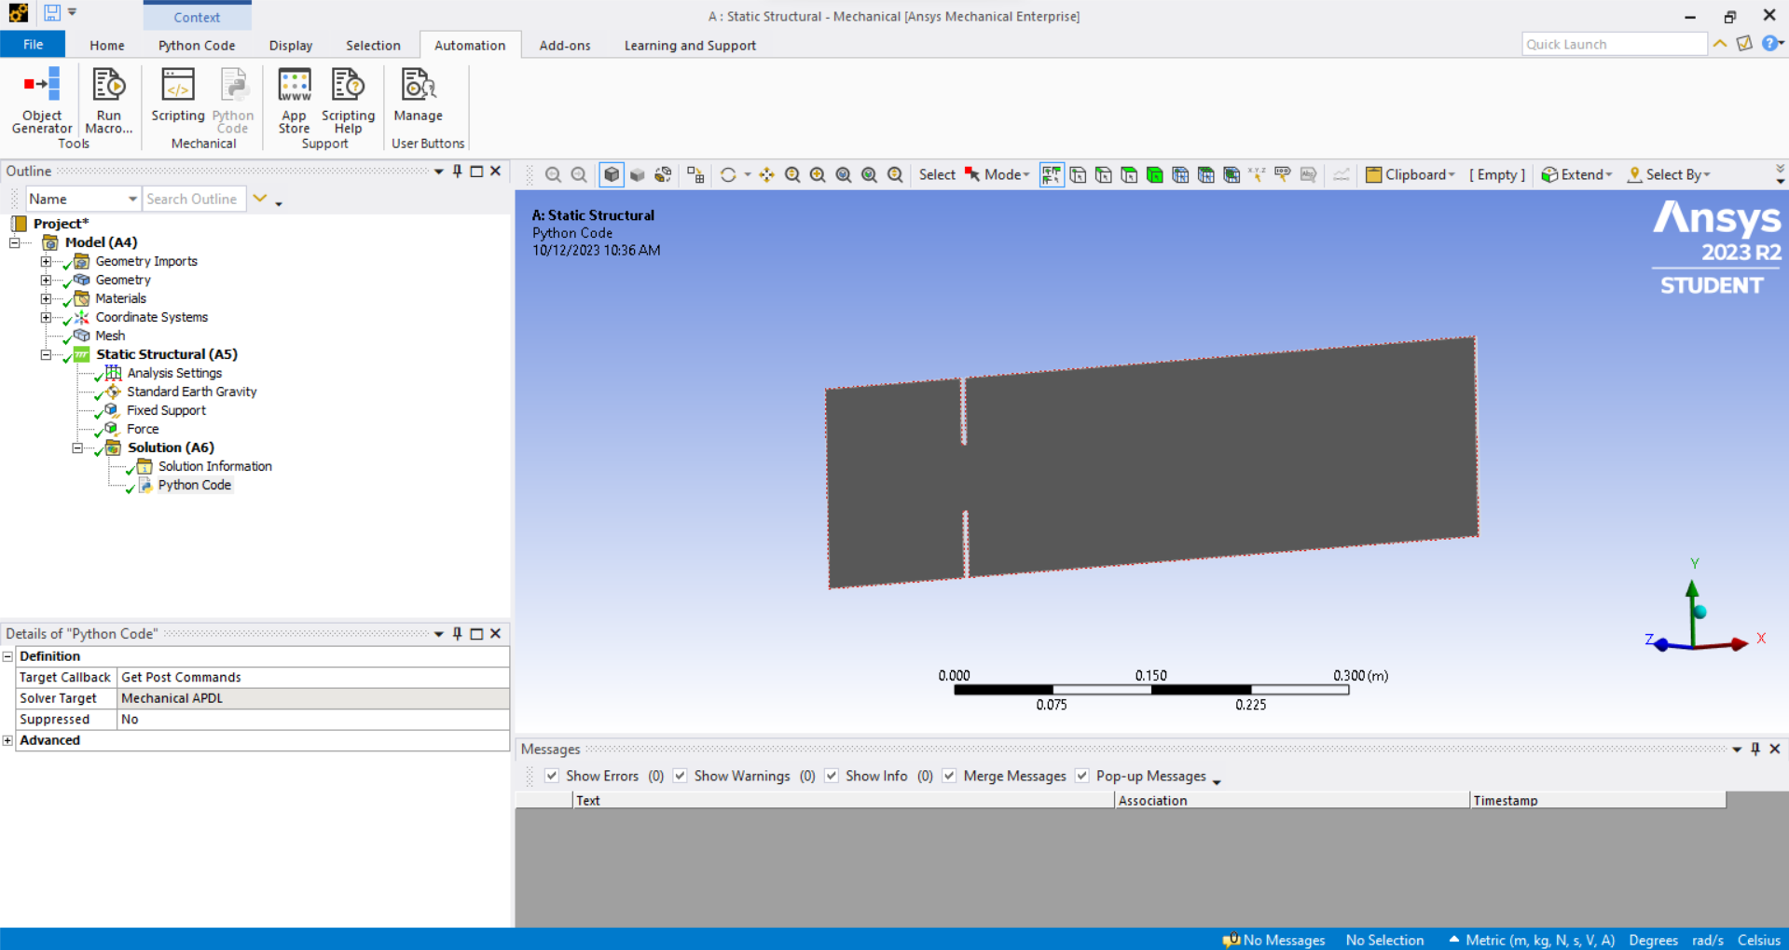
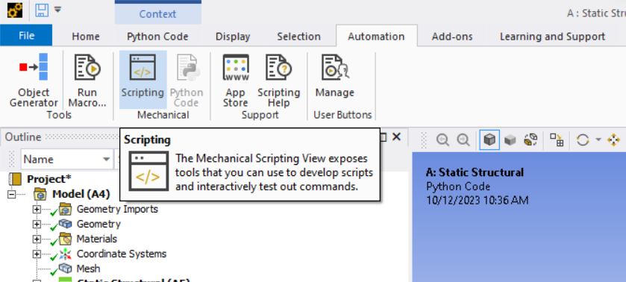
Setting-up Analysis (Mechanical)
Load scenario with forces already set-up
Click on
“Model -> Edit…”
Click-on
“Automation -> Scripting”

Slide 13
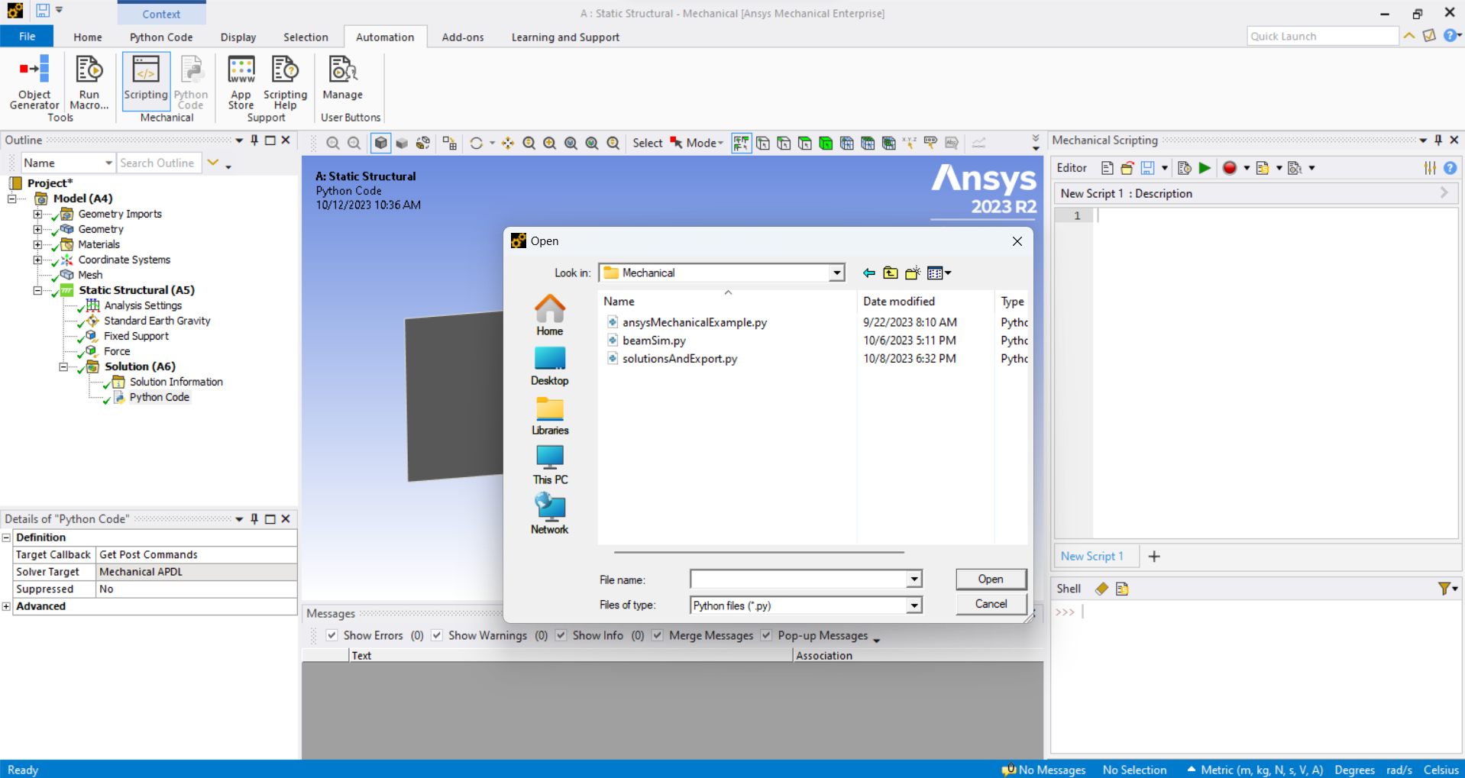
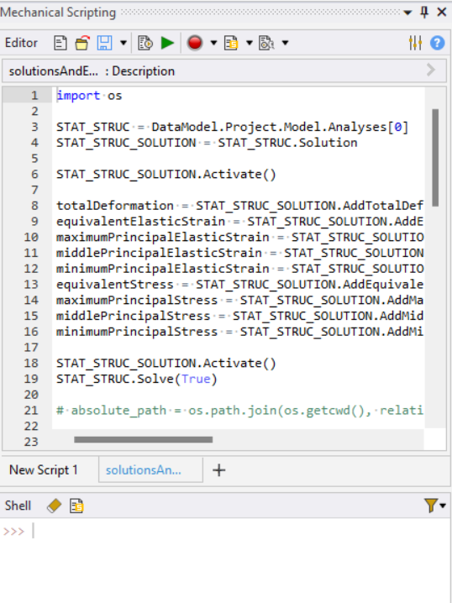
Mechanical Scripting Loading
Click on the
“Folder”
Click on
“solutionsAndExport.py”
Select loads into the IDE

Slide 14
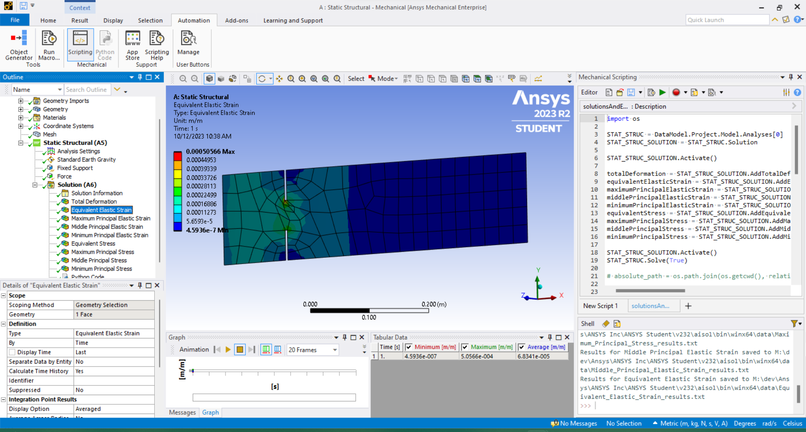
Running the script and solutions
Click on the
“Play button”
View the results of the analysis
Identifies where the files are saves

Slide 15
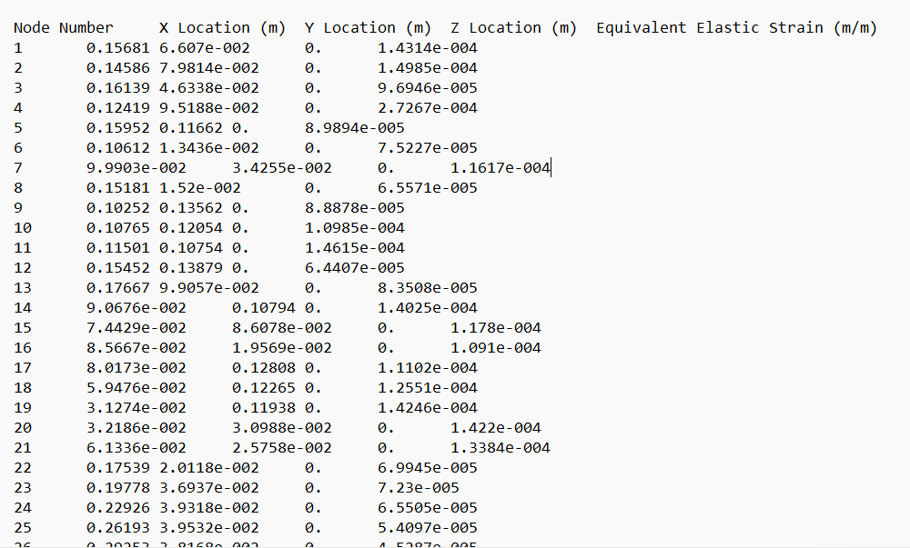
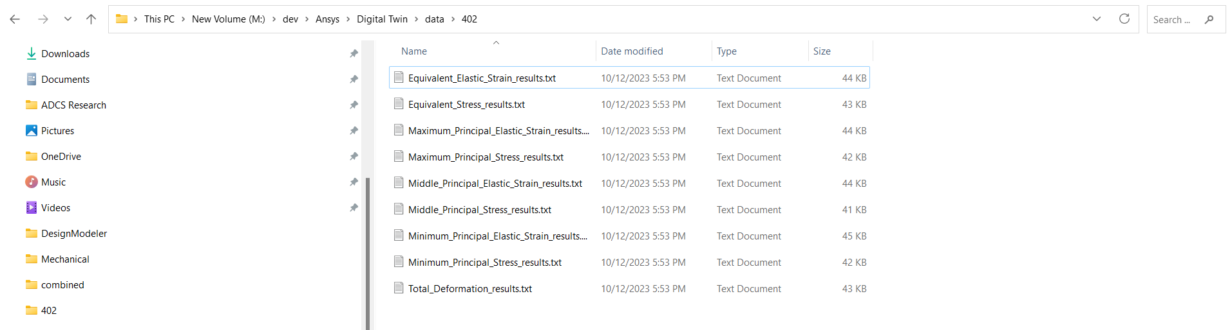
Example Output
Text file containing the results

Slide 16
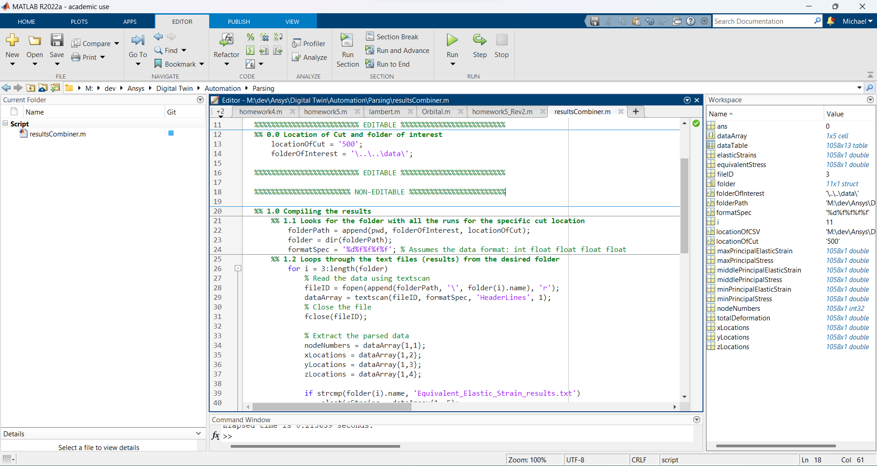
Compiling results
Text file containing the results
resultsComplier.m
resultsCompiler.m

Slide 17
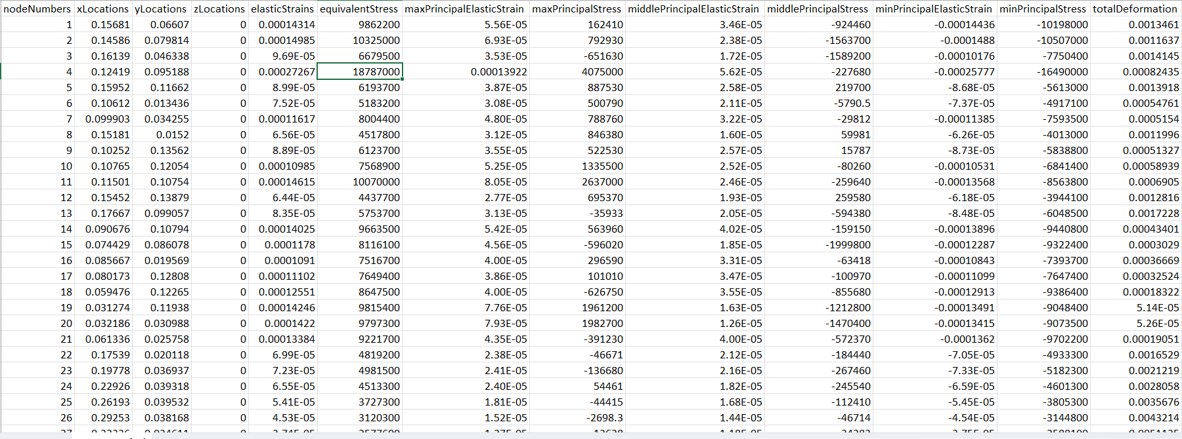
Example of Compiled Results

Slide 18
References

Slide 19

Thank you!

