Slide 2
Empirical trait data
Step 1: Collect empirical data for mosquito traits
Step 2: Fit trait thermal performance curves
Trait thermal performance curves
Step 3: Transform traits into model parameters
Model parameters
Step 4: Build data frame incorporating all axes of variation
Compartmental model
Step 6: Sensitivity analysis of outputs
Step 5: Analysis and visualization of model outputs
Transmission potential

Slide 3
Empirical trait data
Systems
Axes of variation
Uncertainty
Trait thermal performance curves
Model parameters
Temperature
Vertebrate host traits
Compartmental model
Sensitivity analysis
Transmission potential

Slide 4
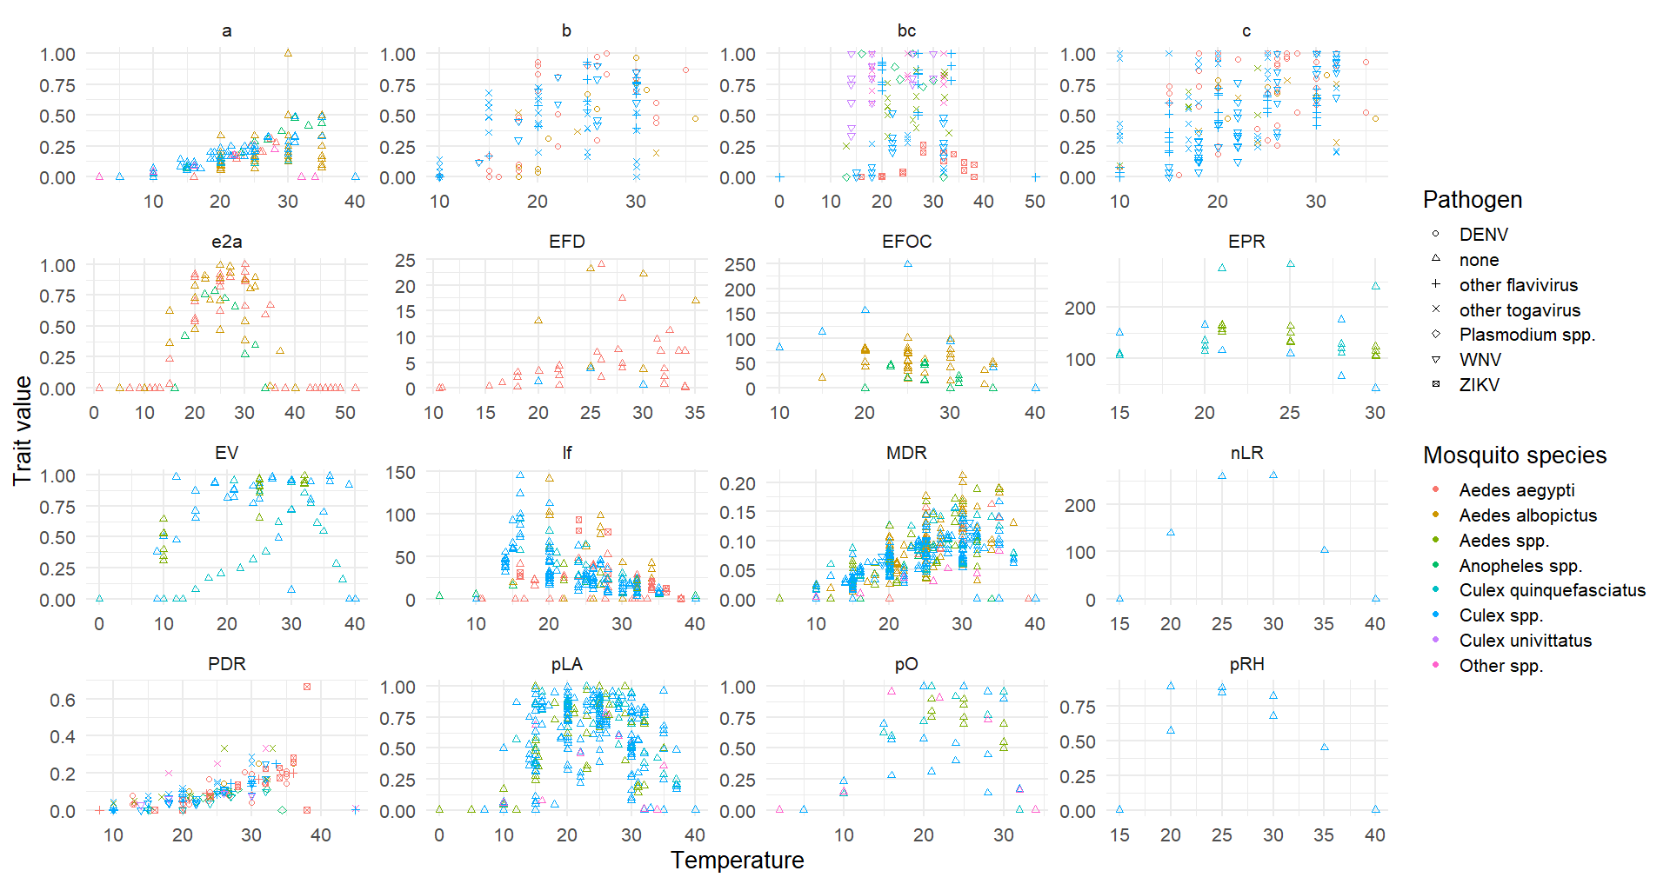
Step 1: All trait data

Slide 5
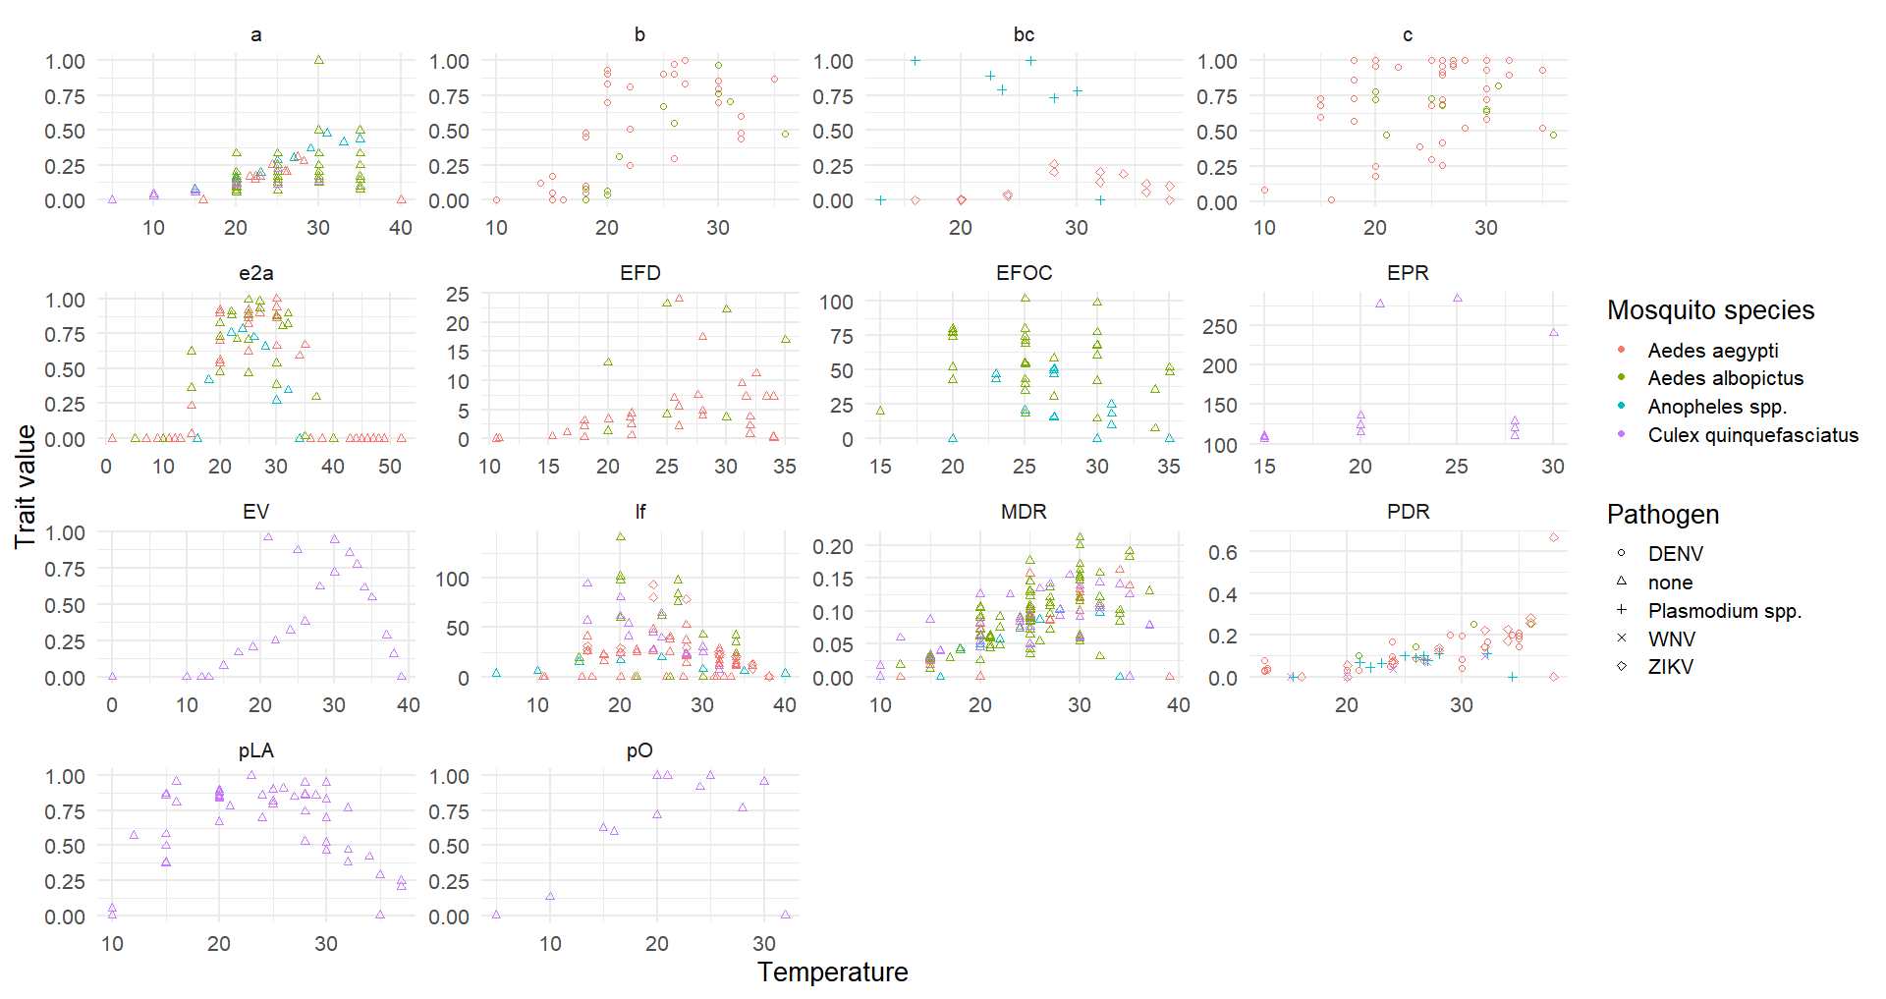
Step 1: Focal systems trait data

Slide 6
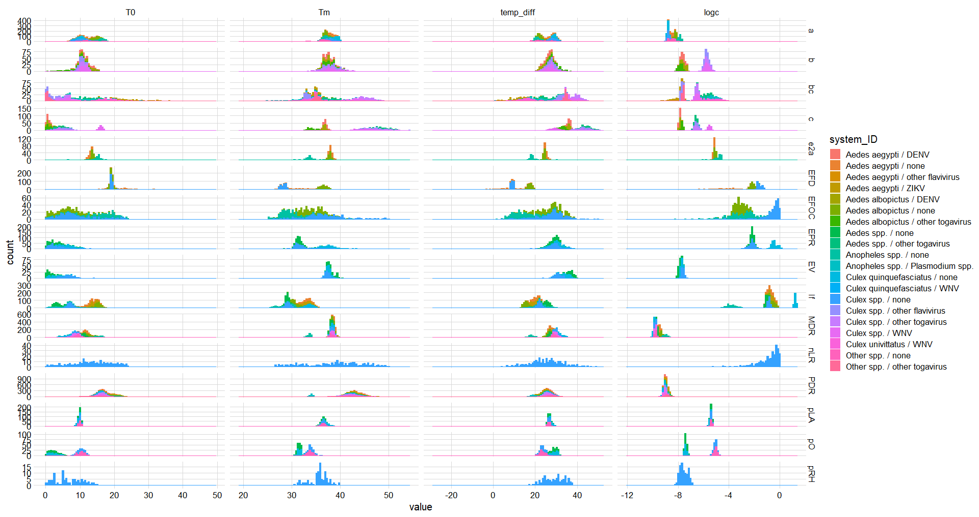
Step 2: All TPC parameter distributions

Slide 7
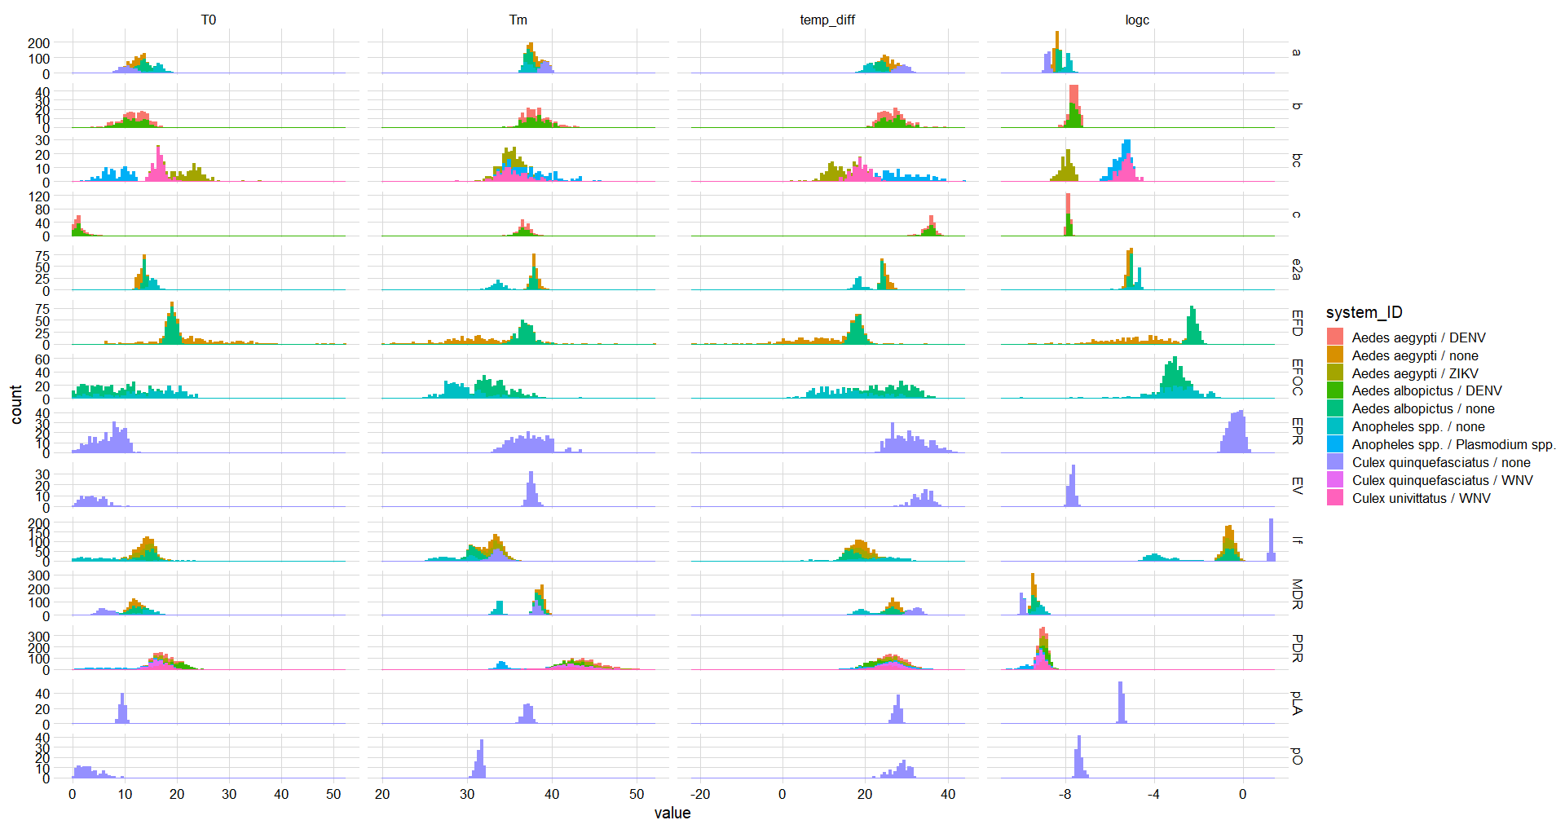
Step 2: Focal system TPC parameter distributions

Slide 8
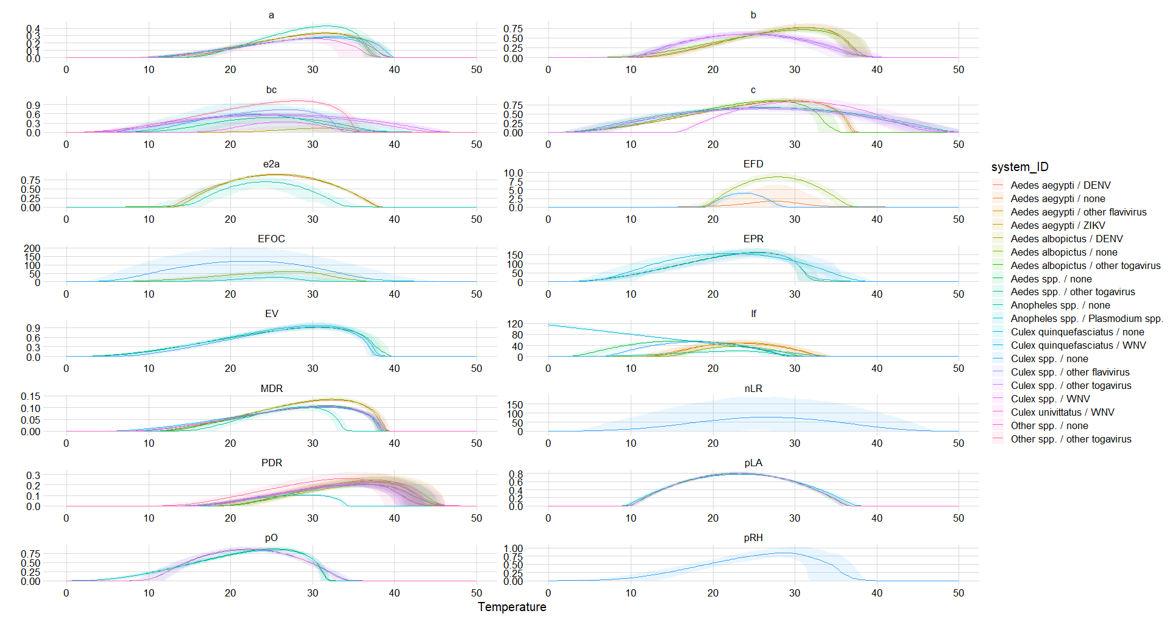
Step 2: All TPC curves

Slide 9
Step 2: Focal TPC curves

Slide 10
Step 3: Focal model parameter TPC curves

Slide 11
Step 4: Incorporate other axes of variation

Slide 12
Step 5: Calculate and analyze transmission potential

