Slide 1
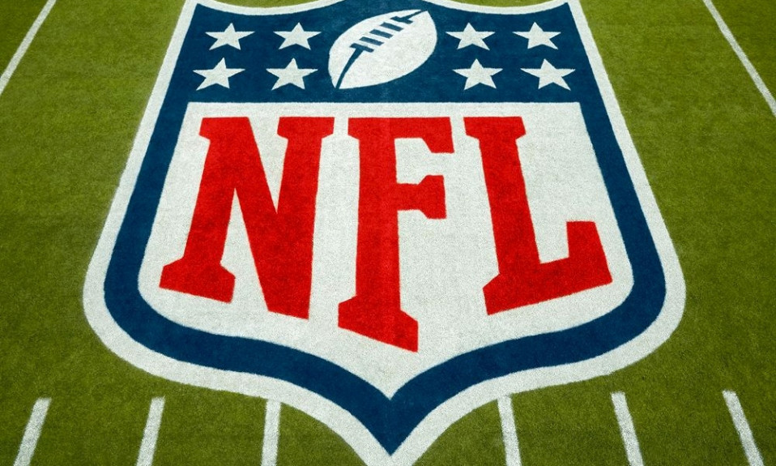
Data Visiualization Project Draker Anderson & Chris Livesay

Slide 2
Project Summary:
We decided to scrape the NFL website for seasonal data to visualize the impact of major rules changes on kick return yards throughout history of the NFL.
-Using Jupyter notebooks we created csv’s to work from collected special teams data.
-Create various images to reflect the impact of these events as well as explaining the events.

Slide 3
The rules and events:
Various factors have had significant impact on kick return yards throughout NFL History.
-1974 Rule change moved the kick from the original 40 to the 35 yard line.
-1982 NFL strike causes statistical drops in all aspects as it was a short season.
-1994 Kickoff moved back to 30 yard line.
-2011 Kick off moved forward to the 35 yard line.
-2024 Less players can move before the ball lands.

Slide 4
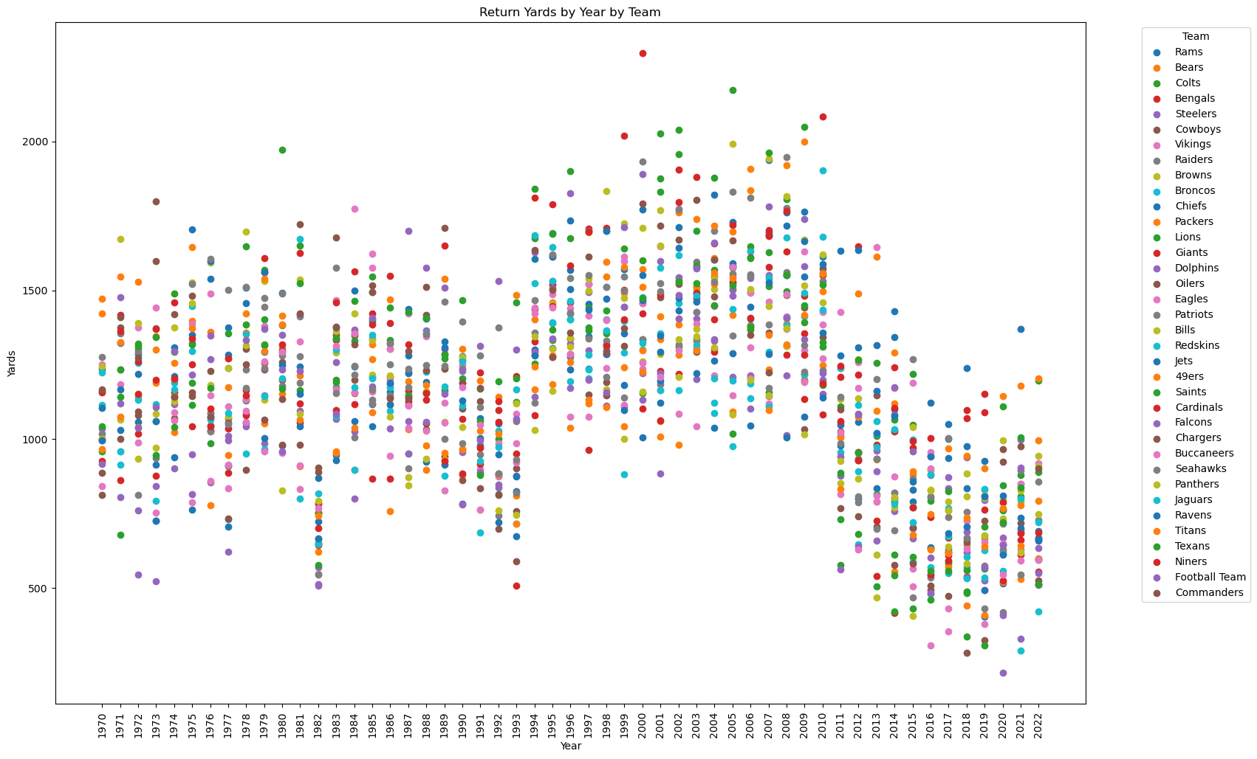
Yards by year: Using several visualizations to portray the overall progression of kick return yards over the lifespan of the NFL!

Slide 5
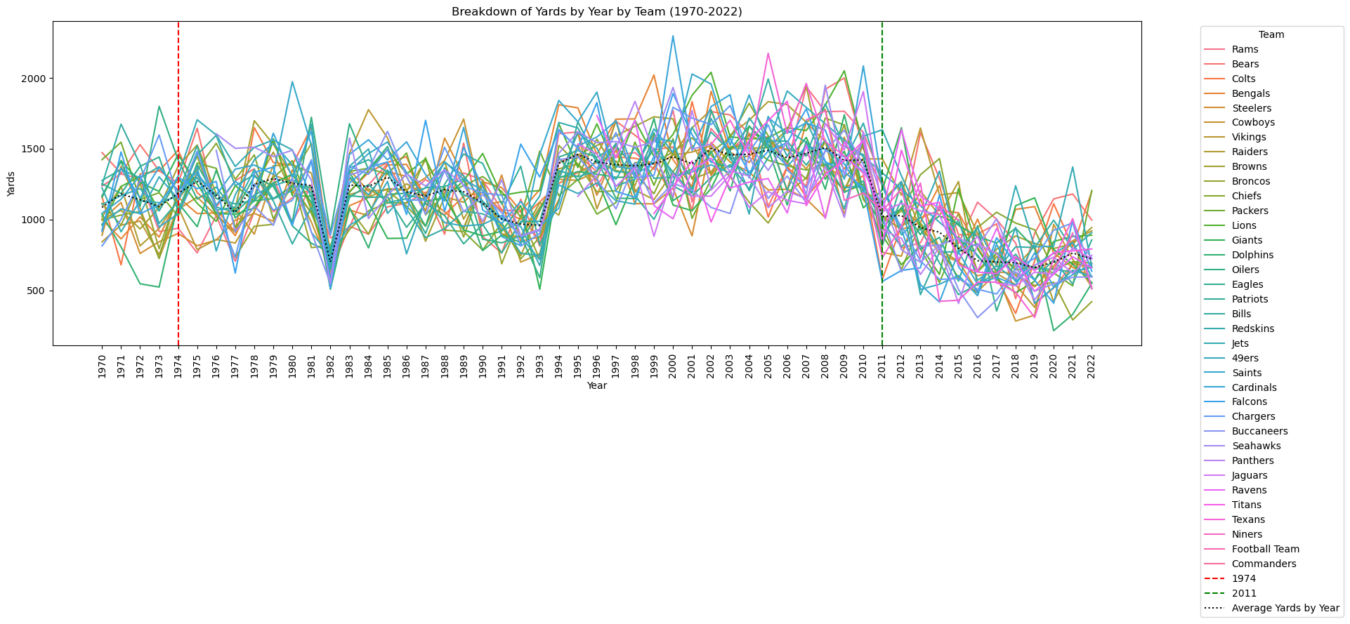
Marked 1974 rule and 2011.

Slide 6
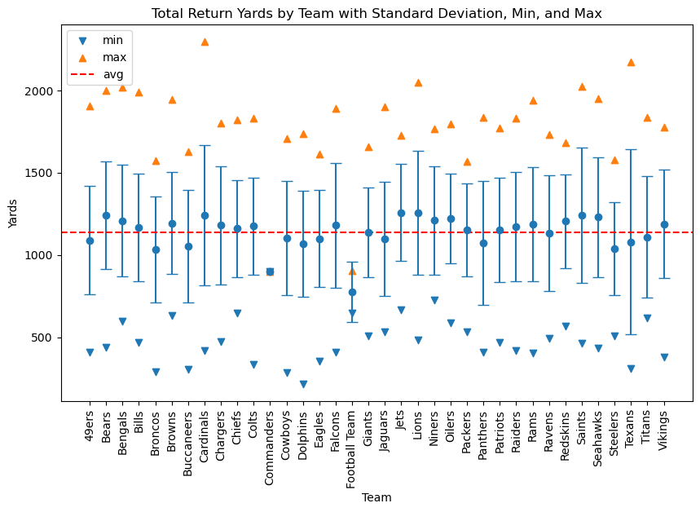
Defines the average return yards and reflects outliers and standard deviation.

Slide 7
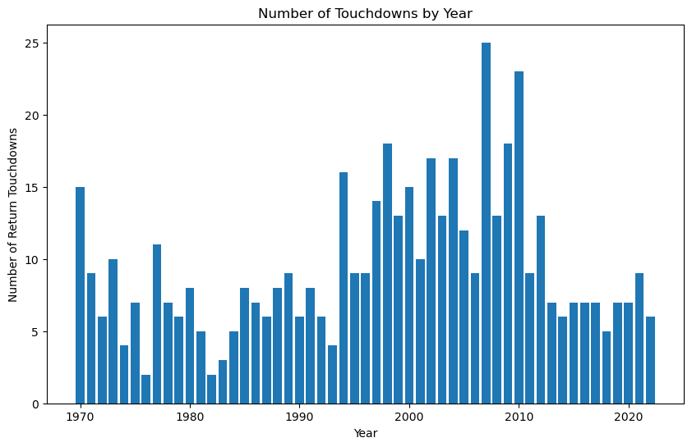
Reflects touchdowns over the course of the NFL. Are touchdowns all outliers or do they match the yard flow.

Slide 8
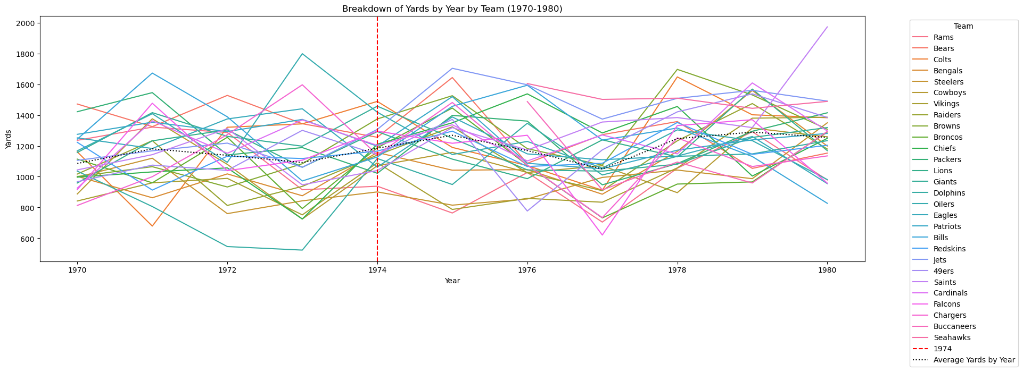
Emphasis on 1974 rules change.

Slide 9
We will reflect the effect of the 2011 rules change on a separate html file.

Slide 10
ANALYSIS:
What is the variations of kick returns yards from 1970 thru 2022? -Significant changes during the 1982, 1994, and 2011 seasons -in 1982 there was a players strike leading to only 25 of the 32 teams playing their seasons - in 94-95 there was a huge increase in kick return yards - after 2011 the kick return yardage decreases significantly over the next several years
What are the rules changes that affected special teams during kickoffs? - in 1974 they moved the kickoffs from the 40 yard line to the 35 yard line - in 94 they moved the kickoff line to the 30 yard line - in 2011 they moved the ball back to the 35 yard line and moved the players 5 yards away from the line to prevent a running startLook for shifting trends in 1974 and 2011 to see if major rule changes affected kick returns - the most significant change was after 2011 when they reimplemented the ball being kicked from the 35 - kickers are becoming more athletic and there are a lot more touchbacks now compared to 1974 when that rule was first implemented

Slide 11
Ethical considerations:
Honoring terms of service.

