Slide 1
Key achievements/outcomes
Generated a Dataset for underlined, strike-through words and Italics.
Developed an OpenCV based model to identify underlined and strike-through words.
3. Developed a CNN based model to classify images with text as italics or non italics
4. Improved the CNN model used to classify italics, underlined words.
5. Developed a KNN based model for classification of bold words.
6. Developed an OpenCV based model to identify bold and italics.
Using morphological operations, successfully identified bold and italic words from images.

Slide 2
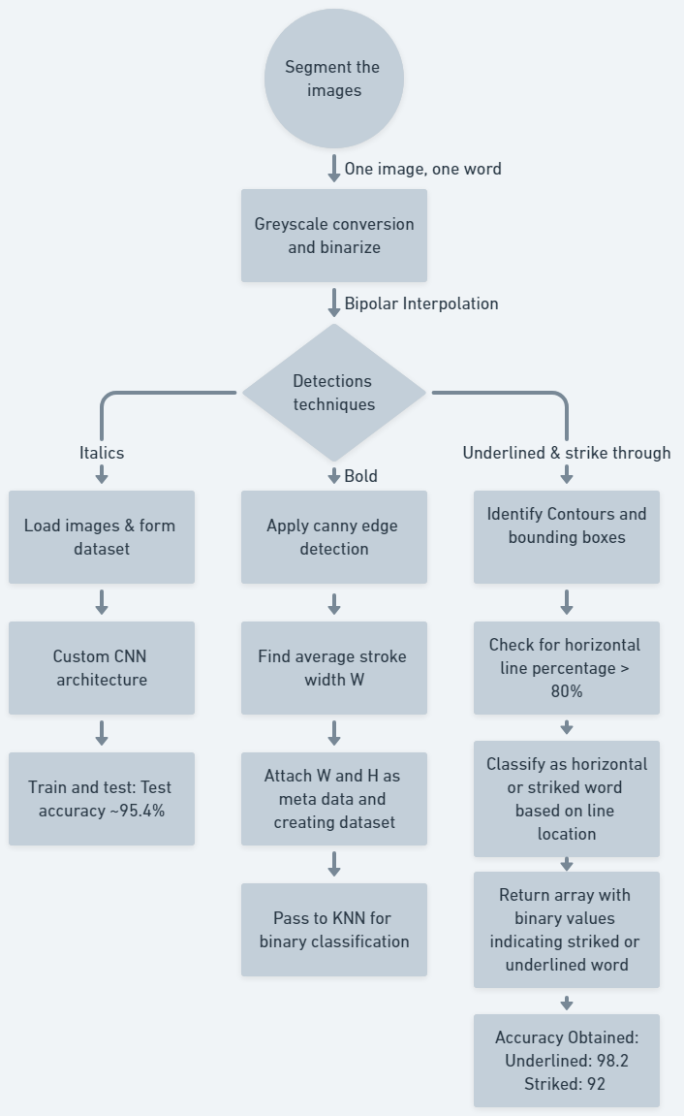
Approach / Solution
Concept Diagram :
( Clear detailed schematic / block diagram / flow chart depicting the proposed concept / solution )

Slide 3
Dataset(s) Analysis / Description
Dataset Capture / Preparation / Generation :
We have generated the dataset of bold, underline, and strikethrough images using a Python script - utilized the Python Imaging Library (PIL) for image creation and manipulation.
The dataset is clean, containing word crops in different font styles and boldness.
Utilized 5 most commonly used fonts [ Calibri, Times, Georgia, Helvetica, Arial]
Dataset Understanding / Analysis :
The dataset comprises word crops in various font styles and boldness, providing a diverse set of text images for analysis.
The inclusion of different font styles and semantic designs (bold, underline, strikethrough) adds variability to the dataset, which is beneficial for training and testing robust machine learning models.
Dataset Pre-Processing / Related Challenges (if any) :
Handling variations in font styles and boldness might require additional preprocessing steps to standardize or normalize the text features for machine learning models.
Addressing potential issues with image quality, such as pixelation or blurriness, which could affect the performance of text recognition algorithms.

Slide 4
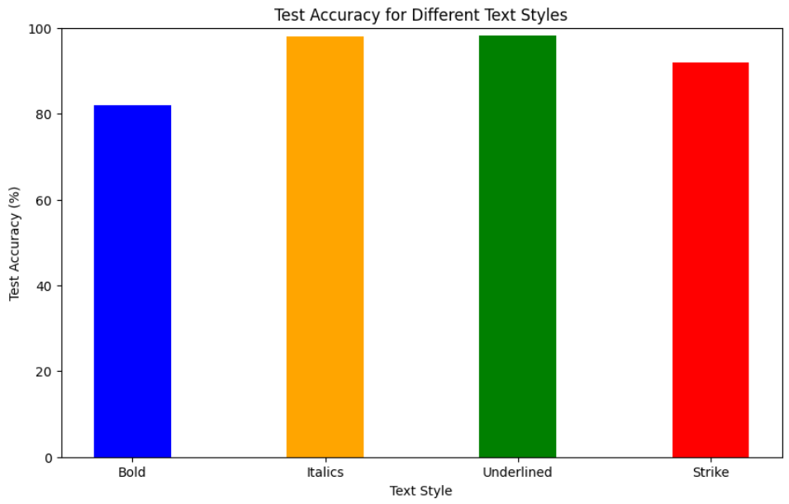
Experimental Results / Simulations / Observations
Results :

Slide 5
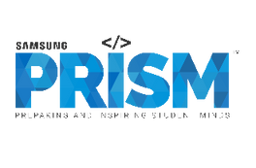
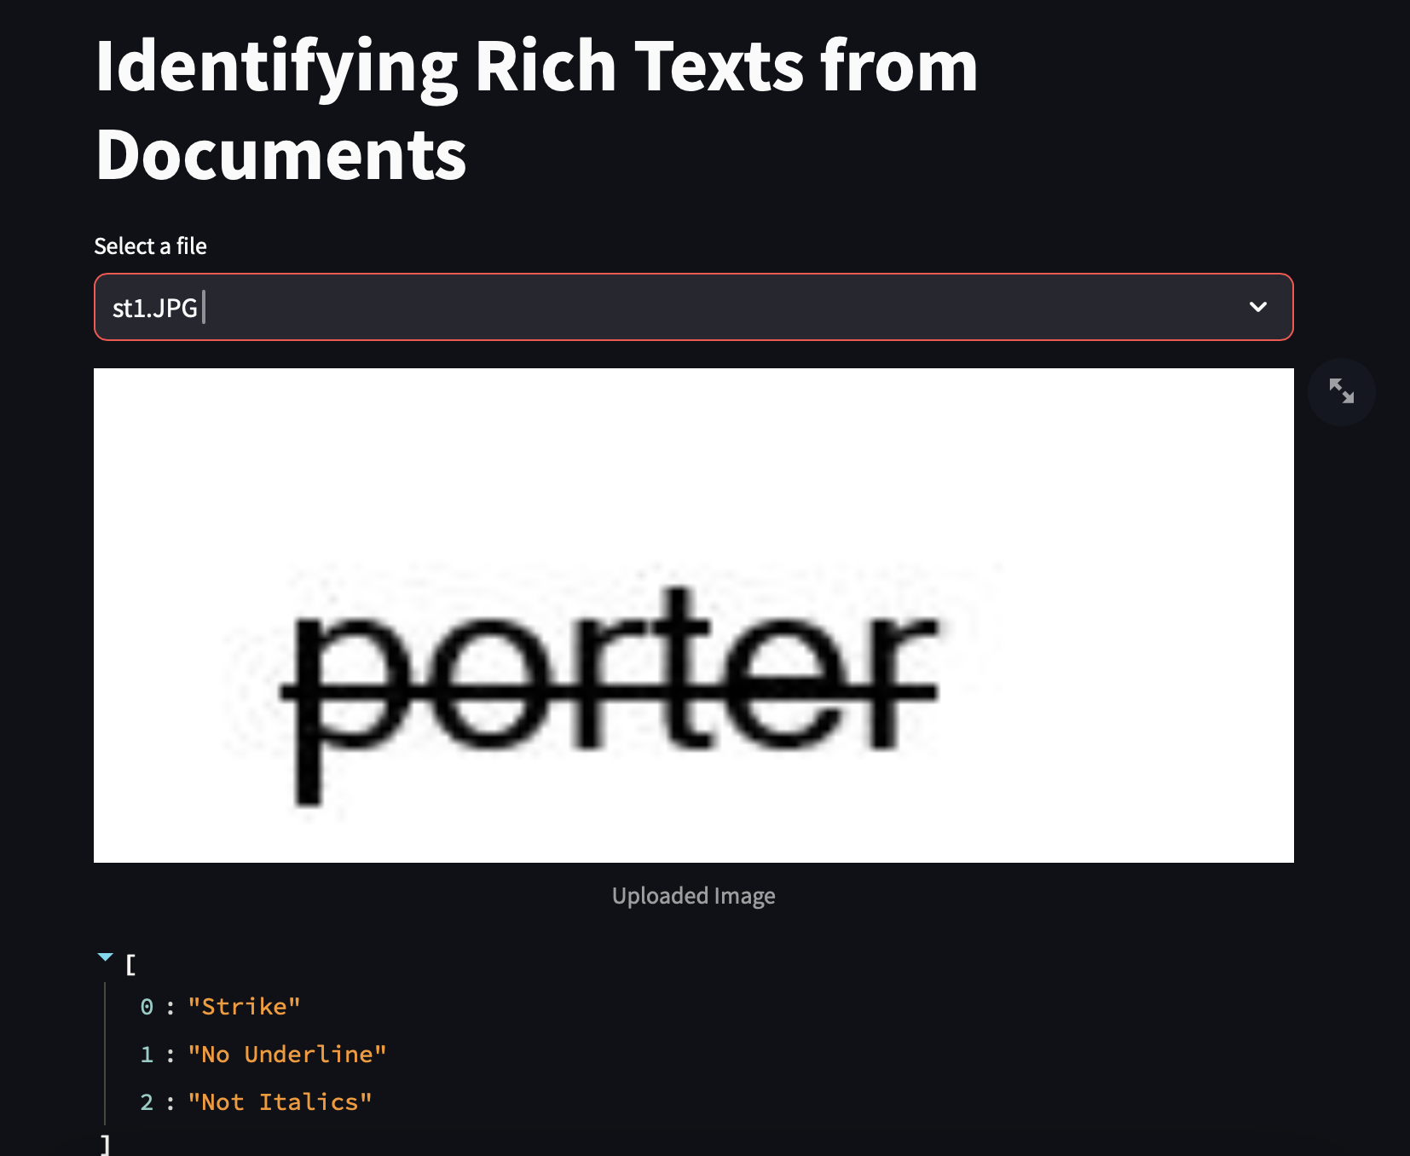
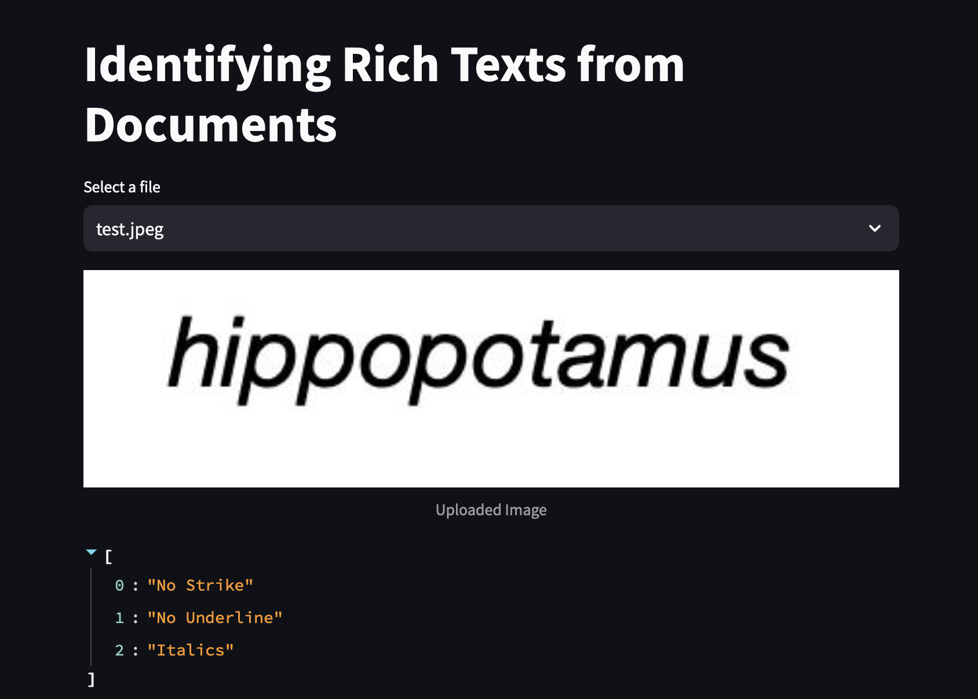
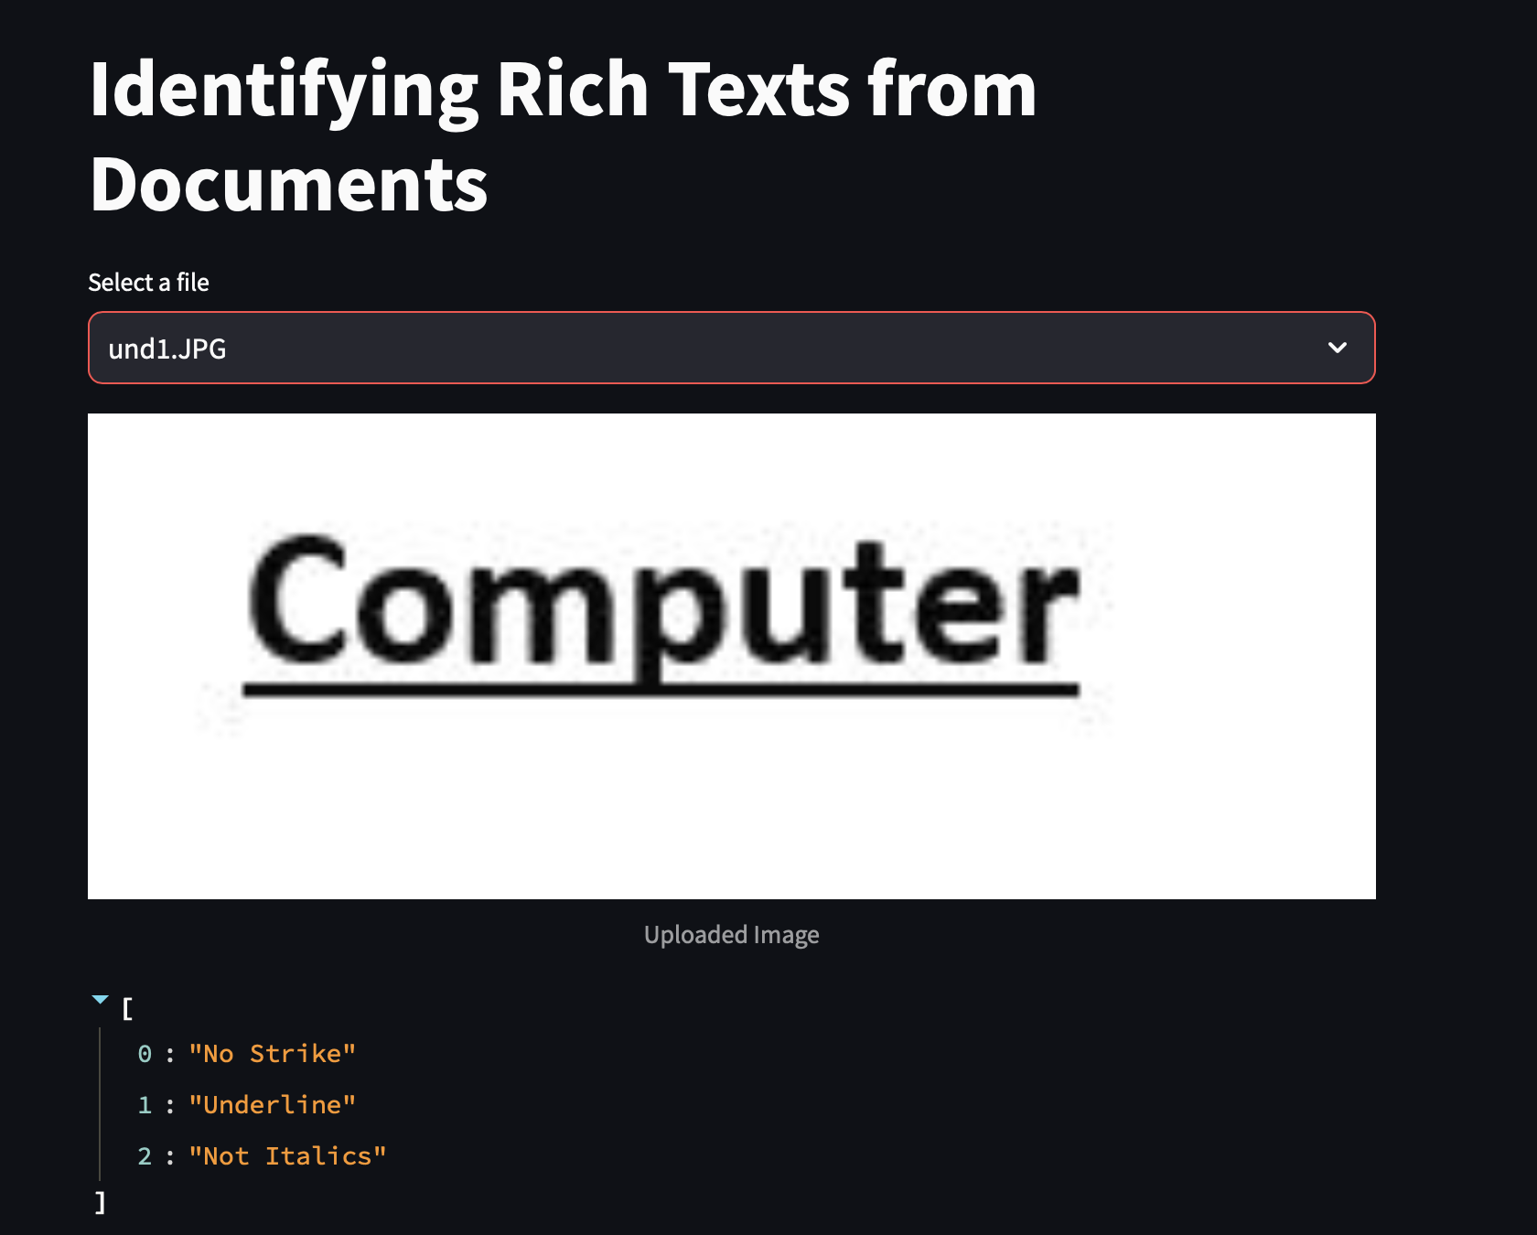
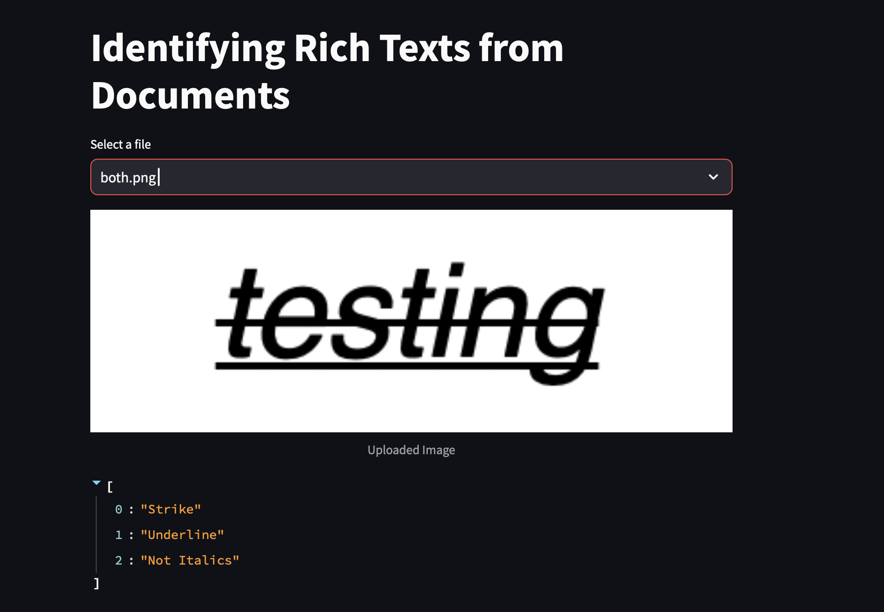
Experimental Results / Simulations / Observations
Results :

Slide 6
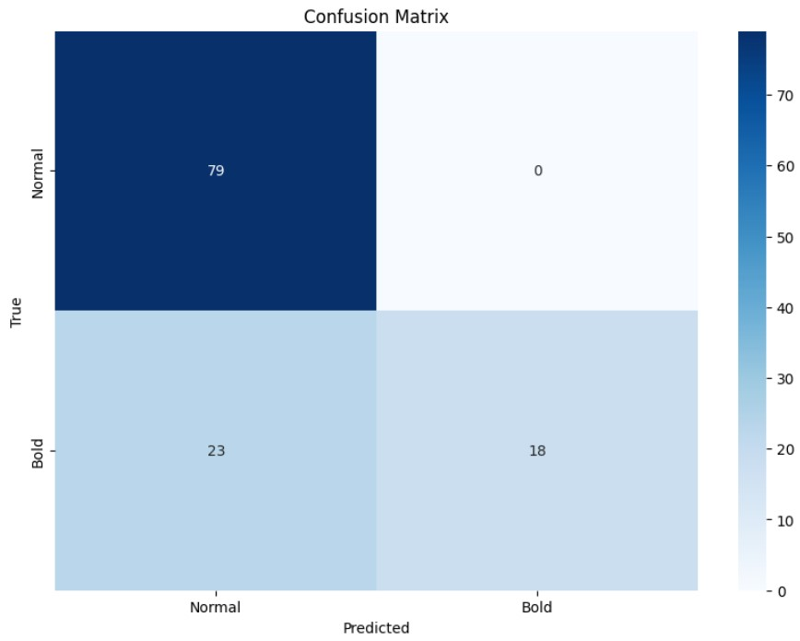
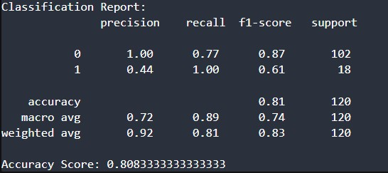
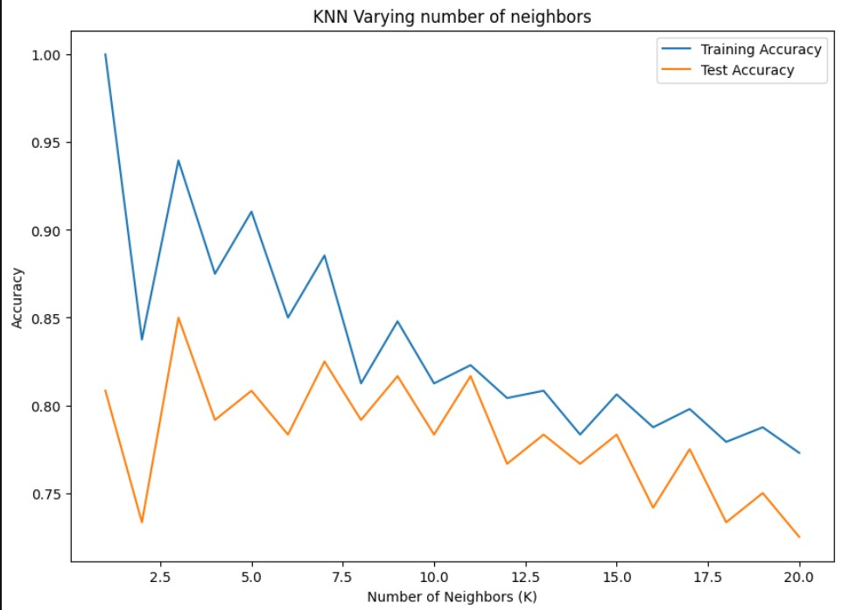
Bold Classification Reports:

Slide 7
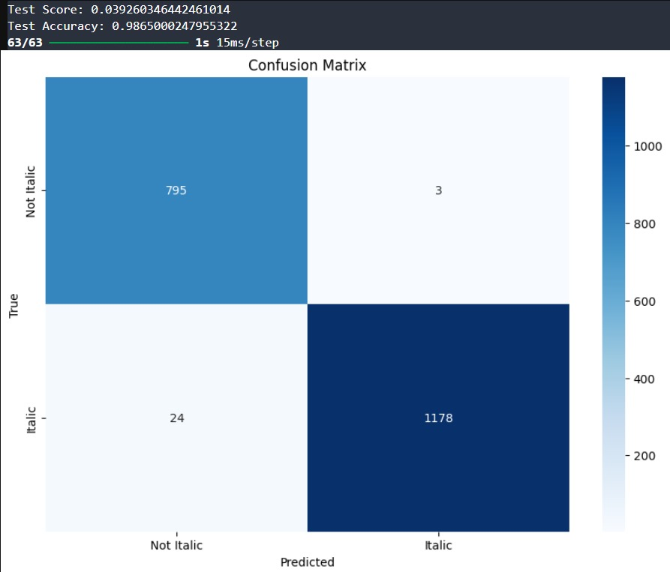
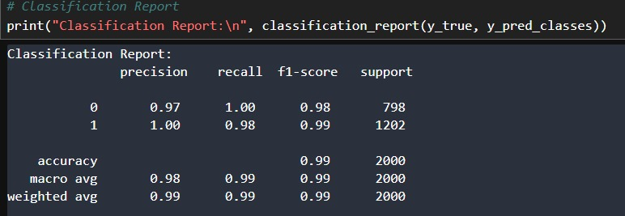
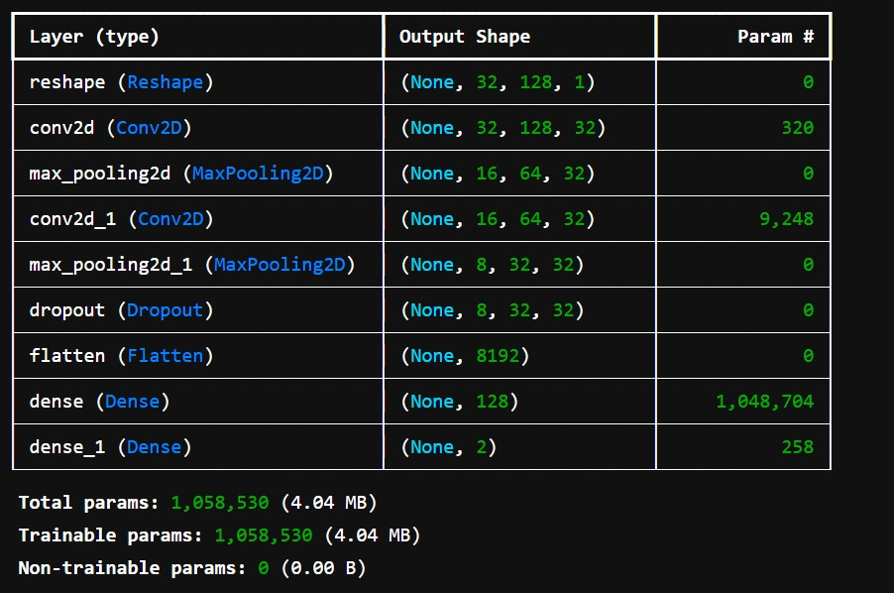
Italics Classification Reports:

Slide 8
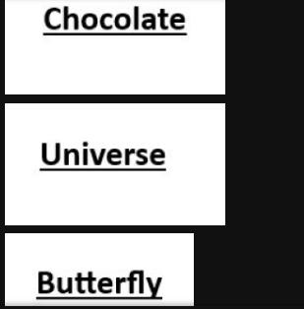
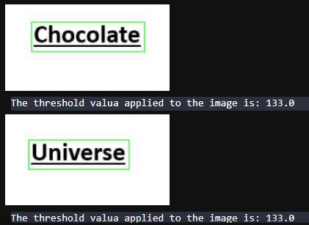
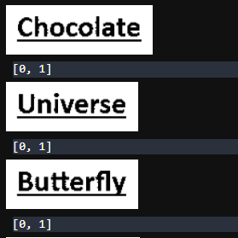
Underline/Strike Classification Reports:
Underlined: 57/58 identified
Strike-through: 52/58 identified
Both: 1
None: 1
Accuracy: 98.19

Slide 9
Deliverable
Final Deliverables :
(Discuss in the form of bullets, what are the next steps to complete the solution, any road blocks / bottlenecks, any support needed from SRIB)
A front-end UI with all the models integrated as one, which allows for detection of features of text from an image.
Improvements in algorithm for a more real time and functional use case.
IP / Paper Publication Plan :
(Details of papers / patentable ideas / innovative aspects that can lead to patentable ideas)
• Comparative papers highlighting the strengths and weaknesses of various models.
• A detailed paper demonstrating the models capabilities, showcasing its potential to detect rich texts in documents.
KPIs delivered/Expectations Met:
Reviewed existing work in the domain and developed benchmark datasets for training, validation, and testing.
Generated a Dataset for underlined, strike-through words, and Italics.
Designed and constructed lightweight models (DNN and OpenCV-based) for various classification tasks.
Developed an OpenCV-based model to identify underlined and strike-through words.
Developed a CNN-based model to classify images with text as italics or non-italics.
Developed a KNN-based model for classification of bold words.
Developed an OpenCV-based model to identify bold and italics using morphological operations.

Slide 10
Work-let Closure Details
Code Upload details:
Items | Details
KLOC (Number OF Lines of codes in 000’s) | 2
Model and Algorithm details | CNN for italics, KNN for bold, and OpenCV-based approach for underlined and stroked words
Is Mid review, end review report uploaded on Git ? | YES
Link for Git | https://github.ecodesamsung.com/SRIB-PRISM/VITC_23OD23_Identifying_rich_texts_in_documents
Data details (if applicable):
Items | Data folder 1 | Data folder 2 | Data Folder 3
Name & Type of Data (Audio/Image/Video) | Dataset_bold_images | Dataset_italics_images | Dataset_normal_images
Number of data points | 4000 | 4000 | 4000
Source of Data (self collected, Scrapped, available on open source) | Self Collected | Self Collected | Self Collected
Google drive link/ git link to access data | bold_dataset | italics_dataset | normal_dataset
Note: If data uploaded on google drive, access to be shared to prism.srib@gmail.com

