Slide 1
Callable & FutureTASk
Java concurrency tools
Matthieu Bandelier & Horia Mut

Slide 2
1.1 Callable - Introduction
 | Callable | Runnable
Requested method | call() | run()
return | «Any Object» | void
Exception | throw | -
Inteface
Since Java 5
java.util.concurrent package
Similar to Runnable

Slide 3
1.2 Callable - Details
Use Generic to define the return type ( <Object> )
Executors class provide useful methods to execute Callable in a thread pool.
Callable tasks return java.util.concurrent.Future object. Using Future (or FutureTask) we can find out the status of the Callable task and get the returned Object.

Slide 4
1.3 Callable – example
We want to compute an Integral in order to get Pi and we want to compute in parallel.
Instead of sequential programming, we split the computation in different Threads.
Each Thread is an instance of a class «SpecializedCallable», which implements Callable interface.

Slide 5
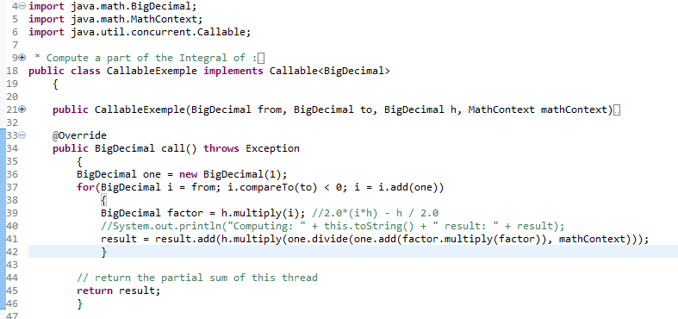
1.3.1 Callable – example / Code (INTERFACE)

Slide 6
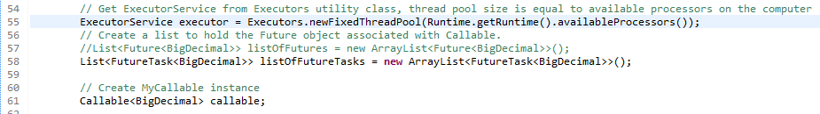
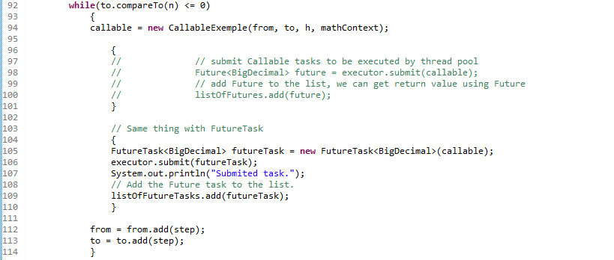
1.3.2 Callable – example / CODE (main)

Slide 7
2.1 Futuretask – Introduction
A cancelable asynchronous computation.
Class
Implementation of RunnableFuture<V> interface

Slide 8
2.2 Futuretask – DETails
Can be used to wrap a Callable or Runnable Object.
RunnableFuture<V> interface: an extension of Runnable and Future<V>
Provides protected methods that can be reimplemented.
Can be extended.

Slide 9
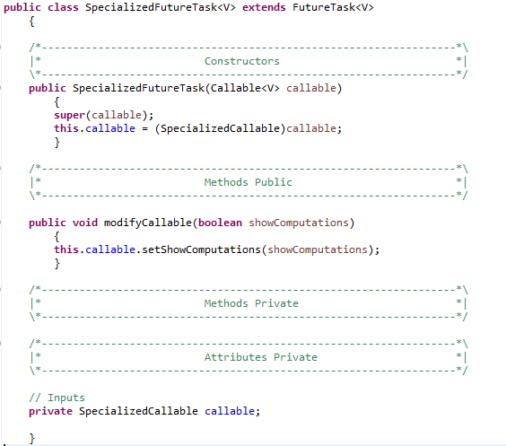
2.3 Futuretask – example
We want to be able to modify the task’s Callable to show the computations.
We can do that by extending FutureTask.

Slide 10
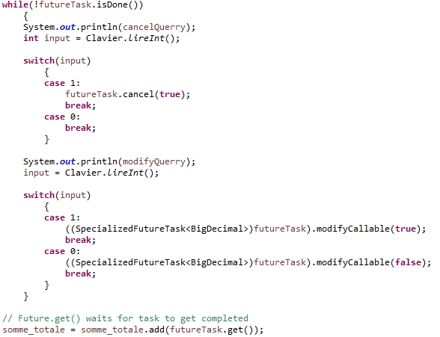
2.3 Futuretask – example / COde
Provide the user with possibility to cancel the running task.
Provide the user the possiblity to show the task’s work in progress.
Wait for the tasks’s result.

Slide 11
2.3 Demo

Slide 12
3.1 Conclusion
 | Callable | FutureTask
description | define a task | get the result of a task allow modification of the wrapped Callable or Runnable
implements | Callable<Type> | RunnableFuture<Type>
methods required | <Type> call() | -
type | interface | class
Exception handling | Yes | Yes

Slide 13
4 Sources
Informations : http://www.journaldev.com/1162/java-multi-threading-concurrency-interview-questions-with-answers#callable-future
Code : http://www.journaldev.com/1090/java-callable-future-example
API :
https://docs.oracle.com/javase/7/docs/api/java/util/concurrent/Callable.html
http://docs.oracle.com/javase/7/docs/api/java/util/concurrent/FutureTask.html

