Slide 1
Callable & FutureTASk
Java concurrency tools
Matthieu Bandelier & Horia Mut

Slide 2
1.1 Callable - Introduction
 | Callable | Runnable
Requested method | call() | run()
return | «Any Object» | void
Exception | throw | -
Inteface
Since Java 5
java.util.concurrent package
Similar to Runnable

Slide 3
1.2 Callable - Details
Use Generic to define the return type ( <Object> )
Executors class provide useful methods to execute Callable in a thread pool.
Callable tasks return java.util.concurrent.Future object. Using Future (or FutureTask) we can find out the status of the Callable task and get the returned Object.

Slide 4
1.3 Callable – example
We want to compute an Integral in order to get Pi and we want to compute in parallel.
Instead of sequential programming, we split the computation in different Threads.
Each Thread is an instance of a class «SpecializedCallable», which implements Callable interface.

Slide 5
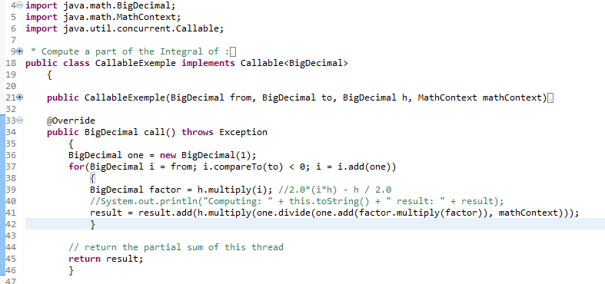
1.3.1 Callable – example / Code (INTERFACE)

Slide 6
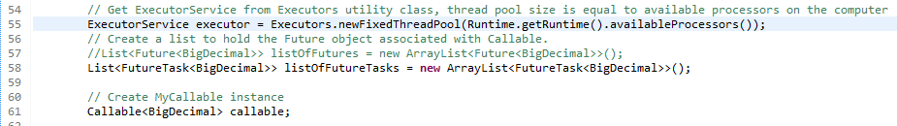
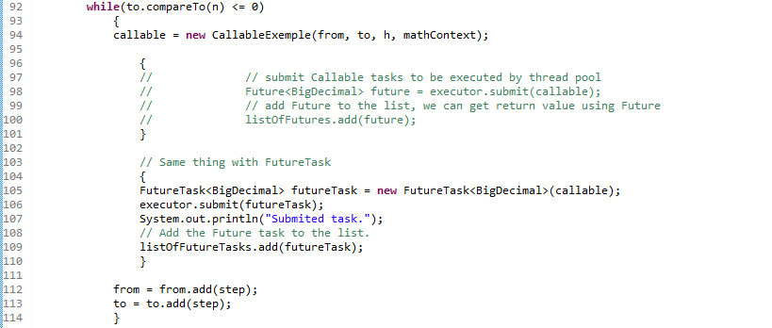
1.3.2 Callable – example / CODE (main)

Slide 7
2.1 Futuretask – Introduction
A cancelable asynchronous computation.
Class
Implementation of RunnableFuture interface

Slide 8
2.2 Futuretask – DETails
Can be used to wrap a Callable or Runnable Object.
RunnableFuture interface: an extension of Runnable and Future<V>
We want to get the compute an Integral in order to get Pi and we want to compute as fast as possible.
Instead of sequential programming, we split the computation in differents Threads.
Each Thread is an instance of a class «CallableExemple», which implements Callable interface.

Slide 9
2.3 Futuretask – example
We want to get the computed results, in order to get Pi.
We could do that with FutureTask class

Slide 10
2.3 Futuretask – example / COde

Slide 11
2.3 Futuretask – example / CODE

Slide 12
3.1 Conclusion
 | Callable class | FutureTask class
description | define a task | get the result of a task
implements | Callable<Type>
methods required | <Type> call()

Slide 13
4 Sources
Informations : http://www.journaldev.com/1162/java-multi-threading-concurrency-interview-questions-with-answers#callable-future
Code : http://www.journaldev.com/1090/java-callable-future-example
API :
https://docs.oracle.com/javase/7/docs/api/java/util/concurrent/Callable.html
http://docs.oracle.com/javase/7/docs/api/java/util/concurrent/FutureTask.html

