Slide 1

FitCash: Revolutionizing Health and Expense Tracking
Created by
Your Name

Slide 2
Overview of FitCash
Concept & Purpose
Features
Benefits
FitCash is an innovative application designed to seamlessly integrate expense tracking with health data management, providing a comprehensive solution for users' financial and fitness goals.
User-friendly interface, secure data storage, real-time expense and health data tracking, note-keeping functionality.
Promotes financial awareness, encourages healthy living, streamlines expense management.

Slide 3

Expense Tracking
Real-time Updates
Storage & Organization
Instantly captures and categorizes expenses, ensuring accurate and up-to-date financial records.
FitCash seamlessly stores and organizes user expenditures, providing insights into spending patterns and financial health.
Photos provided by Pexels

Slide 4
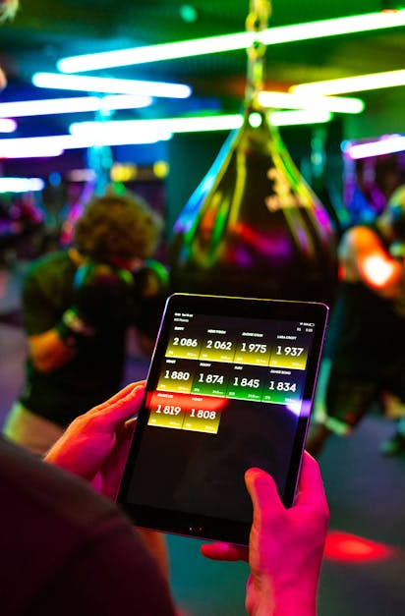
Health Data Tracking
Physical Activity Monitoring
Health Insights
FitCash tracks user's health data, including walking steps for the past week, promoting an active lifestyle.
Provides personalized health insights based on the tracked data, empowering users to make informed lifestyle choices.
Photos provided by Pexels

Slide 5

Note-Keeping Feature
Detailed Notes
Reminders & Insights
Users can keep detailed notes related to expenses, fitness progress, and health milestones, providing a comprehensive view of their well-being.
Offers timely reminders and insights based on the user's notes, enabling effective planning and management.
Photos provided by Pexels

Slide 6
User Interface and Experience
Intuitive Design
Customization Options
Accessibility
FitCash boasts an intuitive interface, ensuring a seamless user experience for managing both finances and fitness data.
Offers customization options to tailor the app to individual preferences, enhancing user engagement and satisfaction.
Available across various platforms, ensuring accessibility and convenience for users on the go.

Slide 7
Q&A and Feedback
Open Discussion
User Input
Future Expectations
Open the floor for questions and facilitate an interactive session to address any queries or feedback from the audience.
Seek user feedback to further enhance FitCash, ensuring continuous improvement and meeting user expectations.
Encourage discussions on potential future features and enhancements, fostering a collaborative approach to development.

