Slide 1

FINAL PROJECT PRESENTATION
SMART
PARKING
Real-time parking discovery, management and payment
FIND • PARK • PAY • EXIT
HIT • Faculty of Science
Advisor: Nethanel Ben Hamo
SMART PARKING / HIT
1
Notes:
Introduce Smart Parking as an end-to-end platform for drivers and parking managers. Source: Smart Parking repository and SmartParkingGDD.docx.

Slide 2
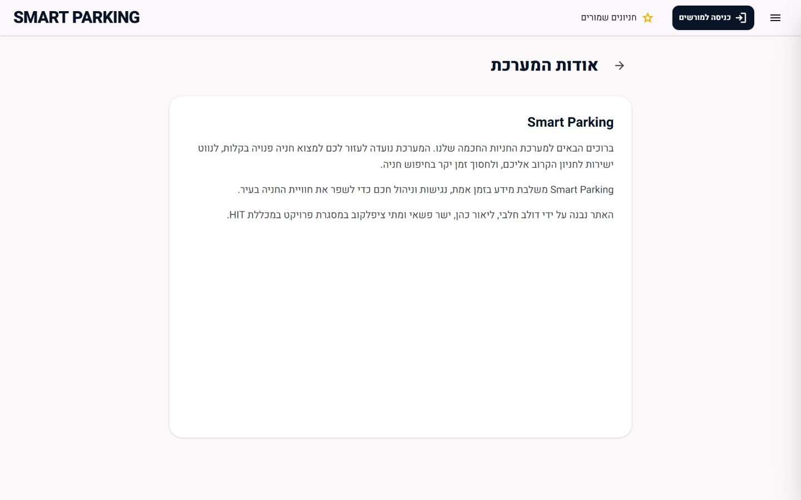
PROJECT TEAM
Team & Academic Context
Project Team
Dolev Halabi
Lior Cohen
Yashar Pashaiy
Matthew Tsiplakov
Advisor
Netanel Ben Hamo
HIT — Holon Institute of Technology
Faculty of Science • Center of Projects and Industrial Cooperation
SMART PARKING / HIT
2
Notes:
Team details supplied by the project team. Advisor: Netanel Ben Hamo.

Slide 3
PRESENTATION ROADMAP
Table of Contents
01
Project Overview
04–07
02
Users & Product Scope
08–19
Section 01
Section 02
03
Driver Experience & Parking Maps
20–28
04
Real-Time, Payment & UX
29–36
Section 03
Section 04
05
Architecture, Models & Security
37–43
06
Coverage, Lessons & Next Steps
44–47
Section 05
Section 06
SMART PARKING / HIT
03

Slide 4
EXECUTIVE SUMMARY
Project in One Minute
Smart Parking connects discovery, guidance, operations and payment in one journey.
01
02
03
04
DISCOVER
GUIDE
OPERATE
COMPLETE
Find parking by city or location and compare live availability.
Open a lot-level map and identify the exact available space.
Give authorized managers control over lots, levels, spaces and prices.
Check debt, pay with PayPal, receive a receipt and exit within 15 minutes.
One platform connects drivers, sensor data, parking operations and digital payment.
SMART PARKING / HIT
4
Notes:
Use this slide to establish the complete value proposition before the detailed walkthrough.

Slide 5
WHY IT MATTERS
The Problem
Drivers lose time before the parking process even begins.
?
TIME
FUEL
TRAFFIC
searching for an available space
consumed while circling
created near busy parking lots
Where is the nearest available space — right now?
The user needs certainty at city, lot and individual-space level.
SMART PARKING / HIT
5
Notes:
Problem statement derived from the project specification.

Slide 6
MARKET GAP
Why Existing Solutions Fall Short
What users commonly receive
What Smart Parking adds
Information for one parking lot at a time
Static or delayed availability
A generic destination — not the exact space
Separate discovery, navigation and payment flows
A unified multi-city parking platform
Live spot-level status
Visual layouts for specific parking sites
One journey from search through exit
SMART PARKING / HIT
6
Notes:
The project differentiates itself through aggregation, real-time data and an end-to-end workflow.

Slide 7
SUCCESS CRITERIA
Project Objectives
Five objectives define what the project needs to achieve, while one design principle guides how it is built.
DESIGN PRINCIPLE
01
Aggregate multiple
parking lots
Mobile first • Hebrew RTL • Accessible
05
Guide to the
exact space
Modular enough to add and remove parking lots without rewriting the product.
02
Expose live
availability
04
Support secure
management
03
Complete digital
payment
SMART PARKING / HIT
7
Notes:
Objectives are based on the current implementation and original GDD requirements.

Slide 8
PEOPLE
User Groups & Permission Model
Public driver / visitor
Authorized parking manager
No account is required
Searches lots and views live availability
Navigates with Waze
Checks debt and pays by license plate
Receives an exit timer and email receipt
Signs in with a secure cookie
Sees only assigned cities and lots
Manages lots, levels, spaces and prices
Views active parked vehicles
Manages exempt license plates
SMART PARKING / HIT
8
Notes:
Important: the system does not use ADMIN and USER roles. Manager access is scoped by authorizedCities.

Slide 9
PRODUCT SCOPE
Public Driver Capabilities
DISCOVERY
PARKING
PAYMENT
ACCESS
Search by city
Nearby parking
All-lots map
Favorites
Live availability
Levels and space numbers
Free / occupied / blocked
Waze navigation
Plate lookup
Live debt
PayPal checkout
Email receipt
Price list
Exit countdown
Accessibility settings
SMART PARKING / HIT
9
Notes:
Public capabilities implemented in the client application.

Slide 10
OPERATIONS
Parking Manager Capabilities
The manager workflow is sequential, while management capabilities fall into two operational groups.
MANAGER WORKFLOW
STRUCTURE
COMMERCIAL & OPS
01
Sign in
Parking structure
Commercial & operational data
Choose an authorized city
• Create, edit or delete a lot
• Add or remove levels
• Add, edit, block or delete spaces
• Update parking prices
• Review parked vehicles
• Add or remove exempt license plates
02
03
Open a managed lot
04
Edit structure and pricing
Authorized access controls which cities and parking lots the manager can operate.
05
Monitor vehicles and exemptions
SMART PARKING / HIT
10
Notes:
Manager functions in the authenticated dashboard.

Slide 11
END-TO-END SCENARIO
Typical Driver Journey
A single driver journey spans discovery, arrival, parking, payment and exit.
Open site
Choose lot
Enter & park
Exit
01
02
03
04
05
06
07
Allow location
Navigate
Pay
REAL-TIME LAYER • LoRa updates space status • Socket.IO updates clients • server owns session and billing state
Payment success starts a 15-minute exit window.
SMART PARKING / HIT
11
Notes:
Narrative flow: discovery, live parking session, payment and exit.

Slide 12
AUTHORIZED AREA
Typical Manager Workflow
Manager actions pass through authentication, authorization and persistence before changes are broadcast.
01
Cookie authentication
PERMISSION RULE
A manager can operate only on parking lots inside the cities assigned to the account.
02
Load authorized cities
03
Load managed lots
authorizedCities is loaded after login and becomes the boundary for city, lot and management operations.
04
Edit lot / level / space
Persist first → broadcast after the server has accepted the change.
05
Persist and broadcast update
SMART PARKING / HIT
12
Notes:
Management permissions are constrained to the user's authorizedCities list.

Slide 13
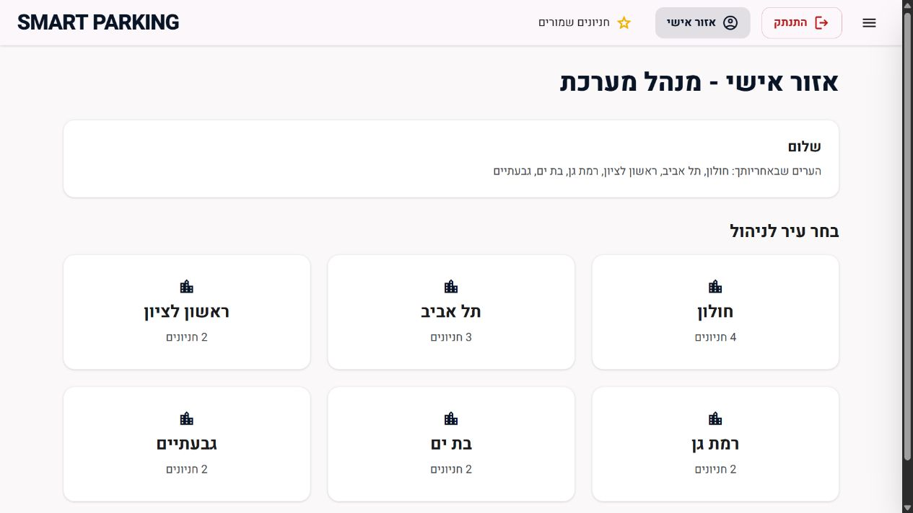
AUTHORIZED MANAGEMENT
Administrator Dashboard
Access follows assigned cities
Cookie-based authenticated session
Cities loaded from authorized Cities
Parking lot count shown for each city
The manager enters only the assigned operational area
SMART PARKING / HIT
13
Notes:
Screenshot captured after signing in to the current local production build. Credentials are not shown.

Slide 14
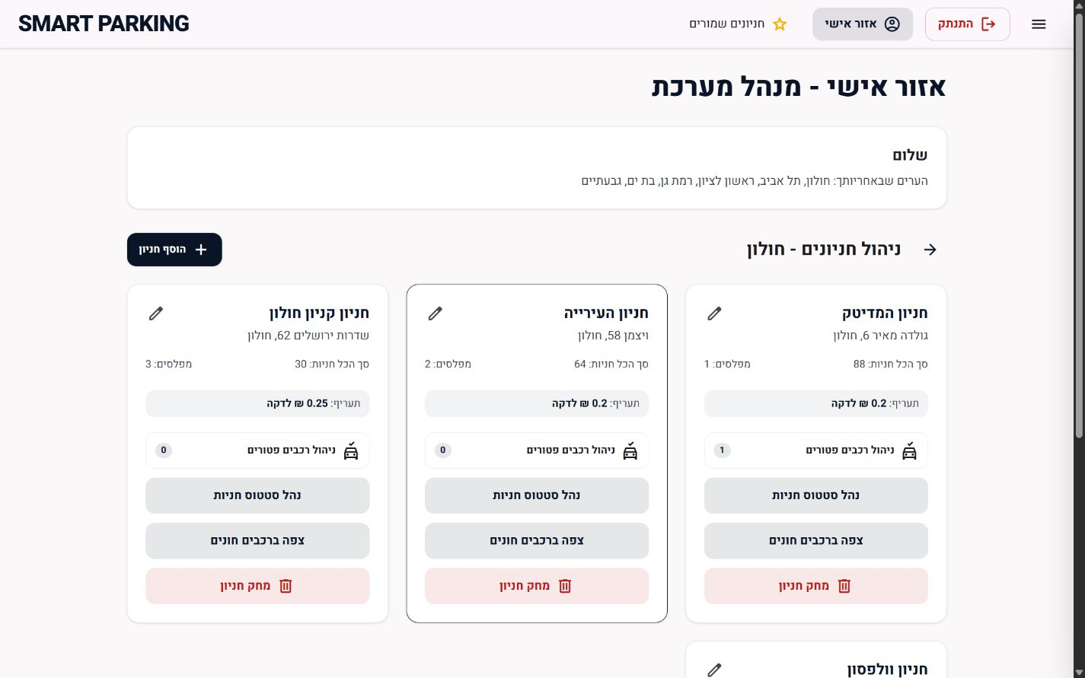
ADMINISTRATOR AREA
Managed Parking Lots
Create a parking lot with its initial spaces
Review address, levels, capacity and tariff
Open pricing and lot details
Manage space status and active vehicles
Maintain exempt vehicle lists
Delete a parking lot after confirmation
SMART PARKING / HIT
14
Notes:
The city view exposes management actions only for lots inside the selected authorized city.

Slide 15
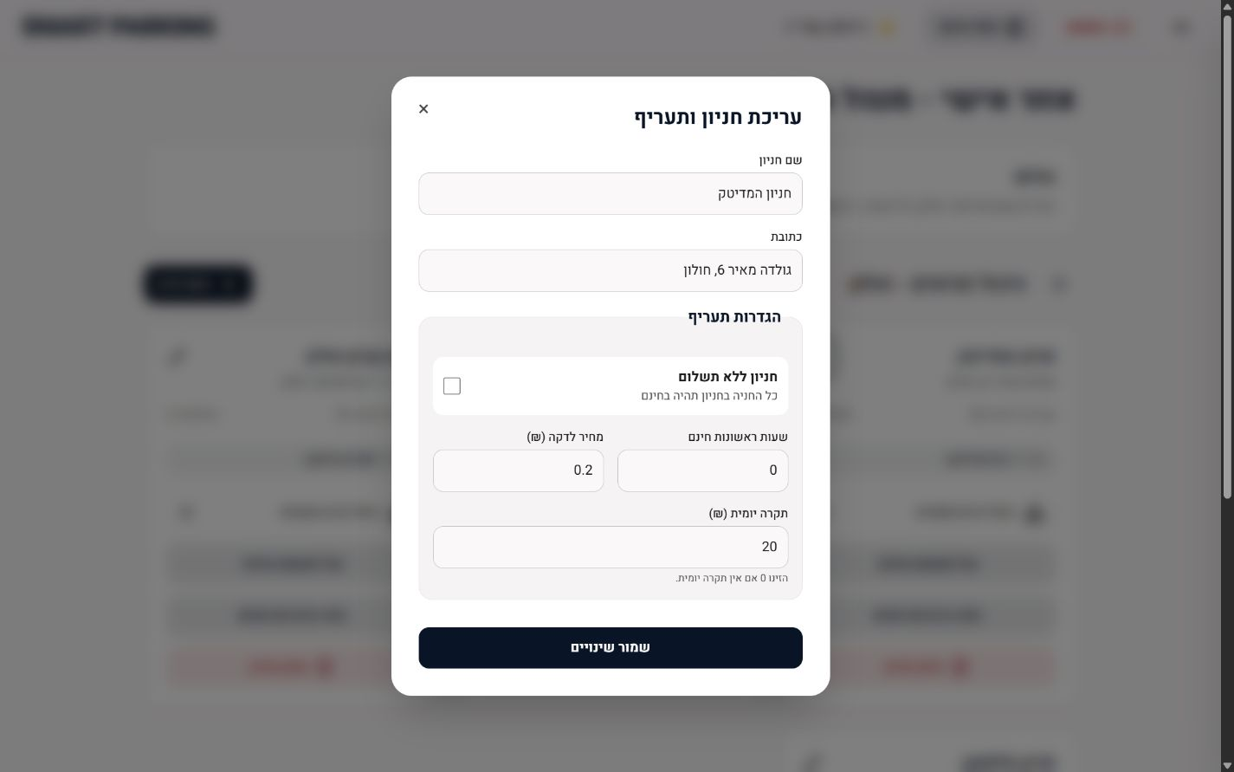
COMMERCIAL CONTROLS
Parking Lot Details & Pricing
Editable fields
Parking lot name and address
Free parking mode
Initial free hours
Price per minute
Daily payment cap
The server remains the source of truth for prices and billing calculations.
SMART PARKING / HIT
15
Notes:
The manager can update parking lot identity and tariff rules without leaving the dashboard.

Slide 16
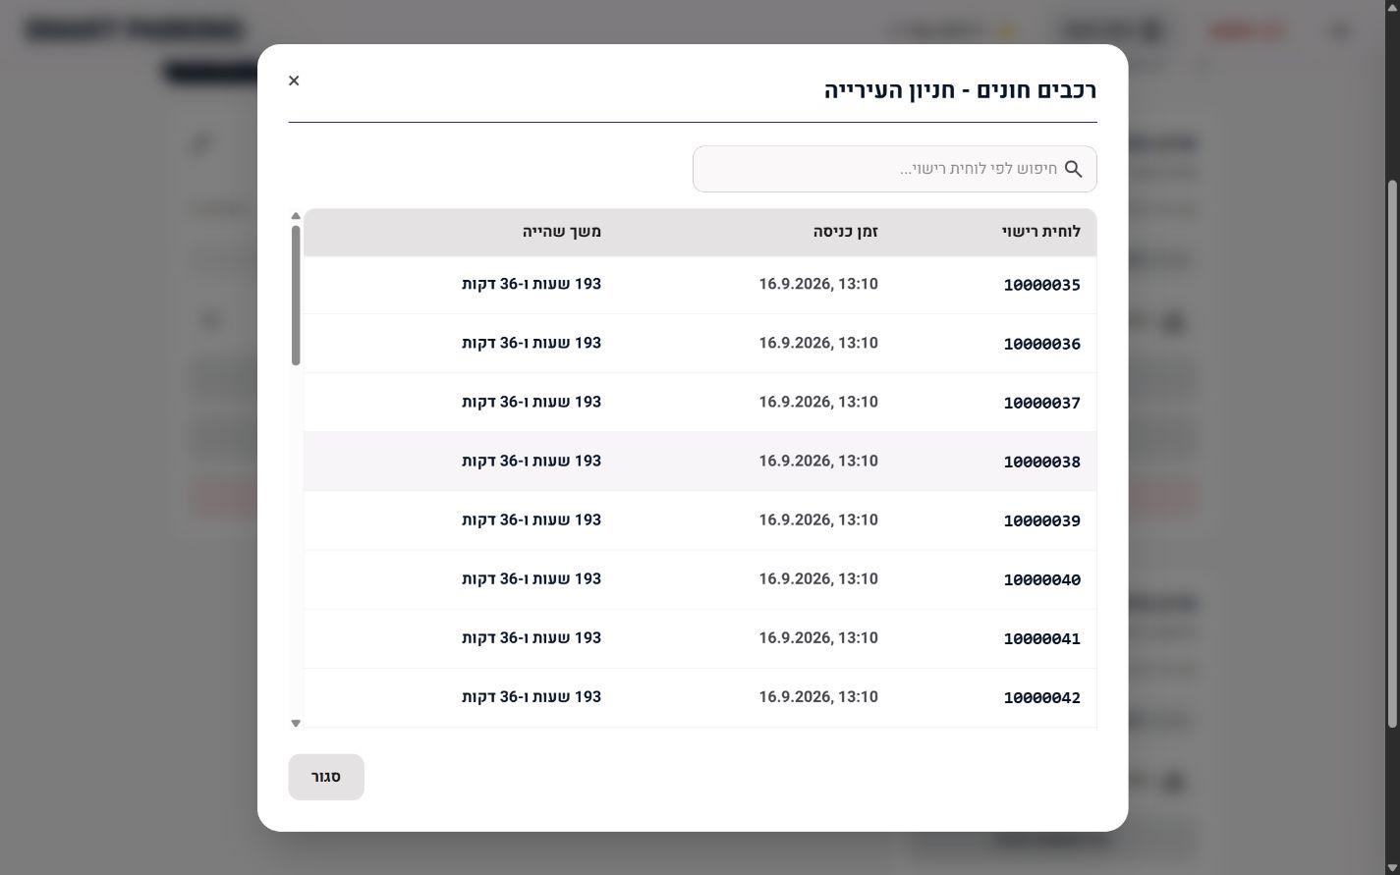
OPERATIONAL VISIBILITY
Live Parked Vehicle Monitoring
Current session view
Search by license plate
View entry time
Track current parking duration
Inspect only the selected parking lot
SMART PARKING / HIT
16
Notes:
The manager can inspect current parking sessions and search by license plate.

Slide 17
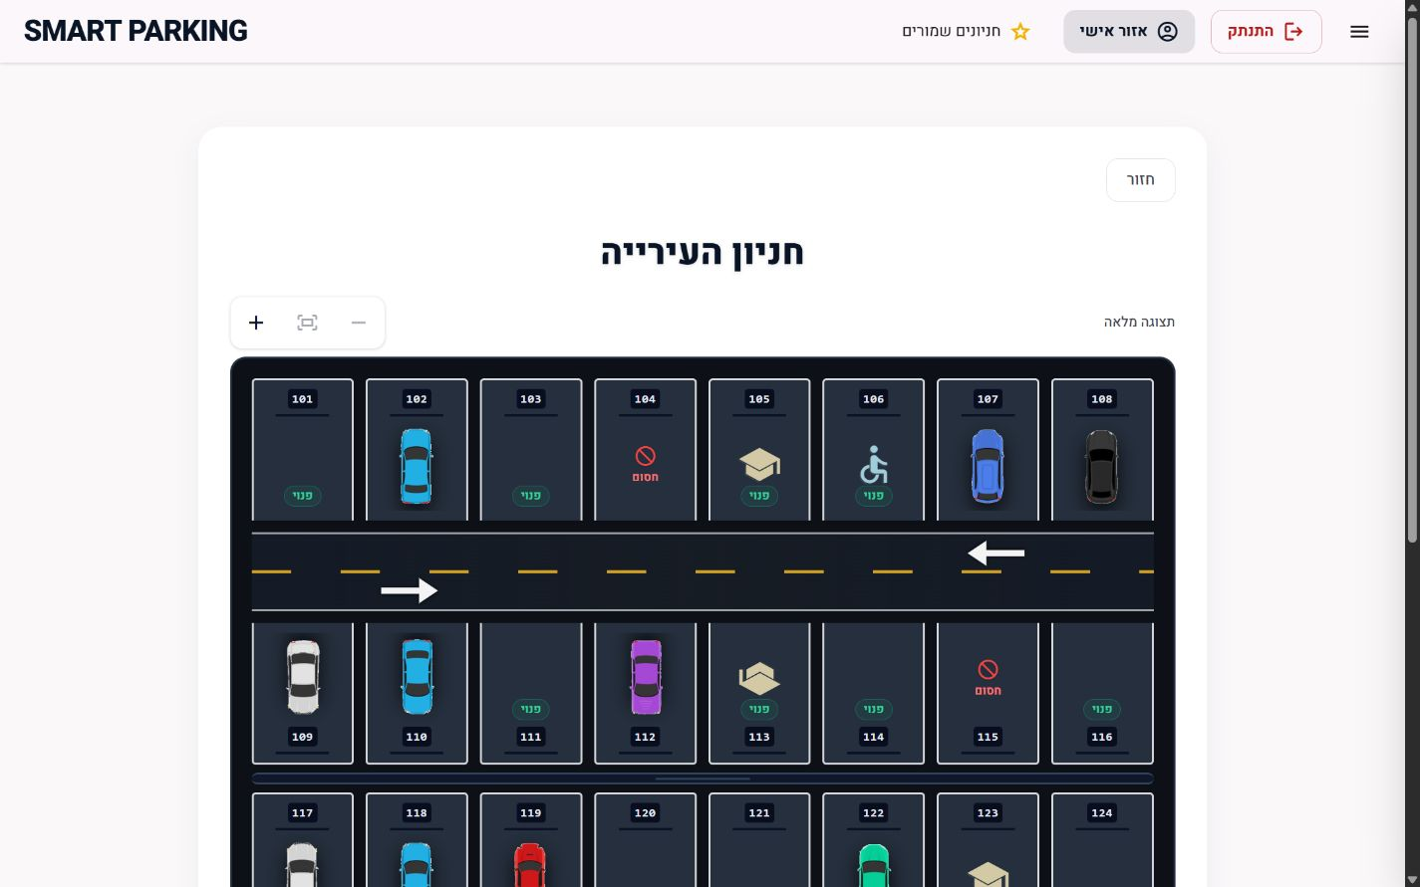
PARKING STRUCTURE
Level & Parking Space Management
Move between parking levels
Add a new level
Remove the final level
Add spaces when capacity permits
Select a space for detailed editing
Read free, occupied, blocked and special types
SMART PARKING / HIT
17
Notes:
Authorized management mode opens the parking layout without the public navigation action.

Slide 18
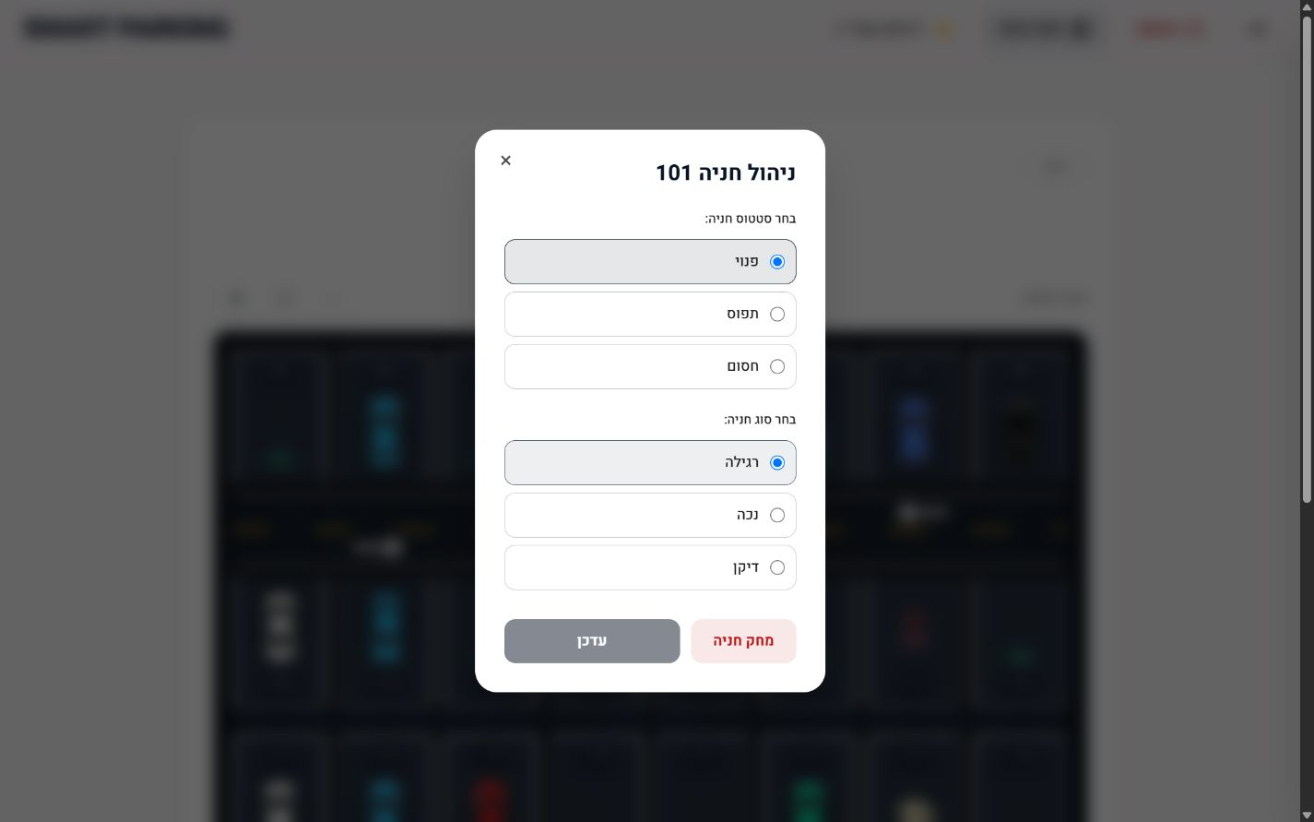
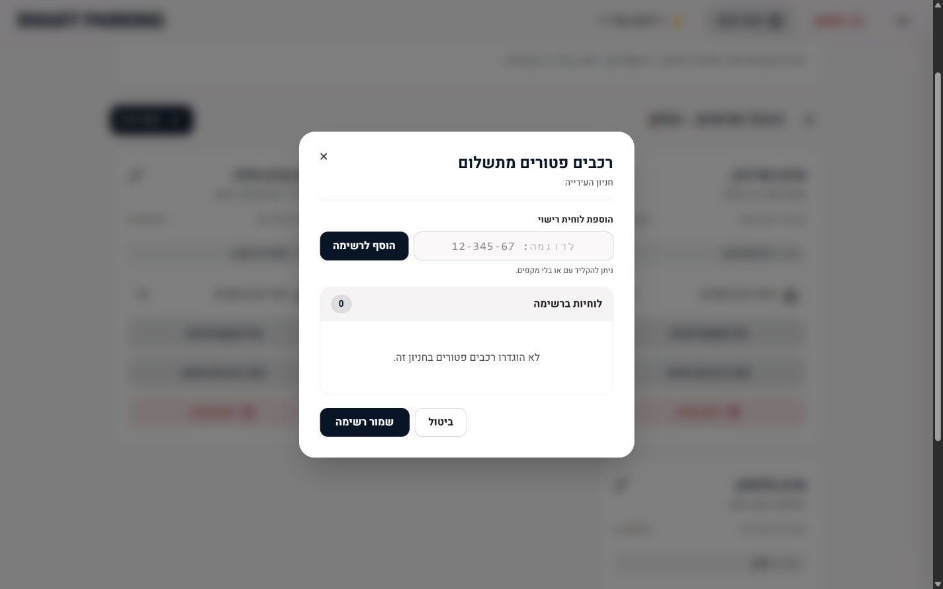
DETAILED ADMINISTRATION
Space Status & Exempt Vehicle Controls
Individual space
Exempt vehicles
Status, type and deletion controls
Add, remove and save license plates per lot
SMART PARKING / HIT
18
Notes:
The screenshots show read-only inspection of the current controls. No parking data was changed.

Slide 19
INFORMATION ARCHITECTURE
Product Navigation
PUBLIC
AUTHENTICATION
MANAGEMENT
Home
Authorized login
Dashboard
Nearby results
Cookie session
Managed cities
All lots + map
JWT token
Managed lots
Parking lot view
Logout
Lot editor
Price list
Space editor
Payment
Active vehicles
Settings
Exempt vehicles
About
SMART PARKING / HIT
19
Notes:
Main public and authenticated screens in the React application.

Slide 20
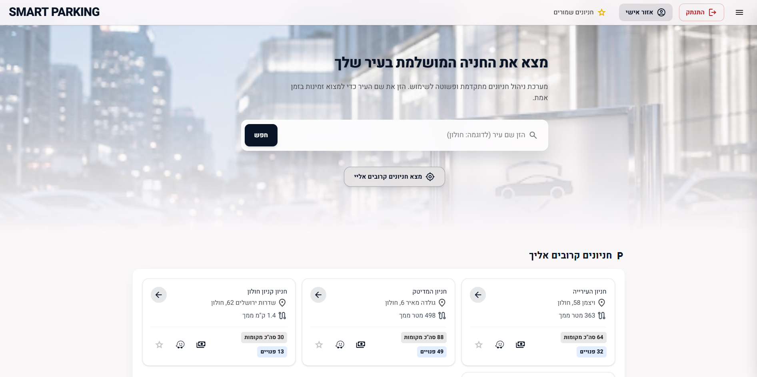
USER EXPERIENCE
Home & Discovery
A fast starting point
Search by city
Use current location
Open recommended lots
Access favorites and authorized login
Designed for mobile-first use
Show nearest lots
SMART PARKING / HIT
20
Notes:
Screenshot captured from the local production build of the current client.

Slide 21
LOCATION-AWARE SEARCH
Nearby Parking
Nearby parking turns browser location into a ranked list of relevant parking lots.
02
03
04
05
Latitude +
longitude
Nearby REST
query
Distance
calculation
Sorted parking
results
BROWSER GPS
USER BENEFIT • The driver sees relevant lots first, including distance and current availability.
SMART PARKING / HIT
21
Notes:
Browser Geolocation and Haversine distance are used to produce nearby results.

Slide 22
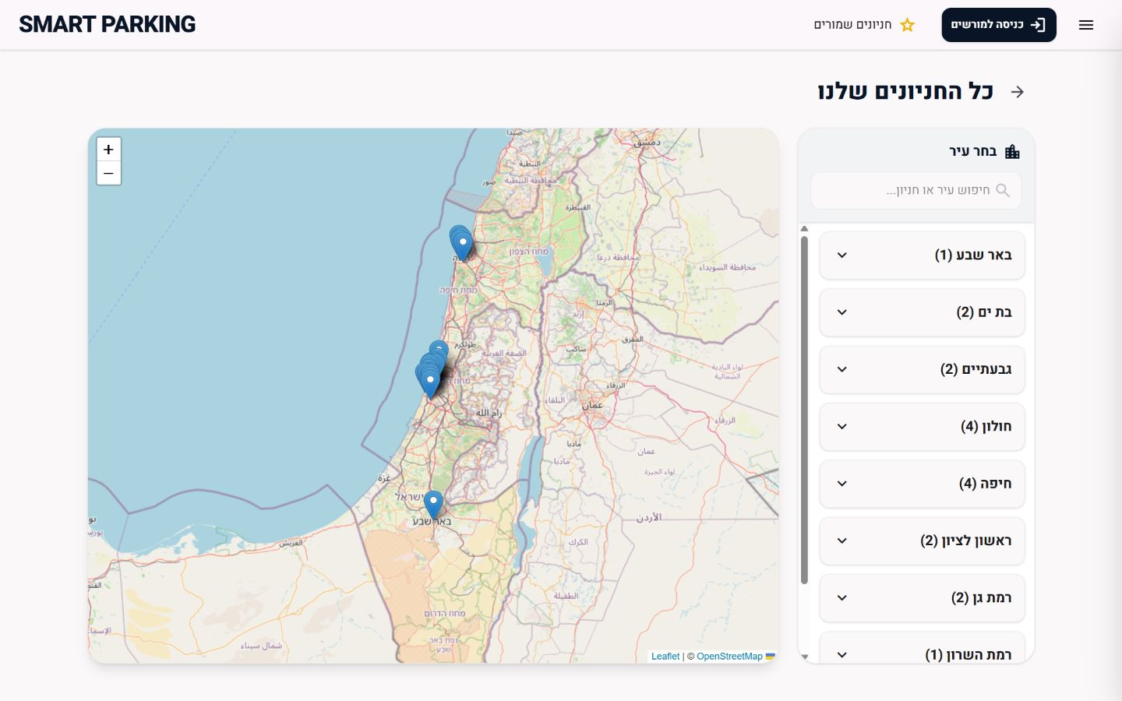
CITY-LEVEL VIEW
All Parking Lots & Interactive Map
Browse lots grouped by city
Search by city, lot or address
View every lot on a Leaflet map
Inspect availability before opening the lot
Continue to the parking map or Waze
OpenStreetMap + Leaflet
SMART PARKING / HIT
22
Notes:
Screenshot captured from the current all-lots page with live server data.

Slide 23
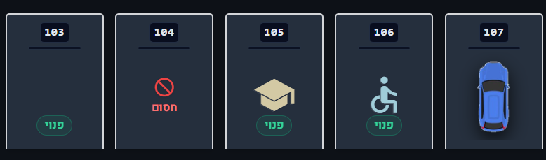
DECISION POINT
Parking Lot Detail
Before arrival
Lot name, city and address
Number of free spaces
Price and tariff conditions
Waze navigation button
Different types of parking spaces
Inside the lot
Switch between levels
Read each numbered space
Recognize free, occupied and blocked states
SMART PARKING / HIT
23
Notes:
The parking lot view combines live operational data with driver navigation.

Slide 24
REUSABLE DESIGN
Visual Parking Map System
Three inputs feed one shared renderer per-lot configuration then produces the visual parking experience.
BACKGROUND IMAGE
01
Mediatheque
90 spaces
Aerial image of the parking site
SHARED RENDERER
Haifa Port
59 spaces
02
LAYOUT CONFIG
ParkingMapLayout
Position, size and rotation for each space
One component, per-lot configuration.
03
Beersheba Center
78 spaces
LIVE SPOT DATA
04
Generic fallback
other lots
Number, type and current status
SMART PARKING / HIT
24
Notes:
The specialized maps use a shared ParkingMapLayout component with per-lot configuration.

Slide 25

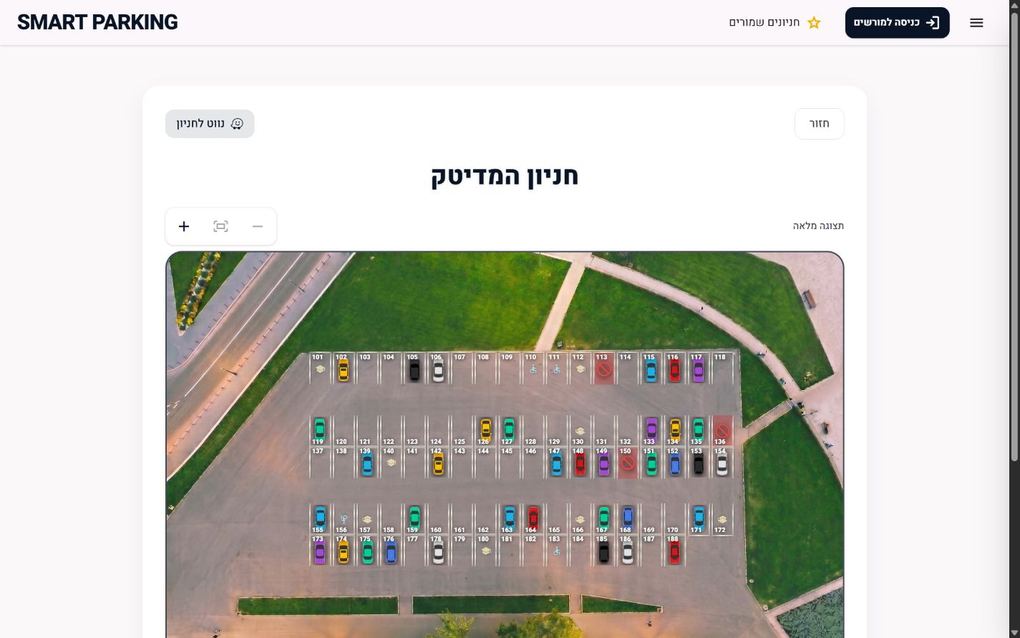
IMAGE-BASED PARKING LAYOUT
Mediatheque Parking
SOURCE IMAGE
Holon
LIVE APPLICATION
90 spaces
SMART PARKING / HIT
25
Notes:
User-provided aerial image plus screenshot of the current image-based Mediatheque layout.

Slide 26

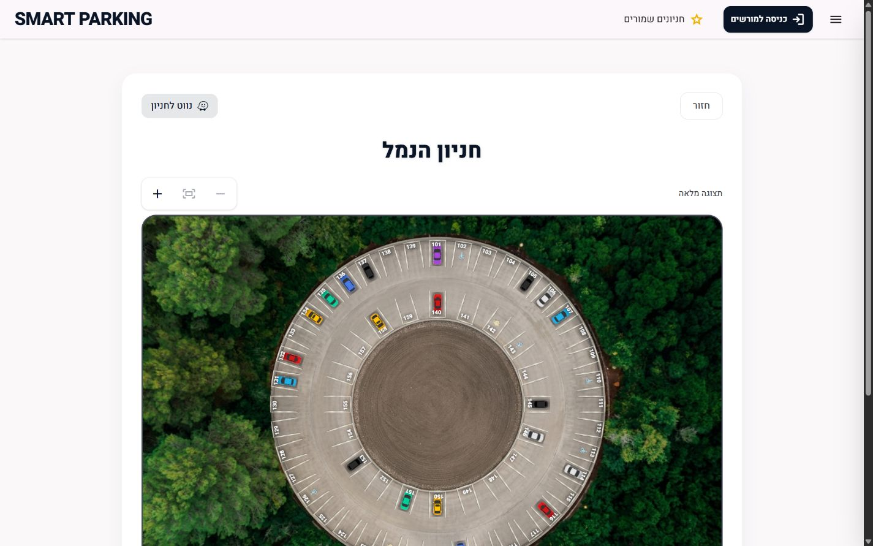
IMAGE-BASED PARKING LAYOUT
Haifa Port Parking
SOURCE IMAGE
Haifa
LIVE APPLICATION
59 spaces
SMART PARKING / HIT
26
Notes:
User-provided aerial image plus screenshot of the current circular Haifa Port layout. The entrance gap remains free of spaces.

Slide 27

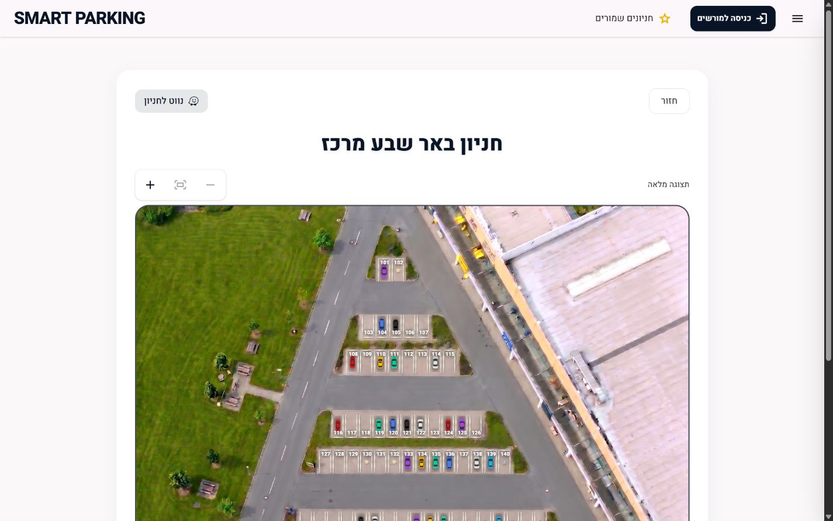
IMAGE-BASED PARKING LAYOUT
Beersheba Center Parking
SOURCE IMAGE
Beersheba
LIVE APPLICATION
78 spaces
SMART PARKING / HIT
27
Notes:
User-provided aerial image plus screenshot of the current triangular Beersheba Center layout.

Slide 28
SCALABLE FALLBACK
Generic Dynamic Layout
Custom images are optional — every new lot can be managed immediately through the generic layout.
GENERIC ENGINE
Dynamic Parking Layout
Interactive management
Parking lot data
Levels + spot numbers + spot types → dynamic grid
BENEFIT
Every lot is supported immediately.
ENHANCEMENT PATH
Add a photo + layout config later for a site-specific visual map.
SMART PARKING / HIT
28
Notes:
Lots without a custom image use DynamicParkingLayout.

Slide 29
REAL-TIME INPUT
LoRa Sensor Data Flow
Sensor events travel through validation and domain logic before the server persists and broadcasts the new state.
01
02
03
04
05
06
Sensor /
simulator
LoRa API
request
Validate &
map
Parking
service
MongoDB
persist
Socket.IO
broadcast
SERVER = SOURCE OF TRUTH • update database first, then notify connected clients
Sensor events can update free/occupied state, while entry and exit events connect physical activity to a parking session.
SMART PARKING / HIT
29
Notes:
LoRa API and simulator feed space and session updates into the Express server.

Slide 30
LIVE DISTRIBUTION
Socket.IO Real-Time Flow
Socket.IO distributes updates through two audience types: public city rooms and private authenticated user rooms.
PUBLIC
CITY ROOMS
PUBLIC CLIENTS
EXPRESS +
SOCKET.IO
availability by city
home, city map, lot pages
server emits domain
events
PRIVATE
MANAGER /
AUTH CLIENT
USER ROOMS
session updates per
authenticated user
dashboard and private flows
City rooms broadcast only non-sensitive lot and space availability updates.
User rooms carry authenticated payment and session details to the correct signed-in client.
SMART PARKING / HIT
30
Notes:
Socket.IO uses shared client context plus server-side city and user rooms.

Slide 31
STATE MANAGEMENT
Parking Session Lifecycle
ParkingSession moves through a repeatable lifecycle from entry to payment, exit and eventual closure or restart.
01
ENTRY
06
02
CLOSED /
RESTART
ACTIVE
PARKING
SESSION
05
03
15-MIN
EXIT
AMOUNT
DUE
04
KEY FIELDS
PAID
BILLING RULE
Plate • lot • timestamps •
payment state
After the exit window, debt can begin
accumulating again.
SMART PARKING / HIT
31
Notes:
ParkingSession connects plate, lot, entry time, payment state and checkout expiration.

Slide 32
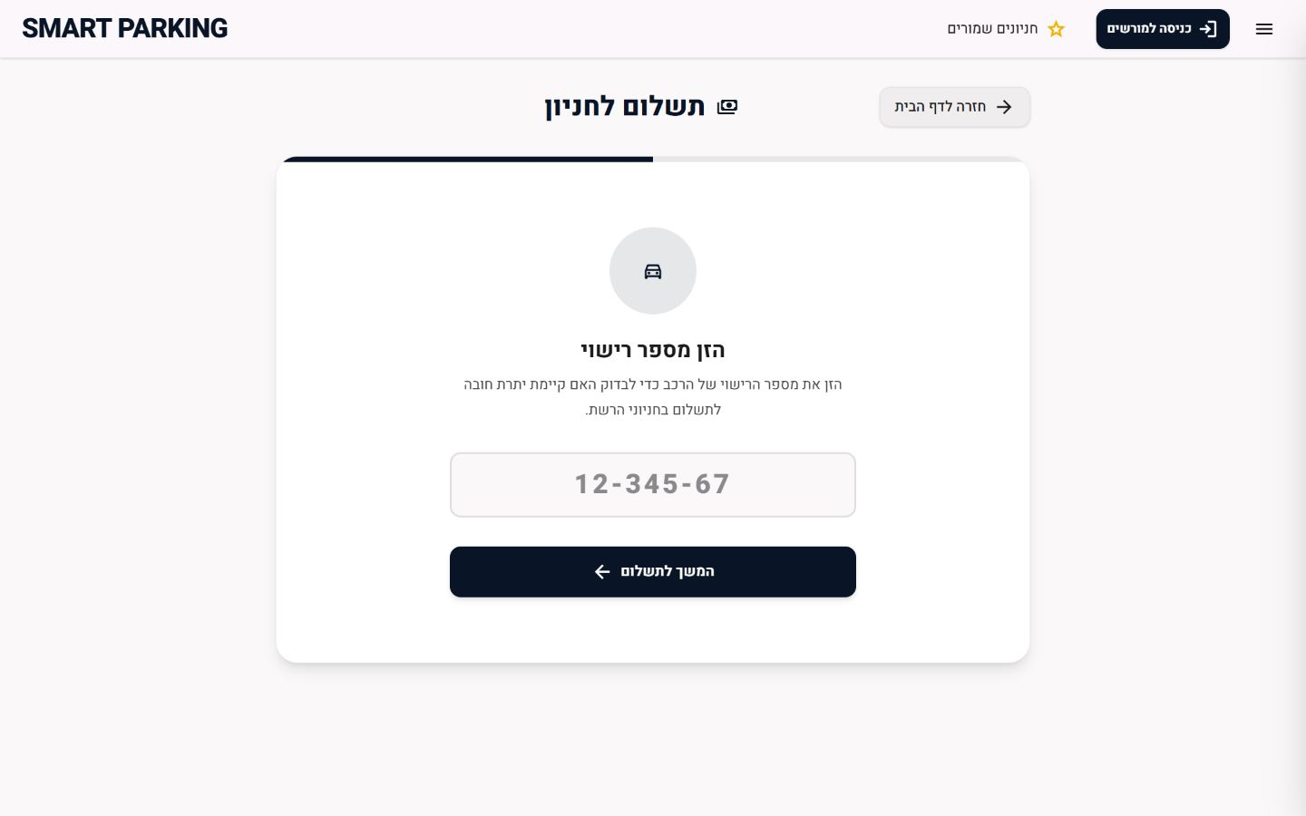
PAYMENT ENTRY
License Plate & Debt Lookup
One input starts the payment flow
Find the current parking session
Return lot, duration and server-calculated debt
Return the exit countdown when already paid
Return no charge for active exemptions or free-time rules
SMART PARKING / HIT
32
Notes:
Screenshot captured from the current payment page.

Slide 33
EXTERNAL PAYMENT
PayPal Checkout
Checkout is coordinated by the backend, with PayPal approval in the middle and reliability controls around the flow.
BACKEND
PAYPAL
BACKEND
01
02
03
04
05
06
Create local
checkout
Create PayPal
order
User
approval
Capture
payment
Persist
transaction
Process webhook
safely
RELIABILITY CONTROLS
MONEY HANDLING
Checkout identifiers • operation lock • PayPal request IDs • webhook event deduplication
Amounts are stored in minor currency units to avoid floating-point rounding errors.
SMART PARKING / HIT
33
Notes:
PayPal order creation and capture are coordinated by the backend payment services.

Slide 34
AFTER PAYMENT
Exit Grace Period & Receipt
Payment success starts a 15-minute exit window while the receipt and final exit flow continue in parallel.
01
Payment captured
If the same plate is searched during the window, the countdown is shown instead of a new debt.
15:00
02
Timer shown
TIME TO EXIT
03
Receipt requested
04
Email delivered via Apps Script
05
Vehicle exits
SMART PARKING / HIT
34
Notes:
The server supplies checkoutExpiresAt; the client renders a live countdown and can request an email receipt.

Slide 35
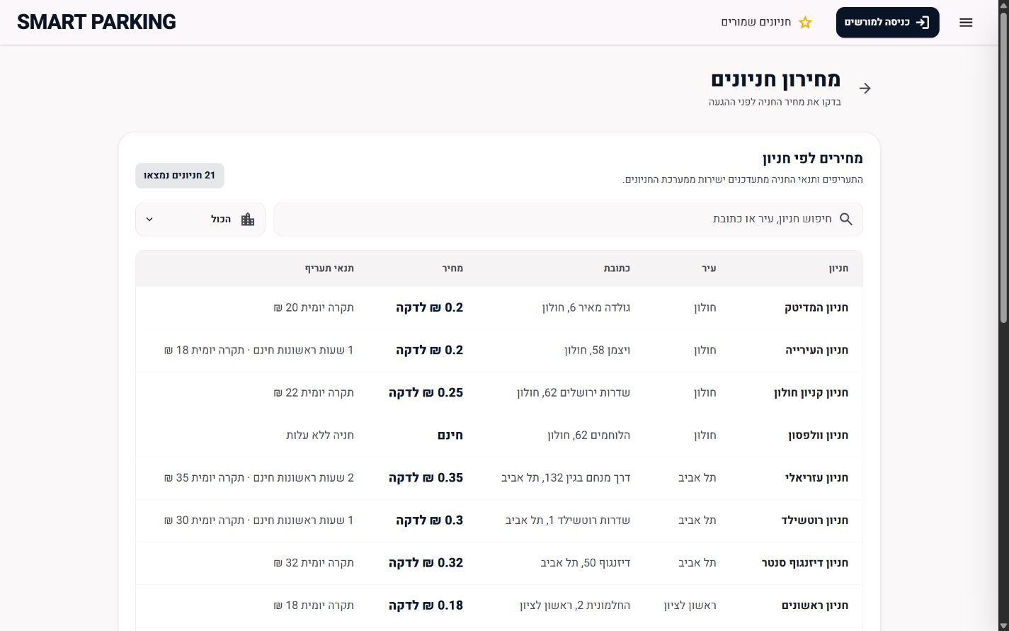
TRANSPARENT PRICING
Central Parking Price List
Live tariffs for every parking lot
City and free-text filters
Price per minute and daily cap
Free-time and special tariff conditions
One public source of truth for parking prices.
SMART PARKING / HIT
35
Notes:
Screenshot captured from the live price-list page. Data is loaded from the backend.

Slide 36
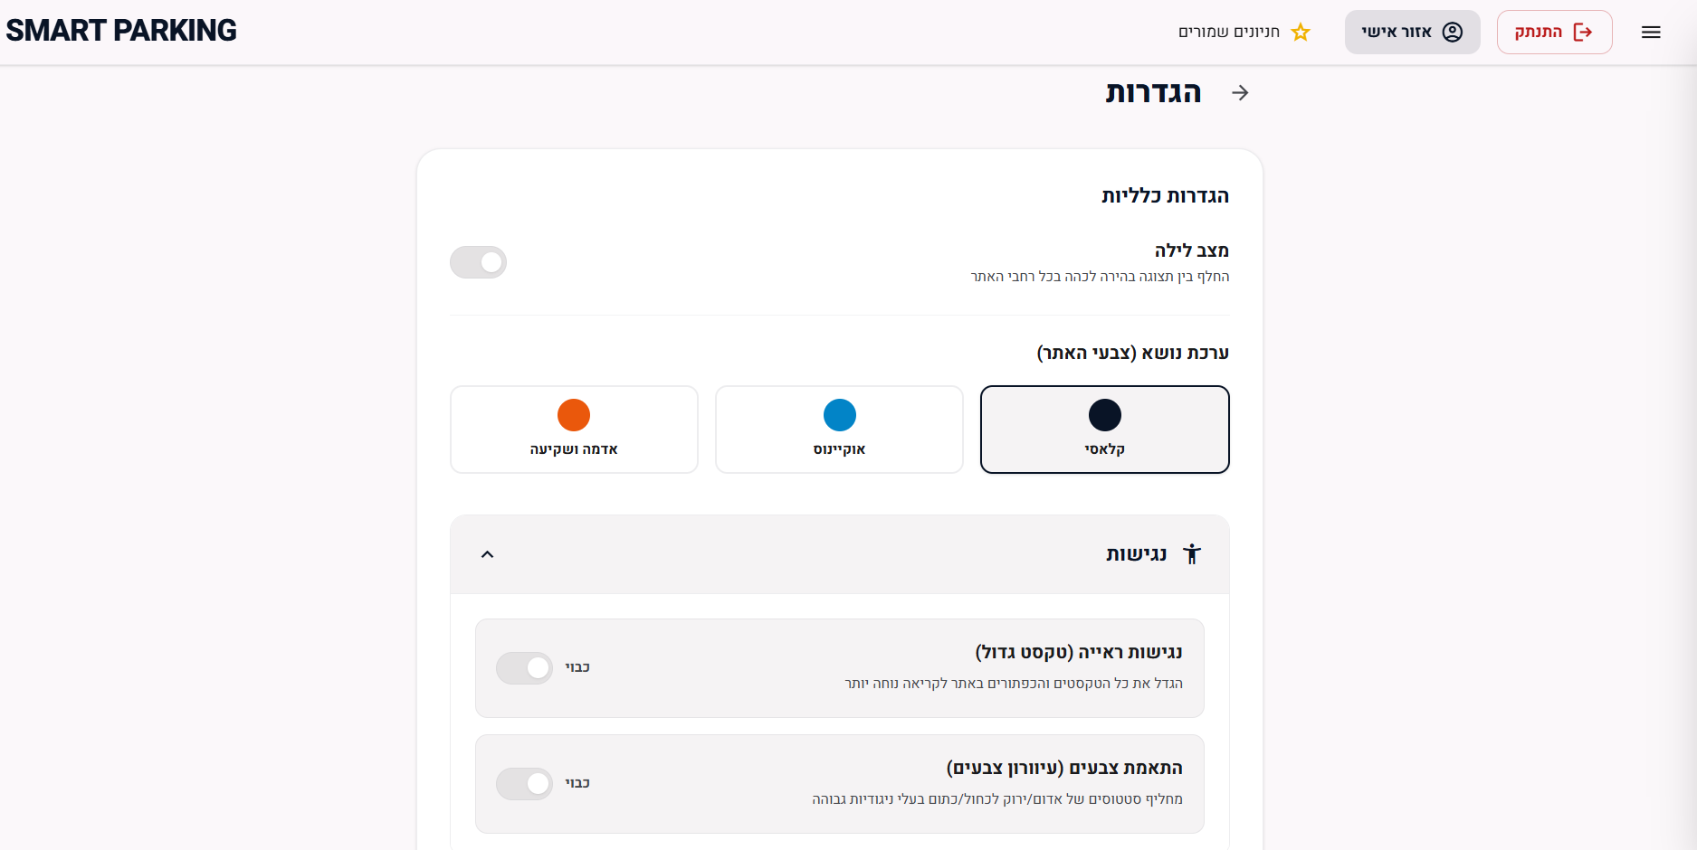
INCLUSIVE EXPERIENCE
Accessibility & Mobile-First Design
Designed for use on the move
Mobile-first responsive layout
Large-text mode
Color-blind-safe status palette
Dark mode and visual themes
Touch-friendly controls and modals
SMART PARKING / HIT
36
Notes:
Screenshot captured from the current settings page.

Slide 37
HIGH-LEVEL DESIGN
System Architecture
A high-level view of how the browser, application server, data layer and external integrations work together.
CLIENT
APPLICATION SERVER
DATA LAYER
React Web App
Node.js Backend
Mobile / desktop browser
React + Vite
Axios REST client
Socket.IO client
REST / WebSocket
Express REST API
Socket.IO server
Domain services
Repositories
Mongoose
MongoDB
Lots • spots
sessions • payments
APIs / events
EXTERNAL INTEGRATIONS
USER INTERFACE
SERVER = SOURCE OF TRUTH
Search • manage • pay
Authorization • sessions • billing
PayPal • Google Apps Script • OSM / Waze • LoRa
SMART PARKING / HIT
37
Notes:
Actual implementation: React SPA + modular Express server + MongoDB. The original GDD's microservice concept was simplified into a modular monolith.

Slide 38
REACT CLIENT
Frontend Architecture
Core stack
Application structure
React 19 + JavaScript / JSX
Vite 7
Tailwind CSS 4
React Router
Axios
Socket.IO Client
Leaflet + React Leaflet
PayPal React SDK
Pages — Home, All Lots, Payment, Price List, Settings, Dashboard
Components — parking views, editors, modals and map layouts
Contexts — authentication, sockets and display settings
Hooks — cities, lots and parking data
api.js — centralized Axios instance with credentials and CSRF
Client preferences and favorites use Local Storage; authentication uses cookies only.
SMART PARKING / HIT
38
Notes:
Current client stack and primary modules from package.json and source code.

Slide 39
CLIENT-SIDE MODEL
Client Application Model
The client handles navigation, interaction and live display, while domain rules stay on the server.
Router
URL / route
change
router selects the active page
Data Sources
Client State
Pages &
Components
REST API
Socket.IO
Local Storage
read / write
api.js
contexts
hooks
Rendered interface
(HTML / visual state)
Maps • forms
modals • dashboard
shared UI renders the selected view
Shared layout and
visual parking maps
Reusable UI
STATE
Favorites and display preferences may use Local Storage.
AUTH
Authentication stays in secure cookies; pricing, session and payment rules stay on the server.
SMART PARKING / HIT
39

Slide 40
NODE.JS SERVER
Backend Architecture
PLATFORM
DOMAIN SERVICES
PROTECTION
Node.js ES Modules
Express 5
Socket.IO
Mongoose
Authentication
Parking and sessions
LoRa processing
PayPal checkout
Receipts and email
JWT Tokens
bcrypt
CORS
API keys
Rate limiting
Routes → Services → Repositories → MongoDB
SMART PARKING / HIT
40
Notes:
Current server stack and services from package.json and source code.

Slide 41
SERVER-SIDE MODEL
Server Application Model
The backend receives requests, runs protected domain logic and persists the source of truth in MongoDB.
Routes
HTTP request
/ webhook
routes forward the request
MongoDB
read / write
Repositories
data access
Controllers / Services
HTTP response
/ Socket broadcast
Mongoose queries
Auth • parking
sessions • billing
integrations
Middleware
External Services
JWT • CSRF • CORS
API keys • rate limits
PayPal • LoRa • Google apps script
Engineering rule: routes stay thin; services own business rules; repositories isolate database access.
SMART PARKING / HIT
41

Slide 42
PERSISTENT STATE
MongoDB Data Model
MongoDB stores the source of truth for parking lots, spaces, active sessions and payment-related records.
Core parking data
Why MongoDB fits this project
Cities
ParkingLots — location, pricing, exemptions
ParkingSpots — level, number, type, status
Flexible documents match parking lots with evolving pricing and settings.
Separate collections keep sessions, payments and webhook logs traceable.
Mongoose schemas validate structure before records reach the database.
Operational state
How the database supports the app
MongoDB
ParkingSessions — plate, entry/exit, payment state, exit window
Users — credentials and authorizedCities
document DB
Real-time updates change spot or session state in one persistent source.
Payment flow reads the active session, calculates debt and stores the final transaction.
Authorization data limits each manager to the cities assigned to the account.
Support collections
ParkingPayments • PaypalwebhookEvents • RateLimitBuckets • Cameras
SMART PARKING / HIT
42
Notes:
Core Mongoose models in the current server.

Slide 43
DATABASE DETAILS
MongoDB Collections & Design Notes
A few key collections drive most of the product behavior.
ParkingLots
Stores address, city, tariff settings and exempt plates.
Relationship summary
ParkingLot → many ParkingSpots
ParkingLot + plate → active ParkingSession
ParkingSession → zero or one final ParkingPayment
ParkingSpots
Stores the spot number, level, type, status and layout-related info.
Operational protection
ParkingSessions
Tracks a vehicle from entry through billing, payment and the exit window.
WebhookEvent prevents duplicated webhook processing.
RateLimitBucket supports abuse control for sensitive endpoints.
ParkingPayments
Stores checkout/order identifiers, captured amount and provider metadata.
Design choices
The server computes pricing and session state; the client only displays the result.
Collections are separated so auditing and debugging stay simple.
SMART PARKING / HIT
43

Slide 44
PRODUCTION CONCERNS
Security, Privacy & Reliability
AUTHENTICATION
REQUEST INTEGRITY
JWT stored in a secure cookie; Axios sends credentials.
JWT token handling and strict CORS origin validation.
AUTHORIZATION
ABUSE CONTROL
Manager access is scoped by authorizedCities.
API keys and persistent rate-limiting buckets.
PAYMENT SAFETY
PRIVACY
Idempotent checkout design, locks and webhook deduplication.
Sensitive session data should remain outside public Socket rooms.
SMART PARKING / HIT
44
Notes:
Controls implemented in the current server and client architecture.

Slide 45
SPECIFICATION VS. IMPLEMENTATION
Requirements Coverage
Implemented
Partially implemented
Multi-lot parking discovery
Spot and level status
LoRa API + simulator
Socket.IO real-time updates
Plate-based sessions
Driver and manager interfaces
Responsive mobile experience
Payment, receipt, pricing and accessibility
Real LoRa hardware still needs field validation
Three sites have image-based maps; others use the generic layout
SMART PARKING / HIT
45
Notes:
Coverage is based on the original GDD and the current repository.

Slide 46
ENGINEERING LESSONS
Development Challenges & Solutions I
Real-time synchronization
Challenge: Multiple clients must see the same parking-space state without refreshing.
Solution: Use Socket.IO city/user rooms and broadcast only after the server updates the source of truth.
Secure authentication
Challenge: Manager access cannot rely on browser-stored tokens or broad global roles.
Solution: Move login to secure cookies, send credentials with Axios and enforce CORS
Reliable payment
Challenge: Retries and asynchronous webhooks can create duplicate payment operations.
Solution: Use checkout IDs, operation locks, PayPal request IDs and webhook deduplication.
SMART PARKING / HIT
46
Notes:
Challenges encountered during implementation and the selected technical responses.

Slide 47
ENGINEERING LESSONS
Development Challenges & Solutions II
Email in cloud deployment
Challenge: Hosted environments made direct email delivery and credentials harder to manage reliably.
Solution: Use a Google Apps Script HTTP webhook as a cloud-friendly bridge and keep provider settings configurable.
Different parking geometries
Challenge: Each parking lot can have a different image, orientation and spot arrangement.
Solution: Render all lots through one ParkingMapLayout component plus per-lot configuration and a generic fallback.
Large lot creation
Challenge: Creating dozens of parking spaces through separate browser requests was slow and fragile.
Solution: Add a bulk /with-spots endpoint so the lot and its initial spaces are created in one server-side flow.
SMART PARKING / HIT
47

Slide 48
NEXT STEPS
Conclusions & Further Development
What the project demonstrated
Priority areas for further development
01
Unified parking journey
Field validation
Connect real LoRa hardware, run longer pilots and validate sensor accuracy and failure handling.
01
Discovery, live availability, management and payment can operate through one platform.
Occupancy analytics
Add historical occupancy trends, peak-hour views and operator reporting dashboards.
Server-owned truth
02
02
Parking sessions, billing and authorization remain consistent while clients receive real-time updates.
Visual layout editor
Let managers upload a parking image and configure spot position, size and rotation without code changes.
03
03
Reusable architecture
Shared components, generic fallbacks and layered backend logic make additional parking lots easier to onboard.
Production hardening
Add monitoring, load testing, delivery/payment configuration checks and stronger recovery for external-service failures.
04
The current prototype provides a modular base for moving from a university project toward a real parking pilot.
SMART PARKING / HIT
48

Slide 49
CONCLUSION
SMART PARKING
A single platform connects parking discovery, live operations, management and payment.
Multi-city and spot-level visibility
Real-time LoRa and Socket.IO updates
Secure manager workflows
PayPal, receipt and exit timer
Accessible mobile-first experience
Reusable visual layout architecture
THANK YOU • QUESTIONS?
SMART PARKING / HIT
49
Notes:
Close with the three central outcomes: better driver decisions, real-time parking operations and a modular path for future expansion.

