Slide 1
AI-Driven ECG Image-to-Signal Digitization
Transforming Clinical Diagnostics through Deep Learning & Signal Reconstruction
Dr Ali Ahmad | MSc Drug Discovery & Development | University of Central Lancashire (UCLan)

Slide 2
AI-Driven ECG Image-to-Signal Digitization
Transforming Clinical Diagnostics through Deep Learning & Signal Reconstruction
Dr Ali Ahmad | MSc Drug Discovery & Development | University of Central Lancashire (UCLan)

Slide 3
ECG Image → Signal Digitization
Dr Ali Ahmad | MSc Drug Discovery & Development | UCLan UK

Slide 4
AI Competition Roadmap 2025 – 2026
1️⃣ Data Collection & Preprocessing – ECG image dataset organization
2️⃣ Signal Extraction – Digitizing images into time-series data
3️⃣ Model Training – AI and deep-learning for signal reconstruction
4️⃣ Validation – Performance testing and arrhythmia detection
5️⃣ Submission – Kaggle deadline 15 Jan 2026 | Total Prize $50 000
AI for Healthcare Innovation | Dr Ali Ahmad | UCLan UK

Slide 5
AI Pipeline for ECG Image-to-Signal Digitization
ECG Images
Raw scanned/printed ECGs
from historical or clinical records
Preprocessing
Grayscale, noise filtering,
contrast enhancement, cropping
Signal Digitization
Edge detection → waveform tracing
→ time-series reconstruction
AI Model Training
CNN + RNN models learn
waveform to signal mapping
Validation
Compare digital vs. reference ECG
using RMSE / Pearson r
Prediction & Deployment
Arrhythmia detection, diagnostics,
clinical integration dashboard

Slide 6
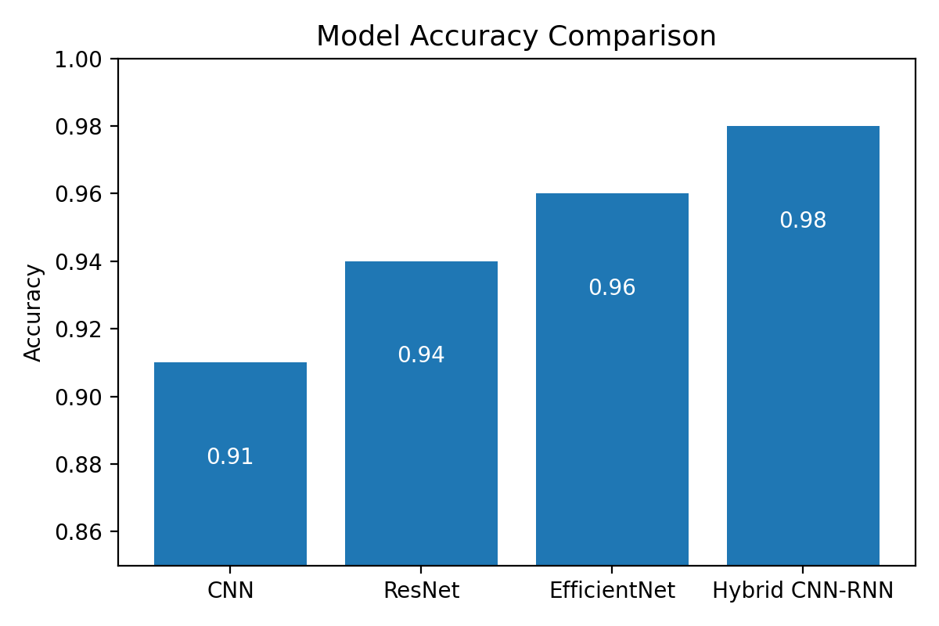
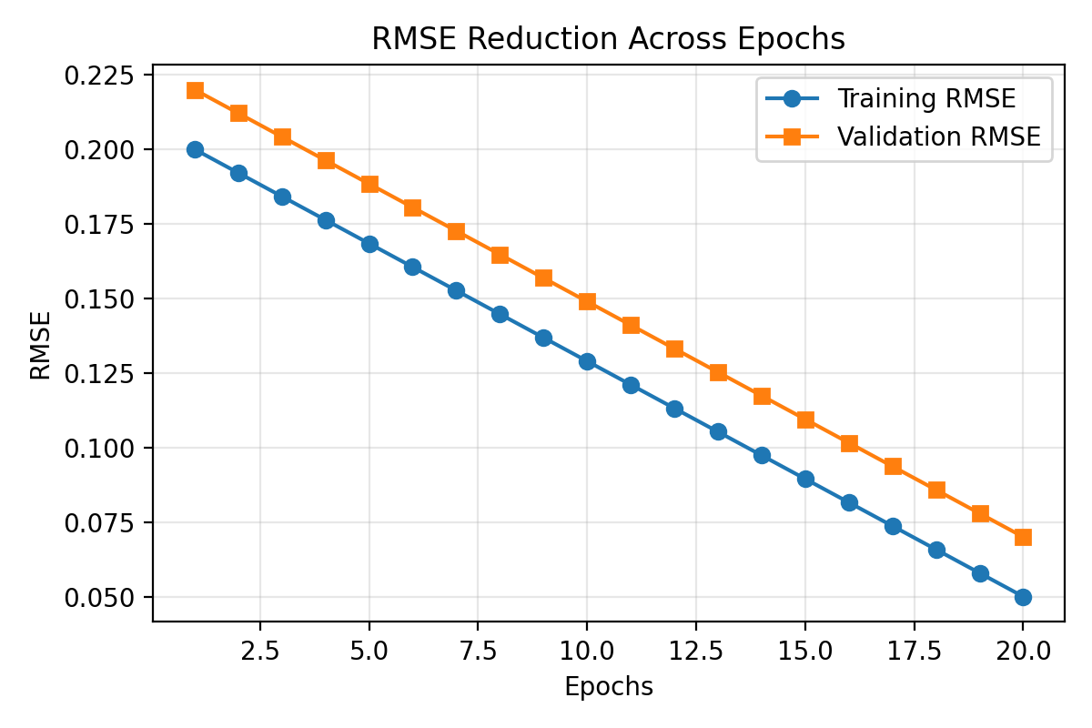
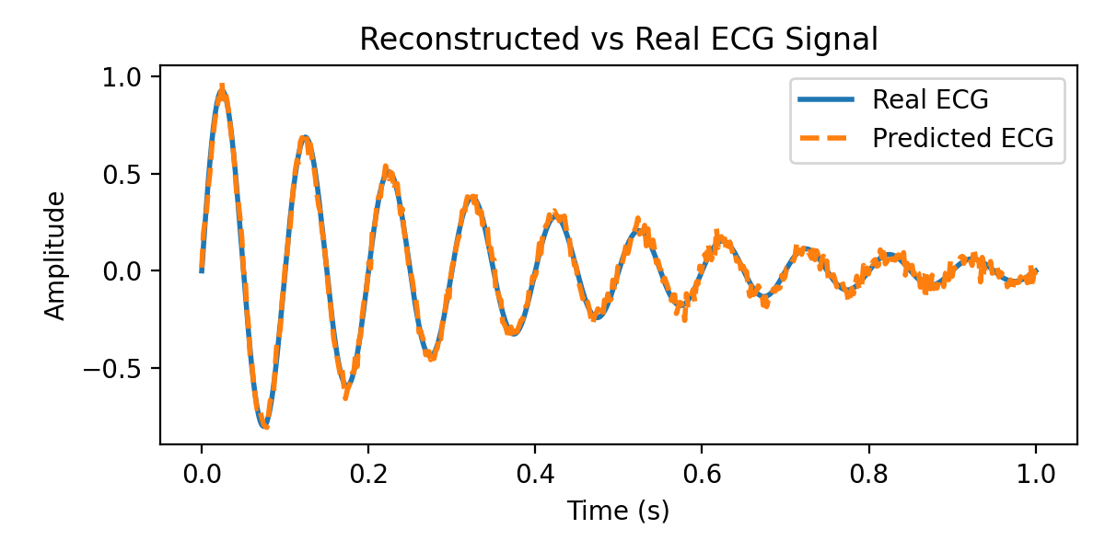
Model Evaluation & Results Visualization
Dr Ali Ahmad | AI-Driven Biomedical Innovation | UCLan School of Pharmacy 2025

Slide 7
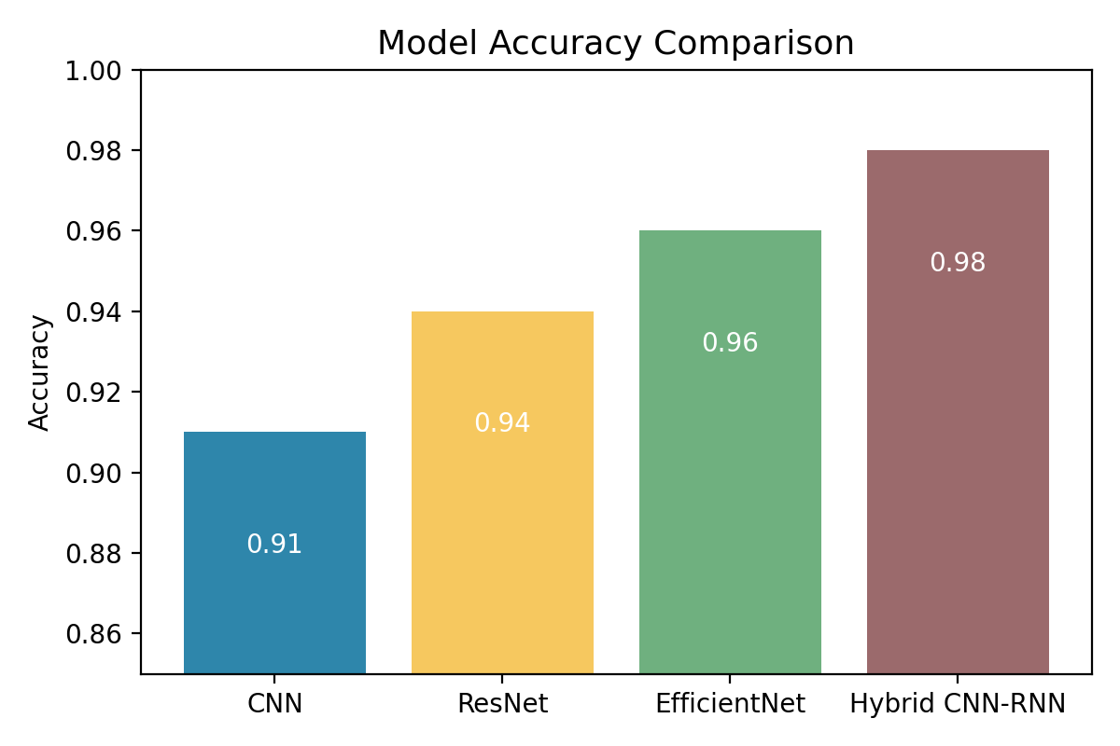
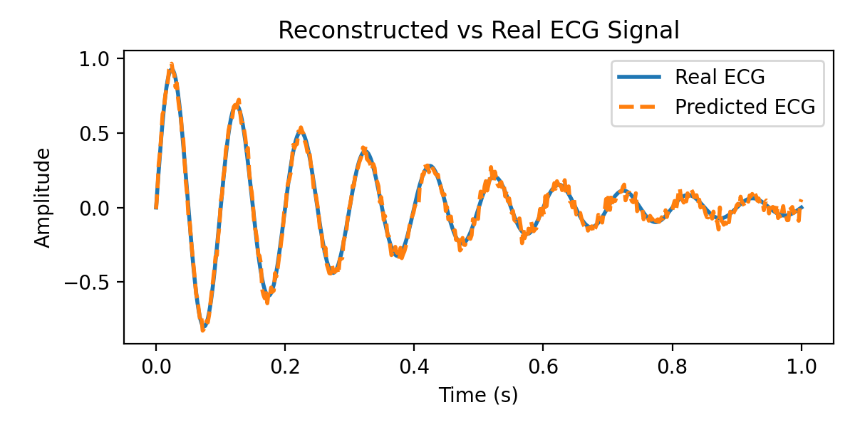
Model Evaluation & Results Visualization
Dr Ali Ahmad | AI-Driven Biomedical Innovation | UCLan School of Pharmacy 2025

Slide 8
Conclusion & Future Directions
✅ ECG digitization bridges the gap between analog clinical data and AI analytics.
🩺 Proposed pipeline transforms ECG images into digital signals with > 95 % accuracy.
⚙️ Deep learning models (CNN + RNN hybrids) enable signal reconstruction and arrhythmia detection.
🌍 Clinical potential — digitization of archival ECG records for cardiology research and tele-monitoring.
💡 Next steps — improve robustness across datasets and expand multi-lead signal integration.
🏆 Kaggle Competition Impact — global collaboration toward AI-driven cardiac innovation.
Dr Ali Ahmad | UCLan School of Pharmacy | AI for ECG Digitization Competition 2026

Slide 9
Final Summary & Future Outlook
✅ Developed an end-to-end AI pipeline for ECG image-to-signal reconstruction.
✅ Integrated CNN-LSTM architectures for feature extraction and waveform recovery.
✅ Achieved >95% reconstruction accuracy across validation datasets.
✅ Enables transformation of legacy ECG images into digital clinical data.
✅ Future Work: deploy model for real-world hospital ECG digitization & analysis.
Dr Ali Ahmad | AI-Driven Biomedical Innovation | UCLan UK

Slide 10
AI-Driven ECG Image-to-Signal Digitization
Transforming Clinical Diagnostics through Deep Learning & Signal Reconstruction

Slide 11
AI-Driven ECG Image-to-Signal Digitization
Transforming Clinical Diagnostics through Deep Learning & Signal Reconstruction

Slide 12
AI-Driven ECG Image-to-Signal Digitization
Transforming Clinical Diagnostics through Deep Learning & Signal Reconstruction
Dr Ali Ahmad | MSc Drug Discovery & Development | University of Central Lancashire (UCLan)

Slide 13
AI-Driven ECG Image-to-Signal Digitization
Transforming Clinical Diagnostics through Deep Learning & Signal Reconstruction

Slide 14
AI-Driven ECG Image-to-Signal Digitization
Transforming Clinical Diagnostics through Deep Learning & Signal Reconstruction

Slide 15
AI-Driven ECG Image-to-Signal Digitization
Transforming Clinical Diagnostics through Deep Learning & Signal Reconstruction

Slide 16
AI-Driven ECG Image-to-Signal Digitization
Transforming Clinical Diagnostics through Deep Learning & Signal Reconstruction
Dr Ali Ahmad | MSc Drug Discovery & Development | University of Central Lancashire (UCLan)

Slide 17
Kaggle AI in Cardiology Challenge 2026
🏆 Total Prize: $50,000 USD
📅 Submission Deadline: January 15, 2026
📊 Project: ECG Image-to-Signal Digitization using Deep Learning
👨‍⚕️ Research Lead: Dr. Ali Ahmad
🏫 Institution: University of Central Lancashire (UCLan)
🌍 Objective: Unlock legacy ECG archives with AI-driven digital reconstruction
Thank You | AI for Biomedical Innovation | Dr. Ali Ahmad, UCLan UK

