Slide 1
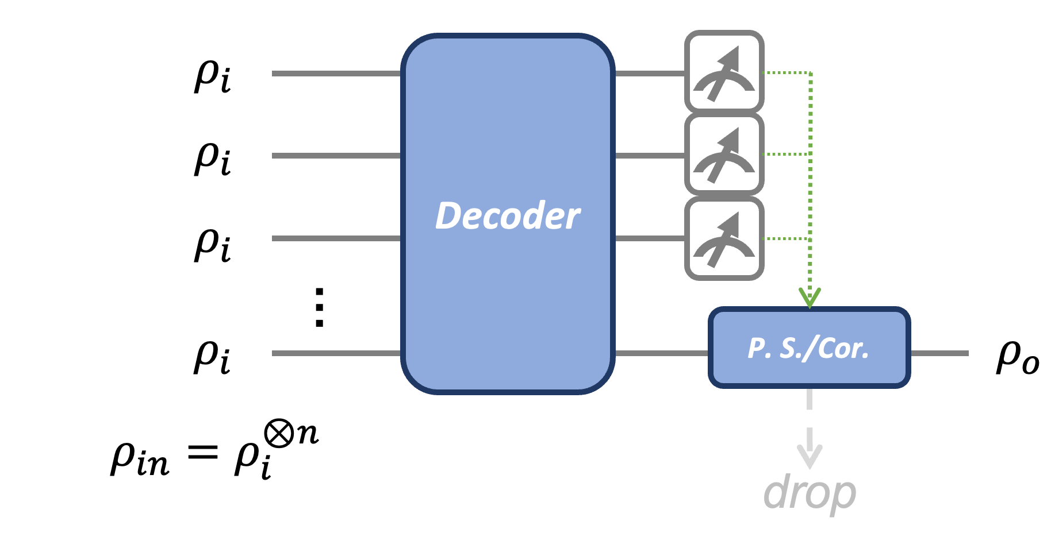
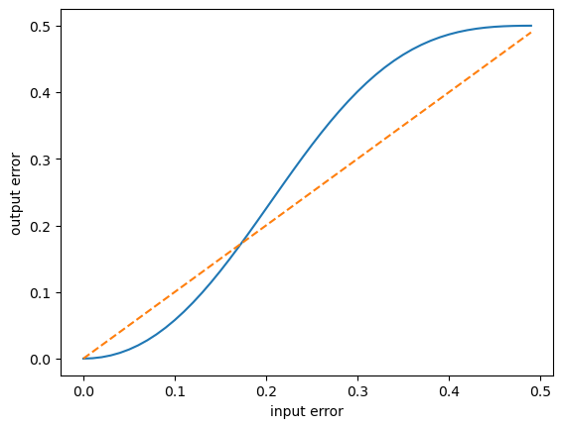
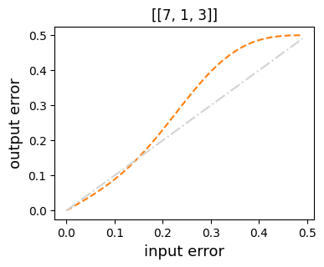
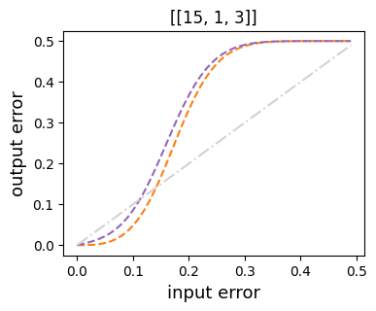
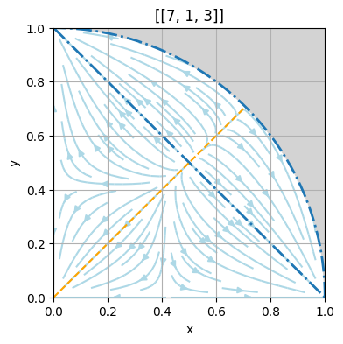
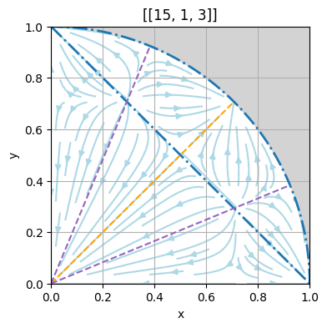
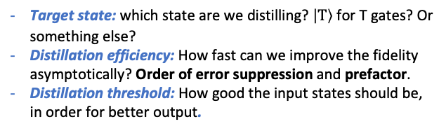
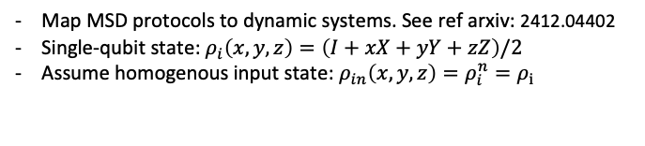
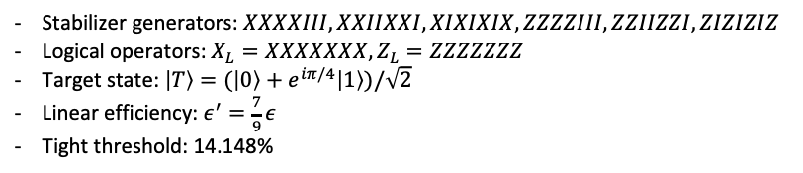
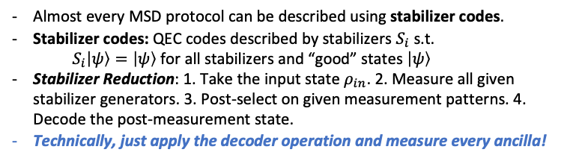
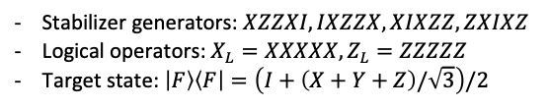
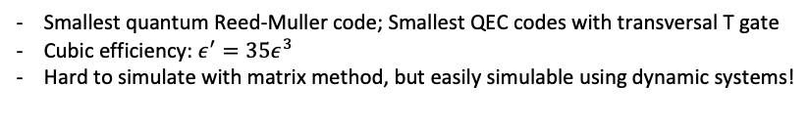
Cheat Sheet for Magic State Distillation (MSD)
APHY 526 Project
Yunzhe Zheng
Why MSD?
- Quantum Computing (QC) need Quantum Error Correction (QEC) for noise robustness.
- Clifford gates are fault-tolerant in common QEC codes.
- Non-Clifford resource is necessary for quantum advantage.
- MSD is needed to prepare high-fidelity non-Clifford resource.
How to describe MSD? – Stabilizer Reduction
Almost every MSD protocol can be described using stabilizer codes.
Stabilizer codes: QEC codes described by stabilizers $S_{i}$ s.t.
$S_{i}\left|ψ\right\rangle =\left|ψ\right\rangle$ for all stabilizers and “good” states $\left|ψ\right\rangle$
Stabilizer Reduction: 1. Take the input state $ρ_{in}$. 2. Measure all given stabilizer generators. 3. Post-select on given measurement patterns. 4. Decode the post-measurement state.
Technically, just apply the decoder operation and measure every ancilla!
Figure from Pennylane
Benchmark MSD
Target state: which state are we distilling? $\left|T\right\rangle$ for T gates? Or something else?
Distillation efficiency: How fast can we improve the fidelity asymptotically? Order of error suppression and prefactor.
Distillation threshold: How good the input states should be, in order for better output.
[[5, 1, 3]] protocol
Stabilizer generators: $XZZXI, IXZZX, XIXZZ, ZXIXZ$
Logical operators: $X_{L}=XXXXX, Z_{L}=ZZZZZ$
Target state: $\left|F\right\rangle \left\langle F\right|=\left(I+\left(X+Y+Z\right)/\sqrt{3}\right)/2$
[[7, 1, 3]] protocol
Stabilizer generators: $XXXXIII, XXIIXXI, XIXIXIX, ZZZZIII, ZZIIZZI, ZIZIZIZ$
Logical operators: $X_{L}=XXXXXXX, Z_{L}=ZZZZZZZ$
Target state: $\left|T\right\rangle =(\left|0\right\rangle +e^{iπ/4}\left|1\right\rangle )/\sqrt{2}$
Linear efficiency: $ε^{′}=\frac{7}{9}ε$
Tight threshold: 14.148%
[[15, 1, 3]] protocol
Smallest quantum Reed-Muller code; Smallest QEC codes with transversal T gate
Cubic efficiency: $ε^{′}=35ε^{3}$
Hard to simulate with matrix method, but easily simulable using dynamic systems!
Visualization with flow diagram
Map MSD protocols to dynamic systems. See ref arxiv: 2412.04402
Single-qubit state: $ρ_{i}\left(x,y,z\right)=\left(I+xX+yY+zZ\right)/2$
Assume homogenous input state: $ρ_{in}\left(x,y,z\right)=ρ_{i}^{n}=ρ_{i}$

