Slide 1
Implement ScipyMilpOptimizer to qiskit-optimization
Yunzhe Zheng
Mentor: Takashi Imamichi
12/8/22

Slide 2

Motivation
Mixed Integer Linear Programming(MILP) Solver is widely used for optimization problems.
Scipy added the milp in its optimize module in the v1.9.0 version and we would like to have it in qiskit-optimization:
Currently classical optimizers in qiskit-optimization (Gurobi, Cplex) only provides limited access for free-use. (maximally 2k var./const.)
The problem sizes will be strictly limited if you don’t pay a big money!

Slide 3
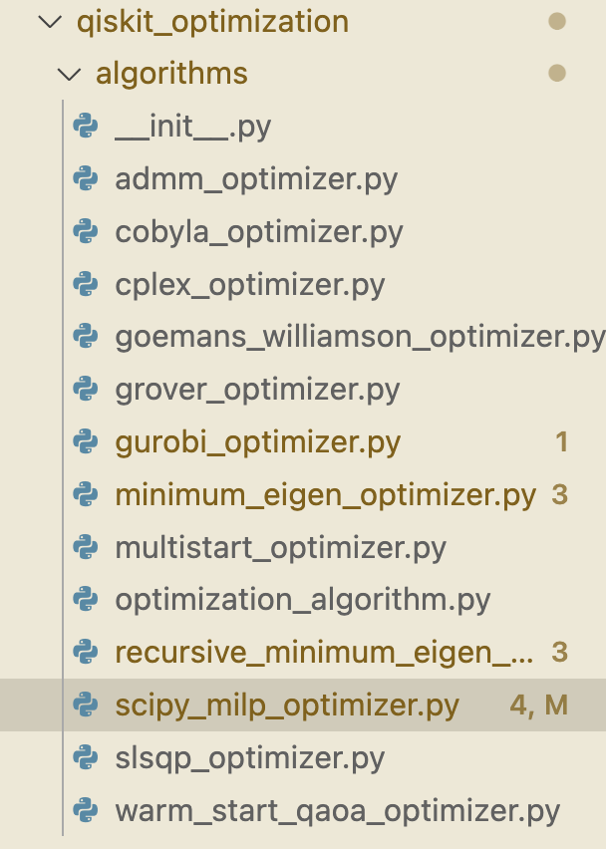
Technical Idea
To develop an interface between qiskit-optimization and scipy:
The QuadraticProblem is translated into matrix form of input.
The input is sent to scipy.optimize.milp solver
The result is wrapped in the QiskitOptimizationResult.
Input: QuadraticProblem(qiskit-optimization)
Translation of QuadraticProblem into matrix format
Solve the problem with scipy.optimize.milp
Wrap the raw result into QiskitOptimizationResult (Output).

Slide 4
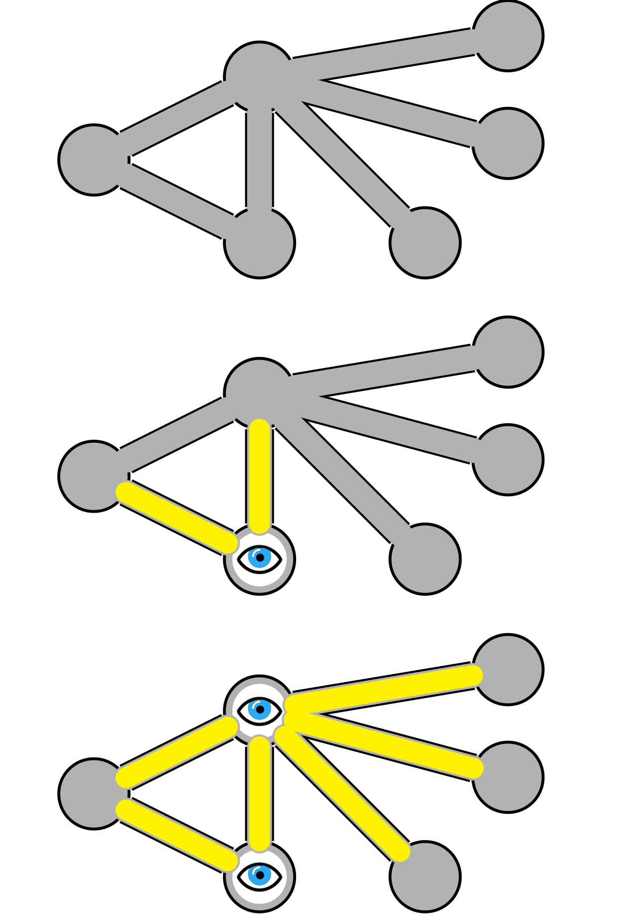
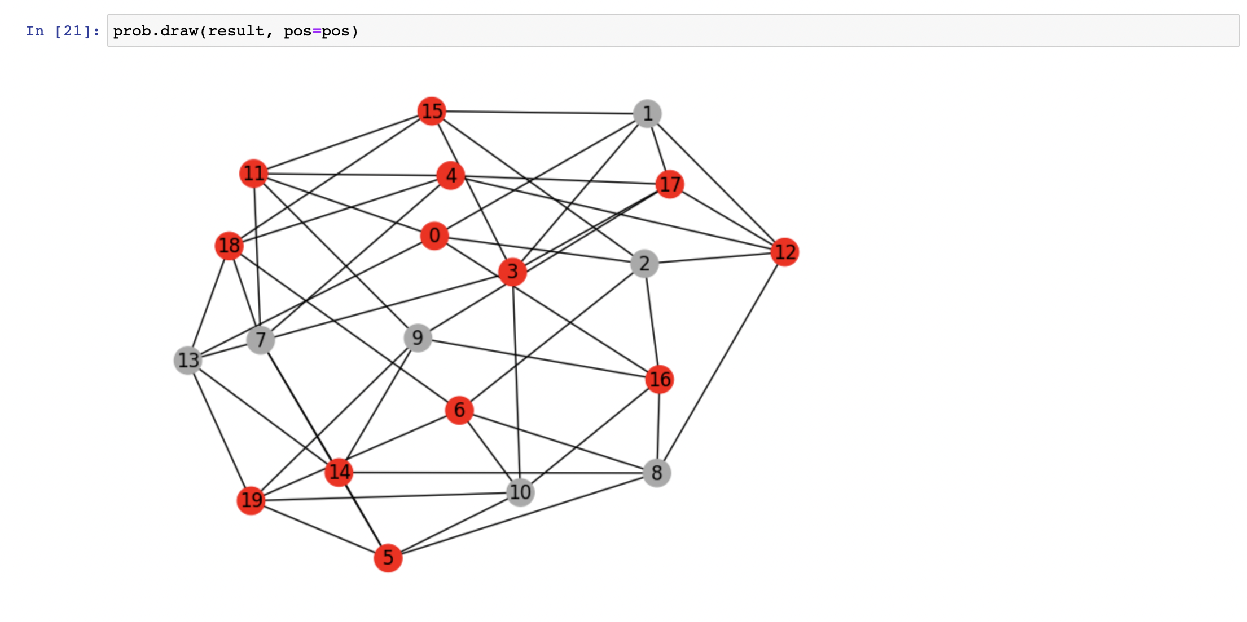
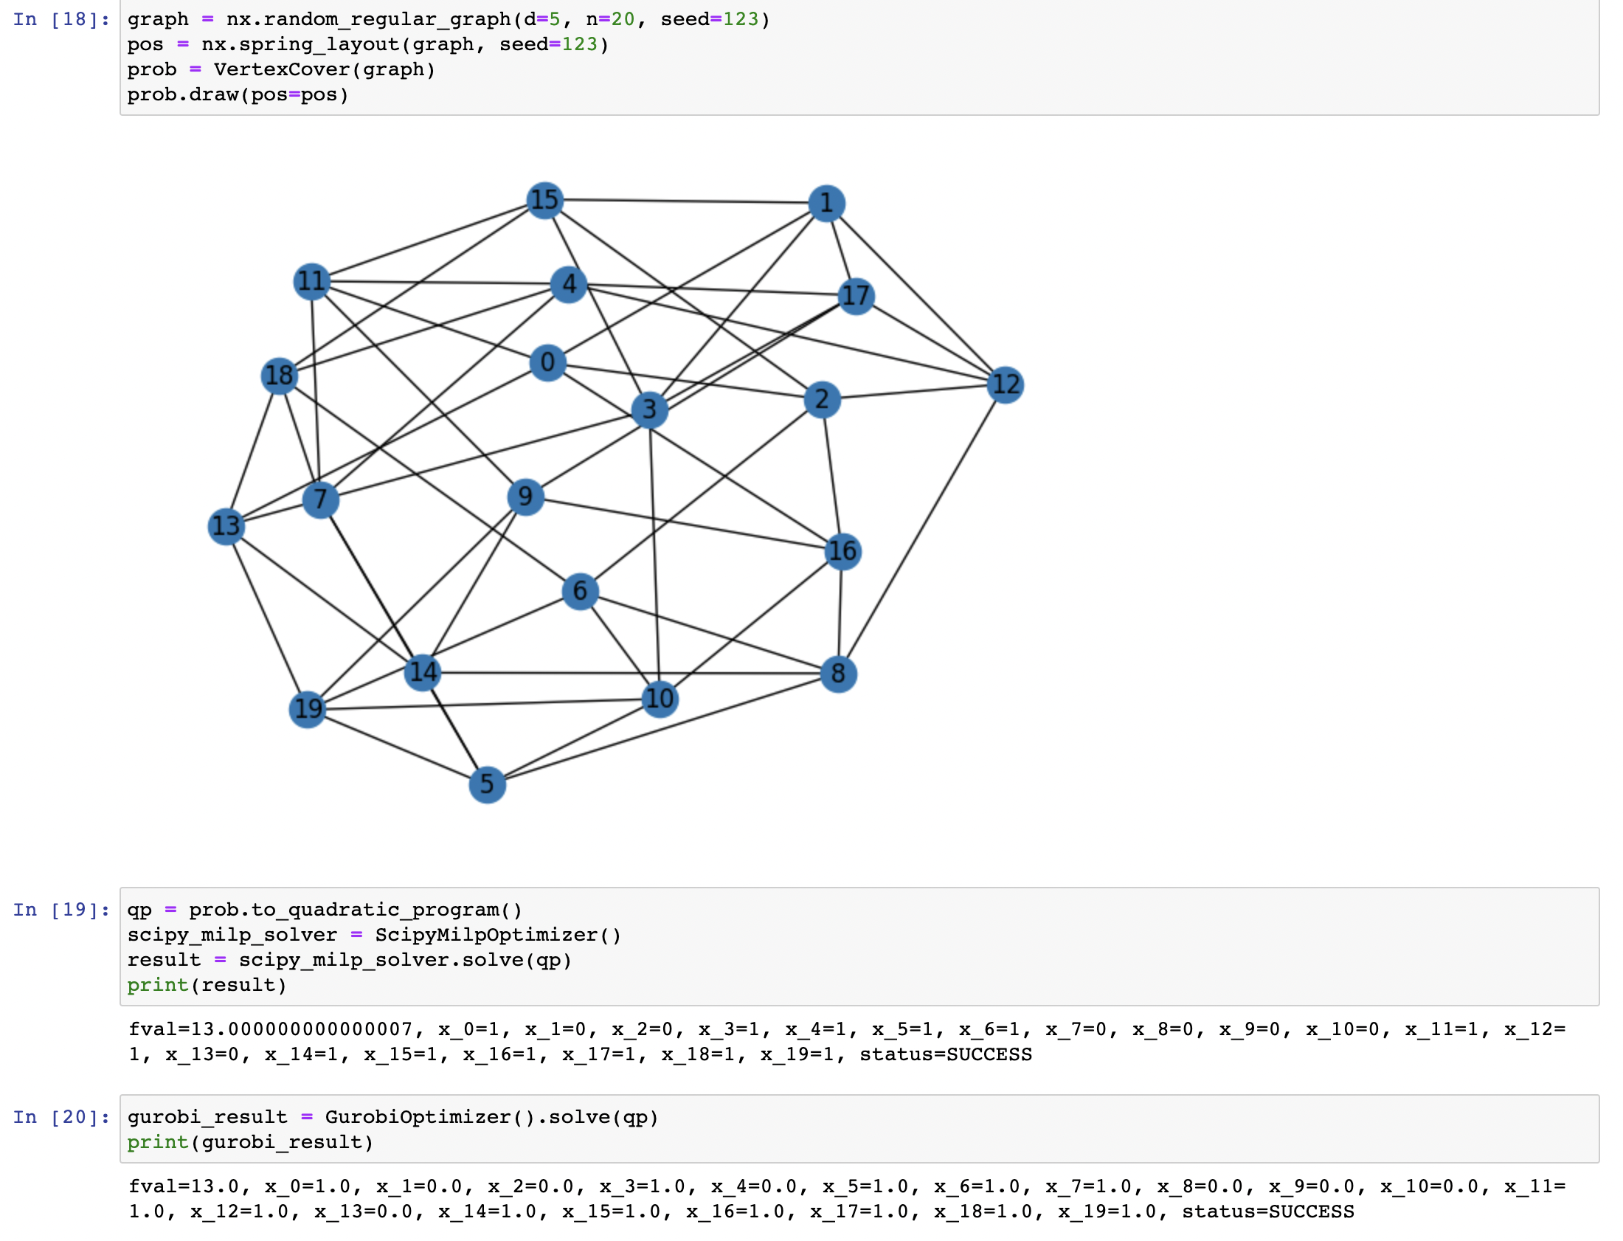
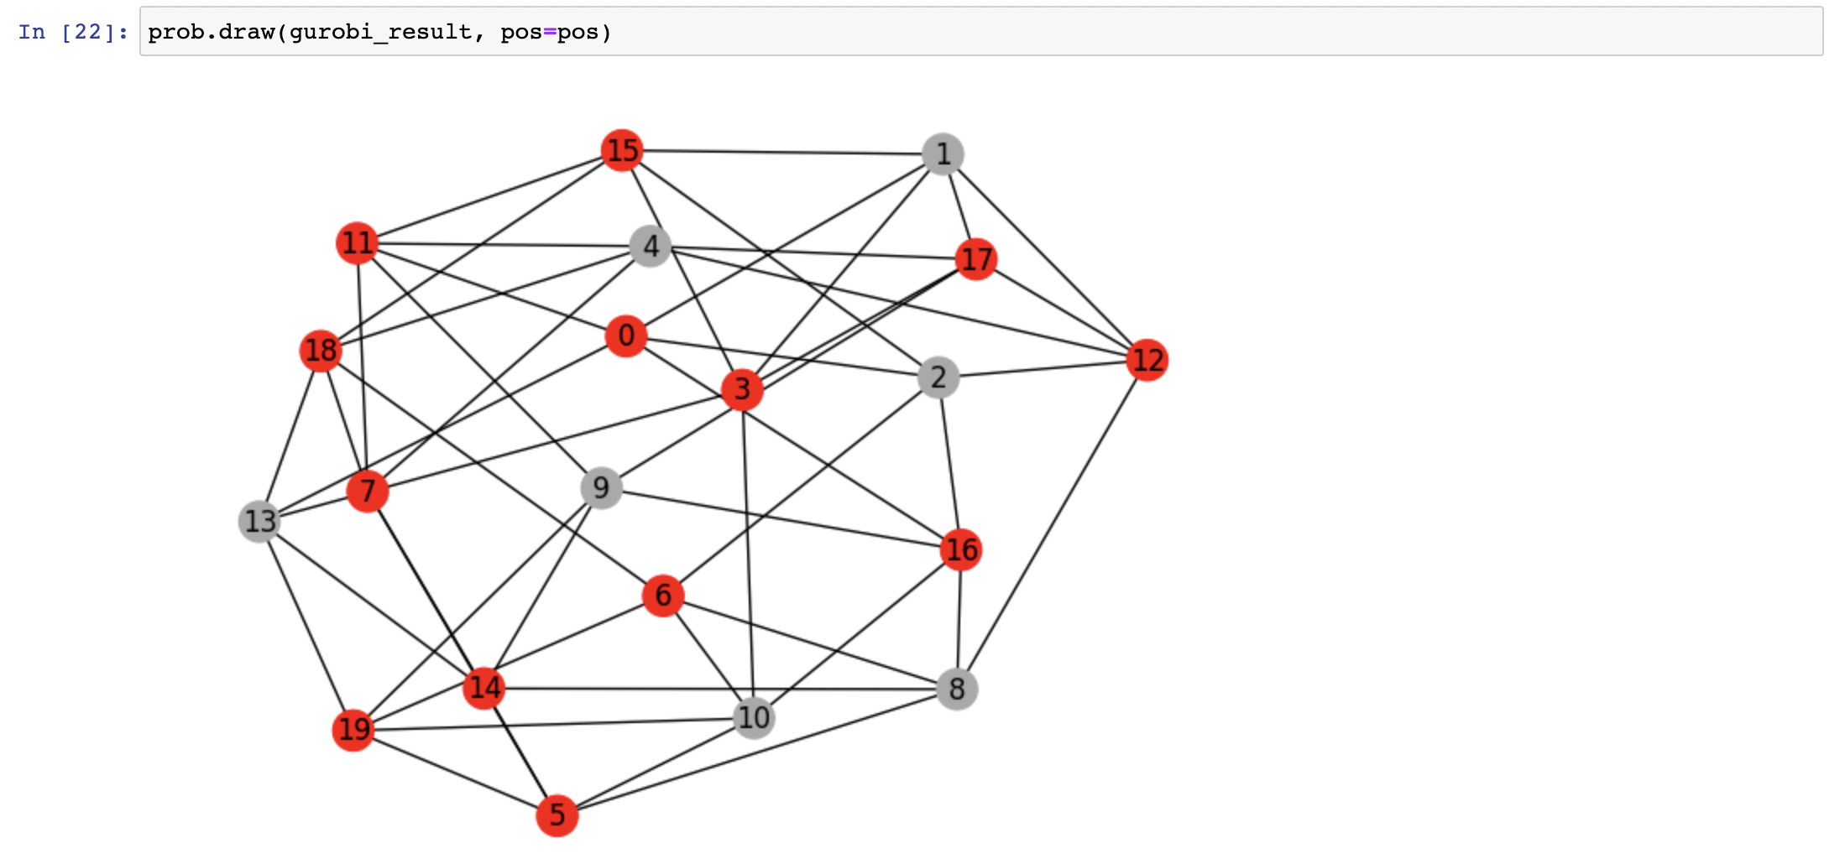
Demonstration – Vertex Cover Problem
In an undirected graph, each node can be “turned on” to cover its connected edges.
Problem: minimize the number of turned-on nodes while keep all edges covered.

Slide 5
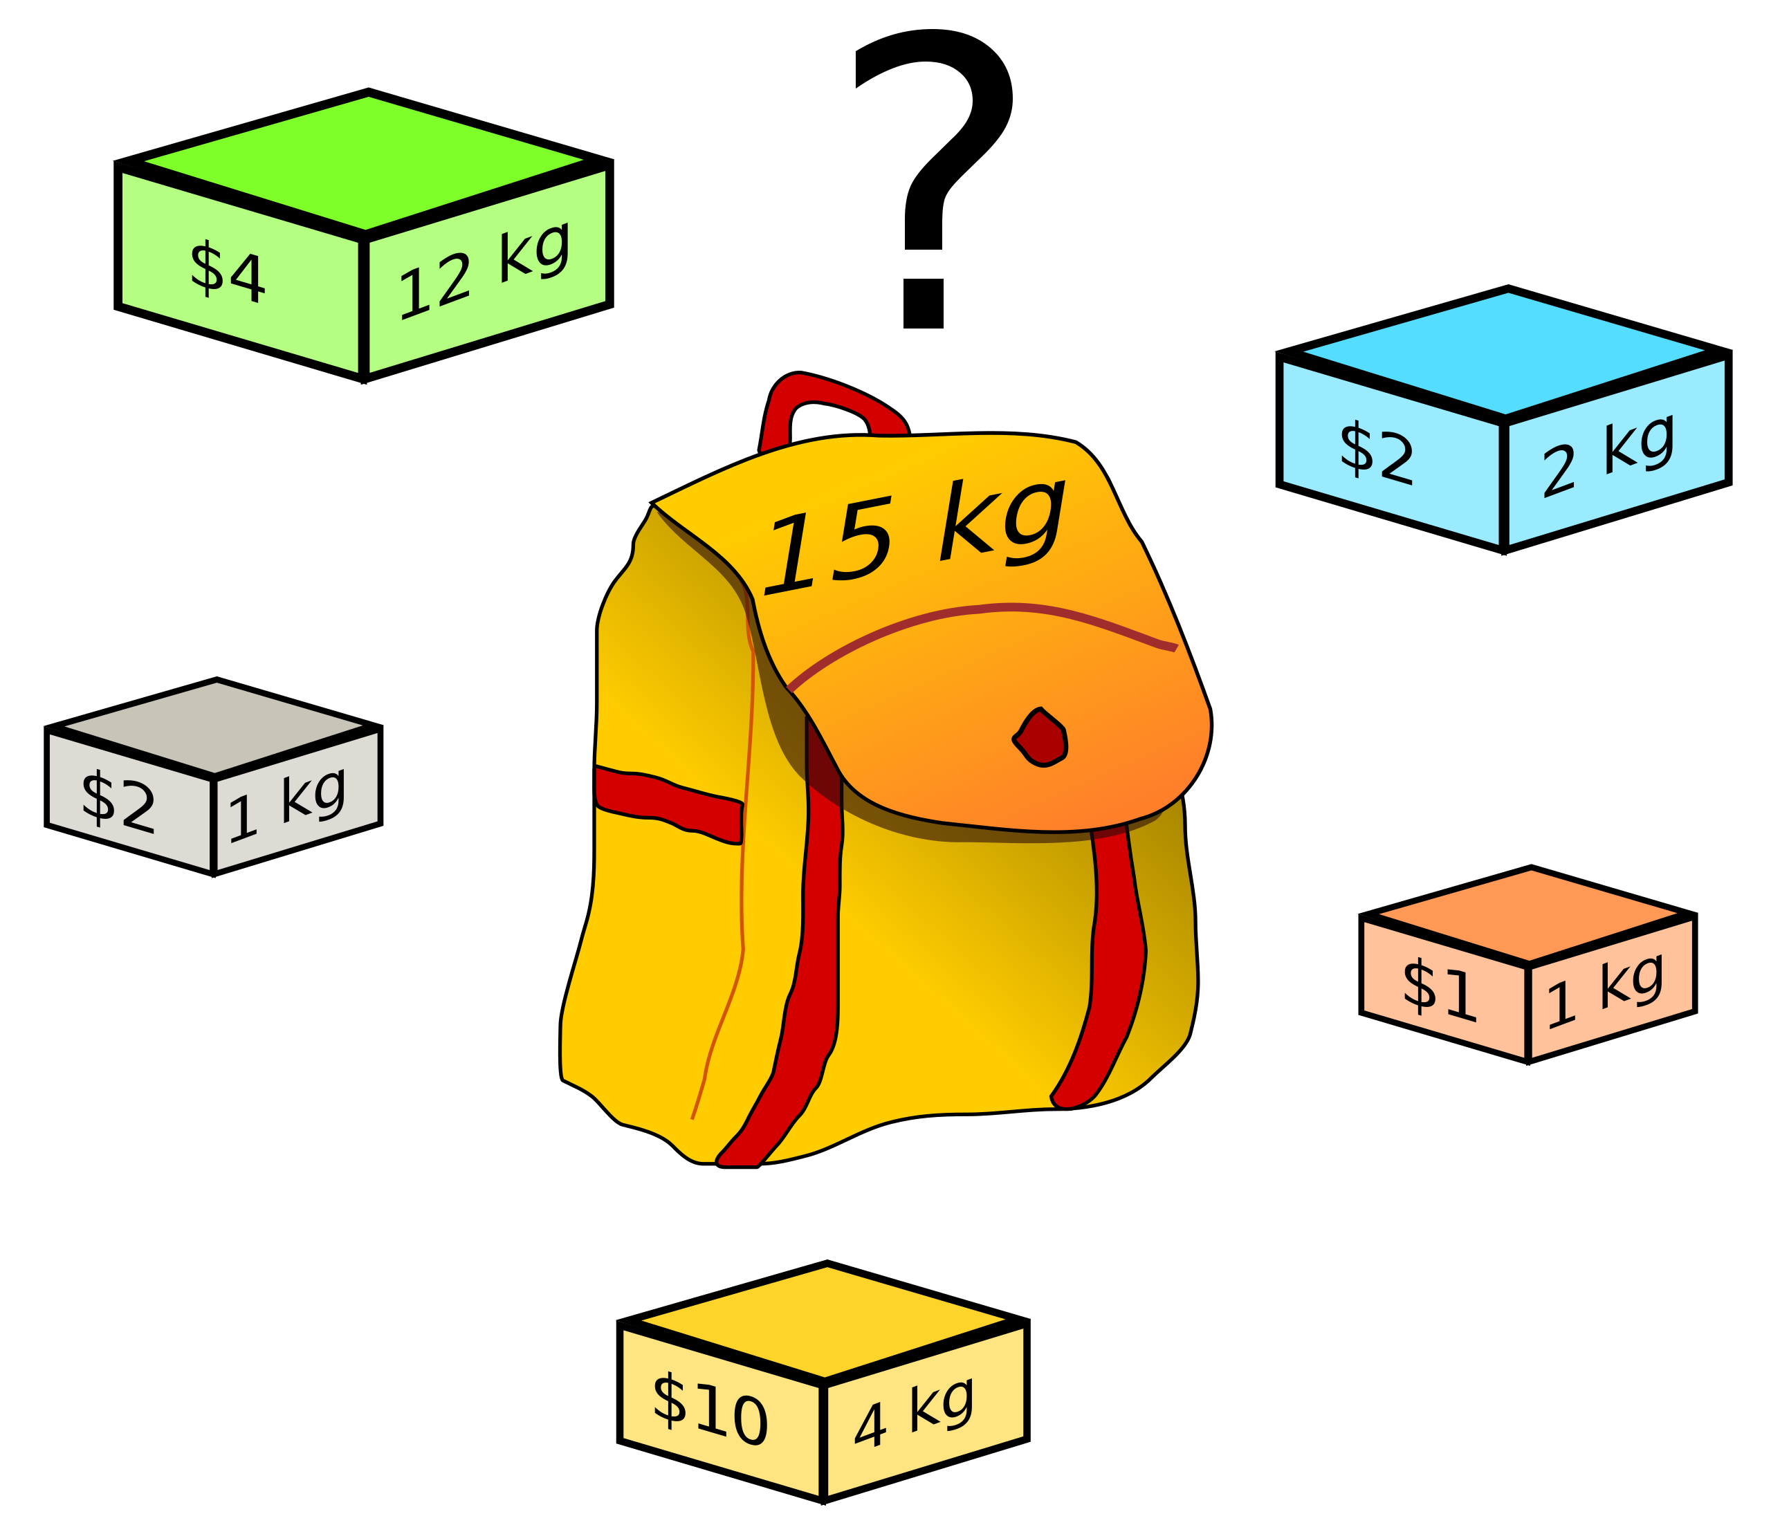
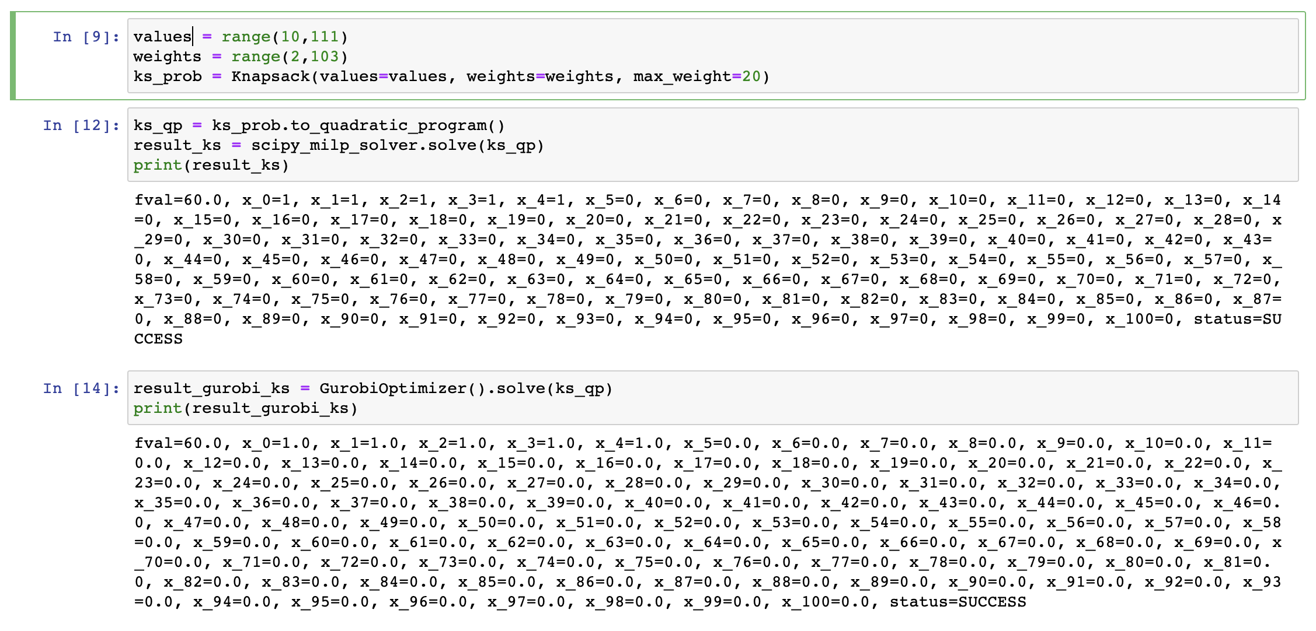
Demonstration – Knapsack Problem
The bag can carry a limited weight. How to maximize the value of the carried items?

Slide 6
Outcome
The Pull Request has been created and only need a compatibility solution for Python 3.7, which is not supported by Scipy 1.9.0.
Our new feature ScipyMilpOptimizer will soon be online!

Slide 7
Thought and Feeling
QAMP is absolutely a great chance to try new challenges and step out into unfamiliar zone.
Many thanks my mentor Takashi and the organizing panel for making this great event!

