Slide 1

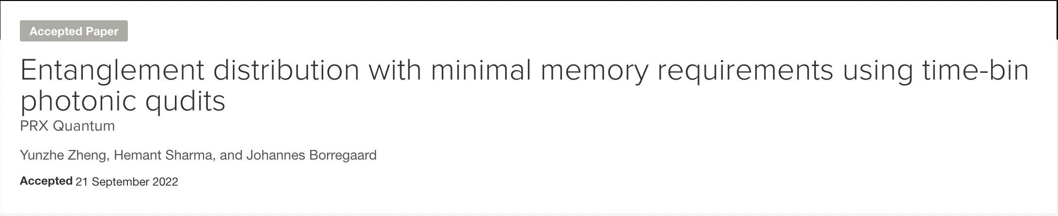

#2 Implement MILP solver within Qiskit Optimization - About us
I just graduated from TU Delft with a MSc Applied Physics.
Interest: Quantum network & Quantum algorithm & Error correction (mitigation)
Now an intern @ Qunasys (a Tokyo startup focusing on quantum algorithm)
I am a heavy fan for Formula 1🏎️
My mentor Takashi is a Research Scientist @ IBM Research -Tokyo
Work based on my master thesis
#2 Implement MILP solver within Qiskit Optimization

Slide 2
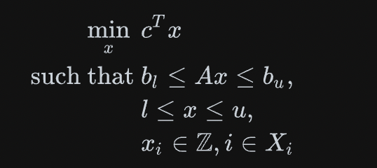
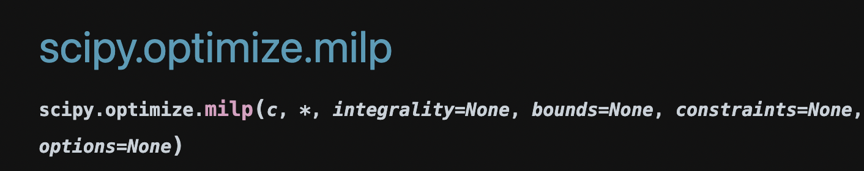
Motivation
Mixed-Interger Linear Programming (MILP) solver
A powerful solver that allows part of variables to take only integer values.
scipy.optimize.milp come out with Scipy v1.9.0 (July 29 2022)
Useful for many linear problems, but not incorporated with Qiskit Optimization.
#2 Implement MILP solver within Qiskit Optimization

Slide 3
Why we need MILP for Qiskit?
In qiskit-optimization, we can use CPLEX and Gurobi to classically solve quadratic problems
but they are commercial APIs and limited by free access! (# of variables & constraints)
On the other hand: Scipy doesn’t ask for you to pay :p.
Our goal: integrate the MILP solver with qiskit-optimization library.
We expect to build a `SciPyMILPOptimizer` class in `qiskit_optimization.algorithms`
A tutorial introducing how to use our new optimizer!
#2 Implement MILP solver within Qiskit Optimization
** Our work is fully about classical optimizers.

