Slide 1
Searching ground state energy with Hybrid NISQ Algorithm
Team SunnyDelft
as a project for QHack 2023 Open Hackathon

Slide 2
Background - How to find ground state energy?
Problem: Given a Hamiltonian(matrix), How to find its ground state energy(minimum eigenvalue)?
Classical Solution: Let’s rely on numpy.linalg.eig! But time complexity is O(n^3), so you won’t do it easily for large matrix :(.
Quantum Solution: Let’s use the powerful Quantum Phase Estimation(QPE)! But currently we don’t have fault-tolerant quantum computers, and the inevitable noise restricts the power of QPE :(.
NISQ Solution A: Let’s try the useful Variational Quantum Eigensolver(VQE)! However, there is no performance guarantee for VQE because of its variational nature, and you don’t know when the algorithm will fail :(.
Do we have any solution B?

Slide 3
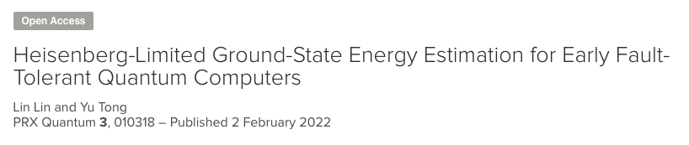
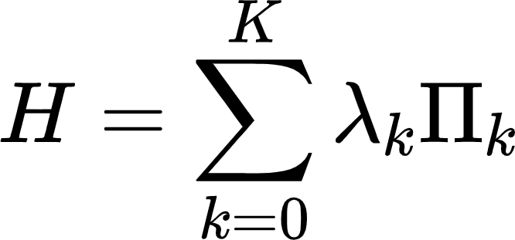
Hybrid NISQ Algorithm with Heisenberg-limit
A new
https://journals.aps.org/prxquantum/abstract/10.1103/PRXQuantum.3.010318

Slide 5
Searching Ground State Energy with Hybrid NISQ Algorithm
PRX Quantum 3, 010318 (2022) - Heisenberg-Limited Ground-State Energy Estimation for Early Fault-Tolerant Quantum Computers
https://journals.aps.org/prl/abstract/10.1103/PhysRevLett.129.030503
https://doi.org/10.1103/PhysRevLett.127.270502

Slide 6
0224
1. Good result on simulator:
Initial state symmetric
Coef of step function
Trotterization/Random compiling

