Slide 1
Momentum Strategy
This is my presentation on how I used a momentum strategy to calculate returns for the future
TY Work Experience – Joshua Bucur

Slide 2
What is a Momentum Strategy?
The momentum hypothesis
How does it work?
1
Look back 12 months at all 11 ETFs
This the idea that assets that have performed well recently tend to keep outperforming.
And poor performers tend to keep underperforming.
The intuition is that investors are slow to react to new information, causing price trends to persist over medium term horizons.
2
Skip the most recent month to prevent look ahead bias
3
Pick the top 3 performers
4
Put one third of your money into each
5
Repeat every month

Slide 3
Data & Signal Construction
I downloaded 20 years price data and then built the momentum signal.
Adjusted Close vs Regular Close
Data Source
I used Adjusted Close not regular Close. Over 20 years ignoring dividends would have seriously understated returns
All price data was downloaded from Yahoo Finance, which is a trustable source
Missing Data — XLC & XLRE
The Signal
XLC and XLRE launched after 2005, so they have gaps at the start of the dataset.
Every month I picked the 3 best performing sectors from the last 12 months and invested equally in them — one third each.

Slide 4
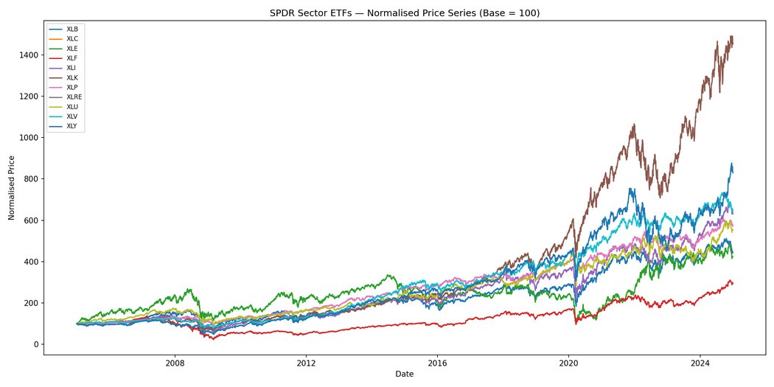
How much each sector grew
Normalised price chart
Tech (XLK) completely dominates over the 20 year period while Energy struggled significantly, crashing around 2014 when oil prices collapsed. The 2008 financial crisis is clearly represented as a drop across every sector simultaneously.

Slide 5
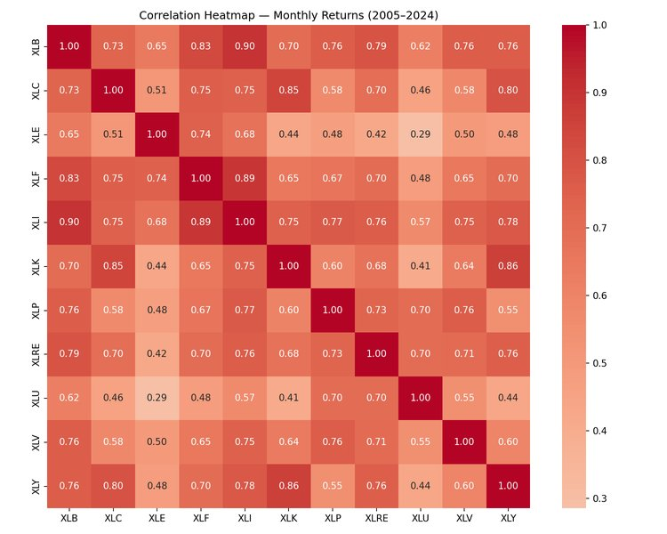
How similar sectors move together
Correlation heatmap
Tech (XLK) and Communications (XLC) are highly correlated at 0.85 while Utilities and Energy are the least correlated as they are driven by interest rates and oil prices rather than the broader market.

Slide 6
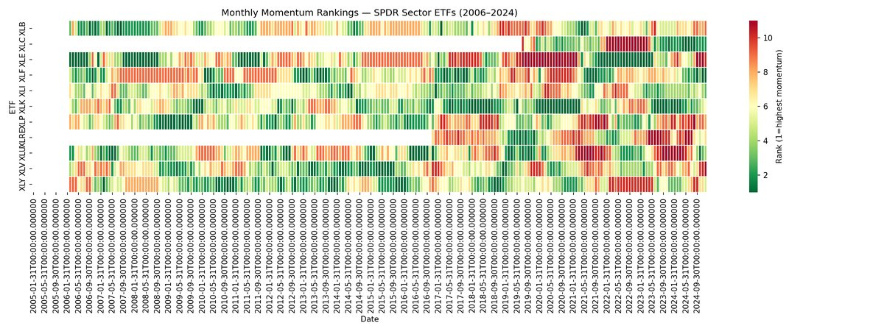
Which sectors had the best momentum each month
Momentum rank heatmap
Tech (XLK) sits in green for long stretches while Energy sits in red for extended periods, confirming the momentum signal was consistently picking up on these long running trends.

Slide 7
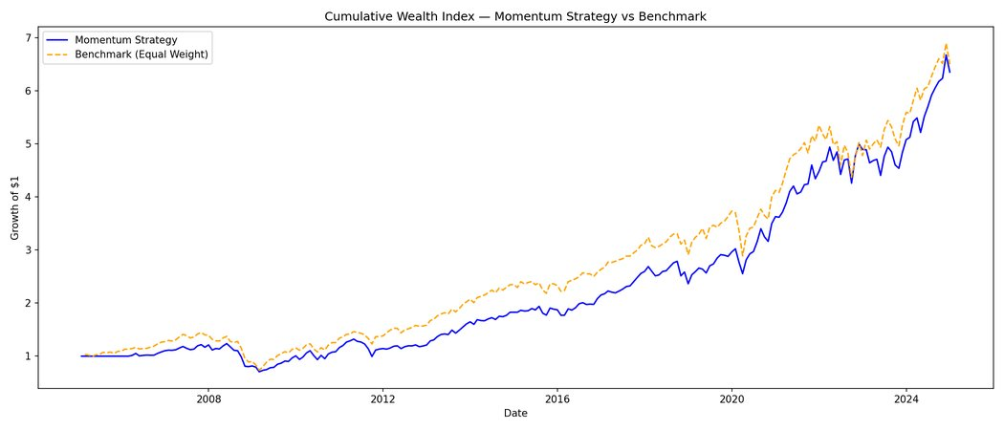
How much money the strategy made over time
Cumulative Wealth Index
$1,000 invested in 2005 grew to $6,354 by 2024 — a 535% return. The strategy and benchmark track each other closely showing the strategy matched the market.

Slide 8
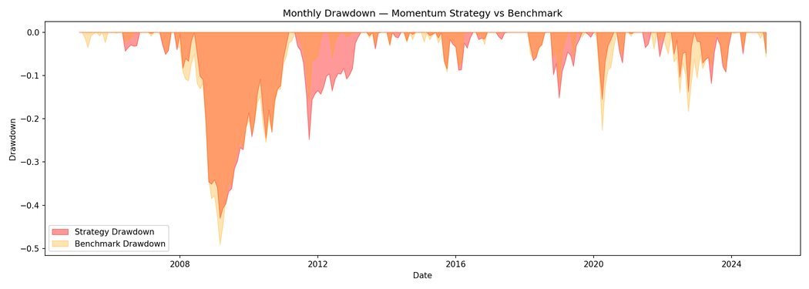
How much the strategy lost during crashes
Monthly Drawdown
During the 2008 financial crisis the strategy fell 43% while the benchmark fell 49.1%, and a smaller drawdown is visible in 2020 during COVID before markets recovered.

Slide 9
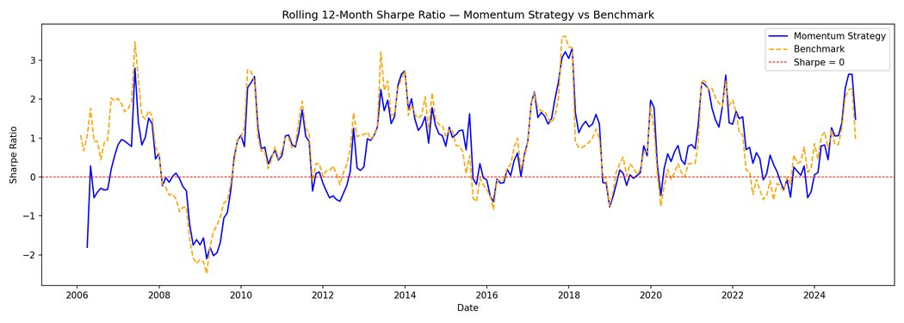
Return per unit of risk over time
Rolling 12-Month Sharpe Ratio
Both lines go negative around 2008 and again in 2022 when the Federal Reserve raised interest rates. Outside of those periods both lines track each other closely.

Slide 10
Backtest Results
From 2005 - 2024
During 2008
€6,354
535%
-43%
62%
€1,000 grew to
Total Return
Strategy Max Drawdown
Months Profitable
Metric
Strategy
Benchmark
Verdict
Annual Return
10.4%
10.5%
Matched the market
Max Drawdown
-43.0%
-49.1%
Strategy wins
Sharpe Ratio
0.43
0.44
Nearly identical
Hit Rate
62.1%
65.4%
Profitable most months

Slide 11
Limitations & What I would investigate next
LIMITATIONS
WHAT I WOULD CHANGE
Universe Too Small
Expand the Universe
With only 11 ETFs the universe is too small to generate a meaningful gap between winners and losers — which is why the strategy matched the benchmark rather than outperforming it.
Expand from 11 ETFs to individual S&P 500 stocks to give the momentum signal a bigger gap between winners and losers.
No Transaction Costs
Long-Short Strategy
Over 20 years of monthly rebalancing these costs would add up and reduce real returns.
Test a long-short version buy the top performers and simultaneously short the bottom performers.

Slide 12
Thank you

