Slide 1
Ticket Vendor Machine
Dương Thành Long
Phạm Lê Anh Khôi
Github: https://github.com/Dranov220805/Ticket_Vendor_Machine

Slide 2
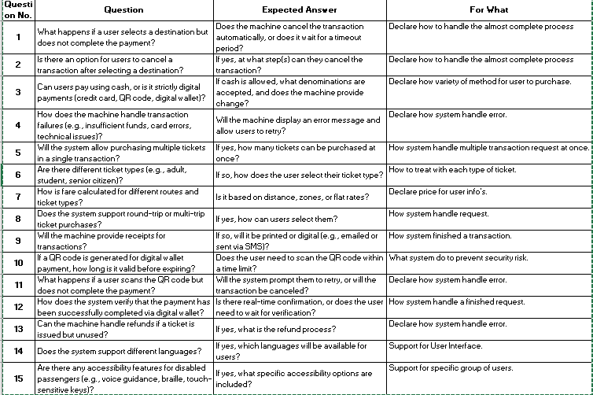
Questions for Requirements Excel

Slide 3
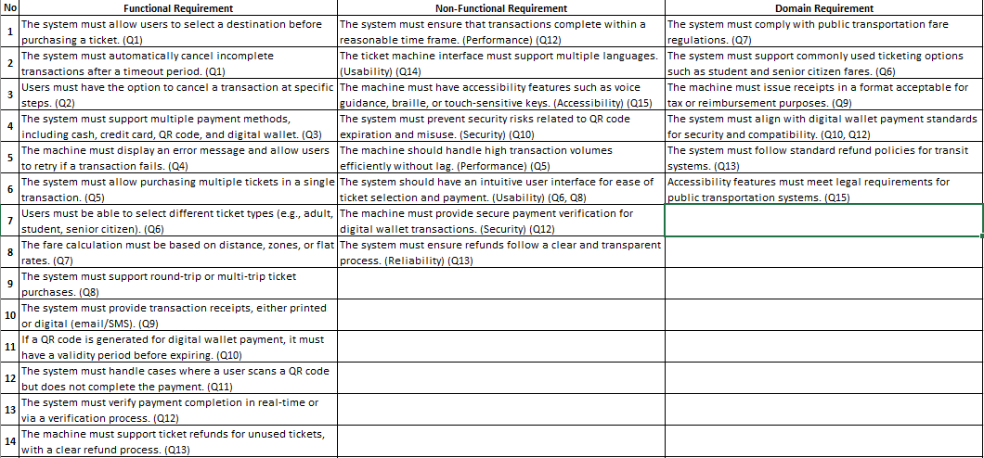
Functional, non-functional and domain requirements

Slide 4
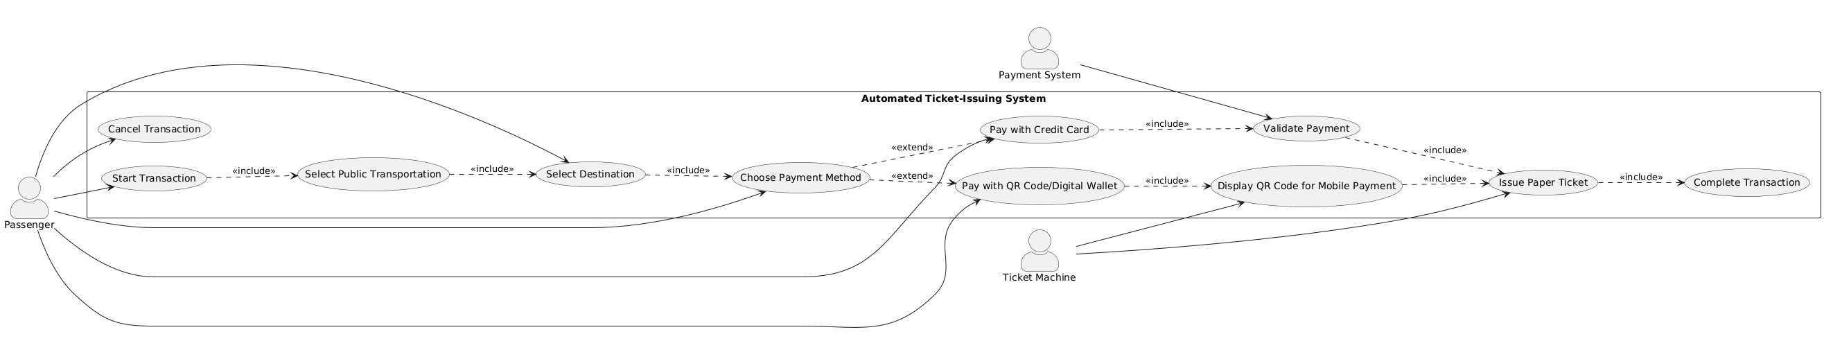
Use Case Diagram

Slide 5
Use Case Descriptions
Use case name: | Start Transaction
Scenario: | Passenger starts a ticket transaction
Triggering event: | Passenger interacts with the ticket machine
Brief description: | Starts a new transaction session for purchasing a ticket
Actors: | Passenger
Related use cases: | Select Public Transportation
Stakeholders: | Passenger
Preconditions: | Ticket machine must be operational
Postconditions: | Transaction session started
Flow of activities | Actor | System
 | 1. Initiates session | 1. Displays welcome screen
Exception conditions: | Machine offline or error – show maintenance message

Slide 6
Use Case Descriptions
Use case name: | Select Public Transportation
Scenario: | Passenger selects transport type (bus, metro)
Triggering event: | Transaction started
Brief description: | System prompts for transport type selection
Actors: | Passenger
Related use cases: | Select Destination
Stakeholders: | Passenger
Preconditions: | Transaction initiated
Postconditions: | Transport type recorded
Flow of activities | Actor | System
 | 1. Selects type | 1. Displays destination options
Exception conditions: | No selection – prompt again

Slide 7
Use Case Descriptions
Use case name: | Select Destination
Scenario: | Passenger chooses destination
Triggering event: | Transportation type selected
Brief description: | Displays destination list and records user choice
Actors: | Passenger
Related use cases: | Choose Payment Method
Stakeholders: | Passenger
Preconditions: | Transportation selected
Postconditions: | Destination stored
Flow of activities | Actor | System
 | 1. Selects destination | 1. Displays payment options
Exception conditions: | No destination selected – display error

Slide 8
Use Case Descriptions
Use case name: | Choose Payment Method
Scenario: | Passenger selects a payment method
Triggering event: | Destination selected
Brief description: | User chooses between credit card or mobile wallet
Actors: | Passenger
Related use cases: | Pay with Credit Card, Pay with QR Code/Digital Wallet
Stakeholders: | Passenger
Preconditions: | Fare calculated
Postconditions: | Payment method stored
Flow of activities | Actor | System
 | 1. Chooses method | 1. Prepares payment interface
Exception conditions: | Invalid option – prompt retry

Slide 9
Use Case Descriptions
Use case name: | Pay with Credit Card
Scenario: | Passenger pays by card
Triggering event: | Credit card selected
Brief description: | Accepts and processes card payment
Actors: | Passenger
Related use cases: | Validate Payment
Stakeholders: | Passenger, Payment System
Preconditions: | Payment method selected
Postconditions: | Payment sent for validation
Flow of activities | Actor | System
 | 1. Taps/Inserts card | 1. Sends data to payment processor
Exception conditions: | Card declined – prompt retry or cancel

Slide 10
Use Case Descriptions
Use case name: | Pay with QR Code / Digital Wallet
Scenario: | Passenger scans QR code using mobile app
Triggering event: | QR code payment selected
Brief description: | Displays QR code and waits for scan confirmation
Actors: | Passenger
Related use cases: | Display QR Code for Mobile Payment
Stakeholders: | Passenger, Payment System
Preconditions: | Payment method selected
Postconditions: | QR scanned and confirmed
Flow of activities | Actor | System
 | 1. Scans code | 1. Displays QR for payment
Exception conditions: | Timeout – offer cancel/retry

Slide 11
Use Case Descriptions
Use case name: | Display QR Code for Mobile Payment
Scenario: | Machine shows QR code
Triggering event: | QR method selected
Brief description: | System shows a scannable code for digital payment
Actors: | Ticket Machine
Related use cases: | Issue Paper Ticket
Stakeholders: | Passenger
Preconditions: | Payment method selected
Postconditions: | Code scanned
Flow of activities | Actor | System
 |  | 1. Displays QR code linked to session
Exception conditions: | Timeout or scan error

Slide 12
Use Case Descriptions
Use case name: | Validate Payment
Scenario: | System confirms payment status
Triggering event: | Payment data sent to processor
Brief description: | Receives and processes payment confirmation
Actors: | Payment System
Related use cases: | Issue Paper Ticket
Stakeholders: | Passenger, Payment System
Preconditions: | Payment initiated
Postconditions: | Payment confirmed or declined
Flow of activities | Actor | System
 |  | 1. Sends and receives confirmation from payment system
Exception conditions: | Network error – show retry prompt

Slide 13
Use Case Descriptions
Use case name: | Issue Paper Ticket
Scenario: | Ticket is printed
Triggering event: | Payment confirmed
Brief description: | Prints and delivers ticket
Actors: | Ticket Machine
Related use cases: | Complete Transaction
Stakeholders: | Passenger
Preconditions: | Payment successful
Postconditions: | Ticket printed and dispensed
Flow of activities | Actor | System
 |  | 1. Prints and ejects ticket
Exception conditions: | Printer jam/error – notify user

Slide 14
Use Case Descriptions
Use case name: | Complete Transaction
Scenario: | Transaction ends
Triggering event: | Ticket issued
Brief description: | System resets and thanks user
Actors: | System
Related use cases: | N/A
Stakeholders: | Passenger
Preconditions: | Ticket printed
Postconditions: | Session ends, system resets
Flow of activities | Actor | System
 |  | 1. Displays thank-you and resets
Exception conditions: | Session does not reset – manual override needed

Slide 15
Use Case Descriptions
Use case name: | Cancel Transaction
Scenario: | Passenger cancels process
Triggering event: | Cancel button pressed
Brief description: | Ends current session
Actors: | Passenger
Related use cases: | N/A
Stakeholders: | Passenger
Preconditions: | Transaction initiated
Postconditions: | Transaction terminated, system reset
Flow of activities | Actor | System
 | 1. Press cancel | 1. Aborts and resets session
Exception conditions: | Refund required if payment completed

Slide 16
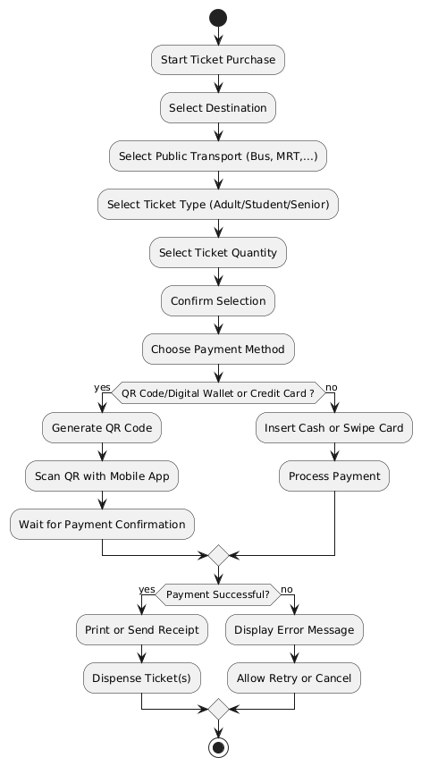
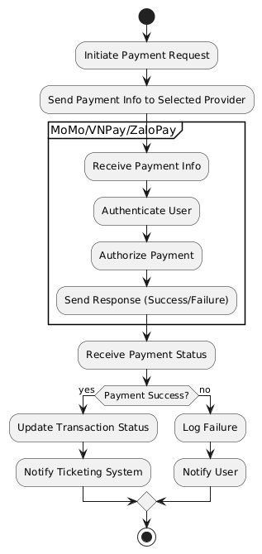
Activity Diagram

Slide 17
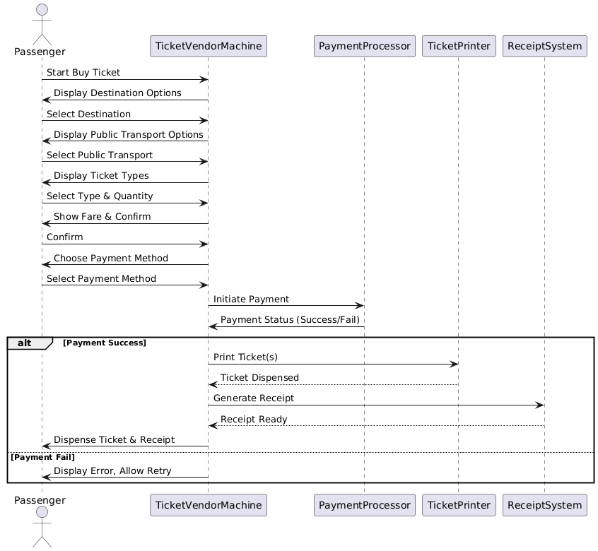
Sequence Diagram

Slide 18
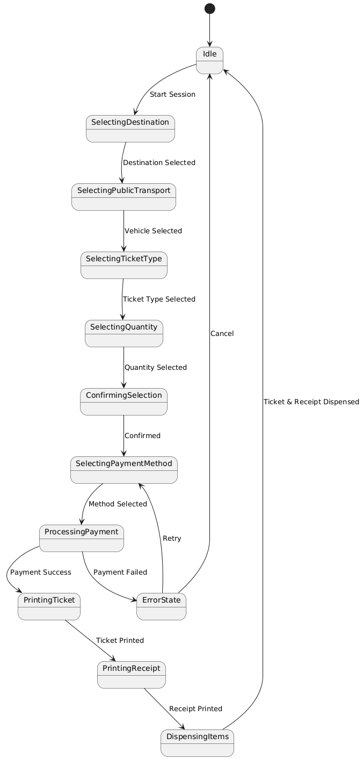
State Chart Diagram

Slide 19
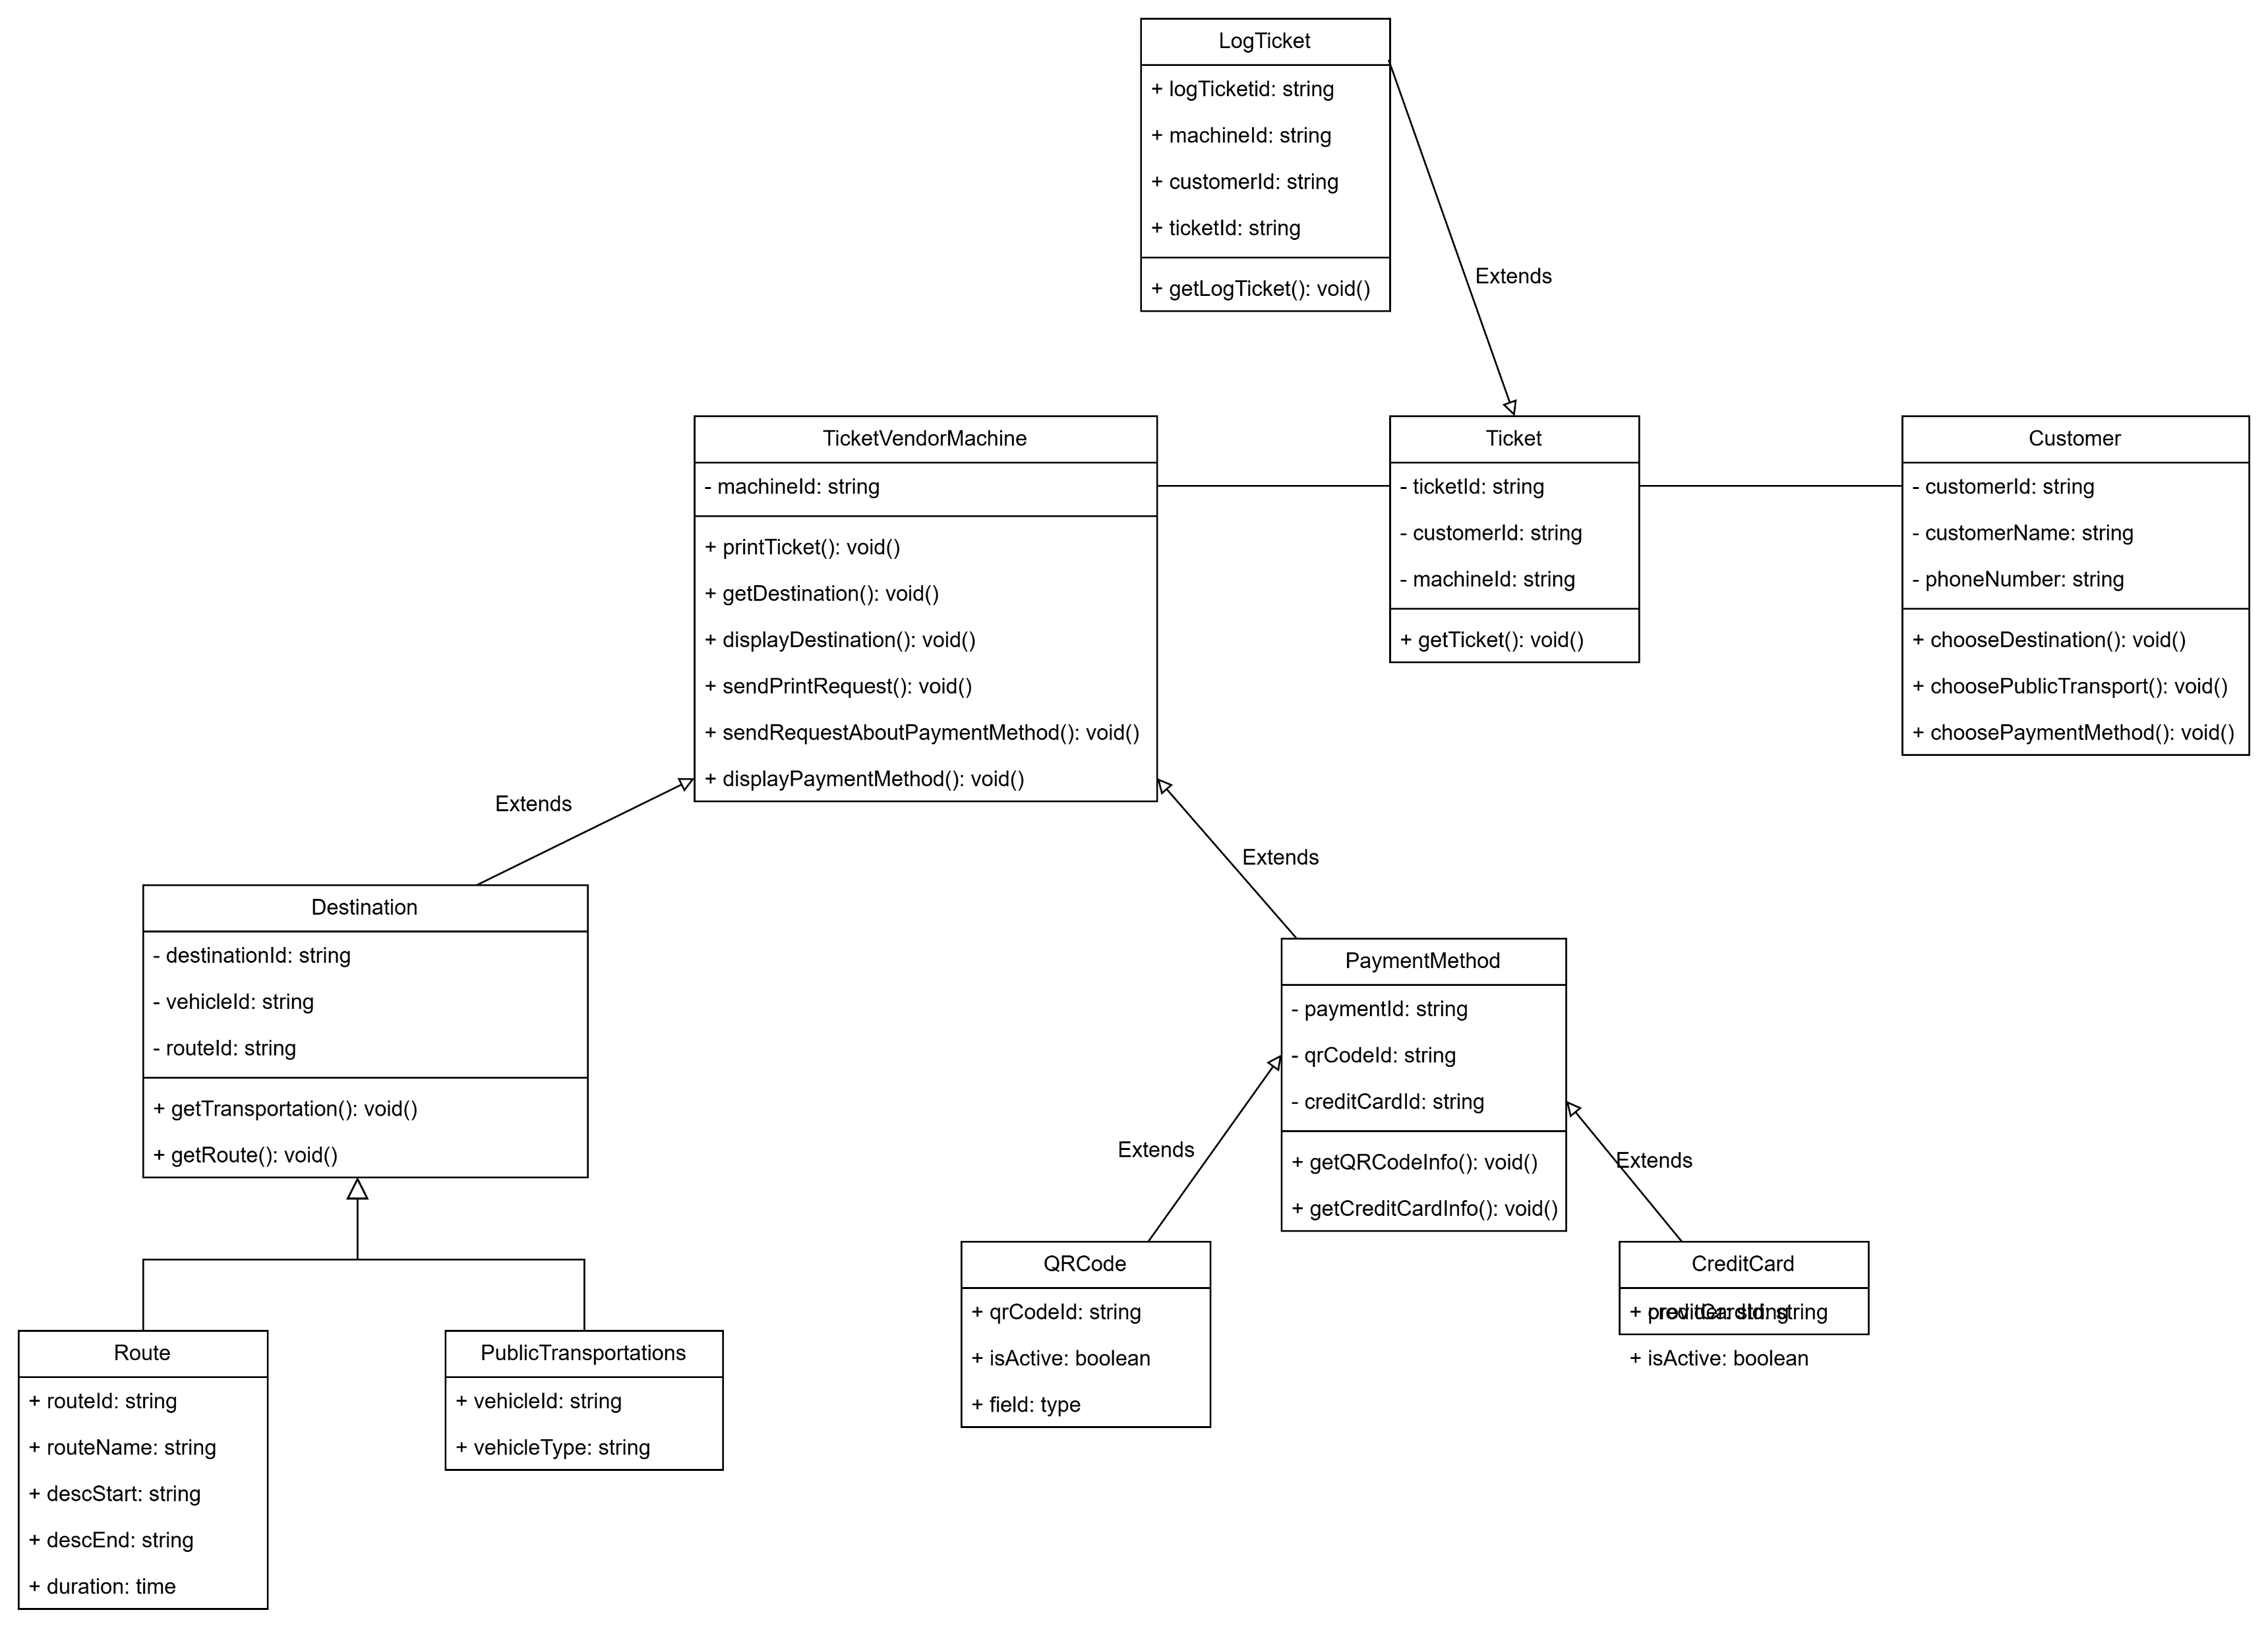
Class Diagram

Slide 20
Wireframe/Mockup

Slide 21
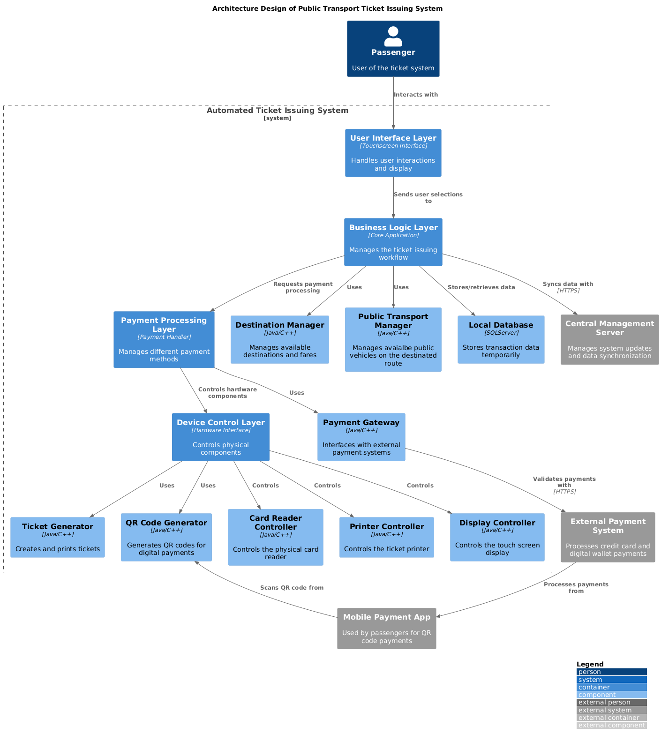
Architecture Design

Slide 22
Demo

