Slide 1
What 什么是质量
“An inherent or distinguishing characteristic”
(American Heritage Dictionary)
Quality is what we love
Quality means value to somebody
Every software problem is of a quality problem
Quality has different meanings to different people
Customer view: fit for use or meet the needs
Project Manager view: deliver compliant products in time
Developer/Tester view: bug-free
What’s your view?

Slide 2
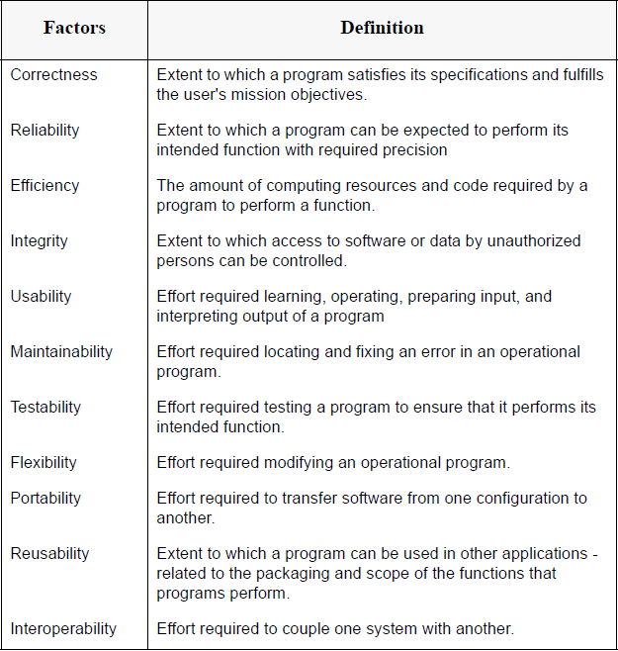
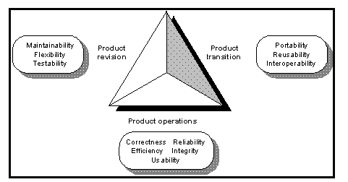
什么是质量
McCall’s Quality Model

Slide 3
Role
 | Quality Assurance （QA） | Tester
Orientation | Process/Policy Oriented | Products/Deliverables Oriented
Defect Goals | Prevent Defects | Discover Defects
Means | Audit/ Governance | Kinds of Test Methods
Methodology | 目标 | 手段（之一）

Slide 4
按照测试方法划分
白盒测试
语句覆盖：
条件覆盖
路径覆盖
……
黑盒测试
等价类法
边界值法
……
灰盒测试

Slide 5
按照测试的粒度或测试的范围
Unit Test
Integration Test
System Test
Acceptance Test
----------------------------------------------
Smoke Test 与 接受
----------------------------------------------
Regression Test 与 退化

Slide 6
1.何为冒烟测试 冒烟测试是自由测试的一种。冒烟测试在测试中发现问题，找到了一个bug，然后开发人员会来修复这个bug。这时想知道这次修复是否真的解决了程序的bug，或者是否会对其它模块造成影响，就需要针对此问题进行专门测试，这个过程就被称为冒烟测试。在很多情况下，做冒烟测试是开发人员在试图解决一个问题的时候，造成了其它功能模块一系列的连锁反应，原因可能是只集中考虑了一开始的那个问题，而忽略其它的问题，这就可能引起了新的bug。 冒烟测试引入到软件测试中，是指测试人员在正规测试一个新版本之前，先投入较少的人力和时间验证一个软件的主要功能，如果主要功能都没有实现，则打回开发组重新开发。这样做的好处是可以节省大量的时间成本和人力成本。 2.何为回归测试 回归测试是指修改了旧代码后，重新进行测试以确认修改没有引入新的错误或导致其他代码产生错误。回归测试作为软件生命周期的一个组成部分，在整个软件测试过程中占有很大的工作量比重，软件开发的各个阶段都会进行多次回归测试。在渐进和快速迭代开发中，新版本的连续发布使回归测试进行的更加频繁，而在极端编程方法中，更是要求每天都进行若干次回归测试。因此，通过选择正确的回归测试策略来改进回归测试的效率和有效性是非常有意义的。 回归测试一般是在进行软件的第二轮测试开始的，验证第一轮中发现的问题是否得到修复。当然回归也是一个循环的过程，穿插在软件测试整个生命周期里面。如果回归的问题不通过，则需要开发人员修改后再次回归，直到通过为止。 3.两者有何区别 冒烟测试就是完成一个新版本的开发后，对该版本最基本的功能进行测试，保证基本的功能和流程能走通。如果不通过，则打回开发那边重新开发；如果通过测试，才会进行下一步的测试(功能测试，集成测试，系统测试等等)。冒烟测试优点是节省测试时间，防止build失败。缺点是覆盖率还是比较低。 回归测试我有两层理解，一是就是当你修复一个bug后，把之前的测试用例再次应用到修复后的版本上进行测试。二是当一个新版本开发好后，而且冒烟测试通过，此时可以先用上一个版本的测试用例对新版本进行测试，看是否有bug！其实回归测试用的很多，比如新增加一个功能模块等等，所以自动化测试可以高效率的进行回归测试。

Slide 7
Test Techniques – By Stage
Unit Test
Integration Test
System & Acceptance Test

Slide 8
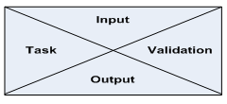
按照测试的粒度或测试的范围
V-Model
RFP
Working
System
Req
Study
Proposal
Review
Acceptance
Test Plan
Acceptance
Test
Client
Review
Proposal
Delivered
System
Accepted
Proposal
Deliverable
System
System
Analysis
FS
Review
System Test
Plan
System
Test
Certification
Functional
Specifications
Executable
System
Approved
FS
Executable
System
Design
Design
Review
Integration Test
Plan
Integration
Int. Test
Design
Document
Unit Tested
Code
Design
Document
Unit Test
Plan
Unit tested
code
Coding
Code
Inspection
Unit Test
Test
Audit
Inspected
Code
Inspected
Code

Slide 9
按照被测软件的评价标准
功能性测试
性能测试
安全性测试
高可用性测试

Slide 10
α测试和β测试
α测试
开发团队内部测试
针对软件的各个方面进行测试（功能，性能，安全，可移植，可扩展，可用性）
测试方法较多（黑盒，白盒）
测试目标 [0.1，1.0)
β测试
最终用户测试
主要针对功能测试
使用黑盒测试
测试目标为有限的production candidate

Slide 11
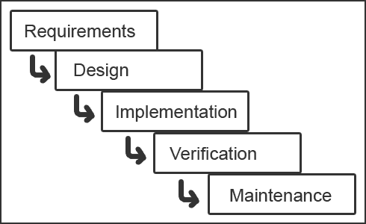
1，从简单的开始——瀑布模型

Slide 12
一个经典的瀑布模型下的瀑布式的测试流程
Test Requirements Analysis
Test Design
Test Delivery
Test Execution
Test Planning
Test Objective
Test Estimation
Test Strategy
Test Process
Test Schedule
Test Requirements
Testability Analysis
Requirement Traceability
Change Control
Issue Tracking
Test Case/Data Design
Automaton Design
Scripts Development
Test Coverage Analysis
Test Case Management
Environment Setup
Development
Smoke Test
Test Execution
Defect Tracking
Test Data Collection
Test Analysis
Improvement Proposal
Test Reporting
Test Package

Slide 13
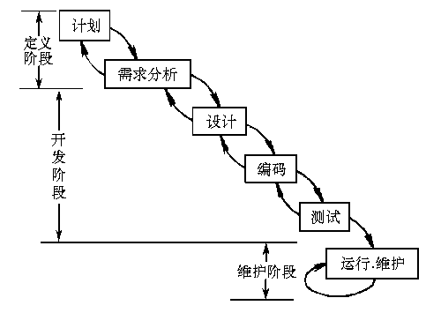
2，带回溯的瀑布模型的改进型 ----回溯造成了循环

Slide 14
3，V模型虽然也是瀑布的一种，但强调了测试
RFP
V-Model
Working
System
Req
Study
Proposal
Review
Acceptance
Test Plan
Acceptance
Test
Client
Review
Proposal
Delivered
System
V-Model Documentation
the User Requirements Specification.
（URS）
the System Requirements Specification
（SS）
the System Design Specifications,
（SDS）
Detailed Design Specifications,
（DDS）
Accepted
Proposal
Deliverable
System
System
Analysis
FS
Review
System Test
Plan
System
Test
Certification
Functional
Specifications
Executable
System
Approved
FS
Executable
System
Design
Design
Review
Integration Test
Plan
Integration
Int. Test
Design
Document
Unit Tested
Code
Design
Document
Unit Test
Plan
Unit tested
code
Coding
Code
Inspection
Unit Test
Test
Audit
Inspected
Code
Inspected
Code

Slide 15
V-Model Documentation
Requirements Gathering produces the User Requirements Specification (URS), which is both the input to Analysis, and the basis for Acceptance Testing.
Analysis produces the System Specification (SS) – also know as the Software Requirements Specification (SRS) – which is both the input for Software Design, and the basis for System Testing.
Design produces the System Design Specification (SDS), which is both the input for the detailed Specification phase, and the basis for Integration Testing.
The Specification activity produces the Detailed Design Specifications (DDS), which are both used to write the code, and also are the basis for Unit Testing.

Slide 16
V-Model Documentation
Each document produced is associated with pairs of phases in the model.
These are the
(a) Detailed Design Specifications,
(b) the System Design Specifications,
(c) the System Requirements Specification,
(d) the User Requirements Specification.

Slide 17
V-model Advantages
It is simple and easy to manage due to the rigidity of the model,
It encourages Verification and Validation at all phases:
Each phase has specific deliverables and a review process.
It gives equal weight to testing alongside development rather than treating it as an afterthought.

Slide 18
V-model Disadvantages
Its disadvantages are that similarly to the Waterfall model there is no working software produced until late during the life cycle
It is unsuitable where the requirements are at a moderate to high risk of changing.
It has been suggested too that it is a poor model for long, complex and object-oriented projects

Slide 19
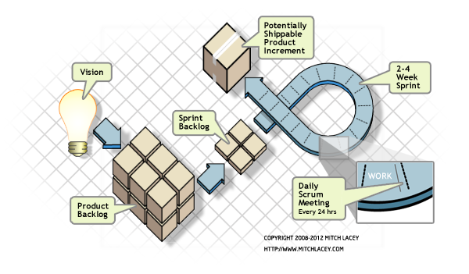
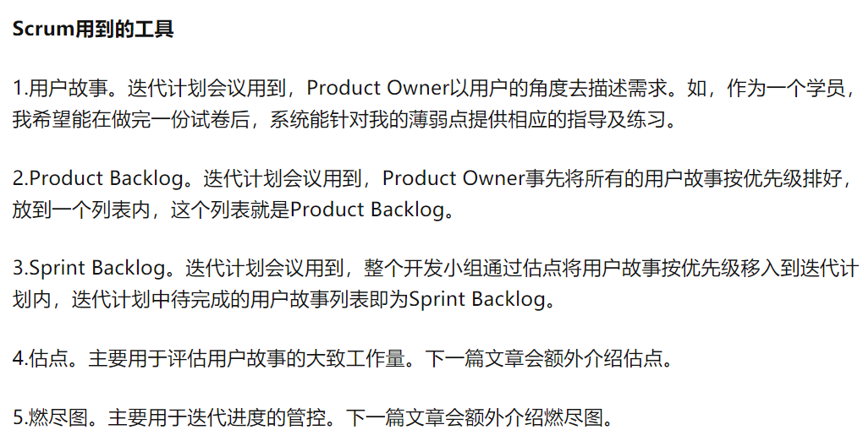
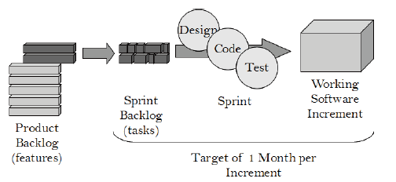
Scrum:敏捷开发的一个增量
Backlog
Sprint
Product increment

Slide 20
The QA’s job on the business analysis task are: 1) help business analyst to make the requirement document and test the requirement from the logic aspect; 2) do the team working, knowledge sharing, training, and communication to keep the team’s understanding of the requirement is on the same line.
The QA’s job on the release candidate submission are do the test analysis and finish the report in order to answer the question whether or not the increment of this sprint is qualified to be released to the product environment and supply service to the end user.

Slide 21
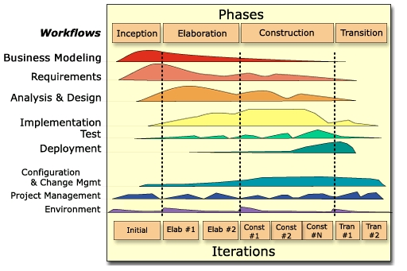
4，统一过程UP

Slide 22
统一过程就是在软件生命周期过程中以用例为驱动、构架为中心来进行一次一次的增量式的迭代，每次迭代都是以上一次迭代为基础并生成包括构件的源代码体、需求说明、测试用例等的制品。每次的迭代又具体分为四个阶段：初始、细化、提交和转移，而在每个阶段又分为多个工作流：需求、分析、设计、实现和测试等。统一过程模型是基于面向对象方法和UML统一建模语言的，用这种方法论来指导软件开发主要可以解决两个问题：
软件复用问题
需求变化问题。
统一过程是用例驱动的
统一过程是以构架为中心的

Slide 23
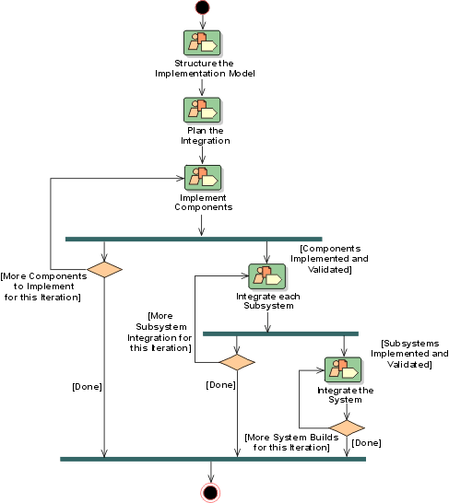
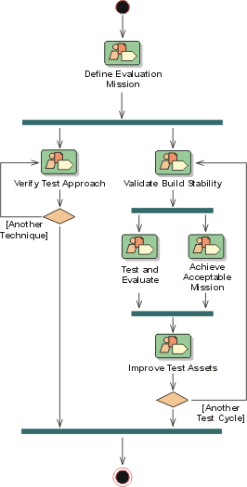
统一过程中的测试流程

Slide 24
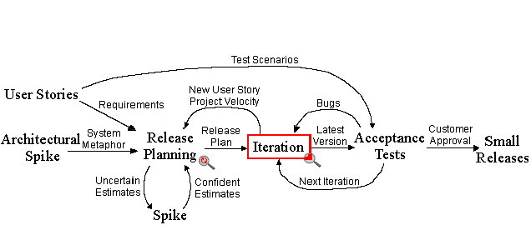
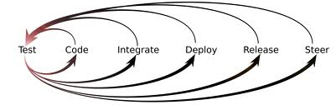
5.2, XP & TDD

Slide 25
归纳一下，什么是流程
流程是一种运行方式
流程是基本概念的一簇定义
流程包括了：
基本任务
基本任务的先后次序
角色与分工
产出物

Slide 26
产出物
测试计划
Schedule
Source （Team）
Scope
测试用例
测什么
怎么测
测试报告
我们处于什么位置
我们该怎么办

Slide 27
产出物需要澄清一下
测试用例和测试计划的区别
先有测试用例还是先有测试计划
测试报告的级别和重要性

Slide 28
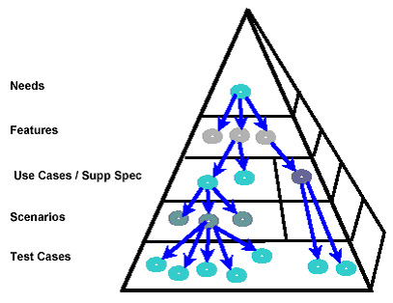
产出物的内在逻辑1：Traceability
文档化是附加产出
也可能是最重要的产出
文档化的逻辑结构呈金字塔型
其内在逻辑叫做Traceability

Slide 29
Traceability is a technique that provides a relationship between different levels of requirements in the system. This technique helps you determine the origin of any requirement. The pyramid illustrates how requirements are traced from the top level down. Every need usually maps to a couple of features, and then features map to use cases and supplementary requirements. Use cases describe functional requirements, and supplementary specifications describe non-functional items. In addition, every use case maps to many scenarios. Mapping use cases to scenarios, then, is a one to many relationship. Scenarios map to test cases also in a one to many relationship. Between needs and features, on the other hand, there is many to many mapping.

Slide 30
产出物的内在逻辑2 ：Coverage
 | UC1 |  |  |  | UC2 |  | UC3
TC | MF | AF1 | AF2 | AF3 | MF | AF | MF | AF1 | AF2
TC1.1 | ● |  |  |  | ● |  | ●
TC1.2 | ● |  |  |  | ● |  | ●
TC1.3 |  | ● |  |  | ● |  | ●
TC1.4 |  | ● |  |  | ● |  |  | ●
TC1.5 |  | ● |  |  | ● |  |  |  | ●
TC1.6 |  |  | ● |  | ● |  |  |  | ●
TC1.7 |  |  | ● |  | ●
TC2.1 |  |  | ●
TC2.2 |  |  |  | ●
TC2.3 |  |  |  | ● |  | ●
TC2.4 |  |  |  | ● |  | ●

Slide 31
Test coverage is defined as a technique which determines whether and how our test cases are actually covering the application original requirement, and how much requirement is exercised when we run those test cases. Frequently the coverage is measured by percentage.

Slide 32
A release
计划
需求分析
设计
实现
测试
验收
使用
计划
需求分析
设计
实现
QA测试
UAT验收
部署
部署
部署
使用
Cycle

Slide 33
A cycle
Enhancement （planned by release）
Bug Fixing （planned by cycle）
实现
单元测试
集成测试
系统测试
计划设计
Daily Build
Bug Fixing

Slide 34
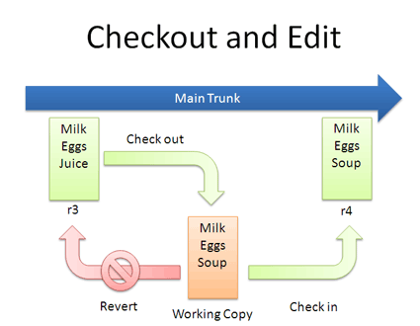
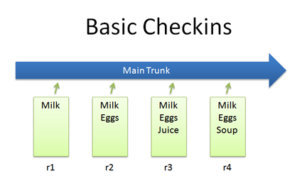
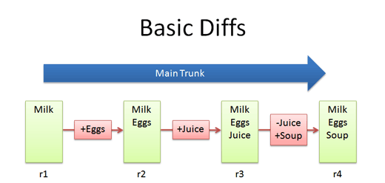
Version Control (1)

Slide 35
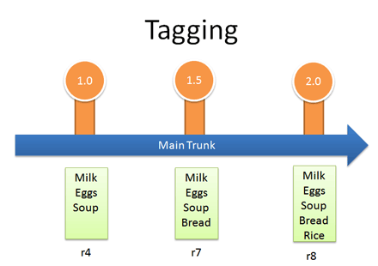
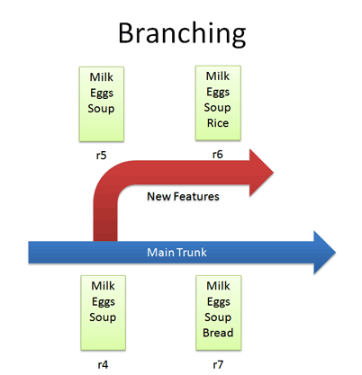

Version Control (2)

Slide 36
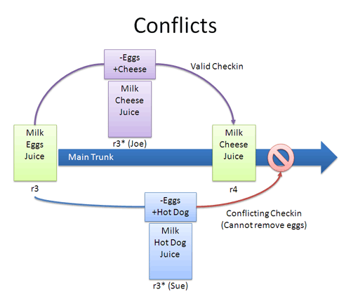
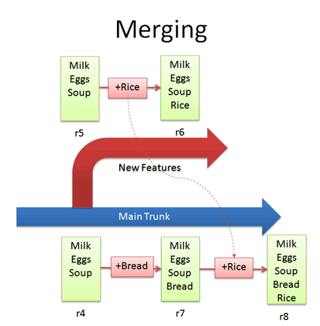
Version Control (3)

Slide 37
测试数据
功能测试不需要大量的数据
功能测试需要数据的覆盖率高
功能测试的测试数据要求尽量真实
性能测试需要大量的数据
性能测试的测试数据应尽可能的达到符合实际的数据分配

Slide 38
IEEE Std. 829-1998 测试环境与测试阶段的关系
不同阶段的测试环境
Attribute | Level
 | Unit | Integration | System | Acceptance
People | Developers | Developers & Testers | Testers | Testers & Users
Hardware O/S | Programmers' Workbench | Programmers' Workbench | System Test Machine or Region | Mirror of Production
Cohabiting Software | None | None | None/Actual | Actual
Interfaces | None | Internal | Simulated & Real | Production
Source of Test Data | Manually Created | Manually Created | Production & Manually Created | Production
Volume of Test Data | Small | Small | Large | Large
Strategy | Unit | Groups of Units/Builds | Entire System | Simulated Production
Notes:
对测试环境的影响体现在测试环境与真实环境的差距和测试结果的准确性上
people——测试者
Hardware O/S——硬件平台
Cohabiting software——操作系统中的其他共存软件
interfaces——接口
Source of test data——数据来源
Volume of test data——数据量
Strategy——策略
下面将对影响测试环境的因素（people, hardware, cohabiting software, interfaces, source and volume of data, and strategy）进行具体说明

Slide 39
计划是什么
计划是一种资源组织方式
计划是从一个状态，经过一系列步骤，到达一个目标
设定范围 Scope
设定目标
设定条件
设定路径 Schedule
组织资源 reSource

Slide 40
全功能提交团队
PM
Technical leader
Developer
Developer
Technical leader
Developer
Developer
QA leader
Tester
Tester
BA
IA
Architecture

Slide 41
“正常向”的提交团队
PM/BA/Architecture
Technical leader/IA
Developer
Developer
QA leader
Tester
Tester

Slide 42
常态化中的一个迭代——需求分析的目标：相对确定的需求文档，让团队对于本文档的理解是一致的 DEV的实现会成为QA测试的目标
BA
DEV
QA
IA
PM
OP
需求分析
写文档
回答问题
YY
需求分析
设计
实现
改Bug
帮运维
需求分析
写测试用例
测
写文档
需求分析
画界面
没啥事
YY 或者叫优化
写文档
需求分析
跟踪进度
协调资源
需求分析
优化（自动化，结构化）
写文档
部署

Slide 43
需求验证的方法
1）形式化方法（面向对象的）
SOFL（Structured Object-Oriented Formal Language）
Petri Net
2）结构化方法（面向对象的）
系统分析与设计
3）原型化方法

Slide 44
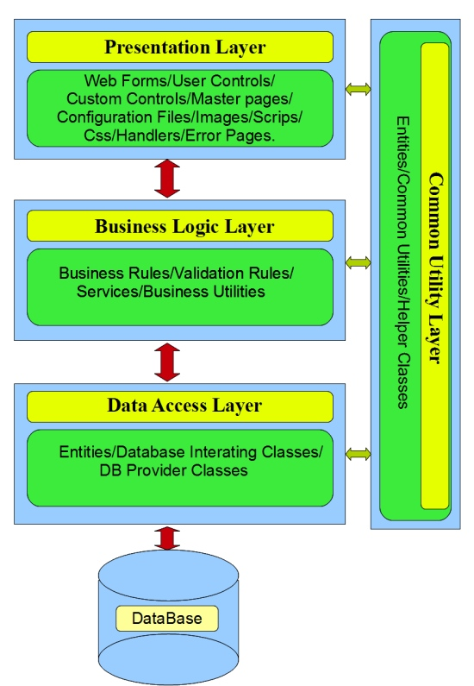
结构化方法的两个思考方向
程序设计
T2B
对进的设计和实现策略
B2T
存储设计

Slide 45
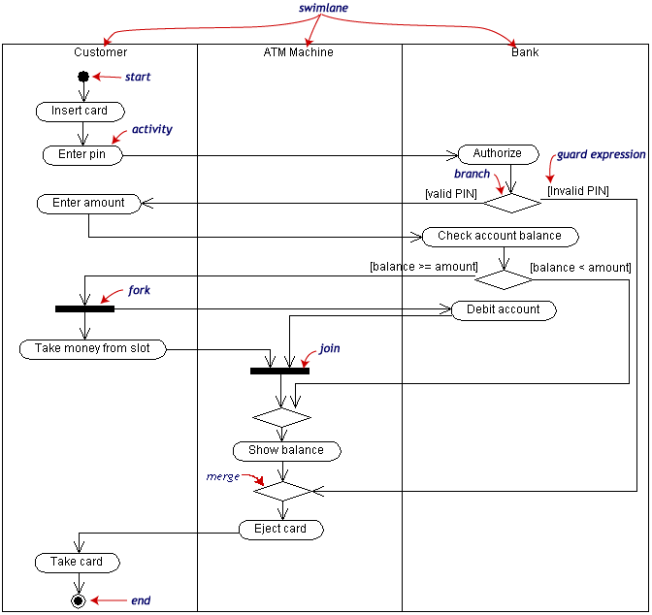
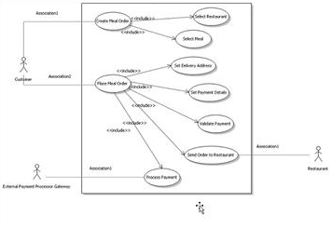
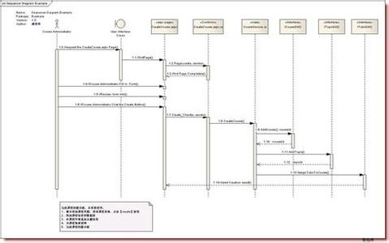
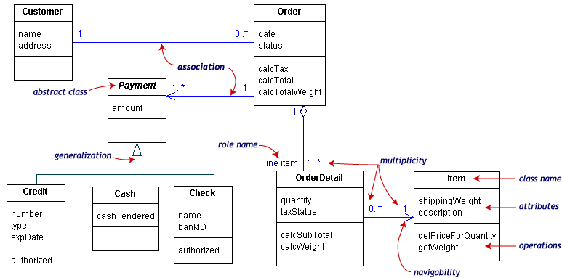
程序设计
T2B

Slide 46
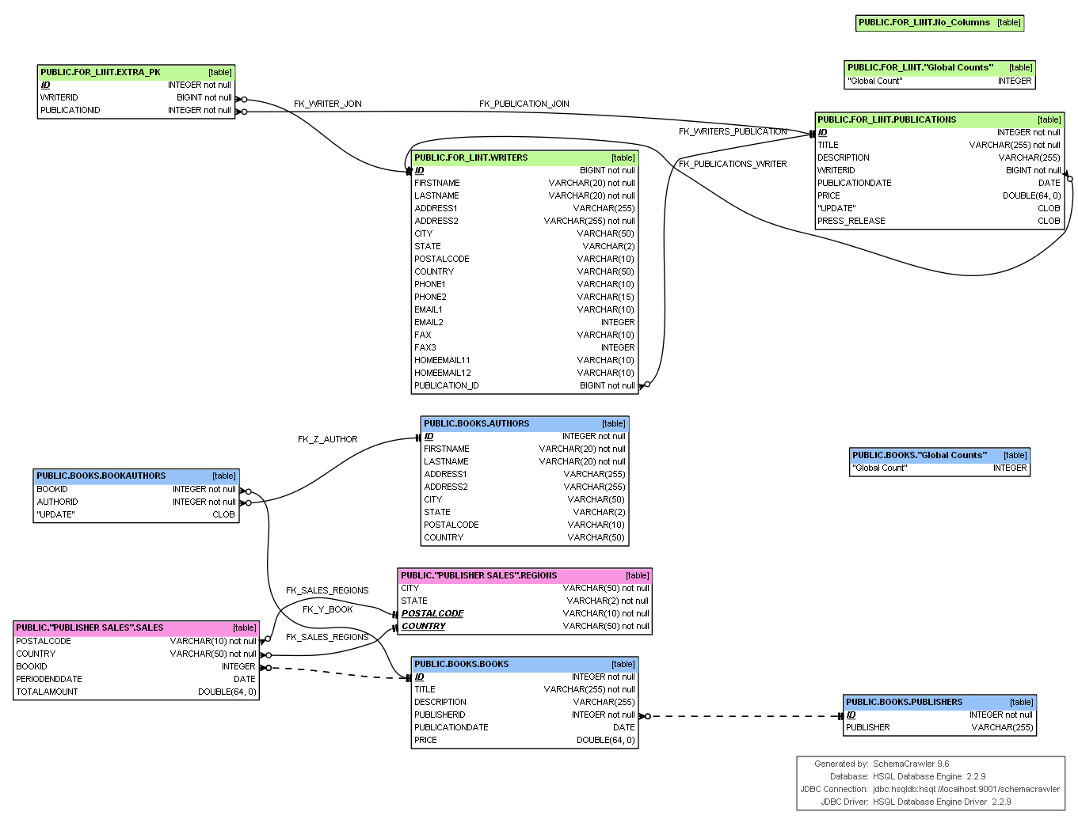
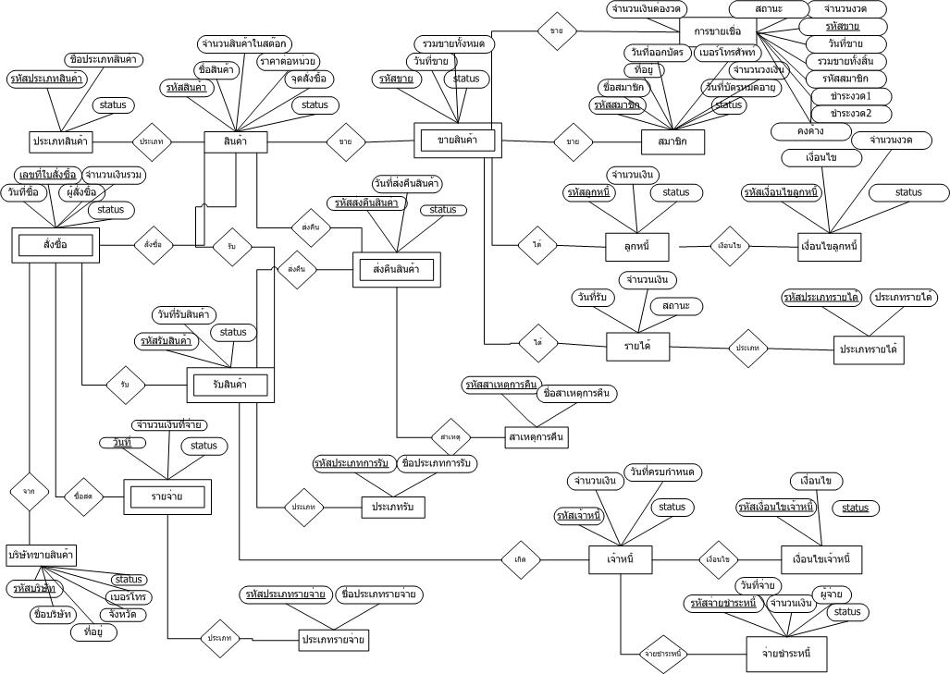
存储设计
B2T

Slide 47
Overview
Functional Testing Techniques
Equivalence Class Partitioning
Combinatorial Analysis
Each Choice Once(EC)
Base Choice(BC)
Boundary Value Analysis
Orthogonal Array(OA)
Combinatorial Test(pair-wise through n-wise)
Exhaustive Testing
Need in-depth Domain and Business Knowledge
The value or effectiveness of using any test technique ultimately depends on the individual test’s system and domain knowledge and ability to apply the applicable technique in the correct situation.

Slide 48
Exhaustively testing all possible inputs to any nontrivial software component is generally impossible due to the enormous number of variations. One approach to create a test suite with high coverage and a low number of variations is known as combinatorial testing. One common strategy, known as pairwise, tests a set of variations where every possible pair of parameters appears at least once. This method can be extended to use higher orders of combinations (3-wise, 4-wise, etc) for increased coverage at the expense of a larger test suite.
Software test techniques exist to reduce the number of tests to be run whilst still providing sufficient coverage of the system under test
There is no single technique or approach that is completely effective in software testing, so by increasing the diversity of methods used in testing and considering different perspectives, we are more likely to be successful in both exposing potential issues as well as increasing the effectiveness of our testing.
The value or effectiveness of using any test technique ultimately depends on the individual test’s system and domain knowledge and ability to apply the applicable technique in the correct situation.

Slide 49
Theory：The single fault assumption in reliability theory states that failures are rarely the result of the simultaneous occurrence of two (or more) faults.
Functional Testing Techniques
Equivalence Class Partitioning
Combinatorial Analysis
Boundary Value Analysis
Combinatorial Test(pair-wise through n-wise)
Single fault assumption
most failures are caused by interactions between relatively few parameters
Failures are only rarely the result of the simultaneous occurrence of two or more faults.

Slide 50
Functional Testing Techniques
Equivalence Class Partitioning
Combinatorial Analysis
Each Choice Once(EC)
Base Choice(BC)
Boundary Value Analysis
Orthogonal Array(OA)
Combinatorial Test(pair-wise through n-wise)
Exhaustive Testing
Need in-depth Domain and Business Knowledge
The value of the ECP helps systematically reduce the number of tests from all possible tests whilst still providing sufficient coverage of the system under test.

Slide 51
Equivalence Partitioning
Divide the set A into ( a1, a2, - - - -, an ) subsets:
a1 U a2 U - - - - U an = A (completeness)
for any i and j, ai ∩ aj = Ø (no duplication)
Equivalence Class Testing
use one element from each equivalence class
Any data element from a specific subset in a given class should produce the same extract result
.
Notes:
等价类之间的边界

Slide 52
Partitioning
First-level partitioning: Separate data into Valid and Invalid classes
Invalid
Valid
Notes:
先分为有效&无效

Slide 53
Partitioning
Carefully analyze the data in each class and further decompose the data in each class into discrete subsets in that class
Invalid
Valid
Notes:
等价类有明确边界
分解大等价类

Slide 54
Partitioning Principle
an integer value from 1 through 999
Range
Data in a class might be handled differently from other data in that class
A list of vehicles includes truck car, and trailer
Principle
Unique
Group
Specific
The condition must be or must not be present, e.g the at symbol(@) for e-mail name
Notes:
If an input condition specifies a range of values, this defines three classes:
within range: a valid input equivalence class
too large: an invalid input equivalence class
too small: a invalid input equivalence class
If an input condition specifies an enumerated set of values (e.g. “car”, “truck”, etc.):
One valid equivalence class for each value in the group.
One invalid equivalence class: all values not in the enumerated set (i.e. everything else).
If an input condition specifies a “must be”, situation (e.g. “first character of the identifier must be a letter”), this
leads to:
One valid equivalence class (e.g. the first character is a letter).
One invalid equivalence class (e.g. the first character is not a letter).
Finally, if there is any reason to believe that elements in an equivalence class are not handled in an identical
manner by the implementation software, split the equivalence class into smaller classes.

Slide 55
Other …
Consider creating an equivalence partition that handle the default, empty, blank, null, zero, or none conditions.
Default: no value supplied, and some value is assumed to be used instead.
Empty: value exists, but has no contents.
e.g. Empty string “”
Blank: value exists, and has content.
e.g. String containing a space character “ ”
Null: value does not exist or is not allocated.
e.g. object that has not been created.
Zero: numeric value
None: when selecting from a list, make no selection.

Slide 56
Approach
1.Decompose the data into discrete subsets
2.Assign a unique identifier to each equivalence class
3.Until all valid equivalence classes have been covered by at least one test case, write a new test case covering as many of the valid equivalence classes as possible
4.Until all invalid equivalence classes have been covered, write a test case that covers one, and only one, of the uncovered invalid equivalence classes while setting the other parameters to nominal valid value
Single fault assumption

Slide 57
Example
A text box accepts a string between upper case A To Z with a min length of 2 and a max length of 10 characters.
Input | Valid class subsets | Invalid class subsets
Characters | A-Z | Not IN A-Z
Length | 2-10 | < 2 > 10

Slide 58
Example
A text box accepts a string between upper case A To Z with a min length of 2 and a max length of 10 characters.
Input | Valid class subsets | Invalid class subsets
Characters | v1 - A-Z | i1 - Not IN A-Z
Length | v2 - 2-10 | i2 - < 2 i3 - > 10
Test Cases | Expected Result | Covered class subsets
BCDBC | allowed | v1, v2

Slide 59
Example
A text box accepts a string between upper case A To Z with a min length of 2 and a max length of 10 characters.
Input | Valid class subsets | Invalid class subsets
Characters | v1 - A-Z | i1 - Not IN A-Z
Length | v2 - 2-10 | i2 - < 2 i3 - > 10
Test Cases | Expected Result | Covered class subsets
eee | Not allowed | v2, i1
G | Not allowed | v1, i2
BCBCBCBCBCD | Not allowed | v1, i3
single fault
assumption

Slide 60
Combined with randomly data generation
File/DB
By executing the test several times and randomly selecting elements from specified class which increases the breadth of coverage beyond simple static data and provides a great deal of flexibility for the tester or for an automated test.

Slide 61
Case Study - Triangle
Specification
We have a triangle three sides A, B, C.
If they can form a triangle three sides must be met:
A>0, B>0, C>0, A+B>C, B+C>A, A+C>B.
1) If it is isosceles, also need to judge whether A = B, or B = C, or A = C.
2) If it is equilateral, also need to judge whether A = B, and B = C, and A = C.
Input condition | Valid class subsets | Invalid class subsets
scalene
isosceles
equilateral
v1（A>0）
v2（B>0）
v3（C>0）
v4（A+B>C）
v5（B+C>A）
v6（A+C>B）
i1（A≤0）
i2（B≤0）
i3（C≤0）
i4（A+B≤C）
i5（B+C≤A）
i6（A+C≤B）
scalene
invalid
isosceles
equilateral
v7 (A = B and A ≠ C)
v8 (B = C and A ≠ B)
v9 (A = C and A ≠ B)
i7 (A ≠ B and A ≠ C and B ≠ C)
v10 (A = C and A = B and B = C)
i8 (A ≠ B)
i9 (B ≠ C)
i10 (A ≠ C)

Slide 62
ID | [A, B, C] | Covered class subsets | Output
1 | [3，4，5] | v1, v2, v3, v4, v5, v6 | scalene
2 | [3，3，4] | v1, v2, v3, v4, v5, v6, v7 | isosceles
3 | [3，4，4] | v1, v2, v3, v4, v5, v6, v8 | isosceles
4 | [3，4，3] | v1, v2, v3, v4, v5, v6, v9 | isosceles
5 | [3，3，3] | v1, v2, v3, v4, v5, v6, v10 | equilateral
6 | [0，1，2] | i1 | invalid
7 | [1，0，2] | i2 | invalid
8 | [1，2，0] | i3 | invalid
9 | [1，2，3] | i4 | invalid
10 | [1，3，2] | i5 | invalid
11 | [3，1，2] | i6 | invalid
12 | [3，4，6] | v1, v2, v3, v4, v5, v6, i7 | scalene
13 | [3，4，4] | v1, v2, v3, v4, v5, v6, i8 | isosceles
14 | [3，4，3] | v1, v2, v3, v4, v5, v6, i9 | isosceles
15 | [3，3, 4] | v1, v2, v3, v4, v5, v6, i10 | isosceles

Slide 63
Boundary Value Analysis
Boundary value analysis focuses on the boundaries of the domain.
Rationale: Historical evidence demonstrates that errors occur most frequently on or near the boundary
operator <= or <
For-loops, While loops and Repeat loops
The requirements may not be clearly understood, especially around the boundaries
Jorgensen’s (6N + 1) formula for robust boundary test
X
a- a a+
b
c- c c+
baseline
Robust augmentation
Single-Variable, Single-Range Baseline Test Cases Augmented With Robustness Tests
(shaded area indicates valid values of the variable X)
Notes:
Main value of robustness testing: focuses attention on exception handling

Slide 64
Example
A text box accepts a string between upper case A To Z with a min length of 2 and a max length of 10 characters.
Char | @ | A | B | … | Y | Z | [
ASCII/Unicode | 64 | 65 | 66 | … | 89 | 90 | 91

Slide 65
Example
A text box accepts a string between upper case A To Z with a min length of 2 and a max length of 10 characters.
Test | String | Expected result | Notes
1 | @@@@ | Not Allowed | char ASCII min - 1, length nominal
2 | AAAA | Allowed | char ASCII min, length nominal
3 | BBBB | Allowed | char ASCII min + 1, length nominal
4 | YYYY | Allowed | char ASCII max - 1, length nominal
5 | ZZZZ | Allowed | char ASCII max , length nominal
6 | [[[[ | Not Allowed | char ASCII max + 1, length nominal
7 | G | Not Allowed | length min - 1, char nominal
8 | GG | Allowed | length min, char nominal
9 | GGG | Allowed | length min + 1, char nominal
10 | FFFFFFFFF | Allowed | length max - 1, char nominal
11 | KKKKKKKKKK | Allowed | length max , char nominal
12 | LLLLLLLLLLL | Not Allowed | length max + 1, char nominal
13 | ABCEFG | Allowed | All nominal
single fault
assumption
6 * 2 + 1 = 13

Slide 66
Dependency Between Parameters
Obvious Conditions:
1 ≤ Day ≤ 31.
1 ≤ month ≤ 12.
1582 ≤ Year ≤ 3000
Month
Day
Year
Next Date
There are more complicated issues to consider due to the dependencies between parameters. For example there is never a day of 31, Feb (tester’s intuition and common sense shows that we require more emphasis towards the end of February)
Many boundary values that have been hidden due to the dependencies between parameters
Notes:
Inadequate when there are dependencies between the variables ("Equivalence Class" Testing is better)
Bounds may not be always obvious (e.g. an upper bound for the triangle problem)
Bounds may not be appropriate (e.g. for Boolean values; “Decision Table” Testing is better)
No bounds in cases of enumerated variables (e.g. in bank transactions “deposit”, “withdrawal”, “query”)

Slide 67
Case Study - Next Day
Obvious Conditions:
1 ≤ Day ≤ 31.
1 ≤ month ≤ 12.
1582 ≤ Year ≤ 3000
Month
Day
Year
Next Date
Fields | Valid class subsets
Day | 1 through 28 29 30 31
Month | those that have 31 days or {1,3,5,7,8,10,12} those that have 30 days or {4,6,9,11} that has less than 30 days or {2}
Year | leap years between 1582 and 3000 non-leap years between 1582 and 3000
Equivalence class subsets are valuable in helping identify potential boundary conditions

Slide 68
Case Study - Next Day
Fields | Valid class subsets
Day | 1 through 28 29 30 31
Month | those that have 31 days or {1,3,5,7,8,10,12} those that have 30 days or {4,6,9,11} that has less than 30 days or {2}
Year | leap years between 1582 and 3000 non-leap years between 1582 and 3000
1-28
2
Leap
29
4, 6, 9, 11
Non-Leap
30
1,3,5,7,8,10,12
31

Slide 69
Case Study - Next Day
1 ≤ Day ≤ 31
Hidden boundary values
due to the dependency
Test | Month | Day | Year | Expected result | Notes
1 | 31-day month | 0 | 1582-3000 | Error Msg | Day Min - 1 (31-day Month)
2 | 31-day month | 1 | 1582-3000 | Next Day | Day Min (31-day Month)
3 | 31-day month | 2 | 1582-3000 | Next Day | Day Min + 1 (31-day Month)
4 | 31-day month | 30 | 1582-3000 | Next Day | Day Max - 1 (31-day Month)
5 | 31-day month | 31 | 1582-3000 | Next Day | Day Max (31-day Month)
6 | 31-day month | 32 | 1582-3000 | Error Msg | Day Max + 1 (31-day Month)
7 | 30-day month | 0 | 1582-3000 | Error Msg | Day Min - 1 (30-day Month)
8 | 30-day month | 1 | 1582-3000 | Next Day | Day Min (30-day Month)
9 | 30-day month | 2 | 1582-3000 | Next Day | Day Min + 1 (30-day Month)
10 | 30-day month | 29 | 1582-3000 | Next Day | Day Max - 1 (30-day Month)
11 | 30-day month | 30 | 1582-3000 | Next Day | Day Max (30-day Month)
12 | 30-day month | 31 | 1582-3000 | Error Msg | Day Max + 1 (30-day Month)

Slide 70
Case Study - Next Day
1 ≤ Day ≤ 31
Hidden boundary values
due to the dependency
Test | Month | Day | Year | Expected result | Notes
13 | 2 | 0 | Leap year | Error Msg | Day Min - 1 (Feb in Leap year)
14 | 2 | 1 | Leap year | Next Day | Day Min (Feb in Leap year)
15 | 2 | 2 | Leap year | Next Day | Day Min + 1 (Feb in Leap year)
16 | 2 | 28 | Leap year | Next Day | Day Max - 1 (Feb in Leap year)
17 | 2 | 29 | Leap year | Next Day | Day Max (Feb in Leap year)
18 | 2 | 30 | Leap year | Error Msg | Day Max + 1 (Feb in Leap year)
19 | 2 | 0 | Non-leap year | Error Msg | Day Min - 1 (Feb in Non-leap year)
20 | 2 | 1 | Non-leap year | Next Day | Day Min (Feb in Non-leap year)
21 | 2 | 2 | Non-leap year | Next Day | Day Min + 1 (Feb in Non-leap year)
22 | 2 | 27 | Non-leap year | Next Day | Day Max - 1 (Feb in Non-leap year)
23 | 2 | 28 | Non-leap year | Next Day | Day Max (Feb in Non-leap year)
24 | 2 | 29 | Non-leap year | Error Msg | Day Max + 1 (Feb in Non-leap year)

Slide 71
Case Study - Next Day
1 ≤ month ≤ 12.
Test | Month | Day | Year | Expected result | Notes
25 | 0 | 1-28 | 1582-3000 | Error Msg | Month Min - 1
26 | 1 | 1-28 | 1582-3000 | Next Day | Month Min
27 | 2 | 1-28 | 1582-3000 | Next Day | Month Min + 1
28 | 11 | 1-28 | 1582-3000 | Next Day | Month Max - 1
29 | 12 | 1-28 | 1582-3000 | Next Day | Month Max
30 | 13 | 1-28 | 1582-3000 | Error Msg | Month Max + 1
Each month have 1-28th day
Notes:
The boundary value and the values immediately above and immediately below are evaluated for each parameter while the other parameters are set to some nominal value

Slide 72
Case Study - Next Day
1582 ≤ Year ≤ 3000
.
Test | Month | Day | Year | Expected result | Notes
25 | 1-12 | 1-28 | 1581 | Error Msg | Year Min - 1
26 | 1-12 | 1-28 | 1582 | Next Day | Year Min
27 | 1-12 | 1-28 | 1583 | Next Day | Year Min + 1
28 | 1-12 | 1-28 | 2999 | Next Day | Year Max - 1
29 | 1-12 | 1-28 | 3000 | Next Day | Year Max
30 | 1-12 | 1-28 | 3001 | Error Msg | Year Max + 1
Each month have 1-28th day
Notes:
The boundary value and the values immediately above and immediately below are evaluated for each parameter while the other parameters are set to some nominal value

Slide 73
Case Study - Next Day
Output Boundary
.
Test | Month | Day | Year | Expected result | Notes
25 | 12 | 31 | 1581 | Error Msg | Output Min - 1
26 | 1 | 1 | 1582 | 1/2/1582 | Output Min
27 | 1 | 2 | 1583 | 1/3/1583 | Output Min + 1
28 | 12 | 30 | 3000 | 12/31/3000 | Output Max - 1
29 | 12 | 31 | 3000 | 1/1/3001 | Output Max
30 | 1 | 1 | 3001 | Error Msg | Output Max + 1
Notes:
The boundary value and the values immediately above and immediately below are evaluated for each parameter while the other parameters are set to some nominal value

Slide 74
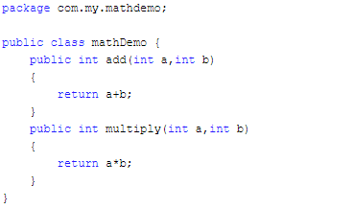
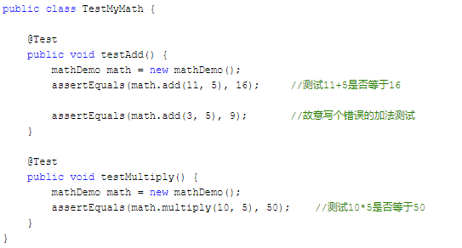
A Sample

Slide 75
Summary
void assertEquals(boolean expected, boolean actual) Check that two primitives/Objects are equal
void assertTrue(boolean expected) Check that a condition is true
void assertFalse(boolean condition) Check that a condition is false
void assertNotNull(Object object) Check that an object isn't null
void assertNull(Object object) Check that an object is null
void assertSame(Object object, Object object) The assertSame() methods tests if two object references point to the same object
void assertNotSame(Object object, Object object) The assertNotSame() methods tests if two object references not point to the same object
void assertArrayEquals(expectedArray, resultArray); The assertArrayEquals() method will test whether two arrays are equal to each other.

Slide 76
assertTrue() and assertFalse()
The assertTrue() and assertFalse() methods tests a single variable to see if its value is either true, or false.
If the program under test returns true, the assertTrue() method will return normally. Otherwise an exception will be thrown, and the test will stop.
If the program under test returns false, the assertFalse() method will return normally. Otherwise an exception will be thrown, and the test will stop.

Slide 77
assertNull() and assertNotNull()
The assertNull() and assertNotNull() methods test a single variable to see if it is null or not null.
If the program returns null, the assertNull() method will return normally. If a non-null value is returned, the assertNull() method will throw an exception, and the test will stop.
The assertNotNull() method works in the opposite way to the assertNull() method,

Slide 78
assertEquals()
The assertEquals() method compares two objects for equality
If the two objects are equal, the assertEquals() method will return normally. Otherwise the assertEquals() method will throw an exception.
The assertEquals() method can compare any two objects to each other, it has versions that compare primitive types like int and float to each other.

Slide 79
assertArrayEquals()
The assertArrayEquals() method will test whether two arrays are equal to each other. In other words, if the two arrays contain the same number of elements, and if all the elements in the array are equal to each other.
If the arrays are equal, the assertArrayEquals() will proceed without errors. If the arrays are not equal, an exception will be thrown, and the test aborted.

Slide 80
assertSame() and assertNotSame()
The assertSame() and assertNotSame() methods tests if two object references point to the same object or not. It is not enough that the two objects pointed to are equals according to their equals() methods. It must be exactly the same object pointed to.

Slide 81
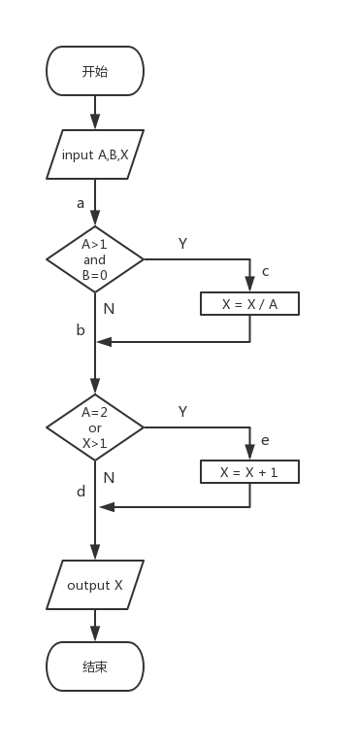
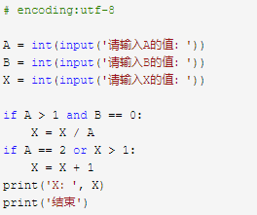
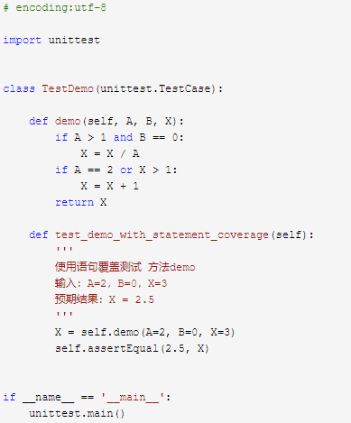
A Sample
Notes:
1A=2，B=0，X=3a-c-eX=2.5

Slide 82
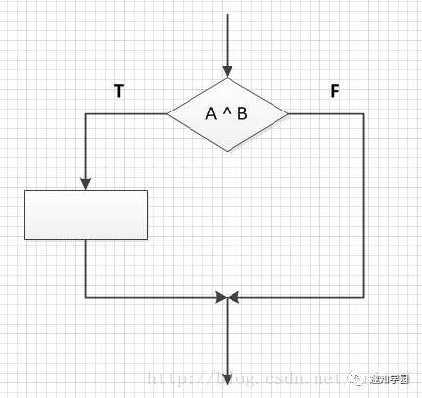
Statement coverage
Notes:
（1）语句覆盖
使程序中的每个可执行语句都能执行一次的测试用例
测试用例条件： A ^ B = T

Slide 83
Statement coverage concept
程序中每一个语句至少能被执行一次
语句覆盖是一种最弱的覆盖方法
无需测试程序的分支情况
可以支持短路
无需测试程序分支判断的输入值以及输入值的组合
无需划分等价类
无需测试程序执行的不同路径
可以取巧

Slide 84
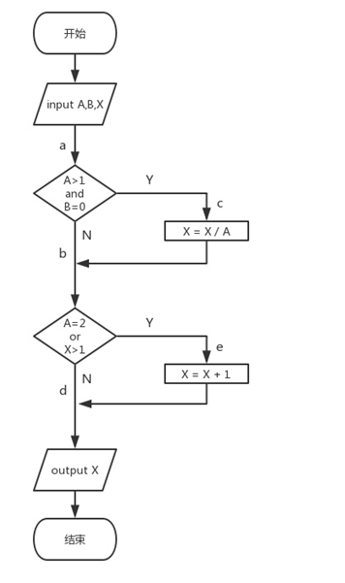
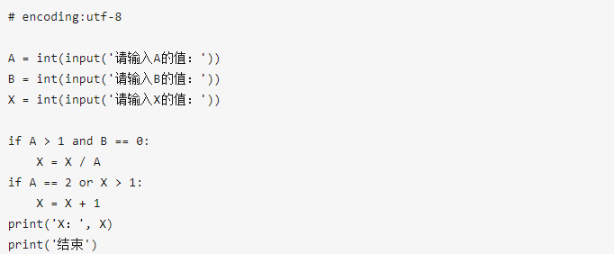
源代码与程序流程图

Slide 85
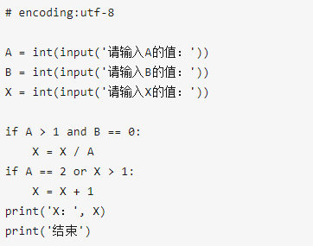
方案1
用例1：A=10，B=0，X=30
用例2：A=2，B=5，X=5

Slide 86
方案2
用例：A=2，B=0，X=3
Expect result：X=2.5

Slide 87
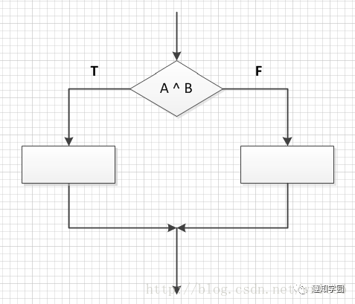
Determine coverage
对于判断语句，在设计用例的时候，要设计判断语句结果为True和False的两种情况 测试用例条件： A ^ B = T A ^ B = F
Branch coverage

Slide 88
Determine coverage concept
程序中每个判定至少有一次为真值，有一次为假值
使得程序中每个分支至少执行一次
满足判定覆盖的测试用例一定满足语句覆盖
对整个判定的最终取值（真或假）进行度量
判定内部每一个子表达式的取值不被考虑

Slide 89
源代码与程序流程图

Slide 90
方案1
用例1：A=10，B=0，X=30
用例2：A=2，B=5，X=5

Slide 91
方案2

Slide 92
方案2

Slide 93
方案3
用例1：A=10，B=0，X=30
用例2：A=2，B=5，X=5

Slide 94
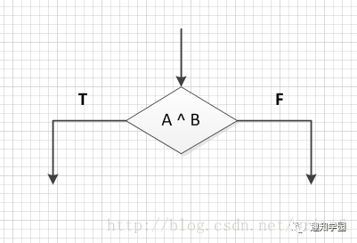
Condition coverage
设计用例时针对判断语句里面每个条件表达式true 和 false各取值一次，不考判断语句的计算结果
测试用例条件： A=T A=F B=T B=F
Notes:
（3）条件覆盖
设计用例时针对判断语句里面每个条件表达式true 和 false各取值一次，不考判断语句的计算结果
测试用例条件： A=T A=F B=T B=F

Slide 95
Condition coverage concept
一个判定（ determine ）中往往包含了若干个条件（condition
执行足够的测试用例，使得判定中的每个条件获得各种可能的结果（T or F）。
条件覆盖是一个比判定覆盖更强的覆盖标准
要同时
判定内部每一个子表达式的取值不被考虑

Slide 96
源代码与程序流程图

Slide 97
方案：
用例1：A=10，B=0，X=30
用例2：A=2，B=5，X=5

Slide 98

Branch conditional coverage
（4）判定条件覆盖（分支条件覆盖）
设计测试用例时，使得判断语句中每个条件表达式的所有可能结果至少出现一次，每个判断语句本身所有可能结果也至少出现一次。
测试用例条件： A ^ B = T A ^ B = F A=T A=F B=T B=F

Slide 99

Conditional combination coverage
（5）条件组合覆盖
设计测试用例时，使得每个判断语句中条件结果的所有可能组合至少出现一次
测试用例条件： A= T B= T A= T B= F A= F B= T A= F B= F

Slide 100
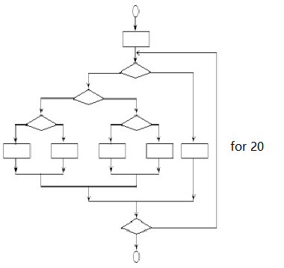
Path coverage
Notes:
上图中包含的不同执行路径数达5的20次方条路径，假定对每一条路径进行测试需要1毫秒，一年工作365 × 24小时，要想把所有路径测试完，需3170年。

Slide 101
For 循环
for fruit in fruits:
print(“当前水果： ”, fruit)
for i in range(2, 10):
print(“当前数字：”, i)
for i in range(2, 10):
print(“当前数字：”, i)
else：
print(“这个数字 ”, i, “我搞不定”)

Slide 102
While循环
While a<10:
print(a)
while a<10:
print(a)
if a>8:
break

Slide 103
Control Flow Graph (CFG)
短路
循环体
循环跳出

Slide 104
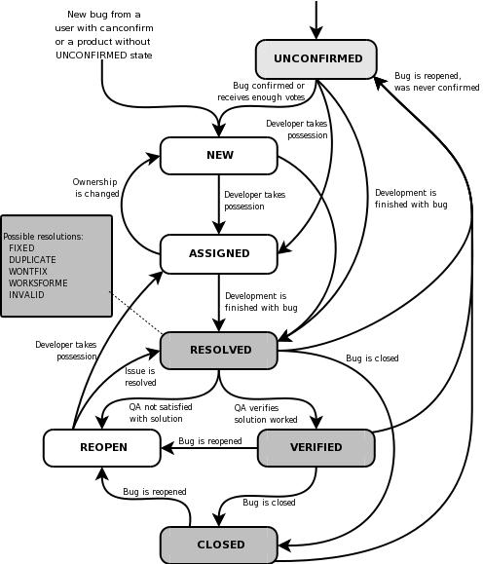
Bug Life Cycle
Defect life cycle, also known as Bug Life cycle is the journey of a defect cycle, which a defect goes through during its lifetime. It varies from organization to organization and also from project to project as it is governed by the software testing process and also depends upon the tools used.
New - Potential defect that is raised and yet to be validated.
Assigned - Assigned against a development team to address it but not yet resolved.
Active - The Defect is being addressed by the developer and investigation is under progress. At this stage there are two possible outcomes; viz - Deferred or Rejected.
Test - The Defect is fixed and ready for testing.
Verified - The Defect that is retested and the test has been verified by QA.
Closed - The final state of the defect that can be closed after the QA retesting or can be closed if the defect is duplicate or considered as NOT a defect.
Reopened - When the defect is NOT fixed, QA reopens/reactivates the defect.
Deferred - When a defect cannot be addressed in that particular cycle it is deferred to future release.
Rejected - A defect can be rejected for any of the 3 reasons; viz - duplicate defect, NOT a Defect, Non Reproducible.

Slide 105
Testing and Debugging
目标不同：测试的目标是发现问题，调试的目标是解决问题（发现在哪里出了问题，错误分析，缺陷定位）
优势不同：单元测试可以与jekins和git/svn这样的集成工具联动，实现自动化，更有利于团队协作和管理；debug必须手动监测变量名称，人肉执行，可以嵌入开发“中”，而不必等到事后。
对运行时的影响：无影响，必须在运行时监控代码中的变量
Value不同：单元测试可以组成不同的process，可以实现开发人员的分工，可以
Defect testing and debugging are distinct processes
Defect testing is concerned with confirming the presence of errors
Debugging is concerned with locating and repairing these errors
Debugging involves formulating a hypothesis about program behavior then testing these hypotheses to find the system error

Slide 106
Debugging Activities
Locate error
& fault
Design fault
repair
Repair fault
Re-test
program

Slide 107
Debugging: Issues
observed bug and its cause may be geographically separated
observed bug may disappear when another problem is fixed
cause of bug may be due to human error that is hard to trace
cause of bug may be due to assumptions that everyone believes
observed bug may be intermittent because of a system or compiler error

Slide 108
Breakpoints
line breakpoint
field breakpoint
method breakpoint
exception breakpoint
Notes:
我们常说的断点(breakpoints)是指line breakpoints,除了line breakpoints,还有其他的断点类型：field(watchpoint)breakpoint,method breakpoint ,exception breakpoint.
field breakpoint 也叫watchpoint(监视点) 当成员变量被读取或修改时暂挂 添加method breakpoint 进入/离开此方法时暂挂(Run-method breakpoint) 添加Exception breakpoint 捕抓到Execption时暂挂

Slide 109
Tools on hands
step into：单步执行，遇到子函数就进入并且继续单步执行（简而言之，进入子函数）； step over：在单步执行时，在函数内遇到子函数时不会进入子函数内单步执行，而是将子函数整个执行完再停止，也就是把子函数整个作为一步。有一点,经过我们简单的调试,在不存在子函数的情况下是和step into效果一样的（简而言之，越过子函数，但子函数会执行）。 step out：当单步执行到子函数内时，用step out就可以执行完子函数余下部分，并返回到上一层函数。
step Filter 逐步过滤 一直执行直到遇到未经过滤的位置或断点(设置Filter:window-preferences-java-Debug-step Filtering) Resume 重新开始执行debug,一直运行直到遇到breakpoint。 例如 ：A和B两个断点，debug过程中发现A断点已经无用,去除A断点，运行resume就会跳过A直接到达B断点。当debug调试跑出异常时,运行resume,重新从断点开始调试。ebug 过程中修改了某些code后--〉save&build-->resume-->重新暂挂于断点
hit count 设置执行次数 适合程序中的for循环(设置 breakpoint view-右键hit count)
inspect 检查 运算。执行一个表达式显示执行值
watch 实时地监视对象、方法或变量的变化
Step Into
Step Over Step Return
Step Filter
Resume
hit count
inspect
watch

Slide 110
Debugging: Approaches
Brute Force – hack away at the code until it is found
Backtracking – fine for small programs
Cause elimination – hypothesise about what is causing the bug and input test data to check this

Slide 111
White box testing
White-box testing (also known as clear box testing, glass box testing, transparent box testing, and structural testing) is a method of software testing that tests internal structures or workings of an application, as opposed to its functionality (i.e. black-box testing). In white-box testing an internal perspective of the system, as well as programming skills, are used to design test cases. The tester chooses inputs to exercise paths through the code and determine the expected outputs. This is analogous to testing nodes in a circuit, e.g. in-circuit testing (ICT).
White-box testing can be applied at the unit, integration and system levels of the software testing process. Although traditional testers tended to think of white-box testing as being done at the unit level, it is used for integration and system testing more frequently today. Though this method of test design can uncover many errors or problems, it has the potential to miss unimplemented parts of the specification or missing requirements.

Slide 112
White box testing coverage pattern
In computer science, test coverage is a measure used to describe the degree to which the source code of a program is executed when a particular test suite runs. A program with high test coverage, measured as a percentage, has had more of its source code executed during testing, which suggests it has a lower chance of containing undetected software bugs compared to a program with low test coverage. Many different metrics can be used to calculate test coverage; some of the most basic are the percentage of program subroutines and the percentage of program statements called during execution of the test suite.
Statement coverage – has each statement in the program been executed
Branch coverage – has each branch (also called DD-path) of each control structure (such as in if and case statements) been executed
Condition coverage (or predicate coverage) – has each Boolean sub-expression evaluated both to true and false

Slide 113
黑盒测试：
也称功能测试、数据驱动测试，它将被测软件看作一个打不开的黑盒，主要根据功能需求设计测试用例，进行测试。
概念：黑盒测试是从一种从软件外部对软件实施的测试，也称功能测试或基于规格说明的测试。其基本观点是：任何程序都可以看作是从输入定义域到输出值域的映射，这种观点将被测程序看作一个打不开的黑盒，黑盒里面的内容(实现)是完全不知道的，只知道软件要做什么。因无法看到盒子中的内容，所以不知道软件是如何实现的，也不关心黑盒里面的结构，只关心软件的输入数据和输出结果。

