Slide 1


Test Case Design
对美外包软件测试实践课程
Weifeng Lu
2012/05/14
Notes:
考试只考：等价类&边界值方法
大作业也只考察这两个方法的应用

Slide 2
Agenda
Test Life Cycle
Test Case Design Workflow
Test Case Concept
Test Case Design Objective
Test Case Design Methods
Equivalence Class Partitioning
Boundary Value Analysis
Combinatorial Analysis(Pairwise)

Slide 3
Roadmap
Test Life Cycle
Test Case Design Workflow
Test Case Concept
Test Case Design Objective
Test Case Design Methods
Equivalence Class Partitioning
Boundary Value Analysis
Combinatorial Analysis(Pairwise)

Slide 4
Execute Test Case
Test Case
Execute
Test Results
Test Plan Phase
Draft/Revise Test Plan
Project Orientation Documents
Test Plan
Review
Test Case Phase
Draft/Revise Test Case
BSD/TAD
Test Case
Analyze
Test Execution Phase
Draft/Review Test Report
Test Results
Test Report
Review and Analyze
Test Report Phase
Task
Input
Output
Effort

Slide 5
Roadmap
Test Life Cycle
Test Case Design Workflow
Test Case Concept
Test Case Design Objective
Test Case Design Methods
Equivalence Class Partitioning
Boundary Value Analysis
Combinatorial Analysis(Pairwise)

Slide 6
BA
QA
BSD
Use Case
Business knowledge
Test Requirement Analyze
Test Requirement
Test Case
TAD
Test Techniques
Dev

Slide 7
Roadmap
Test Life Cycle
Test Case Design Workflow
Test Case Concept
Test Case Design Objective
Test Case Design Methods
Equivalence Class Partitioning
Boundary Value Analysis
Combinatorial Analysis(Pairwise)

Slide 8
A set of test inputs, execution conditions, and expected results developed for a particular objective, such as to exercise a particular program path or to verify compliance with a specific requirement.
IEEE Std 610-1990
Components
Test Case ID
Description/Name
Priority
Pre-condition
Test Data
Steps
Expected Results

Slide 9
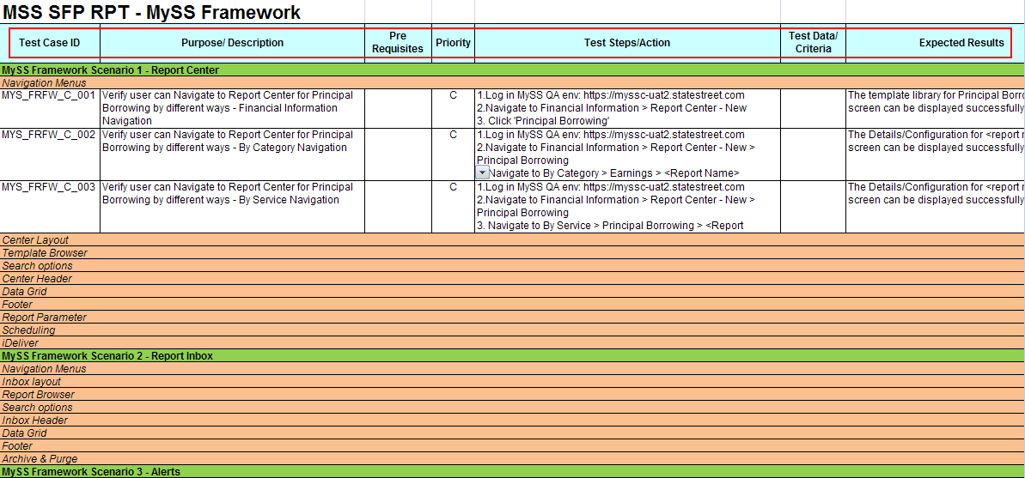

Slide 10
Roadmap
Test Life Cycle
Test Case Design Workflow
Test Case Concept
Test Case Design Objective
Test Case Design Methods
Equivalence Class Partitioning
Boundary Value Analysis
Combinatorial Analysis(Pairwise)

Slide 11
Objectives
Good Test Coverage
Objectives

Slide 12
How does TC cover UC?
 | UC1 |  |  |  | UC2 |  | UC3
TC | MF | AF1 | AF2 | AF3 | MF | AF | MF | AF1 | AF2
TC1.1 | ● |  |  |  | ● |  | ●
TC1.2 | ● |  |  |  | ● |  | ●
TC1.3 |  | ● |  |  | ● |  | ●
TC1.4 |  | ● |  |  | ● |  |  | ●
TC1.5 |  | ● |  |  | ● |  |  |  | ●
TC1.6 |  |  | ● |  | ● |  |  |  | ●
TC1.7 |  |  | ● |  | ●
TC2.1 |  |  | ●
TC2.2 |  |  |  | ●
TC2.3 |  |  |  | ● |  | ●
TC2.4 |  |  |  | ● |  | ●

Slide 13
Objectives
Good Test Traceability
Good Test Coverage
Objectives

Slide 14
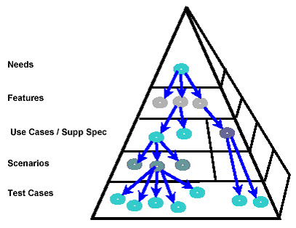
Keep End User Needs in Mind

Slide 15
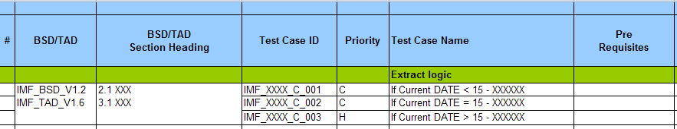
Traceability Matrix
Requirement Traceability Matrix is a two-way mapping between requirements and test cases, which provides confidence about test coverage

Slide 16
Objectives
Good Test Traceability
Good Test Coverage
Objectives
Executability and Maintainability

Slide 17
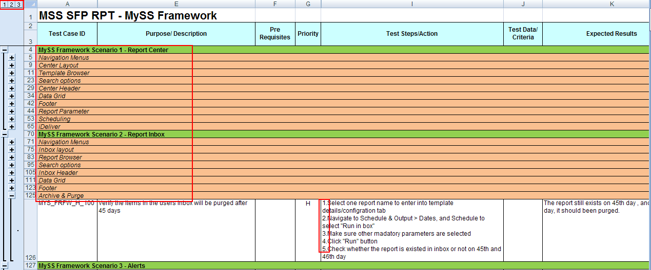
Test cases organizational structure and levels should be reasonable and the execution of the test cases should be smoothly to minimize test execution and maintainability costs.

Slide 18
Roadmap
Test Life Cycle
Test Case Design Workflow
Test Case Concept
Test Case Design Objective
Test Case Design Methods
Equivalence Class Partitioning
Boundary Value Analysis
Combinatorial Analysis(Pairwise)

Slide 19
Overview
Functional Testing Techniques
Equivalence Class Partitioning
Combinatorial Analysis
Each Choice Once(EC)
Base Choice(BC)
Boundary Value Analysis
Orthogonal Array(OA)
Combinatorial Test(pair-wise through n-wise)
Exhaustive Testing
Need in-depth Domain and Business Knowledge
The value or effectiveness of using any test technique ultimately depends on the individual test’s system and domain knowledge and ability to apply the applicable technique in the correct situation.
Notes:
Exhaustively testing all possible inputs to any nontrivial software component is generally impossible due to the enormous number of variations. One approach to create a test suite with high coverage and a low number of variations is known as combinatorial testing. One common strategy, known as pairwise, tests a set of variations where every possible pair of parameters appears at least once. This method can be extended to use higher orders of combinations (3-wise, 4-wise, etc) for increased coverage at the expense of a larger test suite.
Software test techniques exist to reduce the number of tests to be run whilst still providing sufficient coverage of the system under test
There is no single technique or approach that is completely effective in software testing, so by increasing the diversity of methods used in testing and considering different perspectives, we are more likely to be successful in both exposing potential issues as well as increasing the effectiveness of our testing.
The value or effectiveness of using any test technique ultimately depends on the individual test’s system and domain knowledge and ability to apply the applicable technique in the correct situation.

Slide 20
Theory
Functional Testing Techniques
Equivalence Class Partitioning
Combinatorial Analysis
Boundary Value Analysis
Combinatorial Test(pair-wise through n-wise)
Single fault assumption
most failures are caused by interactions between relatively few parameters
Failures are only rarely the result of the simultaneous occurrence of two or more faults.
Notes:
The single fault assumption in reliability theory states that failures are rarely the result of the simultaneous occurrence of two (or more) faults.
The primary purpose of ECP and BVA testing is to expose single fault.
在实际系统中，输入域往往不是单一的，有多个输入域，每个输入域到底该如何组合取值呢。等价类和边界值分析都基于一个十分重要的假设，这个假设在可靠性理论中被称作“单故障”假设，即失效问题通常不会由两个（或多个）故障同时引发。因此，构造测试用例的方式是：仅让一个变量取不同的值，而让其他所有变量都取正常值.

Slide 21
Roadmap
Test Life Cycle
Test Case Design Workflow
Test Case Concept
Test Case Design Objective
Test Case Design Methods
Equivalence Class Partitioning
Boundary Value Analysis
Combinatorial Analysis(Pairwise)

Slide 22
Functional Testing Techniques
Equivalence Class Partitioning
Combinatorial Analysis
Each Choice Once(EC)
Base Choice(BC)
Boundary Value Analysis
Orthogonal Array(OA)
Combinatorial Test(pair-wise through n-wise)
Exhaustive Testing
Need in-depth Domain and Business Knowledge
The value of the ECP helps systematically reduce the number of tests from all possible tests whilst still providing sufficient coverage of the system under test.

Slide 23
Equivalence Partitioning
Divide the set A into ( a1, a2, - - - -, an ) subsets:
a1 U a2 U - - - - U an = A (completeness)
for any i and j, ai ∩ aj = Ø (no duplication)
Equivalence Class Testing
use one element from each equivalence class
Any data element from a specific subset in a given class should produce the same extract result
.
Notes:
等价类之间的边界

Slide 24
Approach
1.Decompose the data into discrete subsets

Slide 25
Partitioning
First-level partitioning: Separate data into Valid and Invalid classes
Invalid
Valid
Notes:
先分为有效&无效

Slide 26
Partitioning
Carefully analyze the data in each class and further decompose the data in each class into discrete subsets in that class
Invalid
Valid
Notes:
等价类有明确边界
分解大等价类

Slide 27
Partitioning Principle
an integer value from 1 through 999
Range
Data in a class might be handled differently from other data in that class
A list of vehicles includes truck car, and trailer
Principle
Unique
Group
Specific
The condition must be or must not be present, e.g the at symbol(@) for e-mail name
Notes:
If an input condition specifies a range of values, this defines three classes:
within range: a valid input equivalence class
too large: an invalid input equivalence class
too small: a invalid input equivalence class
If an input condition specifies an enumerated set of values (e.g. “car”, “truck”, etc.):
One valid equivalence class for each value in the group.
One invalid equivalence class: all values not in the enumerated set (i.e. everything else).
If an input condition specifies a “must be”, situation (e.g. “first character of the identifier must be a letter”), this
leads to:
One valid equivalence class (e.g. the first character is a letter).
One invalid equivalence class (e.g. the first character is not a letter).
Finally, if there is any reason to believe that elements in an equivalence class are not handled in an identical
manner by the implementation software, split the equivalence class into smaller classes.

Slide 28
Other …
Consider creating an equivalence partition that handle the default, empty, blank, null, zero, or none conditions.
Default: no value supplied, and some value is assumed to be used instead.
Empty: value exists, but has no contents.
e.g. Empty string “”
Blank: value exists, and has content.
e.g. String containing a space character “ ”
Null: value does not exist or is not allocated.
e.g. object that has not been created.
Zero: numeric value
None: when selecting from a list, make no selection.

Slide 29
Approach
1.Decompose the data into discrete subsets
2.Assign a unique identifier to each equivalence class
3.Until all valid equivalence classes have been covered by at least one test case, write a new test case covering as many of the valid equivalence classes as possible
4.Until all invalid equivalence classes have been covered, write a test case that covers one, and only one, of the uncovered invalid equivalence classes while setting the other parameters to nominal valid value
Single fault assumption

Slide 30
Example
A text box accepts a string between upper case A To Z with a min length of 2 and a max length of 10 characters.
Input | Valid class subsets | Invalid class subsets
Characters | A-Z | Not IN A-Z
Length | 2-10 | < 2 > 10

Slide 31
Example
A text box accepts a string between upper case A To Z with a min length of 2 and a max length of 10 characters.
Input | Valid class subsets | Invalid class subsets
Characters | v1 - A-Z | i1 - Not IN A-Z
Length | v2 - 2-10 | i2 - < 2 i3 - > 10
Test Cases | Expected Result | Covered class subsets
BCDBC | allowed | v1, v2

Slide 32
Example
A text box accepts a string between upper case A To Z with a min length of 2 and a max length of 10 characters.
Input | Valid class subsets | Invalid class subsets
Characters | v1 - A-Z | i1 - Not IN A-Z
Length | v2 - 2-10 | i2 - < 2 i3 - > 10
Test Cases | Expected Result | Covered class subsets
eee | Not allowed | v2, i1
G | Not allowed | v1, i2
BCBCBCBCBCD | Not allowed | v1, i3
single fault
assumption

Slide 33
Combined with randomly data generation
File/DB
By executing the test several times and randomly selecting elements from specified class which increases the breadth of coverage beyond simple static data and provides a great deal of flexibility for the tester or for an automated test.

Slide 34
Case Study - Triangle
Specification
We have a triangle three sides A, B, C.
If they can form a triangle three sides must be met:
A>0, B>0, C>0, A+B>C, B+C>A, A+C>B.
1) If it is isosceles, also need to judge whether A = B, or B = C, or A = C.
2) If it is equilateral, also need to judge whether A = B, and B = C, and A = C.
Input condition | Valid class subsets | Invalid class subsets
scalene
isosceles
equilateral
v1（A>0）
v2（B>0）
v3（C>0）
v4（A+B>C）
v5（B+C>A）
v6（A+C>B）
i1（A≤0）
i2（B≤0）
i3（C≤0）
i4（A+B≤C）
i5（B+C≤A）
i6（A+C≤B）
scalene
invalid
isosceles
equilateral
v7 (A = B and A ≠ C)
v8 (B = C and A ≠ B)
v9 (A = C and A ≠ B)
i7 (A ≠ B and A ≠ C and B ≠ C)
v10 (A = C and A = B and B = C)
i8 (A ≠ B)
i9 (B ≠ C)
i10 (A ≠ C)

Slide 35
ID | [A, B, C] | Covered class subsets | Output
1 | [3，4，5] | v1, v2, v3, v4, v5, v6 | scalene
2 | [3，3，4] | v1, v2, v3, v4, v5, v6, v7 | isosceles
3 | [3，4，4] | v1, v2, v3, v4, v5, v6, v8 | isosceles
4 | [3，4，3] | v1, v2, v3, v4, v5, v6, v9 | isosceles
5 | [3，3，3] | v1, v2, v3, v4, v5, v6, v10 | equilateral
6 | [0，1，2] | i1 | invalid
7 | [1，0，2] | i2 | invalid
8 | [1，2，0] | i3 | invalid
9 | [1，2，3] | i4 | invalid
10 | [1，3，2] | i5 | invalid
11 | [3，1，2] | i6 | invalid
12 | [3，4，6] | v1, v2, v3, v4, v5, v6, i7 | scalene
13 | [3，4，4] | v1, v2, v3, v4, v5, v6, i8 | isosceles
14 | [3，4，3] | v1, v2, v3, v4, v5, v6, i9 | isosceles
15 | [3，3, 4] | v1, v2, v3, v4, v5, v6, i10 | isosceles

Slide 36
Roadmap
Test Life Cycle
Test Case Design Workflow
Test Case Concept
Test Case Design Objective
Test Case Design Methods
Equivalence Class Partitioning
Boundary Value Analysis
Combinatorial Analysis(Pairwise)
Notes:
边界值设计方法（和等价类设计方法不同不依赖 但往往联合使用）
等价类测试方法只测试一个点（用一个点代表同一个等价类）；对于等价类的区间 利用边界值测试方法 测试边界值的几个点 共7个点 （数学边界 测6个点）

Slide 37
Functional Testing Techniques
Equivalence Class Partitioning
Combinatorial Analysis
Each Choice Once(EC)
Base Choice(BC)
Boundary Value Analysis
Orthogonal Array(OA)
Combinatorial Test(pair-wise through n-wise)
Exhaustive Testing
Need in-depth Domain and Business Knowledge
The value of the BVA helps identify incorrect artificial constraints of a data type, problems with looping structures, incorrect assigned relational operators and Off-by-one errors.
Notes:
This BVA technique believes and extends the concept that the density of defect is more towards the boundaries. This is done due to the following reasons
a) Usually the programmers are not able to decide whether they have to use <= operator or < operator when trying to make comparisons.
b) Different terminating conditions of For-loops, While loops and Repeat loops may cause defects to move around the boundary conditions.
c) The requirements themselves may not be clearly understood, especially around the boundaries, thus causing even the correctly coded program to not perform the correct way.

Slide 38
Boundary Value Analysis
Boundary value analysis focuses on the boundaries of the domain.
Rationale: Historical evidence demonstrates that errors occur most frequently on or near the boundary
operator <= or <
For-loops, While loops and Repeat loops
The requirements may not be clearly understood, especially around the boundaries
Jorgensen’s (6N + 1) formula for robust boundary test
X
a- a a+
b
c- c c+
baseline
Robust augmentation
Single-Variable, Single-Range Baseline Test Cases Augmented With Robustness Tests
(shaded area indicates valid values of the variable X)
Notes:
Main value of robustness testing: focuses attention on exception handling

Slide 39
Example
A text box accepts a string between upper case A To Z with a min length of 2 and a max length of 10 characters.
Char | @ | A | B | … | Y | Z | [
ASCII/Unicode | 64 | 65 | 66 | … | 89 | 90 | 91

Slide 40
Example
A text box accepts a string between upper case A To Z with a min length of 2 and a max length of 10 characters.
Test | String | Expected result | Notes
1 | @@@@ | Not Allowed | char ASCII min - 1, length nominal
2 | AAAA | Allowed | char ASCII min, length nominal
3 | BBBB | Allowed | char ASCII min + 1, length nominal
4 | YYYY | Allowed | char ASCII max - 1, length nominal
5 | ZZZZ | Allowed | char ASCII max , length nominal
6 | [[[[ | Not Allowed | char ASCII max + 1, length nominal
7 | G | Not Allowed | length min - 1, char nominal
8 | GG | Allowed | length min, char nominal
9 | GGG | Allowed | length min + 1, char nominal
10 | FFFFFFFFF | Allowed | length max - 1, char nominal
11 | KKKKKKKKKK | Allowed | length max , char nominal
12 | LLLLLLLLLLL | Not Allowed | length max + 1, char nominal
13 | ABCEFG | Allowed | All nominal
single fault
assumption
6 * 2 + 1 = 13

Slide 41
Dependency Between Parameters
Obvious Conditions:
1 ≤ Day ≤ 31.
1 ≤ month ≤ 12.
1582 ≤ Year ≤ 3000
Month
Day
Year
Next Date
There are more complicated issues to consider due to the dependencies between parameters. For example there is never a day of 31, Feb (tester’s intuition and common sense shows that we require more emphasis towards the end of February)
Many boundary values that have been hidden due to the dependencies between parameters
Notes:
Inadequate when there are dependencies between the variables ("Equivalence Class" Testing is better)
Bounds may not be always obvious (e.g. an upper bound for the triangle problem)
Bounds may not be appropriate (e.g. for Boolean values; “Decision Table” Testing is better)
No bounds in cases of enumerated variables (e.g. in bank transactions “deposit”, “withdrawal”, “query”)

Slide 42
Case Study - Next Day
Obvious Conditions:
1 ≤ Day ≤ 31.
1 ≤ month ≤ 12.
1582 ≤ Year ≤ 3000
Month
Day
Year
Next Date
Fields | Valid class subsets
Day | 1 through 28 29 30 31
Month | those that have 31 days or {1,3,5,7,8,10,12} those that have 30 days or {4,6,9,11} that has less than 30 days or {2}
Year | leap years between 1582 and 3000 non-leap years between 1582 and 3000
Equivalence class subsets are valuable in helping identify potential boundary conditions

Slide 43
Case Study - Next Day
Fields | Valid class subsets
Day | 1 through 28 29 30 31
Month | those that have 31 days or {1,3,5,7,8,10,12} those that have 30 days or {4,6,9,11} that has less than 30 days or {2}
Year | leap years between 1582 and 3000 non-leap years between 1582 and 3000
1-28
2
Leap
29
4, 6, 9, 11
Non-Leap
30
1,3,5,7,8,10,12
31

Slide 44
Case Study - Next Day
1 ≤ Day ≤ 31
Hidden boundary values
due to the dependency
Test | Month | Day | Year | Expected result | Notes
1 | 31-day month | 0 | 1582-3000 | Error Msg | Day Min - 1 (31-day Month)
2 | 31-day month | 1 | 1582-3000 | Next Day | Day Min (31-day Month)
3 | 31-day month | 2 | 1582-3000 | Next Day | Day Min + 1 (31-day Month)
4 | 31-day month | 30 | 1582-3000 | Next Day | Day Max - 1 (31-day Month)
5 | 31-day month | 31 | 1582-3000 | Next Day | Day Max (31-day Month)
6 | 31-day month | 32 | 1582-3000 | Error Msg | Day Max + 1 (31-day Month)
7 | 30-day month | 0 | 1582-3000 | Error Msg | Day Min - 1 (30-day Month)
8 | 30-day month | 1 | 1582-3000 | Next Day | Day Min (30-day Month)
9 | 30-day month | 2 | 1582-3000 | Next Day | Day Min + 1 (30-day Month)
10 | 30-day month | 29 | 1582-3000 | Next Day | Day Max - 1 (30-day Month)
11 | 30-day month | 30 | 1582-3000 | Next Day | Day Max (30-day Month)
12 | 30-day month | 31 | 1582-3000 | Error Msg | Day Max + 1 (30-day Month)

Slide 45
Case Study - Next Day
1 ≤ Day ≤ 31
Hidden boundary values
due to the dependency
Test | Month | Day | Year | Expected result | Notes
13 | 2 | 0 | Leap year | Error Msg | Day Min - 1 (Feb in Leap year)
14 | 2 | 1 | Leap year | Next Day | Day Min (Feb in Leap year)
15 | 2 | 2 | Leap year | Next Day | Day Min + 1 (Feb in Leap year)
16 | 2 | 28 | Leap year | Next Day | Day Max - 1 (Feb in Leap year)
17 | 2 | 29 | Leap year | Next Day | Day Max (Feb in Leap year)
18 | 2 | 30 | Leap year | Error Msg | Day Max + 1 (Feb in Leap year)
19 | 2 | 0 | Non-leap year | Error Msg | Day Min - 1 (Feb in Non-leap year)
20 | 2 | 1 | Non-leap year | Next Day | Day Min (Feb in Non-leap year)
21 | 2 | 2 | Non-leap year | Next Day | Day Min + 1 (Feb in Non-leap year)
22 | 2 | 27 | Non-leap year | Next Day | Day Max - 1 (Feb in Non-leap year)
23 | 2 | 28 | Non-leap year | Next Day | Day Max (Feb in Non-leap year)
24 | 2 | 29 | Non-leap year | Error Msg | Day Max + 1 (Feb in Non-leap year)

Slide 46
Case Study - Next Day
1 ≤ month ≤ 12.
Test | Month | Day | Year | Expected result | Notes
25 | 0 | 1-28 | 1582-3000 | Error Msg | Month Min - 1
26 | 1 | 1-28 | 1582-3000 | Next Day | Month Min
27 | 2 | 1-28 | 1582-3000 | Next Day | Month Min + 1
28 | 11 | 1-28 | 1582-3000 | Next Day | Month Max - 1
29 | 12 | 1-28 | 1582-3000 | Next Day | Month Max
30 | 13 | 1-28 | 1582-3000 | Error Msg | Month Max + 1
Each month have 1-28th day
Notes:
The boundary value and the values immediately above and immediately below are evaluated for each parameter while the other parameters are set to some nominal value

Slide 47
Case Study - Next Day
1582 ≤ Year ≤ 3000
.
Test | Month | Day | Year | Expected result | Notes
25 | 1-12 | 1-28 | 1581 | Error Msg | Year Min - 1
26 | 1-12 | 1-28 | 1582 | Next Day | Year Min
27 | 1-12 | 1-28 | 1583 | Next Day | Year Min + 1
28 | 1-12 | 1-28 | 2999 | Next Day | Year Max - 1
29 | 1-12 | 1-28 | 3000 | Next Day | Year Max
30 | 1-12 | 1-28 | 3001 | Error Msg | Year Max + 1
Each month have 1-28th day
Notes:
The boundary value and the values immediately above and immediately below are evaluated for each parameter while the other parameters are set to some nominal value

Slide 48
Case Study - Next Day
Output Boundary
.
Test | Month | Day | Year | Expected result | Notes
25 | 12 | 31 | 1581 | Error Msg | Output Min - 1
26 | 1 | 1 | 1582 | 1/2/1582 | Output Min
27 | 1 | 2 | 1583 | 1/3/1583 | Output Min + 1
28 | 12 | 30 | 3000 | 12/31/3000 | Output Max - 1
29 | 12 | 31 | 3000 | 1/1/3001 | Output Max
30 | 1 | 1 | 3001 | Error Msg | Output Max + 1
Notes:
The boundary value and the values immediately above and immediately below are evaluated for each parameter while the other parameters are set to some nominal value

Slide 49
Roadmap
Test Life Cycle
Test Case Design Workflow
Test Case Concept
Test Case Design Objective
Test Case Design Methods
Equivalence Class Partitioning
Boundary Value Analysis
Combinatorial Analysis(Pairwise)

Slide 50
Functional Testing Techniques
Equivalence Class Partitioning
Combinatorial Analysis
Each Choice Once(EC)
Base Choice(BC)
Boundary Value Analysis
Orthogonal Array(OA)
Combinatorial Test(pair-wise through n-wise)
Exhaustive Testing
Need in-depth Domain and Business Knowledge
The value of the CA helps identify most defects caused by variable interaction, provides greater structural coverage and reduce overall testing costs.
Notes:
Exhaustively testing all possible inputs to any nontrivial software component is generally impossible due to the enormous number of variations. One approach to create a test suite with high coverage and a low number of variations is known as combinatorial testing. One common strategy, known as pairwise, tests a set of variations where every possible pair of parameters appears at least once. This method can be extended to use higher orders of combinations (3-wise, 4-wise, etc) for increased coverage at the expense of a larger test suite.
考虑循环→条件覆盖（认为是一个choice 用白盒测试方法形成一个逻辑上的通路进行测试 ）

Slide 51
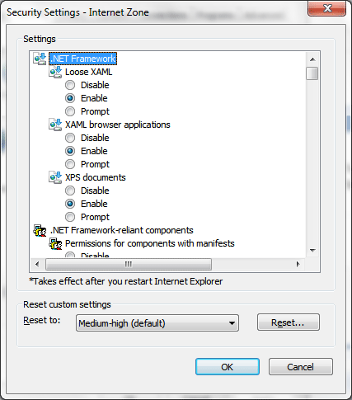
A common testing problem
The interactions between multiple interdependent/semi-coupled parameters with numerous
Variables per parameter are
likely to cause bugs!
Testing problem ...
24 parameters
2 - 5 variable per parameter
> 500,000,000,000
So, how would you choose the tests?

Slide 52
Testing challenge
Design extremely small subset of tests from all possibilities
Within a limited amount of time
Provide a high degree of confidence

Slide 53
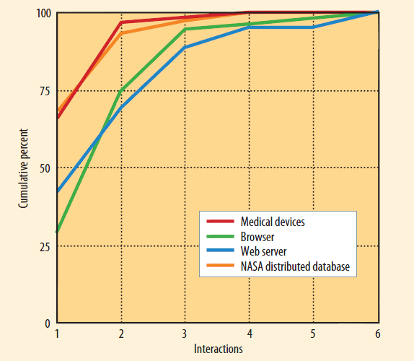
The basis behind combinatorial testing
Cumulative error detection rate for fault-triggering conditions. Many faults
were caused by a single parameter value, a smaller proportion resulted from an interaction between two parameter values, and progressively fewer were triggered by three-, four-, five, and six -way interactions.
Notes:
Pairwise or 2-way analysis is actually pretty effective because the combinatorial fault model suggests that most errors that result from the interaction of input variables occurs between the simple interaction of 2 inputs. Also, many studies demonstrate that a pairwise or 2-way analysis of input values is very effective in exposing a high percentage of multi-modal (and single mode) defects. But, although pairwise testing is effective in revealing more than 50% of the multi-modal errors there could still be bugs lurking that are caused by more complex interactions of input variables. In a multiyear study of various types of software products Richard Kuhn and Raghu Kacker found that some additional multi-modal bugs were exposed when 3 or more input values interacted as illustrated in the graph above.
The theoretical basis for pairwise testing is what is known as coupling effect. This is a practical hypothesis that software faults can be discovered by relatively simple tests. The coupling effect was researched e.g. by Jefferson Offutt who writes already in 1992 that “the major conclusion from this investigation is the fact that by explicitly testing for simple faults, we are also implicitly testing for more complicated faults” (J. Offutt: Investigations on the software testing coupling effect).
How this is related to pairwise testing is that the coupling effect hypothesis suggests that if there is a fault that manifests with a specific setting of configuration variables, it is most likely caused actually by only a small subset of those variable values.

Slide 54
Understanding n-Way
Parameter | Values
OS | Windows, Linux
CPU | Intel, AMD
Protocol | IPv4, IPv6
All Pairwise | (Windows, Intel) (Windows, AMD) (Windows, IPv4) (Windows, IPv6)
 | (Linux, Intel) (Linux, AMD) (Linux, IPv4) (Linux, IPv6)
 | (Intel, IPv4) (Intel, IPv6)
 | (AMD, IPv4) (AMD, IPv6)
Pairwise (2-way) test configurations.
Test Case | OS | CPU | Protocol
1 | Windows | Intel | IPv4
2 | Windows | AMD | IPv6
3 | Linux | Intel | IPv6
4 | Linux | AMD | IPv4
Notes:
Notes:
1）The reduction in test set size from eight to four shown in Table, is not that impressive, but consider
a larger example: a manufacturing automation system that has 20 controls, each with 10 possible settings—a
total of 1020 combinations, which is far more than a software tester would be able to test in a lifetime. Surprisingly, we can check all pairs of these values with only 180 tests if they are carefully constructed.
2）Most field faults were caused by either incorrect single values or by an interaction of pairs of values.

Slide 55
Parameter | Values
OS | Windows, Linux
Platform | x86, x64
CPU | Intel, AMD
Protocol | IPv4, IPv6
All 3-way combination | (Windows, x86, Intel) (Windows, x86, AMD) (Windows, x64, Intel) (Windows, x64, AMD) (Windows, x86, IPv4) (Windows, x86, IPv6) (Windows, x64, IPv4) (Windows, x64, IPv6) (Windows, Intel, IPv4) (Windows, Intel, IPv6) (Windows, AMD, IPv4) (Windows, AMD, IPv6)
 | (Linux, x86, Intel) (Linux, x86, AMD) (Linux, x64, Intel) (Linux, x64, AMD) (Linux, x86, IPv4) (Linux, x86, IPv6) (Linux, x64, IPv4) (Linux, x64, IPv6) (Linux, Intel, IPv4) (Linux, Intel, IPv6) (Linux, AMD, IPv4) (Linux, AMD, IPv6)
 | (x86, Intel, IPv4) (x86, Intel, IPv6) (x64, Intel, IPv4) (x64, Intel, IPv6)
 | (x86, AMD, IPv4) (x86, AMD, IPv6) (x64, AMD, IPv4) (x64, AMD, IPv6)

Slide 56
3-way combination test configurations.
ID | OS | Platform | CPU | Protocol
1 | Windows | x86 | Intel | IPv4
2 | Windows | x86 | AMD | IPv6
3 | Windows | x64 | Intel | IPv6
4 | Windows | x64 | AMD | IPv4
5 | Linux | x86 | Intel | IPv6
6 | Linux | x86 | AMD | IPv4
7 | Linux | x64 | Intel | IPv4
8 | Linux | x64 | AMD | IPv6

Slide 57
Scenario - Configuration
Parameter | Number of Values | Values
OS | 6 | XP SP2, Vista SP1, 7, Server 2003 SP2, Server 2008 SP1, Server 2008 R2
Language | 25 | (using 3-letter language abbreviations) ARA, CHS, CHT, CSY, DAN, DEU, ELL, ENG, ESN, FIN, FRA, HEB, HUN, ITA, JPN, KOR, NLD, NOR, PLK, PSE, PTB, PTG, RUS, SVE, TRK
System Locale | 2 | Same as OS language, TRK
Flavor | 2 | Free, Checked
Platform | 3 | x86, x64, x64 wow
IE version | 3 | OS default, IE7, IE8
High DPI | 2 | 120 DPI, 96 DPI
Theme | 6 | Native, Classic, Luna, Royale, Classic High Contrast, Aero
Side-by-side | 9 | 3.5 SP1 + 4 (3.5 tests), 3.5 SP1 + 4 (4 tests), 3.5 SP1 + 4 - 4 (3.5 tests), 4 + Mock 4.5 (4 tests), 4 + Mock 5 (4 tests), 4 + 3.5 SP1 (4 tests), 4 + 3.5 SP1 (3.5 tests), 4 + 3.5 SP1 - 4 (3.5 tests), 4 (4 tests)
Notes:
Please refer to http://blogs.msdn.com/ivo_manolov/archive/2009/08/26/9884004.aspx.
This example demonstrates how Microsoft WPF Team deals with a real-world problem... , WPF must work reliably on all OS configurations.
Most of the parameters are self-descriptive. “Side-by-side” captures the .NET installation state. For example “3.5 SP1 + 4 - 4 (3.5 tests)” means “install .NET 3.5 SP1, install .NET 4, uninstall .NET 4, run tests built against 3.5 SP1”. This is done to confirm that there are no unexpected side effects as a result of the installation and un-installation of .NET 4.
The trivial full expansion of the matrix results in 583,200 combinations (=6*25*2*2...). Of course, some of these combinations (e.g. XP SP2 OS with a Aero theme) are not valid, but even after removing the invalid combinations, we still end up with a prohibitively large number of platform configurations to test on. There are several ways to deal with this problem. One is identifying the so called equivalence classes. For example, from the point of view of Side-by-Side, Vista SP1 and Server 2008 SP1 can be regarded as equivalent OS-es and so on. Another popular approach is reducing regular testing to “vanilla configurations” (e.g. mostly ENG (English), 96-DPI configurations), venturing outside of the “vanilla domain” in accordance with a predefined schedule (e.g. during test passes at the end of major milestones). A third approach is using a pair-wise combinatorial variation generator, reducing the number of platform variations to about 230 – still a fairly high number for any real-world test pool, but clearly much better than the original number above. In the WPF team, we use the third approach, combined with an adaptive random algorithm, which prioritizes testing on platform configurations that have not been tested on recently.
所有的从右到左的语言(如阿拉伯语)算作一个等价类；所有的多字节语言(如日语)算作一个等价类；俄罗斯语算作一个等价类；英语算作一个等价类；其它语言算作一个等价类。

Slide 58
Scenario - API
public void Function(type Parameter1, type Parameter2, … , type ParameterN) { //Add code implement }
Parameter1 | Value1, value2
Parameter2 | Value3, value4, value5
… | …
ParameterN | value(N – 1), valueN, …

Slide 59
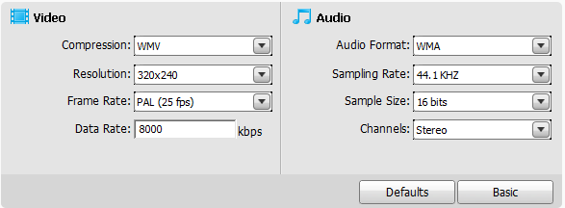
Scenario - GUI
Parameter | Number of Values | Values
Video Compression | 4 | H.264,MPEG-2,MPEG-4,WMV
Resolution | 4 | 320X240,Default,1920X1080,Other
Frame Rate | 4 | 15fps,Default,25fps,Other
Data Rate | 2 | Default, Custom
Audio Compression | 5 | AC3,LPCM,MP2,AAC,WMA

Slide 60
Demo

Slide 61
Thanks

