Slide 1
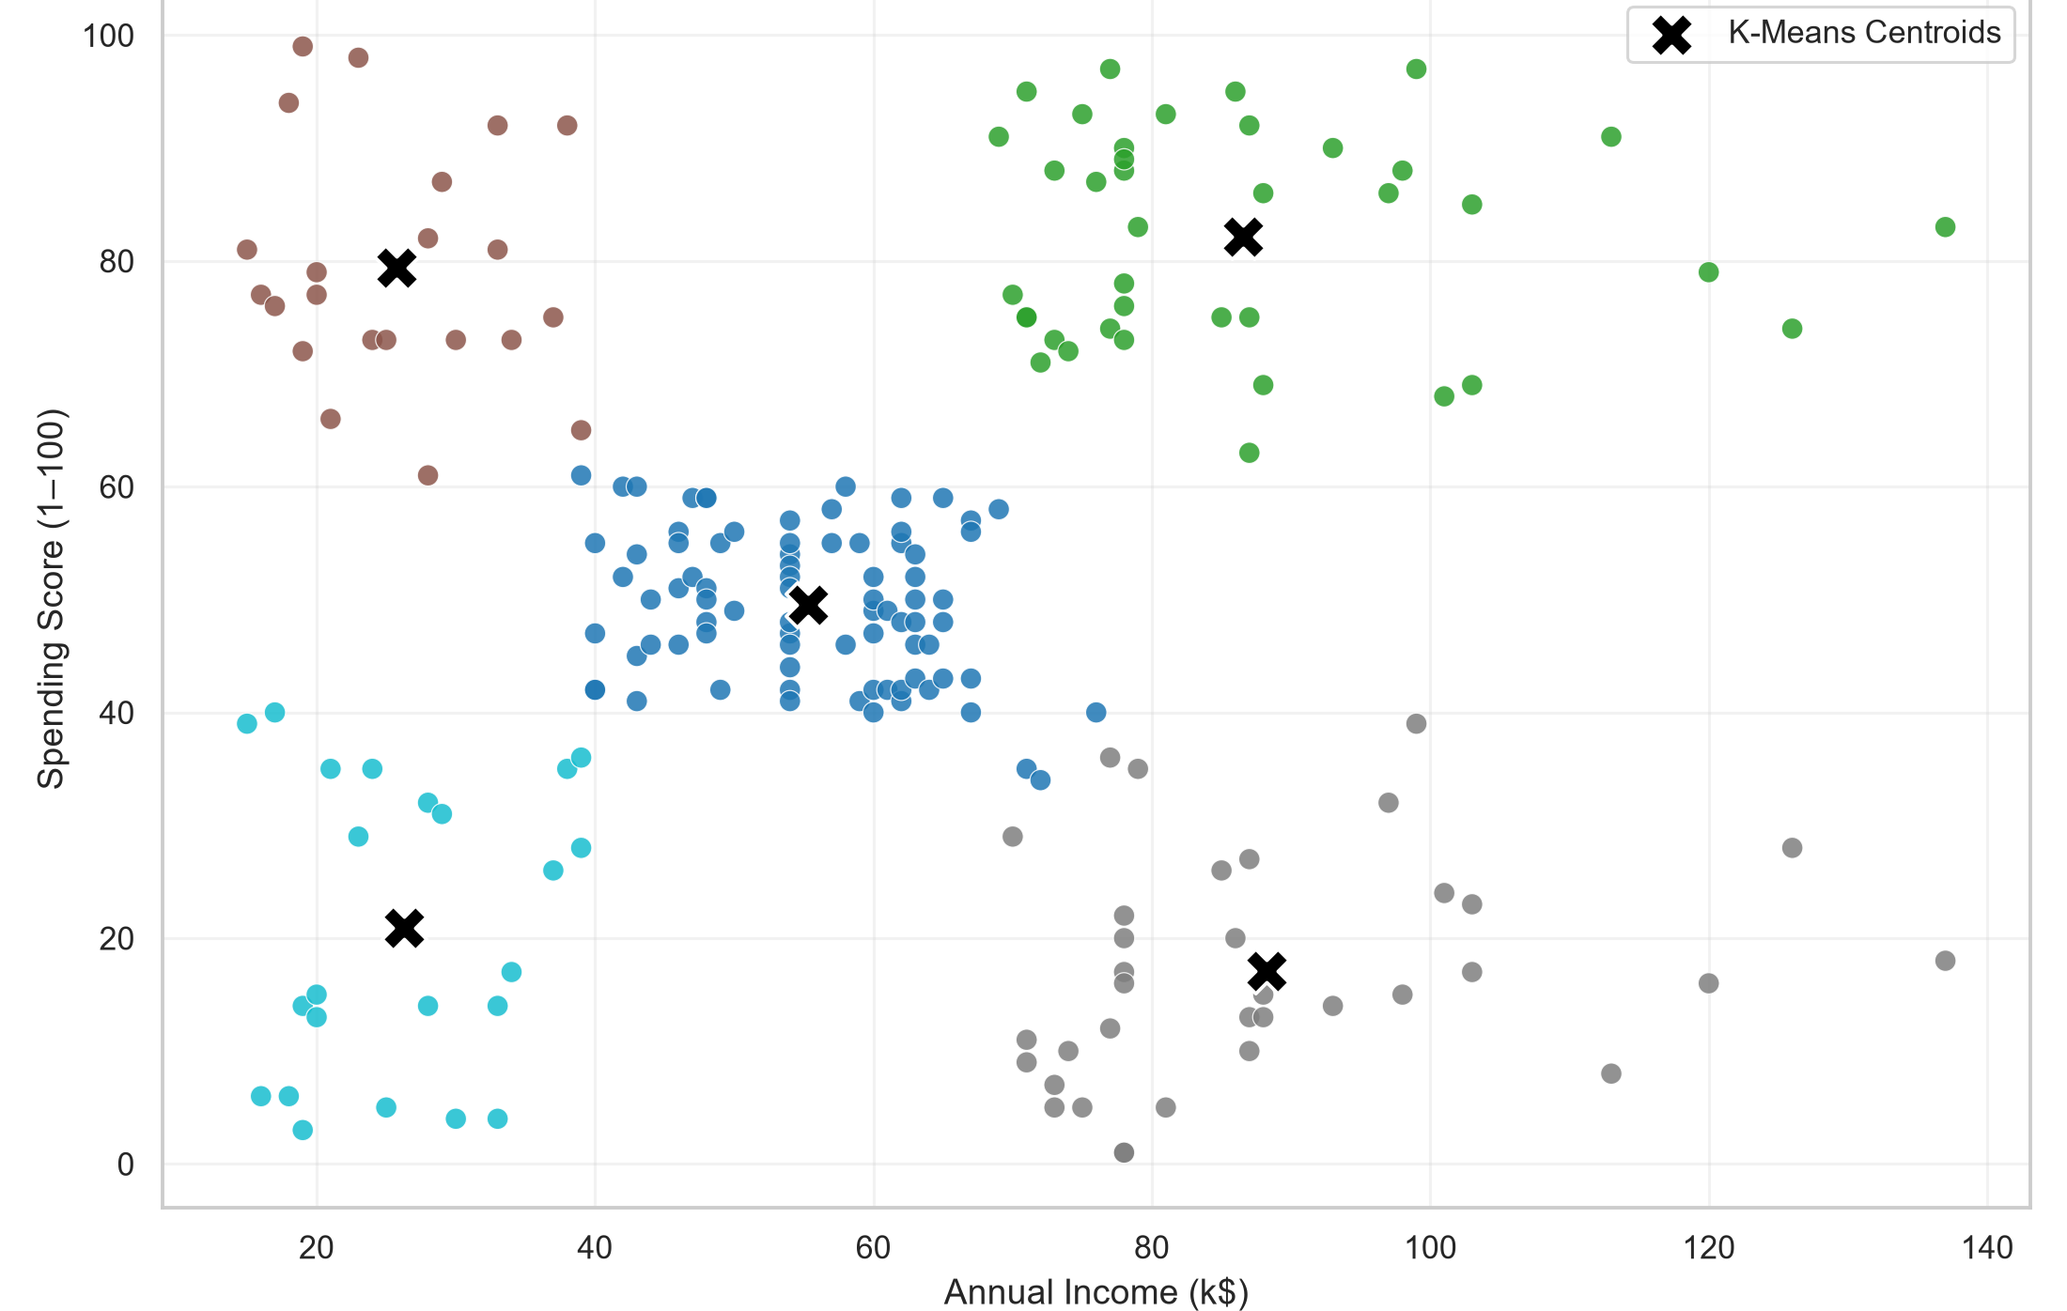
OPEN ENDED PROJECT • DATA MINING AND DATA WAREHOUSING
CustomerLens
Customer Segmentation Using K-Means and K-Medoids Clustering
with Optimal-K Selection and Interactive Analytics
Subject: Data Mining and Data Warehousing (BTCO14505)
Department: Computer Engineering
Institute: Sarvajanik College of Engineering & Technology (SCET), Sarvajanik University, Surat
Class: B.Tech Semester V • Div III • 2026–27
Actual K-Means result: 200 customers, K = 5, Annual Income vs Spending Score
Team
Mevada Drashtant Pareshkumar (ET24BTCO176)
Nirav Panwala (ET24BTCO181)
Priyanshu Makani (ET24BTCO170)
Merit Patel (ET24BTCO185)
Heet Sutariya (ET24BTCO204)
Notes:
Introduce the project: CustomerLens segments 200 mall customers with K-Means and K-Medoids (PAM) using Annual Income and Spending Score, selects K with several validity measures, and exposes the validated results through a Streamlit app and a React dashboard. The picture is the real K-Means result from the project. The department is inferred from the 'CO' code in the faculty template footer; the division should be confirmed before submission.

Slide 2



Problem Statement
Why segment customers?
Why use clustering?
What CustomerLens does
Customers differ in income and engagement
Treating everyone as one group hides useful structure
Segments make behaviour easier to interpret
The data has no predefined customer categories
Clustering finds groups from feature similarity
K-Means (centroids) and K-Medoids (real data points)
Clusters 200 mall customers on Annual Income and Spending Score
Chooses K using silhouette, Davies-Bouldin and objective curves
Compares both algorithms and explores results interactively
Goal: turn raw customer attributes into a small number of interpretable groups, and be explicit that the groups are analytical constructs rather than ground-truth customer types.
Notes:
Customer segmentation divides customers into groups with similar characteristics. The dataset has no class labels, so this is an unsupervised problem — clustering is the appropriate tool. CustomerLens uses two features, Annual Income and Spending Score, so results can be visualised in 2D. The segments are descriptive interpretations of cluster characteristics, not ground-truth categories, and the system does not predict future behaviour.

Slide 3
Objectives
1
Preprocessing
2
Exploratory analysis
3
K-Means
Data-quality checks and StandardScaler
Distributions, correlations, relationships
Centroid-based partitioning at K = 5
4
K-Medoids (PAM)
5
Optimal K selection
6
2D visualisation
Medoid-based partitioning at K = 5
K = 2…10 with multiple measures
Income vs Spending Score, colour-coded clusters
7
Cluster profiling
8
Algorithm comparison
9
Interactive analytics
Size, income, spending and age per cluster
Silhouette, Davies-Bouldin, ARI, runtime
Streamlit app and React dashboard
Notes:
These nine objectives map directly onto the OEP task list: preprocessing, clustering, K-Means, K-Medoids, the Elbow/bend-in-the-knee analysis for K, and the 2D Income vs Spending Score scatter plot colour-coded by cluster. We additionally added cluster profiling, algorithm comparison and interactive analytics.

Slide 4

Dataset: Mall Customer Segmentation Data
200
5
0
0
customer records
original columns
missing values
duplicate rows
Schema and role in the project
First rows of Mall_Customers.csv
Column | Type | Role
CustomerID | Integer | Identifier — excluded
Gender | Categorical | Profiling only
Age | Integer | Profiling only
Annual Income (k$) | Numeric | Clustering feature
Spending Score (1-100) | Numeric | Clustering feature
ID | Gender | Age | Income (k$) | Spending
1 | Male | 19 | 15 | 39
2 | Male | 21 | 15 | 81
3 | Female | 20 | 16 | 6
4 | Female | 23 | 16 | 77
5 | Female | 31 | 17 | 40
Spending Score is a behavioural score supplied by the dataset, not directly measured customer expenditure. Gender: 112 female, 88 male; age 18–70.
Notes:
The project uses the Mall Customer Segmentation dataset: 200 customers, five columns. There are no missing values and no duplicates. Annual Income and Spending Score are the clustering features; CustomerID is only an identifier and is excluded, while Gender and Age are kept to profile the clusters afterwards. Important caveat: Spending Score is a behavioural score supplied by the dataset, not raw expenditure.

Slide 5
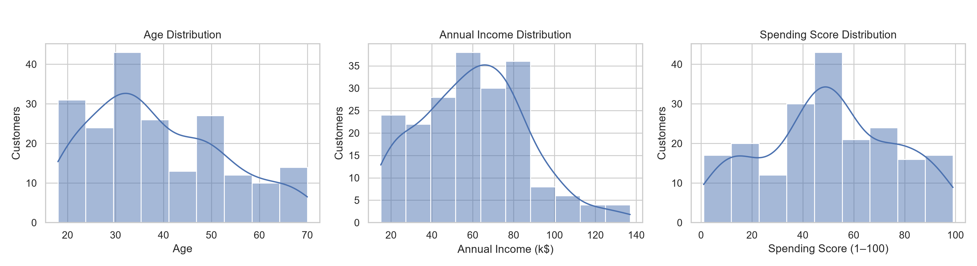

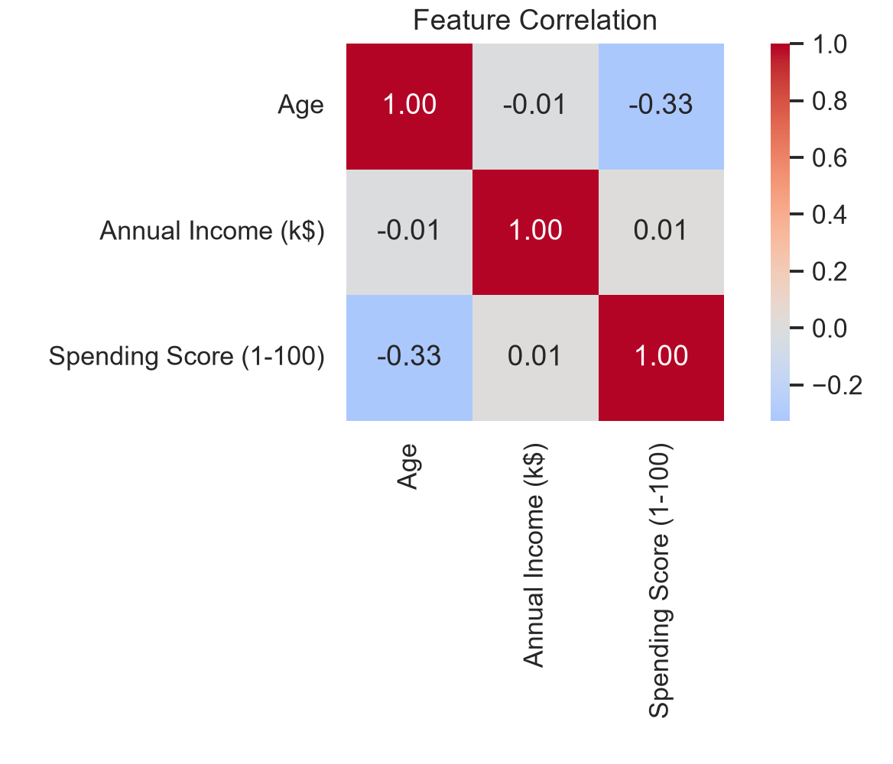
Data Preprocessing and EDA
Data quality checks
0 missing values; no duplicate customer IDs
Feature selection
Annual Income (k$) + Spending Score (1-100)
CustomerID excluded
Feature distributions (Age, Annual Income, Spending Score)
Identifier, not a behavioural feature
What the EDA shows
Income vs Spending correlation ≈ 0.01: no linear relationship
Age vs Spending ≈ −0.33
Group structure only appears when both features are viewed together
StandardScaler
Equal weight in distance calculations
No train/test split
Unsupervised task — nothing to predict
Source: 02_feature_distributions.png, 03_eda_relationships.png (project assets)
Notes:
Data quality: no missing values and no duplicate IDs. We keep only Annual Income and Spending Score for clustering. Because K-Means and K-Medoids are distance based, we standardise with StandardScaler so both features contribute comparably. There is no train/test split because clustering is unsupervised. The heatmap shows income and spending are essentially uncorrelated (0.01), so any structure is non-linear grouping, which is exactly what clustering can find. Age has a mild negative correlation (-0.33) with spending score.

Slide 6
Methodology Pipeline
1
2
3
4
5
Dataset
Data Quality Validation
Feature Selection
StandardScaler
Optimal K Evaluation
Mall_Customers.csv, 200 × 5
Missing values, duplicates
Annual Income (k$), Spending Score (1-100)
Zero mean, unit variance
K = 2 … 10
6
7
8
9
10
K-Means + K-Medoids
Cluster Validation
Cluster Profiling
Business Interpretation
CustomerLens Dashboard
Both with K = 5
Silhouette, DB index, ARI
Size, income, spending, age
Descriptive labels
Streamlit + React
Optimal-K evaluation and final clustering run on the same standardised feature matrix.
Notes:
Walk through the pipeline left to right, top row then bottom row. The key design choice is that both algorithms use the same standardised Income/Spending matrix, the same candidate range K=2..10 and the same validity measures, so the comparison is fair. The dashboard only displays validated outputs exported from the Python pipeline.

Slide 7
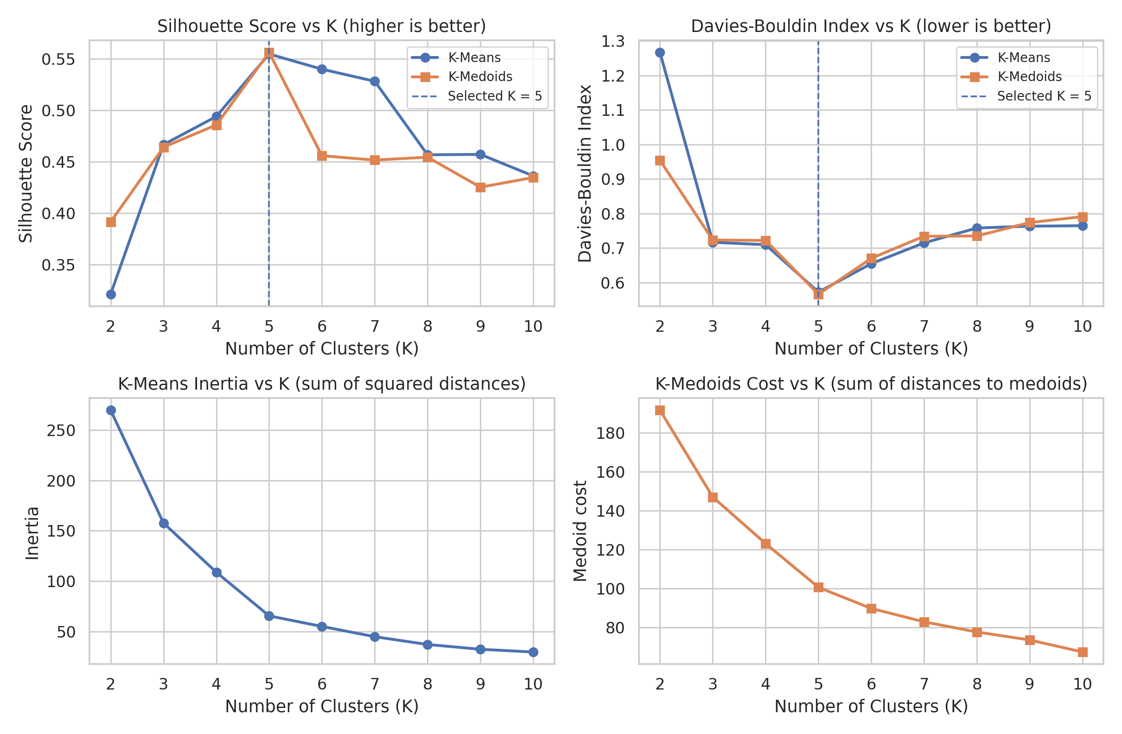
Optimal K Selection: K = 5 (best of K = 2…10)
K | Sil. KM | Sil. KMed | DB KM | DB KMed
2 | 0.3213 | 0.3916 | 1.2670 | 0.9540
3 | 0.4666 | 0.4641 | 0.7165 | 0.7230
4 | 0.4939 | 0.4857 | 0.7096 | 0.7218
5 | 0.5547 | 0.5562 | 0.5722 | 0.5661
6 | 0.5399 | 0.4558 | 0.6546 | 0.6700
7 | 0.5281 | 0.4516 | 0.7148 | 0.7341
8 | 0.4567 | 0.4544 | 0.7579 | 0.7349
9 | 0.4571 | 0.4252 | 0.7632 | 0.7736
10 | 0.4362 | 0.4347 | 0.7645 | 0.7909
Sil. = Silhouette (higher is better); DB = Davies-Bouldin (lower is better); KM = K-Means, KMed = K-Medoids (PAM)
K = 2…10, plotted from the project result CSVs
Silhouette is highest at K = 5
Davies-Bouldin is lowest at K = 5
Objective curves bend near K = 5
among evaluated K, both algorithms (0.5547, 0.5562)
among evaluated K, both algorithms (0.5722, 0.5661)
but fall steadily: elbow supports, not proves, K = 5
Notes:
We evaluated K from 2 to 10 for both algorithms. Silhouette measures how well each point fits its own cluster compared with the nearest other cluster — higher is better. Davies-Bouldin measures average similarity between each cluster and its most similar cluster — lower is better. Both measures agree on K=5 for both algorithms. The right-hand plot is the elbow-style curve: K-Means inertia is a sum of squared distances, K-Medoids cost is a sum of distances to medoids, so the two curves are different objectives and must not be compared as the same quantity. The elbow alone does not prove K=5; the multiple measures together do. The Davies-Bouldin values in the table come from the project's optimal-K result files.

Slide 8
K-Means Segmentation: Income vs Spending Score
K = 5 clusters
High-Value
39
High-Spending Budget
22
Balanced / Moderate
81
Low-Engagement
23
High-Income Low-Spending
35
customer counts shown on the right
✕ marks each K-Means centroid (original units)
Five groups are visually well separated
Silhouette 0.5547, Davies-Bouldin 0.5722
Notes:
This is the required OEP visualisation: Annual Income on x, Spending Score on y, points coloured by K-Means cluster, with centroids as black crosses. Colours in the legend match the dots in the plot. The five groups: top-right is high income and high spending; top-left is low income and high spending; the centre is moderate on both; bottom-right is high income but low spending; bottom-left is low on both. Names are descriptive interpretations, not ground truth. Clustering was done on standardised data; the plot is drawn in original units.

Slide 9
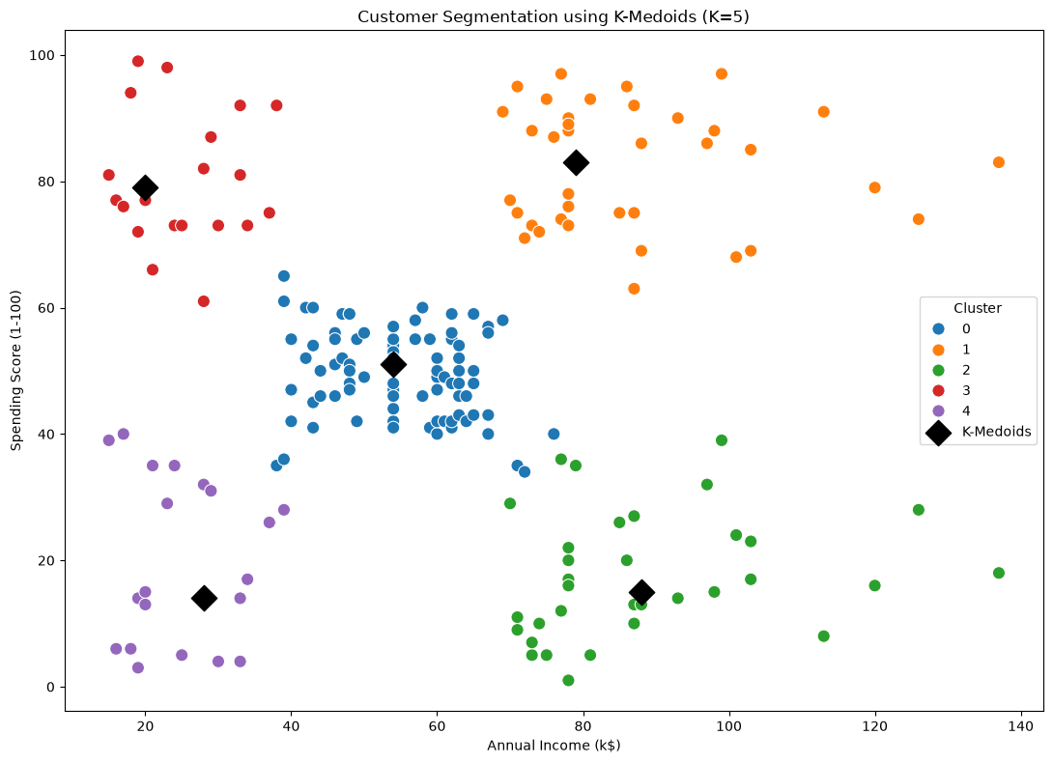
K-Medoids (PAM) Segmentation
How PAM works
BUILD: greedily choose K starting medoids
SWAP: exchange a medoid with a non-medoid if total cost falls
Assign each customer to the nearest medoid
Result at K = 5
Medoid customers: IDs 81, 162, 177, 16, 25
Cluster sizes: 84, 39, 35, 21, 21
Cost 100.72 = sum of distances to medoids — a different objective from K-Means inertia, so not directly comparable
Project notebook output: K = 5, ◆ = medoid (an actual customer). Cluster IDs/colours are independent of the K-Means figure.
Notes:
K-Medoids uses actual data points, medoids, as cluster representatives, so it is less sensitive to extreme values than a mean-based centroid. We implemented PAM with NumPy on a pairwise Euclidean distance matrix of the standardised features: BUILD picks initial medoids greedily, SWAP improves them. The medoids for K=5 are real customers with IDs 81, 162, 177, 16 and 25. The medoid cost (100.72) is a sum of distances, whereas K-Means inertia (65.57) is a sum of squared distances — different objectives, so they are not compared. Cluster numbering is independent of K-Means numbering.

Slide 10
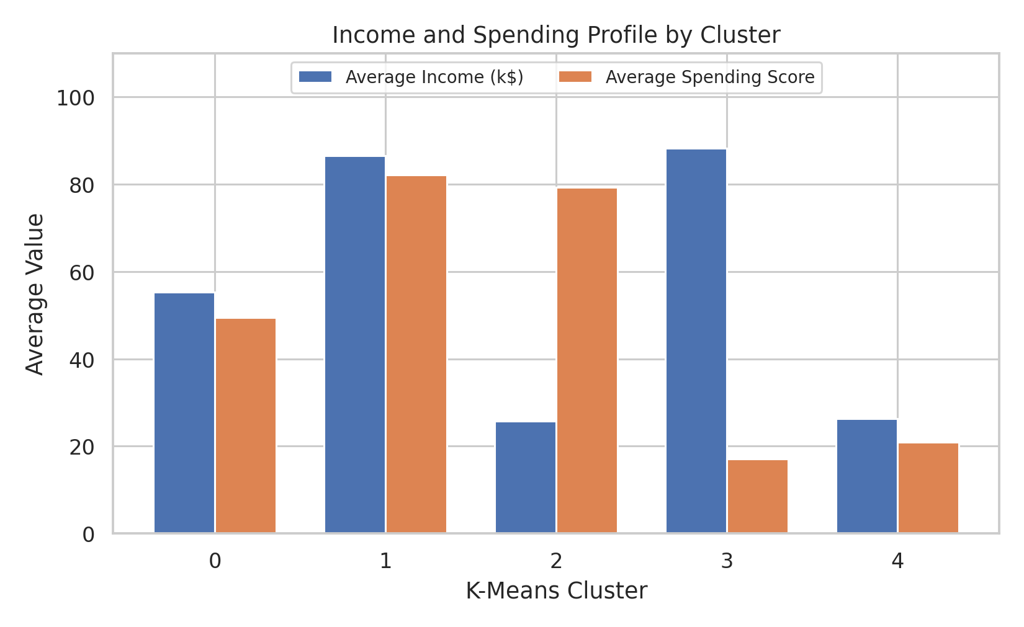
Cluster Profiles (K-Means, K = 5)
ID | Segment label | Customers | Share | Avg income (k$) | Avg spending | Avg age
0 | Balanced / Moderate | 81 | 40.5% | 55.30 | 49.52 | 42.72
1 | High-Value | 39 | 19.5% | 86.54 | 82.13 | 32.69
2 | High-Spending Budget | 22 | 11.0% | 25.73 | 79.36 | 25.27
3 | High-Income Low-Spending | 35 | 17.5% | 88.20 | 17.11 | 41.11
4 | Low-Engagement | 23 | 11.5% | 26.30 | 20.91 | 45.22
Average income and spending by cluster (from project result CSV)
Cluster 0 is the largest group (40.5%) and sits near the dataset means.
Clusters 2 and 4 share low income but differ sharply in spending (79.4 vs 20.9).
Cluster 1 is the youngest high-income group (avg age 32.7).
Notes:
These are the actual cluster statistics from final_business_segment_profile.csv. Income is in thousands of dollars; spending is the dataset's 1-100 behavioural score. Cluster IDs are arbitrary identifiers; the labels are descriptive names we gave based on where each cluster's averages lie. Note that cluster 0 averages 55.3 income and 49.5 spending, close to the overall means (60.6 and 50.2), which is why we call it Balanced / Moderate.

Slide 11
Algorithm Comparison at K = 5
Metric | K-Means | K-Medoids (PAM)
K | 5 | 5
Silhouette (higher is better) | 0.5547 | 0.5562
Davies-Bouldin (lower is better) | 0.5722 | 0.5661
Runtime* | 0.164474 s | 0.076011 s
ARI (agreement between partitions) | 0.9597
Partition agreement (customers)
KM \ KMed | 0 | 1 | 2 | 3 | 4
K-Means 0 | 81 | 0 | 0 | 0 | 0
K-Means 1 | 0 | 39 | 0 | 0 | 0
K-Means 2 | 1 | 0 | 0 | 21 | 0
K-Means 3 | 0 | 0 | 35 | 0 | 0
K-Means 4 | 2 | 0 | 0 | 0 | 21
In this experiment K-Medoids scored slightly better on both Silhouette and Davies-Bouldin; the differences are small.
197 of 200 customers fall in the same matching group; 3 low-income customers differ.
Result applies to this dataset and setup, not to the algorithms in general.
*Recorded runtime from the project's own run; specific to this implementation, run and machine. K-Means was timed with n_init = 20 restarts; the PAM timing excludes the pairwise distance-matrix step. It does not show that either algorithm is generally faster. ARI = Adjusted Rand Index (partition agreement), not accuracy.
Objective values (K-Means inertia 65.57, K-Medoids cost 100.72) measure different things and are deliberately not compared.
Notes:
Silhouette: higher is better; K-Medoids 0.5562 vs K-Means 0.5547. Davies-Bouldin: lower is better; K-Medoids 0.5661 vs K-Means 0.5722. Both differences are small, so the right conclusion is that the algorithms give very similar segmentations in this experiment, not that one is universally better. ARI 0.9597 compares the two partitions with each other; it is not accuracy because there are no ground-truth labels. The contingency table shows that only three customers (K-Means clusters 2 and 4, boundary customers with IDs 41, 43 and 46) are grouped differently. Runtime: the recorded values are 0.164474 s and 0.076011 s in the project's own run; K-Means was configured with 20 restarts, the PAM timing excludes the pairwise distance-matrix computation, and the numbers depend on implementation and hardware. We do not claim K-Medoids is faster in general. Inertia and medoid cost are different objectives and are not compared.

Slide 12
Business Insights: Descriptive Segments
High-Value Customers
Balanced / Moderate Customers
High-Spending Budget Customers
High-Income Low-Spending Customers
Low-Engagement Customers
39 • 19.5%
81 • 40.5%
22 • 11.0%
35 • 17.5%
23 • 11.5%
Income 86.5k • Score 82.1
Income 55.3k • Score 49.5
Income 25.7k • Score 79.4
Income 88.2k • Score 17.1
Income 26.3k • Score 20.9
Relatively high income and high spending score.
Moderate income and moderate spending behaviour.
Lower income but relatively high spending score.
High income but relatively low spending score.
Relatively low income and low spending score.
Possible action: Loyalty programmes, premium offers, retention.
Possible action: Maintain engagement; personalised promotions.
Possible action: Affordable, value-oriented campaigns.
Possible action: Investigate barriers to spending; targeted engagement.
Possible action: Introductory offers and engagement campaigns.
Labels are descriptive analytical interpretations of cluster averages — not ground-truth customer categories. Actions are suggestions, not tested outcomes.
Notes:
Segment names come from the project's final_business_segment_profile.csv and the React Business Insights page. They describe where each cluster's average income and spending score lies; they are not ground truth. The suggested actions come from segment_business_insights.csv and are hypotheses a business could test, not validated results. Spending Score is a behavioural score supplied by the dataset, so 'high-spending' means high score, not measured expenditure. Note: the Streamlit app's Business Insights page uses a simpler four-way naming rule relative to dataset means; the five labels shown here are the ones used in the project's exported results and React dashboard.

Slide 13
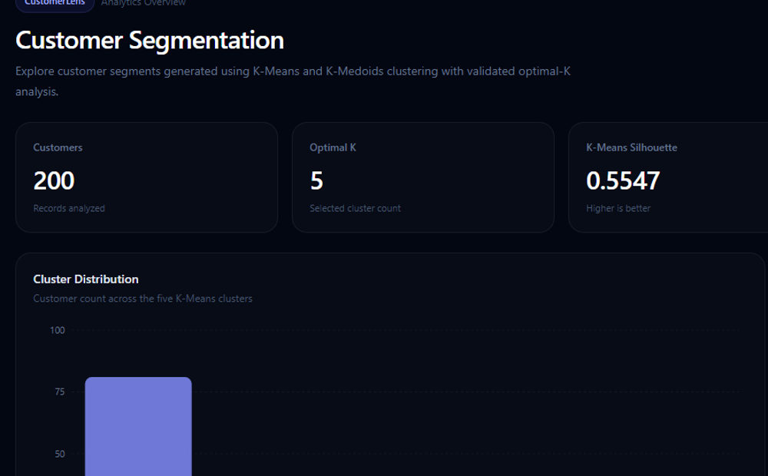
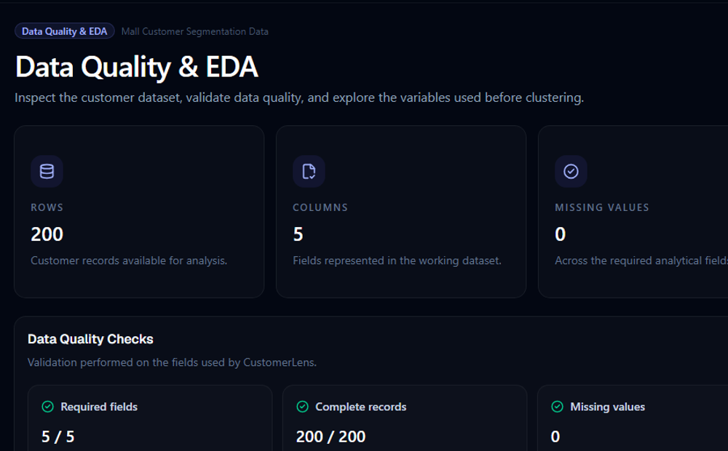
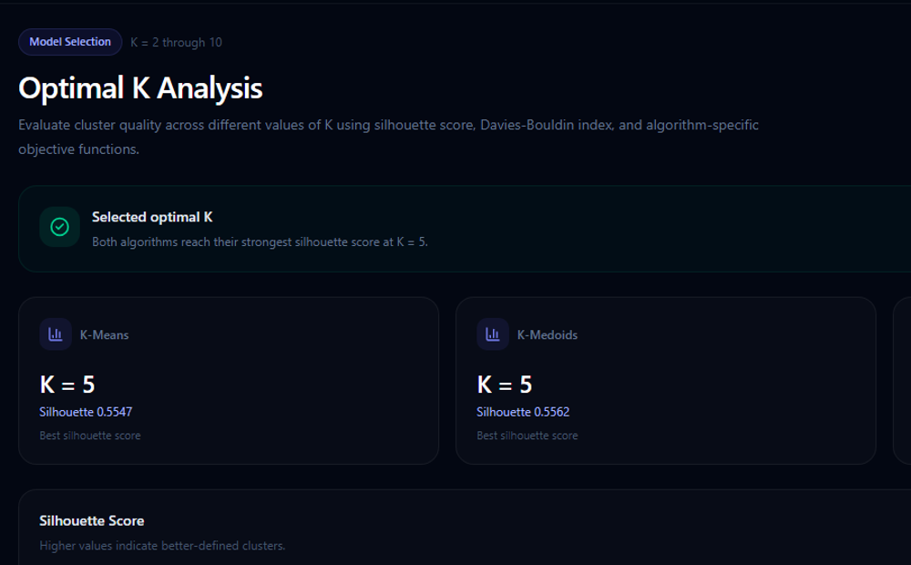
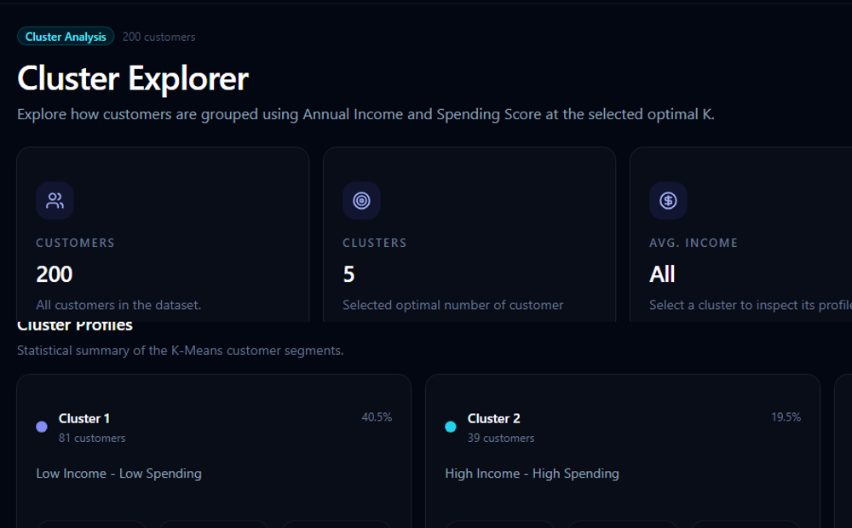
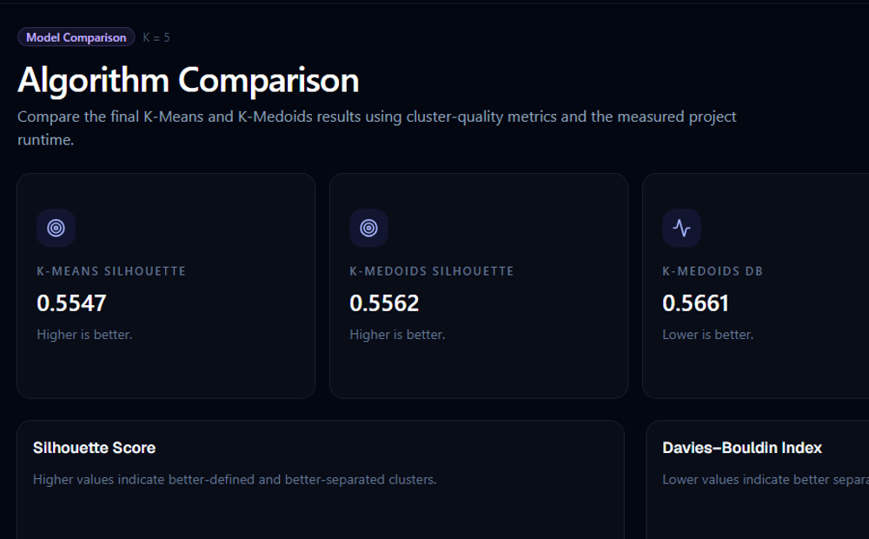
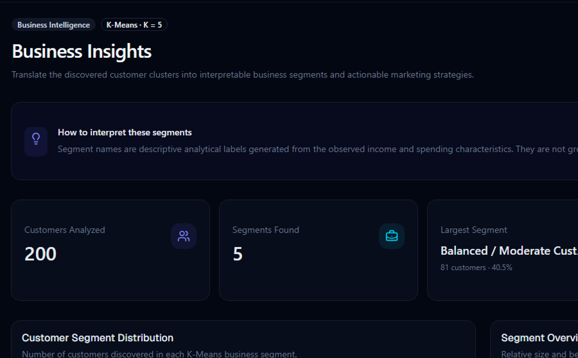
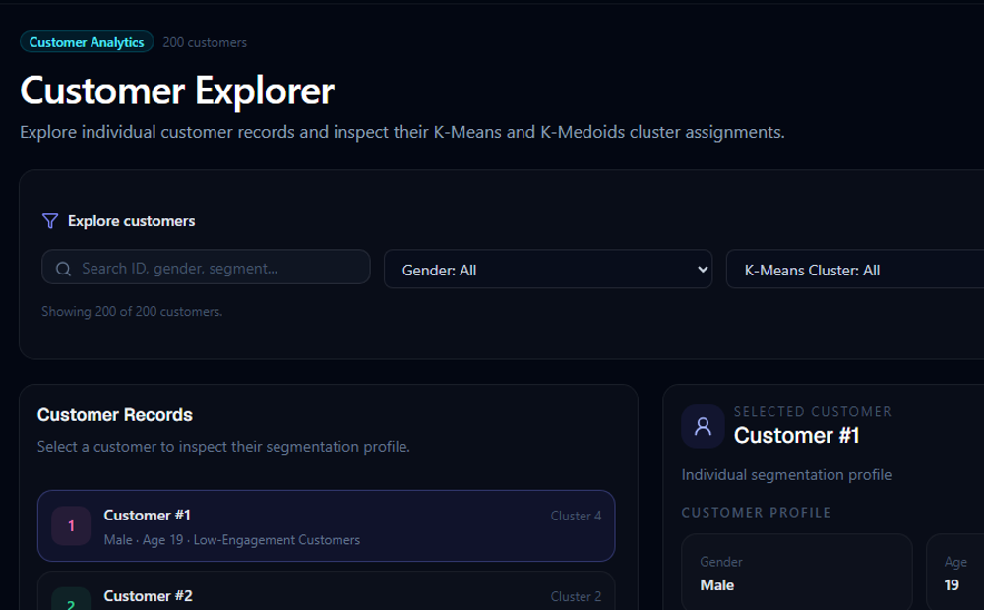
CustomerLens Application (React Dashboard)
Overview
Data Quality
Optimal K
Cluster Explorer
React + Vite + TypeScript
Reads customerlens.json exported from the validated Python results
Companion Streamlit app (app.py) with the same seven sections
Algorithm Comparison
Business Insights
Customer Explorer
Overview montage only (cropped project screenshots; larger views on the next slide). Some dashboard pages show the legacy label "Low Income - Low Spending" for Cluster 0; this deck uses "Balanced / Moderate".
Notes:
The React dashboard has seven pages: Overview, Data Quality, Optimal K, Cluster Explorer, Algorithm Comparison, Business Insights and Customer Explorer. It reads a JSON file exported by export_frontend_data.py from the validated Python artifacts, so what you see is the same data as in the report. A Streamlit app (app.py) provides the same seven sections and also lets a hypothetical customer be assigned to the nearest existing cluster. These are screenshots from the project; the tiles are cropped views for readability.

Slide 14
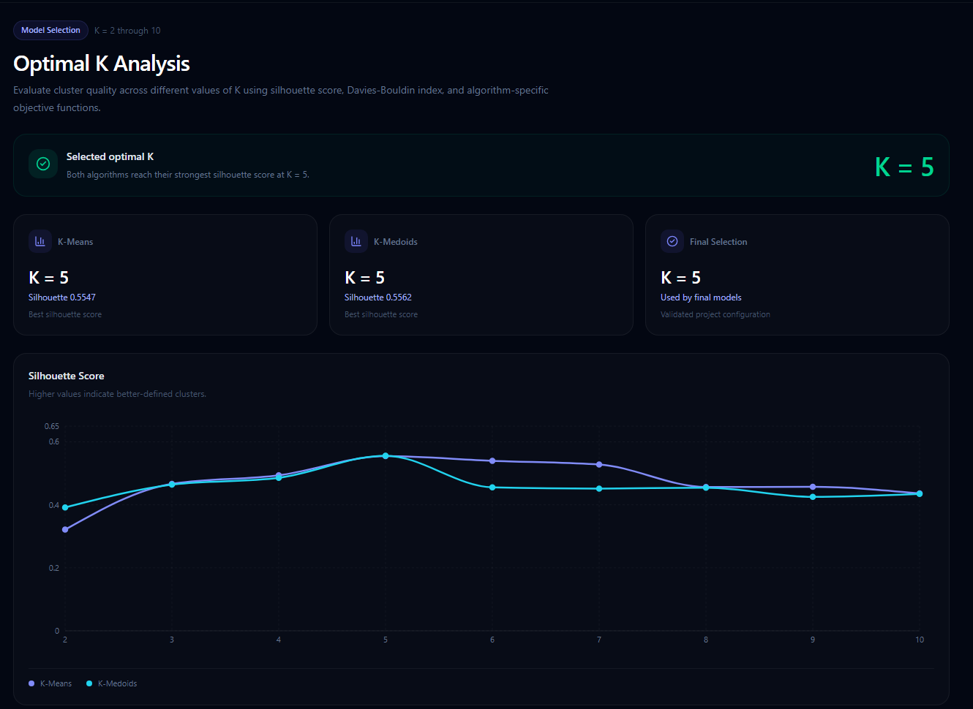
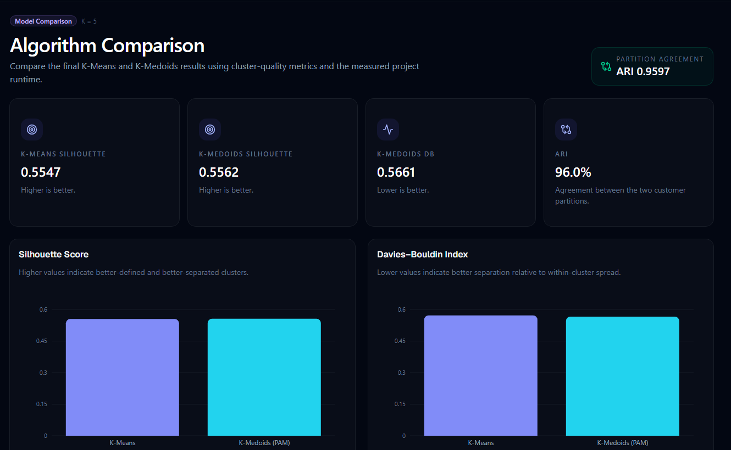
Dashboard Detail: Optimal K and Comparison
Optimal K page: selected K and silhouette curve (Davies-Bouldin and objective curves are further down the page)
Algorithm Comparison page: silhouette and Davies-Bouldin of both algorithms
Cropped regions of the project's own screenshots. The dashboard reads exported results; it does not retrain models.
Notes:
Two dashboard pages shown at a readable size. The Optimal K page plots silhouette, Davies-Bouldin, K-Means inertia and K-Medoids cost for K = 2 to 10. The Algorithm Comparison page compares both algorithms on the same measures. Screenshots are cropped from the project's own captures.

Slide 15
Testing and Validation
8 / 8
Passed
Passed
automated tests passed
frontend production build
frontend lint
recorded status — tests/test_clustering.py
recorded status — npm run build
recorded status — npm run lint
What the 8 tests verify
Dataset has 200 records and at least 5 columns
Clustering features are Annual Income and Spending Score
Clustering features contain no missing values
Selected optimal K is 5
K-Means model has 5 clusters
K-Medoids artifact has 5 medoids
K-Means assigns every customer to a cluster 0–4
K-Medoids assigns every customer to a cluster 0–4
Tests validate configuration and assignment completeness; clustering quality is assessed separately with Silhouette, Davies-Bouldin and ARI. Reported metrics were cross-checked against the saved cluster assignments.
Notes:
The project's recorded validation status is: 8 automated pytest tests passed, the React frontend builds, and ESLint passes. The tests check dataset size, the two clustering features, absence of missing values, K=5, the K-Means model's cluster count, the K-Medoids artifact's medoid count, and that both algorithms can assign every customer to one of five clusters. They validate the setup, not clustering quality — quality is judged with Silhouette, Davies-Bouldin and ARI.

Slide 16


Conclusion and Future Scope
What was achieved
Future scope (not implemented)
End-to-end pipeline on 200 customers: quality checks, scaling, clustering, profiling
K = 5 selected for both algorithms using Silhouette and Davies-Bouldin, supported by objective curves
K-Means and K-Medoids (PAM) produced very similar partitions (ARI 0.9597); K-Medoids was marginally better on both quality measures here
Five descriptive segments profiled by size, income, spending and age
Streamlit and React dashboards expose the validated results; 8/8 tests passed
Larger, real-world customer data
Additional behavioural features
Temporal customer behaviour
Deployment and monitoring
Richer segmentation features
Limitations: only 200 customers and two features; Spending Score is a dataset-supplied behavioural score; segments are interpretations, not ground truth; no prediction of future behaviour.
Notes:
Summarise the achievements, then state the limitations honestly: 200 customers, two features, a behavioural score rather than expenditure, interpretive labels, runtime numbers specific to one implementation. Future scope items are only proposals — none of them is implemented in this project.

