Slide 1
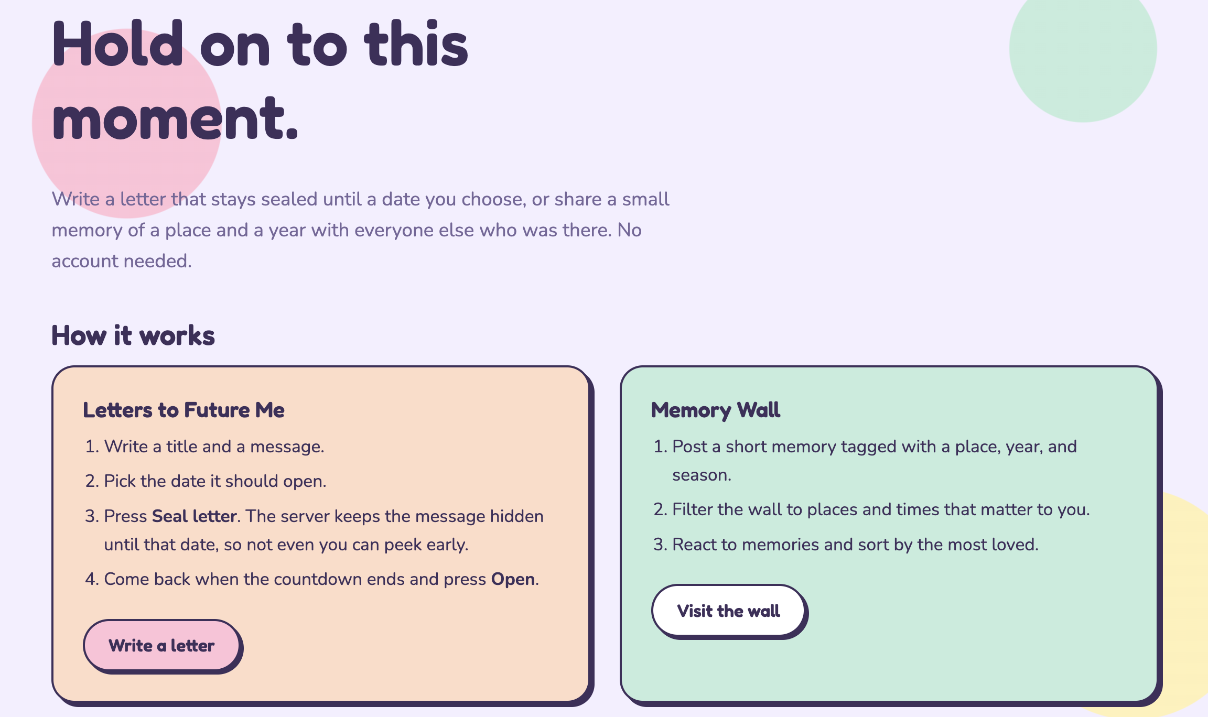
✿ TimeCapsule
Letters to the Future & Memory Wall
Hold on to this moment
Trupal Jageshkumar Patel
Heta Vimaleshkumar Patel
Project 2 · Node + Express + MongoDB
Notes:
Introduce TimeCapsule in one sentence: a website where you can seal letters to your future self and read anonymous memories from other people. Two team members, two features, one app.

Slide 2


Two questions, one app
What would I want to tell my future self?
What are others remembering from the same places and years?
Life moves fast. Small thoughts, goals and moments from a semester, a move or a milestone are easy to forget.
Notes:
Explain the problem: people forget small moments. TimeCapsule answers two questions. Letters is private and personal. The Memory Wall is public and shared.

Slide 3


Two independent features
Letters to Future Me
Memory Wall
Write a letter, pick an unlock date
Server hides it until then
Private to you
Post short anonymous memories
Tag by place, year, season
Browse, filter, react
Notes:
The two features share no data and neither depends on the other's code. Trupal built Letters, Heta built the Memory Wall.

Slide 4
Who it is for
Priya
Graduating student
Letter to open on graduation day
Ravi
New arrival in Boston
Letter to open in one year
Sam
Nostalgic browser
Filters memories by city and year
Maya
Storyteller
Shares small moments anonymously
Leo
Reactor
Reacts to what resonates
Letters to Future Me
Memory Wall
Notes:
Five personas from the proposal. Priya and Ravi use Letters. Sam, Maya and Leo use the Memory Wall.

Slide 5
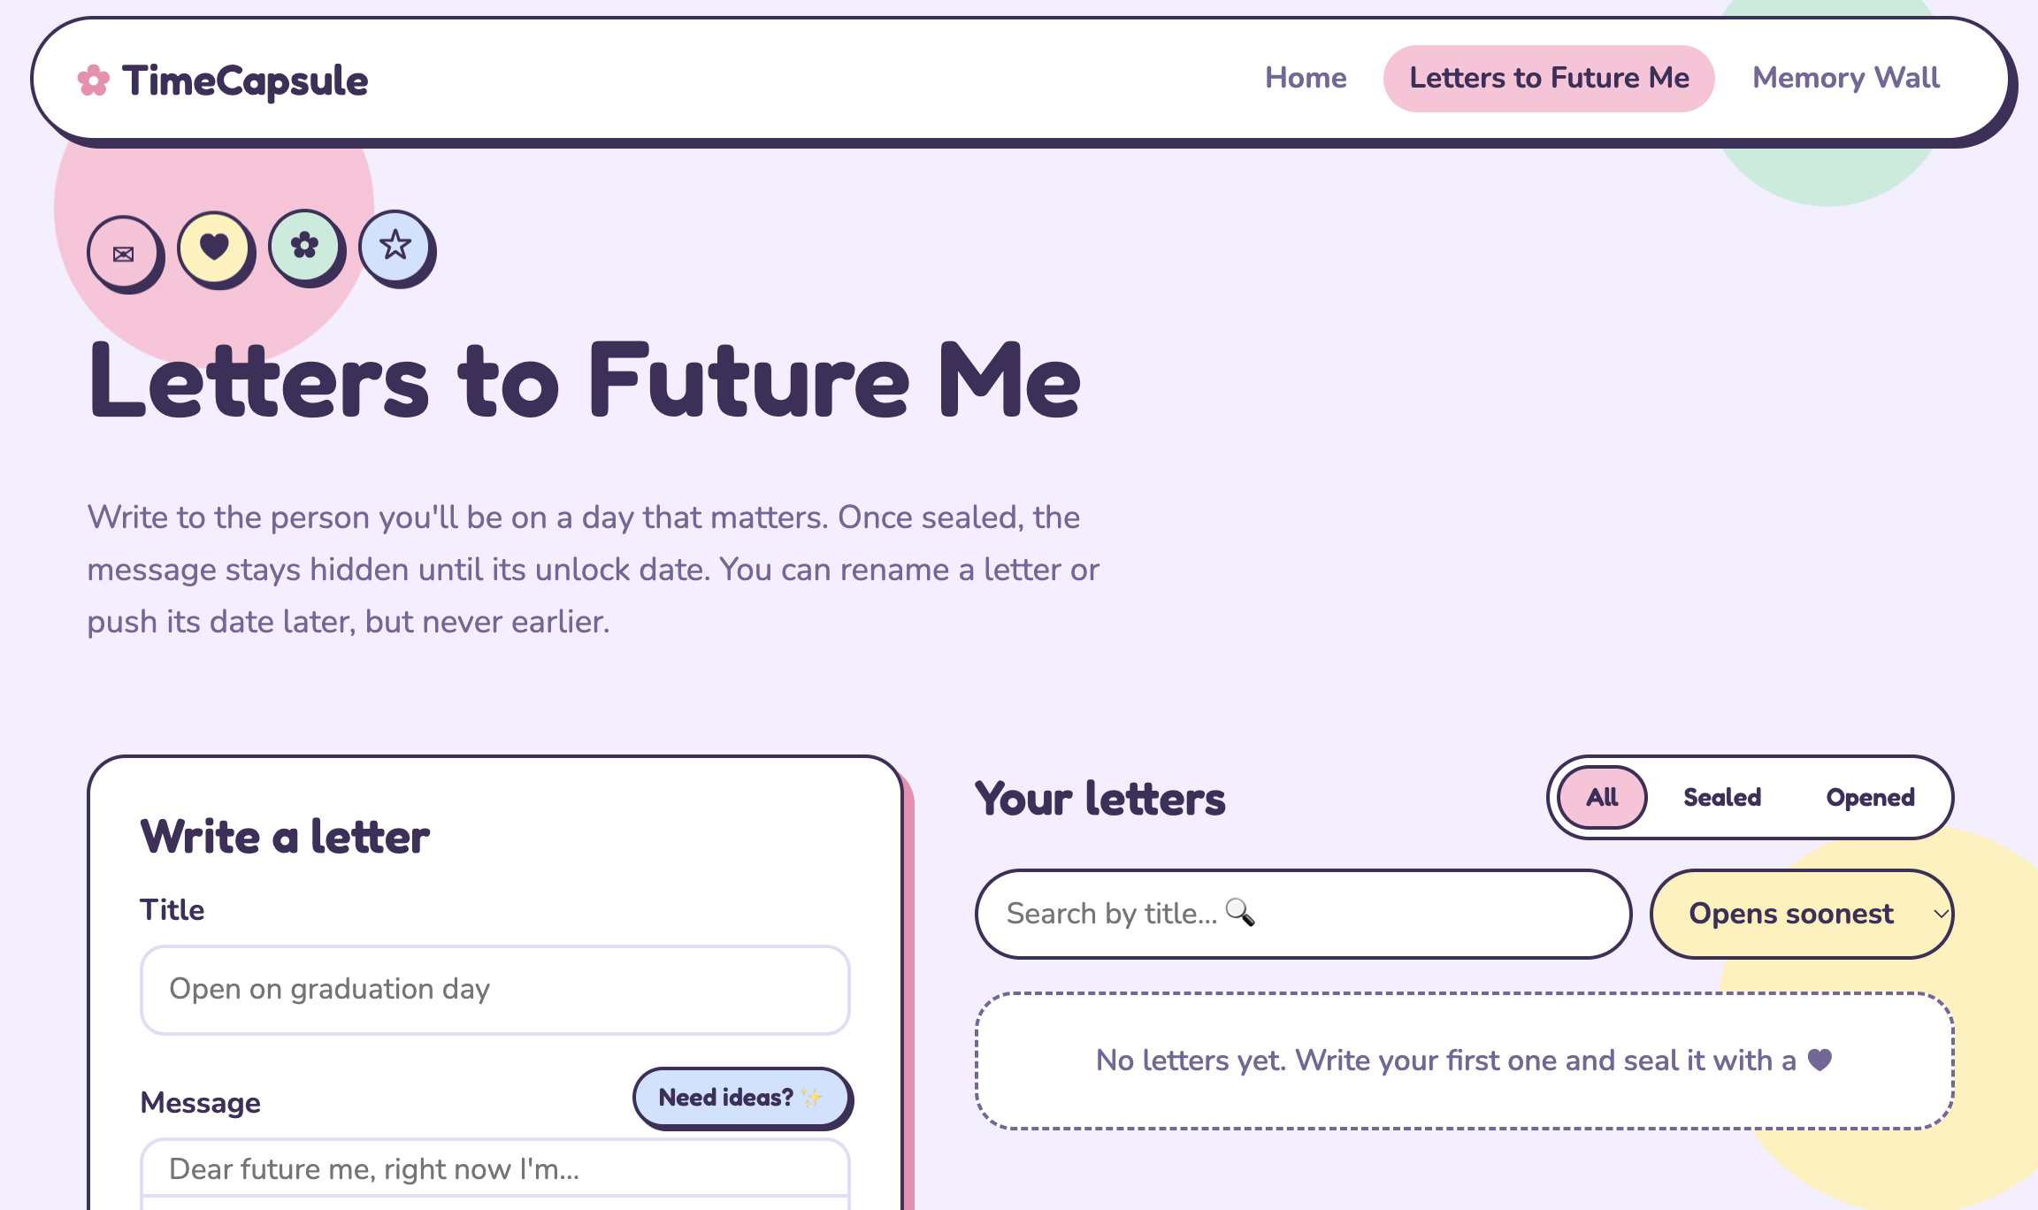
Letters to Future Me
Title, message and unlock date
Live countdown, then an Open button
Edit title, push date later, or delete
Search, filter and sort your letters
Stats: locked vs. opened
Built by Trupal
Notes:
Walk through the letter form, then the list. Locked letters show a countdown. Once unlocked, an Open button appears.

Slide 6
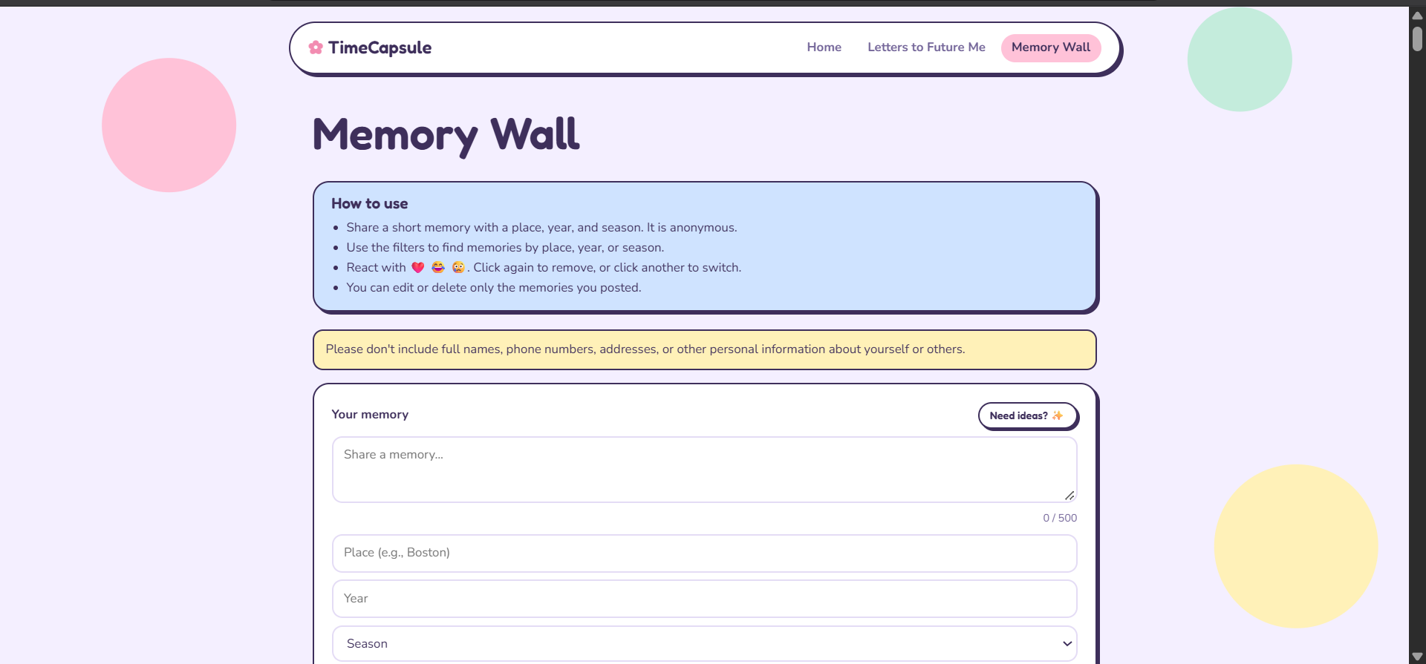


Memory Wall
Anonymous memory with place, year, season
Pick a mood and card color
Filter by place, year, season
Edit or delete only your own
Built by Heta
One reaction each. Sort by most reacted.
Notes:
Reactions are one per person per memory: click again to remove, click another to switch. The wall summary counts memories per place and year using a MongoDB aggregation.

Slide 7



How it works
Browser
Express server
MongoDB
HTML, CSS, vanilla JS
Routes and validation
capsules and memories
Every request carries a random anonymous ID cookie
Notes:
The browser calls the Express API with fetch. Express validates input and talks to MongoDB with the native driver. A small middleware gives every visitor a random ID in a cookie, so there are no accounts.

Slide 8

The lock lives on the server
Before the date
After the date
List returns title and date only
Reading it returns 403
Message is sent
Open button appears
Inspecting the browser reveals nothing
Edits can only push the date later
Notes:
This is the key rule from the proposal. The server never sends the message before the unlock date, so there is nothing to find in the browser. Edits can only move the date later, never earlier.

Slide 9
Two collections, full CRUD
capsules
memories
ownerId
title
message
unlockAt
createdAt
ownerId, text
place, year, season
mood, color
reactions[ ]
createdAt
1,200+ seeded memories
Aggregation: letter stats
Aggregation: wall summary
Notes:
Each person owns one collection and builds its full stack. Both support create, read, update and delete. Both use MongoDB aggregation for a summary.

Slide 10





Clean, modular code
ES modules, no require
ESLint, no errors
Formatted with Prettier
Express + native driver
No Mongoose, no templates
CSS split by module
Notes:
Points from the grading rubric: modules, ESLint, Prettier, Express with the native MongoDB driver, no Mongoose or template engines, CSS organised per module.

Slide 11
Live demo
1
Seal a letter for the future
2
Try to open it early: blocked
3
Post a memory with mood and color
4
Filter, react, and sort the wall
Notes:
Follow these four steps in the live demo or video. Show the locked letter returning nothing, then switch to the Memory Wall.

Slide 12
Thank you
Trupal Jageshkumar Patel
Letters to Future Me
Heta Vimaleshkumar Patel
Memory Wall
Shared setup: anonymous ID cookie, layout, ESLint and Prettier
Questions?
Notes:
Thank the audience and invite questions.

