Slide 1


EE665-Project
A BIDIRECTIONAL BATTERY CHARGER WITH MODULAR
Integrated Charge Equalization Circuit
GEORGE JOSEPH(244102103)
DRASHTI DOSHI(244102102)
1

Slide 2

Motivation and Objective
Growing need for high-voltage, reliable EV battery packs and smart charging.
Need to tackle charge imbalance, battery degradation, and grid integration.
Achieve power factor correction and low grid current distortion
Develop and integrate a modular charge equalisation (CEC) algorithm
Enable bidirectional power flow.
Enhance battery life and system reliability via modular architecture
2

Slide 3
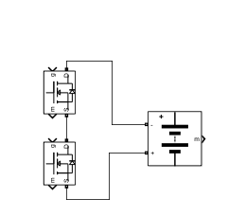
Buck/Boost Switching
Batter current ripple reduction -> improves battery life
PWM pulse through CC mode and CV mode Controller
Source
Boost H-Bridge Rectifier (Single switch operation)
Battery Stack
Buck/Boost Converter
Dual Loop Controller for Boost H-Bridge switching
First loop to get ref Current and power
Second loop to generate switching pulse
Switching logic
CEC Control
Reconfig. Battery stack based on SoC of the module
PLL
Genaration of
I_{ref} and V_{ref}
PID Controller
Measured Current and power
Minimize imbalance
Improved PF -> 0.99 (sim.), 0.97 (exp.)
50% reduction of Switching losses
Improved THD -> <3% (sim.), <5% (exp.)

Slide 4

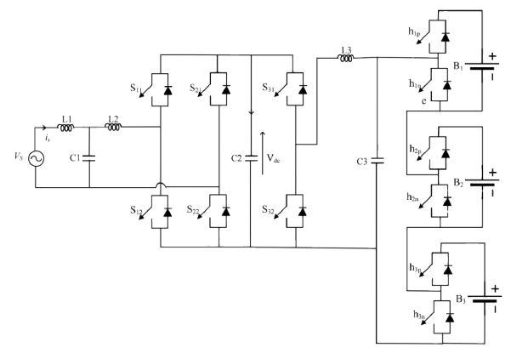
System Overview
There are three main parts in this circuit
H-bridge
DC-DC Converter
Battery stack
Two modes of operation
G2V Mode
V2G Mode

Slide 5
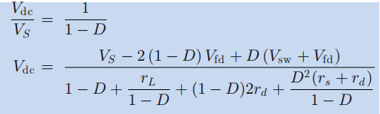

G2V Mode
Charge the battery from the grid using a controlled current/voltage.
H-Bridge AC-DC Converter
Here, it acts as a boost rectifier
Positive Half-Cycle (Vs>0):
Switches: S12 conducts(Dual loop Control), S22 (body diode conducts).
Current Path: Vs→S12→L1→Diode of S22→Grid
Switches: S11, S22(both body diode conducts).
Current Path: Vs→Diode of S11→L1→Diode of S22→Grid
Negative Half-Cycle (Vs<0):
Switches: S22 conducts(Dual loop Control), S21(body diode conducts).
Current Path: Vs→S12→L1→Diode of S22→Grid
Switches: S21, S12 (both body diode conducts).
Current Path: Vs→Diode of S21→L1→Diode of S12→Grid
Buck Converter
ON State (S31 ON)-Inductor charges
Current Path: Vdc→S31→L3→Battery
OFF State (S31 OFF)-Inductor discharges
Current Path: Freewheeling diode of S32.
4

Slide 6


V2G Mode
1. DC-DC Boost Converter
Discharging the battery
ON State (S32 ON)-Inductor charges
Current Path: Battery → L3 → S32 → Battery.
OFF State (S31 OFF)-Inductor discharges
Current Path: Freewheeling diode of S32.
2. DC-AC Inverter
Positive Half-Cycle (Vs > 0):
Switches: S11 (Dual Loop Control) and S22
Current Path: Vdc → S11→ L1 → Grid → S22
Switches: S21 diode and S11
Current Path: S21diode→ S11 → L1 → Grid
Negative Half-Cycle (Vs < 0):
Switches: S21 ,S12 (diode conducts).
Current Path: Vdc → S21 → Grid → L1 → S12 diode
Switches: S21 ,S12 (diode conducts).
Current Path: L2→ S12 → S22 diode → Grid
5

Slide 7
CEC
Balances State-of-Charge (SOC)
Ensuring that each module charges and discharges uniformly
Prevents Imbalance and Degradation
Corrects small differences in capacity or ageing between modules, the CEC prevents overcharging or over-discharging of individual modules
Enhances Reliability and Flexibility
Allows faulty modules to be bypassed without interrupting system operation, improving reliability and making maintenance easier
Improves Battery Life and Usable Capacity
By maintaining balanced SOC, the CEC extends the overall battery lifespan, maximises usable energy, and supports efficient, safe operation of the EV charger system
6

Slide 8
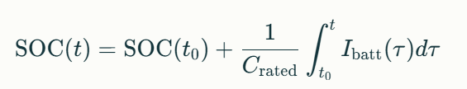
CEC Algorithm
G2V Mode (Charging)
Activation Order:
Start with lowest SOC module → connect via hip switch.
Sequentially activate next-lowest SOC modules as they approach average.
Thresholds:
Connect: If module SOC ≤ average SOC.
Bypass: If module SOC ≥ average SOC + 2% or reaches 100%.
Bypass Conditions:
Fully charged (SOC = 100%).
SOC deviation >2% from average.
SOC Estimation:
Coulomb counting + OCV calibration every 60 sec
V2G Mode (Discharging)
Activation Order:
Start with highest SOC module → connect via hip switch.
Sequentially activate next-highest SOC modules as others deplete.
Thresholds:
Connect: If module SOC ≥ average SOC.
Bypass: If module SOC ≤ average SOC – 5% or drops below 30%.
Bypass Conditions:
SOC <30% (prevent over-discharge).
SOC deviation >5% from average.
Dynamic Reconfiguration:
Maintains minimum DC-link voltage (e.g., 400V) by adding/removing modules.
7

Slide 9
Control Strategies
Outer Voltage Loop:
Regulates DC-link voltage (Vdc) to a fixed reference (e.g., 400V) using a PI controller
Compensates for load variations and ensures stable DC bus voltage for both G2V/V2G modes.
Inner Current Loop:
Tracks sinusoidal reference current (iref) synchronized to grid voltage via PLL.
Minimizes THD (<5%) using PI error correction:
CC-CV charging in G2V mode:
Constant Current (CC): Battery charged at fixed current until near full voltage
Constant Voltage (CV): Voltage held constant, current tapers off as battery reaches full charge
However this is not typically used in V2G mode
V2G primarily focuses on discharging energy to the grid, where the goal is to regulate power flow rather than follow a CC-CV profile
8

Slide 10
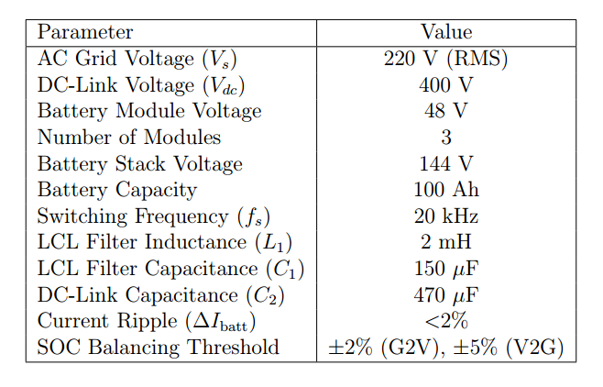
Simulation Parameters
9

Slide 11
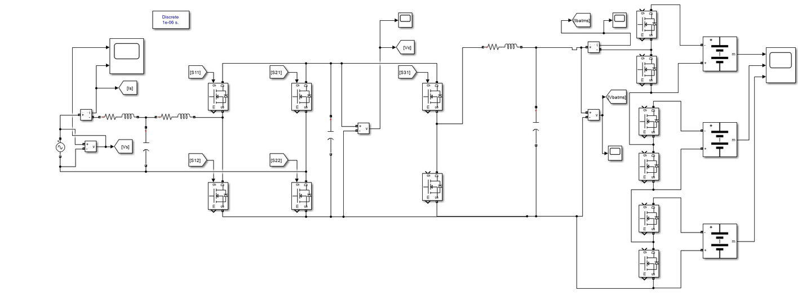
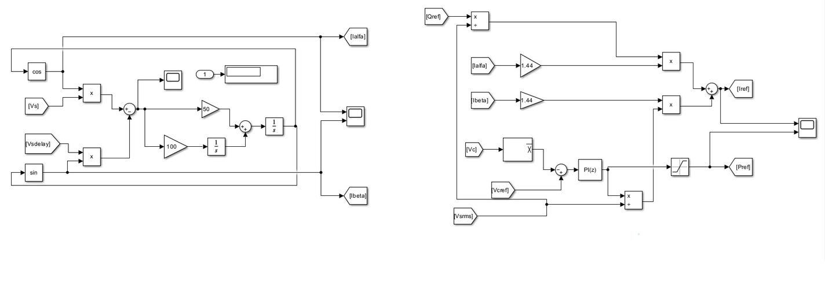
Simulation Diagram
Main Circuit
PLL and Reference Generation
10

Slide 12
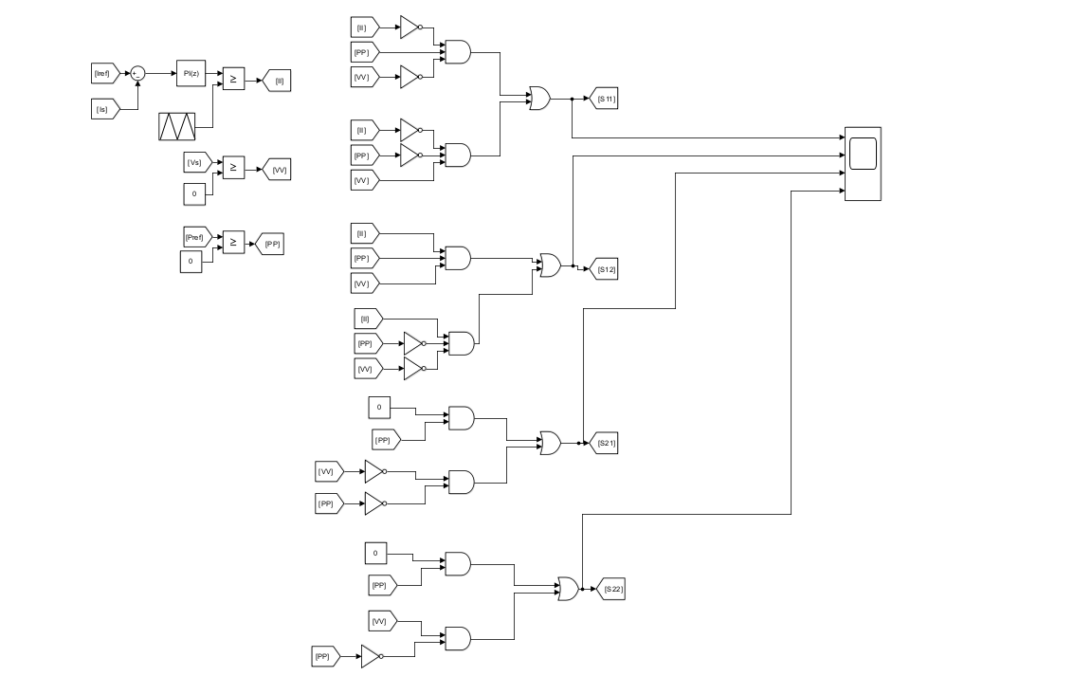
Simulation Diagram
Switching Control Logic
11

Slide 13
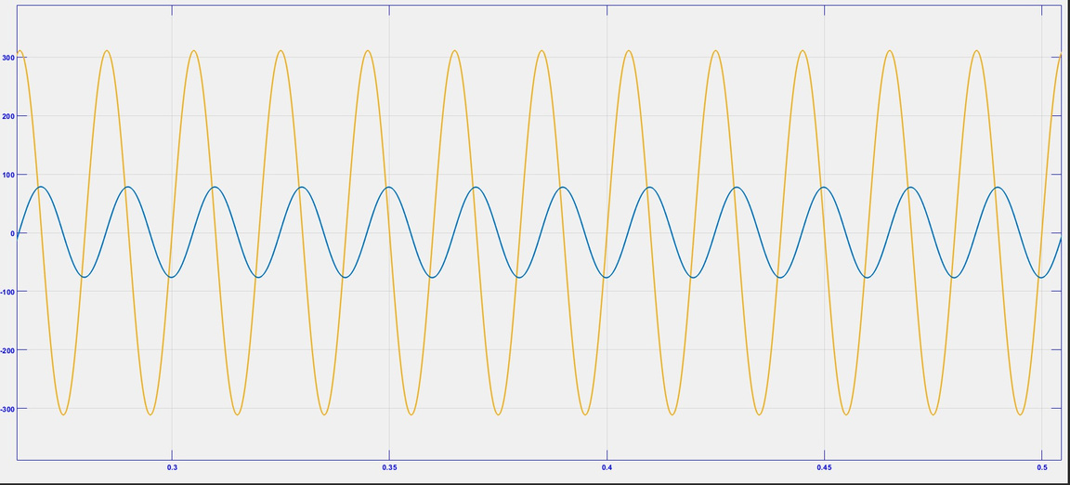
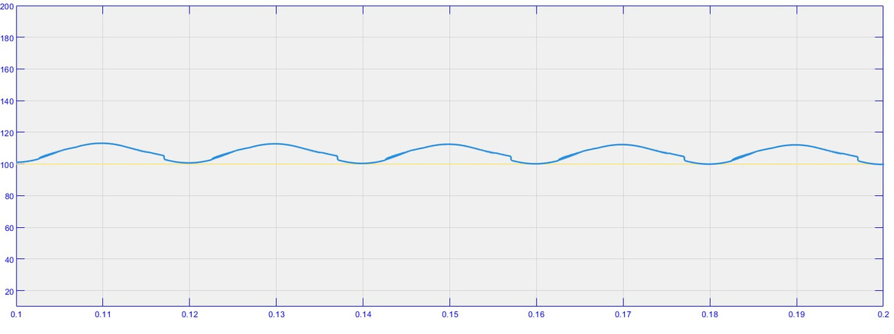
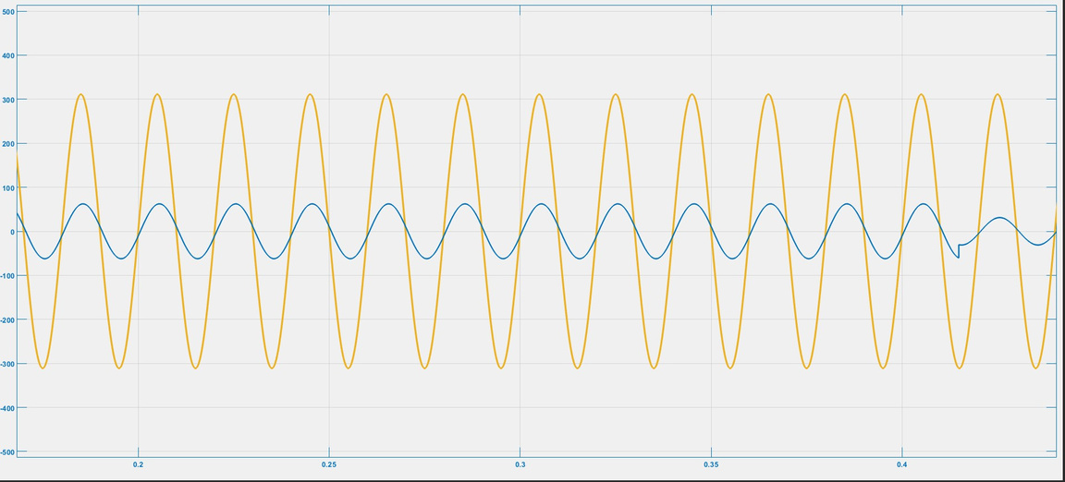
Result
12

Slide 14
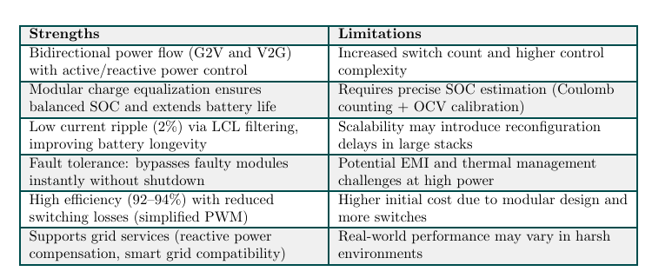
Strengths And Limitations
13

Slide 15
References
[1] N. Tashakor, E. Farjah, and T. Ghanbari, “A Bidirectional Battery Charger With Modular
Integrated Charge Equalization Circuit,” IEEE Transactions on Power Electronics, vol. 32,
no. 3, pp. 2133–2143, Mar. 2017.
THANK YOU
14

