Slide 1

PRESENTATION
ON
DUAL ACTIVE BRIDGE (DAB) CONVERTER
Under Guidance of :
Dr. Shabari Nath
Presented By :
Aditi Gupta (244102108)
Shuchi Pathak (244102113)
Department of Electrical And Electronics Engineering
Indian Institute of Technology , Guwahati

Slide 2
Content
Introduction.
Why DAB Converter?
Components.
Circuit Diagram.
Working.
Simulation Parameters.
Open Loop Control.
Close Loop Control.
Result.
Conclusion.
Department of Electrical And Electronics Engineering
Indian Institute of Technology , Guwahati

Slide 3
INTRODUCTION
A Dual Active Bridge (DAB) converter is a type of DC-DC converter that offers bidirectional power flow and galvanic isolation between its input and output sides.
DAB converters are commonly used in applications requiring efficient and isolated power conversion, such as Renewable energy systems, electric vehicle charging, and vehicle-to-grid (V2G) systems.
.
Department of Electrical And Electronics Engineering
Indian Institute of Technology , Guwahati

Slide 4
WHY DAB CONVERTER ?
High efficiency.
Bidirectional power flow.
Ability to handle fluctuating renewable energy inputs.
Isolated Operation.
Flexible control of power flow.
Zero-Voltage-Switching characteristics.
.
Department of Electrical And Electronics Engineering
Indian Institute of Technology , Guwahati

Slide 5
COMPONENT
Dual Active Bridge Converter consists of :-
1. Primary and secondary side H-bridges.
2. A high frequency transformer.
3. An energy transfer inductor and resonance capacitors.
Department of Electrical And Electronics Engineering
Indian Institute of Technology , Guwahati

Slide 6
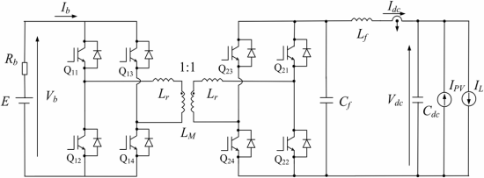
CIRCUIT DIAGRAM
.
Department of Electrical And Electronics Engineering
Indian Institute of Technology , Guwahati

Slide 7
WORKING OF DAB CONVERTER:
Power flow in the DAB is achieved by phase-shifting the pulses of one bridge with respect to the other.
Identical pulses are sent to the diagonal switches.
The power transfer between the two bridges can be controlled by changing the angle of the two square waves of the bridges.
For a positive angle , power will be transferred from the high-voltage bridge to the low-voltage bridge.
Power flow will be reversed for a negative angle.
.
Department of Electrical And Electronics Engineering
Indian Institute of Technology , Guwahati

Slide 8
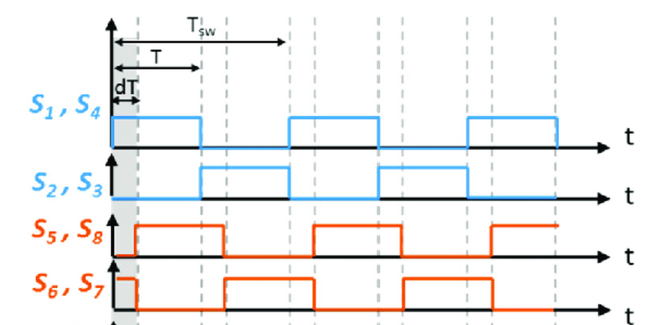
WORKING OF DAB CONVERTER:
S1,S4
S2,S3
.
S5,S6
S5,S6
S7,S8
Department of Electrical And Electronics Engineering
Indian Institute of Technology , Guwahati

Slide 9
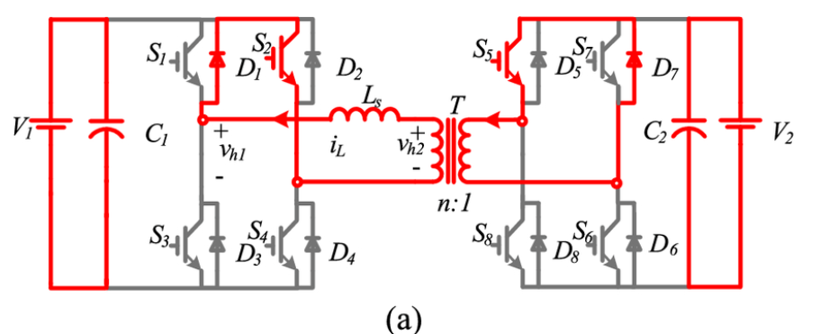
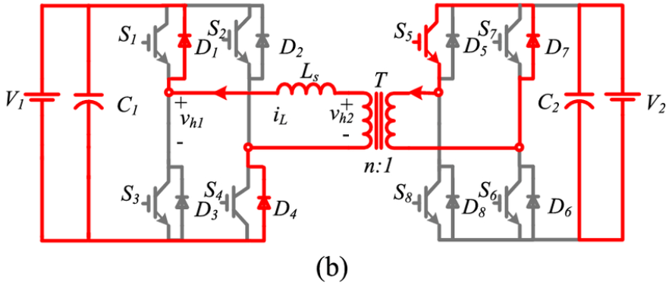
WORKING OF DAB CONVERTER:
.
Department of Electrical And Electronics Engineering
Indian Institute of Technology , Guwahati

Slide 10
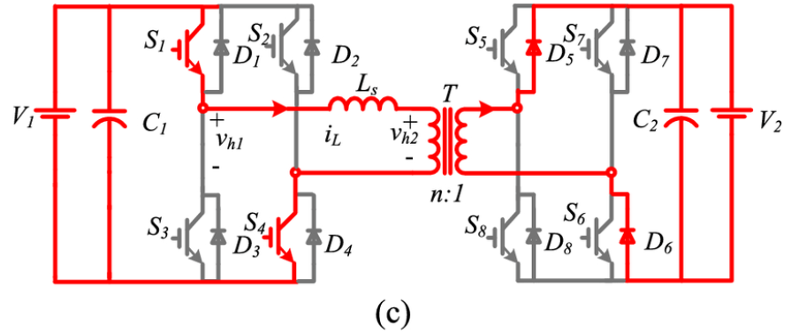
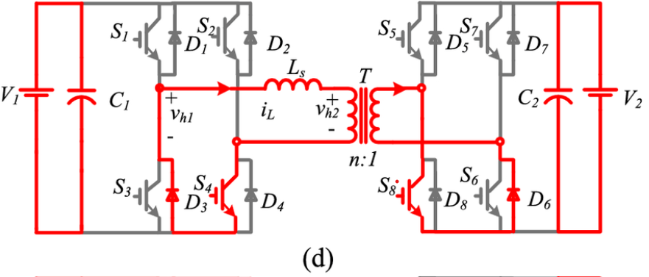
WORKING OF DAB CONVERTER:
.
Department of Electrical And Electronics Engineering
Indian Institute of Technology , Guwahati

Slide 11
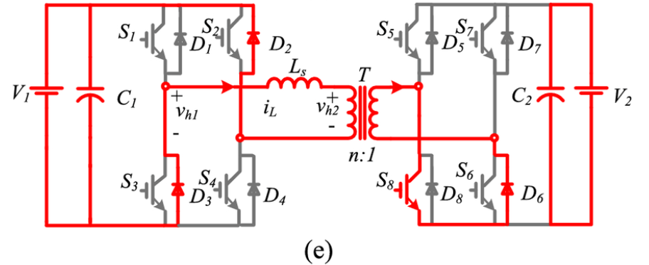
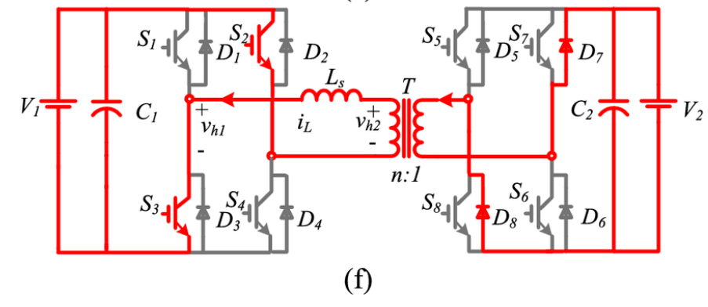
WORKING OF DAB CONVERTER:
.
Department of Electrical And Electronics Engineering
Indian Institute of Technology , Guwahati

Slide 12
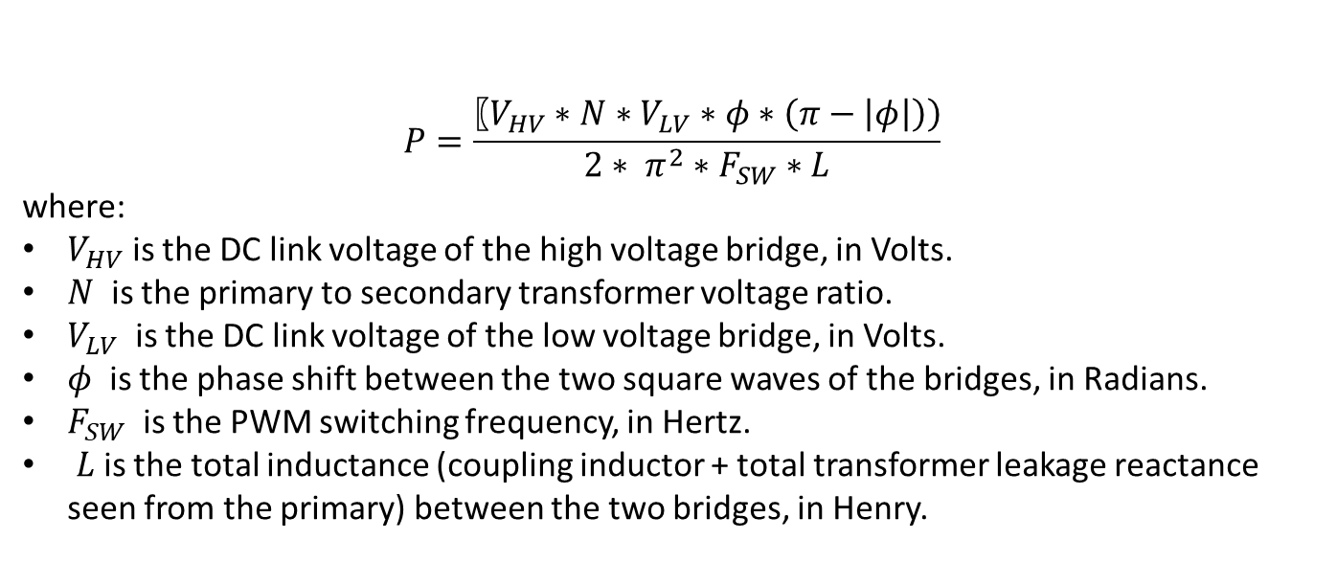
WORKING OF DAB CONVERTER:
The theoretical output power transfer between the two bridges is given by:
$$P=\frac{〖V_{HV}∗N∗V_{LV}∗φ∗\left(π−\left|φ\right|\right))}{2∗ π^{2}∗F_{SW}∗L}$$
where:
$V_{HV}$ is the DC link voltage of the high voltage bridge, in Volts.
$N$ is the primary to secondary transformer voltage ratio.
$V_{LV}$ is the DC link voltage of the low voltage bridge, in Volts.
$φ$ is the phase shift between the two square waves of the bridges, in Radians.
$F_{SW}$ is the PWM switching frequency, in Hertz.
$L$is the total inductance (coupling inductor + total transformer leakage reactance seen from the primary) between the two bridges, in Henry.
.
Department of Electrical And Electronics Engineering
Indian Institute of Technology , Guwahati

Slide 13
SIMULATION PARAMETERS:
Parameters | Values considered in SIMULATION
Input Voltage (Volts) | 1000
Turns ratio | 2:1
Inductance (H) | 0.0102 m
Capacitance (F) | 660 micro
Output Resistance (ohm) | 1
.
Department of Electrical And Electronics Engineering
Indian Institute of Technology , Guwahati

Slide 14
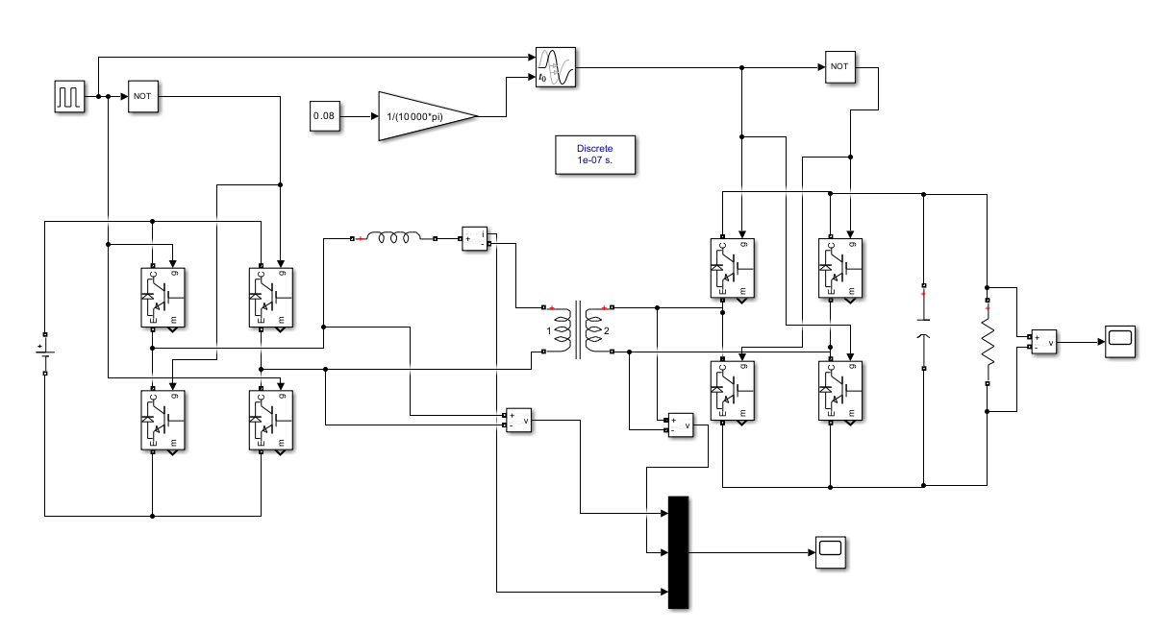
OPEN LOOP CONTROL SIMULATION

Slide 15
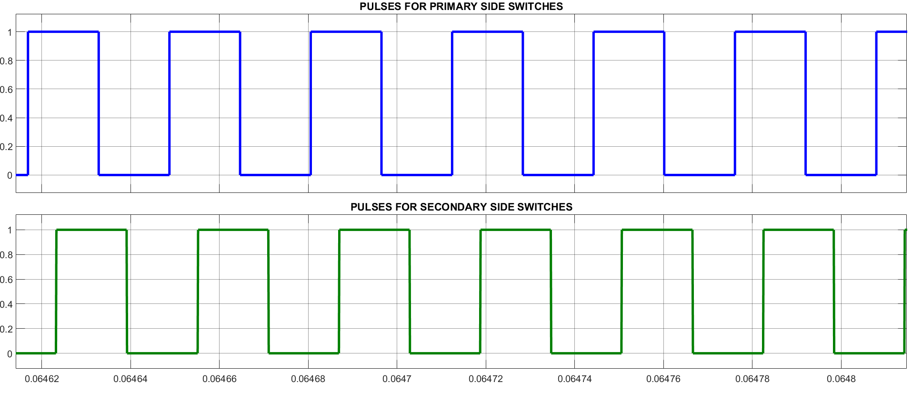
WAVEFORM
phi
Department of Electrical And Electronics Engineering
Indian Institute of Technology , Guwahati

Slide 16
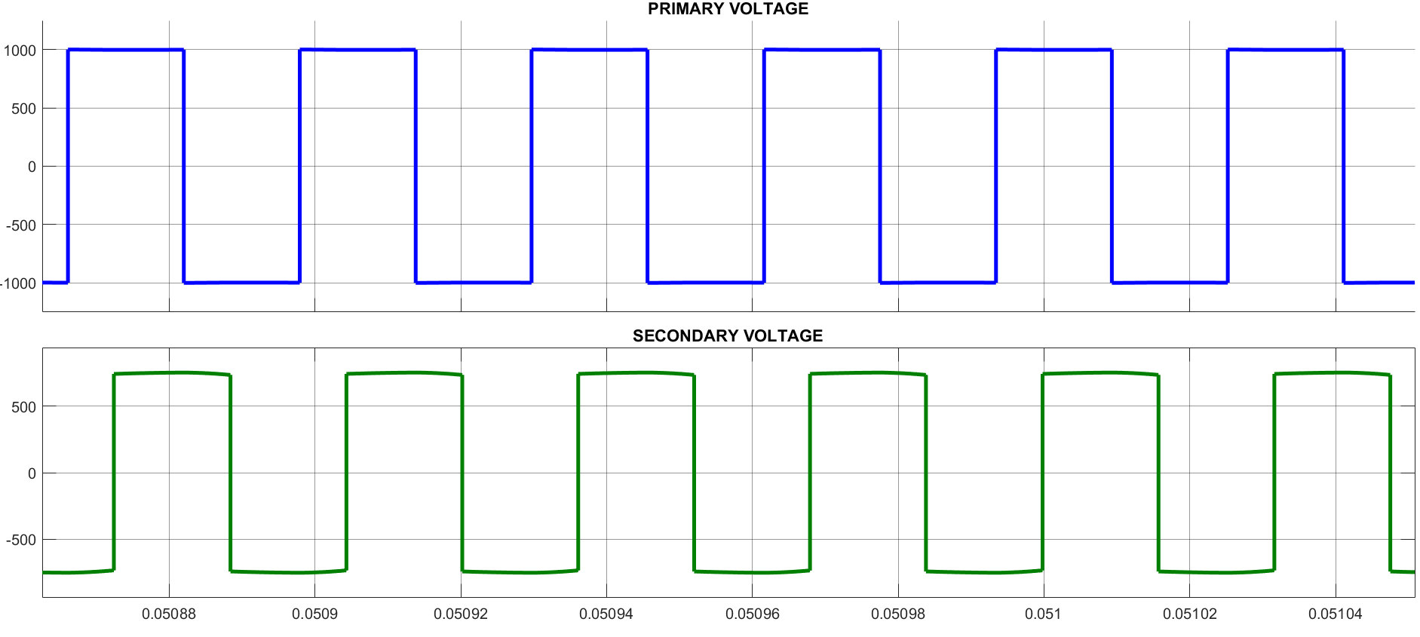
WAVEFORM
Department of Electrical And Electronics Engineering
Indian Institute of Technology , Guwahati

Slide 17
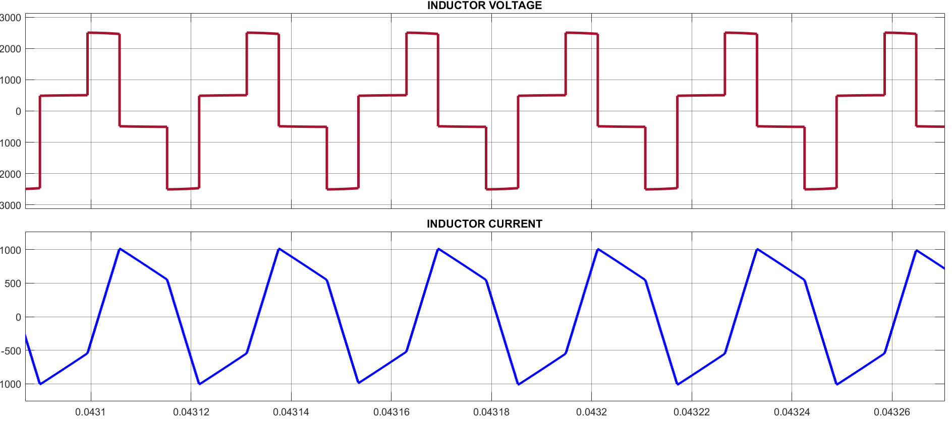
WAVEFORM
Department of Electrical And Electronics Engineering
Indian Institute of Technology , Guwahati

Slide 18
CLOSE LOOP CONTROL
For generating the closed-loop control for the DAB converter, a PI (Proportional Integral) controller is used.
The PI controller adjusts the converter’s operation by comparing the actual output to a desired reference value, minimizing the error between them.
The general transfer function for a PI controller is: C(s) = K_{p} + K_{i} /s

Slide 19
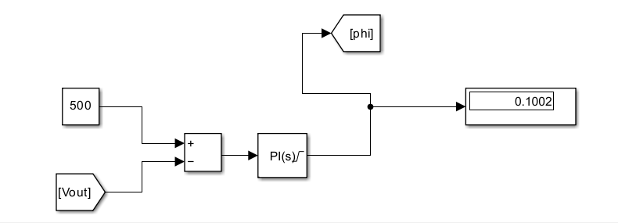
PI CONTROLLER DESIGN
By performing tuning of the PI Controller, we got :-
K_{p} = 0.000085
K_{i} = 0.25
Department of Electrical And Electronics Engineering
Indian Institute of Technology , Guwahati

Slide 20
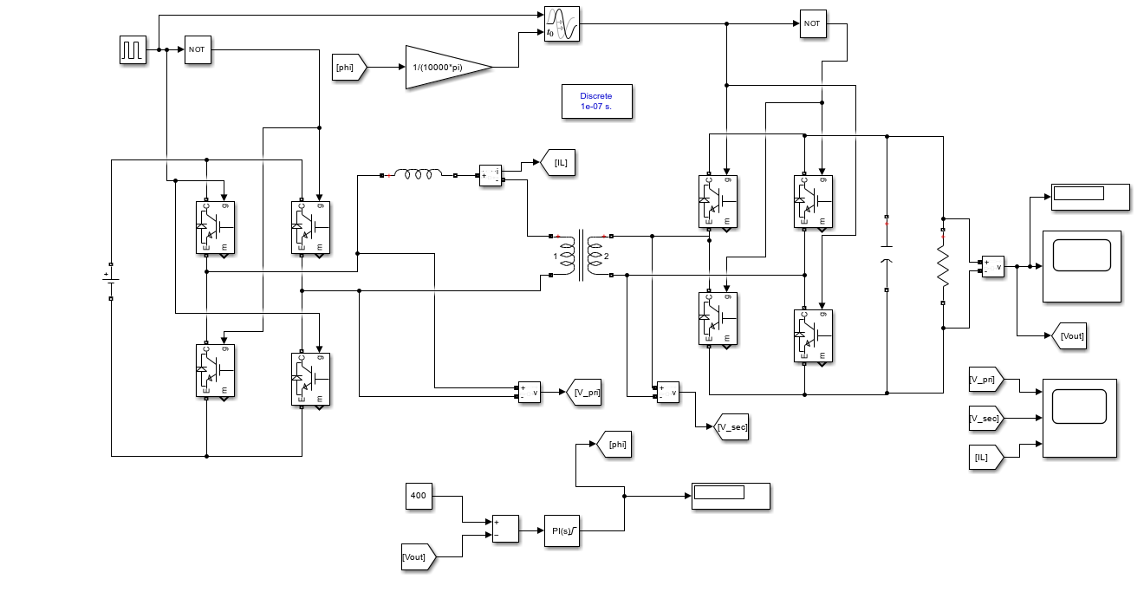
CLOSE LOOP CONTROL SIMULATED CIRCUIT

Slide 21
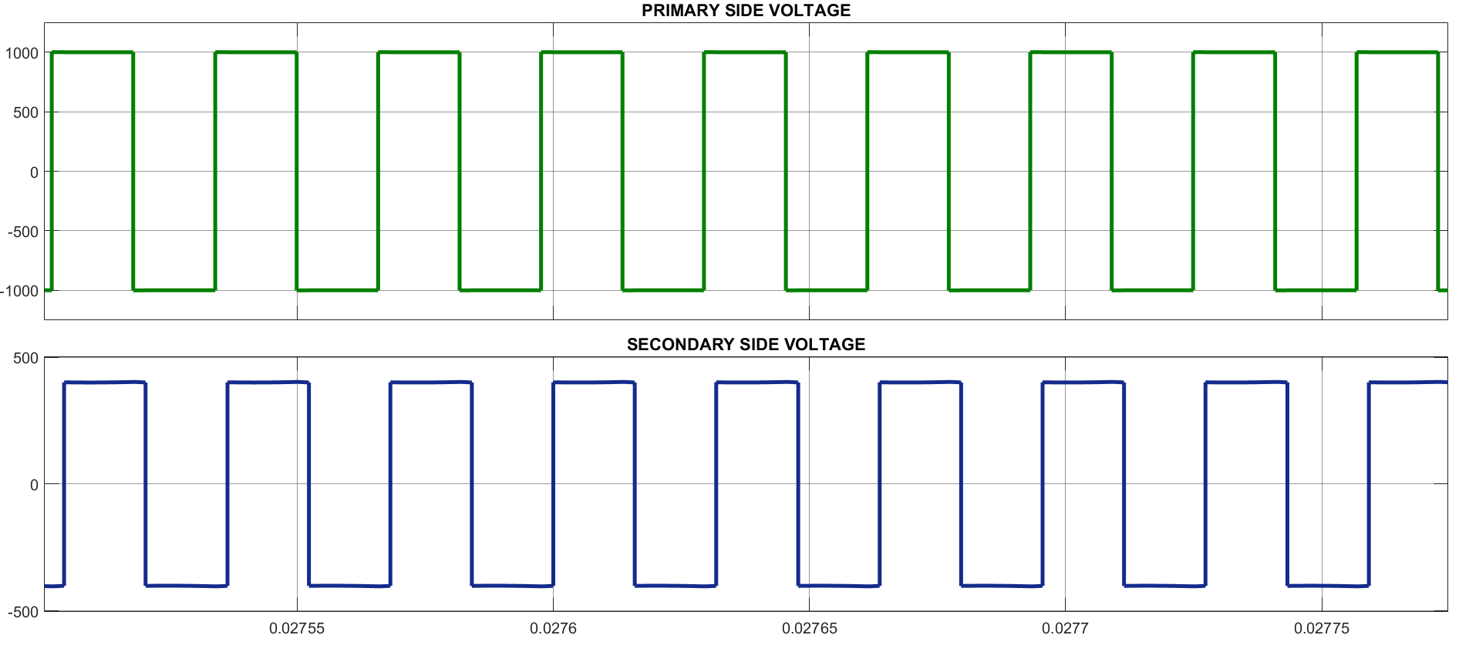
WAVEFORM
Department of Electrical And Electronics Engineering
Indian Institute of Technology , Guwahati

Slide 22
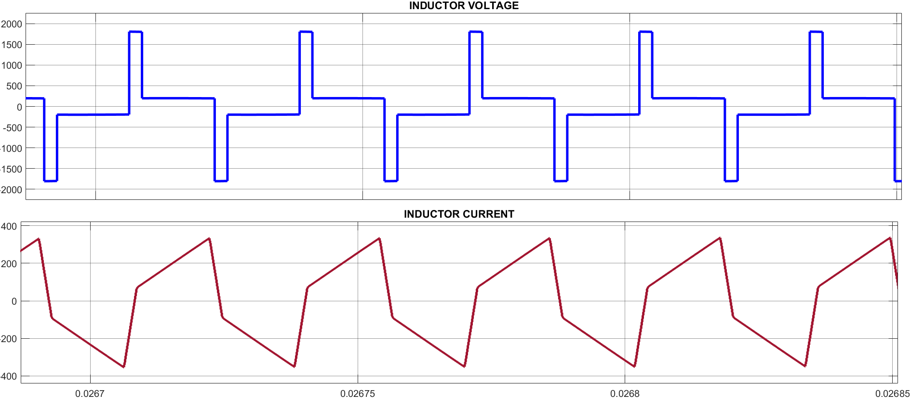
WAVEFORM
Department of Electrical And Electronics Engineering
Indian Institute of Technology , Guwahati

Slide 23
RESULT
PARAMETERS | DESIRED OUTPUT VOLTAGE (IN VOLT) | OBTAINED OUTPUT VOLTAGE (IN VOLT) | PHASE ANGLE DELAY (IN RADIAN)
OPEN LOOP CONTROL | 500 Volt | 654 volt | 0.150 radians
CLOSE LOOP CONTROL | 500 Volt | 499.1 volt | 0.1002 radians
Department of Electrical And Electronics Engineering
Indian Institute of Technology , Guwahati

Slide 24
DAB Converters in Renewable energy sources:
Converts the DC power generated by solar panels to AC power suitable for the grid
Provide electrical isolation between the solar panel system and the grid.
Can reduce the number of conversion stages in a PV system, simplifying the overall design and potentially increasing efficiency.
Used in conjunction with MPPT controllers to optimize the power output of solar panels by adjusting the voltage and current to match the optimal operating point.
Department of Electrical And Electronics Engineering
Indian Institute of Technology , Guwahati

Slide 25
CONCLUSION:
We have done the open loop simulation first, following that we have used a PI Controller to execute closed loop simulation system.
We have observed that with Closed loop simulation, we are able to achieve our desired output voltage.
PI Controller used is able to maintain the output voltage constant by changing the phase angle delay between the pulses of the two H-bridge.
Department of Electrical And Electronics Engineering
Indian Institute of Technology , Guwahati

Slide 26
THANK YOU
Department of Electrical And Electronics Engineering
Indian Institute of Technology , Guwahati

