Slide 1

Bank Management System
Drashti Darji(2205101260006)
Krupa Patel(2205101240018)
Adit Lakhnotra(2205101260012)
Faculty of IT & Computer Science,
Parul Institute Of Computer Application
PARUL University

Slide 2
Introduction
To keep track of a person's bank account, use the Bank Account Management System application.
In order to support end banking users' needs by offering a variety of banking task completion options, a project for resolving customer financial applications in a banking environment is being developed.
Numerous features are available, including deposit, fast cash, pin change, cash withdrawal, mini statement, balance inquiry.

Slide 3
Features:
Deposit
Cash Withdrawal
Fast cash
Pin change
Mini statement
Balance Inquiry

Slide 4
Technology Used:
Apache NetBeans ID 20 for Java code
MySQL Workbench 8.0 CE for Database Storage

Slide 5
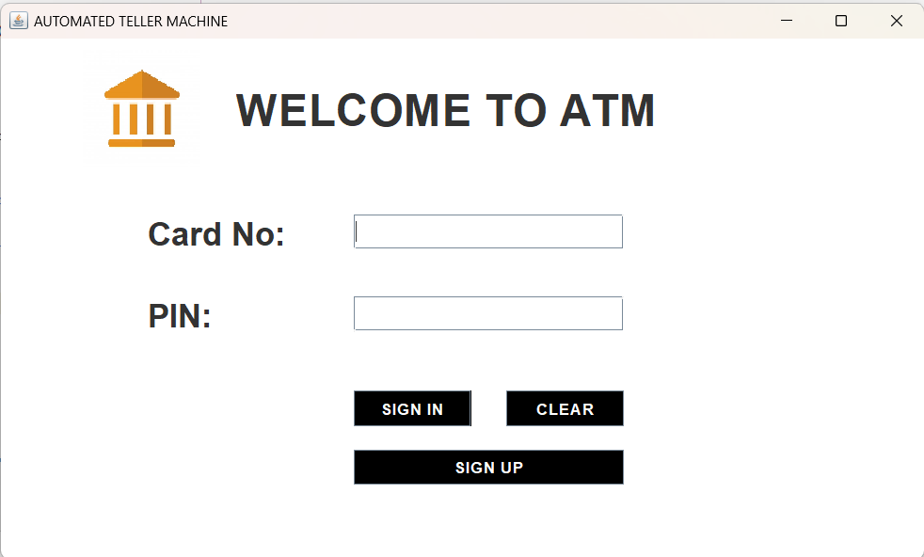
Login Page :

Slide 6
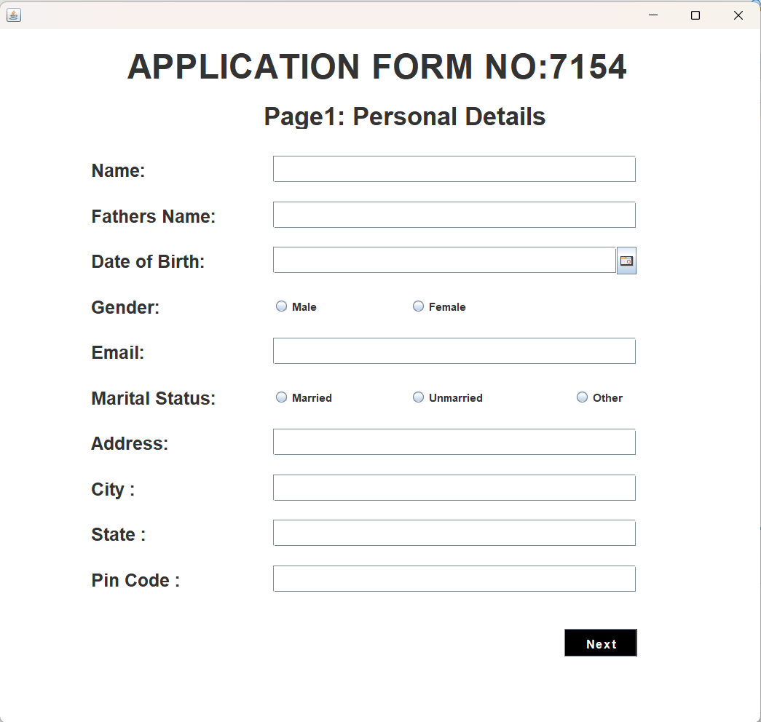
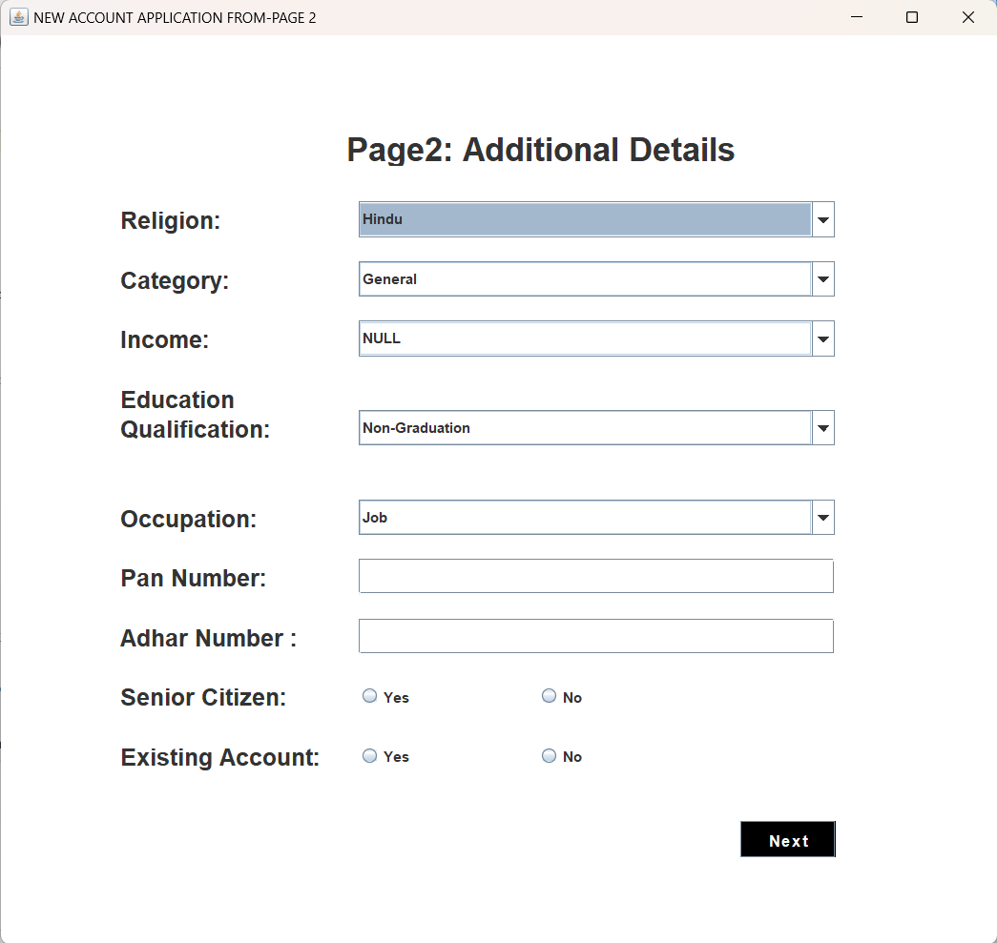
Signup Page :

Slide 7
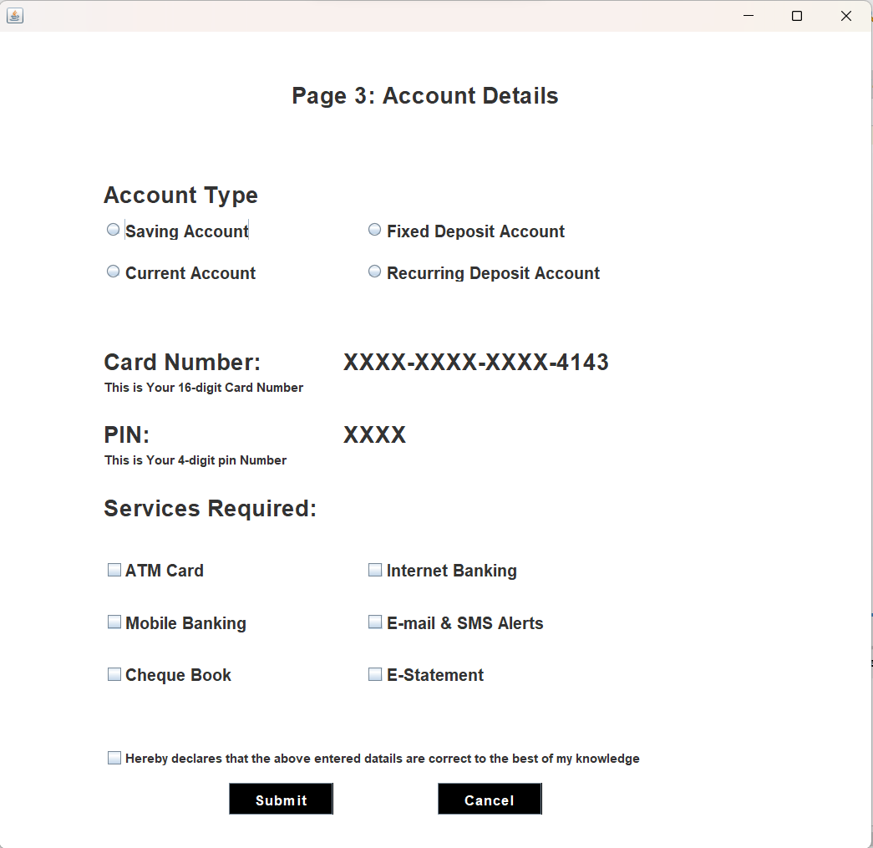
Continue…

Slide 8
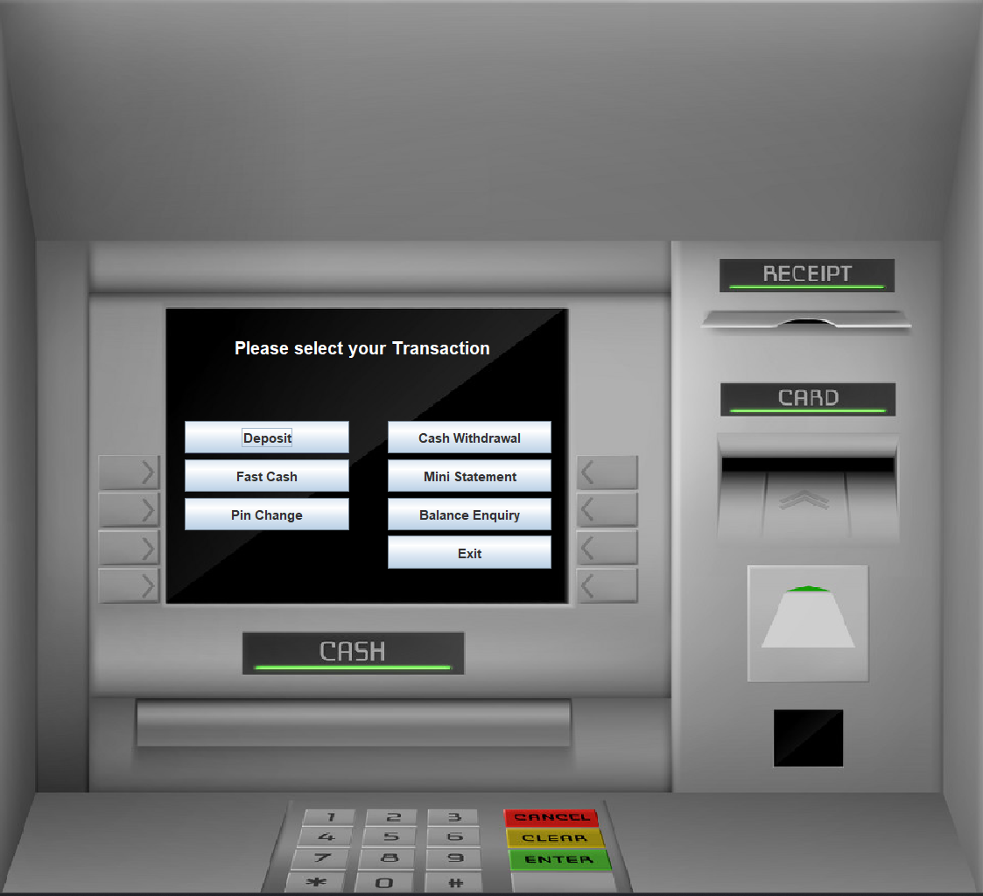
After Login:

Slide 9
Future Enhancement
Digital Transformation: To improve client experiences, expedite processes, and bolster security, banks will keep investing in digital technologies.
Artificial Intelligence: In order to provide individualized financial solutions, data analysis, fraud detection, and client care will all depend heavily on AI.
Sustainability and ESG: When making operational and investment decisions, banks will give careful consideration to environmental, social, and governance (ESG) factors. 9.
Financial Inclusion: Banking systems will endeavour to provide services to underserved groups and rural places in order to increase financial inclusion.

Slide 10
Conclusion
A Banking Management System's System needs Specification (SRS) is a vital document that lists both the software system's functional and non-functional needs.
In order to guarantee that the finished system satisfies the requirements and expectations of the bank and its clients, this document acts as a foundation for the project's design, development, and testing stages.
In the banking sector, the confidentiality, accessibility, and integrity of client data are crucial.

Slide 11
Thank You….

