Slide 1
Crop Yield Prediction of Groundnut in Gujarat State using Machine Learning Algorithms
Indian Institute of Remote Sensing, ISRO
Submitted By
Drashti Nayakpara
ID: 202319019 / TS90709
Divya Prajapati
ID: 202319024 / TS90712
Submitted To
Dr. N. R. Patel
(Agriculture & Soils Department)
Dr. Kamal Pandey
(Geoweb Services, IT and Distance Learning)

Slide 2

Contents
Crop Biology
Objective
Data / Feature Engineering
Methodology
Machine Learning Techniques for Yield Prediction
Results
(Dashboard/ Model Deployment)
Conclusion

Slide 3
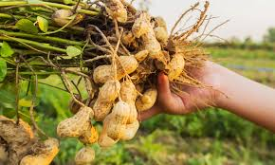
Crop Biology
Scientific Name: Arachis hypogea L.
Optimum Temp. : 20-25℃
Type of soil : Sandy Loamy
Optimum Relative Humidity : 60 – 70%
Optimum Soil Temperature : above 19%
Optimum irrigation: 5 - 6 irrigation
Optimum yield : 1500 to 2000 kg/ha

Slide 4
Problem Statement
The Groundnut Yield Prediction Models serve as valuable tools, benefiting:
Farmers :optimize resource allocation, and mitigate risks.
Policymaker: Formulate policies, plan initiatives, and enhance food security strategies
Resource Allocation: Recommend targeted investments, allocate funds effectively, and prioritize regions for support.
Productivity Enhancement: Boost yields, ensure sustainability, and drive economic growth in the agricultural sector.
Extension Services: Provide advice, foster technology adoption, and enhance capacity building for groundnut farmers.

Slide 5
Status of Groundnut Crop in India
Groundnut is a crucial oilseed and cash crop, contributing to industry and employment.
Cultivation Challenges: India faces obstacles like arid conditions and minimal input control, leading to lower yields compared to other nations.
Increased Production: Recent advancements in farming technologies have boosted groundnut production in India.
Major Cultivating States: Gujarat leads groundnut cultivation, followed by Andhra Pradesh, Karnataka, and Rajasthan.
Machine Learning and Agriculture: Remote sensing and machine learning aid in precise yield predictions, facilitating informed decisions for farmers and policymakers.

Slide 6
Objectives
To develop different ML models for yield prediction of Groundnut Crop.
To evaluate the performance of the models for yield prediction.
To develop a web-based dashboard for feature visualisation.
To deploy the best model for yield prediction in the web platform.
Research Questions
What are the Parameters used for Groundnut yield Prediction, and how can they be measured?
Which machine learning techniques work best for estimating Groundnut Yield?
What effect does the selection of features have on the yield estimating model's performance?
How precise crop yield estimation benefits various stakeholders, such as farmers and policymakers?

Slide 7
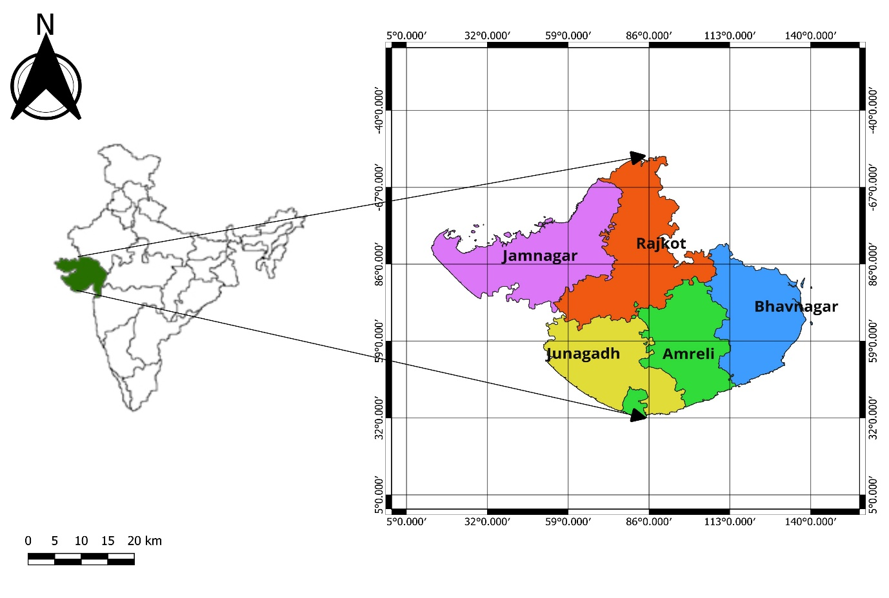
Study Area
The study area comprises five districts of Gujarat state, focusing on crop-masked based analysis

Slide 8
Material
Independent Variables / Features:
Normalized Difference Vegetation Index (NDVI) - MODIS
Enhanced Vegetation Index (EVI) - MODIS
Gross Primary Product (GPP) - MODIS
Leaf Area Index (LAI) – MODIS
Land Surface Temperature (LST) - MODIS
Fraction of Photosynthetically Active Radiation (FPAR) - MODIS
Rainfall - CHIRPS
Soil Moisture index (SMI) – NASA (GEE)
Area - Production – Directorate of Agriculture, Gujarat
Production - Directorate of Agriculture, Gujarat
Dependent Variable / Target:
Yield – Directorate of Agriculture, Gujarat
Satellite | Parameter
MODIS | NDVI, EVI, GPP, FPAR, LAI, LST
CHIRPS | Rainfall
NASA | SMI

Slide 9
Data
The dataset comprises 22 years of data for five distinct districts, resulting in 13 columns representing each district's name, eight indices (Mean of four months jun-oct), production, and yield. With a total of 110 rows collected from GEE.
Year | District | Area | Production | Yield | NDVI | EVI | FAPAR | GPP | LAI | Rainfall | Temperature | SMI
2000 | Jamnagar | 3.91 | 0.91 | 0.02 | 0.279311 | 0.185789 | 2.432149 | 13.17307 | 0.507552 | 53.79903 | 260.5452 | 13.5095
2000 | Junagadh | 4.06 | 41.48 | 1.02 | 0.362143 | 0.242622 | 3.178018 | 17.65736 | 0.716806 | 75.49108 | 247.3395 | 7.129536
2000 | Rajkot | 3.81 | 2.16 | 0.06 | 0.283901 | 0.179621 | 2.730903 | 12.6288 | 0.580709 | 58.79141 | 259.4099 | 8.31062
2000 | Amreli | 2.48 | 4.21 | 0.17 | 0.270095 | 0.164502 | 2.809569 | 13.95941 | 0.611284 | 61.55397 | 255.451 | 8.357046
2000 | Bhavnagar | 1.46 | 1.31 | 0.09 | 0.272157 | 0.172519 | 2.7509 | 13.13728 | 0.588492 | 64.48066 | 252.5557 | 7.433608
2001 | Jamnagar | 4.09 | 56.93 | 1.39 | 0.327263 | 0.22718 | 2.432149 | 13.17307 | 0.507552 | 53.79903 | 260.5452 | 13.5095
2001 | Junagadh | 4.44 | 71.71 | 1.62 | 0.409822 | 0.302695 | 3.178018 | 17.65736 | 0.716806 | 75.49108 | 247.3395 | 7.129536
2001 | Rajkot | 3.68 | 46.58 | 1.27 | 0.344001 | 0.240411 | 2.730903 | 12.6288 | 0.580709 | 58.79141 | 259.4099 | 8.31062
2001 | Amreli | 2.81 | 40.82 | 1.45 | 0.386433 | 0.273748 | 2.809569 | 13.95941 | 0.611284 | 61.55397 | 255.451 | 8.357046
2001 | Bhavnagar | 1.93 | 26.34 | 1.36 | 0.37938 | 0.268815 | 2.7509 | 13.13728 | 0.588492 | 64.48066 | 252.5557 | 7.433608
2002 | Jamnagar | 4.46 | 1.62 | 0.04 | 0.272169 | 0.167696 | 2.432149 | 13.17307 | 0.507552 | 53.79903 | 260.5452 | 13.5095
2002 | Junagadh | 4.58 | 41.22 | 0.9 | 0.392342 | 0.263078 | 3.178018 | 17.65736 | 0.716806 | 75.49108 | 247.3395 | 7.129536
2002 | Rajkot | 4.31 | 5.39 | 0.13 | 0.311328 | 0.191837 | 2.730903 | 12.6288 | 0.580709 | 58.79141 | 259.4099 | 8.31062
2002 | Amreli | 3.13 | 22.45 | 0.72 | 0.367216 | 0.236359 | 2.809569 | 13.95941 | 0.611284 | 61.55397 | 255.451 | 8.357046

Slide 10
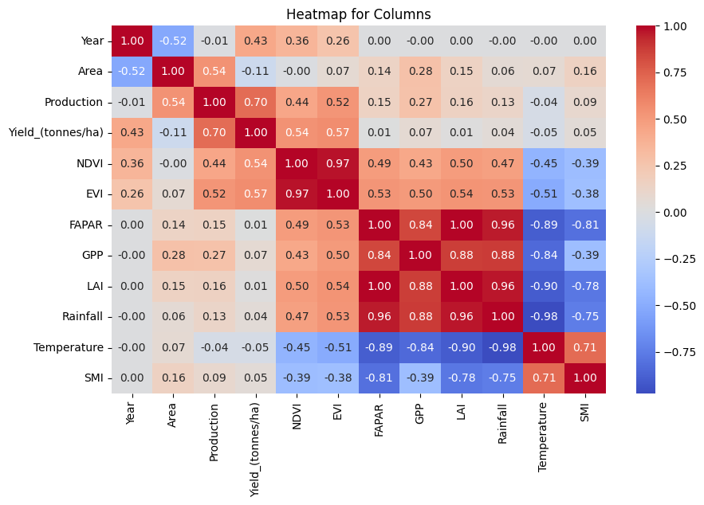
Feature Engineering
Heat Map

Slide 11
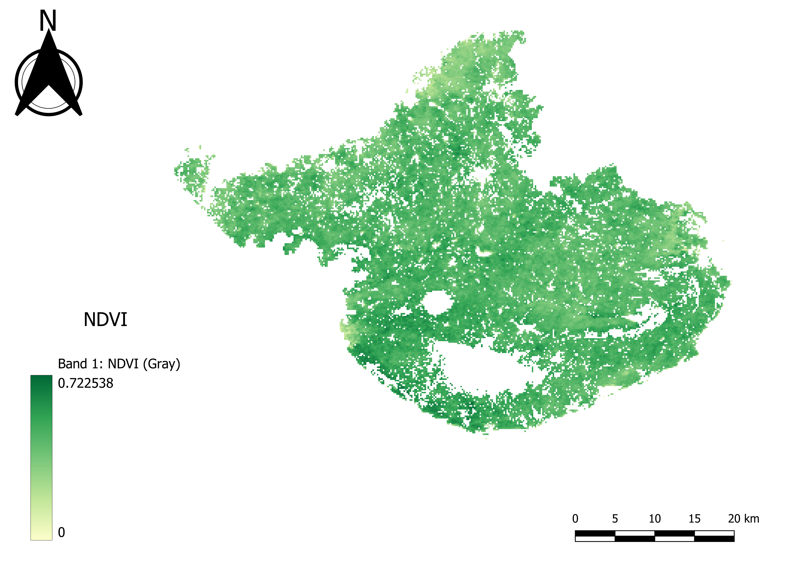
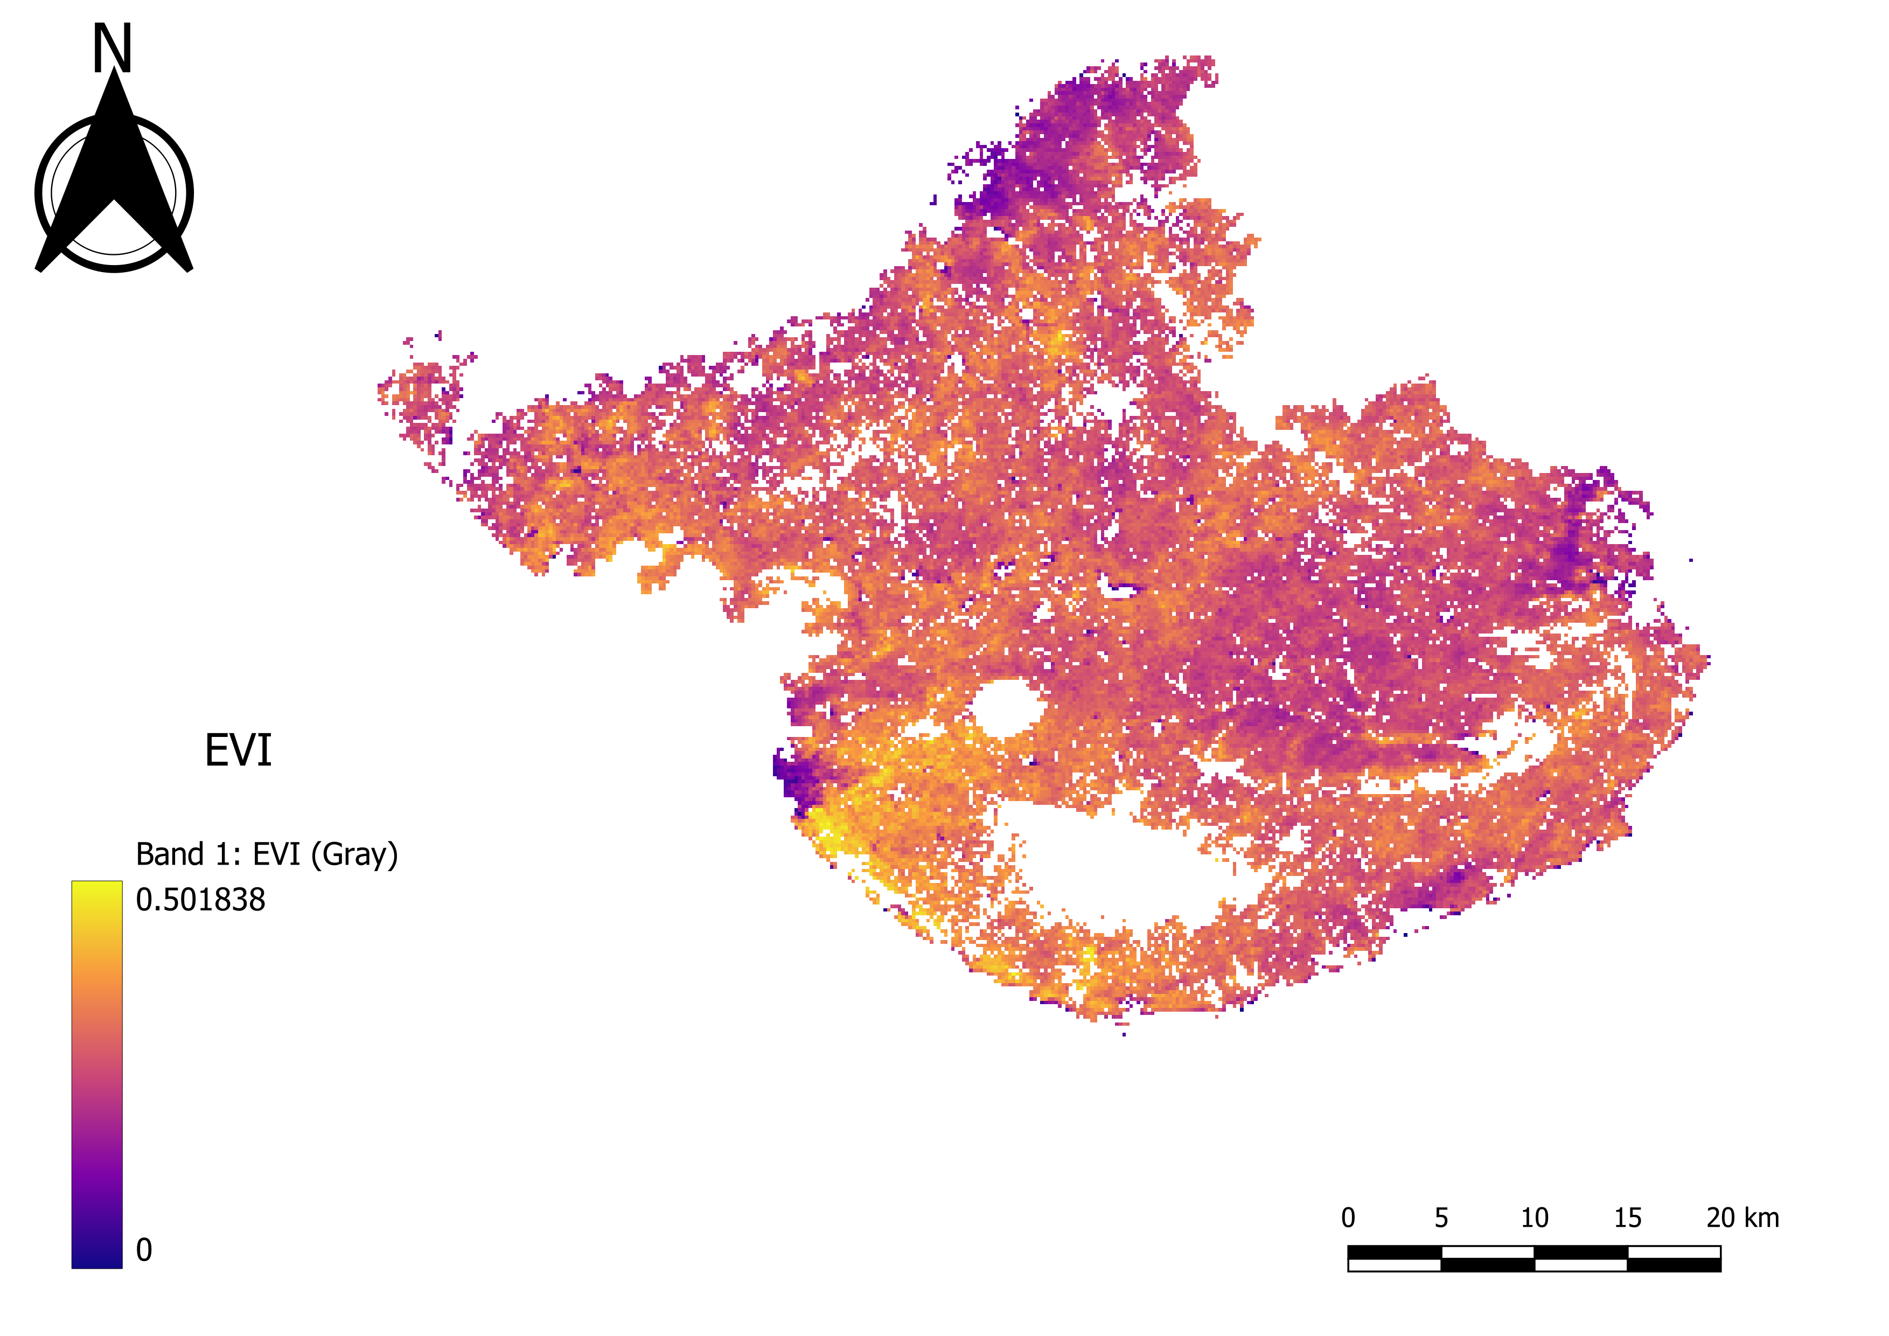
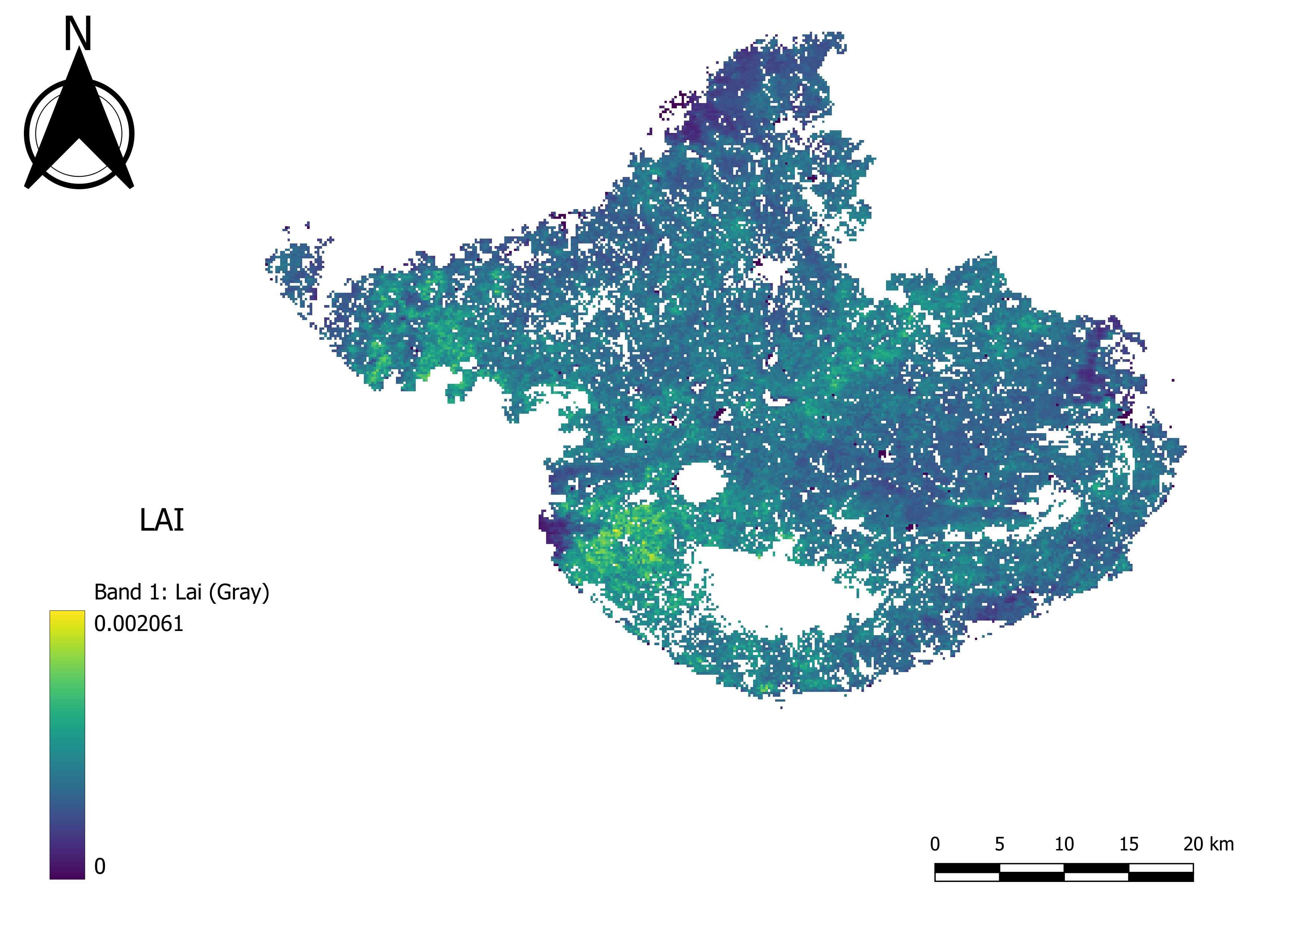
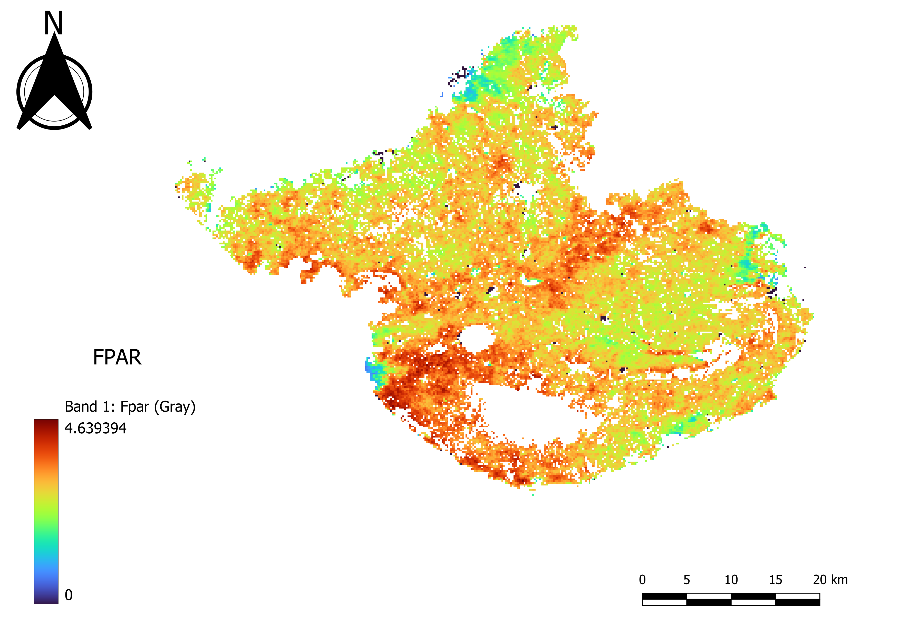
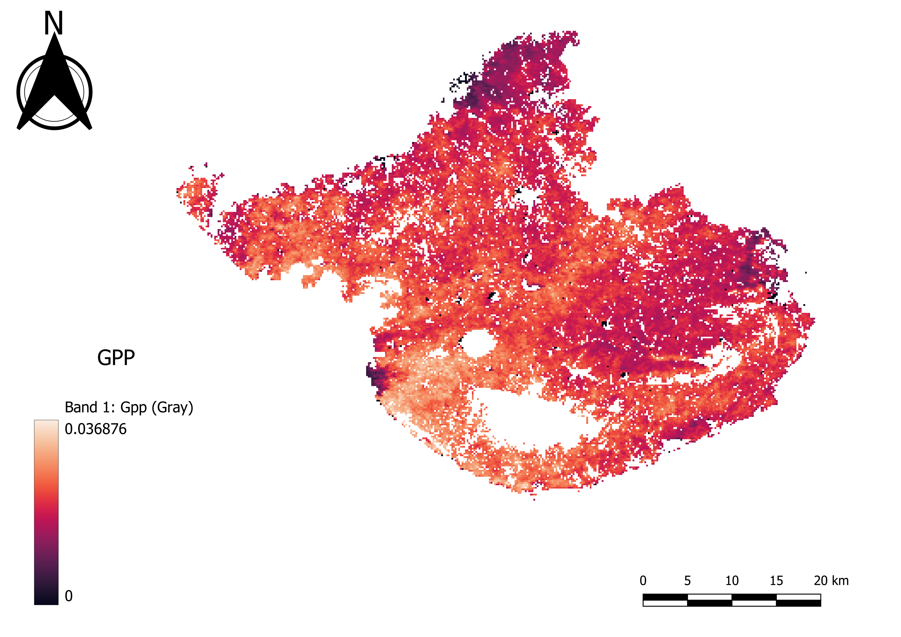
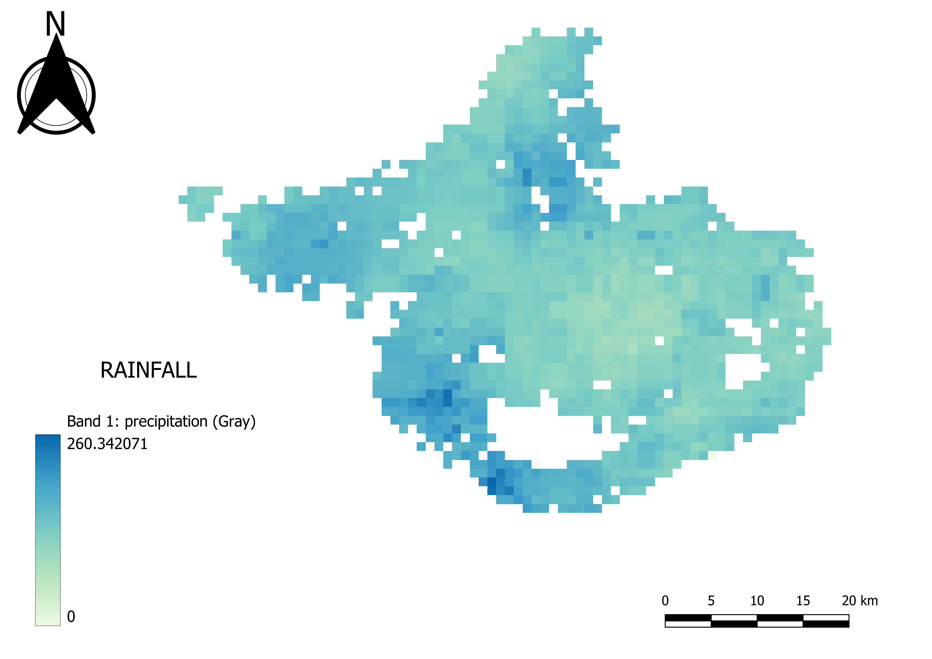
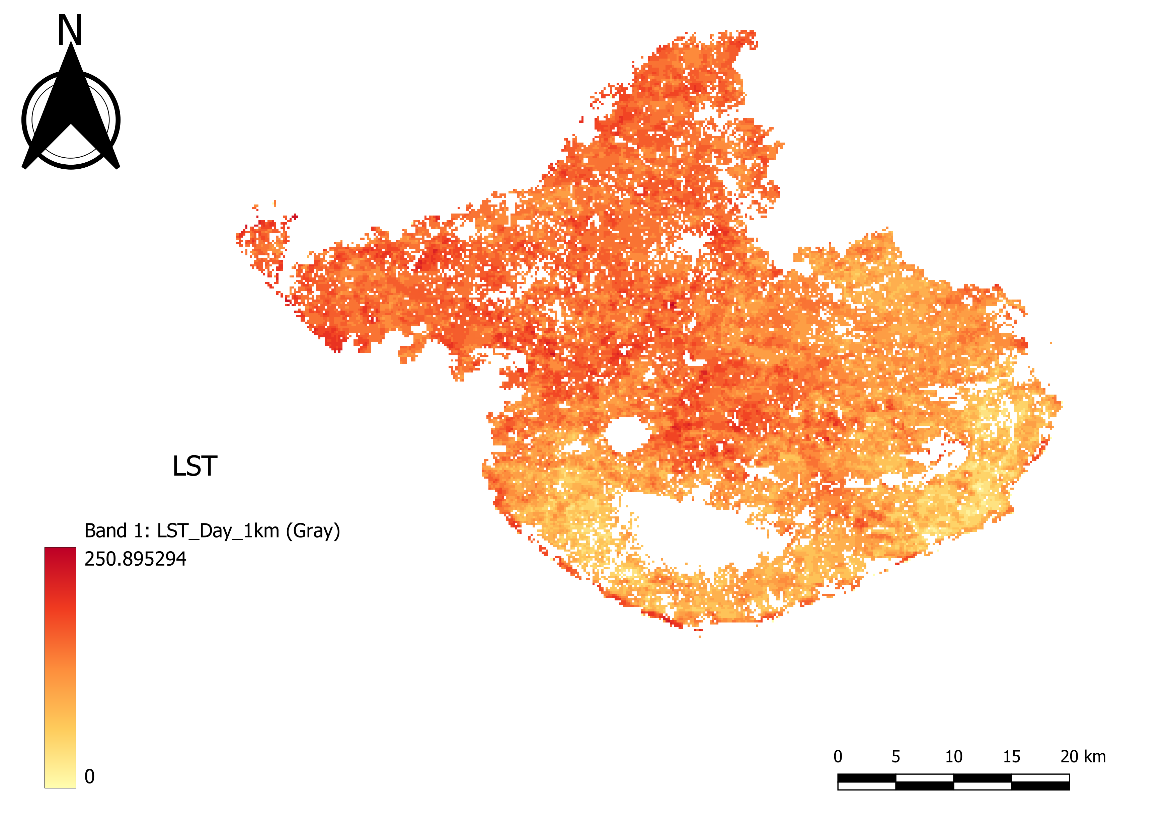
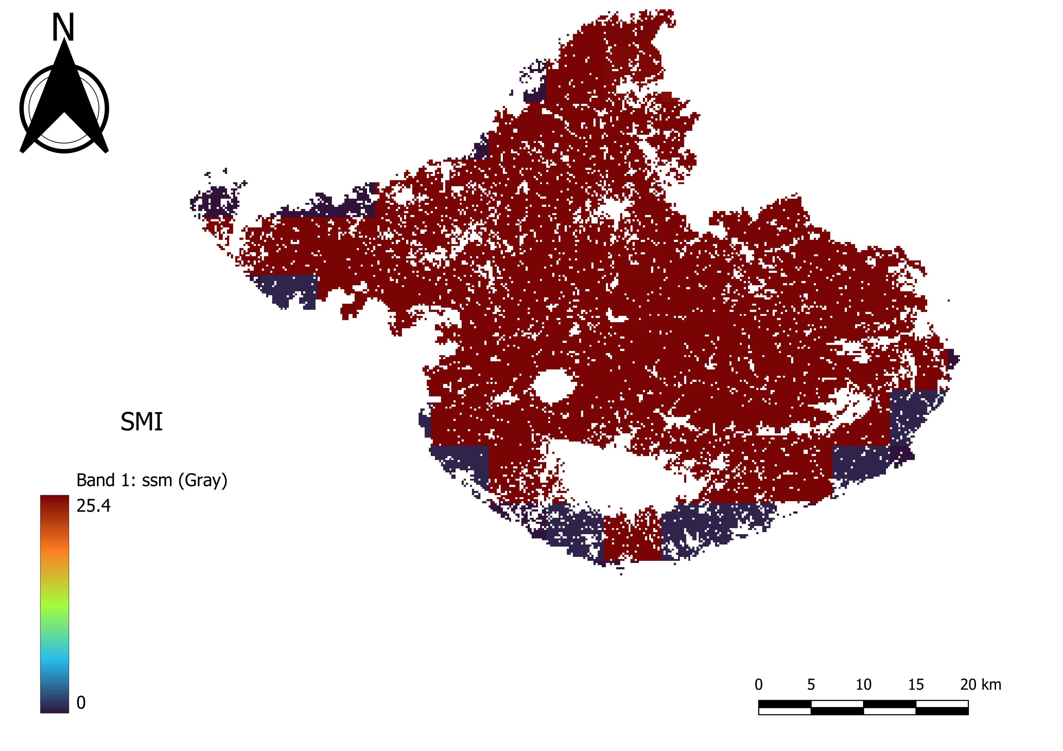
Parameter Maps
NDVI
EVI
LAI
FPAR
GPP
RAINFALL
LST
SMI

Slide 12
Methodology
STEP 1
STEP 2
STEP 3
STEP 4
Understand The Problem Statement
Data Collection
(GEE)
Data Preparation
Training The Model
STEP 8
STEP 7
STEP 6
STEP 5
Dashboard Creation
(looker studio)
Model Deploy
(Stream lit)
Hyperparameters Tunning
Evaluation of Model

Slide 13
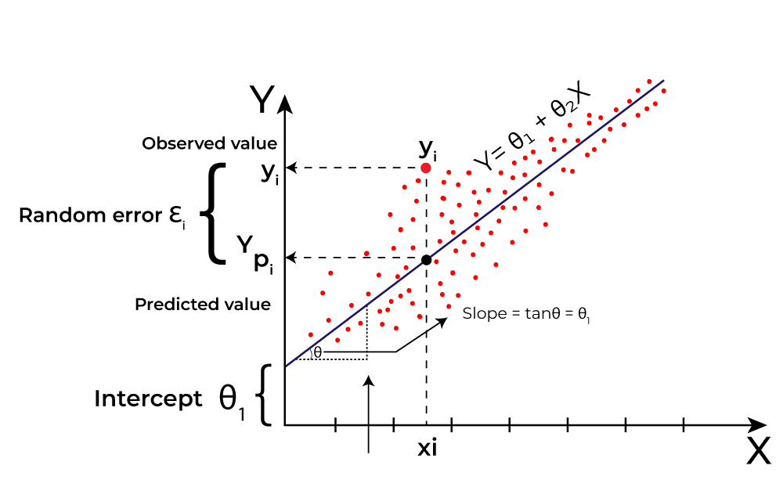
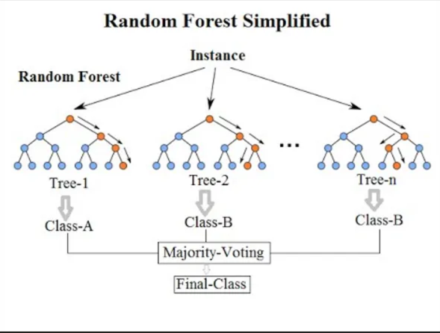
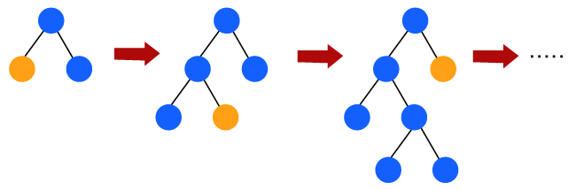
Algorithm Used
Linear Regression
Ridge Regressor
Lasso Regressor
Decision Tree Regression
Gradient Boosting Regression
Random Forest Regression
XGBoost Regressor
Support Vector Regression (SVR)

Slide 14
Results
Hyperparameter Tunning
ML MODEL NAME | R2 SCORE
Linear Regression | 0.749976
Random Forest Regression | 0.832916
Decision Tree Regression | 0.872531
XG Boost Regressor | 0.915705
Gradient Boosting Regression | 0.896246
Lasso Regressor | 0.727212
Ridge Regressor | 0.758049
Support Vector Regressor (SVR) | 0.823192
Hyperparameter tuning is crucial for improving model performance. Adjusting parameters like learning rate (0.1), maximum depth (3), and the number of estimators (300) have enhanced accuracy of the XGBoost model.

Slide 15
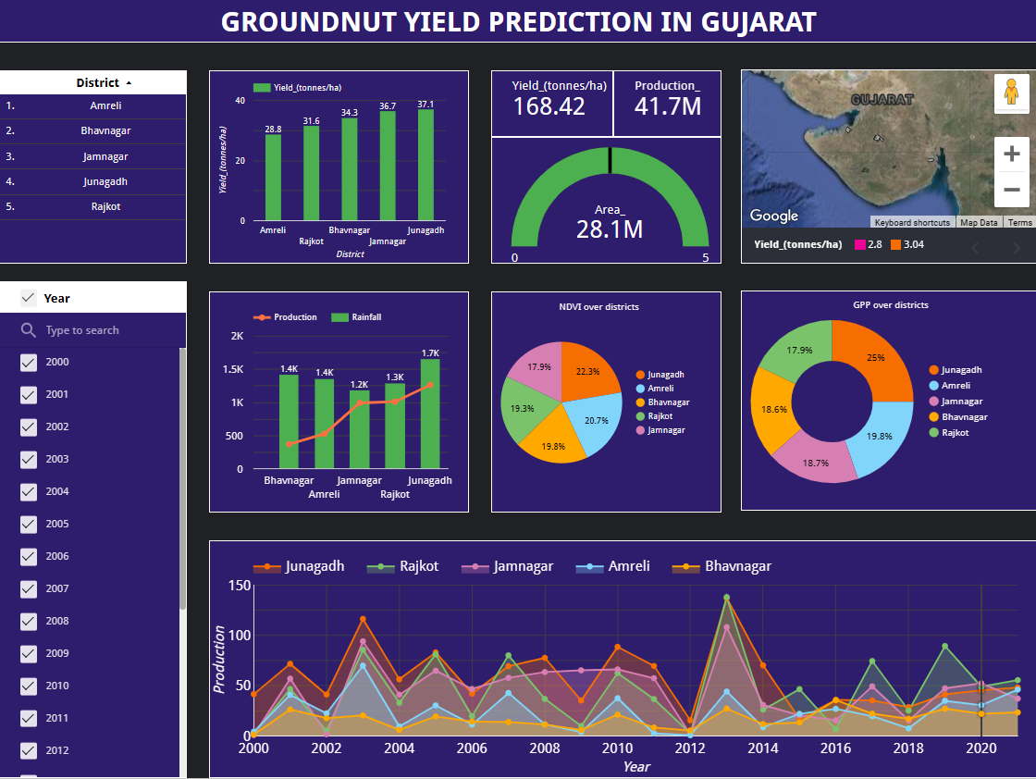
Dashboard By Google Looker Studio
Link of dashboard by Google looker Studio: https://lookerstudio.google.com/reporting/ec76b4e8-2a47-4e96-95e1-a543a5ad3852

Slide 16
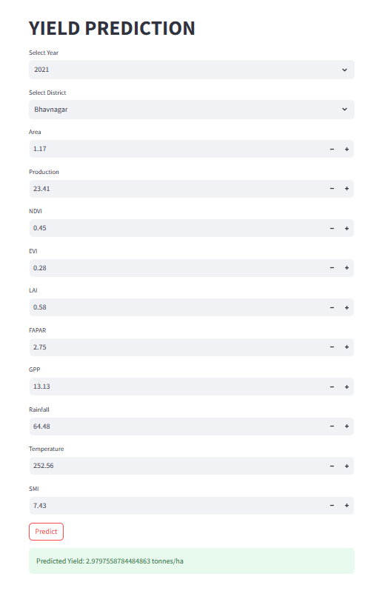
MODEL DEPLOY USING STREAMLIT LIBRARY

Slide 17
Conclusion
Accurate Yield Prediction: Crucial for optimizing agricultural practices and boosting local economy.
Data Inputs for Yield Prediction: Combine vegetation indicators and meteorological variables for accurate Predictions.
Regression Model Evaluation: XGBoost yields highest accuracy and R2 Score among nine models.
Enhancing Model Accuracy: Hyperparameter Tunning is used for enhancing accuracy of model’s predictions.
Promoting Sustainable Agriculture: Accurate yield estimation fosters sustainable practices and boosts productivity.

Slide 18


