Slide 1

Indian Institute of Remote Sensing, ISRO
Module: 2 Machine Learning
Weather prediction
Submitted To
Mr. Kamal Pandey (Scientist)
Geo web Service, IT & Distance Learning
Submitted By
Group 4

Slide 2
Group members
Sr.no | Name | Course | Reg. No | Roles
1. | Gusai Nidhi | MSc. Agri Analytics | TS90707 | Data collection, Code, and PPT
2. | Nayakapara Drashti | MSc. Agri Analytics | TS90709 | Data collection, Code, and PPT
3. | Prajapati Divya | MSc. Agri Analytics | TS90712 | Data collection, Code, and PPT
4. | Jyoti Kulhari | PGD | TS90572 | Data collection, Code, and PPT
DATA SOURCE: DATA ACCESS VIEWER
https://power.larc.nasa.gov/data-access-viewer/
We have downloaded weather data of Dehradun of the year 2021.

Slide 3
Content
Introduction
Problem Statement
Methodology of weather prediction using ML
Different Algorithms used for Weather prediction
Results
Conclusion

Slide 4
Introduction
Weather forecasting refers to predicting atmospheric conditions at a certain area and time using scientific methods and technology.
Weather prediction has always been a critical aspect of our daily lives, influencing various decisions from agricultural planning to disaster management.
Through machine learning, we can enhance the accuracy and reliability of weather forecasts.
By analyzing historical weather data and combining it with real-time observations, machine learning algorithms can provide valuable insights into weather patterns, making predictions more precisely and timely.
Parameter used for classification of labeled data : Humidity, Precipitation, temperature, windspeed.

Slide 5
Problem statement
How to utilize Machine learning algorithms for weather prediction?
What are the different ML Models for classification that are used in weather prediction?
How cross-validation and hyperparameter tunning increase the efficiency of the ML Model?

Slide 6
Methodology of weather prediction using ML
Data collection
Feature engineering and selection
Model selection
Data Preprocessing
Exploratory Data Analysis
Finalizing model and cross-validation
Hyperparameter tuning
Model evolutions
Model training and testing

Slide 7
Algorithms Used
Decision tree
Random forest
Support vector classifier
K NeighborsClassifier
Logistic regression
GaussianNB

Slide 8
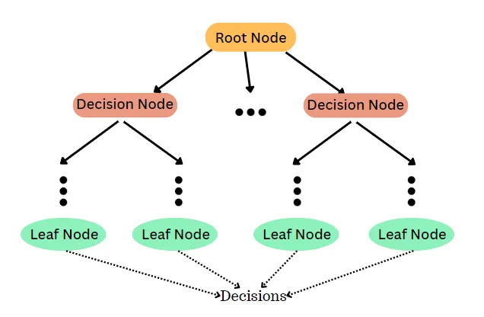
Decision tree
A decision tree is a supervised learning algorithm commonly used in machine learning to model and predict outcomes based on input data.
It is a tree-like structure where each internal node tests on attribute, each branch corresponds to attribute value and each leaf node represents the final decision or prediction.
The decision tree algorithm falls under the category of supervised learning. They can be used to solve classification problems.

Slide 9
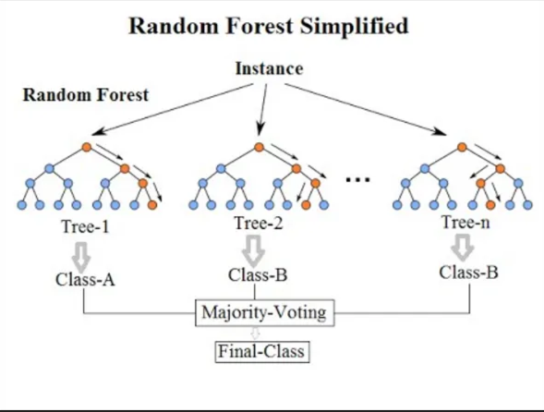
Random Forest
A random forest is an ensemble learning method that combines the predictions from multiple decision trees to produce a more accurate and stable prediction.
It is a type of supervised learning algorithm that can be used for classification tasks.

Slide 10
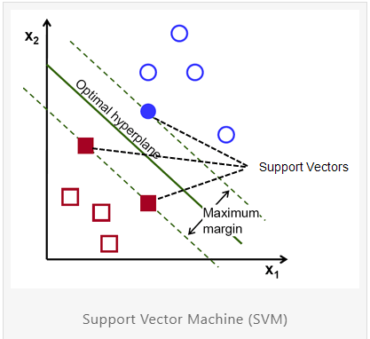
Support vector classifier
The main objective of the SVM algorithm is to find the optimal hyperplane in an N-dimensional space that can separate the data points in different classes in the feature space.
The hyperplane tries that the margin between the closest points of different classes should be as maximum as possible.
The dimension of the hyperplane depends upon the number of features.

Slide 11
KNN (K-Neighbours Classifier)
KNN works on a principle assuming every data point falling in near to each other is falling in the same class. In other words, it classifies a new data point based on similarity.
Deciding the k can be the most critical part of K-nearest Neighbors.
If the value of k is small then noise will have a higher dependency on the result, Overfitting of the model is very high in such cases. The bigger the value of K will destroy the principle behind KNN.

Slide 12
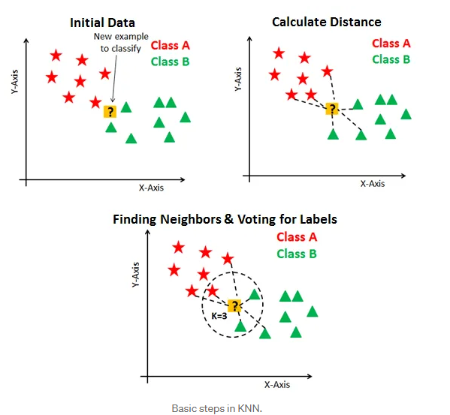
Basic steps in KNN

Slide 13
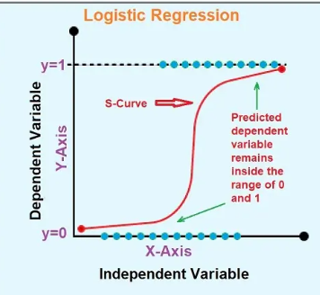
Logistic regression
Logistic regression is a supervised machine learning algorithm used for classification tasks where the goal is to predict the probability that an instance belongs to a given class or not.
Logistic regression is a statistical algorithm that analyzes the relationship between two data factors.

Slide 14
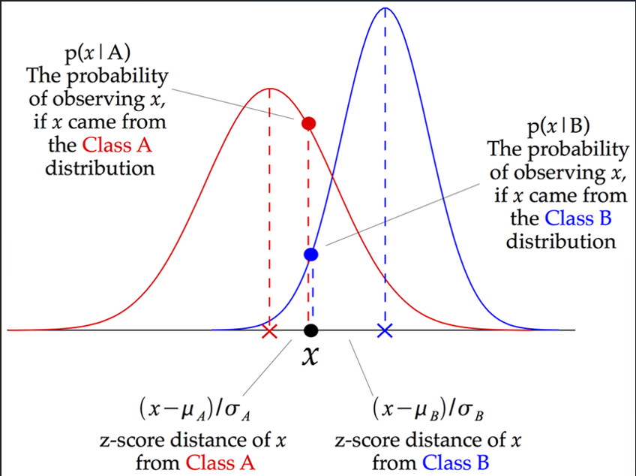
GaussianNB
Naive Bayes considers the probability of occurrence of each class and assigns the label value to the class with higher probability.
The Naive Bayes Classifier is based on a simple concept from probability theory called the Bayes Theorem.

Slide 15
Results
Sr.no | Model | Accuracy
1. | Decision Tree Classifier | 0.945946
2. | Random forest | 0.891892
3. | SVC | 0.594595
4. | K Neighbors Classifier | 0.648649
5. | Logistic Regression | 0.567568
6. | GaussianNB | 0.810811

Slide 16
Conclusion
Among the classifiers mentioned, the Decision Tree Classifier and Random forest exhibit the best performance, with 0.94 and 0.89 accuracies respectively.
After Cross validation and hyperparameter tuning of the Decision Tree Classifier and Random forest accuracy changes to 0.93949 and 0.91207 respectively.
So we conclude that hyper parameter tuning increases efficiency of the model by suggesting best parameter.

Slide 17
Thank you….

