Slide 1
Division

Slide 2
CONTENT
Restoring Division Algorithm
Verilog Code
Test Bench
Non Restoring Algorithm
Verilog Code
Test Bench

Slide 3
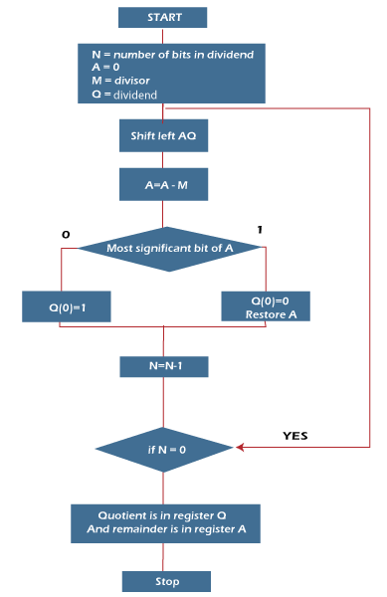
Restoring Algorithm

Slide 4
Example
Dividend = 11 (1101) —> Q
Divisor = 3 (0011) —> M
-M = 11101
A=0 (initially)

Slide 5
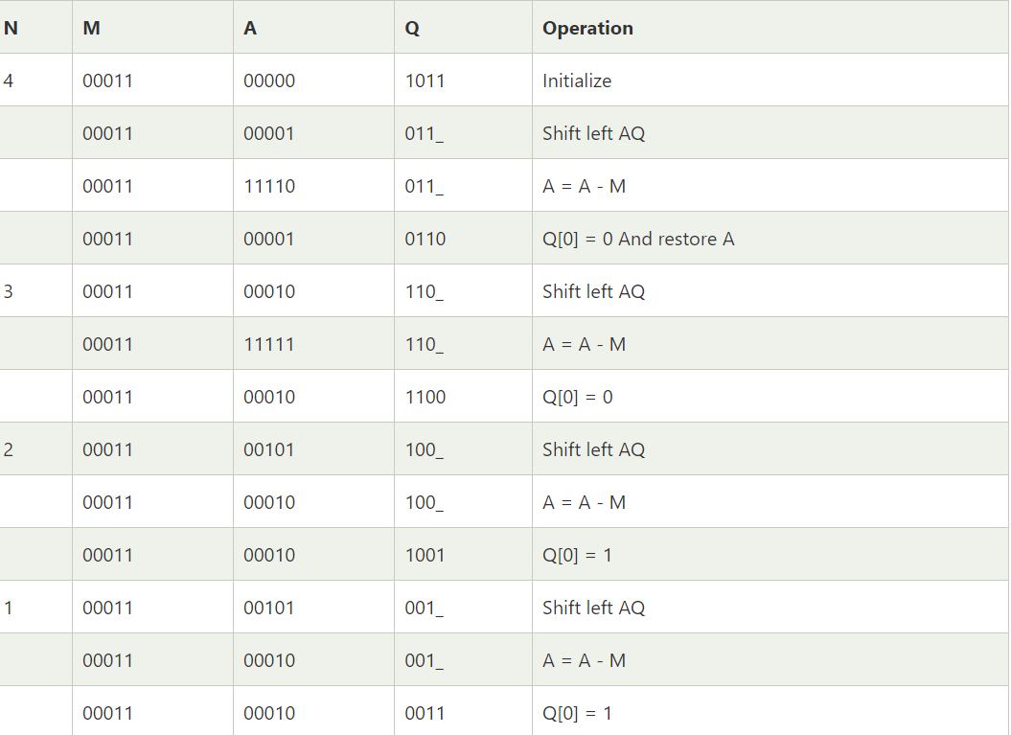

Slide 6
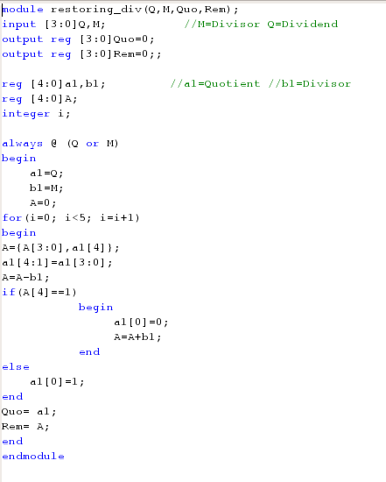
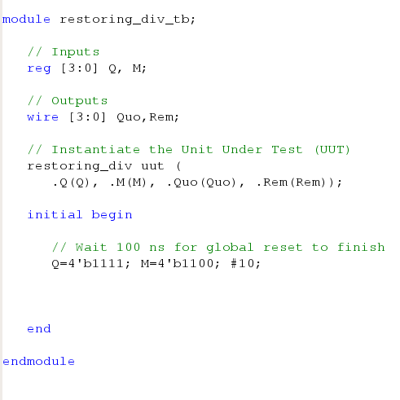

Slide 7
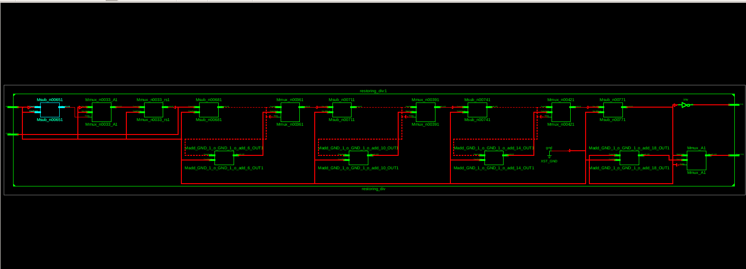

Slide 8
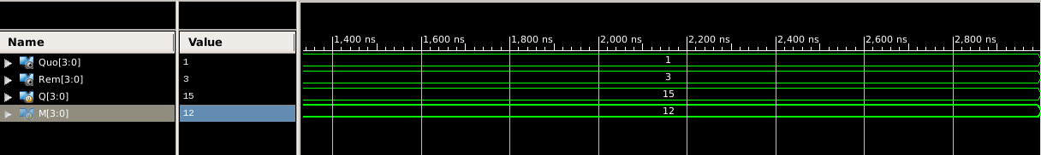

Slide 9
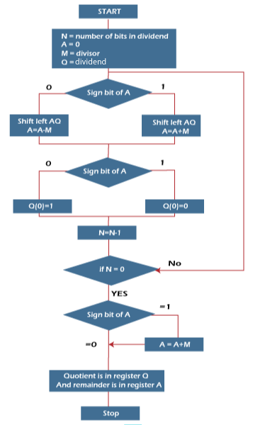
Non-Restoring Algorithm
Now, here performing Non-Restoring division, it is less complex than the restoring one because simpler operation are involved i.e. addition and subtraction, also no restoring step is performed. In the method, rely on the sign bit of the register which initially contain zero named as A.

Slide 10
Example
Dividend = 11 (1101) —> Q
Divisor = 3 (0011) —> M
-M = 11101
A=0 (initially)

Slide 11
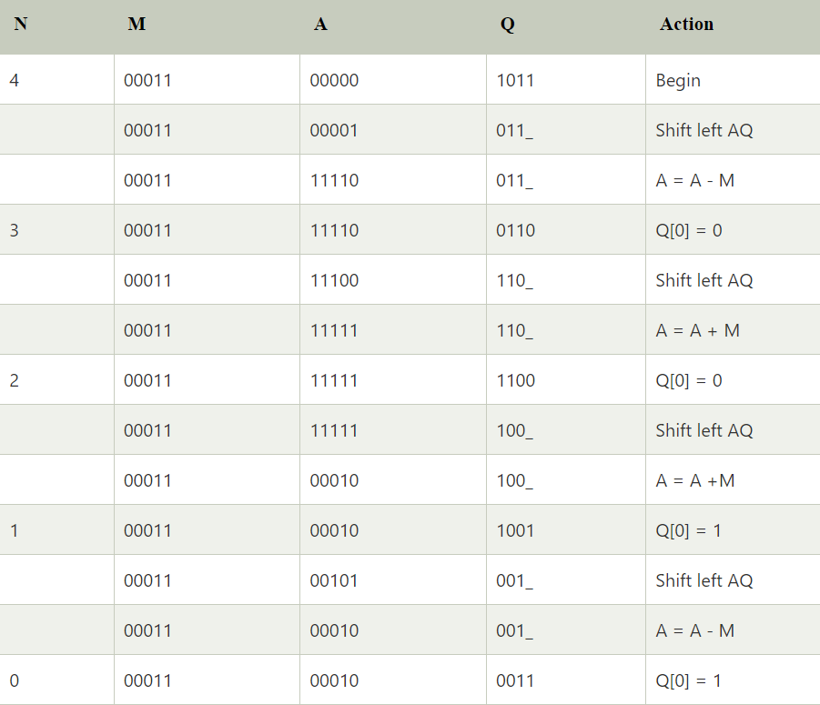

Slide 12
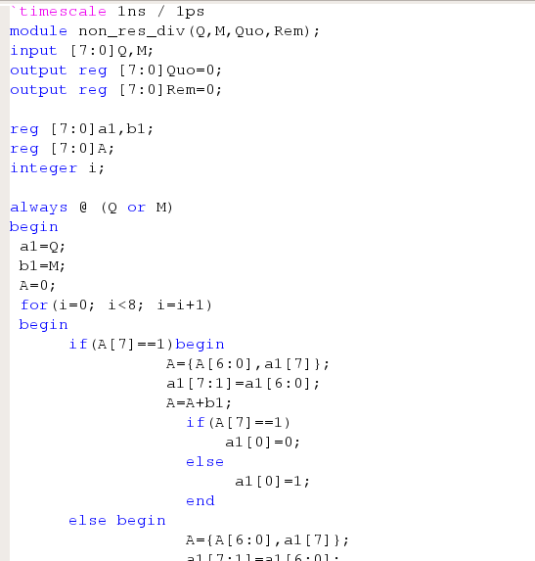
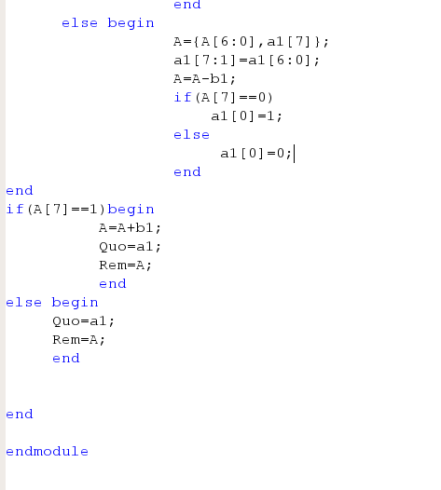

Slide 13
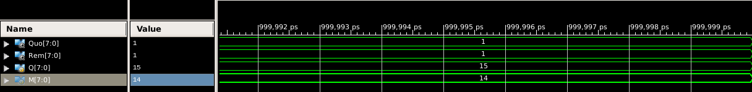

Slide 14
Thank you

