Slide 1
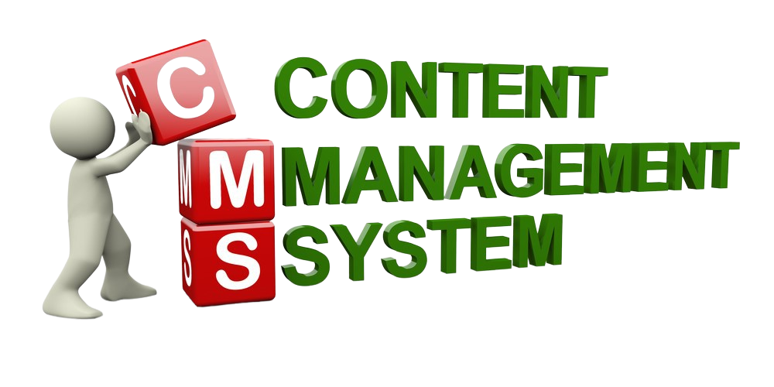

Slide 2
Guided by Mr. Rakesh Savant
Team
Drashti H. Pancholi
201806100110024
Yash M. Dhameliya
201806100110110

Slide 3

Introduction
Content management system is a software application that allows users to collaborate in the creation, editing, and production of digital content: web pages, blog posts, etc.

Slide 4


Problem Definition
An increasing number of organizations or bloggers have web sites. The trend is to disseminate responsibility of managing web content for the web site to the people who generate it rather than webmaster. At the same time, this scenario creates a situation in which people who are uncomfortable with working on web design are forced to complete tasks for a web site.

Slide 5



Project Objective
01
Quick Publish
02
Easier to Create
03
Reduce Cost
PUBLISH
CMS have quick publish facility without any external verification.
The ability easier to add, update or delete any images, text, title or categories.
Keep number of content categories wise and reduce their overall cost.

Slide 6


Project Scope
Author
Template
This system allow only one author in one particular user account.
This system can only use to manage content in the one default template.
Template
Categories
Widgets
Provide category facility to show category wise blog post.
This system don’t have any widgets.
Author
Widgets
Categories

Slide 7


Technology
ExpressJS
NodeJS
A framework layered on top of
NodeJS, used to build the backend
of a site using NodeJS functions
and structures.
The JavaScript runtime
environment, used to run
JavaScript on machine
rather than in an browser.
(backend )
MongoDb
ReactJS
Document-oriented,
No-SQL database
used to store the
Application date.
(Binary JSON)
Used to build UI (used Material-ui)
components that create
the user interface of the
single page web
application.

Slide 8
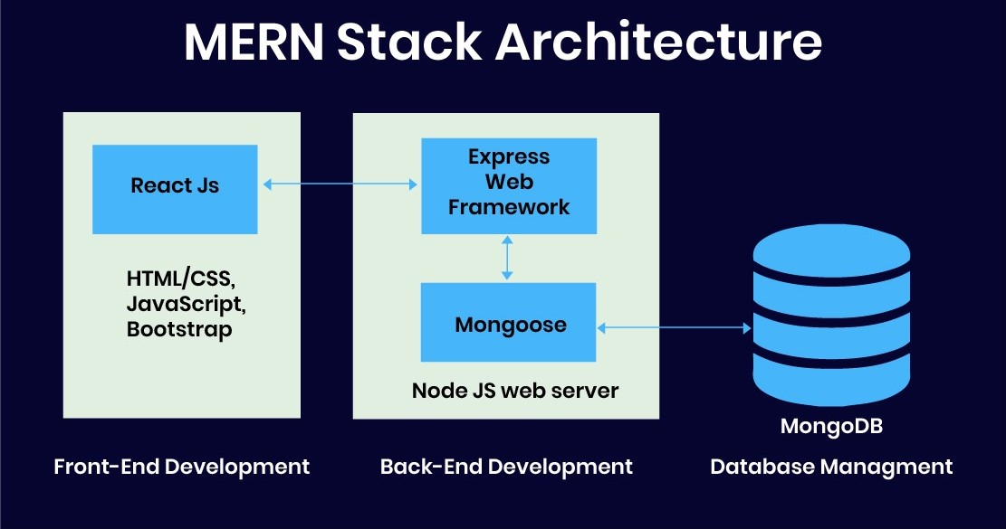
Technology Benefits
The principle advantage for engineers utilizing the MERN stack is that each
line of code is written in JavaScript.
This is a programming language
that is utilized all over the place, both
for client side and server-side.

Slide 9
Functional Requirement
Registration and Login
User basic information
Forgot Password
System-generated email
Manage Bloggers
Admin can see all blogger details (View)
Okta Authentication (Email Verification )
Username
E-mail address
Password
Reset password
New Password
Confirm Password
Blogger forgot their password
Registered E-mail address

Slide 10
Functional Requirement Continue
Manage Blog Categories
Blogger manage it (Add, Update, Delete, View)
Post id
Post title
Post Image
Post Content
Post URL
Admin manage it (Add, Update, Delete, View)
Blogger can able to see it (View)
Manage Blog Post
Category id
Category name
Manage comments
Blogger can do comments on all post
Blogger manage their post comments (Add, Update, Delete, View)

Slide 11
Functional Requirement Continue
Manage About Us
Blogger manage it (Add, Update, Delete, View)
Site name
Blogger manage it (Add, Update, Delete, View)
Manage Contact Us
About Us Id
Site name
Author name
Author image
Description
Email id
Website Url
Social media links

Slide 12
Functional Requirement Continue
Manage Privacy Policy
Blogger manage it (Add, Update, Delete, View)
Site name
Site Url
Cookies
Google ads
Third party ads

Slide 13



Non Functional Requirement
01
Usability
02
Security
03
Responsive
The System will be user-friendly and easy to operate, and the functions will be easily understandable.
The System will be password protected. Users will have to enter the correct Email ID and password to access the system.
The system will be designed to work on any modern digital device with browser compatibility of its display size, resolution, orientation and aspect ratio.

Slide 14
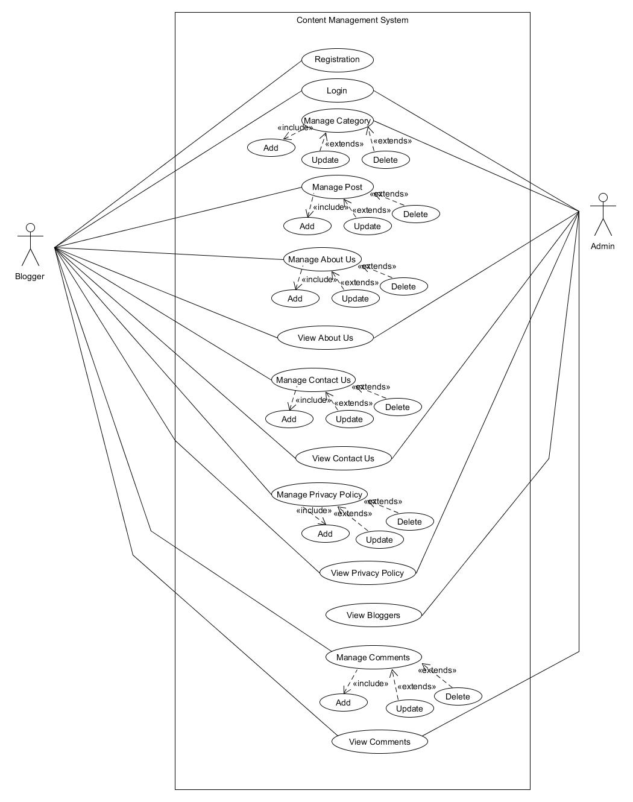
Use case Diagram
Click Here…

Slide 15
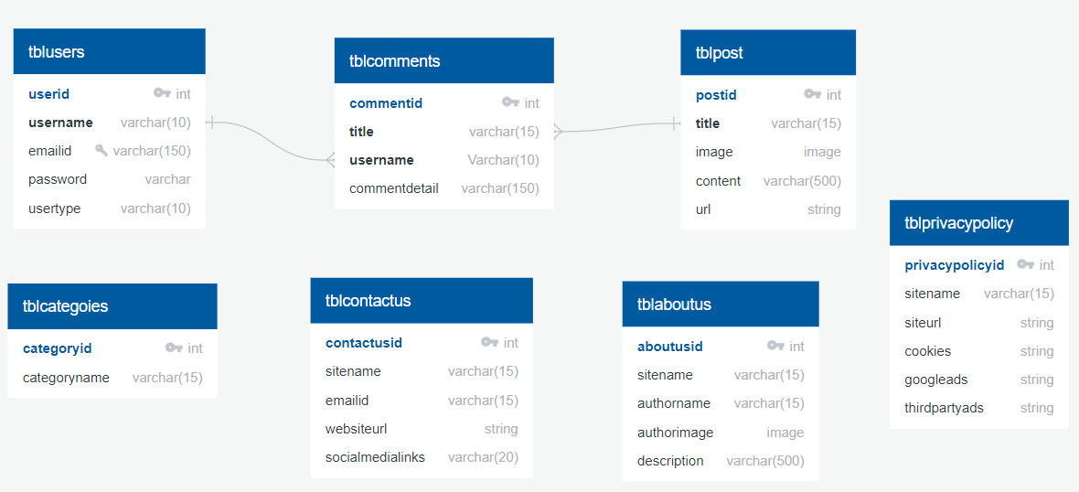
Database Schema
Click Here…

Slide 16

CMS
Thank You

