Slide 1

Department of Computer Engineering
Mini Project
Semester - VII
“Resume builder Application”
Guided By: Ms. Tosal M. Bhalodia
Prepared By: Drashti Ranpariya ( 220007006 )

Slide 2
Outline
Introduction
Project Overview
Objectives and Scope
Challenges and Solutions
Diagrams
Implementation and Roadmap
Future Plans
Conclusion
Thank You

Slide 3
Introduction
Purpose
To create a Resume & CV Builder app
Helps users generate professional resumes quickly
Multiple templates with customizable data
User-friendly interface with smooth navigation

Slide 4
Introduction
Objectives
Reduce manual effort in resume formatting
Provide modern & stylish resume templates
Ensure structured data collection with validation
Enable users to preview & export resumes

Slide 5
Project Overview
Core Functionalities
Personal info, education, skills, projects, experience
Additional sections (summary, certifications, awards, hobbies)
Multiple templates for Resume & CV
Profile image support in Template 4

Slide 6
Project Overview
Key Features
Validation & autosave across sections
PageView navigation with tabs
Animations & professional UI
Export/Preview option

Slide 7
Objectives and Scope
Objectives
Provide a user-friendly mobile app for creating professional resumes & CVs
Automate resume formatting with modern templates
Ensure structured and validated data entry across multiple sections
Allow real-time preview of resumes before exporting
Save time for students & professionals in preparing resumes

Slide 8
Objectives and Scope
Scope
Functional Scope
Multi-section form: Personal Info, Education, Skills, Projects, Experience.
Multiple resume & CV templates with different designs
Profile image support in templates (default initials or custom image)
Validation before moving between sections
Non-Functional Scope
Cross-platform support (Android & iOS using Flutter)
Lightweight & responsive UI with animations
Data persistence via singleton model (ResumeData / CVData)
Privacy-focused: local storage only, no unnecessary data sharing

Slide 9
Challenges and Solutions
Challenges
Ensuring proper form validation
Maintaining data persistence across screens
Designing flexible resume templates
Handling multiple entries (education, projects, etc.)

Slide 10
Challenges and Solutions
Solutions
Singleton model for central data storage
Validation checks before moving sections
Reusable template structure
List-based UI for dynamic entries

Slide 11
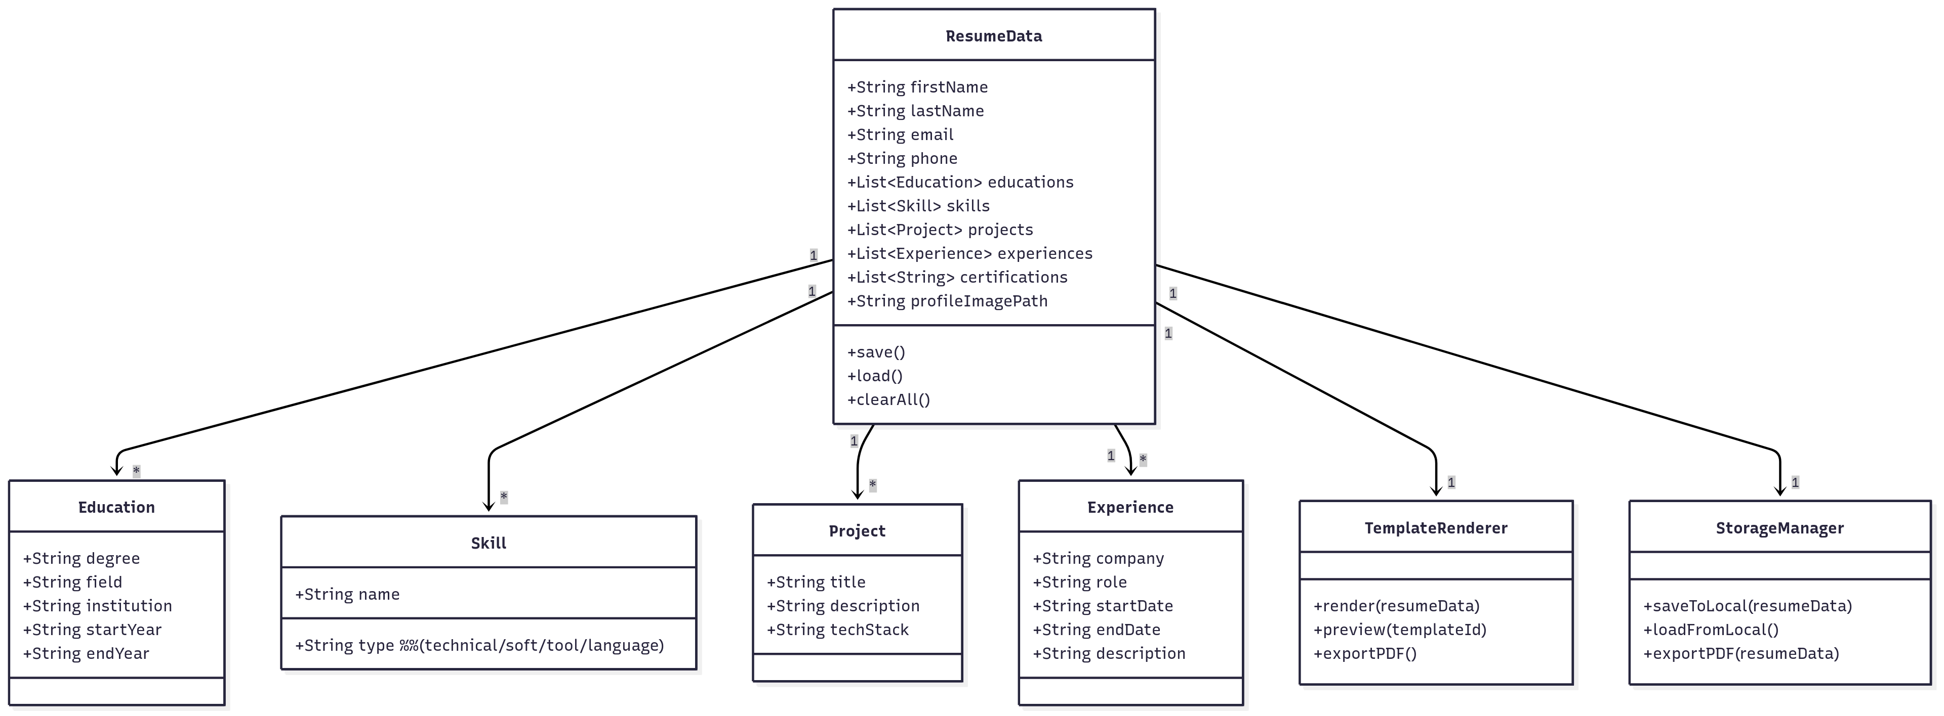
Diagrams
1. Class Diagram

Slide 12
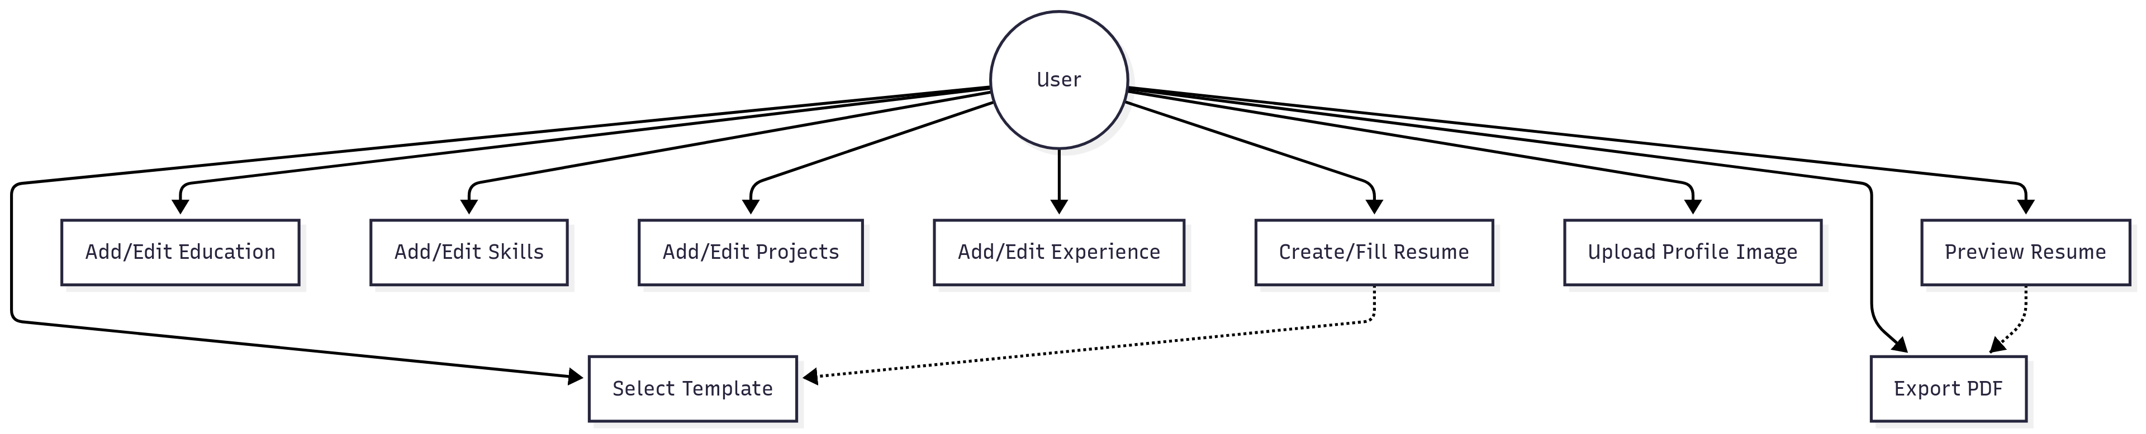
Diagrams
2. Use – Case Diagram

Slide 13
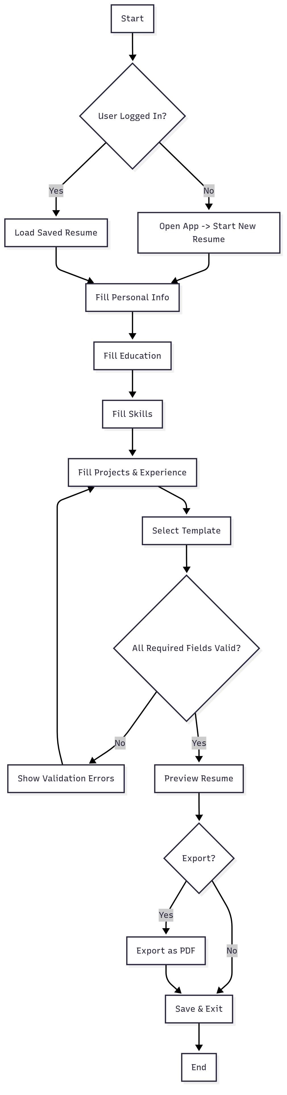
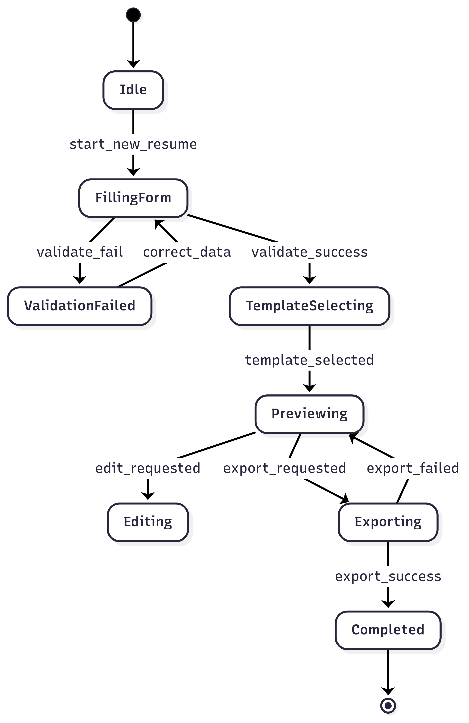
Diagrams
3. Activity Diagram
4. State Diagram

Slide 14
Future Plans and Roadmap
Future Enhancements
Export as PDF/Word directly
Cloud sync for saving resumes
AI-assisted content suggestions
More templates with modern designs
Resume sharing via app

Slide 15
Future Plans and Roadmap
Roadmap (Resume Builder Application)
Week 1–2: Requirements gathering & environment setup
Week 3–4: Develop core sections (Personal Info, Education, Skills, Projects)
Week 5–6: Implement resume & CV templates (Template 1–4) and live preview
Week 7: Testing of forms, navigation, and template rendering
Week 8: Add PDF export functionality
Week 9: Enable profile image customization in Template 4
Week 10: Final testing, optimization, and documentation

Slide 16
Conclusion
Fully functional Resume + CV Builder
Multi-section data entry with validation
Multiple templates including profile image option
Smooth animations & professional UI
Reduces manual effort in resume building
Provides professional, ready-to-use templates
Scalable for future AI & cloud integration
Practical tool for students & professionals

Slide 17


