Slide 1
MYSQL

Slide 2
What is SQL
Allows users to access data in relational database management systems. Allows users
to describe the data.
Allows users to define the data in database and manipulate that data.
Allows to embed within other languages using SQL modules, libraries & precompilers.
Allows users to create and drop databases and tables.
Allows users to create view, stored procedure, functions in a database.
Allows users to set permissions on tables, procedures, and views
SQL stands for Structured Query Language
SQL allows you to access a database
SQL is an ANSI standard computer language
SQL can execute queries against a database
SQL can retrieve data from a database
SQL can insert new records in a database

Slide 3
What is MYSQL?
MYSQL is a relational database management system (RDBMS) developed by oracle that is based on structured query language (SQL).

Slide 4
What is databases?
A database is an organized collection of structured information or data which can be accessed electronically.

Slide 5
What is DBMS?
Database management system (DBMS ) are software system to store, retrieve, and run queries on data.
Create , Read ,Update ,Delete

Slide 6
Types of DBMS
DBMS
Relational (SQL)
NON-Relational (No-SQL))

Slide 7
What is Relational Database?
A relational database is a collection of data items with pre-defined relationships between them, stored in the form of tables ,row,columns.
List of SQL databases
MySQL
MariaDB ,MS Access,FoxPro
Oracle , PostgreSQL , MSSQL

Slide 8
Steps to follow to set the environment of MySQL
1.Install a server
MySQL Community Server
2. Install MySQL Workbench.

Slide 9
What is a database table?
Database table is a collection of rows and columns that contains relational data.
Table name:students
Id | Name | Email | DOB
1 | Ramesh | r@gmail.com | 10-10-1999
2 | Suresh | s@gmail.com | 05-02-1994
3 | Riya | riya@gmail.com | 17-07-1997

Slide 10
Categories of data type
1.String
2. Numeric
3.Date and time.

Slide 11
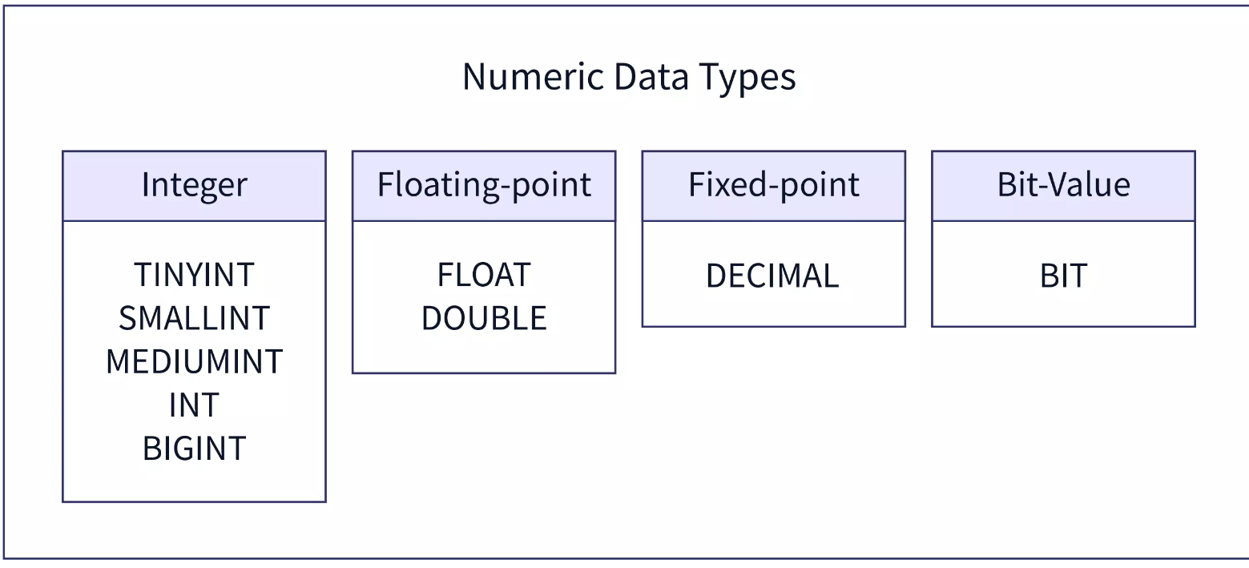
Numeric datatype

Slide 12
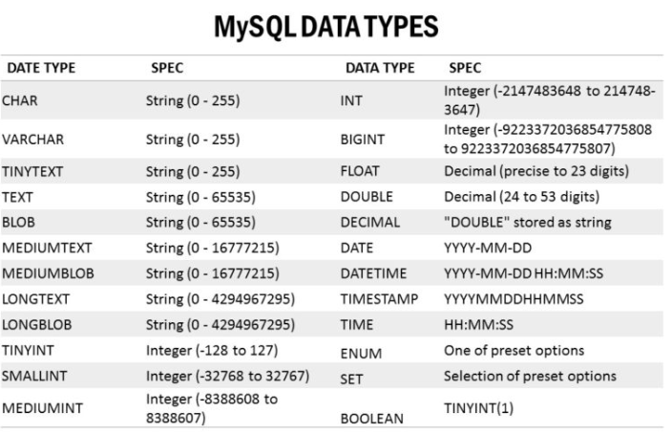
String datatype

Slide 13
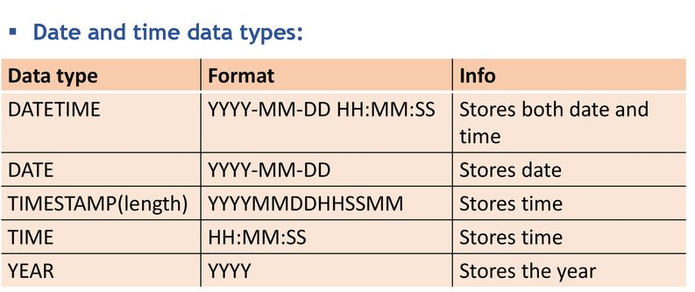

Slide 14
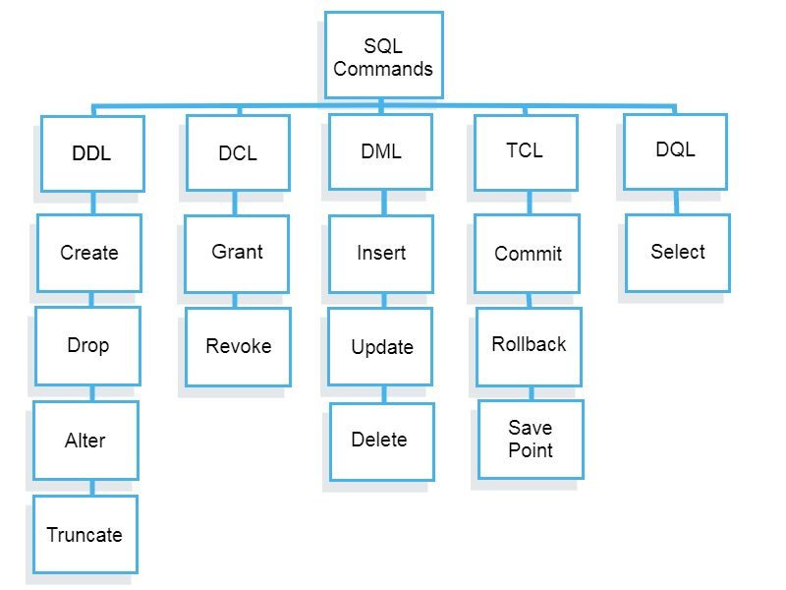
Sql commands

Slide 15
Create table syntax
Create table table_name (
Column1 datatype
Column 2 datatype
Column 3 datatype
…….. );

Slide 16
Suppose we need to create table user
The field we need ares:
Id, Name,email,contact
Password ,Address

Slide 17
Insert data into table
Syntax:
Insert into table_name(
Column1,column2,column3,...)
VALUES
(value1,value2,value3,.....);

Slide 18
Select Query with where clause Synatx:
Select Some column ;
Select column1,colmun2,colmun3..
From table_name;
Or
Select * from table_name;
Or
Select id,name as “Student Name” ,age from student ;

Slide 19
Where clause :
The where clause is used to filter records.
It is used to extract only those records that fulfil a specified condition.
Syntax:
Select column1,column2,..
From students where condition

Slide 20
Basic Condition with where clause
=,!=,>= ,<= ,<,>

Slide 21
SQl Keys
Sql keys is and attribute or set of attribute which uniquely identifies the row in a table.
Uniquely identifies a row in a table by one or more column in a database table.
It creates constraints that enforces data integrity to the database table.
Keys and constraints are the rule that data values that allows certain data columns .
Needs of this keys in sql:
1 keys used in tables are used to identify each row uniquely.

Slide 22
Tables Constraints
1.NOT NULL.
2.UNIQUE
3.DEFAULT.
4.CHECK.
5.PRIMARY KEY.
6. FOREIGN KEY.

Slide 23
TABLE WITHOUT CONSTRAINTS:
ID | NAME | AGE | GENDER | PHONE | STATUS
1 | RAMESH | 17 | M | 7458963557 | 1
 | SURESH | 25 | M | 745632187 | 1

Slide 24
Table with constraint:
Implementing constraints example:
Create table students (id int not null unique,
Name varchar(10) not null,
Email varchar(50) not null unique,
Age tinyint check(age>=18),
Status boolean default 1 ) ;
Insert into students values(1,”Ananya”,”anu@gmail.com”,23)

Slide 25
Command: AND,OR,NOT Operator
Logical And operator compares two expression and returns true if both of the expression are true.
Logical or operator compares two expression and return true if either of the expression is true.
Logical not: revers the input.

Slide 26
syntax:
Select * from table where condition1 AND condition2
Example:
Select * from students where age>=18 and age<=25 AND city=”surat”;

Slide 27
Or operator
Select * from students where city=”agra” or city=”surat”
Select * from students where not city =’agra’ and not city=”surat”

Slide 28
IN operator
In operator allows you to specify multiple values in a where clause.
In operator is a shorthand for multiple or conditions.
Ex; select * from table_name
Where columnnm IN (value1,vlaue2,...,);
Select * from student where where age in(19,21,23)

Slide 29
Like operator
The like operator is used in where clause to search for a specified pattern in a column.
The wildcards which we used in like operator:
1.The percent sign (%)represent zero ,one,or multiple characters.
2. The underscore sign(_) represent one,single character.

Slide 30
Between and not between
When we want a particular range we use between and not between operator.
Select * from student where age between 20 and 25;
Select * from student where age not between 20 and 25;

Slide 31
Order by and distinct keywords:
Syntax: select * from table_name order by column asc||desc;
Ex:: Select * from students order by name desc;
Distinct:
Select DISTINCT column from table_name;
Ex: select distinct age from students order by age desc;

Slide 32
Is NULL and IS NOT NULL Operators:
Syntax:
Select * from tablename where column Is NULL || Is NOT NULL;

Slide 33
Limit Clause and offset:
If we want to limit the number of results that are returned you can simply use the limit command with several rows to limit by.
Select * from table_name limit number ;
Ex:
Select * from students order by name DESC limit 3;

Slide 34
Offset
You can also specify an offset where to start returning data.
Ex for pagination
Syntax:
Select * from students limit 3 offset 5

Slide 35
Aggerate function:
Count(): returns the number of rows in database table.
sum():returns total of sum.
avg(): returns the average for column.
min(): returns minimum value.
Max(): returns max value.

Slide 36
Update query
Syntax:
Update tablename set columnname =” ”,
Where [clause]
Ex:
Update student set age =20, where rollno=2;

Slide 37
Delete query:
Syntax:
Delete from tablename where with particular id;
Ex:
Delete from student where rollno=7;

Slide 38
What is mysql Inner join?
The mysql inner join is used to return only those results from the tables tha match the specified condition and hides other rows and columns.
Mysql assumes it as the default join so it is optional to use the inner join keyword with the query. Dynamic memory allocation.
Syntax:select columns
from table1
Inner join table2 on condition;

Slide 39
What is mysql left join?
The mysql left join keyword returns all records from the left table(table1), and the matched records from the right table(table2).
Syntax:
Select column_name(s)
From table1
Left join table2 on table.column_name=table2.column_name.

Slide 40
What is mysql right join?
The right join keyword returns all records from the right table(table2),and the matched records from the left table(table1).
Syntax: Select column_name(s)
From table1
Right join table2
On table1.column_name = table2.column_name;

Slide 41
What is Cross join in mysql ?
The mysql cross join produces a result set which is the number of rows in the first table multiplied by the number of rows in the second table if no where clause is used along with cross join.
This kind of result is called as cartesian product.
Syntax:
Select column_name(s)
From table1
Cross join table2
On table1.column_name=table2.column_name;

Slide 42
Join multiple tables using mysql command/
Syntax:
Select colunm_name(s)
From table1
Inner join table2 on table1.column_name=table2.column_name;
Inner join table2 on
table1.column_name=table2.column_name;

Slide 43
What are mysql group by and having clause?
Syntax:
Select column_name(s)
From table1
Where condition group by col_name(s)

Slide 44
Having clause
Syntax:
Select column_name(s)
From table1
Group by column_name(s)
Having condition;

Slide 45
What is function?
It is a set of instructions which takes some input and performs certain tasks. In SQL, a function returns a value. In other words, a function is a tool in SQL that is used to calculate anything to produce an output for the provided inputs.
However, in a function, we cannot use some DML statements like Insert, Delete, Update, etc.
Another important point about functions is that they may or may not return a value, i.e. a function can return a null valued as well.
A select statement can have a function call.

Slide 46
Syntax of function:
Syntax:
Delimiter //
CREATE FUNCTION function_name(
Parameters..datatype,parameter datatype,... )
RETURN return_type deterministic
Begin
Function body;
End //
Delimiter ;

Slide 47
fun_example.
delimiter //
create function cube_f(num int) returns int deterministic
begin
declare total int;
set total=num*num*num;
return total;
end //
delimiter ;
select cube_f(5) as cube_num;

Slide 48
What is procedure?
A procedure is a set of instructions which takes input and performs a certain task. In SQL, procedures do not return a value.
In SQL, a procedure is basically a precompiled statement which is stored inside the database. Therefore, a procedure is sometimes also called a stored procedure. A procedure always has a name, list of parameters, and compiled SQL statements. In SQL, a procedure does not return any value.
A procedure is compiled once and can be called multiple times without being compiled.
A select statement can't have a procedure call.

Slide 49
Procedure syntax:-
DELIMITER //
CREATE PROCEDURE procedure_name ( [IN|OUT|INOUT] parameter_name parameter_datatype)
BEGIN
-- SQL statements to be executed
END //
DELIMITER;
To run procedure : call procedure_name(parameter);

Slide 50
Transaction control statements:
The creation of one logical unit from a set of related tasks is known as a transaction.
Transactions in MySQL are a group of logically related statements which will either be executed completely or no statement execution will occur.
Atomicity, Consistency, Isolation, and Durability (ACID)
are the properties of a MySQL transaction.

Slide 51
Two things will happen if multiple modifications are done by the MySQL transaction in the database.
If the transaction is committed, then all the modifications will be successful.
If the transaction is rolled back, then all the modifications will be undone.

Slide 52
Properties of Transaction MySQL transactions show the ACID property.
A stand for Atomicity,
C stands for Consistency,
I stands for Isolation,
D stands for Durability.

Slide 53
Atomicity
It makes sure that all the operations available in the work unit must be run completely. If not, then at the time of failure, the transaction will be aborted and all previously performed operations will be rolled back to their original state.

Slide 54
Consistency
It makes sure that the database is in a consistent state before and after the execution of the transaction.
For instance, if there is a transaction for transferring funds from one account to another account, then this property makes sure that the sum of funds of both accounts is equal before and after the transaction.

Slide 55
Isolation
It makes sure that the transaction will operate independently and it is also transparent to the other transactions until it is committed.

Slide 56
Durability
It makes sure that even if there is any failure in the system, the result or effect of a committed transaction will persist.

Slide 57
Transaction control statements:
1.commit
2.rollback.
3.savepoint

Slide 58
Trigger
A trigger in MySQL is a set of SQL statements that reside in a system catalog. It is a special type of stored procedure that is invoked automatically in response to an event. Each trigger is associated with a table, which is activated on any DML statement such as INSERT, UPDATE, or DELETE.
A trigger is called a special procedure because it cannot be called directly like a stored procedure. The main difference between the trigger and procedure is that a trigger is called automatically when a data modification event is made against a table. In contrast, a stored procedure must be called explicitly.

Slide 59
Triggers are of two types
1. Row-level triggers :- It is a trigger, which is activated for each row by a triggering statement such as insert, update, or delete.
2. Statement-level triggers:-It is a trigger, which is fired once for each event that occurs on a table regardless of how many rows are inserted, updated, or deleted.

Slide 60
Syntax:
CREATE TRIGGER trigger_name
(AFTER | BEFORE) (INSERT | UPDATE | DELETE)
ON table_name FOR EACH ROW
BEGIN
--variable declarations
--trigger code
END;

Slide 61
Cursor
A cursor in SQL is a database object that allows you to retrieve and manipulate data one row at a time. Cursors are typically used when performing operations on each result set row, such as updating or deleting. Cursors are similar to pointers in programming, allowing you to move through a result set and access the data in each row.
Types of cursor:
1.Implict cursor.
2. Explicit cursor.

Slide 62
Implicit cursor
Implicit Cursors
Implicit cursors are created by the SQL engine whenever you execute a SELECT statement. The cursor is automatically opened, and you can fetch rows from the result set one at a time.
Implicit cursors are helpful when retrieving a small amount of data and performing simple operations on each row.

Slide 63
Explict cursor
Explicit cursors are created by the programmer to retrieve and manipulate data from a result set. They provide greater control over the cursor, such as the ability to open and close it, fetch rows, and also, perform operations on the data.Explicit cursors are specifically useful while dealing with large amounts of data and also performing complex operations on each row. Thus, they enable the programmer to process the data one row at a time. This can improve performance and reduce memory usage.

Slide 64
Cursor
Cursor allows to iterate a set of rows returned by a query and process them accordingly.
We create cursor inside a stored procedure to handle the result set returned by a query.
Mysql cursor are read only and non-scrollable.
Read only: cursor only allow you to read data; you can’t make changes to it.
non -scrollable: cursors move through records in one direction,from the top to the bottom.

Slide 65
Steps for working with cursors
1.declare <cursor name> for select statement
2.open <cursor name> initializes the result set for operation
3.fetch <cursor name> into variable list to retrieve the next row pointed by the cursor and move the cursor to the next row in the result set.
4. Close <cursor name> to deactivate the cursor and release any memory associated with it.

Slide 66
Normalization:
Normalization is a technique of organizing the data into multiple related tables, to minimize data redundancy.
To remove duplicate data form table.
We 3 normal forms:
1 NF
2NF
3NF

Slide 67
Rule for 1 normal form
The 1st normal form exceptsyou to design your table in such a way that it can easily be extended and it is easier for you to retrieve data from it whenever required.
Rule 1: single valued attributes
Rule 2: attribute domain should not change
Rule 3: unique name for attribute/columns
Rule4: order doesn’t matters.

Slide 68
Rule for 2 NF
For a table to be in 2 nf ,it must satisfy two conditions:
The table should be in the first normal form.
There should be no Partial dependency.
What is dependency?
Let’s take an example:student table with fields: sid,name,regno,branch,st_address
Consider sid as primary key, hence row data is easy to fetch from a table.
Hence we can say a primary key for a table is the column or a group of columns which can uniquely identifies each record in the table.
This is dependency and we also call it functional dependency.

Slide 69
Now we can understand partial dependency?
Sid can uniquely identify all records in a table.but this is not true all the time.
Create another table subject :fields: subject_id,subject_name
Considering subject_id as primary key.
Create table score: to store marls obtained b student
Fields:score_id ,sid,subject_id,marks,teacher
Now together, sid,subject_id forms a candidate key. For the score table ,which can be a primary key

Slide 70
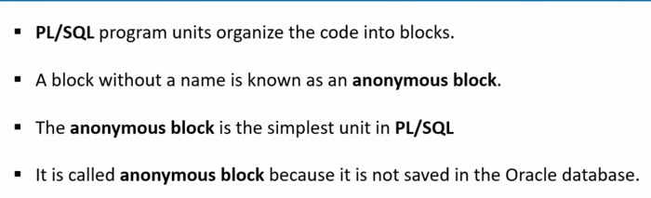
PL/SQL

Slide 71
Definition of PL/SQL
PL/SQL(procedural language/structured query language) is oracle corporation’s extension for sql and the oracle relations database.
The basic unit in PL/SQL block which is made of 3 parts:
A declarative part
2.An executable part.
3. An exception- building part.

Slide 72
Syntax for declaring a PL/SQL code blocks:
Declare
<declare section>
Begin
<exceutable part>
Exception
<exception handling part>
end;

