Slide 1


Analyzing Content Popularity and User Engagement

Slide 2


Today's agenda
Project recap
Problem
The Analytics team
Process
Insights
Summary

Slide 3

Objective: To identify the top content categories based on user reactions.
Datasets Used: Content, Reactions, ReactionTypes.
Key Activities:
Data Cleaning
Data Standardization
Data Merging
Popularity Analysis
Project Recap

Slide 4

Problem
Business Problem: Understanding which content categories drive the most user engagement to inform content strategy and resource allocation.
Analysis Goal: To determine the top 5 content categories based on the number of user reactions.

Slide 5



Andrew Fleming: Chief Technical Architect
The Analytics team
Marcus Rompton: Senior Principle
Dravid Nagi: Data Analyst

Slide 6
Process
1
Data Import: Imported Content, Reactions, and ReactionTypes datasets.
2
Data Merging: Merged datasets on 'ReactionID' to create a comprehensive dataset.
Data Merging: Merged datasets on 'ReactionID' to create a comprehensive dataset.
3
Popularity Analysis: Grouped data by 'Category' to count reactions.
Identified and listed the top 5 categories based on reaction counts.
4
5
Result Integration: Appended the results to the merged dataset.
Saved the final dataset for further analysis.

Slide 7

Insights
The analysis revealed the top 5 content categories with the highest user engagement.
These insights can guide the content creation strategy to focus on the most engaging categories.
Future steps include deeper analysis of reaction types and user demographics for more targeted strategies.

Slide 8
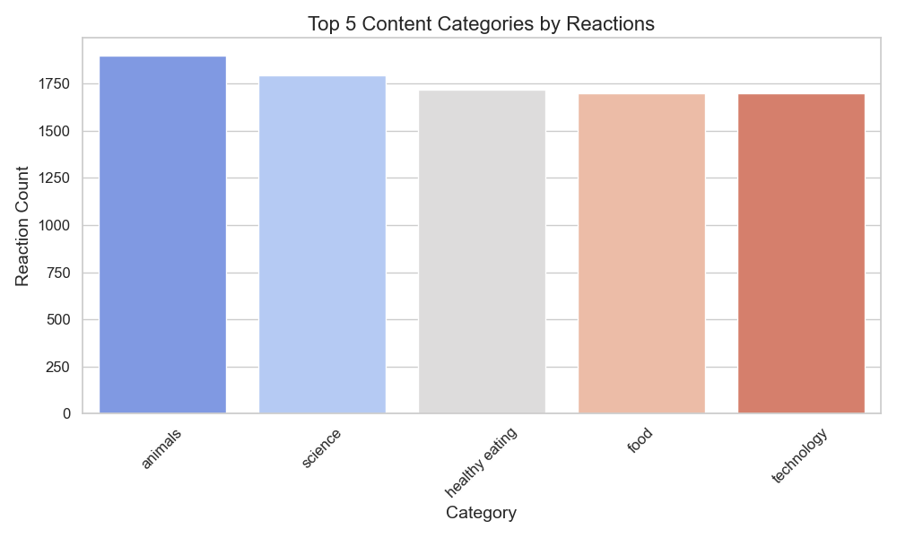
The bar chart shows the top 5 categories based on the number of user reactions.
Each bar represents content a category, with the height indicating the total reaction count, making it easy to compare the popularity of different categories.

Slide 9
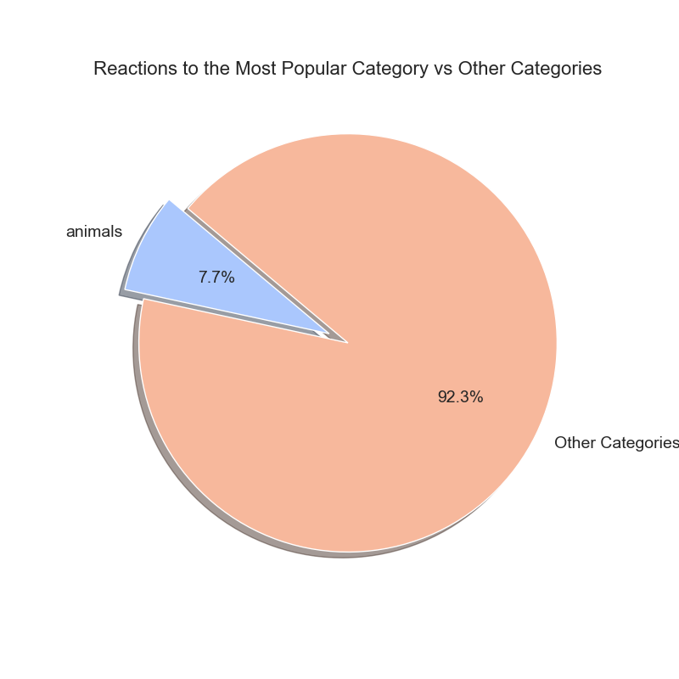
The pie chart illustrates the proportion of reactions for the most popular category compared to all other categories combined.
This visualization highlights the dominance of the leading category, giving a clear sense of its relative engagement.

Slide 10

Summary

Slide 11
Thank you!
ANY QUESTIONS?

