Slide 1

Team name – the tech titans
CYBERCUP 3.0
THEME- A.I. And Cloud Computing
Problem Statement 3 – AI/ML Based Chatbot with interactive digital mascot for helping in strengthening the system for cleanliness of water bodies such as rivers and big ponds.
Team Members -
Dravid Nagi Sana parveen
Tanmay Sharma AISHWARYA KASHYAP

Slide 2
The Problem
What is the problem?
No presence of Artificial intelligence for helping in strengthening of cleanliness of water bodies like rives and big ponds.
Why should this problem be solved?
To create a better solution and hence help in cleanliness of such water bodies in a better way.
How will I know this problem has been solved?
Our chatbot with integrated digital mascot will interact better with people and hence will be much more efficient solution

Slide 3
Features
Prompt Engineering - We are using it to design and refine the prompts given to our chatbot to cater all different kinds of questions.
Supervised Learning- We are using it to provide labeled data, consisting of input-output pairs, to learn and generalize patterns.
Natural Language Processing – We are using NLP for interaction between computers and human language. It involves the development of algorithms and models that enable computers to understand, interpret, and generate human language.
Knowledge retention – learns from every search and expands the knowledge base

Slide 4
Can search in multiple languages(regional only) and give answer based on it
Can escalate to human if query is unsolved.
Personalized to topic – cleanliness of water bodies.

Slide 5
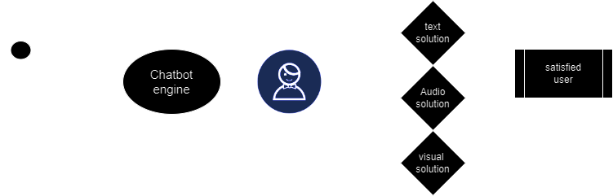

Slide 6
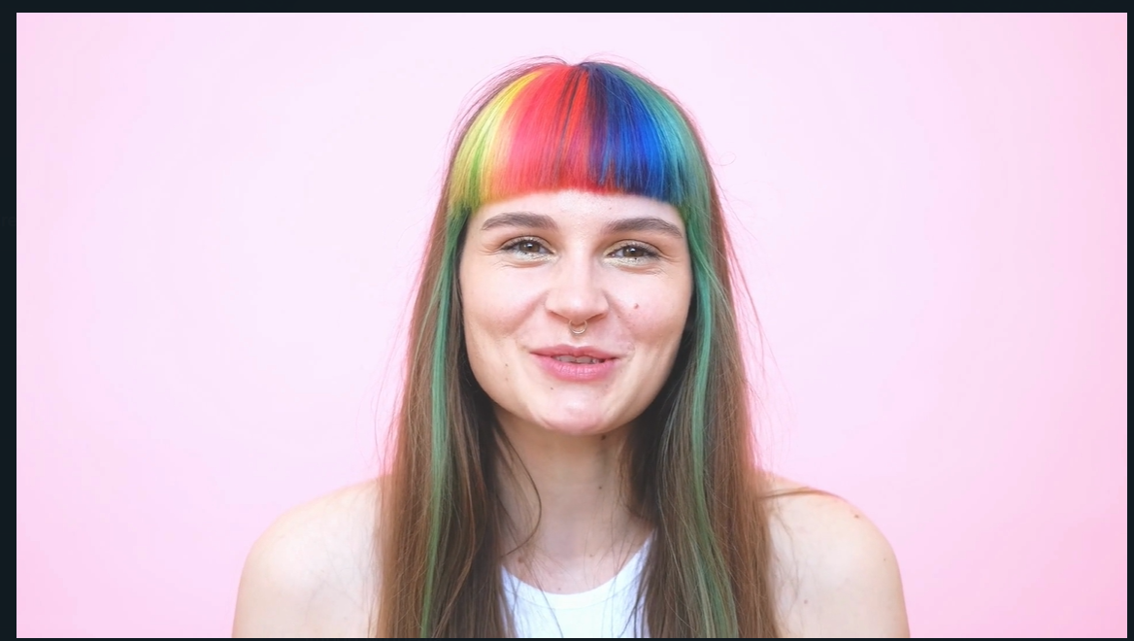
Mascot

Slide 7
How We Developed The MASCOT
Generated 2d avatar realistic face using MidJourney
Fed these images to Blender for generating 2D Motion animation

Slide 8
THANK YOU

