Slide 1

Team Name : AZURA
Team Members : Dravid B M and Dhayanithi M U
College Name : Chennai Institute of Technology
Graduating year: 2028

Slide 2
Tell us a bit about yourself:
We are working together on a GPS and IoT-based tracking system for farm machinery, and we are also participating in the Hackersearth Hackathon to build an Emergency Safe Agent app that helps people in urgent situations by quickly locating nearby hospitals, gas stations, and repair shops saving valuable time when it matters most.

Slide 3
Problem Statement:
In today’s digital age, organizations are flooded with all kinds of unstructured documents policy papers, legal contracts, technical manuals, emails, and more. Finding specific information buried in these documents is often slow, frustrating, and prone to errors. People waste valuable time scanning through pages, only to miss key details or misunderstand important points. Traditional keyword search tools don’t help much they simply look for exact word matches without understanding what the user is asking. That means they struggle with complex or context-based questions. To make things worse, important information is spread across different file types like PDFs, Word docs, and emails, which makes it even harder to access everything in one place. All of this slows down decision-making and reduces productivity. At the heart of the problem is the lack of smart systems that can truly understand natural language queries and deliver accurate, relevant answers from messy, unstructured data.

Slide 4
Tech Stack(Cost Efficient):
Cloud Service Providers: Google Cloud Platform.
Database:FAISS (local vector store).
Backend:FastAPI (lightweight)
Frontend:React.js.
LLM/Embeddings: Sentence transformers.
Document Parser: PyMuPDF, docx2txt, email.parser.

Slide 5
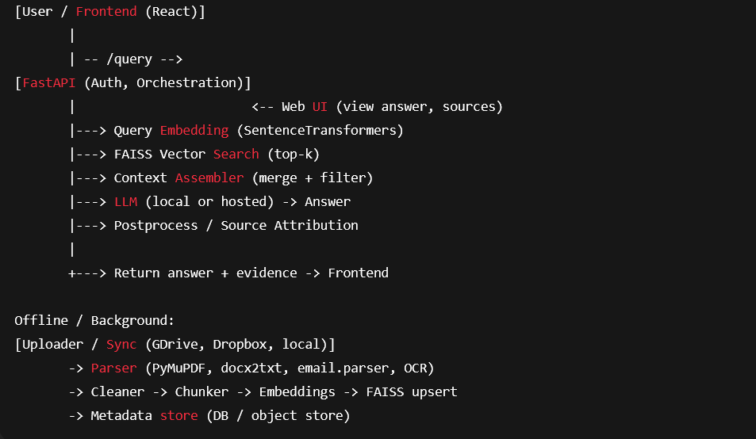
Description of the Solution:

Slide 6
Data Flow of your Solution:
Document Ingestion :
The Uploader / Sync Service receives documents from local uploads or cloud storage like Google Drive or Dropbox.
The Document Parser (PyMuPDF, docx2txt, email.parser) extracts raw text from PDFs, DOCX files, and emails.
Query Processing :
The user submits a natural language query through the React.js frontend.
The Fast API Backend receives the query, manages authentication, and embeds it using Sentence Transformers.
Post-Processing and Output:
The Post-Processor adds source citations and highlights supporting snippets.
The frontend shows the final answer along with clickable links to the original documents.

Slide 7
So, how if your solution different?
Semantic Understanding over Keyword Matching:
Understands the intent behind queries for accurate, context-aware results
Supports Multiple Formats:
Seamlessly handles PDFs, DOCX, and emails in one unified search system
RAG-Based Answering:
Combines vector retrieval with LLMs to generate reliable, sourced answers.
Fully Open-Source & Cost-Efficient:
Built using free, local tools—no expensive APIs or vendor lock-in.

Slide 8
Future possible Enhancements:
Please mention possible enhancements that you for see in future
OCR Integration:
Add OCR capabilities to extract and search text from scanned PDFs and images.
Conversational Chat Interface:
Enable multi-turn question-answering for deeper document exploration.
Conversational Chat Interface:
Enable multi-turn question-answering for deeper document exploration.
Real-Time Document Syncing:
Auto-sync and re-index documents from cloud storage (e.g., Google Drive, Dropbox

Slide 9
Risks/Challenges/Dependencies:
Accuracy of LLM Responses:
LLMs may generate plausible but incorrect answers if retrieval is weak or context is missing.
Data Privacy & Security:
Ensuring sensitive documents are not exposed or misused, especially if hosted in the cloud.
Handling Poorly Formatted or Scanned Documents:
Extracting clean text from noisy or image-based files can affect indexing quality
Limited Generalization:
Pretrained models may not perform well on highly domain-specific queries without fine-tuning..

Slide 10
Acceptance Criteria Coverage:
Natural Language Query Support:
Users can input complex, conversational queries without needing exact keyword
Multi-format Document Handling:
Supports PDFs, DOCX, TXT, and emails—ensuring wide document compatibility.
Context-Aware Retrieval:
Uses embeddings and vector search to retrieve semantically relevant content.
Accurate and Explainable Responses:
Combines LLM output with retrieved context to generate grounded, traceable answers.
Low-Cost and Open-Source Stack:
Fully functional without relying on paid APIs—ideal for MVPs and local deployments.

Slide 11
What Makes Our Project Different?
True Semantic Understanding, Not Just Keyword Matching:
Our system understands what the user means, not just what they type making responses more accurate and relevant.
Cross-Format Search Capability:
Unlike many systems limited to one file type, we support PDFs, DOCX, emails, and more—out of the box.
Open-Source, Cost-Efficient LLM Pipeline:
We use local, free models and tools (like FAISS and MiniLM), avoiding the need for costly APIs like GPT-4.

Slide 12
THANK YOU

