Slide 1
Pitch synchronous residual MFCC for language identification.
Team-17
Rhuthik - 2019112013 Vaibhav - 2019112019
Sanjai Kumaran - 2019112012

Slide 2
Introduction
Language Identification is the problem of identifying the language given an audio clip of a speaker irrespective of their Physical attributes(gender,accent etc).
Generally we use fixed window length during framing but in Pitch synchronous analysis we extract the locations of pitch and get frames between the pitch cycles.
Residual is the error obtained between the predicted and the actual speech signal using LP analysis.
MFCC is used as the feature extraction step which is done by using mel frequency filters and cepstral analysis.

Slide 3
Preprocessing
Data
Voiced Region Extraction
GCI
Extraction
Framing
Results
Model
(Gmm)
MFCC
Residual

Slide 4
Preprocessing
(GCI and Framing)
There are 7 languages(Odia, Assamese, manipuri, etc..) which are divided randomly into 80:20 Train-Test ratio.
Voiced region carries most information in a speech signal.
We extract voiced regions from the data and apply preprocessing on it.
We find the Glottal closure instants(GCI) using ZFF.
Pitch cycles are identified and are extracted in the form of frames for each audio file.

Slide 5
Residual
Residual is nothing but error obtained from the LP analysis equation
Residual = Original Speech Signal - Signal reconstructed from LP analysis
Residual is applied on each frame of the audio signal(pitch cycles)

Slide 6
MFCC
To all the frames after applying Residual we apply MFCC.
We get 13 features for each frame
We concatenate all these frames of MFCC’s into a single file for training the models.
This final file is the Feature representation of the audio file.

Slide 7
Model
All the Features files are combined form a single Vector for each language.
Gaussian Mixture Model for each language is trained using this feature representation of the corresponding language.
We experimented with 8,16,32,64,128,256 Guassian components in the model.
Testing was done on each of these models.

Slide 8
Results
Guassians / epochs | 8 | 16 | 32 | 64 | 128 | 256
50 | 92.14 | 92.85 | 94.28 | 93.57 | 95.0 | 96.42
100 | 92.85 | 93.57 | 95.0 | 95.0 | 95.0 | 96.42
200 | 92.85 | 94.57 | 94.28 | 94.28 | 94.28 | 95.71

Slide 9
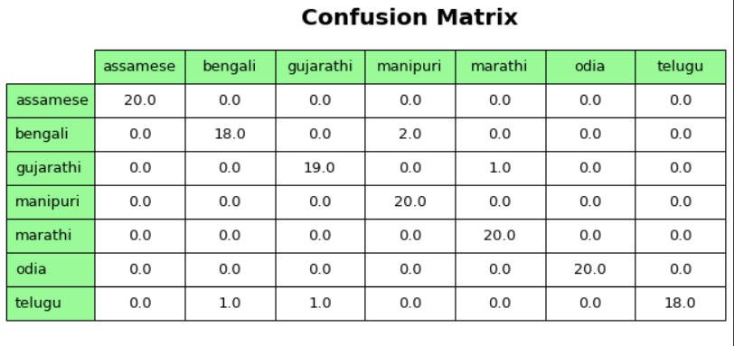

Slide 10
Thank You

