Slide 2
Get Certified in Azure Fundamentals

Slide 3


Hi, I’m Drazen and here to talk to you about our lord and savior, Azure.
Lets talk about the cloud.
Drazen Dodik | Developer Buddy at Microsoft
@diggthedrazen

Slide 4
Agenda of the day
Azure Resource Manager templates
Azure Pipelines
Cognitive Services

Slide 5

Azure Resource Manager templates = JSON-templates to automate your deployments of Azure resources by defining what you want created by the Resource Manager. Improve consistency, reduce manua, error-prone tasks, promote re-use etc.
Azure Quickstart templates = ready-made templates provided by the community and hosted on GitHub. Some of them work as in and some might need extra definitions from you.

Slide 6
Azure Pipelines = a cloud service you can use to automatically build and test your code project and make it available to others.
Take your code from GitHub and automate the build, testing and deployment of your code to Azure.

Slide 7
Cognitive Services = APIs, SDKs and services available to help devs build intelligent apps without having direct AI or data science skills or knowledge. There are APIs across vision, speech, language, search and knoweldge.
Face API = exposed as REST-based web services calls, to detect, verify, identify, and analyze faces. The API can verify, detect, identify, find similiarity and group photos with faces.

Slide 8
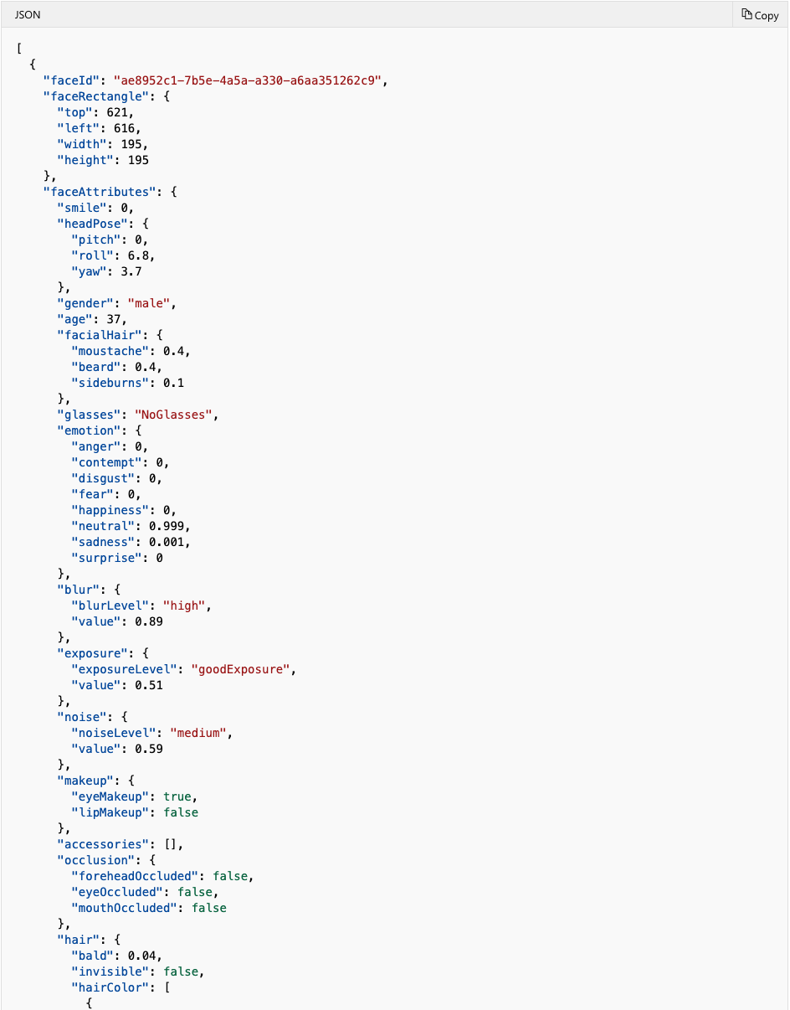

Slide 9
Go deep with creating VMs and Storage
Complete the Build Azure Resource Manager templates
Start on the Identify faces and expressions by using the Computer Vision API in Azure Cognitive Services

Slide 10
Next Steps
Read through What is Azure Pipelines? And create your first pipeline with a sample repo
Load test Azure web apps by using Azure DevOps
Complete the Azure Fundamentals practise exam from Future-Proof

