Slide 1
Outline
Pulse Width Modulation
Oscilloskop projekt
Delelementer
Signalgenerator
Analyse af et digital system (SigGenDatapath)
Sinus Look-up table
Block RAM/ROM
Xilinx Core Generator

Slide 2
Digital vs. Analogue signals
A signal from a digital system is in principle an analogue signal
High
3.3V
V_{Dig}
Low
0V
V_{Ana}
Digital system
V_{Dig}
V_{Ana}
Placing a low pass filter in front of a digital signal will average out the digital pulses

Slide 3
Puls Width Modulation
Pulse Width Modulation (PWM) is an technique to control the amplitude of a signal (after filtering) by switching on-off the source
The time spend in on-state as compared to the off-state determines the filtered amplitude. This is also called Duty-Cycle
Digital PWM is normally done by a repetitive process
t
High (on)
3.3V
Low (off)
PWMout
0V
T
Repetition
T: PWM Period is the time duration of one PWM cycle.
t: Pulse With is the time spend in on-state during one PWM Period
D: Duty-cycle is the relative time spend in on-state (t/T)
The analogue level (after filtering) is determined by the duty-cycle
V_{Ana} = 3.3V * Duty-cycle

Slide 4

Digital Puls Width Modulation
PWM Resolution is the minimum change that can be made to the duty-cycle
Consider the PWM period being accomplished by a 8-bit counter (PWMcnt 0 – 255).
The PWM period start at 0 (zero) and end at 255 and a new PWM period then start.
The on-period can only be adjusted in quantum of one PWMcnt count
t
High (on)
3.3V
0
1
2
3
Low (off)
PWMout
0V
T
PWMcnt
254
255
0
1
2
3
4
5
6
7
252
253
254
255
0
1
The PWM resolution would then be:
$$R= \frac{1 count}{256 count}∙3.3 V=12 mV$$
Normally the PWM resolution is just referred to as ”8-bit” resolution

Slide 5
Digital to Analog Converter
Based on the PWM principle
PWMmodule
PWMcount
Reset
Reset
Clk
PWMcnt
PWMcompt
Q
-
8
PWMout
R
V_{Ana}
SigAmpl
+
C
Analogue
8
Comparator
Digital

Slide 6

Øvelse D6
Pulse Width Modulation

Slide 7
Øvelse
LYSregul
U1
BTN3
Rst
MClk
50MHz
U2
4
BTN3
Reset
TimeP
Clk
LD
R
ClkDiv
PWMout
SW
SigAmpl
8
PWMmodule
Bestem styrken af lysdioden ved hjælp af skyde knapperne

Slide 8
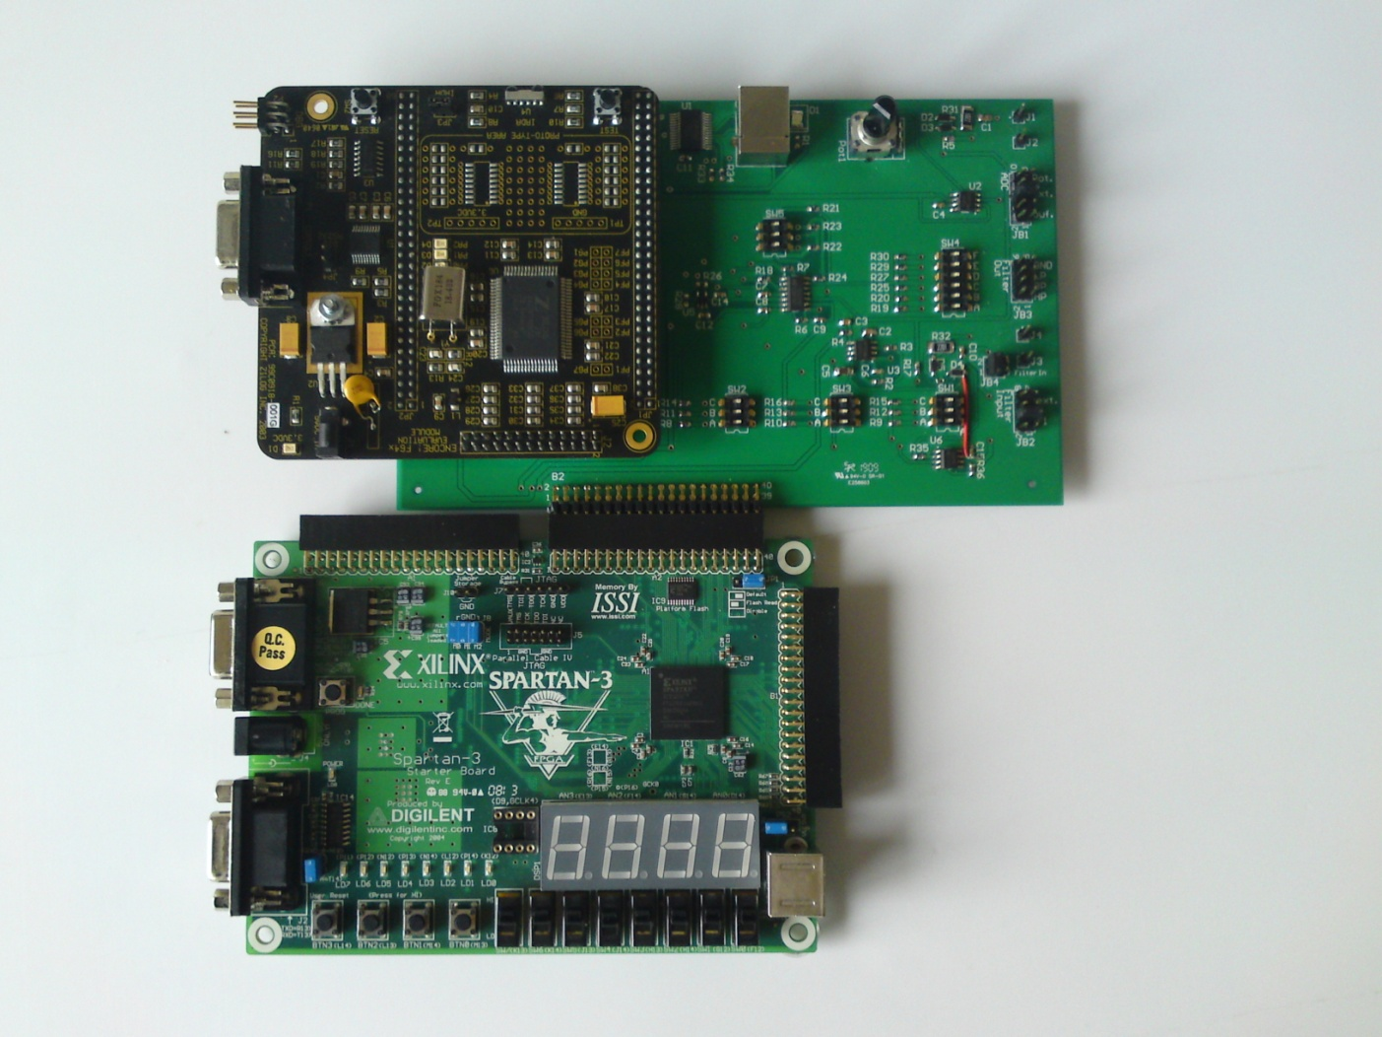
Oscilloskop Projekt
I 3-ugers perioden skal I lave et system der består af en signalgenerator og et oscilloskop som styres fra en brugerflade på en PC. Systemet er baseret på Spartan-3 FPGA bordet og Z8-Encore MCU bordet som I har arbejdet med i 13-ugersperioden. Systemets elementer kan ses af nedenstående diagram:

Slide 9
Systemets delelementer
Systemets elementer kan ses af nedenstående diagram:
Analog spænding
Måle-data til PC
ADC
UART
SPI
Frekvens
Amplitude
Shape
Opsætning fra PC

Slide 10
Signalgenerator
Signalgeneratoren er baseret på et signalbehandlingsprincip der kaldes Pulse Width Modulation (PWM). Tanken bag PWM er at middelværdien (lavpasfiltreret) af et digitalt signal har en analog spænding (0V – 3.3V). Ved at pulse den digitale udgang (PWMOut) på passende vis kan man således generere en analog spænding. Denne spænding kan så være konstant eller periodisk varierende (enten som firkantet, savtakket eller sinusformet). Der er til projektet lavet en VHDL kode som kan bruges som udgangspunkt for signalgeneratoren.
BTN3
CLK
AN
CAT
BTN0
BTN1
BTN2
SW
PWMout
LD

Slide 11
Udleveret Signalgenerator

Slide 12

Pause

Slide 13
SigGenDatapath
VHDL code for the entity of the SigGenDatapath component
library IEEE; use IEEE.STD_LOGIC_1164.ALL; use IEEE.STD_LOGIC_ARITH.ALL; use IEEE.STD_LOGIC_UNSIGNED.ALL; entity SigGenDatapath is generic( PWMinc : std_logic_vector(6 downto 0) := "0010000" ); Port ( Reset : in std_logic; Clk : in std_logic; SigEN : in std_logic; Shape : in std_logic_vector(1 downto 0); Ampl : in std_logic_vector(7 downto 0); Freq : in std_logic_vector(7 downto 0); PWMOut : out std_logic); end SigGenDatapath; architecture Behavioral of SigGenDatapath is signal SigCnt, FreqInc: std_logic_vector(11 downto 0); signal Sig, SigSquare, SigSaw, SigSinus : std_logic_vector(7 downto 0); signal SigAmpl: std_logic_vector(6 downto 0); signal MulC: std_logic_vector(15 downto 0); signal PWMcnt: std_logic_vector(6 downto 0) := "0000000"; signal PWM, PWMwrap : std_logic; Begin See following 3 slides end Behavioral;
Reset
Clk
Freq
8
Ampl
8
Shape
2
SigEN
PWMout
PWMinc
7
SigGenDatapath
PWMinc is a generic input value that can be changed in the port map.
For HW implementation PWMinc should be 1.
For simulation it should be ”0010000” (default)

Slide 14
PWM part of SigGenDatapath
VHDL code for the PWM part of SigGenDatapath
PWMcount: process(Reset, Clk) begin if Reset = '1' then PWMcnt <= "0000000"; elsif Clk'event and Clk = '1' then PWMcnt <= PWMcnt + PWMinc; end if; end process; PWMdec: PWMwrap <= '1' when PWMcnt = "0000000" else '0'; PWMcomp: PWM <= '1' when PWMcnt <= SigAmpl else '0'; PWMon: PWMout <= PWM when SigEn = '1' else '0';
Reset
PWMCount
PWMDec
Clk
Reset
PWMwrap
PWMinc
PWMcnt
PWMComp
PWMon
Inc
Q
-
7
7-bit counter
7
PWM
PWMout
SigAmpl
+
7
Comparator
SigEN

Slide 15
Amplitude part of SigGenDatapath
VHDL code for the Amplitude part of SigGenDatapath
SigMux: Sig <= X"FF" when Shape = "00" else SigSquare when Shape = "01" else SigSaw when Shape = "10" else SigSinus; AmplDec: process(Ampl, Sig) variable MulC: std_logic_vector(15 downto 0); begin MulC := Sig * Ampl SigAmpl <= MulC(15 downto 9); end process;
X”FF”
SigMux
8
00
SigSq uare
01
8
Sig
SigSaw
10
8
8
SigSinus
11
Sel
8
Shape
AmplDec
2
SigAmpl
Ampl
7
8
Multiplier

Slide 16
Signal part of SigGenDatapath
VHDL code for the signal part of SigGenDatapath
FreqEnc: FreqInc <= "00" & Freq(7 downto 6) & Freq(5 downto 4) & '0' & Freq(3 downto 2) & '0' & Freq(1 downto 0); SigCount: process (Reset, Clk) begin if Reset = '1' then SigCnt <= X"000"; elsif Clk'event and Clk = '1' then if PWMwrap = '1' then SigCnt <= SigCnt + FreqCnt; end if; end if; end process; SquareDec: SigSquare <= "00000000" when SigCnt < X"800" else "11111111"; SawDec: SigSaw <= SigCnt(11 downto 4); SinusDec : entity WORK.SinusLUT PORT MAP ( clka => Clk, addra => SigCnt, douta => SigSinus);
SquareDec
SigSquare
8
Reset
SigCount
Clk
Reset
SawDec
Q
SigCnt
SigSaw
PWMwrap
En
12
8
FreqEnc
Freq
FreqInc
Inc
SinusDec
8
12
Clk
clka
12-bit counter
douta
SigSinus
addra
8
ROM

Slide 17
Sinus Signal Generation
Look-up table:
Consider SinusDec as a bookcase with 2¹² = 4096 different shelfs
On each shelf is an 8-bit value
SigCnt points out the shelf
SigSinus is the 8-bit value pointed out
The memory needed for this block is
2¹² * 8bit = 32768 Flip-Flop registers
SinusDec
Clk
clka
SigSinus
SigCnt
douta
addra
8
12
ROM
From Sequential SquareSum example
=========================================================================
* Final Report *
=========================================================================
Device utilization summary:
---------------------------
Selected Device : 3s200ft256-4
Number of Slices: 38 out of 1920 1%
Number of Slice Flip Flops: 29 out of 3840 0%
Number of 4 input LUTs: 70 out of 3840 1%
Number of bonded IOBs: 41 out of 173 23%
Number of MULT18X18s: 1 out of 12 8%
Number of GCLKs: 1 out of 8 12%

Slide 18
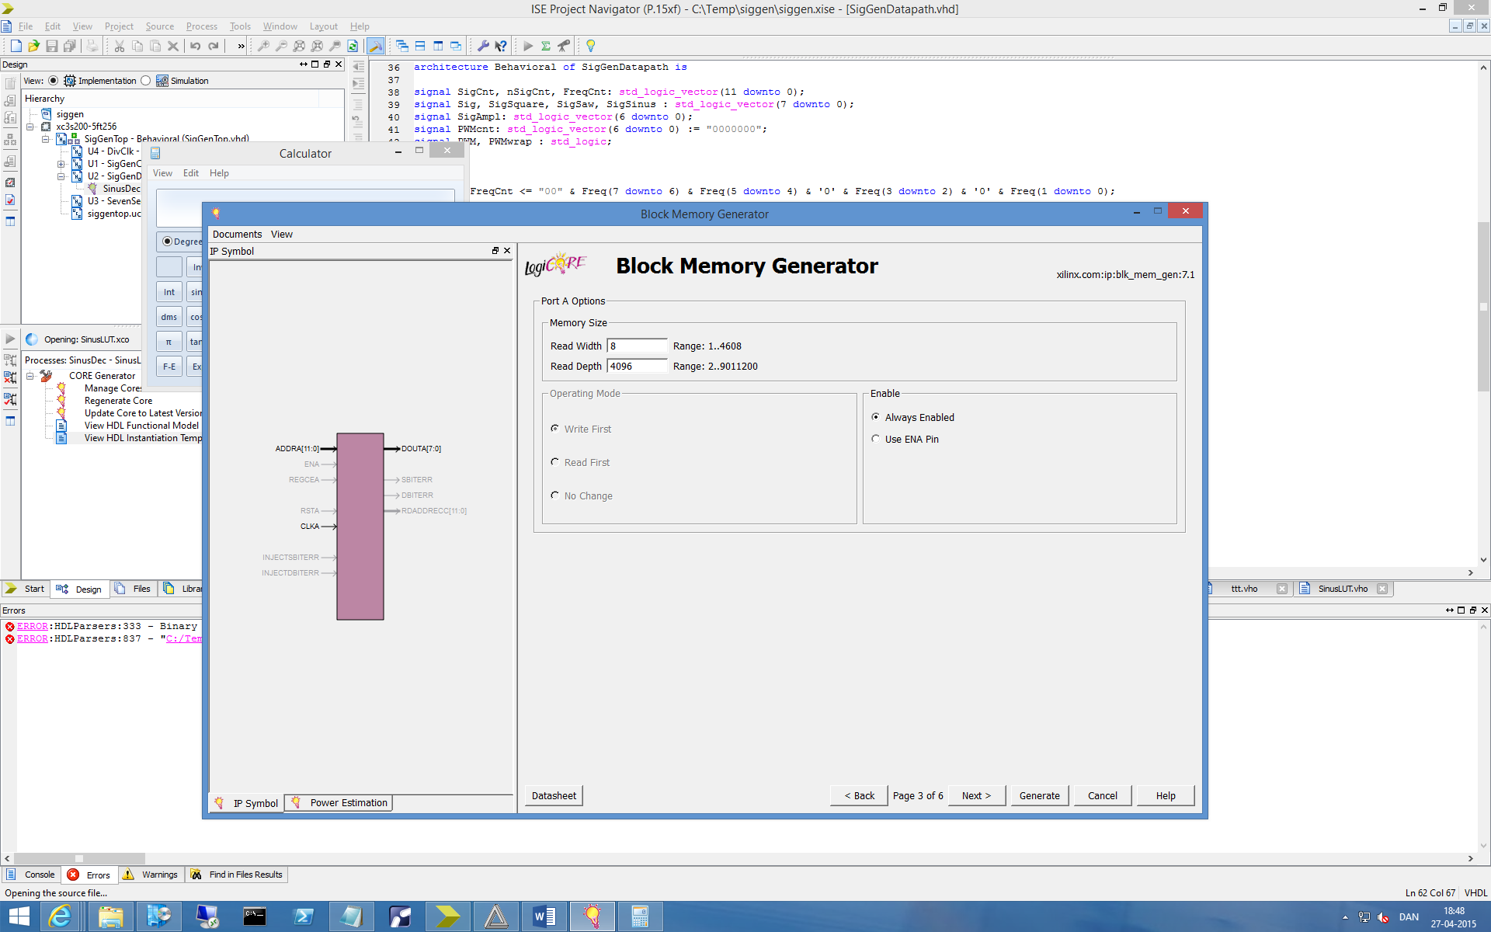
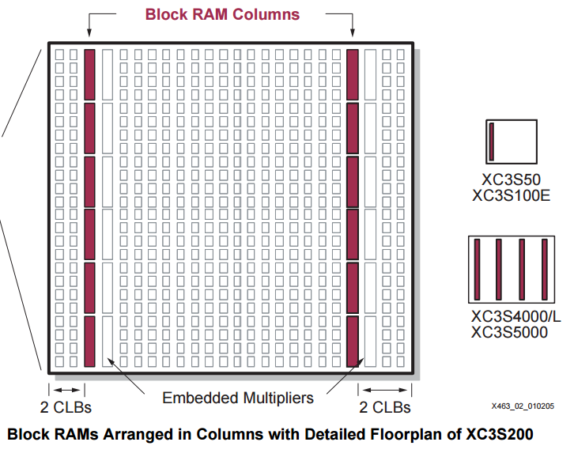
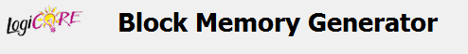
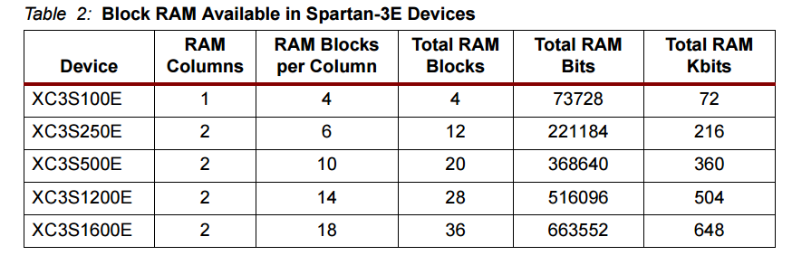
Block RAM/ROM
Block RAM in the Spartan FPGA can be used as ROM for the Sinus look-up table
Xilinx Core Generator
221184
Use the Xilins Core Generator to instantiate Block ROM for the SinusLUT component
From: Using Block RAM in Spartan-3 Generation FPGAs

Slide 19
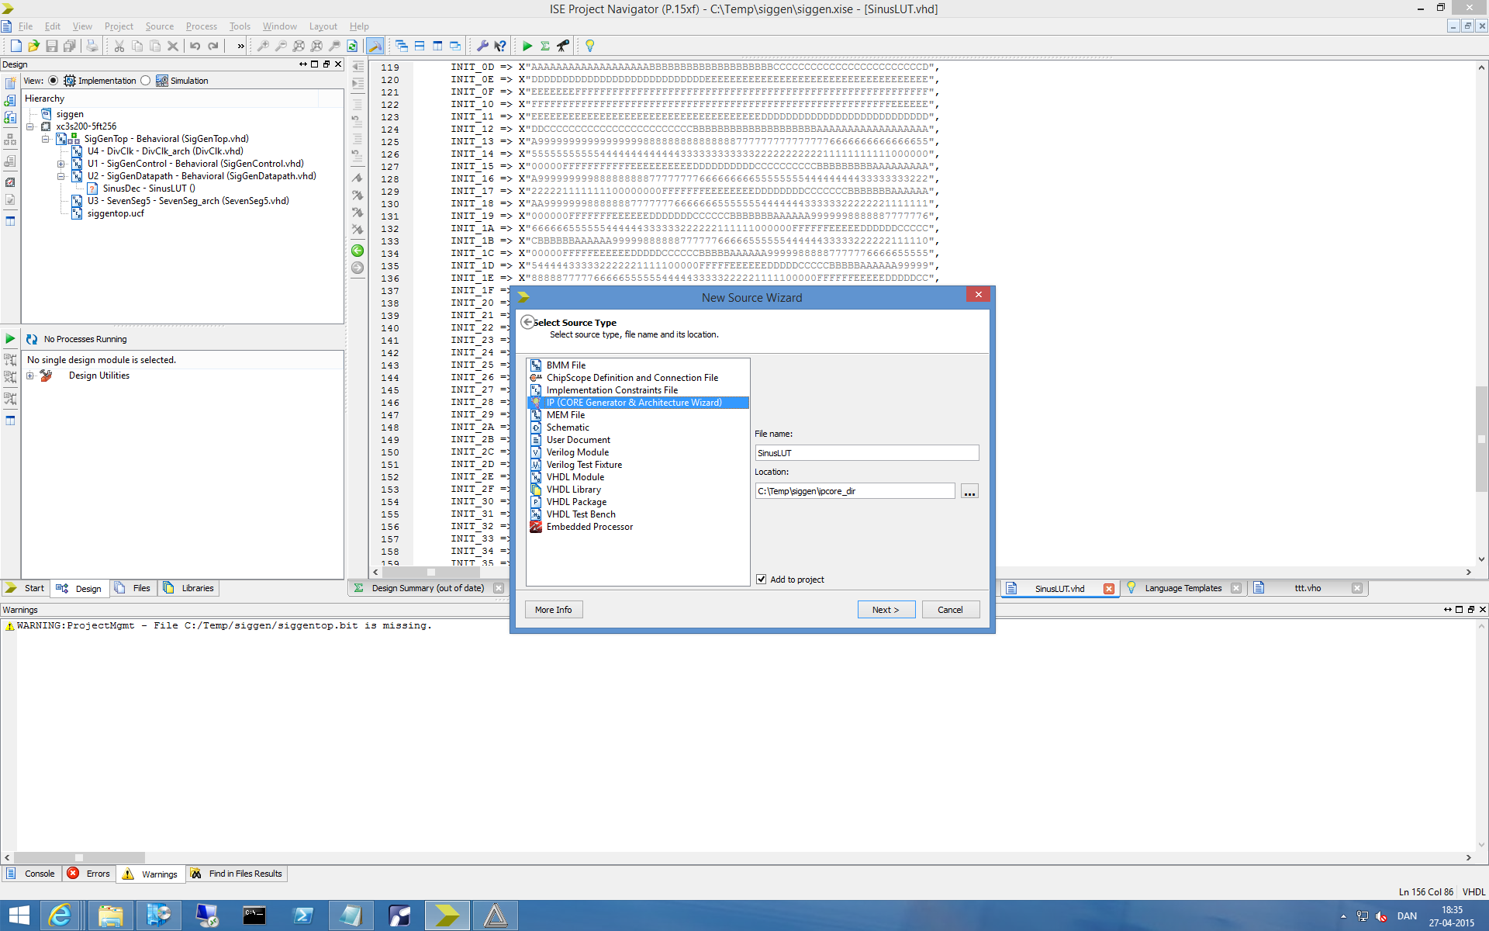
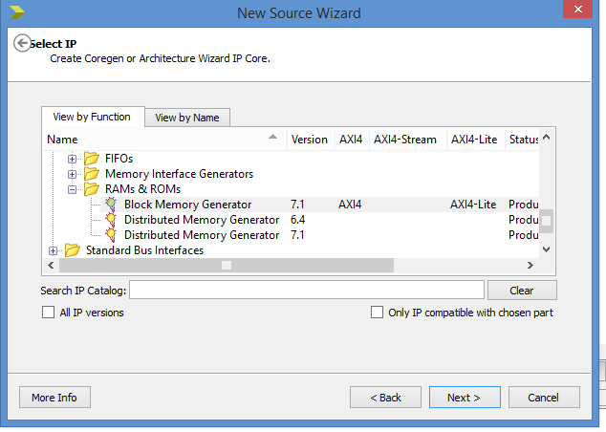
Implementing SinusLUT (1)

Slide 20
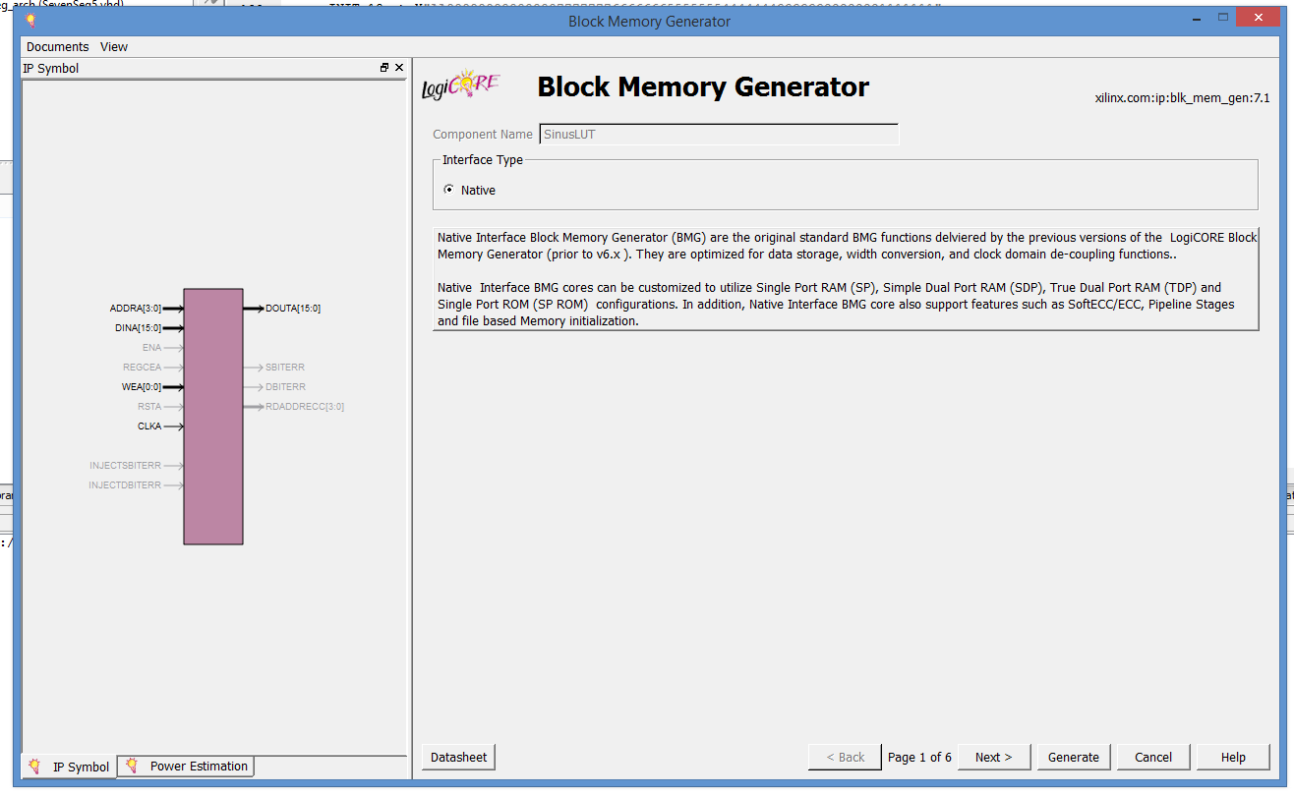
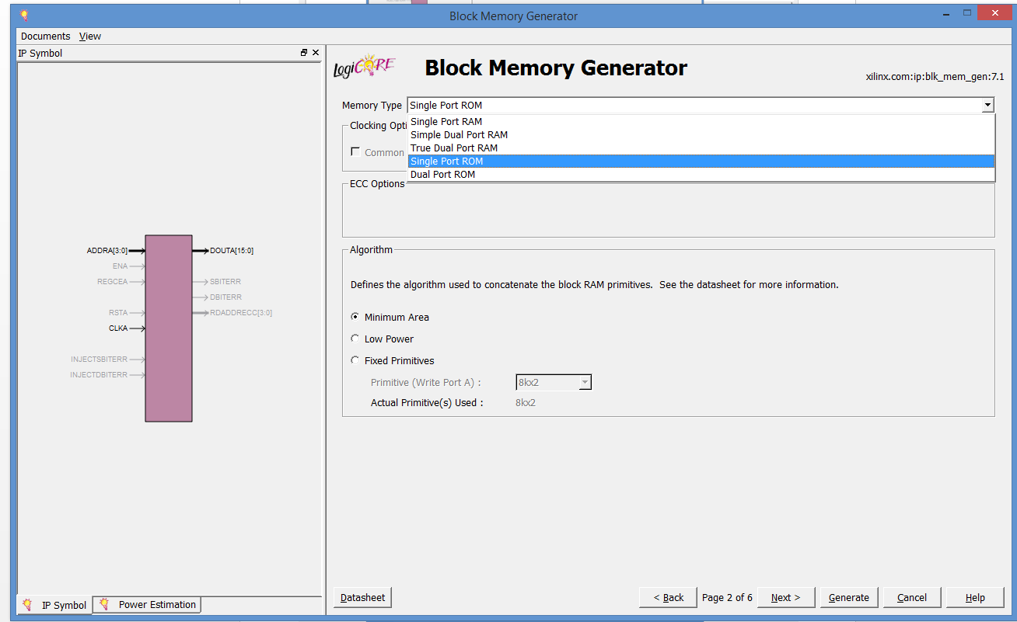
Implementing SinusLUT (2)
Single Port ROM
Read Width: 8 (bit)
Read Depth: 4096

Slide 21
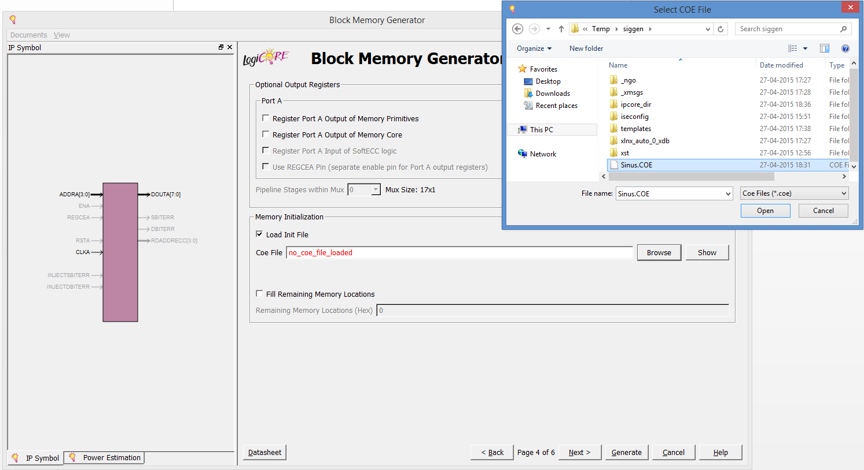
Implementing SinusLUT (3)
Sinus.COE
******************************************************************
******** Example of Single Port Block Memory .COE file *********
******************************************************************
; Sample memory initialization file for Single Port Block Memory,
; v3.0 or later.
;
; This .COE file specifies initialization values for a block
; memory of depth=16, and width=8. In this case, values are
; specified in hexadecimal format.
memory_initialization_radix=16;
memory_initialization_vector=
ff,
ab,
f0,
11;

Slide 22
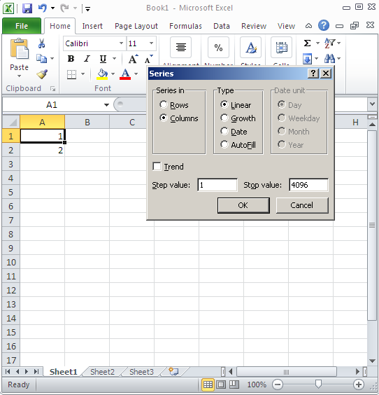
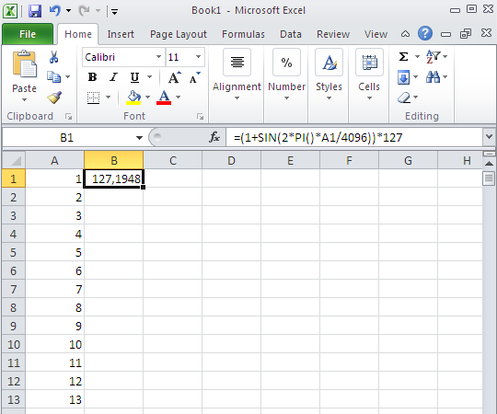
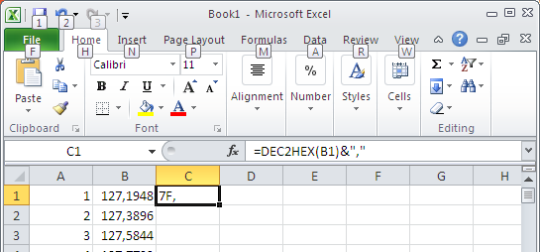
Implementing SinusLUT (3)
Use Excel to make the sinus look-up table in the COE format
=DEC2HEX(B1)&","
=(1+SIN(2*PI()*A1/4096))*127

Slide 23
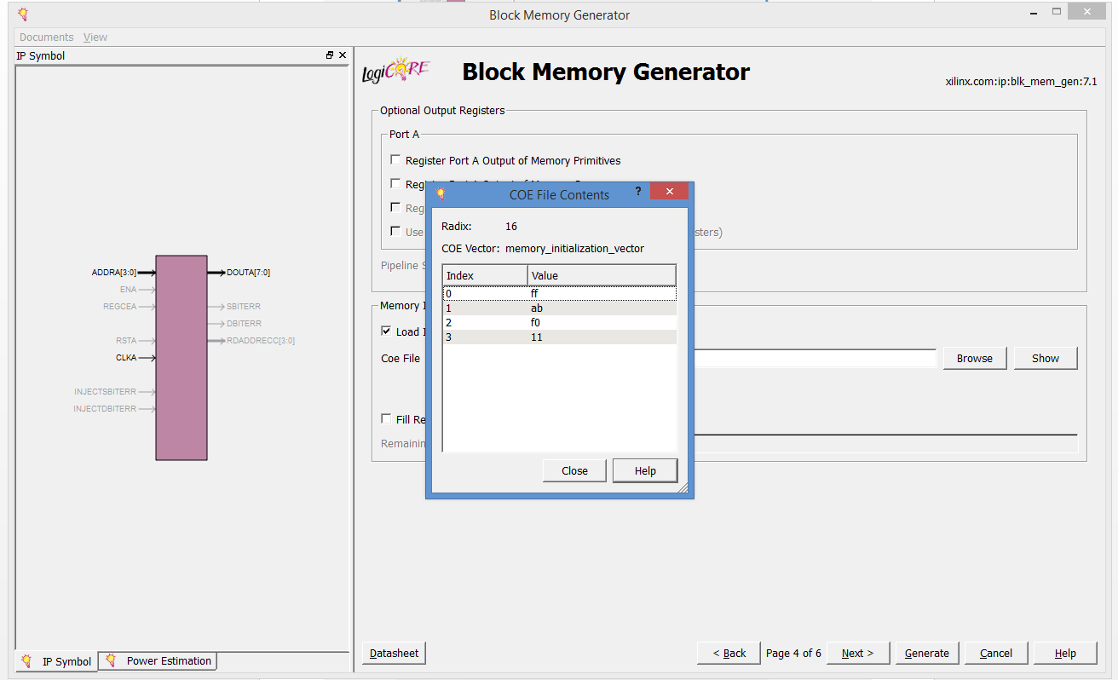
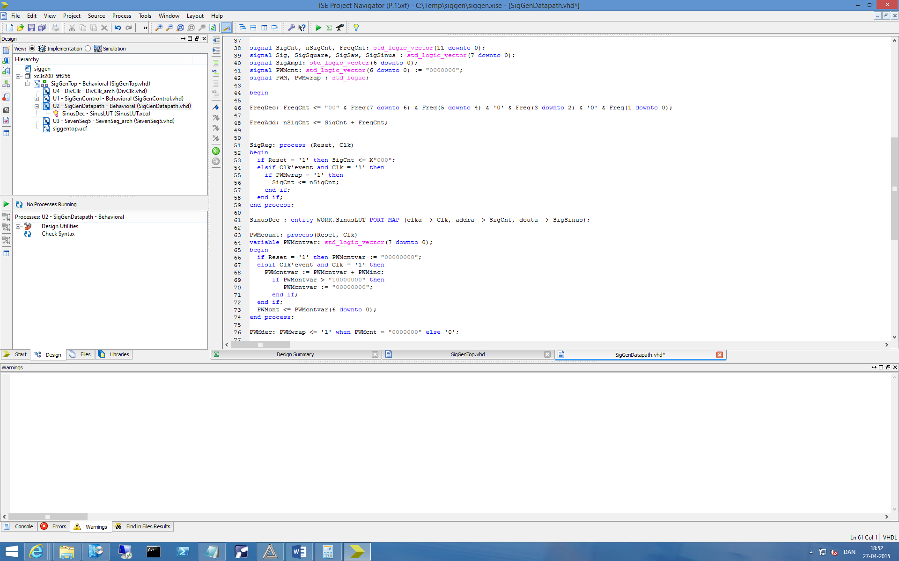
Implementing SinusLUT (4)

