Slide 1

7-MINUTE CAPSTONE PRESENTATION
Tech It & Go!
Capstone project
Dr. Chantell McDowell
Per Scholas Software Engineering
Notes:
Introduction | 0:00–0:34
Recorded narration starts automatically when this slide appears.
Presenter guide: Introduce Dr. Chantell McDowell and Tech It & Go!, a full-stack technology lending library inspired by libraries and makerspaces.

Slide 2
What is Tech It & Go?
A real-world problem turned into a full-stack application.
The Problem
My Solution
Technology can be expensive. Schools, nonprofits, and learners may only need equipment for one project or a short period of time.
Users can browse technology, read related lessons, and submit borrowing requests. Staff can manage the equipment catalog.
I combined access to equipment with learning resources.
Notes:
The idea | 0:34–1:16
Recorded narration starts automatically when this slide appears.
Presenter guide: Explain equipment access for schools, nonprofits and learners. Pair technology borrowing with lesson plans and guidance.

Slide 3
What Can a User Do?
I designed the app around a simple borrower and staff workflow.
Borrower
Staff
Browse and search equipment
Read equipment details and lessons
Register and log in
Submit, edit, or delete a pending request
Log in with staff access
Add new equipment
Edit equipment information
Delete or archive equipment
Notes:
Borrowers and staff | 1:16–2:01
Recorded narration starts automatically when this slide appears.
Presenter guide: Show the borrower and staff roles. Borrowers browse, learn and manage their own requests; staff manage equipment.

Slide 4
How the Full Stack Works
The frontend, backend, and database each have a job.
1. Frontend
2. Backend
3. Database
React + Vite
HTML/CSS concepts
JavaScript
React Router
Fetch API
This is what the user sees and clicks.
Node.js
Express.js
REST API
Middleware
CORS + dotenv
This handles rules and requests.
MongoDB Atlas
Mongoose
Models + validation
This saves users, equipment, lessons, and requests.
Notes:
The full stack | 2:01–3:03
Recorded narration starts automatically when this slide appears.
Presenter guide: Explain the three layers: React and Vite frontend, Node and Express API, and MongoDB Atlas with Mongoose.

Slide 5
CRUD + Authentication
These are two of the most important parts of my capstone.
CREATE
READ
UPDATE
DELETE
POST
Add equipment or submit a request.
GET
View equipment, lessons, and requests.
PATCH
Edit equipment or a pending request.
DELETE
Remove or archive data when allowed.
Security: bcrypt + JWT + role checks + ownership checks
Notes:
CRUD and authentication | 3:03–4:03
Recorded narration starts automatically when this slide appears.
Presenter guide: Explain Create, Read, Update and Delete for equipment and requests. Cover bcrypt, JWT, role checks and request ownership.

Slide 6
Tools I Used and Learned
I used the right tools for the MVP and learned additional technologies in the course.
Used Directly in Tech It & Go!
Other Course Skills
HTML5 • CSS3 • JavaScript
React • Vite • React Router
Node.js • Express.js • REST API
MongoDB Atlas • Mongoose
bcrypt • JWT • dotenv • CORS
Git • GitHub • Postman • Supertest
TypeScript • DOM
GraphQL • OAuth 2.0
Java / Spring Boot concepts
SQL + NoSQL concepts
Agile workflow
AI for Software Engineering
Notes:
Course tools | 4:03–4:42
Recorded narration starts automatically when this slide appears.
Presenter guide: Describe the tools used in this MVP and additional course concepts. Distinguish project tools from topics learned.

Slide 7
Challenges + Testing
The challenges helped me understand how the pieces connect.
Connecting MongoDB Atlas and understanding database credentials
Connecting the React frontend to the Express backend
Understanding JWT, roles, and protected routes
Preparing CORS and environment variables for deployment
Testing the full workflow instead of only testing one file at a time
My debugging process: read the error → isolate the layer → test → fix → test again
Notes:
Challenges and testing | 4:42–5:32
Recorded narration starts automatically when this slide appears.
Presenter guide: Describe database, frontend/API, permissions and deployment challenges. Explain testing one layer at a time and checking complete workflows.

Slide 8
Deployment Status
Recorded plan: Vercel frontend. The repository now uses Render.
MongoDB Atlas
Render
Frontend hosting
Cloud database
Stores users, equipment, lessons, and borrowing requests.
Express API
Validates requests and connects to MongoDB Atlas.
Original plan: Vercel.
Current repository: Render for the React frontend.
The catalog URL returned 404. The walkthrough uses sample data.
Notes:
Deployment | 5:32–6:11
Recorded narration starts automatically when this slide appears.
Presenter guide: The recording describes the original Vercel frontend plan. The current repository documents Render for both frontend and backend. Production workflows still require verification; the presentation demonstration uses a local sample API.

Slide 9
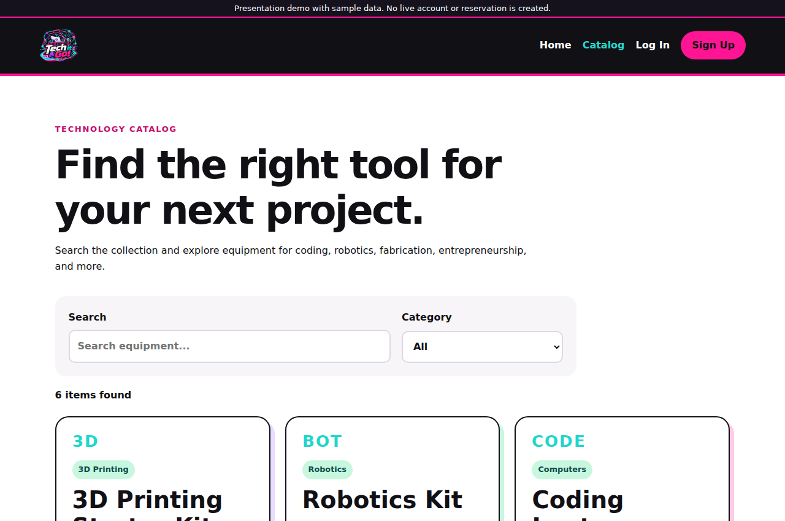
App demonstration
Actual app screens with sample data
Browse
Learn
Request
Manage
Dr. Chantell
McDowell
MakeHERspace
makeherspace.org
Project files on GitHub
Notes:
App demonstration and close | 6:11–7:00
Recorded narration starts automatically when this slide appears.
Presenter guide: Show the catalog, search, kit details, lesson plan, borrowing request and staff equipment tools. The movie uses actual React app screens with sample data. Close with the full-stack takeaway, MakeHERspace affiliation and thanks.

