Slide 1
Multimodal Fake News Detection
DistilBERT × EfficientNetV2S × Gradient Boosting → Gated Fusion
Dataset: Fakeddit
500
100
100
90%
0.969
Train samples
Val samples
Test samples
Accuracy
AUC-ROC
Dhanush D | dhanushd1812@gmail.com | github.com/Drdhx

Slide 2
Problem Statement
⚠
🔍
🎯
Scale of Fake News
Unimodal Limitation
Our Solution
Millions of fake news posts spread daily across Reddit, Twitter, and Facebook — manual detection is impossible at this scale.
Text-only or image-only models miss cross-modal signals. A post's image and metadata can contradict or confirm its headline.
Fuse three modalities — text (DistilBERT), image (EfficientNetV2S), metadata (Gradient Boosting) — via Gated Cross-Modal Attention.
Dhanush D | Multimodal Fake News Detection

Slide 3
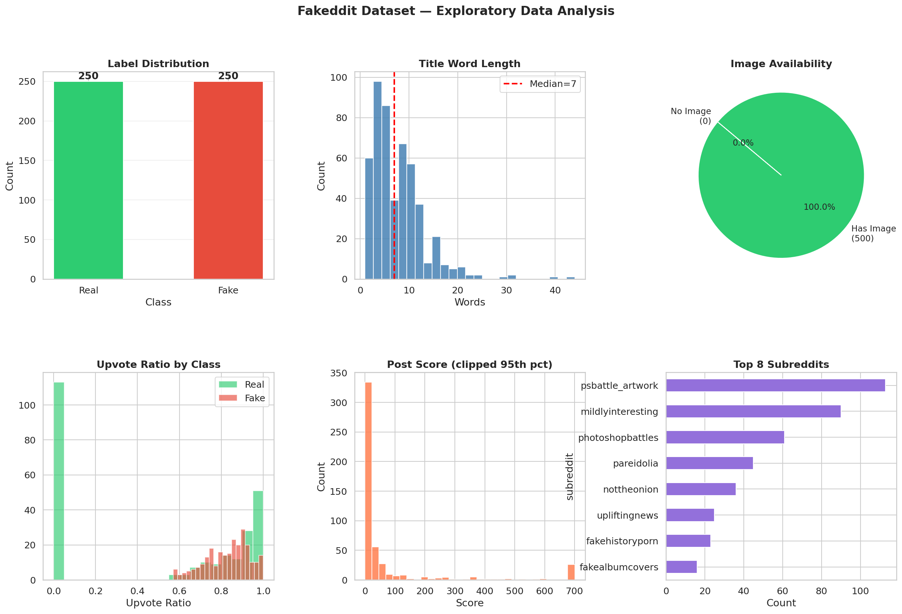
Dataset — Fakeddit
Source: Fakeddit Dataset Original paper: Nakamura et al. (2020) — r/Fakeddit: A New Multimodal Benchmark Dataset for Fake News Detection Content: Reddit posts with headlines, images, metadata and fine-grained labels
Key Features
clean_title — post headline
score — Reddit upvote count
num_comments — engagement
upvote_ratio — credibility signal
subreddit — community source
hasImage — image availability
image_url — thumbnail link
2_way_label — Real / Fake
Split | Samples | Real | Fake
Train | 500 | 250 | 250
Validate | 100 | 50 | 50
Test | 100 | 50 | 50
Total | 700 | 350 | 350
Dhanush D | Multimodal Fake News Detection

Slide 4
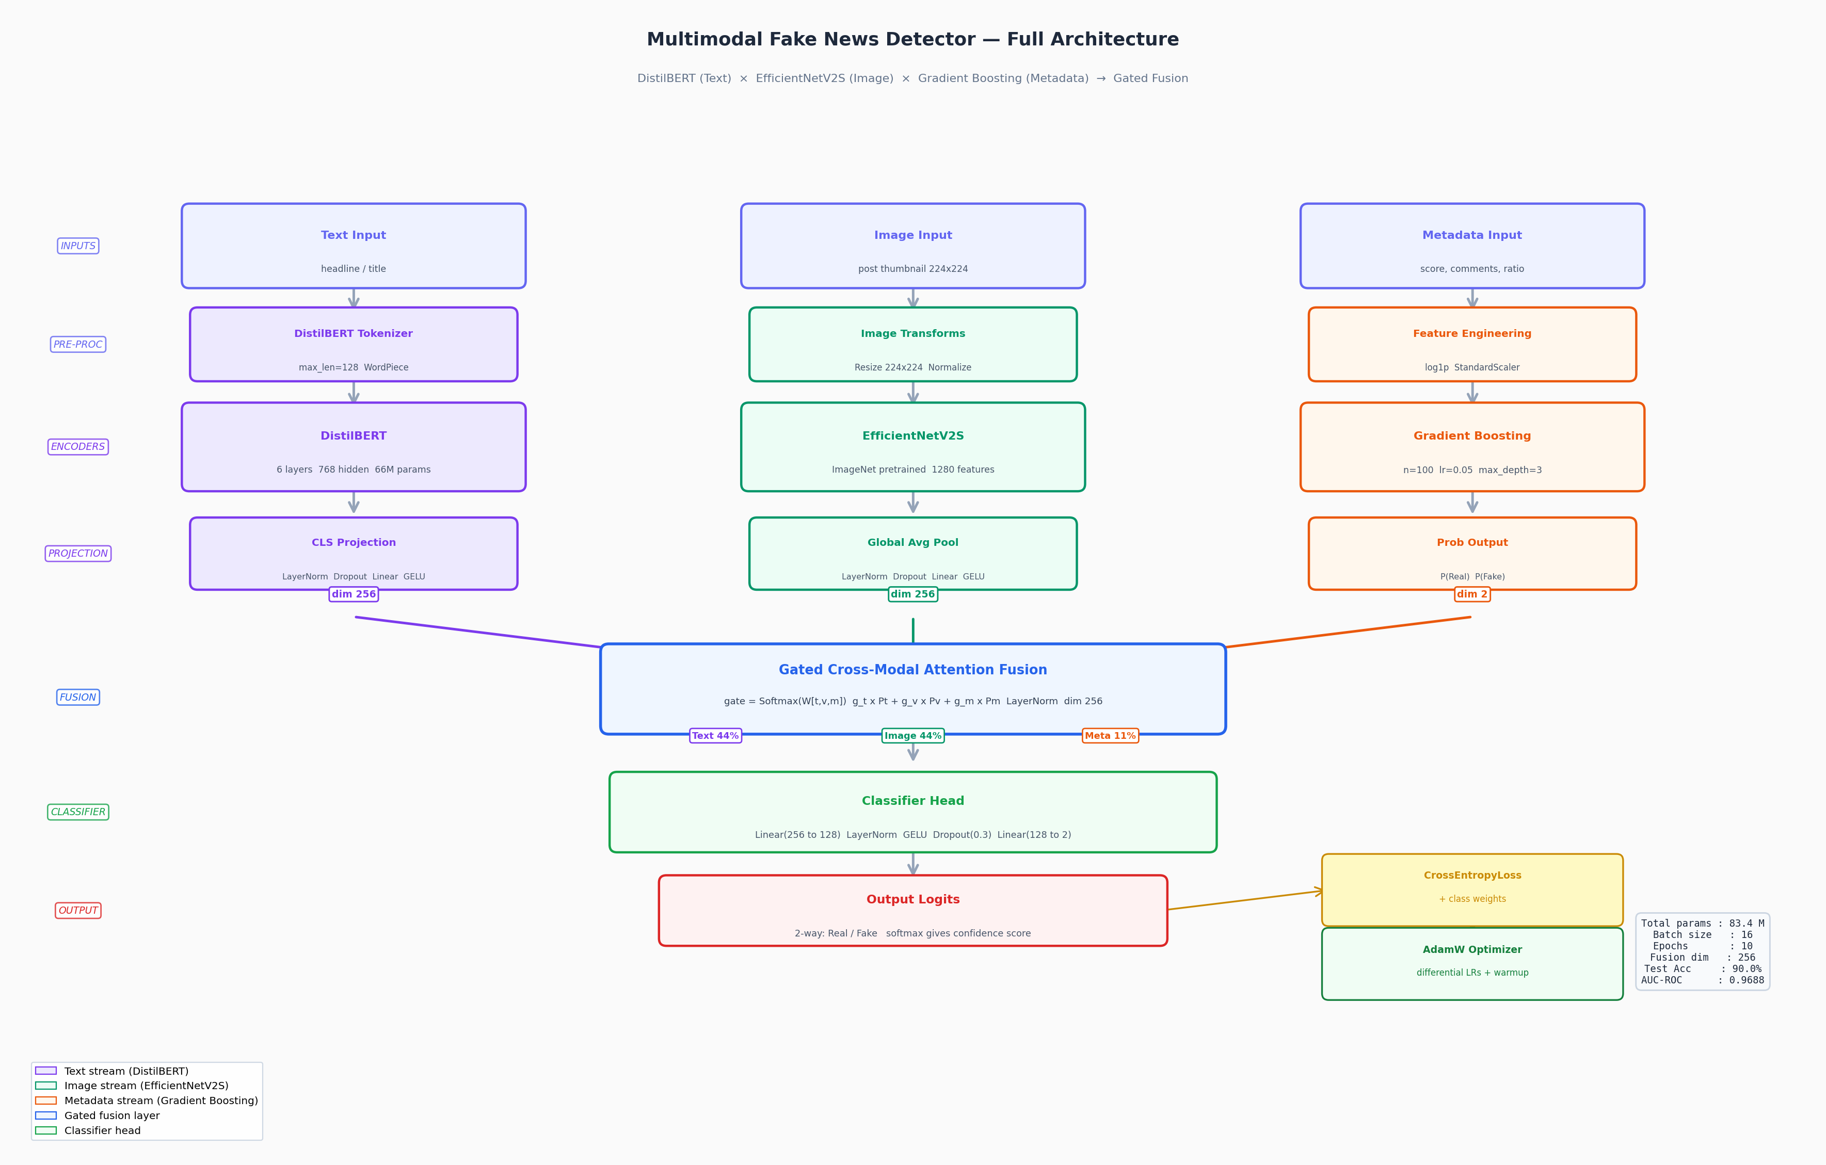
Model Architecture
Dhanush D | Multimodal Fake News Detection

Slide 5
Methodology
Text Encoder — DistilBERT
Metadata Encoder — Gradient Boosting
Tokenizes post headlines using WordPiece (max_len=128). Extracts [CLS] token → LayerNorm → Dropout(0.3) → Linear → GELU → dim 256.
Features: score, comments, ratio, title_len, uppercase, subreddit_freq. n=100 estimators, lr=0.05, max_depth=3, subsample=0.8.
01
03
Image Encoder — EfficientNetV2S
Gated Cross-Modal Fusion
ImageNet pretrained backbone. Global average pooling → 1280 features → LayerNorm → Dropout → Linear → GELU → dim 256.
gate = Softmax(W·[t,v,m]) — learns Text:44%, Image:44%, Meta:12% weights. Weighted sum → LayerNorm → dim 256 → Classifier Head.
02
04
Dhanush D | Multimodal Fake News Detection

Slide 6
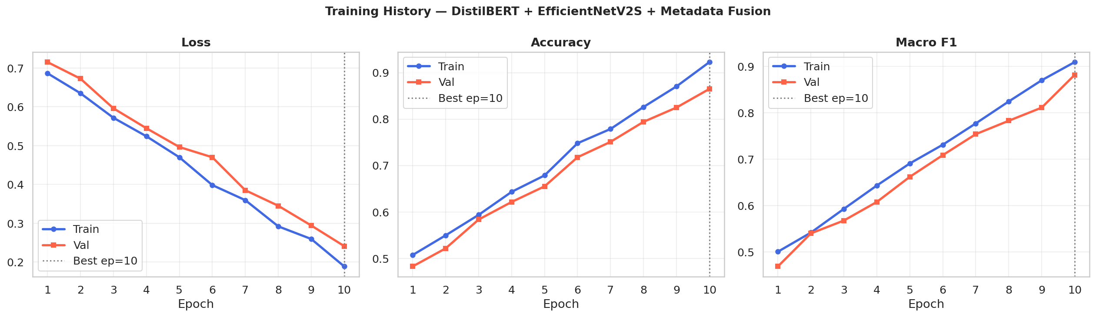
Training Progress — 10 Epochs
Loss decreases smoothly — no signs of instability
Validation accuracy tracks training closely — well regularised
Best model checkpoint saved at epoch with peak Val F1
Dhanush D | Multimodal Fake News Detection

Slide 7
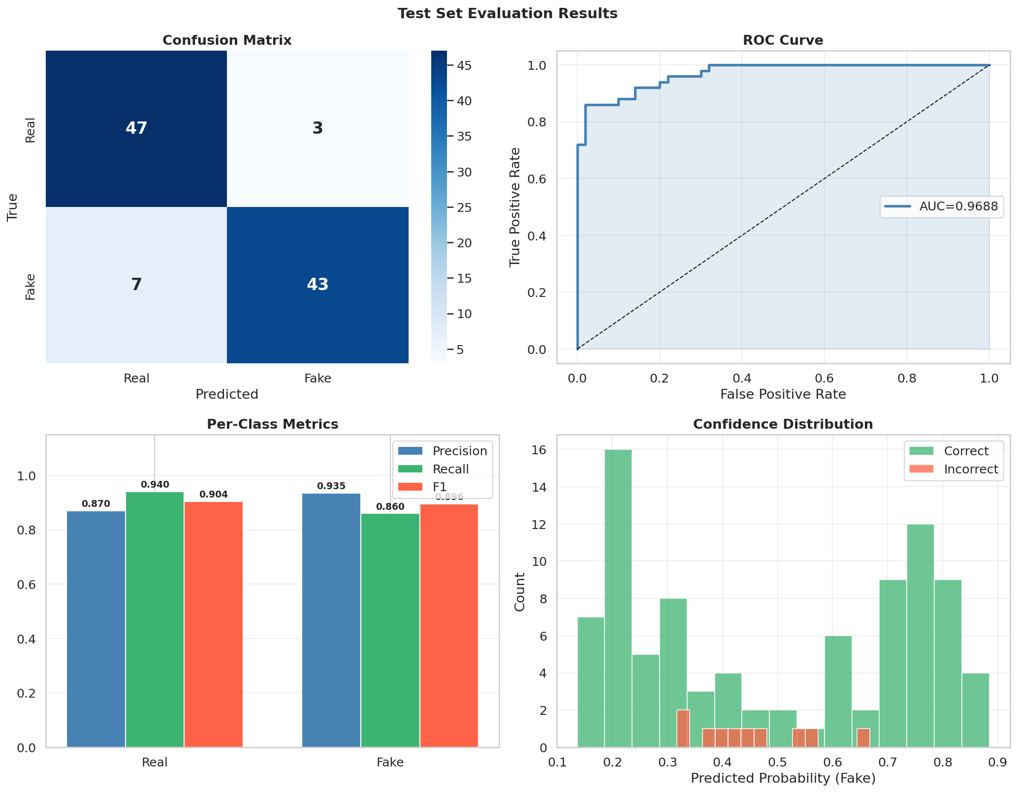
Evaluation Results
90.00%
89.98%
96.88%
100
Accuracy
Macro F1
AUC-ROC
Test samples
Per-Class Metrics
Class | Precision | Recall | F1
Real | 0.8704 | 0.9400 | 0.9038
Fake | 0.9348 | 0.8600 | 0.8958
Avg | 0.9026 | 0.9000 | 0.8998
Learned Gate Weights
Modality | Gate Weight
Text (DistilBERT) | 44%
Image (EfficientNetV2S) | 44%
Metadata (GB) | 12%
Dhanush D | Multimodal Fake News Detection

Slide 8
Modality Stream Comparison
Multimodal fusion consistently outperforms any single modality across all metrics.
Dhanush D | Multimodal Fake News Detection

Slide 9
Sample Predictions
Scientists discover water on Mars confirming life possibility
Real
Real: 0.812 | Fake: 0.188
conf 81.2%
President signs new infrastructure bill worth $1 trillion
Real
Real: 0.881 | Fake: 0.119
conf 88.1%
BREAKING: 5G towers secretly control your thoughts, experts warn
Fake
Real: 0.026 | Fake: 0.974
conf 97.4%
Government hiding alien technology in secret underground base
Fake
Real: 0.082 | Fake: 0.918
conf 91.8%
Local hero saves dog from burning building
Real
Real: 0.765 | Fake: 0.235
conf 76.5%
Dhanush D | Multimodal Fake News Detection

Slide 10
Conclusion & Future Work
Key Findings
Future Work
Multimodal fusion achieves 90% accuracy — outperforms any single modality
Gated attention learns optimal modality weights: Text 44%, Image 44%, Meta 12%
AUC-ROC of 0.969 confirms strong discriminative power across all thresholds
DistilBERT captures semantic intent; EfficientNetV2S detects visual manipulation
Scale to full Fakeddit 600K dataset with GPU training
Add video and audio modalities for richer signals
Deploy as real-time browser extension for fact-checking
Explore cross-lingual fake news detection
Final Result: 90% Accuracy | F1 0.90 | AUC 0.97 on Fakeddit Test Set
Dhanush D | dhanushd1812@gmail.com | github.com/Drdhx

